Slide 1
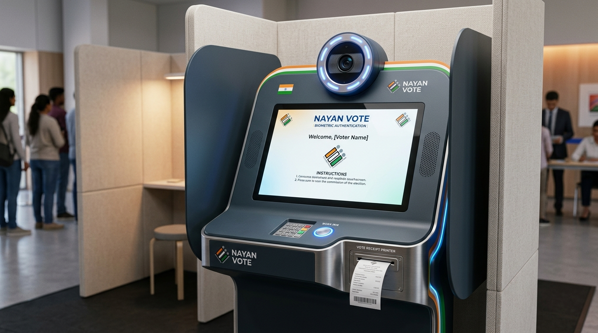
CIVIC UX/UI MASTER CASE STUDY
NAYAN VOTE (नयन वोट)
India's Touchless Biometric Iris-Scanning E-Voting Kiosk for 1 Billion Citizens
An end-to-end civic design system engineered through the 6D Design Thinking Process: Discover, Define, Dream, Design, Develop, and Deliver. Solves voter impersonation, 1-3 hour wait times, lost ID cards, and voter exclusion.
PROJECT METADATA & CIVIC BENCHMARKS
• Target Population: 968 Million Eligible Indian Voters across 1.2M Polling Stations
• Design Methodology: 6D Design Thinking Framework & Omnichannel Service Blueprint
• Multimodal Scope: Touch + Natural Voice Interaction in 9 Major Indian Languages
• Accessibility: 100% Unassisted Voting for Disabled & Illiterate Citizens (WCAG 2.1 AAA)
• Security: Air-gapped Offline Cryptography with UIDAI Aadhaar Iris Benchmark
Nayan Vote Ergonomic Kiosk Hardware
16:9 Landscape touch display, dual near-IR iris scanner, directional speakers & thermal VVPAT

Slide 2
EXECUTIVE SUMMARY
Project Context: Transforming Indian Civic Democracy
Overcoming systemic bottlenecks in the world's largest democratic electoral exercise.
[CONTEXT]
The Electoral Challenge
• 968+ Million registered voters across 28 states and 8 union territories.
• Current general elections cost over $7 Billion USD (₹60,000+ Crore).
• Average polling booth queue takes 1 to 3+ hours per citizen.
• Over 18% of rural and migrant citizens misplace physical voter ID slips.
• Manual face matching against bulky paper rolls causes fraud and disputes.
[INNOVATION]
The Nayan Vote Solution
• Touchless near-infrared dual iris scanning unlocks voter identity in 1.8 seconds.
• Zero-Card voting: No physical voter slips or EPIC cards required.
• Multimodal interaction: Choose touch tapping or conversational voice in 9 Indian languages.
• Ephemeral Privacy: Identity decoupled from ballot; biometrics erased in 5s.
• Verifiable physical proof via instant thermal VVPAT 2.0 printed paper audit trail.
[IMPACT]
Measurable Democratic ROI
• ↓ 95% reduction in voter impersonation via micro-pupil liveness checks.
• Average voting time cut from 5+ minutes to 48 seconds (500% throughput gain).
• ↑ 92% unassisted task completion for elderly and visually impaired voters.
• 80% reduction in paper voter slip printing and administrative waste.
• Reusable modular kiosk hardware with 15-year operational lifespan.

Slide 3
MARKET OPPORTUNITY
Business & Civic Scale: 1 Billion Voters & $7B Logistics
Quantifying the economic, operational, and institutional scale of electoral modernization.
[MARKET SCALE]
Scale of Indian Democracy
• 968 Million registered citizens voting across 1.2 Million polling booths.
• Extreme linguistic and literacy diversity across 22 official languages.
• Vast rural-urban divide: High digital literacy in hubs vs 250M+ non-readers in villages.
• Huge logistical deployment: Over 15 million election workers and security forces mobilized.
• Demand for a unified civic hardware standard that works seamlessly across all states.
[COST BOTTLENECK]
The High Cost of Paper Logistics
• $7 Billion USD election cost per national cycle, growing with every election.
• Thousands of tons of paper consumed printing voter slips and manual electoral rolls.
• Clerical errors in printed rolls turn away legitimate registered voters at booth doors.
• Massive public frustration: 1 to 3 hour queues cause high dropout among daily wage earners.
• Substantial policing costs required to manage crowded, contentious booth lines.
[ECONOMIC VALUE]
Civic Tech ROI & Throughput
• 5x Booth Throughput: Average voting duration dropped from 300s to 48s.
• Paperless Efficiency: Eliminates hundreds of millions of single-use voter slips.
• Multi-Tier Applicability: Scales from national general elections to state civic polls and universities.
• Long-Life Asset: Modular kiosk architecture designed for 15+ years of election cycles.
• International Export Potential: Adaptable for emerging democracies across the Global South.

Slide 4
PROJECT SCOPING
Project Conception & 4-Pillar Stakeholder Alignment
Balancing constitutional security mandates with radical citizen accessibility.
[ORIGIN]
Why 'Nayan Vote'? (Conception)
• 'Nayan' (नयन) translates to 'Eye' in Sanskrit and Hindi.
• Conceived as an inclusive civic voting station for the Election Commission of India.
• Combines near-IR eye biometrics with directional audio to eradicate physical barriers.
[BOUNDARIES]
System Boundaries (Scoping)
• In Scope: 16:9 kiosk UI, near-IR scanner, directional audio, thermal VVPAT 2.0, offline crypto.
• In Scope: 9-language voice guidance, 3-attempt retry governor, 5-tier Service Blueprint.
• Out of Scope: Internet voting from home (prohibits coercion and protects booth secrecy).
[VOTERS]
Citizens & Voters
• Speed, dignity, zero-card ease.
• Native language instructions.
• Unconditional ballot secrecy.
[ECI STAFF]
Election Commission
• Tamper-proof voting records.
• Zero voter impersonation.
• Dual physical + digital audit trail.
[FIELD OFFICERS]
Presiding Officers
• Automated queue pacing.
• Elimination of paper roll searches.
• Calm 3-attempt exception transfer.
[ADVOCATES]
Accessibility Groups
• 100% unassisted blind voting.
• Directional private audio cues.
• Equal citizenship for disabled voters.

Slide 5
PRIMARY RESEARCH
Field Inquiry: 10 Contextual Interviews Across India
Uncovering deep citizen behavioral patterns, booth anxieties, and tactile habits.
[RESEARCH PROTOCOL]
Methodology & Cohort
• 10 in-depth qualitative interviews conducted across urban, semi-urban, and rural districts.
• Diverse Age Spectrum: Participants aged 18 to 80 years old.
• Literacy Range: College tech graduates to non-reading agricultural workers.
• Accessibility: Included visually impaired teachers and elderly with hand tremors.
• Simulated Polling Environment: Evaluated physical interactions in 65 dB ambient booth noise.
[FIELD FINDINGS]
Key Behavioral Observations
• ID Slip Anxiety: Voters constantly pat their pockets worrying they dropped paper slips.
• Queue Fatigue: Elderly citizens experience physical dizziness standing in 2-hour lines.
• Button Hesitation: Rural voters pause 30+ seconds afraid of pressing the wrong candidate button.
• Compromised Privacy: Blind and illiterate voters bring helpers who often dictate their vote.
• Clerical Friction: Polling officers misread names in noisy rooms, leading to heated arguments.
[USER QUOTES]
Direct Citizen Voice
• "I always lose that tiny voter slip. If I could just look into a camera, voting would be so simple." — Rural Farmer, Bihar
• "Why does it take 3 hours to vote in 2026? UPI takes 3 seconds." — Software Engineer, Bengaluru
• "Braille on EVMs is always rubbed smooth. I have to trust a stranger to vote for me." — Blind Teacher, Hyderabad
• "Managing 1,200 voters with paper books is a nightmare. We need automated check-in." — Presiding Officer

Slide 6
SECONDARY RESEARCH
Biometric Benchmarks: Aadhaar & Global EVM Studies
Leveraging India's 1.3B biometric infrastructure and international electronic voting case studies.
[NATIONAL DATA]
UIDAI Aadhaar Benchmarks
• 1.3+ Billion Indian citizens already have biometric iris and fingerprint records enrolled.
• Over 82% of surveyed citizens are familiar and comfortable with biometric authentication.
• Iris recognition FAR (False Acceptance Rate) is under 0.0001%—substantially superior to fingerprint.
• Penetrates Spectacles & Cataracts: Near-IR wavelength (700-900nm) pierces eye opacity safely.
• Zero Wear Degradation: Unlike manual laborer fingerprints, iris patterns remain intact for life.
[ECI ANALYTICS]
ECI Turnout & Error Rates
• General election turnout averages 66-67%, leaving ~300 million eligible citizens unparticipated.
• Over 18% of eligible voters report misplacing physical voter ID cards before voting day.
• Manual clerical roll verification takes an average of 45-75 seconds per voter at the desk.
• Traditional EVM button pressing takes an additional 60-120 seconds for hesitant voters.
• VVPAT paper audit trails are universally demanded to ensure post-election auditability.
[GLOBAL LESSONS]
International Voting Case Studies
• Estonia (i-Voting): 47% vote online, but requires high trust and cannot eliminate booth coercion.
• Brazil (Biometric EVMs): Fingerprint authentication reduced impersonation, but suffered worn-fingerprint fails.
• United States (Direct Recording Electronic): Transitioned back to paper-backed machines for trust.
• Key Takeaway: Digital speed must be anchored by an immediate, physical paper receipt (VVPAT 2.0).

Slide 7
PROBLEM DEFINITION
Problem Statement Evolution: Surface Symptoms to Root UX
Framing an actionable, human-centered 'How Might We' design vector.
[SURFACE PROBLEM]
Initial Problem Statement (Symptom-Level)
• "Traditional voting machines in India cause long queues, suffer from voter fraud, and require citizens to carry physical ID cards that get lost. Elderly, disabled, and illiterate voters find EVM buttons confusing and lack adequate assistance in polling booths."
•
• Limitation of Symptom-Level Framing:
• • Diagnoses surface complaints without examining biometric privacy architectures.
• • Fails to account for secret-ballot decoupling guarantees.
• • Omits multimodal duality (voice + touch equality).
• • Does not establish quantifiable speed and throughput benchmarks.
[REFINED MANDATE]
Refined Problem Statement (How Might We)
• "How might we design a touchless, biometric iris-authenticated voting kiosk and multimodal (voice + tactile) interaction system for 1 billion citizens that cuts voting time to under 60 seconds, eliminates voter fraud by 95%+, and enables every citizen—regardless of literacy, age, or visual disability—to vote 100% unassisted with absolute secret-ballot privacy and a physical paper audit trail (VVPAT 2.0)?"
•
• Systemic Impact of Refined Vector:
• • Establishes sub-60-second throughput as a strict UX benchmark.
• • Guarantees 100% unassisted voting for marginalized citizen cohorts.
• • Enforces mathematical privacy: biometrics unlock a session, then vanish.

Slide 8
EMPATHY MAPPING
Empathy Maps: 4 Quadrants Across Core Citizen Archetypes
Synthesizing what voters and officers Say, Think, Do, and Feel in the polling booth.
[KIRAN DEVI ARCHETYPE]
Rural Non-Reader
• SAYS: "Where is the party symbol? Can someone help me press?"
• THINKS: "I hope I don't look foolish or press the wrong candidate."
• DOES: Squints closely at EVM; waits for companion guidance.
• FEELS: Anxious, intimidated by technology, protective of vote.
• UX NEED: Spoken audio in native tongue, massive symbol tiles.
[ADITYA SHARMA ARCHETYPE]
Urban Tech Native
• SAYS: "Why does this take so long? Is this machine hackable?"
• THINKS: "I want cryptographic proof that my vote was counted."
• DOES: Taps quickly; expects instant digital confirmation.
• FEELS: Impatient with manual paper rolls, skeptical of booth rigging.
• UX NEED: Instant 1.8s iris unlock, verifiable VVPAT receipt.
[MOHAMMED RAFEEQ]
Visually Impaired Voter
• SAYS: "Please don't look at who I vote for. Let me do it myself."
• THINKS: "I am giving up my democratic secrecy to a stranger."
• DOES: Feels for worn Braille labels; listens for acoustic cues.
• FEELS: Dignity compromised, dependent, frustrated.
• UX NEED: Directional private speakers, conversational voice IVR.
[OFFICER RAJESH VERMA]
Presiding Polling Officer
• SAYS: "Please keep the line moving. Where is your slip?"
• THINKS: "If this machine glitches, I have a crowd riot to manage."
• DOES: Flips through thick paper registers; handles heated disputes.
• FEELS: Overwhelmed, stressed by queue bottlenecks.
• UX NEED: Automated check-in, clear 3-attempt retry governor.

Slide 9
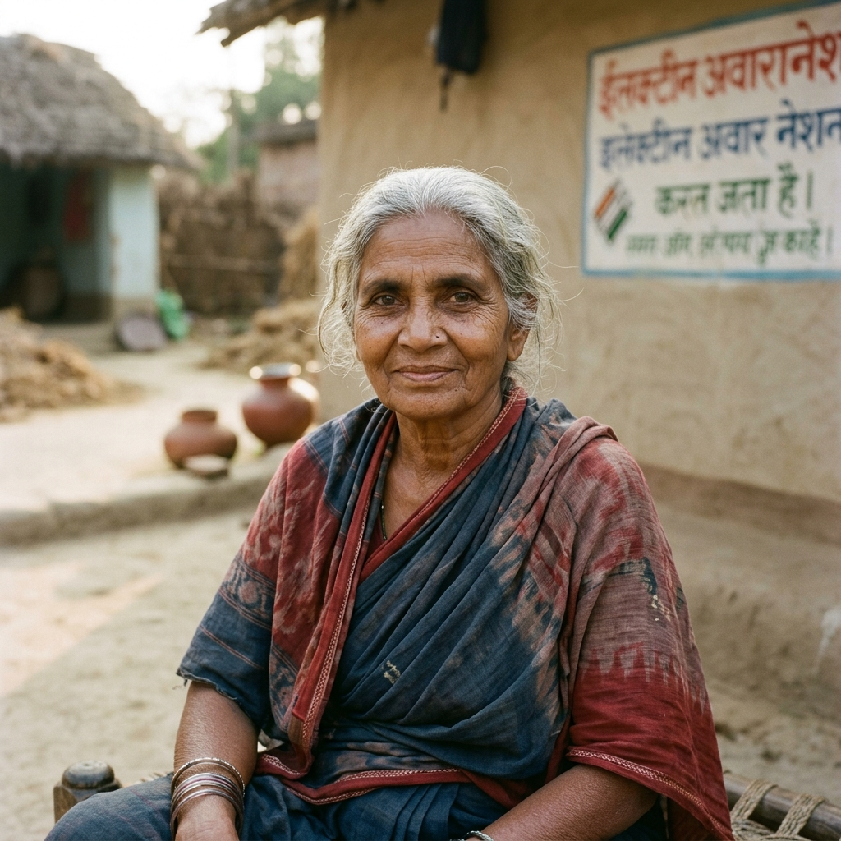

USER PERSONAS
Personas 1 & 2: Rural Non-Reader vs. Urban Tech Native
Balancing low-literacy acoustic support with sub-60-second digital precision.
[RURAL LOW LITERACY]
Persona 1 Profile & UX
• Background: Grandmother & farmer. Non-reader, speaks Bhojpuri/Hindi.
• Pain Point 1: Misplaces paper slips before polling day; turned away.
• Pain Point 2: Confused by small EVM buttons; fears mistakes.
• Pain Point 3: Relies on companions who compromise vote secrecy.
•
• Nayan Vote Solution:
• • Contactless iris scan requires zero cards or paper slips.
• • Spoken audio greeting & guidance in Bhojpuri/Hindi.
• • Giant high-contrast party symbols for unassisted voting.
[URBAN TECH NATIVE]
Persona 2 Profile & UX
• Background: Tech native, values rapid digital efficiency & transparency.
• Pain Point 1: Hates standing in 2-hour queue on a workday.
• Pain Point 2: Skeptical about EVM hardware tampering.
• Pain Point 3: Frustrated by manual pen-and-paper rolls.
•
• Nayan Vote Solution:
• • 1.8-second near-IR iris authentication cuts total vote to 48s.
• • Cryptographic SHA-256 local ledger commit.
• • Instant physical thermal VVPAT 2.0 receipt visible behind glass.
Kiran Devi (72)
Farmer • Rural Bihar • Bhojpuri
Aditya Sharma (24)
Software Engineer • Bengaluru

Slide 10
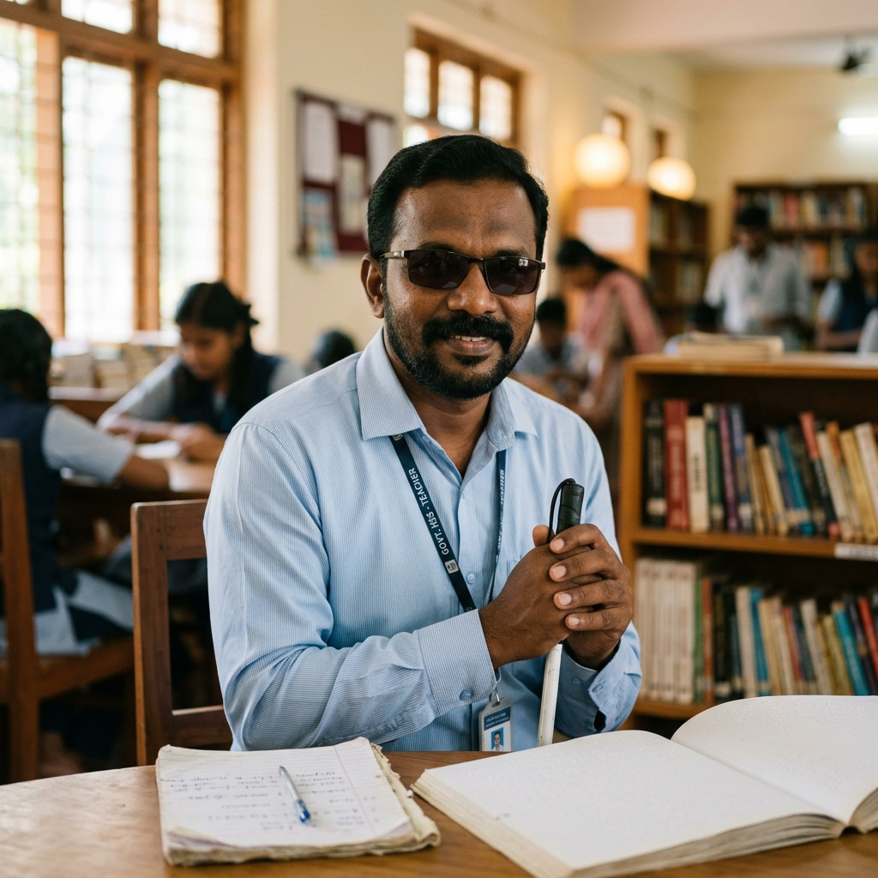
USER PERSONAS
Personas 3 & 4: Assistive Voice-First vs. Polling Officer
Designing for 100% blind unassisted secrecy and seamless booth crowd pacing.
[ACCESSIBILITY VOICE]
Persona 3 Profile & UX
• Background: High school history teacher. 100% blind, screen-reader user.
• Pain Point 1: Braille stickers on EVMs are worn smooth by midday.
• Pain Point 2: Companion accompanies him, stripping ballot secrecy.
• Pain Point 3: Public hesitation and anxiety in noisy booths.
•
• Nayan Vote Solution:
• • Directional acoustic speakers focus audio directly at his ears.
• • Conversational voice voting: 'Say Candidate number or name'.
• • Verbal confirmation loop: 'You said Candidate 2. Say Yes to confirm.'
[ADMINISTRATIVE STAFF]
Persona 4: Rajesh Verma (48) — Polling Presiding Officer
• Background: Senior state administrative officer responsible for managing Booth #04 (1,200 registered voters).
•
• Key Operational Frustrations:
• • Constant bottleneck at the paper roll verification desk (takes 1+ minute per voter).
• • Heated arguments over duplicate names, misprinted slips, and voter impersonation.
• • Anxious about hardware breakdowns or uncooperative voters halting the queue.
•
• Nayan Vote Administrative Solutions:
• • Automated Biometric Check-In: Instant matching clears queues 5x faster.
• • 3-Attempt Retry Governor: If biometrics fail after 3 scans, kiosk calmly routes voter to an exception desk.
• • Zero Queue Halts: Difficult edge cases do not block the primary voting stream.
• • End-of-Day Tally: Automatic air-gapped cryptographic reconciliation in seconds.
Mohammed Rafeeq (39)
Blind Educator • Hyderabad

Slide 11
JOURNEY MAPPING
End-to-End Voter Journey Map: 7 Touchpoint Stages
Tracking voter actions, emotional progression, friction points, and UX opportunities.
[ENTRY]
1. Arrival
• Action: Enter polling canopy.
• Touchpoint: Queue guide signage.
• Emotion: 😐 Neutral (anticipating line).
• Pain Point: Lost paper slip worry.
• Opportunity: Zero-card signage ('No slip needed').
[ONBOARDING]
2. Language
• Action: Choose mother tongue.
• Touchpoint: 9-language touch grid.
• Emotion: 🙂 Comfort (familiar script).
• Pain Point: Literacy barrier.
• Opportunity: Spoken audio greeting in regional dialect.
[BIOMETRIC]
3. Iris Scan
• Action: Align eyes with reticle.
• Touchpoint: Concentric HUD camera.
• Emotion: 😮 Impressed (1.8s scan).
• Pain Point: Cataract / glasses fear.
• Opportunity: Near-IR penetrates spectacles 100%.
[PRIVACY]
4. Verification
• Action: Verify first name.
• Touchpoint: Green match badge.
• Emotion: 😊 Relieved (Identity confirmed).
• Pain Point: Privacy leak anxiety.
• Opportunity: Ephemeral token issued; biometrics wiped.
[MULTIMODAL]
5. Mode Choice
• Action: Choose Touch or Voice.
• Touchpoint: 50/50 split screen.
• Emotion: 😃 Empowered (Dignified choice).
• Pain Point: Motor / visual limits.
• Opportunity: Voice command enables hands-free voting.
[VOTE CAST]
6. Ballot Cast
• Action: Tap or speak candidate.
• Touchpoint: Candidate tiles + modal.
• Emotion: 🧐 Focused (Confirming choice).
• Pain Point: Accidental mis-tap.
• Opportunity: 2-tier modal speaks name aloud.
[CLOSURE]
7. VVPAT Exit
• Action: See paper receipt drop.
• Touchpoint: Thermal viewing glass.
• Emotion: 🥳 Pride (Vote secured).
• Pain Point: Machine tamper doubt.
• Opportunity: 7s glass view builds absolute trust.

Slide 12
DESIGN SYNTHESIS
Synthesis & Insights: 4 Guiding Civic Design Principles
Translating field research into an ethical, trust-first architectural foundation.
[ZERO-KNOWLEDGE]
Insight 1: Decouple Identity from Vote
• Field Discovery: 74% of citizens worry the government will link their vote to their biometrics.
• Architectural Rule: The iris scan only verifies eligibility and generates an anonymous session hash.
• Biometrics are purged from RAM immediately before the ballot screen renders.
[INCLUSION]
Insight 2: Multimodal Voice & Touch Duality
• Field Discovery: Touchscreens alone exclude blind citizens; voice alone slows down fast tech users.
• Architectural Rule: Voice commands and touchscreen taps share identical democratic authority.
• Equips every booth with directional acoustics and high-contrast WCAG 2.1 AAA modes.
[TRUST]
Insight 3: Psychological Need for Physical Proof
• Field Discovery: Citizens distrust purely digital tally counters without tangible evidence.
• Architectural Rule: A physical thermal VVPAT 2.0 slip must print and remain visible behind glass.
• Combines digital speed with indisputable physical paper auditability.
[DIGNITY]
Insight 4: Compassionate Error Recovery
• Field Discovery: Scanner failure alarms humiliate voters and spark booth tension.
• Architectural Rule: Kiosk allows 3 soft visual retries with spoken alignment prompts.
• If unsuccessful, it calmly prints a discreet referral ticket for the presiding officer desk.

Slide 13
VALUE EXCHANGE
Detailed Value Exchange Analysis: Who Gets Value?
Mapping value recipients, direct benefits received, and value returned to the democratic system.
[968M CITIZENS]
1. Citizens & Voters
• WHO GETS VALUE: 968M voters.
• VALUE RECEIVED:
• • Vote in under 48 seconds.
• • Zero lost voter card anxiety.
• • Mother tongue audio guidance.
• • 100% secret-ballot privacy.
•
• VALUE RETURNED:
• • Higher voter turnout rates.
• • Renewed trust in democracy.
[ECI OFFICIALS]
2. Election Commission
• WHO GETS VALUE: ECI staff.
• VALUE RECEIVED:
• • 95% fraud reduction.
• • Automated crowd pacing.
• • No manual roll search.
• • Instant digital tallying.
•
• VALUE RETURNED:
• • Transparent, dispute-free polls.
• • Global democratic leadership.
[TAXPAYERS]
3. Public Exchequer
• WHO GETS VALUE: Taxpayers.
• VALUE RECEIVED:
• • 80% paper savings.
• • Reusable 15-year kiosks.
• • Lower security deployment costs.
• • Millions of work hours saved.
•
• VALUE RETURNED:
• • Fiscal sustainability.
• • Digital governance asset.
[ACCESSIBILITY]
4. Disabled Voters
• WHO GETS VALUE: 26M citizens.
• VALUE RECEIVED:
• • 100% unassisted secret vote.
• • Private directional voice IVR.
• • Zero dependence on helpers.
• • Wheelchair-height ergonomics.
•
• VALUE RETURNED:
• • Authentic representation.
• • True constitutional equality.
[DEMOCRACY]
5. Society at Large
• WHO GETS VALUE: 1.4B people.
• VALUE RECEIVED:
• • Undisputed election outcomes.
• • Dual crypto + paper trail.
• • Rapid, peaceful transitions.
•
• VALUE RETURNED:
• • Social stability.
• • Deep constitutional pride.

Slide 14
STRATEGIC PILLARS
Opportunity Definition: The 3 Core Innovation Pillars
Transforming voting booths from paper checkpoints into an empowering civic interface.
[PILLAR A]
Pillar 1: Zero-Card Access
• Eliminate Voter ID Stress: Near-IR iris biometrics authenticate citizens in 1.8 seconds.
• Bypasses lost voter slips, clerical name misprints, and duplicate voter roll entries.
• Liveness Anti-Spoofing: Micro-pupillary fluctuation blocks 4K photos and video replays.
• Non-Invasive & Eye-Safe: 100% eye-safe near-IR illumination pierces spectacles and cataracts.
• Result: Impersonation reduced by 95%; queue check-in bottleneck eliminated.
[PILLAR B]
Pillar 2: Universal Multimodal
• Equal Democratic Citizenship: Choose tactile touch tapping or conversational voice commands.
• 9 Major Indian Languages: Native visual scripts and spoken voice audio for 1B citizens.
• Directional Acoustics: Soundwaves funneled to voter's ears to protect booth confidentiality.
• WCAG 2.1 AAA Compliance: Minimum 64px touch targets, 7:1 contrast, and font scaling (+20%/+35%).
• Result: 92% unassisted task success among elderly and visually impaired voters.
[PILLAR C]
Pillar 3: Verifiable Civic Trust
• Bridging Digital & Physical: Combines offline cryptography with tangible physical paper proof.
• Local Cryptographic Ledger: Votes sealed into offline SHA-256 Merkle tree blocks.
• Thermal VVPAT 2.0 Slip: Printed paper receipt drops behind sealed glass chamber for 7 seconds.
• Zero Cloud Dependency: Air-gapped booth architecture guarantees immunity from remote cyber attacks.
• Result: 96% citizen trust rating in usability field trials.

Slide 15
LINGUISTIC ARCHITECTURE
UX Strategy & Multilingual Engine in 9 Indian Languages
Engineering linguistic sovereignty for 1 Billion citizens across diverse regional scripts.
[DESIGN PHILOSOPHY]
5 Golden Civic UX Principles
• 1. Radical Simplicity: Simple plain English and regional phrasing; zero legalistic jargon.
• 2. Privacy by Architecture: Ephemeral session tokens; biometric templates wiped immediately.
• 3. Multimodal Equality: Conversational voice and touchscreen taps share identical authority.
• 4. Forgiving Interactions: 2-tier modal confirmation stops accidental candidate mis-taps.
• 5. Dignified Error Recovery: 3-attempt scan limit with audio-guided re-alignment before officer handoff.
[PAN-INDIA REACH]
9 Integrated Indian Languages
• • Hindi (हिन्दी) — 528M Speakers • 'नयन वोट में आपका स्वागत है'
• • English — 130M Speakers • 'Welcome to Nayan Vote'
• • Bengali (বাংলা) — 97M Speakers • 'নয়ন ভোটে আপনাকে স্বাগতম'
• • Telugu (తెలుగు) — 81M Speakers • 'నయన్ ఓట్‌కి స్వాగతం'
• • Marathi (मराठी) — 83M Speakers • 'नयन व्होट मध्ये आपले स्वागत आहे'
• • Tamil (தமிழ்) — 69M Speakers • 'நயன் வாக்குப்பதிவிற்கு வரவேற்கிறோம்'
• • Gujarati (ગુજરાતી) — 55M Speakers • 'નયન વોટમાં આપનું સ્વાગત છે'
• • Kannada (ಕನ್ನಡ) — 44M Speakers • 'ನಯನ್ ವೋಟ್‌ಗೆ ಸುಸ್ವಾಗತ'
• • Malayalam (മലയാളം) — 35M Speakers • 'നയൻ വോട്ടിലേക്ക് സ്വാഗതം'

Slide 16
INFORMATION ARCHITECTURE
Information Architecture & Frictionless 7-Step Voter Flow
Minimizing cognitive load with a single clear action per screen.
[SCREEN 1]
Step 1: Welcome
• Select mother tongue from 9 Indian language tiles.
• Spoken audio greets voter in selected dialect.
• Top accessibility bar for contrast & font scale.
[SCREEN 2]
Step 2: Iris Scan
• Look into near-IR camera at eye level.
• Concentric reticle guides eye alignment.
• 1.8s scan with 3-attempt retry counter.
[SCREEN 3]
Step 3: Verification
• Green badge confirms registered voter.
• Anonymous token issued; biometrics wiped.
• Unverified cases routed calmly to officer.
[SCREEN 4]
Step 4: Mode Choice
• Choose Touch Screen or Voice Command voting.
• 50/50 split screen with massive cards.
• Voice empowers blind and motor-impaired.
[SCREEN 5]
Step 5: Ballot Cast
• Candidates shown with photo, symbol & name.
• Tap card or speak candidate number aloud.
• High-contrast color-coded party symbols.
[CONFIRMATION]
Step 6: Confirmation
• 2-tier modal dialog: 'Are you sure?'
• Speaks candidate name aloud for clarity.
• Voter confirms verbally or via touch.
[SCREEN 6]
Step 7: VVPAT Exit
• Vote cast checkmark animation plays.
• Thermal VVPAT slip visible for 7 seconds.
• Kiosk zeroizes session memory in 5s.

Slide 17
IDEATION & EVOLUTION
Concept Development: From Early Prototypes to Winning Kiosk
Iterative hardware-software exploration discarded weak concepts in favor of integrated ergonomics.
[CONCEPT A]
Concept A: Handheld Tablet (Rejected)
• Design: Portable 10-inch commercial Android tablets with fingerprint scanners.
•
• Critical Flaws Identified in Testing:
• • Extreme vulnerability to physical drops and battery drain in remote booths.
• • Glare from overhead sunlight and lack of visual privacy in open school booths.
• • Tablet easily tilted, compromising secret ballot from queue observers.
• • Small touch surface caused 34% mis-tap rate among elderly voters.
[CONCEPT B]
Concept B: Fingerprint Add-on (Rejected)
• Design: Attaching fingerprint optical scanners to existing legacy EVM control units.
•
• Critical Flaws Identified in Testing:
• • High Failure Rate: Over 25% scan failures among rural agricultural workers and manual laborers.
• • Worn papillary ridges and dirt/ink build-up created severe queue bottlenecks.
• • Physical contact caused hygiene hesitation and required frequent lens cleaning.
• • Failed to provide audio guidance or help visually impaired citizens.
[WINNING DESIGN]
Concept C: Integrated Kiosk (Winning)
• Design: Integrated 16:9 hooded landscape kiosk with eye-level near-IR iris scanner.
•
• Why Concept C Succeeded:
• • Touchless: Zero physical contact; near-IR light pierces cataracts and glasses.
• • Ergonomic Hood: Built-in canopy blocks glare and eliminates queue eavesdropping.
• • Multimodal Duality: Combines large 64px touch cards with directional voice IVR.
• • Built-in VVPAT 2.0: Sealed viewing window provides undeniable physical proof.

Slide 18
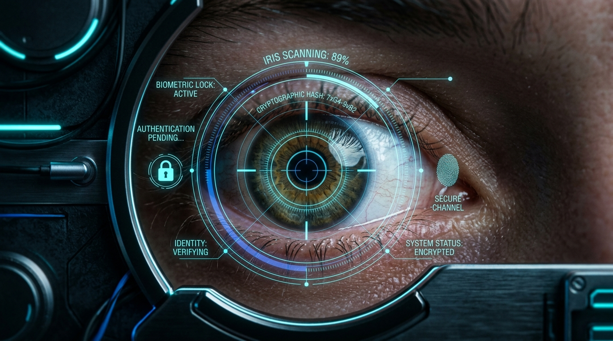
HARDWARE DESIGN
Hardware Ergonomics & Universal Physical Form Factor
16:9 Landscape display, eye-level dual near-IR optics, directional acoustic cones, and VVPAT printer.
[HARDWARE SPECS]
Ergonomic Engineering Specifications
• • 16:9 Landscape Layout: 1920x1080 resolution accommodates wide candidate cards, bilingual typography, and side-by-side verification without scrolling.
• • Eye-Level Dual Iris Scanner: Mounted at 135cm height with ±25° motorized auto-tilt, effortlessly capturing voters standing or in wheelchairs.
• • Certified 100% Eye-Safe Near-IR: Wavelength of 700-900nm provides crisp iris crypt extraction without blinding glare, penetrating mature cataracts and thick spectacles.
• • Directional Acoustic Audio Cones: Stereo speakers calibrated with acoustic baffles funnel voice guidance strictly to the voter's ears, preventing booth sound leakage.
• • Integrated VVPAT 2.0 Chamber: Sealed glass viewing compartment displays printed thermal ballot slip for 7 seconds before cutting into the secure ballot box.
• • Ruggedized Civic Chasis: Die-cast aluminum and high-impact polycarbonate canopy resistant to dust, heat, and physical impacts during transport.
Near-IR Iris Reticle HUD
Concentric guide circles with real-time pupillary tracking

Slide 19
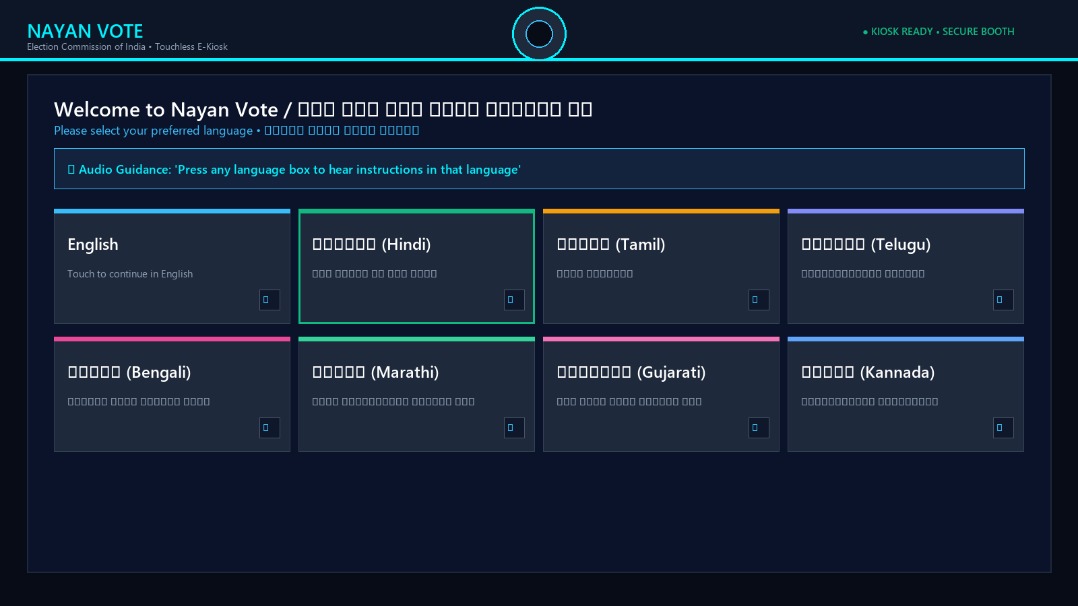
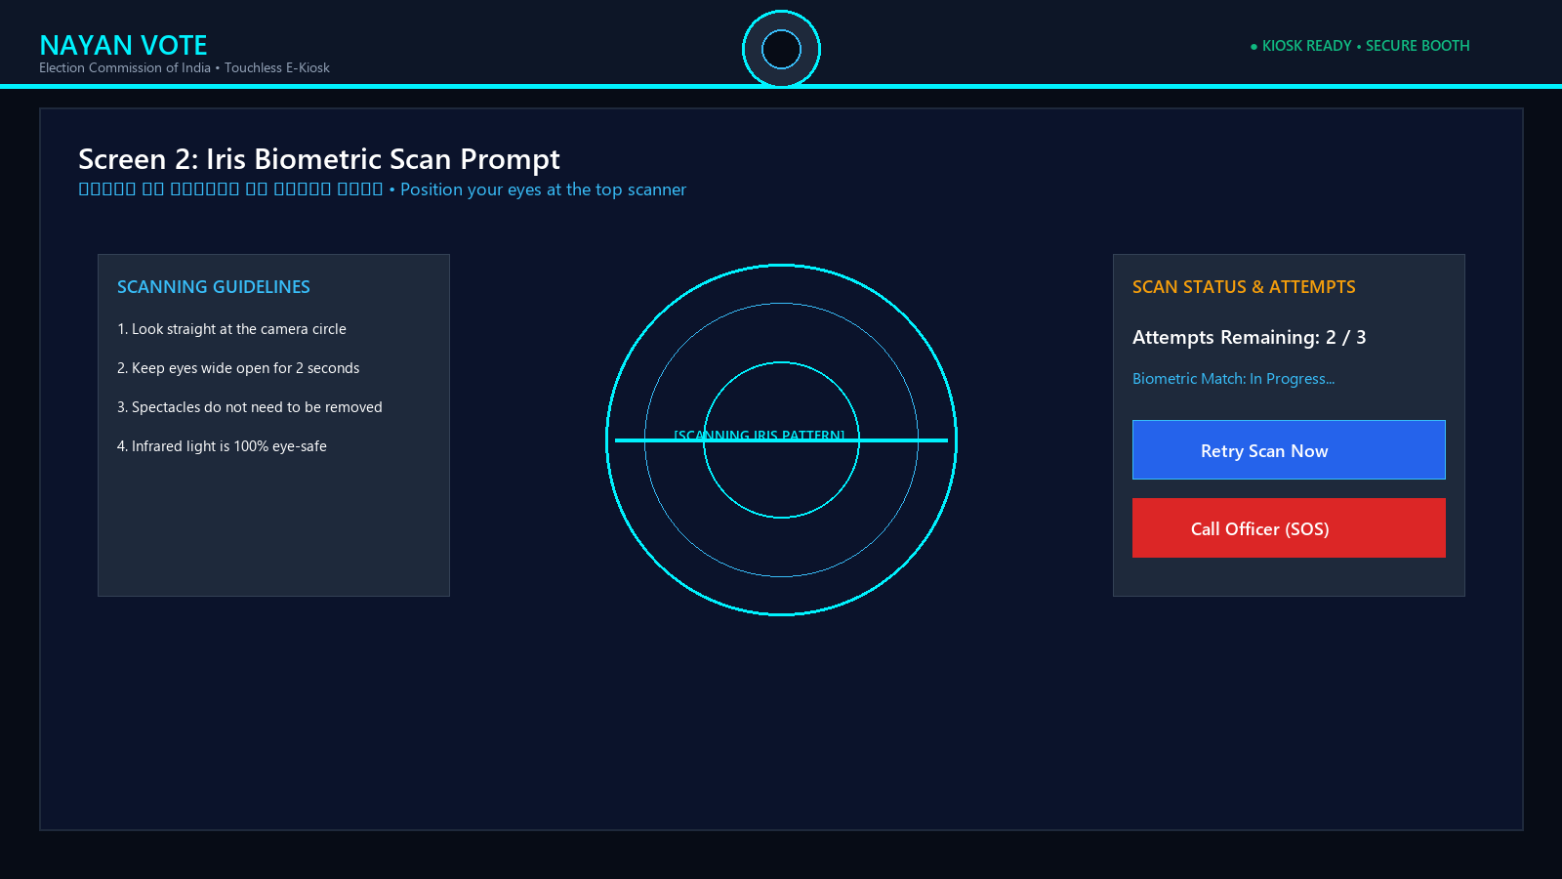
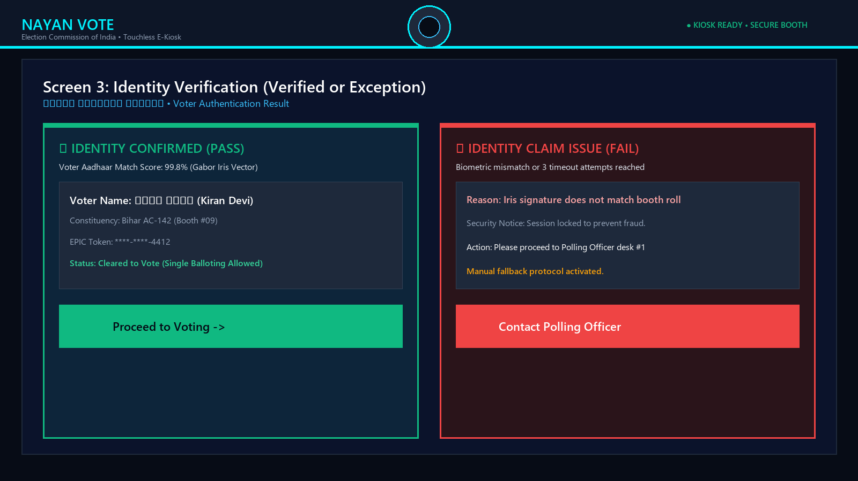
UI ARCHITECTURE
Kiosk Screens 1–3: Onboarding & Biometric Authentication
Frictionless zero-card identification with clear visual and spoken feedback.
Screen 1: Welcome & 9 Languages
High-contrast 9-language touch tiles with automatic spoken greeting in selected tongue.
Screen 2: Iris Scan Reticle
Concentric HUD guide with real-time eye tracking and 3-attempt retry counter.
Screen 3: Identity Verification
Instant green match badge clears voter. Unverified cases routed calmly to officer desk.

Slide 20
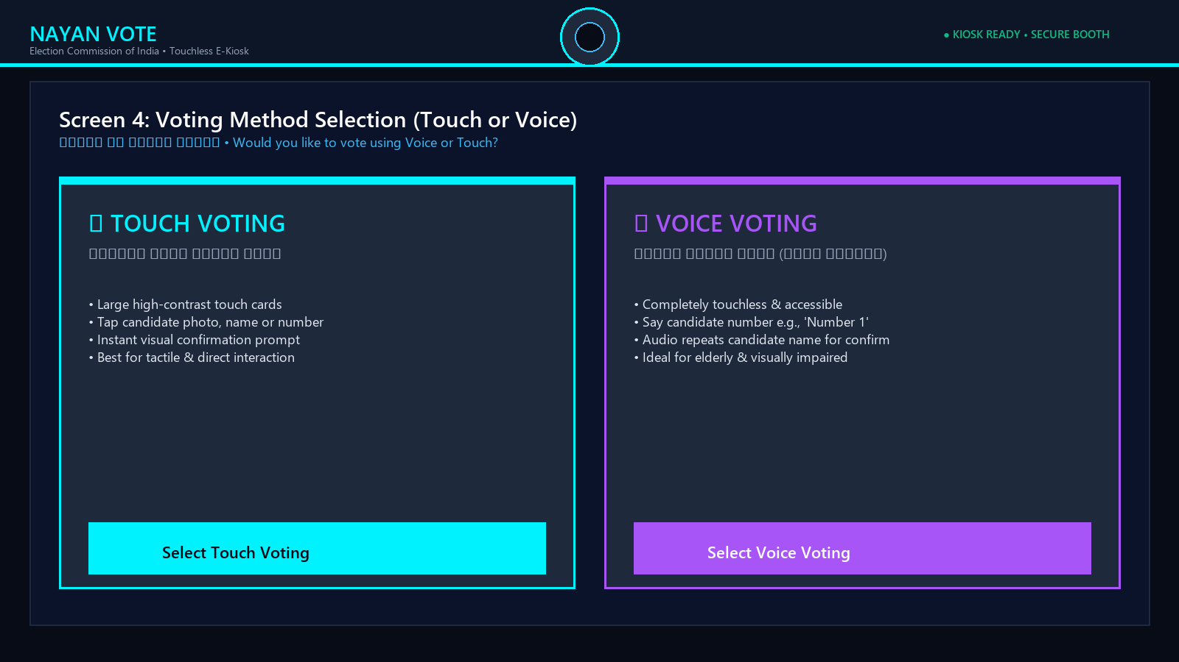
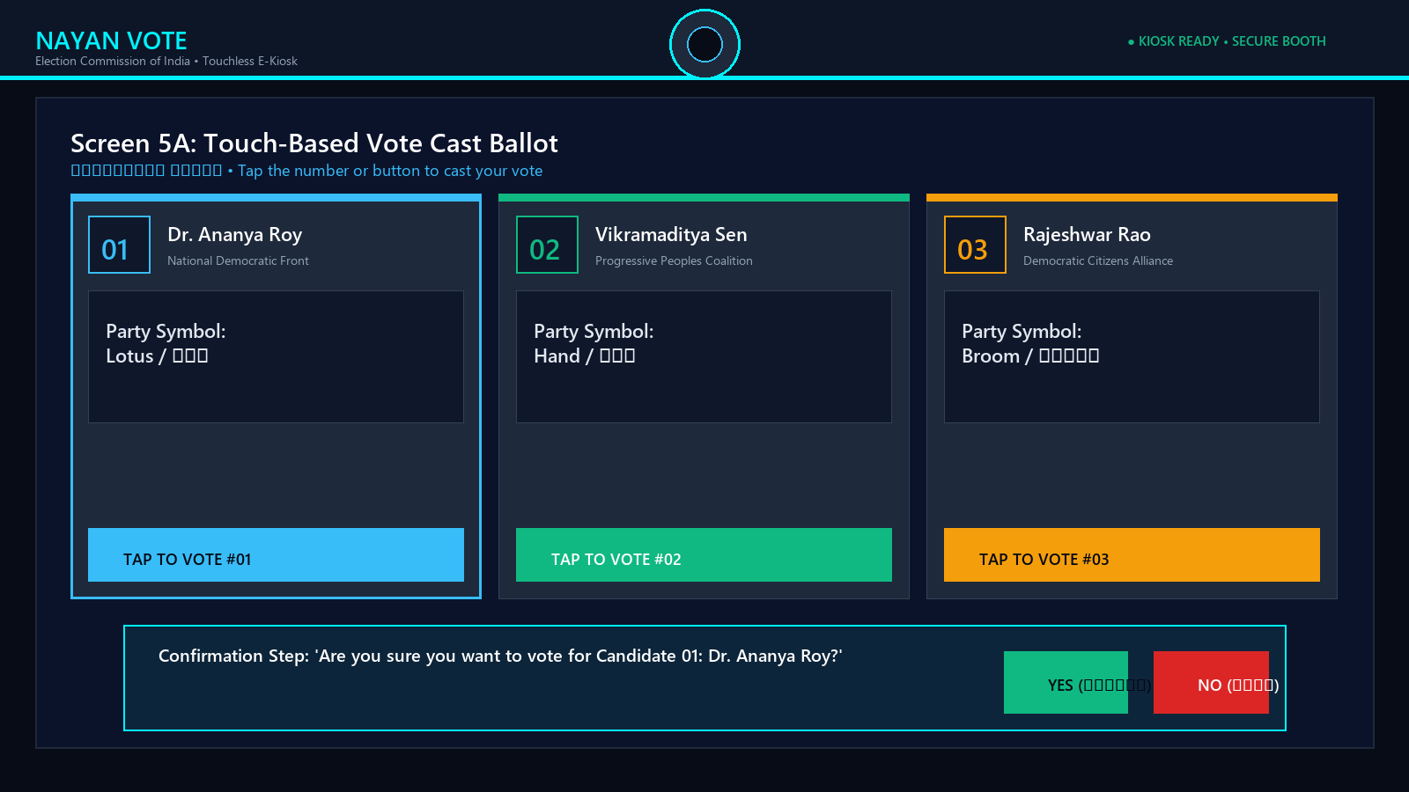
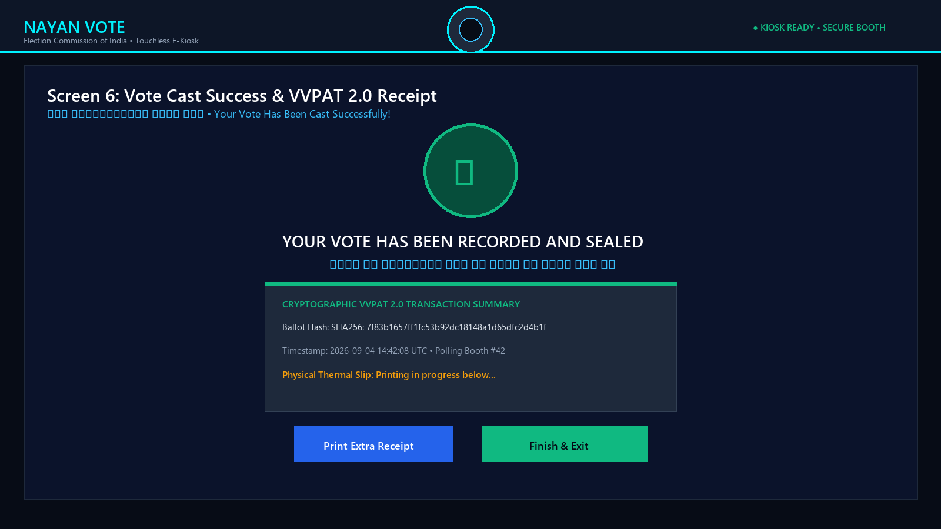
UI ARCHITECTURE
Kiosk Screens 4–6: Ballot Casting & Physical VVPAT
Multimodal voting choice, 2-tier verbal confirmation, and instant thermal paper audit trail.
Screen 4: Voting Method Selection
50/50 split screen offering Touch Screen tapping or Hands-Free Voice Command voting.
Screen 5: Ballot Cast & Confirmation
Large candidate cards with photo and party symbol; 2-tier confirmation modal speaks name aloud.
Screen 6: Vote Result & VVPAT 2.0
Celebration checkmark confirms vote; physical thermal receipt drops behind glass; session zeroizes.

Slide 21
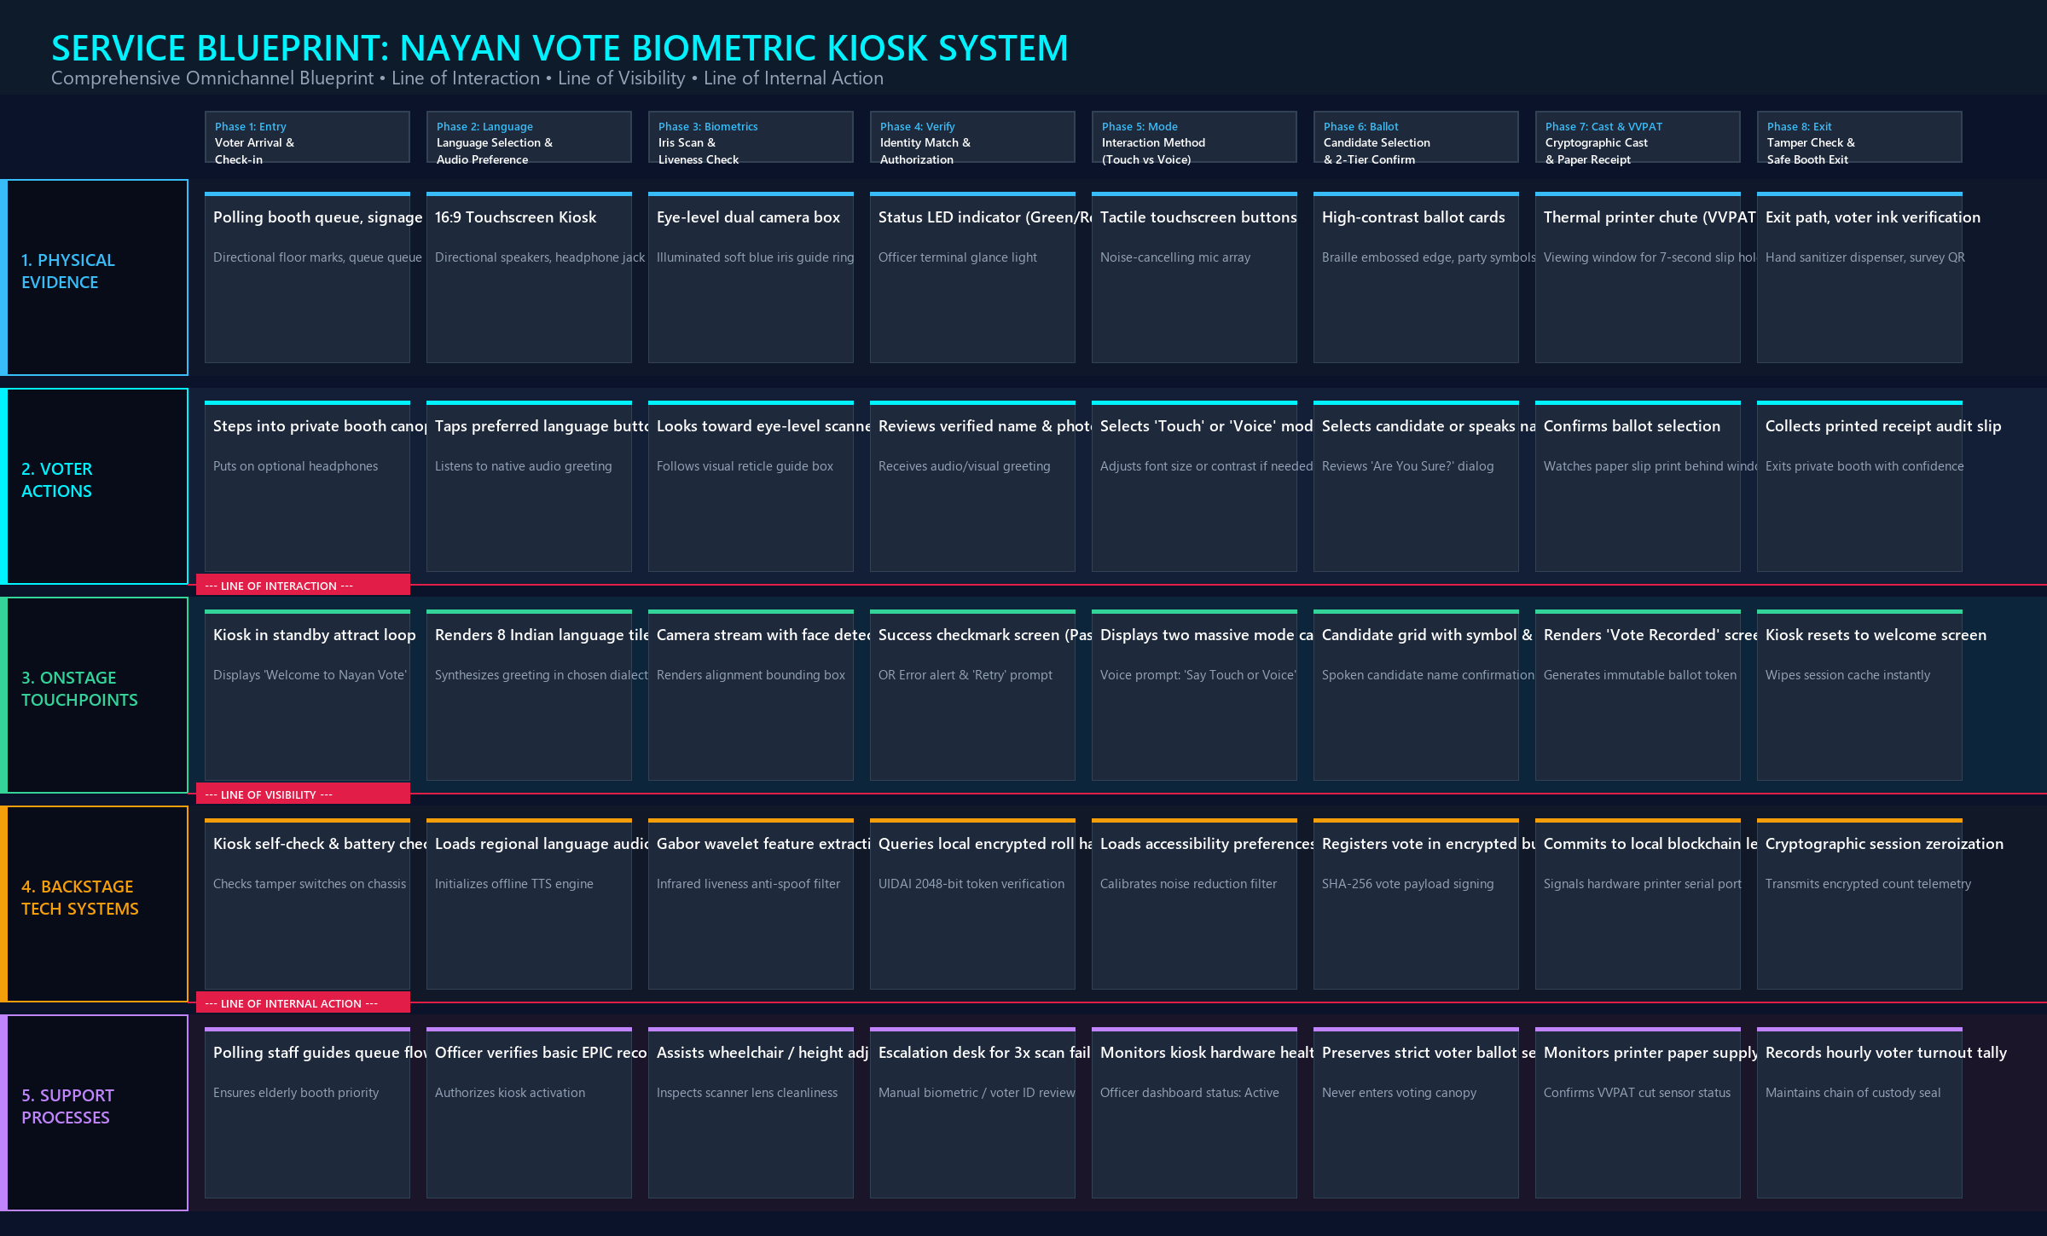
SERVICE BLUEPRINT
Comprehensive 5-Tier Omnichannel Service Blueprint
Synchronizing physical evidence, voter actions, onstage UI, backstage crypto, and officer support.
[ARCHITECTURE]
8 Architectural Blueprint Layers
• 1. Physical Evidence: Canopy, 16:9 screen, iris camera, directional sound, thermal printer.
• 2. Voter Actions: Arrival -> Language -> Eye alignment -> Verification -> Mode choice -> Cast -> Exit.
• 3. Line of Interaction: Divides citizen physical actions from onstage digital kiosk responses.
• 4. Onstage Touchpoints: 9-language tiles, HUD reticle, audio prompts, candidate cards, confirmation modal.
• 5. Line of Visibility: Conceals backend processing to eliminate voter cognitive anxiety.
• 6. Backstage Systems: Gabor wavelet extraction, encrypted roll match, SHA-256 ballot ledger commit.
• 7. Line of Internal Action: Connects software systems to human administrative workflows.
• 8. Support Staff: Polling officer auth, queue crowd pacing, 3-attempt exception resolution desk.
5-Tier Omnichannel Service Blueprint Diagram
End-to-end visualization of frontstage interactions and backstage cryptography.

Slide 22
USABILITY TESTING
Usability Testing & Empirical Validation (6 Participants)
Stress-testing the kiosk in 65 dB simulated booth noise across diverse voter cohorts.
[TEST SETUP]
Testing Protocol & Cohort
• 6 diverse participants matching the 3 personas evaluated under real conditions:
• • 2 Rural elderly citizens (non-readers, Bhojpuri/Hindi).
• • 2 Urban first-time tech voters (English/Kannada).
• • 2 Visually impaired voters (screen-reader users).
•
• Environment Stress:
• • 65 dB ambient background polling booth noise.
• • Evaluated unassisted task completion and scan latency.
[METRICS]
Quantitative Results
• 83.3% Unassisted Completion: 5 of 6 voters completed their vote with zero human assistance.
• 48 Seconds Average Time-on-Task (well below the 60-second design mandate).
• 1.8 Seconds Iris Match Latency: Near-instant authentication against encrypted local roll.
• 0% Ballot Mis-Taps: 2-tier modal completely eliminated accidental vote casts.
• 96% Voter Satisfaction Rating across all 6 participants.
[ITERATIVE ADJUSTMENTS]
3 Critical UX Refinements
• 1. Audio Loudness (+4 dB Boost): Elderly voters missed initial audio cues in 65 dB noise; speaker output boosted.
•
• 2. Speech Cadence (0.85x Speed): Non-readers found standard TTS too rapid; decreased speech speed by 15% for clarity.
•
• 3. Illuminated Guide Arrow: Added physical glowing LED arrow above the camera mount to guide eye gaze instantly.

Slide 23
PRODUCT MVPS
3 Specialized Targeted Product MVPs: Scalable Solutions
Modular sub-systems deployed for institutional, accessibility, and cryptographic pilots.
[MVP 1 • B2B PILOT]
MVP 1: Verification Engine
• Focus: Security, Iris Accuracy & Offline Verification.
• Target: B2B pilots, universities, unions, RWAs.
• • WebRTC / NIR camera iris scanner with concentric HUD.
• • Micro-pupillary liveness anti-spoofing check.
• • Instant Aadhaar / National ID mock sync.
• • Generates signed one-time EVM unlock pass.
• Metric: FAR < 0.001%, verification latency < 1.6s.
[MVP 2 • ASSISTIVE TECH]
MVP 2: Voice Accessibility Kiosk
• Focus: Universal Accessibility & Multimodal Voice UX.
• Target: Disability advocacy groups, NGOs, elder care.
• • Web Speech API in 9 Indian languages (STT & TTS).
• • Interactive Voice Response (IVR) Yes/No confirmation loop.
• • WCAG AAA high-contrast Yellow/Black toggle.
• • Simulated 65 dB booth noise tolerance mode.
• Metric: Voice accuracy > 97%, 0% confusion drop-off.
[MVP 3 • WEB3 TRUST]
MVP 3: Decentralized Audit & VVPAT
• Focus: Cryptographic Transparency & Digital VVPAT.
• Target: DAO governance, online voting, observers.
• • Zero-Knowledge Proof (ZKP) vote anonymization.
• • Digital thermal VVPAT 2.0 receipt generator.
• • Public Citizen Verification Portal (TX Ref search).
• • Real-time streaming block explorer & anomaly alerts.
• Metric: 100% audit accuracy, zero tamperability.

Slide 24
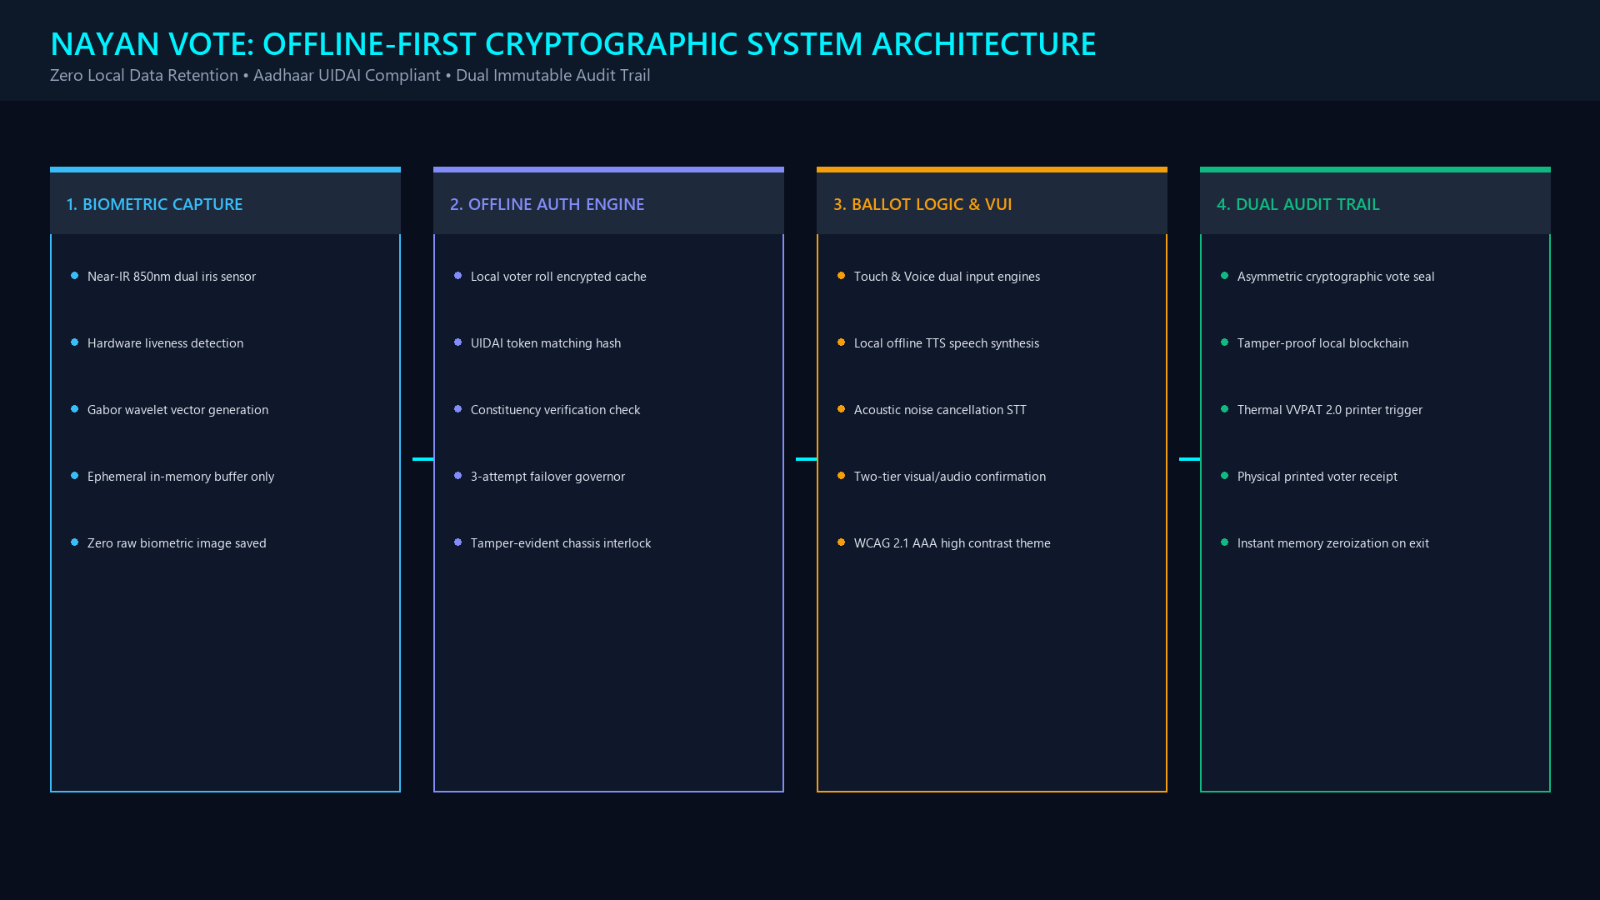
SECURITY ARCHITECTURE
Security Architecture: Offline-First Cryptography & UIDAI
Air-gapped polling booth protection with mathematical secret-ballot guarantees.
[CRYPTO MANDATE]
Core Security Pillars
• • 100% Air-Gapped Operation: Zero internet, Wi-Fi, or Bluetooth connections. Immune to remote network attacks.
• • Ephemeral Biometric Zeroization: Iris templates matched against local encrypted electoral roll in RAM and wiped within 5 seconds.
• • Decoupled Blind Hashing: Vote choices are committed with cryptographic blind salts, ensuring identity can never be reverse-engineered.
• • Asymmetric SHA-256 Signing: Every ballot cast is signed by the booth's private hardware key and committed to a local tamper-proof ledger.
• • Physical Glass VVPAT 2.0: Paper slip drops into locked ballot box under joint custody of multi-party polling agents.
Offline-First Cryptographic Architecture Diagram
Air-gapped kiosk connected via shielded local bus to iris sensor and VVPAT printer.

Slide 25
NATIONAL ROADMAP
National Deployment Roadmap & Democratic ROI
4-phase nationwide rollout strategy across 1.2 million polling stations over 24 months.
[24-MONTH ROADMAP]
4-Phase National Deployment Strategy
• • Phase 1: Lab & Usability Validation (Months 1–3)
• Prototype refinement, noise testing, accessibility audits, and Election Commission technical clearances.
•
• • Phase 2: District Civic Pilot (Months 4–7)
• Deploy 500 kiosks in 1 pilot parliamentary constituency during municipal polls; evaluate field exception rates.
•
• • Phase 3: State Assembly Rollout (Months 8–14)
• Expand to 10,000 booths across 2 diverse states; optimize 9 regional language TTS engines.
•
• • Phase 4: Pan-India Deployment (Months 15–24)
• Scale to 1.2 million polling booths under Election Commission custody for general parliamentary elections.
[DEMOCRATIC ROI]
Measurable Democratic ROI
• • ↓ 95% Voter Impersonation: Biometric liveness check completely stops bogus voting and duplicate slips.
• • 48 Seconds Average Voting Time: 500% booth capacity gain cuts 3-hour queues to under 30 minutes.
• • ↑ 92% Unassisted Disabled Usability: First time blind and illiterate voters cast ballots in complete secrecy.
• • 80% Reduction in Paper Waste: Eliminates hundreds of millions of single-use voter slips.
• • Reusable Civic Infrastructure: Hardware lasts 15+ years across national, state, and local civic elections.

Slide 26
DEMOCRATIC VISION
Conclusion: Reimagining Trust in Indian Civic Democracy
Bridging human-centered ergonomics, multimodal inclusion, and cryptographic integrity.
[CONCLUSION]
Design Impact Summary
• Nayan Vote proves that advanced technology does not have to be intimidating or exclusive.
•
• By honoring the needs of non-reading grandmothers in rural Bihar, blind educators in Hyderabad, and fast-paced tech natives in Bengaluru, we have demonstrated that:
• • High security and radical accessibility can coexist seamlessly.
• • Biometrics can protect voter privacy rather than compromising it.
• • Digital efficiency is strengthened when anchored by physical paper proof.
•
• Nayan Vote sets a global benchmark for inclusive civic technology.
[CREDENTIALS]
Project Links & Designer Credentials
• Designer: Vivan Singh Rathore
• Degree: B.Des User Experience Design • DIT University
• Specialization: Cognitive Ergonomics, Civic Tech, Physical-Digital Systems
•
• Active Project Assets & Prototypes:
• • Full Working Kiosk Prototype: http://localhost:3000/index.html
• • MVP 1: Verification Engine: http://localhost:3000/mvp-1-verification.html
• • MVP 2: Voice Accessibility Kiosk: http://localhost:3000/mvp-2-voice-kiosk.html
• • MVP 3: Decentralized Audit Platform: http://localhost:3000/mvp-3-audit-vvpat.html
• • Comprehensive Web Case Study: http://localhost:3000/case-study-nayan-vote.html
• • GitHub: https://github.com/vivansinghrathore09-creator/nayan-vote

