Slide 1

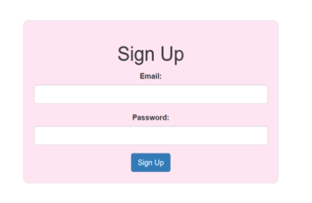
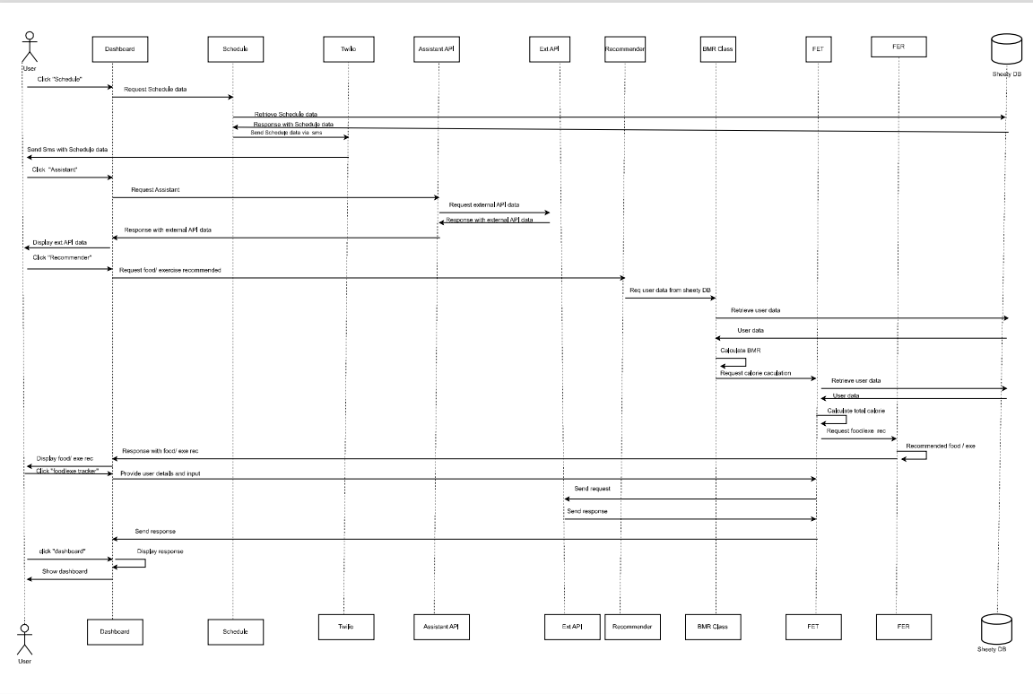
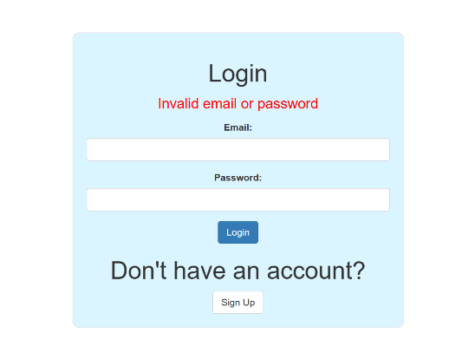
Health Manager System
MAULI DESAI(IU1941230028)
Vipsa kamani(IU1941230181)
ABSTRACT/INTRODUCTION
WORKING AlGORITHMS/ IMPLEMENTATION
SCREENSHOTS
Health Manager is basically a web-application that helps users to improve their physical health and wellbeing by providing a comprehensive set of tools
and resources.
The app includes features such as customized workout plans, meal plans, calories tracking and progress monitoring.
The app utilizes Ml algorithms to provide personalized recommendations based on user’s goal and preferences.
In this project we have developed a web app. that helps people in achieving their fitness goals.
The project is aimed to provide an efficient, secure and scalable web app design.
OBJECTIVES
FUTURE ENHANCEMENT
To create a user-friendly application.
To create an app that provides information about weight loss, weight gain and all necessary nutritional details.
To reduce cost and save time.
To make an app that is available to users any time.
To provide clear and easy to understand information.
To reduce paper work.
Health Manager app requires a range of tools and technologies to be used for its development. Here is a detailed overview of some of the important tools and technologies that are used in the development of this application.
Some of the technologies used are as follows:
HTML5
CSS
JAVASCRIPT
FLASK(PYTHON)
JINJA
MACHINE LEARNING(ML)
MICROSOFT WORD 2021
PYCHARM
Problem Statement
There are several potential enhancements that could be made to the health manager system to improve its functionality and effectiveness. Some potential future enhancements are:
Integration with wearable devices
Social features
Gamification
Mindfulness and Meditation
Virtual Personal Trainers
Mobile app integration
Maintaining daily habit of workout is essential to avoid being obese and having several health related issues.
This project tackle the issues by taking daily exercise details and stored it into a table which user can get access to. So that they can check their daily progress and routine.
It also has a feature of sending a notification or email to user if they did not give update about the exercise in given timespan.
TOOLS AND TECHNOLOGY
Project Outcome
CONCLUSION
This app is designed to provide a comprehensive and personalized fitness experience for users . This app is built to help users achieve their fitness goals by providing access to workout plans, nutrition plans.
The key outcomes of this project are as follows:
Nutrition Plans: The app will provide personalized nutrition plans based on the user’s dietary requirements and fitness goals.
Progress Tracking: The app will allow users to track their progress by logging their workouts and meals.
User-friendly Interface: The app will have a clean intuitive interface that is easy to navigate. Users will be able to access their
workout and nutrition plans.
The development of a ‘Health Manager ‘app can provide a powerful tool for individuals to achieve their fitness and wellness goals.
Overall, this project has the potential to make a positive impact on people’s lives by promoting healthy habits and improving overall wellbeing.
GUIDED BY:
Internal Guide:
Dr. Ashwin Patani
CE Department,
IITE, Indus
University

