Slide 1
Health Manager System
Vipsa Kamani - IU1941230181
Mauli Desai - IU1941230028

Slide 2
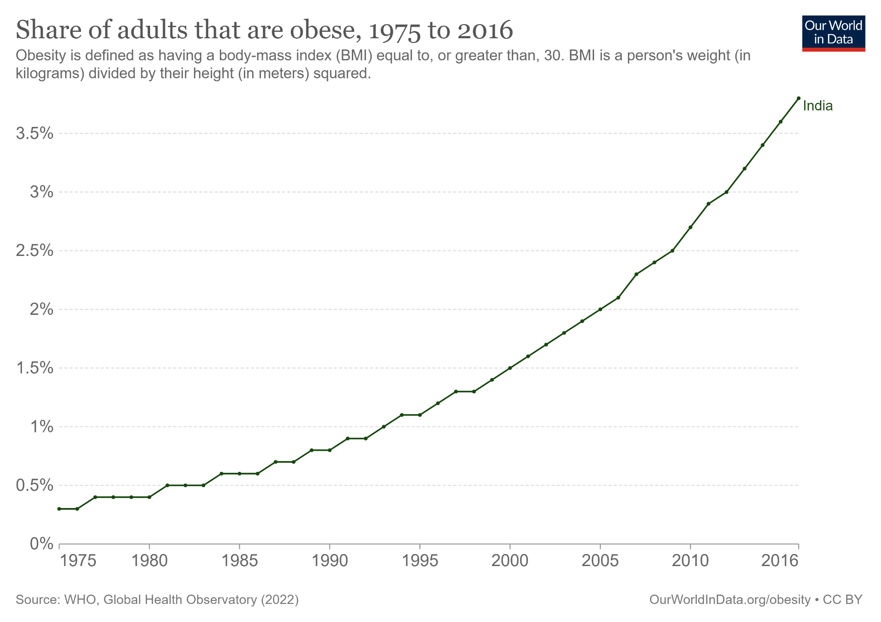

Introduction : Problem
Sedentary lifestyles due to reliance on online services and mobile devices, and busy schedules challenge exercise and diet, leading to unhealthy choices, obesity, underweight, and diseases.
Obesity has increased by 3.5% from [1975] to [2016], causing health concerns like cardiovascular diseases, musculoskeletal disorders, depression, stress, and malnutrition.
Lack of motivation hinders regular exercise and healthy eating, impacting personal health and work productivity.

Slide 3

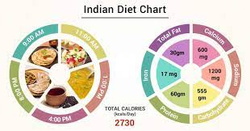
Maintaining a proper body weight is crucial for a healthy lifestyle, addressing both underweight and overweight conditions.
Balancing energy intake and calories burned per day is a solution to mitigate these concerns.
Mechanism to motivate user on daily bases.
Healthy individuals lead to improved personal lives and enhanced work productivity in today's fast-paced world.
Solution:

Slide 4
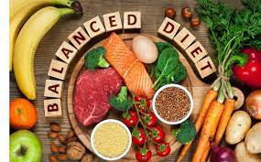



Objective:
Develop a user-friendly system for easy and convenient input of food intake and exercise routines tracking using natural language processing.
Include a feature that allows users to review their previous exercise sessions, including specific date and time, and calorie burn, to track their progress and encourage adherence to healthy exercise habits.
Implement automatic calculation of calorie gain, burn, or maintenance based on user's input to provide accurate and real-time feedback to the user.
Offer personalized recommendations for food items and exercises based on the user's calorie requirements.
Motivate users through constant customized messages suggesting food/exercise and calorie goals.
Incorporate an interactive assistant to address user's questions and provide additional guidance related to health.

Slide 5
Tools & Technology
HTML5:-HTML5 is a markup language for structuring and presenting content on web
CSS:-A stylesheet language used to describe the presentation of a doc written in HTML
JS:-A lightweight,interpreted programming language with first class function used in frontend
Bootstrap:Used in Creation of the project
Backend:
PYTHON:-Project Backend Logic is implemented in Python
FLASK:- Works as interface between UI and backend
JINJA:- Provides dynamic features on HTML page
External Resources:- News API, Nutritionix API, Sheety API
Tools:
MS WORD 2021:-A word processing program that allows for the creation of documents
PYCHARM:-An IDE which is used to write code and develop applications
Browser(Google Chrome): A software application
Health Manager app requires a range of tools and technologies to be used for its development. Here is a detailed overview of some of the important tools and technologies that are used in the development of this application.
Some of the technologies used are as follows:
HTML5
CSS
JAVASCRIPT
FLASK(PYTHON)
JINJA
MACHINE LEARNING(ML)
MICROSOFT WORD 2021
PYCHARM

Slide 6
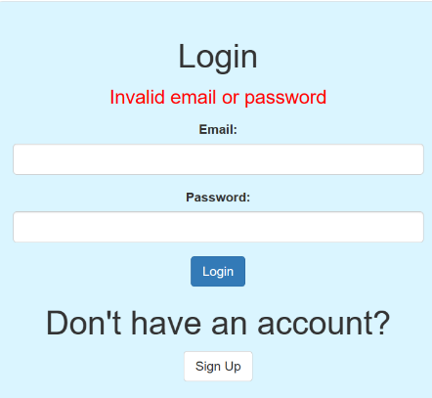
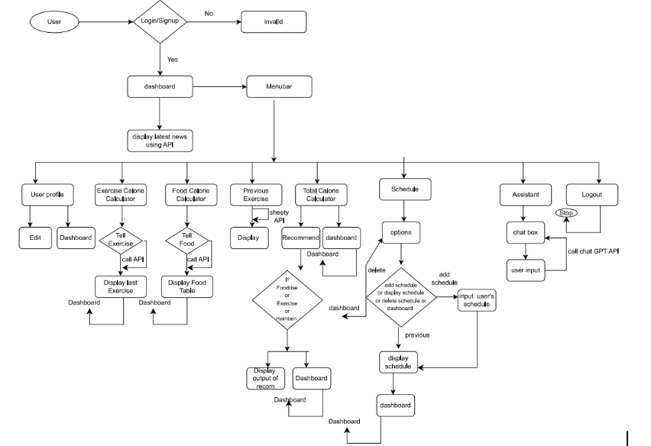
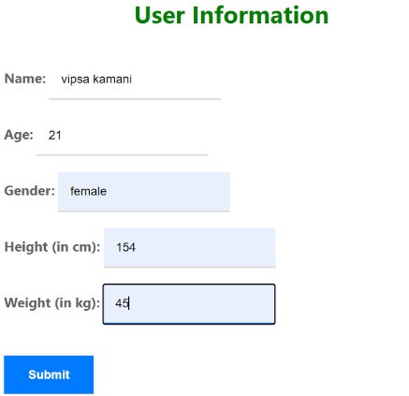
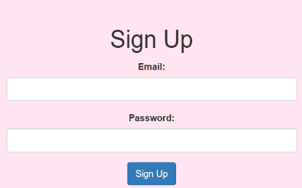
Proposed Technical Methdology:

Slide 7
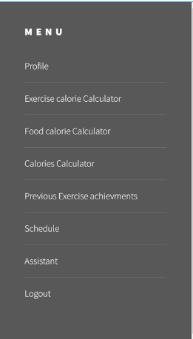
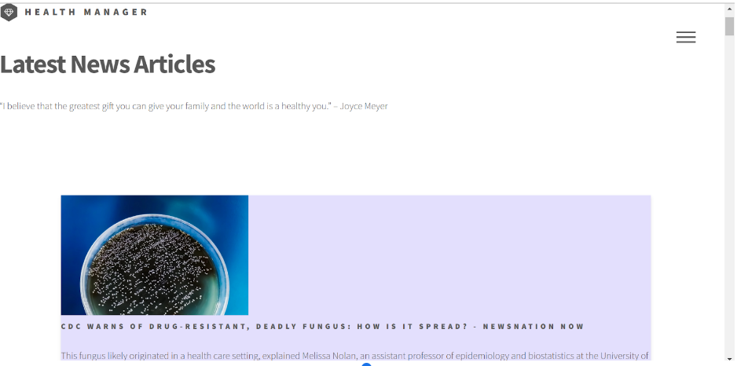
Dashboard :
Successful login leads to a dashboard display.
Dashboard showcases latest health-related articles using newAPI.
Menu bar on right-hand side offers numerous options

Slide 8
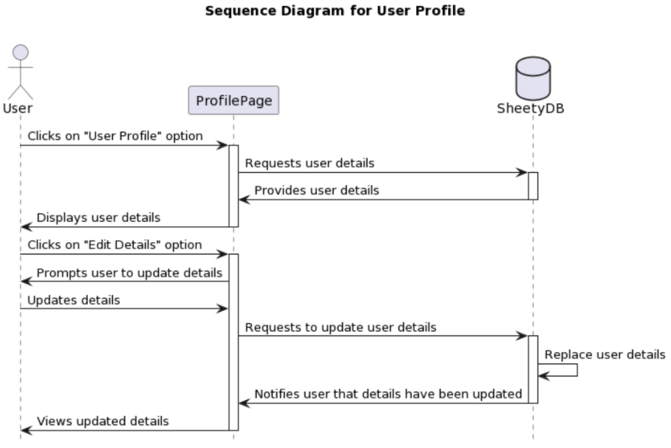
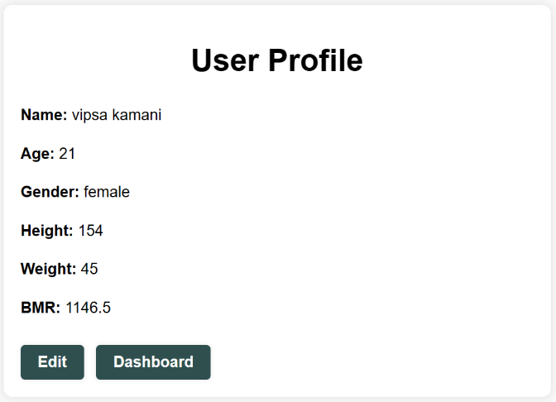
User Profile :
System fetches user data from database using Sheety API
Users can update personal details, which replaces data in database
Jinja library enables dynamic updation.

Slide 9
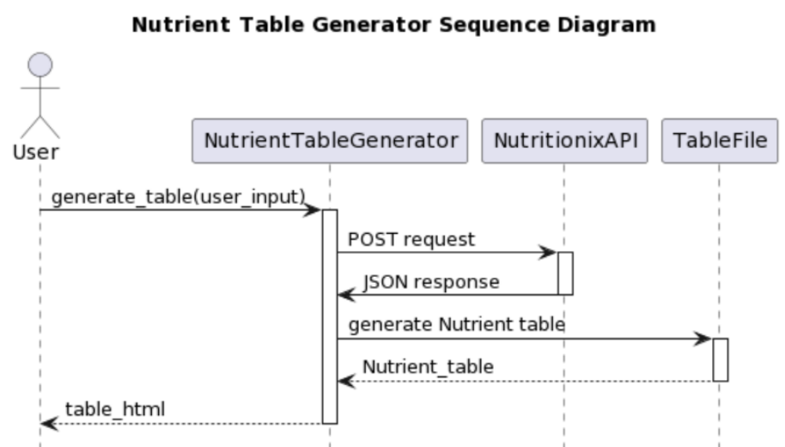
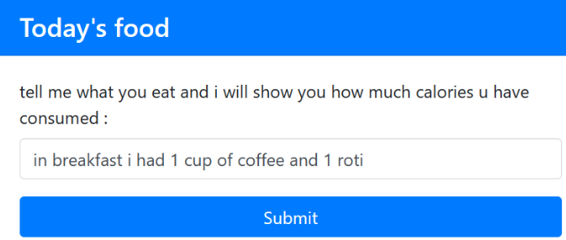
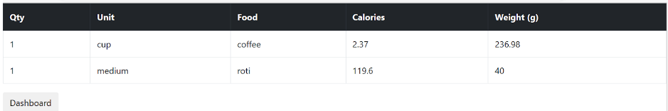
Food/Exercise Calorie calculator :
Exercise and Food Calorie Calculators utilize NLP APIs for generation of Exercise(includes details such as name, date/time, duration, and calories burned.) and food results.
display dynamic table
calculated total food/exercise calories
store previous exercise details(only for exercise)
Previous exercise option display the past exercise details.

Slide 10
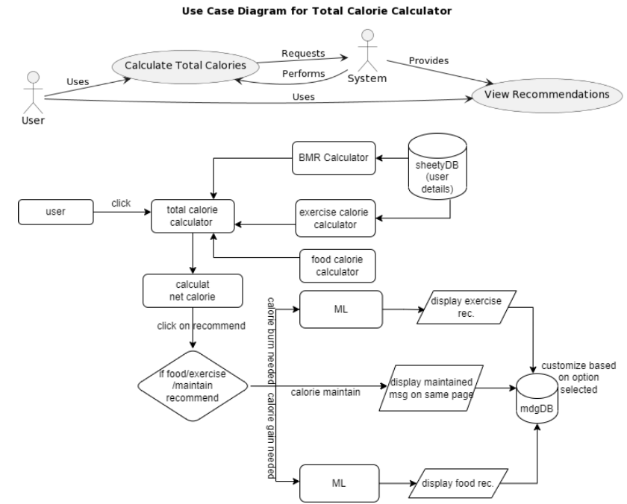
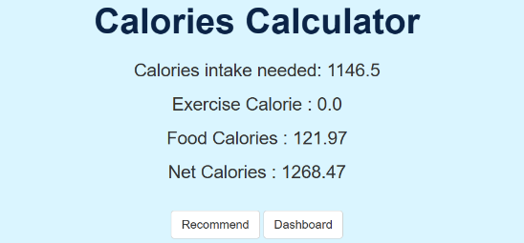
Total Calories Calculator
TotalFoodCalories = Σ caloriesFoodItem_i for i = 1 to n
TotalExerciseCalories = Σ caloriesExercise_i for i = 1 to n
CaloriesIntakeNeed = BMR Formula (by Harris-Benedict) calculated using user’s details from database.
NetCalories = calculate by using above info which depicts the recommendation.

Slide 11
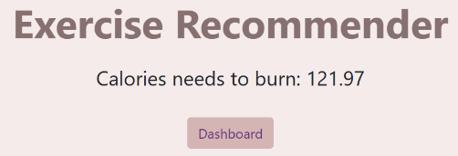
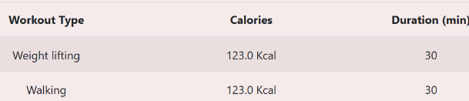
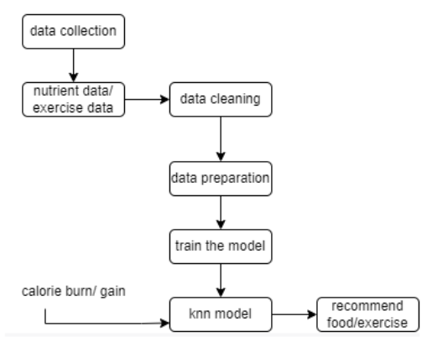
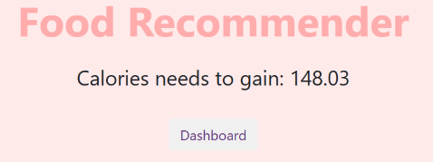


Recommender :
KNN algorithm finds nearest items based on calorie input.
Preprocesses data: replaces 't' with 0, commas with "", drops null values, and converts data types.
Trains KNN model and predicts food items.
Displays recommender table.

Slide 12
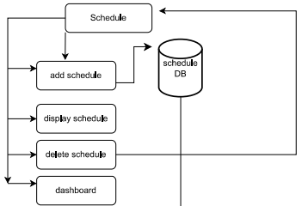
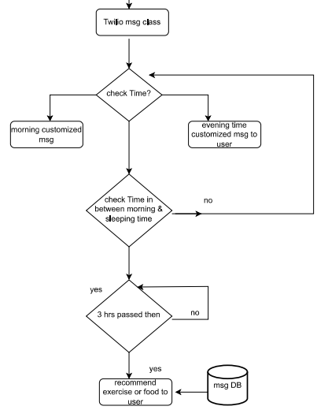
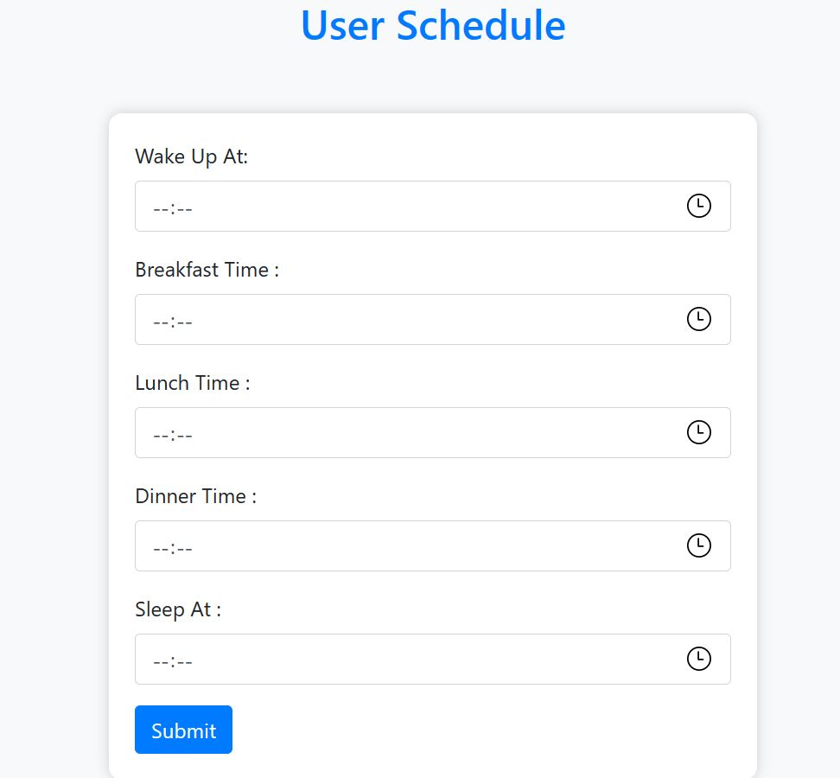
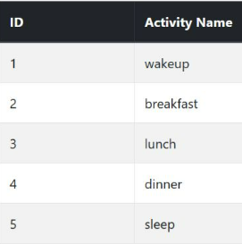

Schedule:
schedule management: adding, viewing, and deleting schedules.
Added schedules are automatically stored in the database.
System sends custom reminders to the user's phone using TwilioApi based on schedule times, aiding in efficient daily planning.

Slide 13
Conclusion & Future Directions
The development of a ‘Health Manager ‘app can provide a powerful tool for individuals to achieve their fitness and wellness goals.
Overall, this project has the potential to make a positive impact on people’s lives by promoting healthy habits and improving overall wellbeing.
Future Directions:
There are several potential enhancements that could be made to the health manager system to improve its functionality and effectiveness. Some potential future enhancements are:
Integration with wearable devices
Social features
Gamification
Mobile app integration
Customized diet plans for users as per their likings
Mental health and wellbeing
Virtual Personal Trainers

