Slide 1
SER 502 PROJECT
Members:
Shloka Manish Pandya - 1231997574
Vipsa Kamani - 1231818590
Malavika Anand - 1231722364

Slide 2
Programming Language Description
Language Name: Poodle
Programming Paradigm: Imperative
Extension: .poo
Github Link: https://github.com/Malavika-Anand/SER502-Poodle-Team23

Slide 3
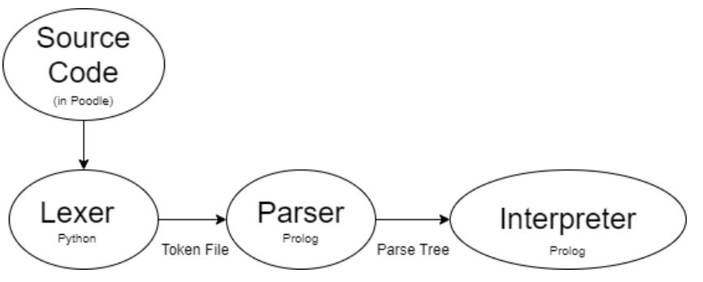
Process Flow
1. Lexer: Breaks down source code into tokens
2. Parser: Constructs parse tree from tokens
3. Interpreter: Executes instructions represented by parse tree

Slide 4
Implementation Details
- Lexer: PLY (Python Lex-Yacc)
- Parser: Prolog
- Interpreter: Prolog
Flow:
fileName.poo -> lexer.py -> fileName.pootokens -> parser.pl -> interpreter.pl

Slide 5
Language Design
Imperative language, mix of C and Python
Program structure: Series of commands or blocks, hierarchically organized
Commands: Loop statements, conditional statements
Data types: Integer, String, Boolean, Float
Operators: Arithmetic(+,-,/,*, braces,ternary operator), relational, logical, assignment, conditional
Variable handling: Declaration, initialization, declaration and initialization, naming conventions of variables.
Print statement: print>>'This is yellow world';

Slide 6
Language Features
Blocks defined by curly braces { }
Loop statements: For, While, Range for loop
Conditional statements: If, If-Else, Else-If
Enhanced features:
Variable declaration and initialization: int num = 5;
Syntactic sugar: ++, --

Slide 7
Reserved keywords
print>> - To print the statement && - Logical AND || - Logical OR !! - Logical NOT true - Boolean True value false - Boolean False value int - Integer data type float - Floating-point data type
bool - Boolean data type
string - String data type if - Conditional statement else - Alternative condition
elseif - Additional Condition for - Loop iteration while - Conditional loop

Slide 8
Lexer
⁤An interpreter or compiler must have a lexical analyzer, or lexer. ⁤⁤Its primary goal is to breakdown the input source code into a collection of tokens, or meaningful units that correspond to a language's smallest grammatical units. ⁤⁤Once that is done, the tokens are sent to the parser for additional processing. ⁤

Slide 9
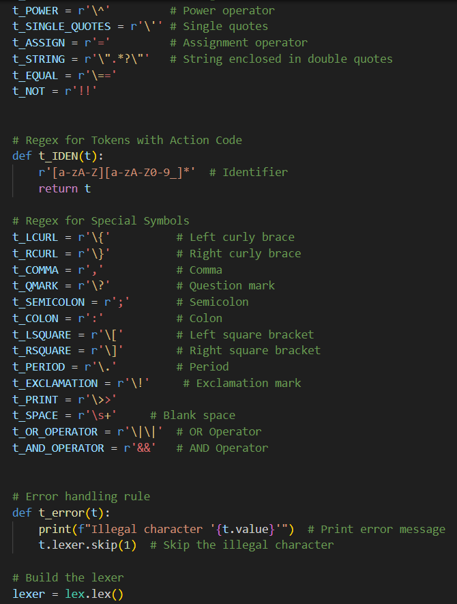
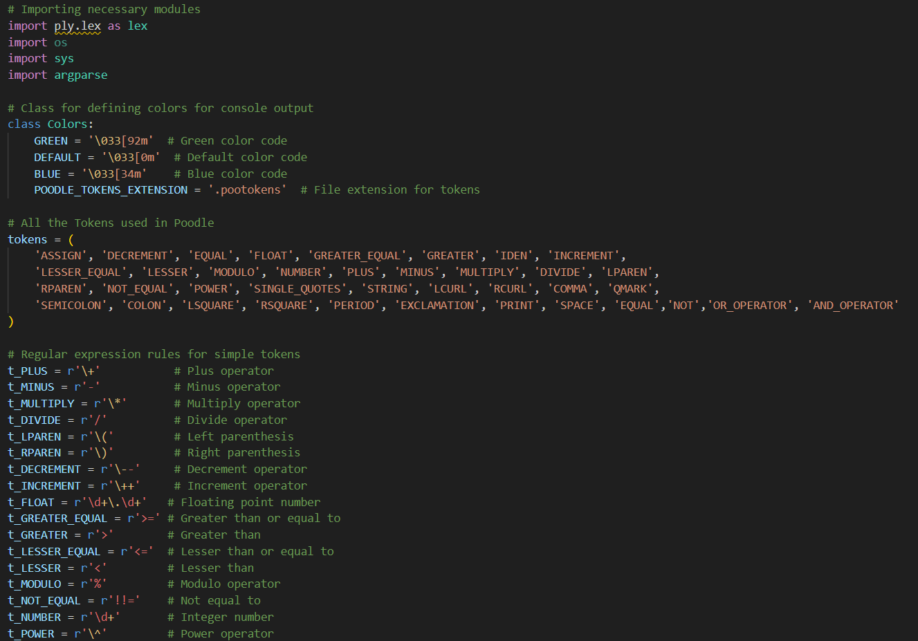
Lexer

Slide 10
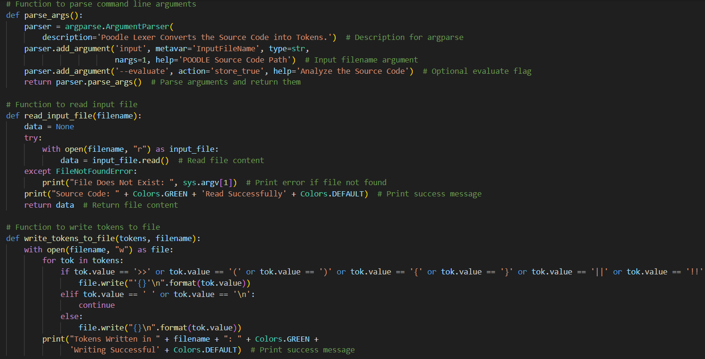
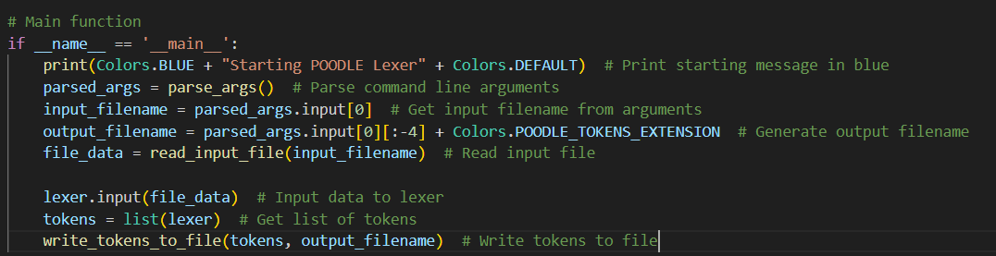
Lexer

Slide 11
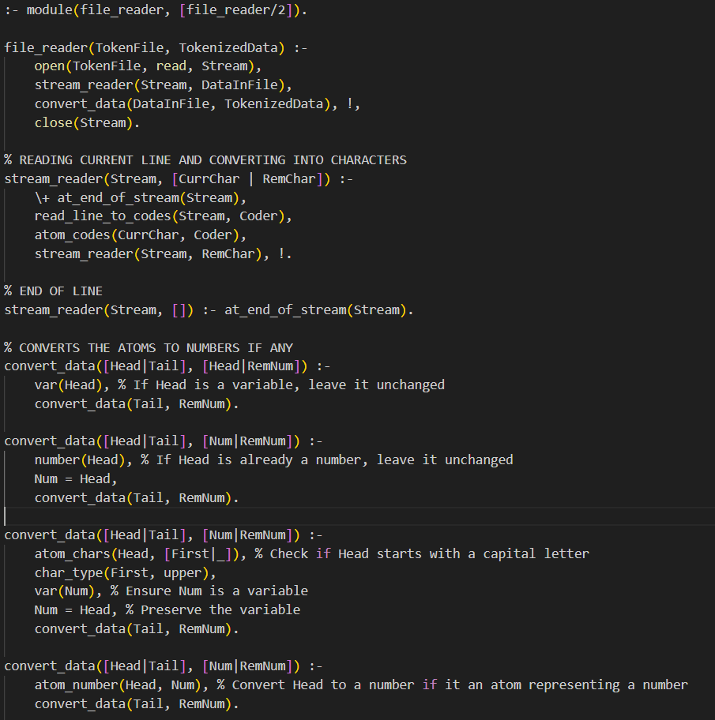
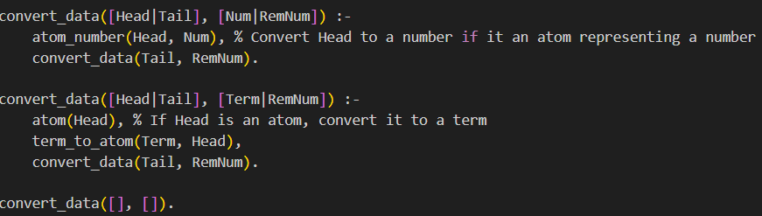
Token Reader

Slide 12
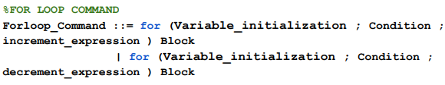
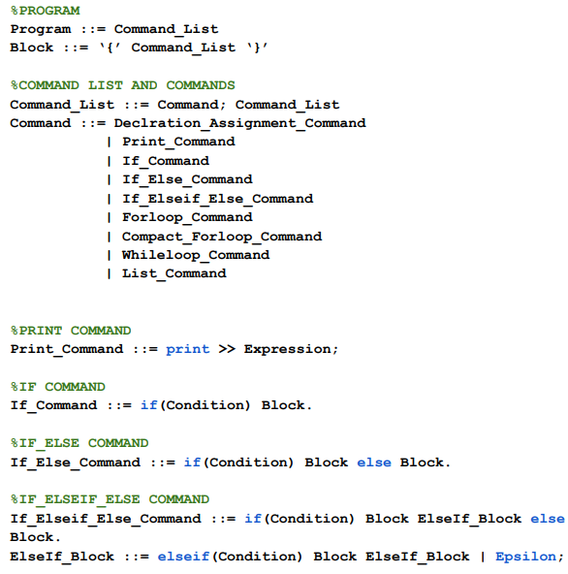
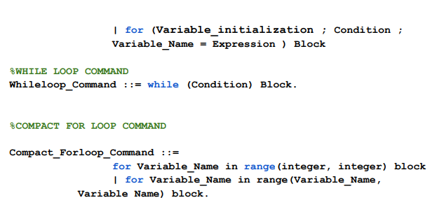
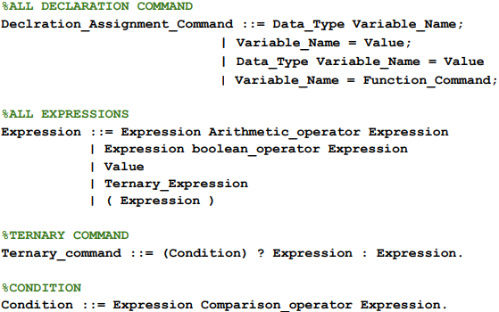
Dcg Grammar

Slide 13
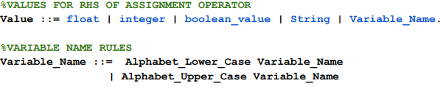
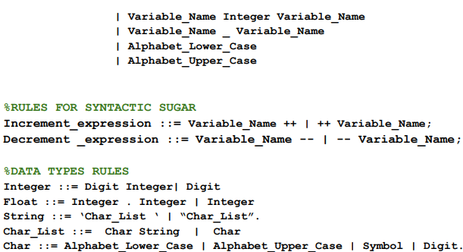
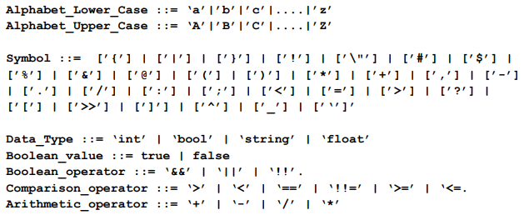
DCG grammar

Slide 14
Parsing Technique
- Top-down approach
- Definite Clause Grammar (DCG) in Prolog

Slide 15
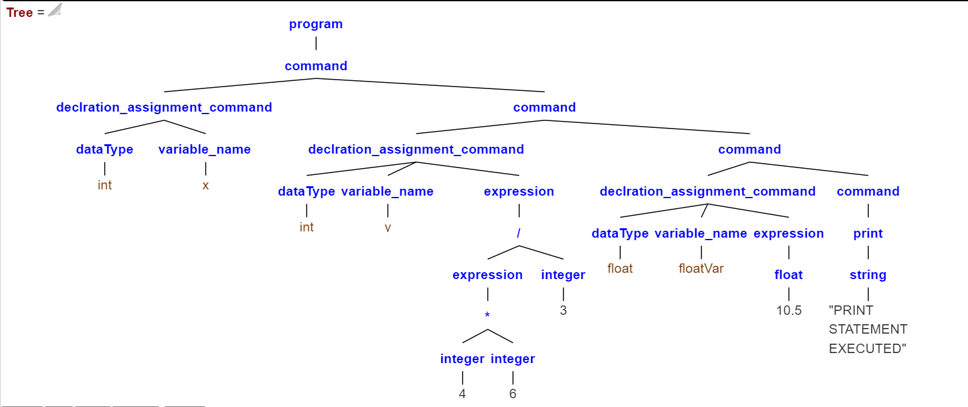
Sample Parse Tree
CODE:
Int x ;
Int y = (4*6)/3;
Float floatVar = 10.5;
print>>”PRINT STATEMENT EXECUTED”;
GENERATED QUERY :
program(Tree,[int, x, ;,int, y, =, '(', 4, *, 6, ')', /, 3, ;,float, floatVar, =, 10.5, ;, print, >>, "PRINT STATEMENT EXECUTED", ; ],[]).

Slide 16
Interpreter
The interpreter is a component that executes the instructions represented by the parse tree. This interpreter will receive a parse tree generated by the parser as input. Thereafter, it will traverse through each node of the tree and generate the semantics of it by executing the instructions in each node.

Slide 17
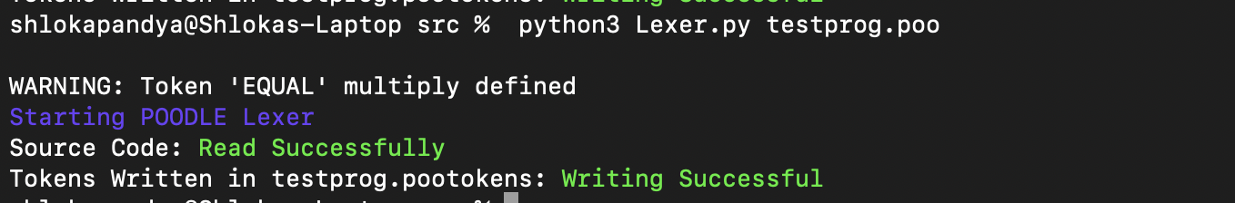
SNAPSHOTS
Running the lexer by giving it the .poo file for generating .pootokens file

Slide 18
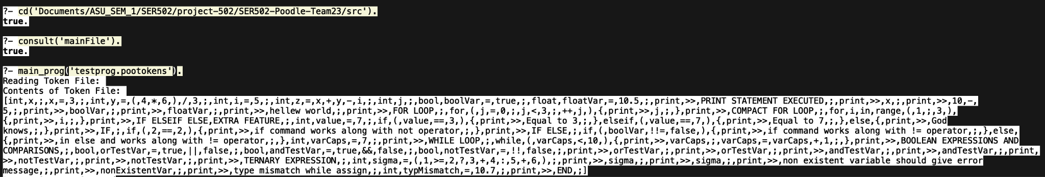
Giving .pootokens to mainFile, it first reads the content of .pootokens file and prints the content which will be sent to parser.

Slide 19
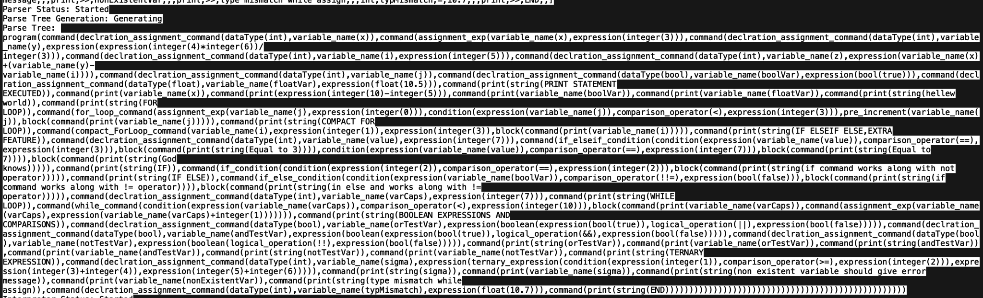
Parse tree generation

Slide 20
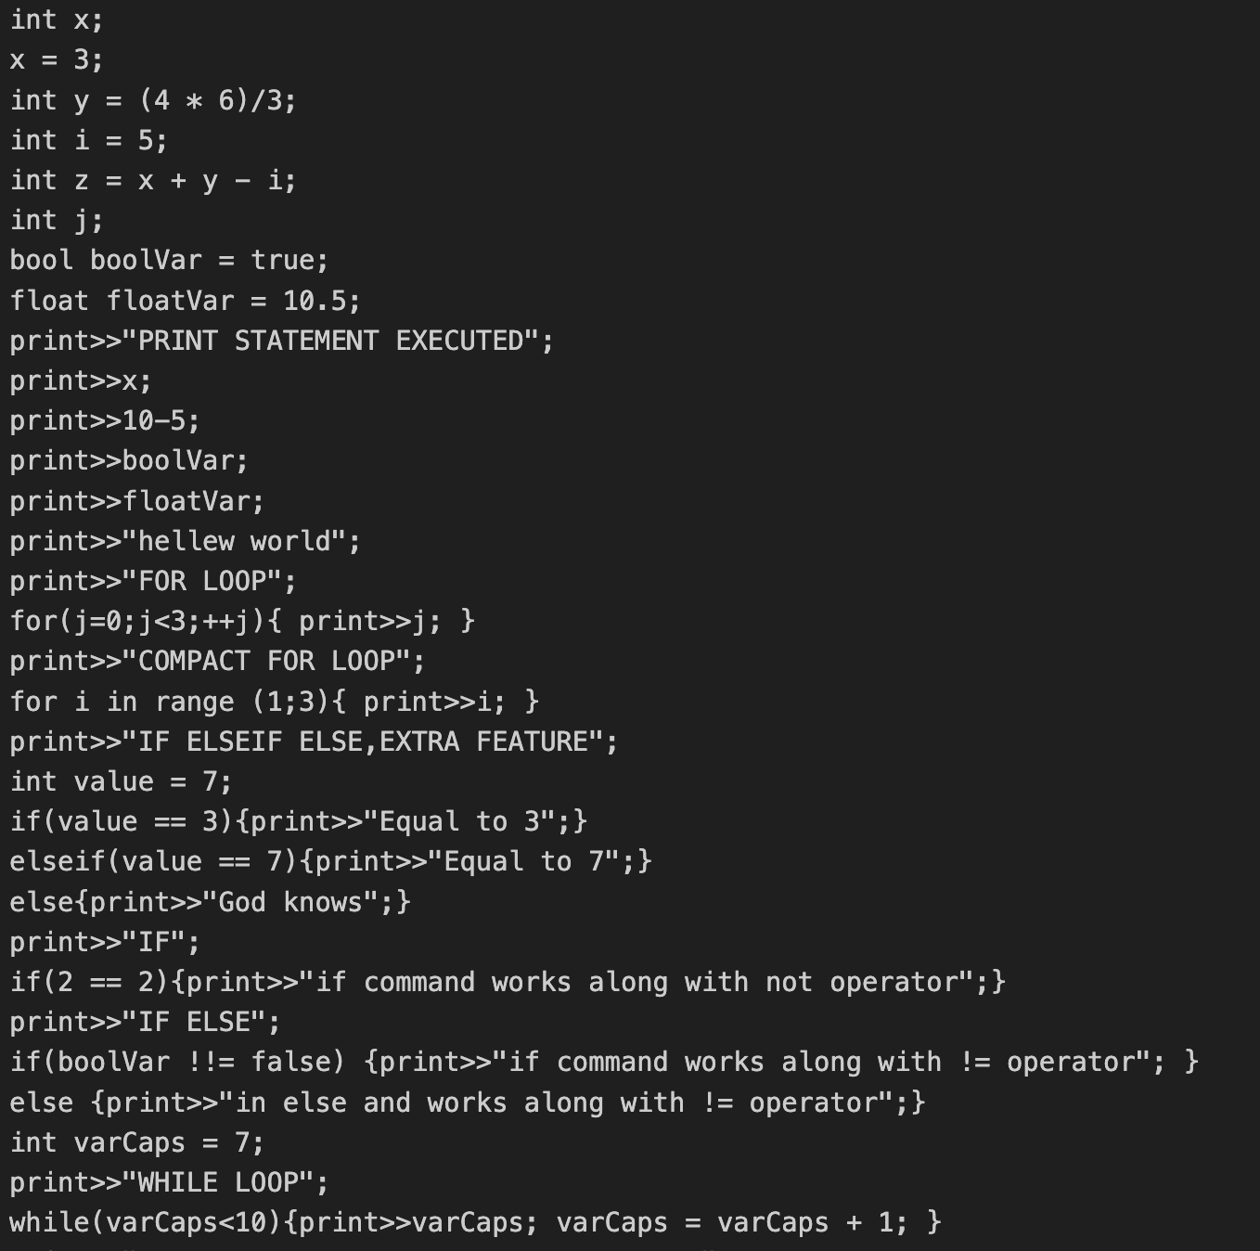
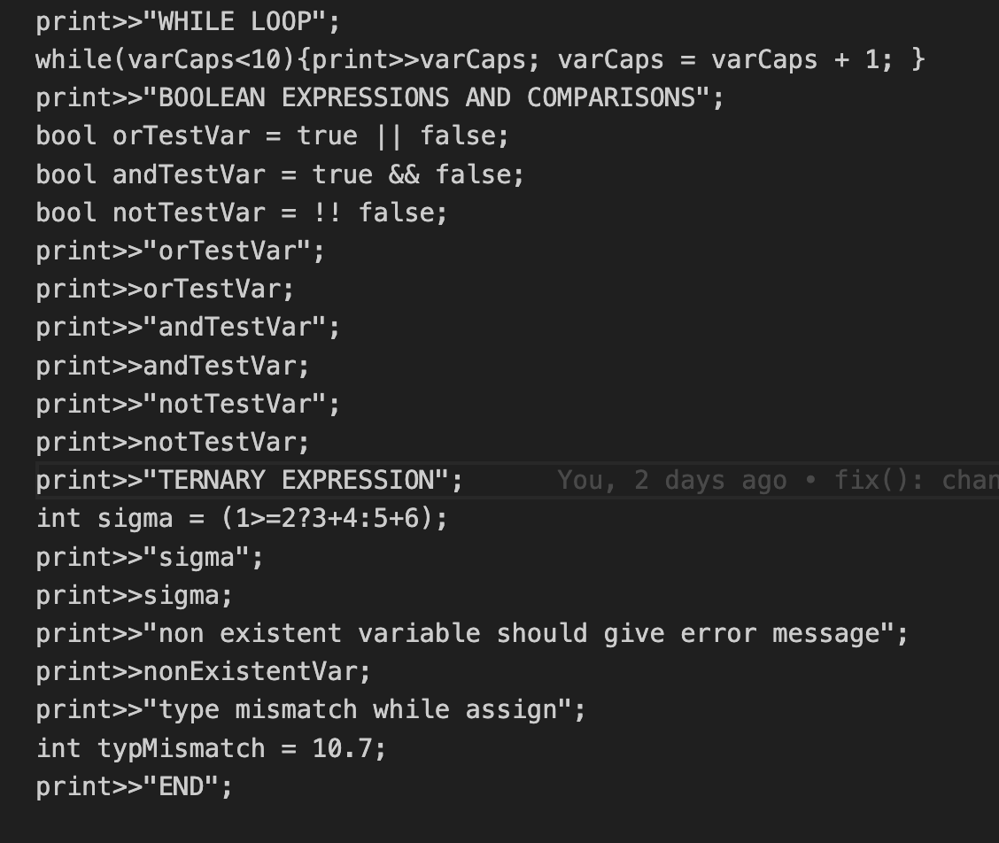
POO file source code:

Slide 21
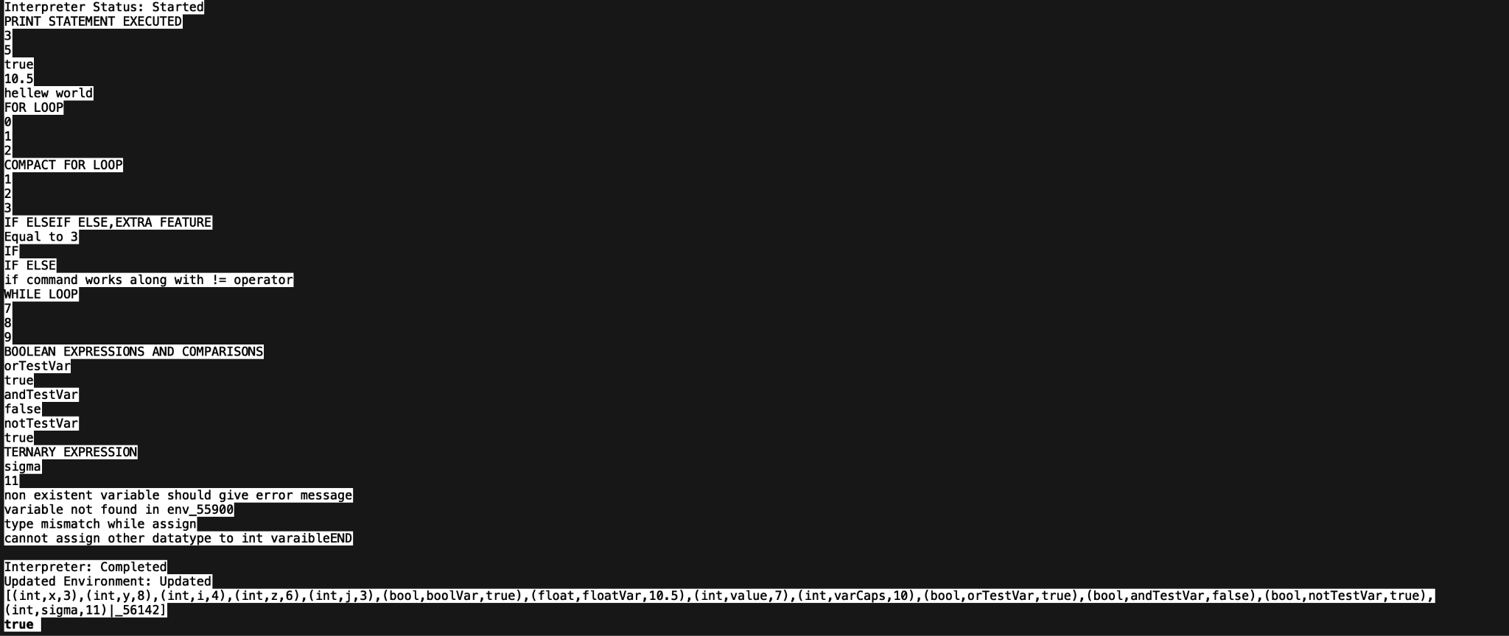
Parse tree is then is passed to Interpreter which gives the semantics to it and in the end prints the final ENV.

