Slide 1
Come in, Let’s Tableau

Slide 2
Agenda
Day2
Day1
Why Tableau or DataViz?
Explore and Play with Tableau
Why not we solve a business case?
Let’s start story telling
How can Tableau help a Data Scientist?
Connecting Tableau with a ML model
Use case of applying machine learning with data from HDFS

Slide 3
Why Data Visualization?
Efficient and Effective
Informative
Interactive and Predictive

Slide 4
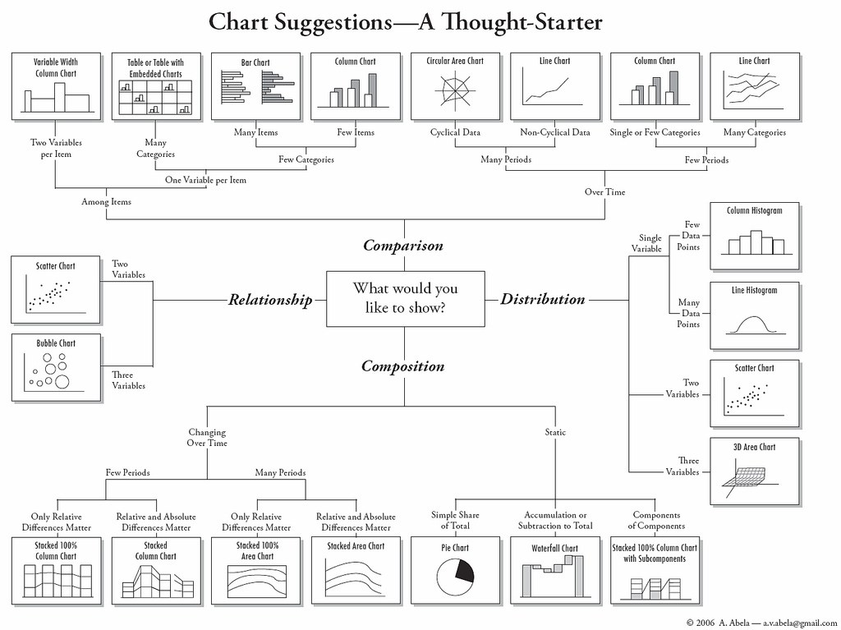

Slide 5
Tableau and its products
Tableau Desktop
Tableau Server
Tableau public
Tableau online
Tableau reader

Slide 6
Use Case 1
Statistics Summary - Dhoni
How has been his performance across different countries in terms of batting and wicket keeping?
What’s his favourite venue for scoring runs?
How’s his performance over time?

Slide 7
Use Case 2
Am I hitting the daily step goal of 10,000?
How do the Calories burnt change across time?
Am I having enough activity per day?
What was the best day on the month

Slide 8
TabPy
Execute Python code on the fly and display results in Tableau visualizations
Tabpy – Server
Tabpy - Client

Slide 9

TabPy <---> Tableau Architecture
TabPy Server
http://localhost:9004
API Call to the server endpoint
JSON Response from server
Deploy model from Tabpy Client to Server
Tableau workbook with Viz

Slide 10




SparkML Lib
Source data
Flat Files
Oracle DB
API Response
HDFS as
Hive table
Spark ML Lib
Machine Learning
Output Targets loaded to HDFS hive table

Slide 11
Chatbot Architecture
Intent,Entities Identification & Dialog Processing
Facebook /Web
Message Processing
Watson

Slide 12
Intents
Purpose or goals expressed in a customer's input.
Eg:
1. Help me order a @PhoneModelName
2. Can I get a @PhoneModelName?
3. Pay my account balance

Slide 13
Entities
Class of object or a data type that is relevant to a user's purpose.
Eg:
location
menu_item
product

Slide 14
Chatbot Platforms
Dialog Flow
Wit.ai
Chatfuel
Botsify
Watson

