Slide 1

TaskBoard Lite
End-to-end DevOps project: code to production with CI/CD, DevSecOps, Kubernetes, Terraform, monitoring and GitOps
Vivek Singh Solanki | Roll No. 24bcs10338 | Session 21 - Final DevOps Project & Troubleshooting
github.com/vivek-0509/Devops_Final_Assignment_N_Project
Notes:
Title slide. Introduce yourself, the project name and the GitHub repository.

Slide 2
What this presentation covers
1
Goal & architecture
2
Application & Docker
What TaskBoard Lite is and how every DevOps layer fits together
Flask API, tests, multi-stage Alpine image, docker compose
3
CI/CD & DevSecOps
4
Infrastructure & Kubernetes
GitHub Actions pipeline with SAST, SCA, secret and image scanning gates
Terraform on AWS, Helm deployment with ingress, HPA, probes, storage
5
Monitoring & GitOps
6
Troubleshooting & lessons
Prometheus, Grafana, alert rules, Argo CD reconciliation
Four injected failures fixed, what the project taught me

Slide 3
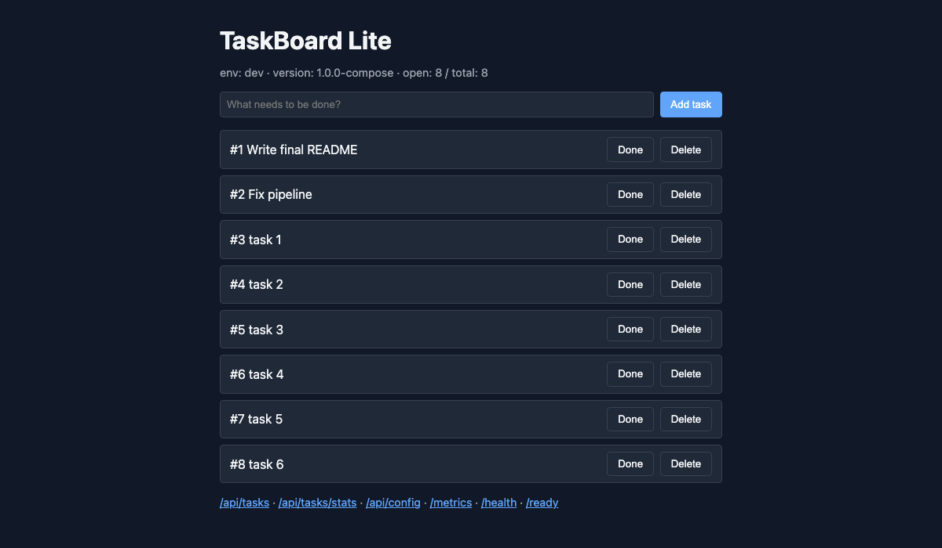

Goal: laptop to a monitored cluster
TaskBoard Lite is a small task-management web app (Python/Flask + SQLite, Prometheus metrics). The application is deliberately simple so that the focus stays on the delivery pipeline around it.
Code
→
Git / GitHub
→
CI pipeline
→
Build & Test
→
Security scans
The running application (docker compose)
Docker image
→
Registry (GHCR)
→
Kubernetes + Helm
→
Monitoring
→
GitOps
Flask 3.1 | SQLite on a PVC | /health /ready /metrics /api/tasks
Infrastructure provisioned with Terraform on AWS (VPC, subnet, IGW, route table, security group, EC2, S3).

Slide 4
Architecture
Developer
GitHub repo
GitHub Actions
GHCR
git push
PR review
source of truth
workflows, manifests
test > SAST > SCA > secret scan >
docker build > Trivy > security gate >
push image > deploy (helm)
ghcr.io/vivek-0509/
taskboard-lite:<sha>
Argo CD
Prometheus
watches gitops/manifests
sync + self-heal
Kubernetes (namespace taskboard)
scrapes /metrics
alert rules
Ingress
Service
Deployment
nginx, taskboard.local
ClusterIP :80
2-5 pods, probes
Grafana
Terraform -> AWS
HPA
ConfigMap + Secret
PVC 1Gi
dashboard
requests, tasks, up
VPC, subnet, IGW, SG,
EC2, S3
60% CPU target
env injection
/app/data
Notes:
Walk the diagram left to right: a push triggers the pipeline, the gate protects the registry and the cluster, Argo CD keeps the cluster equal to Git, Prometheus and Grafana watch the running pods, and Terraform provisions the cloud side.

Slide 5








Technology stack
Application
Containers
CI/CD
DevSecOps
Python 3.12, Flask 3.1, SQLite, prometheus-client, gunicorn, pytest (17 tests, 92% coverage)
Docker multi-stage build on python:3.12-alpine, non-root uid 10001, docker compose
GitHub Actions with 9 jobs, artifacts, GHCR login with GITHUB_TOKEN, act for local runs
Bandit, pip-audit, gitleaks, Trivy, CodeQL and a security-gate job
Kubernetes + Helm
Infrastructure
Monitoring
GitOps
minikube 1.39 / Kubernetes 1.37, nginx ingress, metrics-server, HPA, probes, PVC, Helm chart
Terraform 1.14 with the AWS provider 6.x: VPC, subnet, IGW, route table, SG, EC2, S3
Prometheus 3.5, Grafana 11, alert rules, ServiceMonitor and PrometheusRule manifests
Argo CD Application with automated sync, prune and self-heal over kustomize manifests

Slide 6
Application, tests and container image
17
0
10001
pytest tests passing
HIGH / CRITICAL CVEs
non-root container user
92% line coverage
Trivy on the final image
read-only friendly, Alpine base
REST API
Docker
GET /health (liveness), GET /ready (readiness, checks the database), GET /metrics (Prometheus)
GET/POST /api/tasks, GET/PUT/DELETE /api/tasks/<id>, GET /api/tasks/stats, GET /api/config
Configuration from environment: APP_ENV, LOG_LEVEL, FEATURE_FLAGS, DB_PASSWORD (never printed)
Stage 1 installs dependencies; stage 2 copies only the result into python:3.12-alpine
The Debian slim base failed the Trivy gate with 44 HIGH CVEs; switching to Alpine gave a clean scan
docker compose runs the app with Prometheus and Grafana for local monitoring

Slide 7
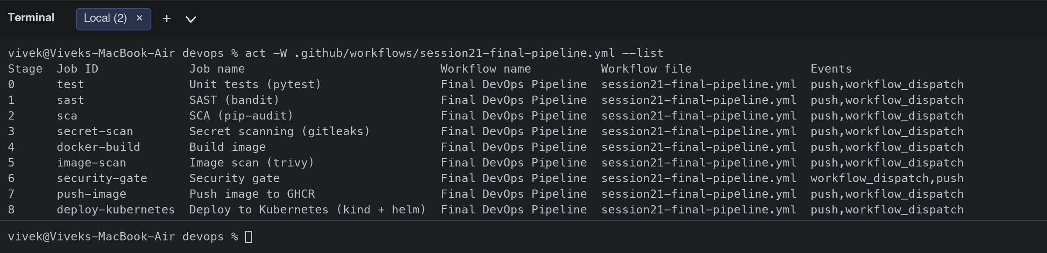
CI/CD pipeline: GitHub Actions
Unit tests
SAST (Bandit)
SCA (pip-audit)
Secret scan
Docker build
Image scan (Trivy)
Security gate
Push to GHCR
Deploy (kind + Helm)
Each job runs on its own ubuntu-latest runner; needs: chains them so a failure stops the pipeline. Push and deploy run only on main. The image is tagged with the Git commit SHA and handed between jobs as an artifact.
Artifacts: test results, coverage, bandit report, image.tar
Secrets: GITHUB_TOKEN for GHCR, no credentials in the repo
Deploy job: kind cluster on the runner, kind load, helm upgrade --install, curl smoke test
act fallbacks replace GitHub-only actions locally
Pipeline executed locally with act (all 7 CI jobs green)

Slide 8
DevSecOps: gates that actually blocked
Control | Tool | What it caught / result
SAST | Bandit, CodeQL | B104 bind-all-interfaces reviewed and suppressed with a justification; 0 open findings
SCA | pip-audit --strict | Flask 3.1.1 had PYSEC-2026-2151; upgraded to 3.1.3, now 0 known CVEs
Secret scanning | gitleaks | Repository clean; a planted AWS key and GitHub token were detected in a test
Image scanning | Trivy (HIGH/CRITICAL, ignore-unfixed) | Debian base: 44 HIGH; Alpine base: 0 HIGH / 0 CRITICAL
Security gate | security-gate job (if: always()) | Fails the run unless all four scans succeeded; push and deploy depend on it
Fixing real findings was part of the work: a dependency CVE, base-image CVEs and a hardening side effect (read-only root filesystem broke gunicorn until /tmp got an emptyDir).

Slide 9
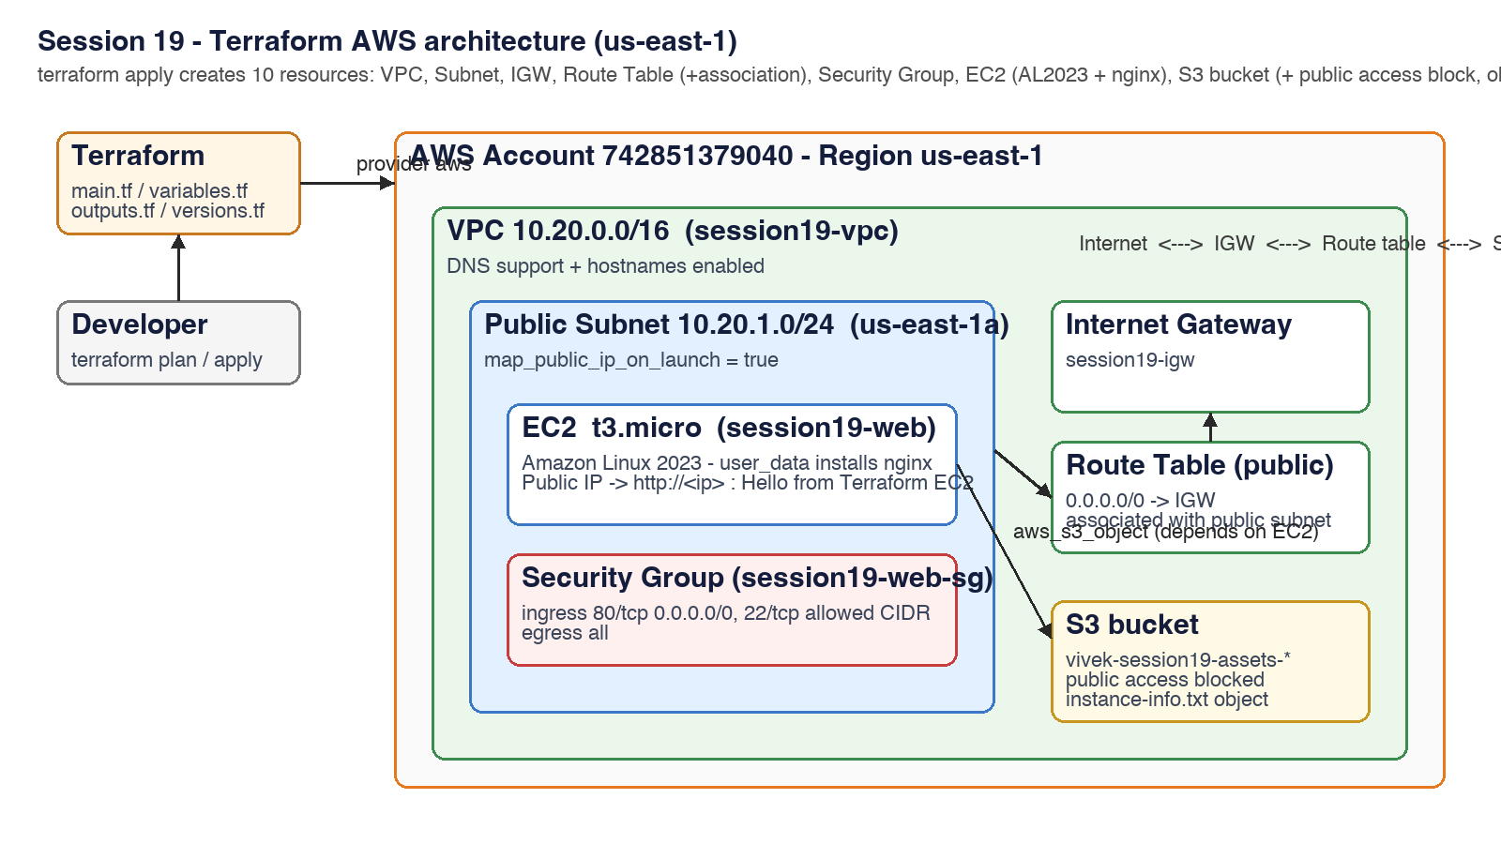
Infrastructure as Code: Terraform on AWS
12
resources created by terraform apply, then destroyed
init > fmt > validate > plan > apply > destroy
full workflow executed against my AWS account
SSM lookup
latest Amazon Linux 2023 AMI, no hard-coded IDs
VPC 10.30.0.0/16, public subnet, Internet Gateway, route table, security group (80/22), EC2 t3.micro with Docker user_data, private S3 bucket

Slide 10
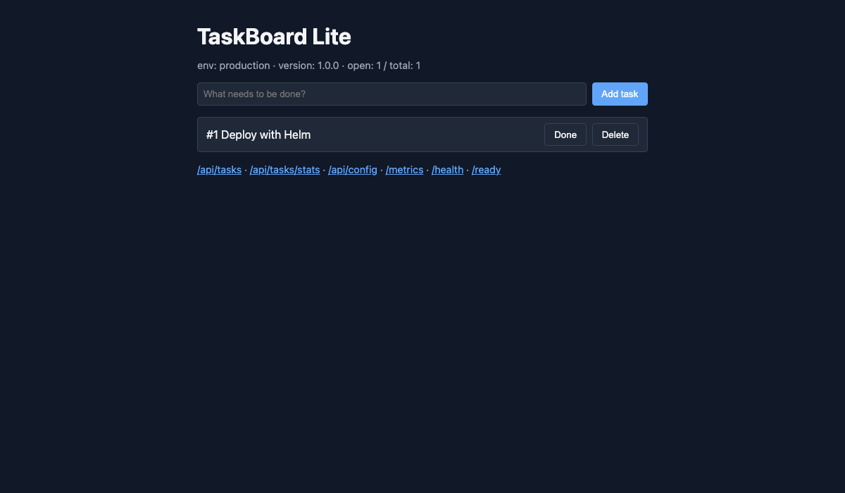

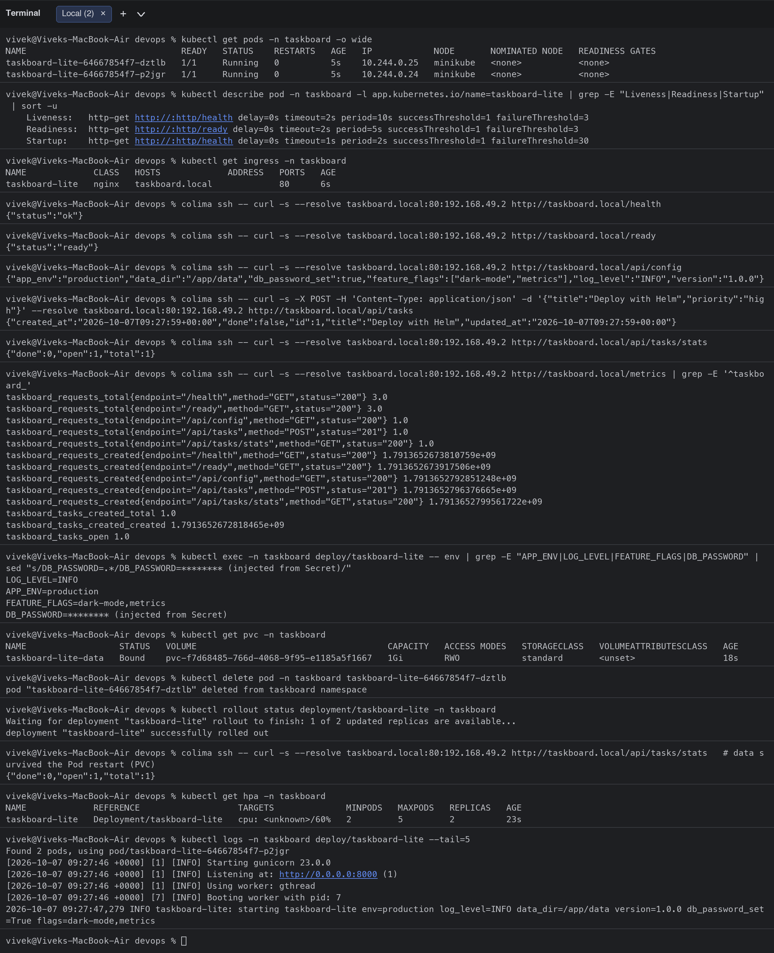
Kubernetes deployment with Helm
Deployment
Service + Ingress
2 replicas, startup / readiness / liveness probes, resource requests and limits, runAsNonRoot
ClusterIP behind nginx ingress at taskboard.local; verified with curl through the ingress
ConfigMap + Secret
PVC storage
APP_ENV, LOG_LEVEL, FEATURE_FLAGS and DB_PASSWORD injected and shown by /api/config
1Gi volume for the SQLite file; tasks survived a Pod deletion
HPA
Helm chart
2 to 5 replicas at 60% CPU; scaled 2 -> 4 under a wget load test
values.yaml / values-prod.yaml, helm lint, helm upgrade --install, used by the CD job

Slide 11
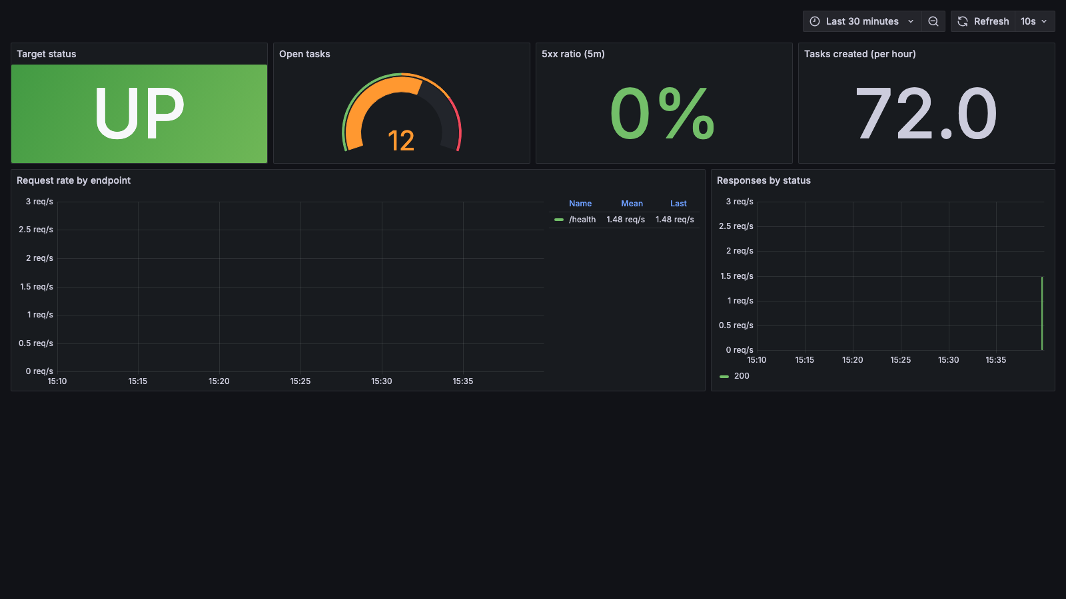


Monitoring and observability
Metrics
/metrics exposes taskboard_requests_total, taskboard_tasks_open and more; Prometheus scrapes it, kubectl top feeds the HPA
Logs
Structured application logs via kubectl logs and docker compose logs
Alerts
TaskboardDown and error-rate rules; an alert was made to fire and resolve in the Session 20 demo
Grafana dashboard provisioned from the repo: target status, open tasks, 5xx ratio, request rate by endpoint

Slide 12
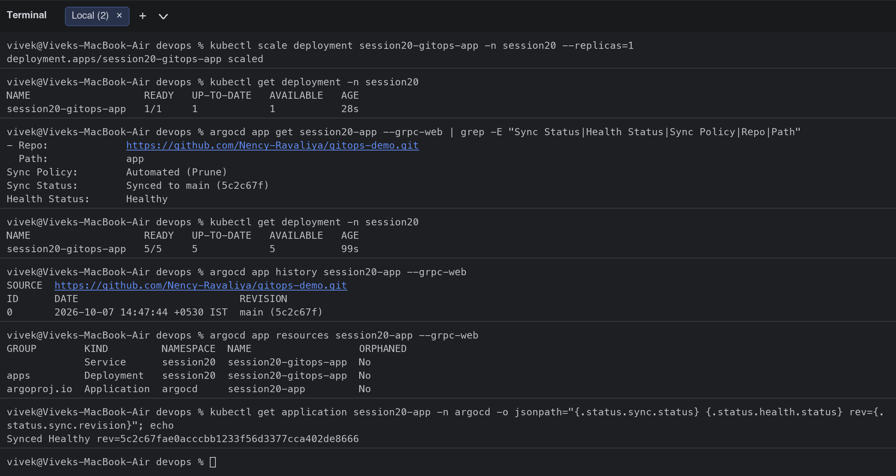
GitOps with Argo CD
1
Developer opens a PR with a manifest or image-tag change
2
Merge to main: Git is the only source of truth
3
Argo CD detects the new commit and syncs the namespace
4
Manual drift (kubectl scale) is reverted by selfHeal
gitops/argocd-application.yaml: automated sync, prune, selfHeal, CreateNamespace
Notes:
Explain that Argo CD was installed on minikube, synced an Application from Git and restored the replica count after a manual scale-down within a minute.

Slide 13

Troubleshooting: four injected failures
# | Symptom | Investigation | Root cause and fix
1 | ImagePullBackOff | kubectl describe pod: manifest unknown | Tag v9.9.9 does not exist; kubectl set image to a valid tag
2 | Service has no endpoints, requests fail | kubectl get endpoints, --show-labels | Selector scenario-2 vs label scenario-02; patch the selector
3 | CreateContainerConfigError | Events: couldn't find key DB_PASS | Wrong secretKeyRef key; patch it to DB_PASSWORD
4 | Pods never Ready, 503 via ingress | describe pod: readiness probe 404 on /readyz | Probe path typo; patch readinessProbe path to /ready
Same loop every time: identify (kubectl get) > investigate (describe, logs, endpoints) > root cause > fix > verify. Every step is captured with before/after output in the README.

Slide 14
The whole course, hands-on
21
83
62
204
sessions completed
commits in the repo
README files
screenshots of real runs
Linux, shell scripting, networking, git | Docker images, networking, volumes | Kubernetes objects, services, ingress, config, storage, HPA, troubleshooting | Helm | GitHub Actions and DevSecOps | Terraform and AWS | Monitoring and GitOps
Every session folder has its own README with the commands, their real output and screenshots; the submission links point to them.

Slide 15



Lessons learned
A gate must bite
Hardening has side effects
State shapes the strategy
The dependency CVE and the base-image CVEs were real; the pipeline only became green after fixing them.
readOnlyRootFilesystem broke gunicorn until /tmp became an emptyDir; non-root needs the image to define the user.
A ReadWriteOnce PVC forces Recreate or a single writer; a real database belongs outside the Pod.
Test the pipeline before pushing
Plan, apply, destroy
Git as the source of truth
act runs the workflow locally; GitHub-only actions need conditional fallbacks.
Terraform experiments cost nothing when every apply ends with destroy.
Argo CD turns drift into a non-event: the cluster converges back to what is committed.

Slide 16

Demo and repository
Repository: github.com/vivek-0509/Devops_Final_Assignment_N_Project
Presentation video: demo/ folder (see demo/README.md for the link)
Project README: session-21-final-devops-project/final-devops-project/README.md
Thank you. Questions welcome.
Vivek Singh Solanki | 24bcs10338

