Slide 1
Project Presentation of Industry Oriented Hand on Experience (22CS422)
On
Smart Enterprise Employee Management System
Presented By:
1. Vivek Singh (2211981468)
2. Utkarsh (2211981443)
Department of Computer Science and Engineering,
Chitkara University, Punjab
Supervised By:
Dr. Rajat Takkar
Assistant Professor
Chitkara University, Rajpura

Slide 2
Project Overview
A modern, web-based Employee Task Management System built with React that enables organizations to streamline task assignment, tracking, and workforce management through a clean, role-based interface.
Problem It Solves
No more scattered emails for task delegation
No more manual attendance registers
No more spreadsheets for tracking performance
Everything in one centralized platform

Slide 3
Key Features
1. Role-Based Authentication
Secure login for Admin and Employee with session persistence via localStorage and a sign-up flow for new users.
2. Task Management
Admin can create and assign tasks with title, description, due date, category, and priority. Employees can accept, update, and track task status (New → Active → Completed / Failed).
3. Attendance System
Employees can mark check-in/check-out. Admin can verify attendance with camera photo capture. Full attendance history with monthly tracking.
4. Smart Attendance Tracker
Auto-calculates monthly attendance percentage per employee, flags low attendance warnings.

Slide 4
Key Features
5. Leaderboard & Recognition
Ranks employees based on performance and task completion. Admins can give recognition badges to top performers.
6. Analytics Dashboard
Visual overview of task completion rates, employee performance scores, and overall organizational productivity.
7. Leave Management
Employees can apply for leaves. Admin can approve or reject requests with full leave history maintained.
8. Late Penalty Tracking
Monitors late check-ins and maintains a penalty log for admin review.

Slide 5
Key Findings
Key Findings
Client-Side Architecture is Viable for Enterprise Features
Context API is Sufficient for Mid-Scale State Management
LocalStorage Has Practical Limits
Role-Based UI Separation Improves UX Significantly
Camera-Based Attendance Adds Real-World Value
Real-Time Feedback Increases User Confidence
Modular Design Accelerates Development

Slide 6
Outcomes
Outcome 1 — Fully Functional Product Delivered
Outcome 2 — Fully Functional Product Delivered
Outcome 3 — Zero Infrastructure Cost
Outcome 4 — Scalable Codebase for Future Development
Outcome 5 — Improved Understanding of Real-World Workflows
Outcome 6 — Enhanced Developer Competency

Slide 7
System Architecture & Tech Stack
UI Library: React 18 – Used for component-based UI rendering.
State Management: Context API + useState – Used for global state like authentication, theme and user data.
Styling: Tailwind CSS – Used for utility-first responsive design.
Persistence: LocalStorage – Used for session handling and storing application data.
Routing Logic: Conditional Rendering – Used for role-based dashboard and view switching.
Camera API: Web MediaDevices API – Used for capturing photos for attendance feature.
Build Tool: Vite – Used for fast development and project bundling.

Slide 8
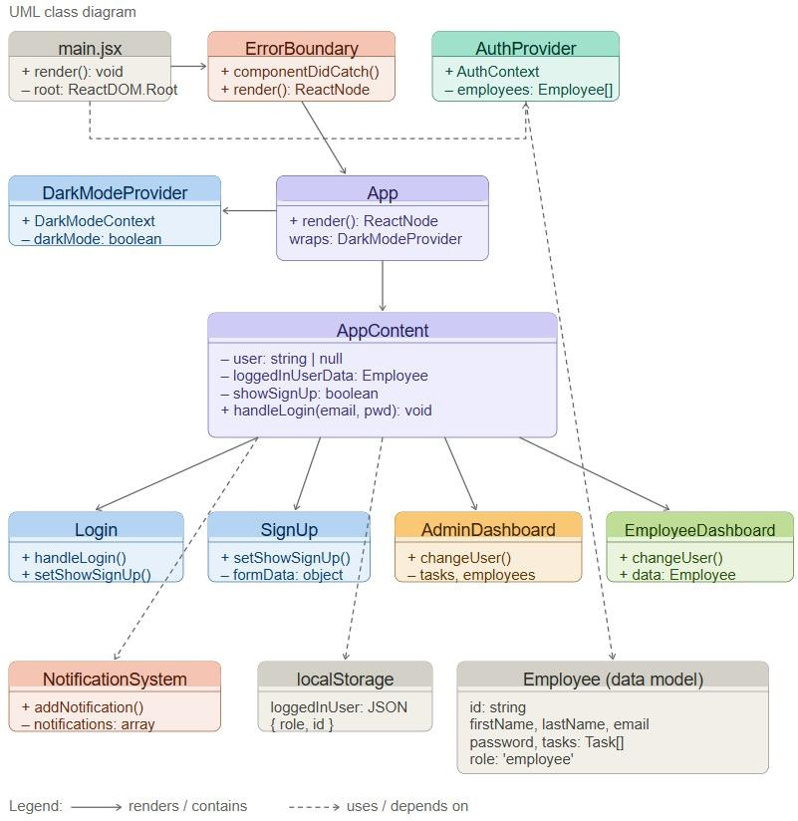
UML Class Diagram

Slide 9
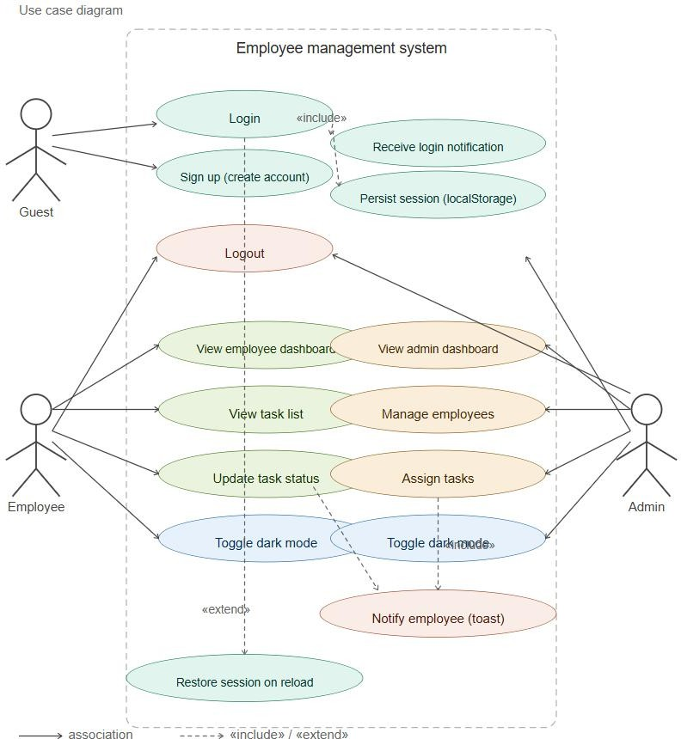
Use Case Diagram

Slide 10
Admin System
AnalyticsDashboard: Shows task completion rates, active vs pending tasks, and overall productivity metrics.
SmartAttendance: Shows monthly attendance percentage per employee, low attendance warnings, and best employee badge.
PerformanceScore: Shows individual employee performance scores based on task completion.
Leaderboard: Shows ranked list of employees based on productivity and task output.
Employee Selection: Dropdown to select any employee.
Mark Check-In: Admin can manually mark check-in with timestamp.
Mark Check-Out: Admin can manually mark check-out with timestamp.
Admin Verified Badge: Attendance records marked by admin are flagged as “Admin Verified”.

Slide 11
Conclusion & Future Scope
TaskMate was developed with a clear and focused mission — to replace the fragmented, inefficient methods of traditional task and workforce management with a unified, intelligent, and user-friendly web platform. Over the course of this project, a fully functional, client-side employee management system was successfully designed, developed, and deployed using modern web technologies.
Future Scope
1. Backend Integration
2. AI-Powered Face Recognition for Attendance
3. Mobile Application
4. Email & Push Notifications
5. Advanced Reporting & Analytics
6. In-App Messaging & Collaboration

Slide 12
Thank You

