Slide 1
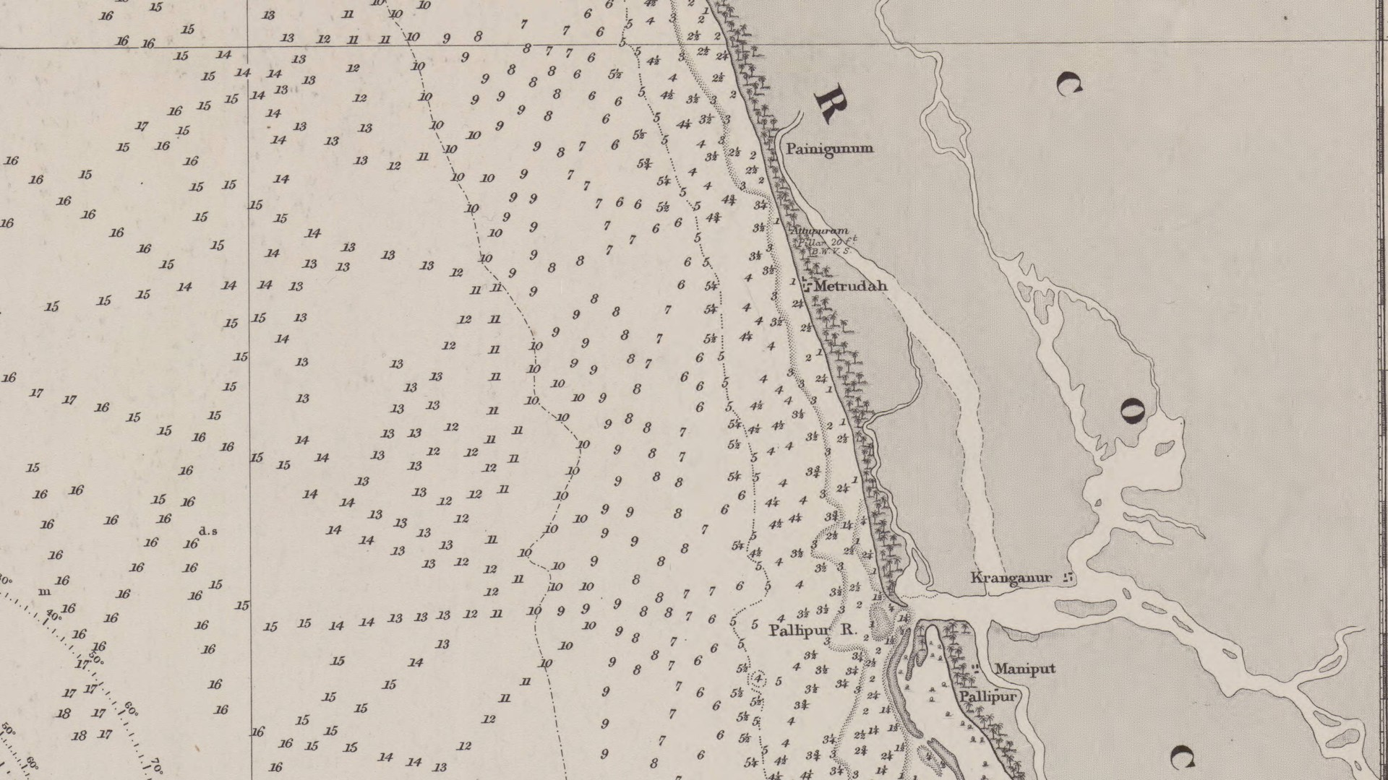
What can the landscape and the archaeology of port cities tell us about Indo-Roman trade?
Vivek Shah
Chart: Admiralty Chart 749, Malabar Coast, surveyed by W. B. Selby 1851–53, published 1857 (Wikimedia Commons, public domain)
Notes:
Focusing on the Indo-Roman trade, mostly around the 1st century AD
A lot of the work here is based on the Periplus Maris Erythrae, which is a first century handbook for merchants sailing the Indian ocean, a lot of it is probably based on the author’s experience, but some of it is speculated to be second-hand accounts from other sailors

Slide 2
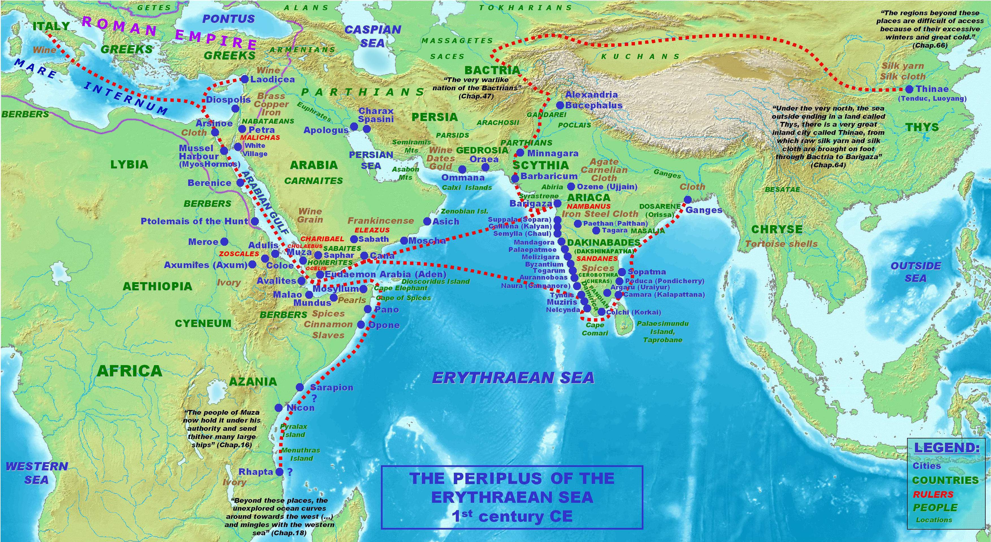
The thesis focuses on the Malabar coast and Ed-Dur, which were ports along the routes outlined in the Periplus
Map: PHGCOM, 'Map of the Periplus of the Erythraean Sea', Wikimedia Commons, CC BY-SA 4.0. Ed-Dur ring placed by the author
2
Notes:
• The Periplus, c. AD 50: a merchant's guide from Egypt to India.
• Two case studies: the Malabar ports (Tyndis, Muziris, Nelkynda, Bakarē) and Ed-Dur in the Gulf.
• Today: Malabar.

Slide 3
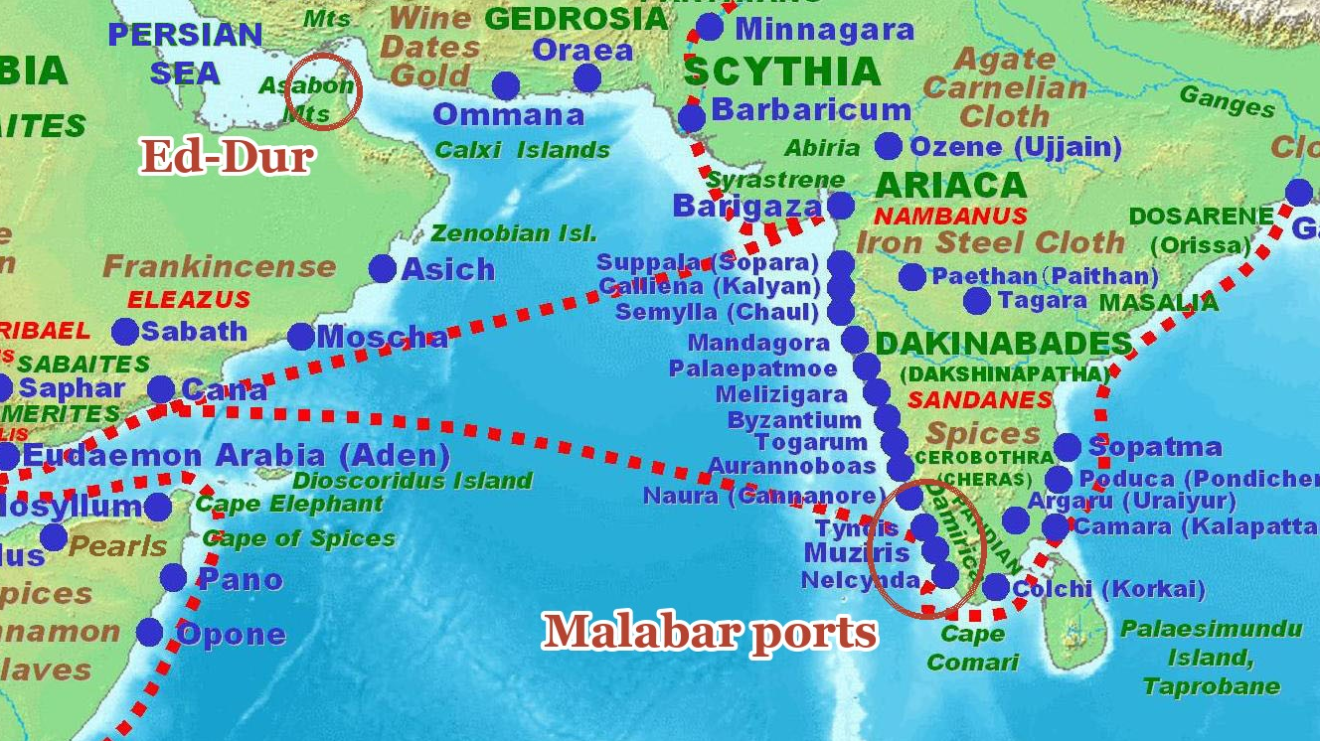
The thesis focuses on the Malabar coast and Ed-Dur, which were ports along the routes outlined in the Periplus
Map: PHGCOM, 'Map of the Periplus of the Erythraean Sea', Wikimedia Commons, CC BY-SA 4.0. Ed-Dur ring placed by the author
3
Notes:
• The Periplus, c. AD 50: a merchant's guide from Egypt to India.
• Two case studies: the Malabar ports (Tyndis, Muziris, Nelkynda, Bakarē) and Ed-Dur in the Gulf.
• Today: Malabar.

Slide 4
The thesis examines each port quantitatively to determine its location and qualitatively to understand how it functioned within the broader trading network
Statistical framework
locating a place from noisy, partial evidence
Where was the coastline?
How deep was the water?
Quantitative
Where did the rivers run?
Where were the
Periplus ports, and
how did they work?
Malabar coast
Tyndis, Muziris, Nelkynda, Bakarē
How fast did ships sail?
When the crossing began
Qualitative
How the port worked
Ed-Dur
the Gulf
Quantitative
After Rome
Qualitative
Conclusion
blending the evidence
4
Notes:
• The whole thesis: a statistical framework, two case studies each with a quantitative and a qualitative half, and a conclusion.

Slide 5
Today, we’ll focus on Malabar Coast water depths and the ports’ role in Indo-Roman trade.
Statistical framework
locating a place from noisy, partial evidence
Where was the coastline?
How deep was the water?
Quantitative
Where did the rivers run?
Where were the
Periplus ports, and
how did they work?
Malabar coast
Tyndis, Muziris, Nelkynda, Bakarē
How fast did ships sail?
today
When the crossing began
Qualitative
How the port worked
Ed-Dur
the Gulf
Quantitative
After Rome
Qualitative
Conclusion
blending the evidence
5
Notes:
• Today: Malabar. On the quantitative side, the water depth; on the qualitative side, three arguments.

Slide 6
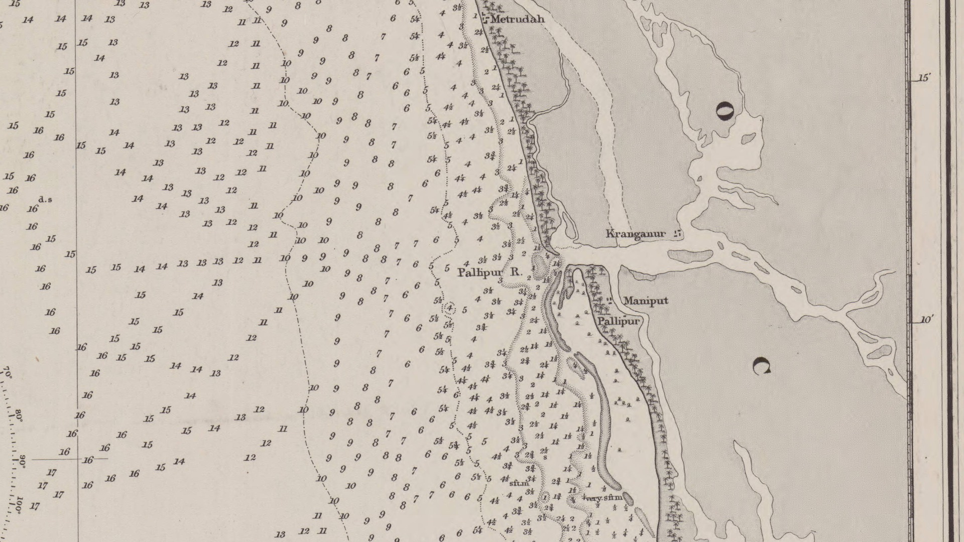
Part I
How deep was the water at the mouths?
Chart: Admiralty Chart 749, Malabar Coast, surveyed by W. B. Selby 1851–53, published 1857 (Wikimedia Commons, public domain)
6
Notes:
• Part one: the seabed.

Slide 7
The primary evidence for coastal depths comes frrom British and Dutch admiralty surveys
Admiralty Chart 749, Malabar Coast, surveyed by W. B. Selby 1851–53, published 1857 (Wikimedia Commons, public domain)
7
Notes:
• A British Admiralty survey of 1851–53, measured with a lead line.
• The oldest measured depths for this coast.
• Zoom to the Kodungallur mouth, the traditional Muziris area.

Slide 8
The primary evidence for coastal depths comes frrom British and Dutch admiralty surveys
Admiralty Chart 749, Malabar Coast, surveyed by W. B. Selby 1851–53, published 1857 (Wikimedia Commons, public domain)
8
Notes:
• A British Admiralty survey of 1851–53, measured with a lead line.
• The oldest measured depths for this coast.
• Zoom to the Kodungallur mouth, the traditional Muziris area.

Slide 9
The numbers on this chart are depth (measured in fathoms), and these soundings are transcribed
Admiralty Chart 749, Malabar Coast, surveyed by W. B. Selby 1851–53, published 1857 (Wikimedia Commons, public domain)
9
Notes:
• Every number on the chart is a depth in fathoms.
• 428 soundings read by hand and checked a second time.

Slide 10
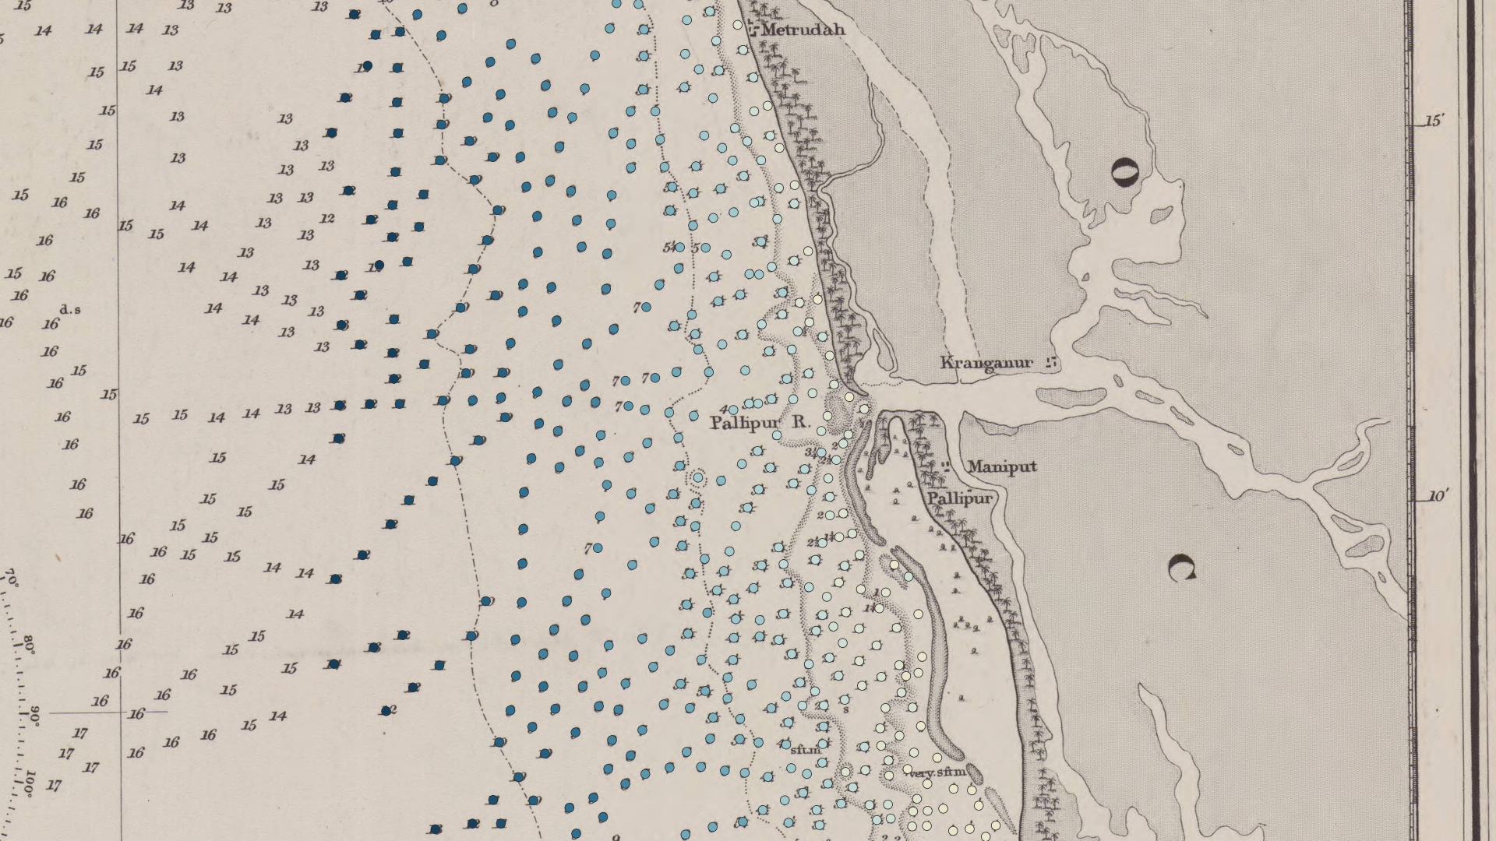
The numbers on this chart are depth (measured in fathoms), and we transcribe these soundings
Admiralty Chart 749, Malabar Coast, surveyed by W. B. Selby 1851–53, published 1857 (Wikimedia Commons, public domain); points: the author's transcription
10
Notes:
• Every number on the chart is a depth in fathoms.
• 428 soundings read by hand and checked a second time.

Slide 11
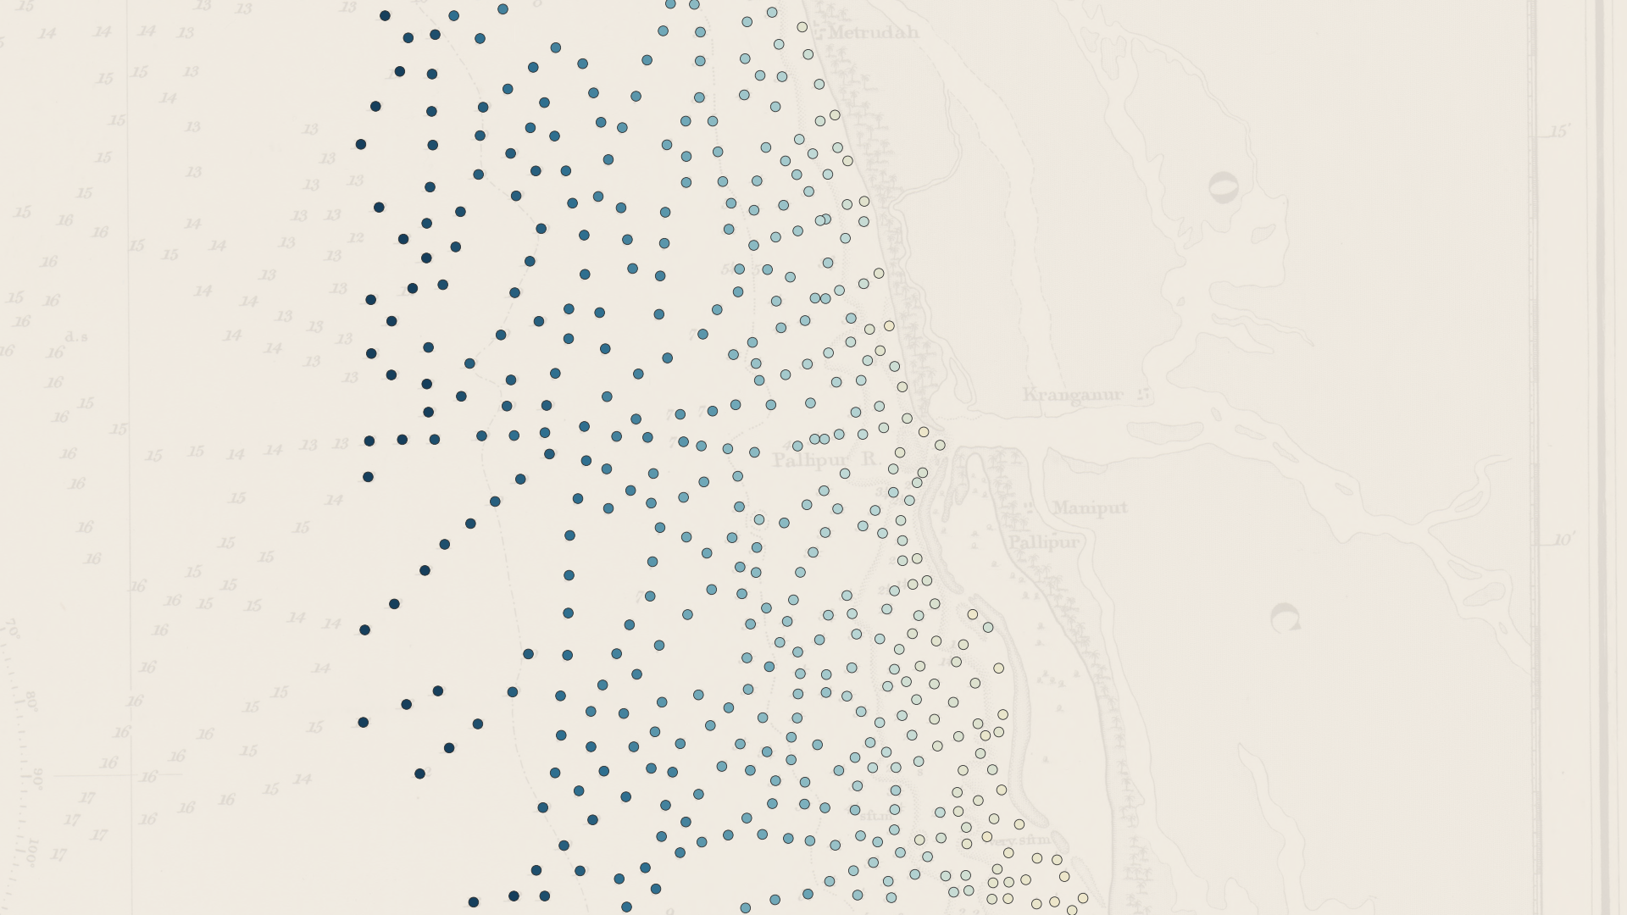
The numbers on this chart are depth (measured in fathoms), and we transcribe these soundings
Admiralty Chart 749, Malabar Coast, surveyed by W. B. Selby 1851–53, published 1857 (Wikimedia Commons, public domain); points: the author's transcription
11
Notes:
• Every number on the chart is a depth in fathoms.
• 428 soundings read by hand and checked a second time.

Slide 12
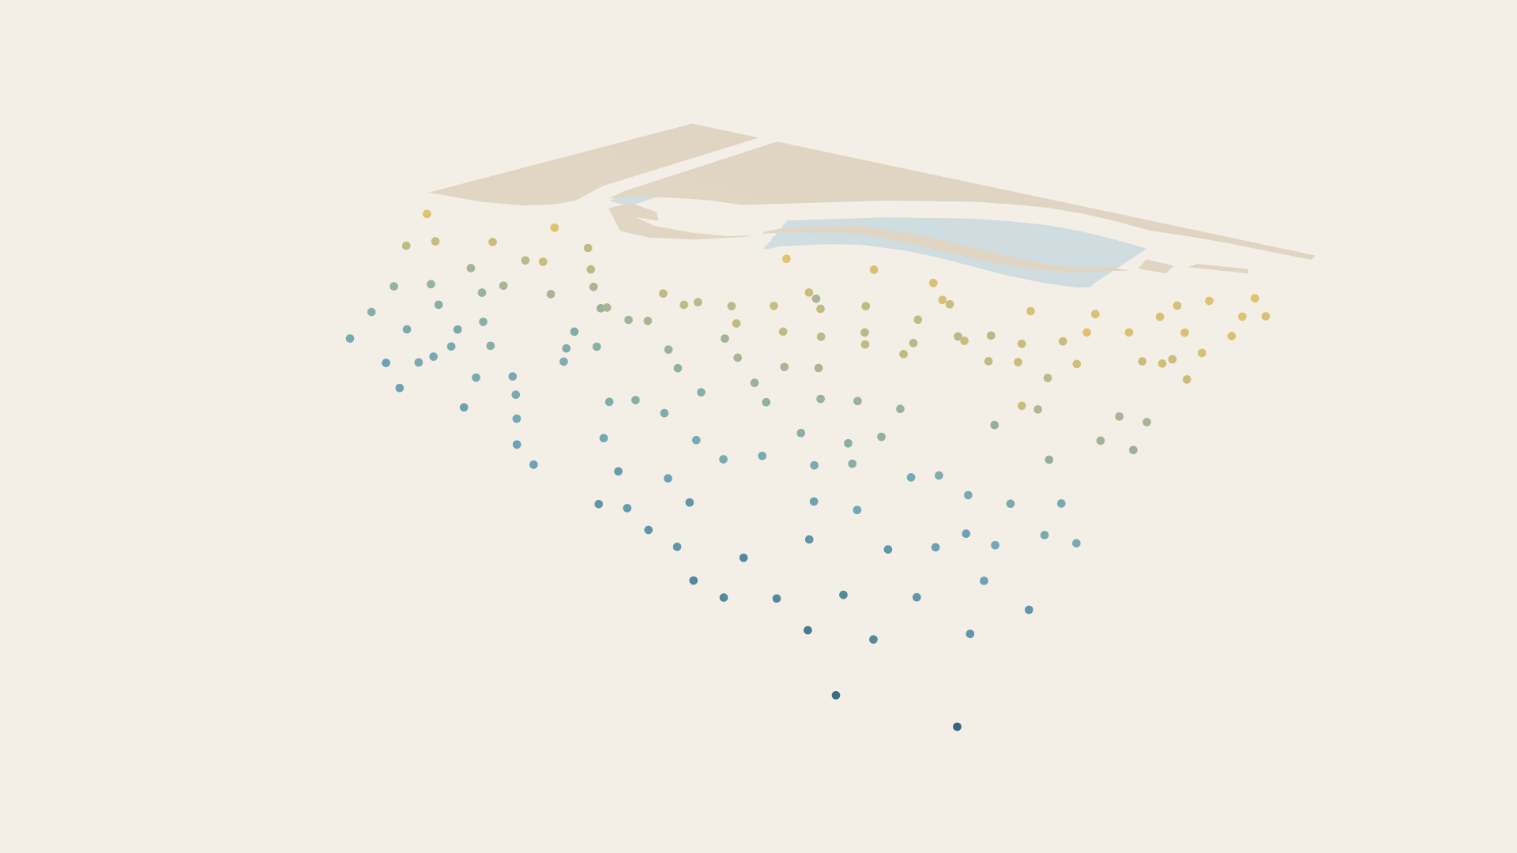
These depth soundings can then be used, along with the coordinates of these points, to map the coast in 3D
Soundings from Admiralty Chart 749; seabed modelled with a Gaussian process (R-INLA)
12
Notes:
• Each point is a measured depth.

Slide 13
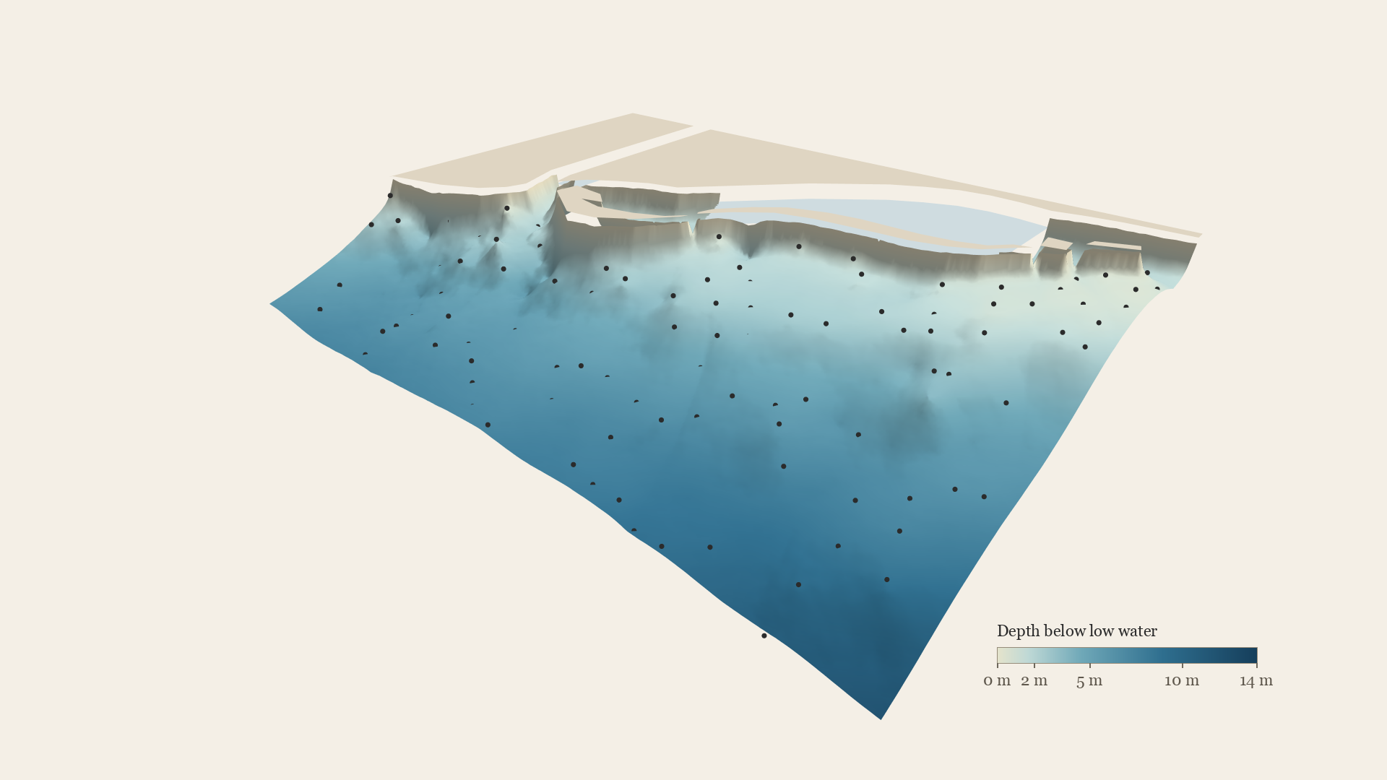
Established statistical models are used to fill in the depths between the points to get a richer sense of the coast
Soundings from Admiralty Chart 749; seabed modelled with a Gaussian process (R-INLA)
13
Notes:
• A Gaussian process fills in the seabed between the soundings, with uncertainty.
• It allows for a beach slope near shore and extra roughness at the river mouth.

Slide 14
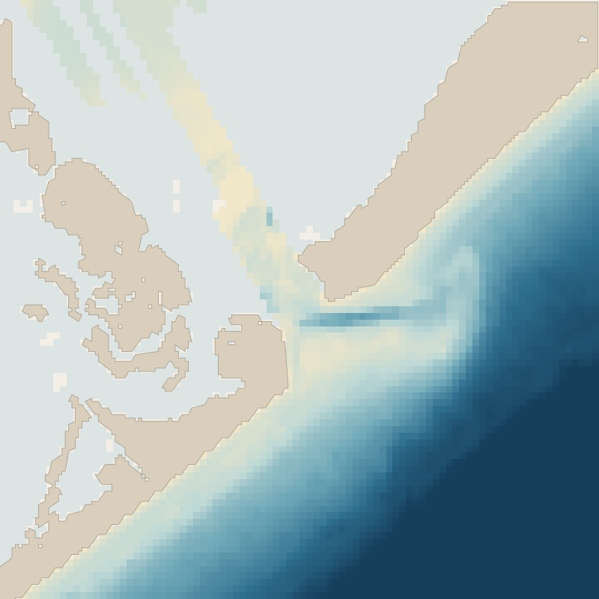
To test out the method, it can be used on a modern Texas inlet whose seabed is known
The real seabed
San Luis Pass, Texas: NOAA Continuously Updated DEM (CUDEM); survey simulated at the 1853 Kodungallur density
14
Notes:
• Proof of concept: a modern Texas inlet whose whole seabed is known.
• We survey it as sparsely as Kodungallur was surveyed in 1853, then rebuild it.
• It comes back to within about 30 cm in open water and 40 cm along the shore. In the inlet itself, about 1.2 m.
• If asked: we also hid the mouth soundings at Kodungallur and predicted them. 8 of 9 fell inside the predicted range.

Slide 15
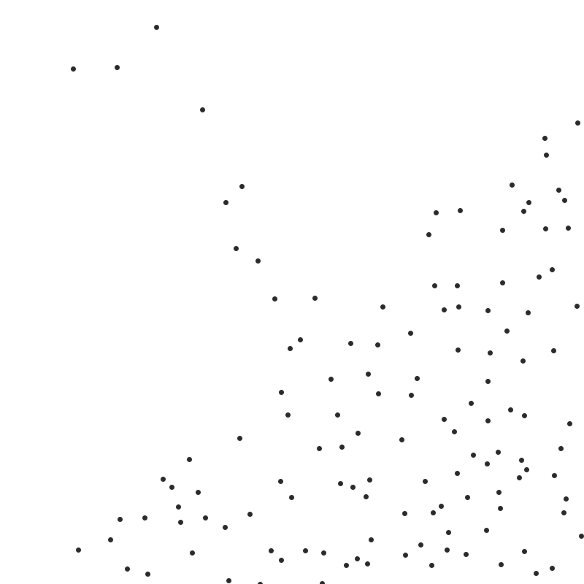
The seabed is sampled 130 times to create “soundings” that are similar to the ones in the British admiralty survey
The real seabed
San Luis Pass, Texas: NOAA Continuously Updated DEM (CUDEM); survey simulated at the 1853 Kodungallur density
15
Notes:
• Proof of concept: a modern Texas inlet whose whole seabed is known.
• We survey it as sparsely as Kodungallur was surveyed in 1853, then rebuild it.
• It comes back to within about 30 cm in open water and 40 cm along the shore. In the inlet itself, about 1.2 m.
• If asked: we also hid the mouth soundings at Kodungallur and predicted them. 8 of 9 fell inside the predicted range.

Slide 16
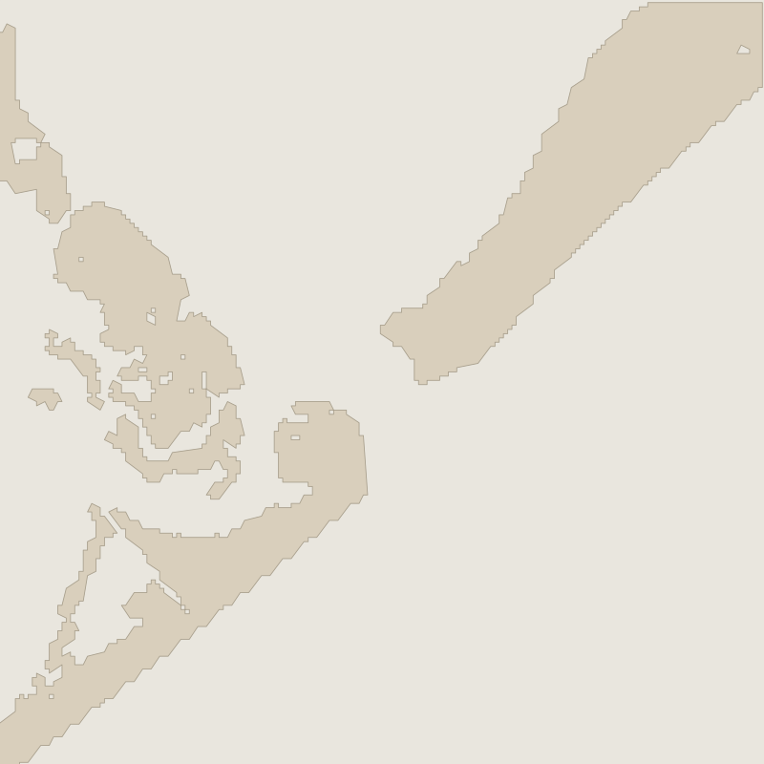
The seabed is sampled 130 times to create “soundings” that are similar to the ones in the British admiralty survey
The real seabed
Rebuilt (130 soundings)
San Luis Pass, Texas: NOAA Continuously Updated DEM (CUDEM); survey simulated at the 1853 Kodungallur density
16
Notes:
• Proof of concept: a modern Texas inlet whose whole seabed is known.
• We survey it as sparsely as Kodungallur was surveyed in 1853, then rebuild it.
• It comes back to within about 30 cm in open water and 40 cm along the shore. In the inlet itself, about 1.2 m.
• If asked: we also hid the mouth soundings at Kodungallur and predicted them. 8 of 9 fell inside the predicted range.

Slide 17
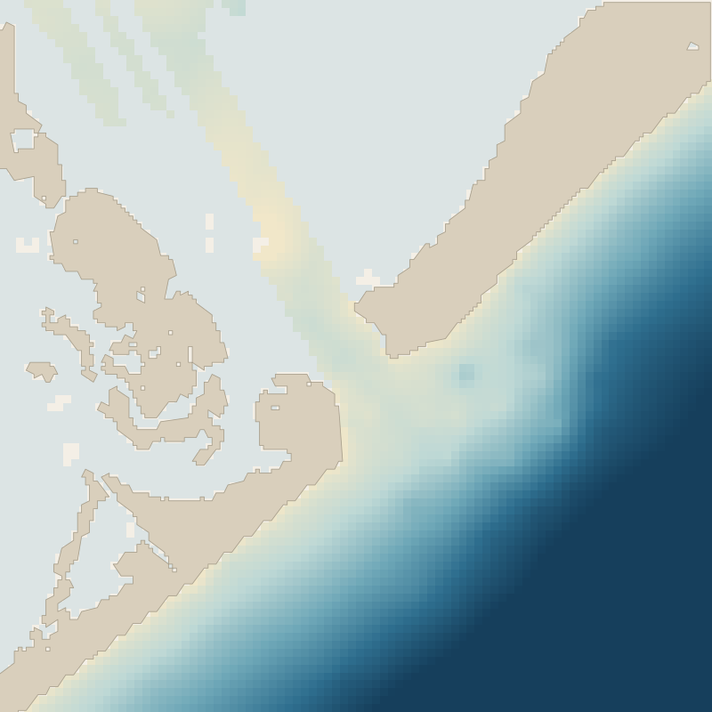
The seabed is then rebuilt from the soundings and the rebuilt version is extremely similar to the original
The real seabed
Rebuilt (130 soundings)
The seabed comes has an error of about 30cm in open water, 40cm along the shore, and ~1.2m in the inlet
San Luis Pass, Texas: NOAA Continuously Updated DEM (CUDEM); survey simulated at the 1853 Kodungallur density
17
Notes:
• Proof of concept: a modern Texas inlet whose whole seabed is known.
• We survey it as sparsely as Kodungallur was surveyed in 1853, then rebuild it.
• It comes back to within about 30 cm in open water and 40 cm along the shore. In the inlet itself, about 1.2 m.
• If asked: we also hid the mouth soundings at Kodungallur and predicted them. 8 of 9 fell inside the predicted range.

Slide 18

The coastal depths can be used to understand where ships can approach the shore
Soundings from Admiralty Chart 749; seabed modelled with a Gaussian process (R-INLA)
18
Notes:
• Blue is deep enough for a ship drawing 3 m; sand is too shallow.
• At Kodungallur, ship-worthy water starts about 1.3 km out.

Slide 19
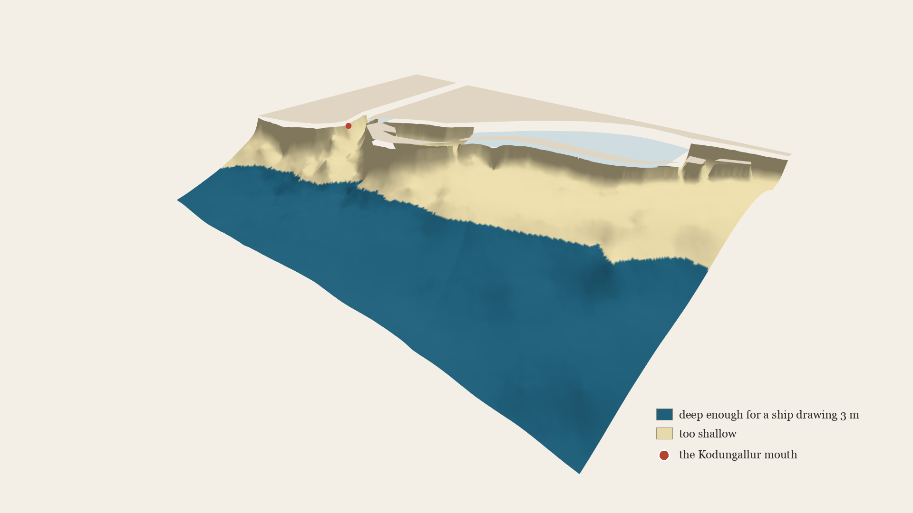
A loaded ship could not come in near the coast: water deep enough to accommodate it starts 1.3 km offshore
Soundings from Admiralty Chart 749; seabed modelled with a Gaussian process (R-INLA)
19
Notes:
• Blue is deep enough for a ship drawing 3 m; sand is too shallow.
• At Kodungallur, ship-worthy water starts about 1.3 km out.

Slide 20
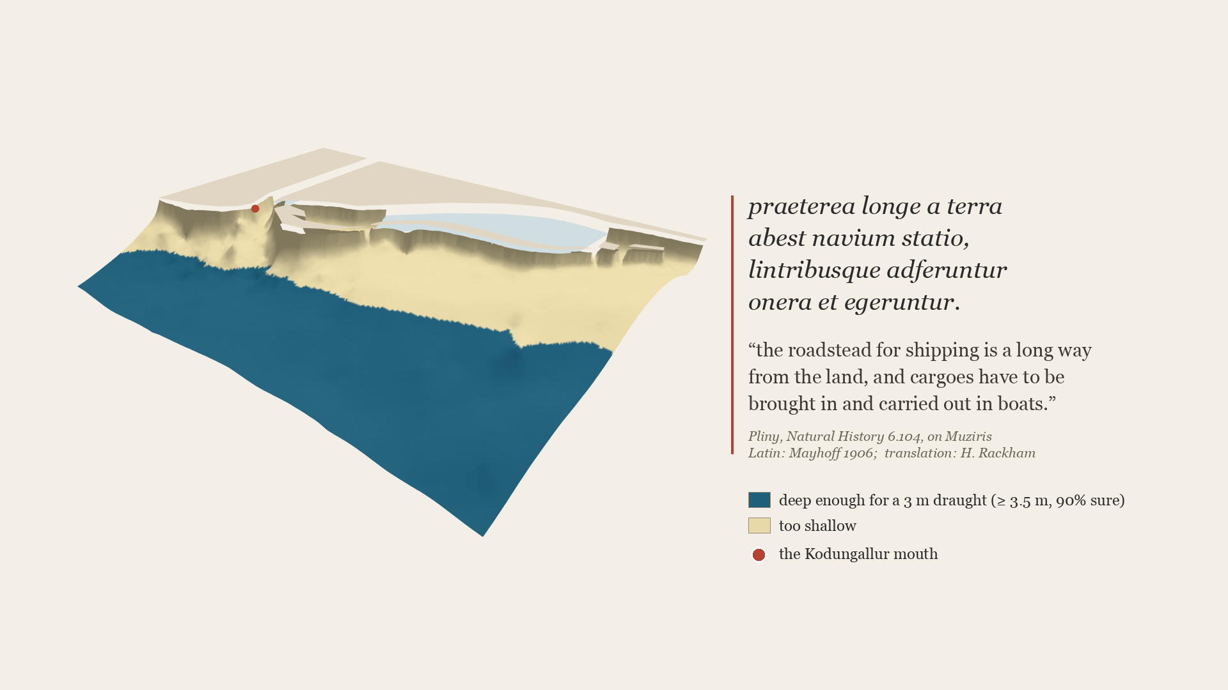
Pliny mentions this fact when talking about Muziris
Pliny, Natural History 6.104: Latin, ed. Mayhoff (Teubner, 1906); translation H. Rackham (Loeb). Soundings from Admiralty Chart 749; seabed modelled with a Gaussian process (R-INLA)
20
Notes:
• Pliny says the same of Muziris: ships anchored far from land, and boats carried the cargo.
• The 1866 Admiralty Pilot: the bar was 'only available for small coasting craft'.

Slide 21
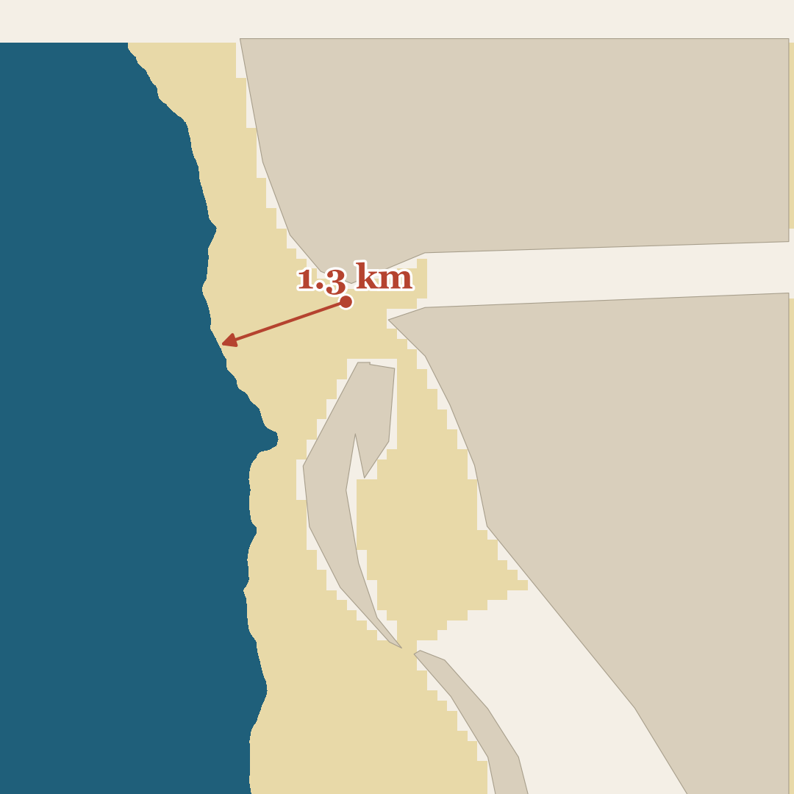
A loaded ship could not come in near the coast: water deep enough to accommodate it starts 1.3 km offshore
Soundings from Admiralty Chart 749; seabed modelled with a Gaussian process (R-INLA)
21
Notes:
• Blue is deep enough for a ship drawing 3 m; sand is too shallow.
• At Kodungallur, ship-worthy water starts about 1.3 km out.
• From above: the arrow runs from the mouth to the first water that is 90 per cent sure to be deep enough.

Slide 22
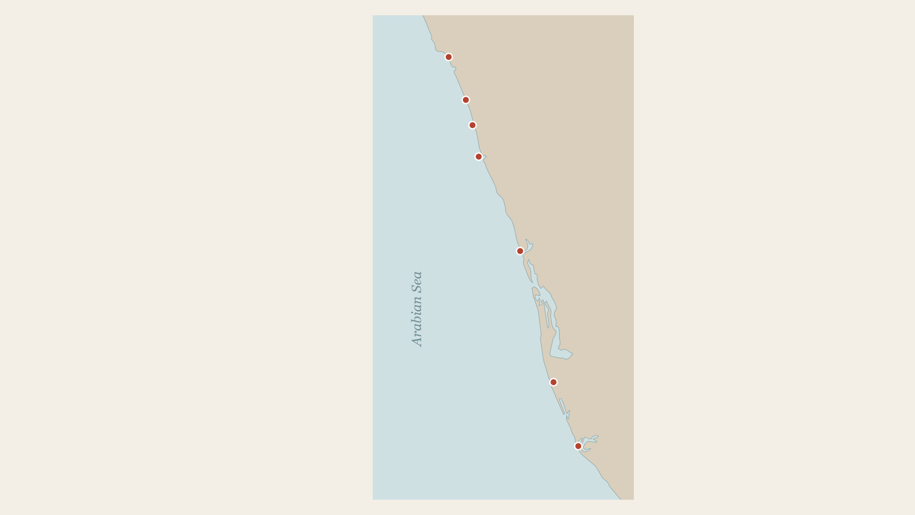
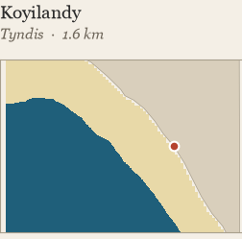
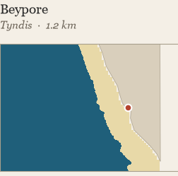
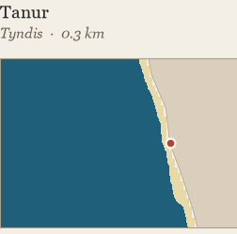
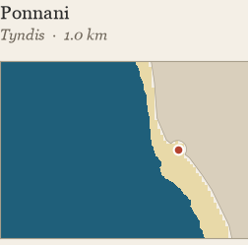
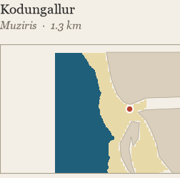
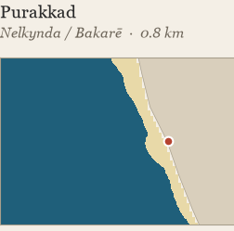
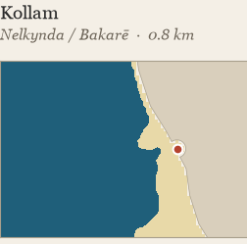
Similar analysis is run for the other possible port locations along the Malabar coat
Koyilandy
Beypore
Tanur
Ponnani
Kodungallur
Purakkad
Kollam
Admiralty Charts 749, 750 (Selby, 1850–53) and 64 (1887); coast: Natural Earth; seabeds modelled by the author
22
Notes:
• Seven candidate mouths, all modelled the same way.
• At every one, ship water is 0.3 to 1.6 km out.
• Every mouth worked as an offshore anchorage, so depth does not pick the port.

Slide 23
Every candidate didn’t have sufficient coastal depth (in 1850) to enable Roman ships docking at the harbor
Admiralty Charts 749, 750 (Selby, 1850–53) and 64 (1887); coast: Natural Earth; seabeds modelled by the author
23
Notes:
• Seven candidate mouths, all modelled the same way.
• At every one, ship water is 0.3 to 1.6 km out.
• Every mouth worked as an offshore anchorage, so depth does not pick the port.

Slide 24
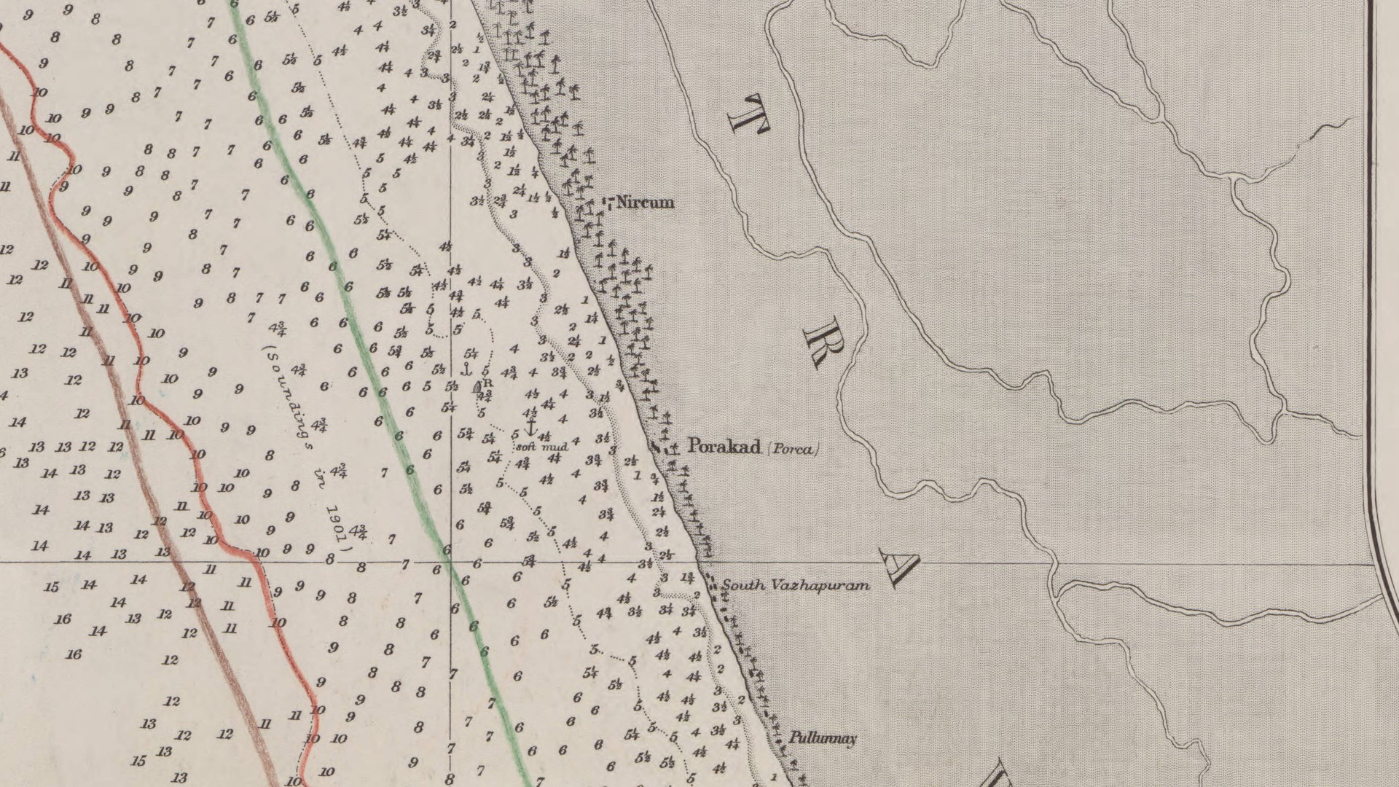
Part II
How did the ports work, and what came after Rome?
Chart: Admiralty Chart 750, off Porakad (Purakkad), Selby 1850–52, published 1857 (Wikimedia Commons, public domain)
24
Notes:
• Part two: the texts and the objects.

Slide 25
The turnaround
How the port worked
25
Notes:
• If ships lay offshore, the question is the turnaround: how a ship was handled.

Slide 26
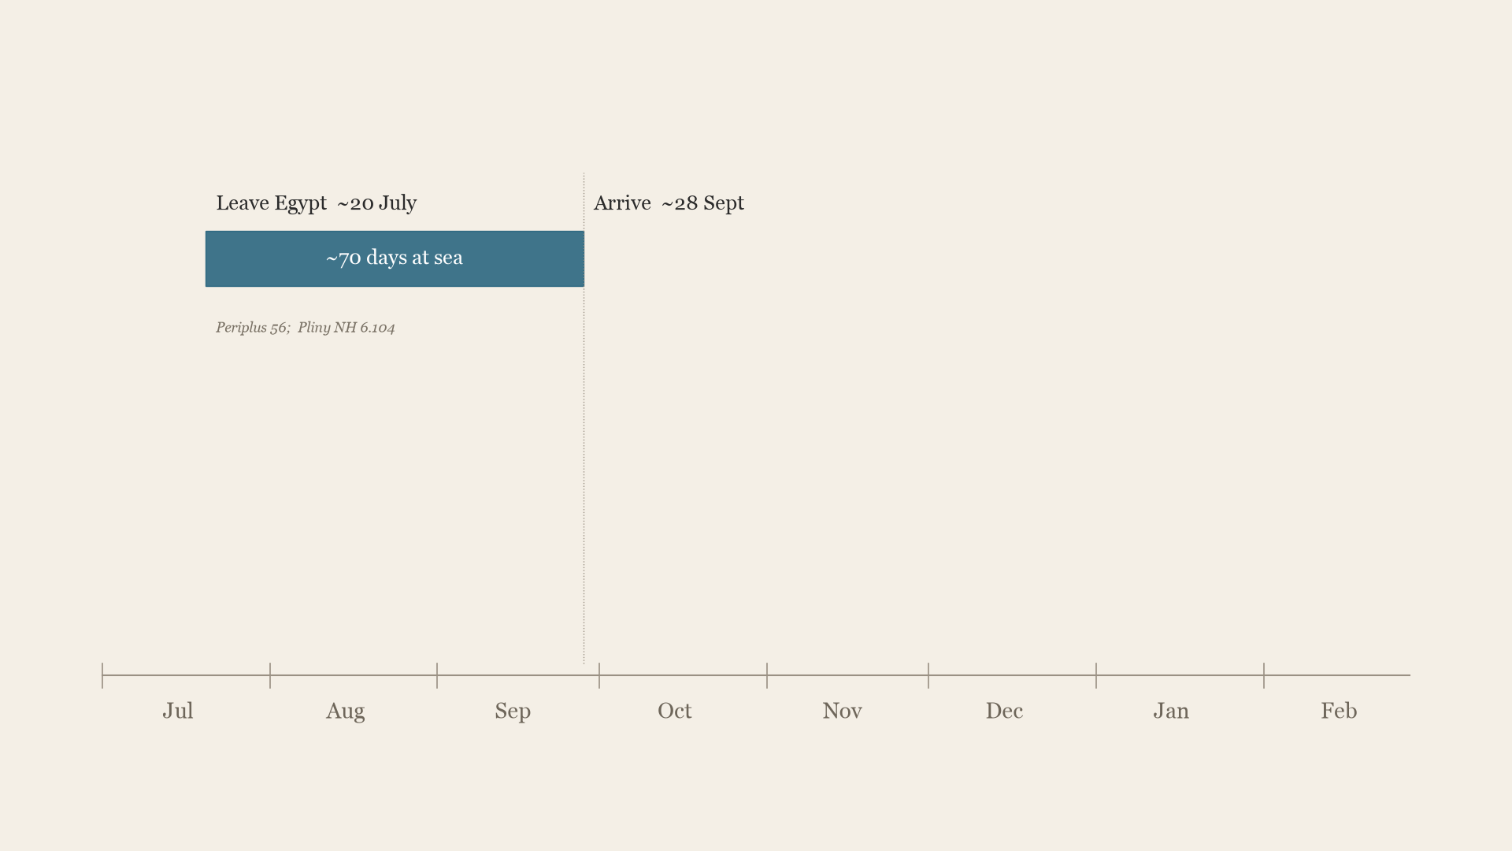
Ships often lay offshore for months waiting for the monsoon wind even though
loading took only weeks
Periplus 56; Pliny, Natural History 6.104, 6.106; Admiralty West Coast of India Pilot (1909); loading time: the author's estimate
26
Notes:
• Leave Egypt about 20 July and arrive about 28 September, just as the coast reopens.
• Loading takes days to about three weeks, but ships must leave by 13 January.
• So most of the stay was waiting.
• The pepper harvest is not in until after the deadline, so cargoes came from store, held by locals.

Slide 27
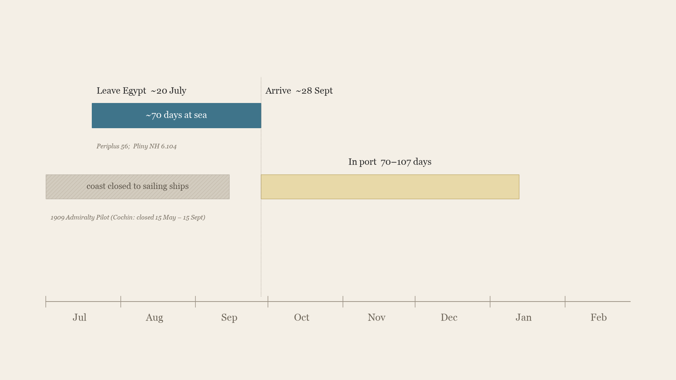
Ships often lay offshore for months waiting for the monsoon wind even though
loading took only weeks
Periplus 56; Pliny, Natural History 6.104, 6.106; Admiralty West Coast of India Pilot (1909); loading time: the author's estimate
27
Notes:
• Leave Egypt about 20 July and arrive about 28 September, just as the coast reopens.
• Loading takes days to about three weeks, but ships must leave by 13 January.
• So most of the stay was waiting.
• The pepper harvest is not in until after the deadline, so cargoes came from store, held by locals.

Slide 28
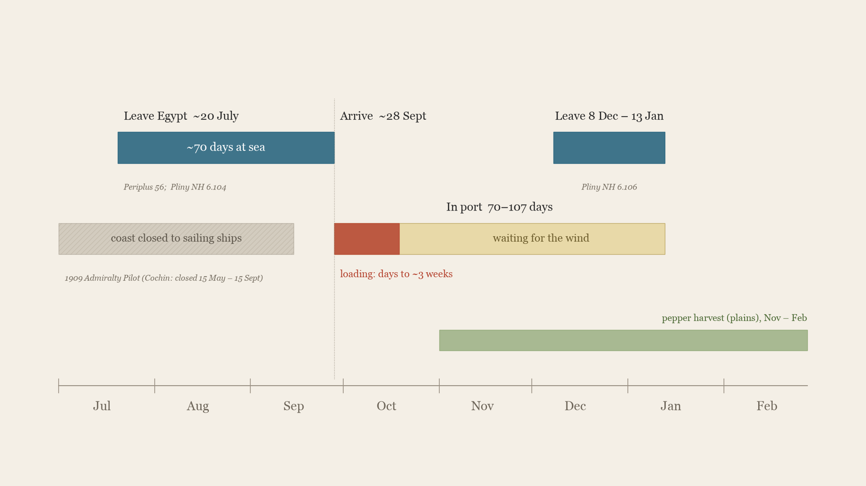
Ships often lay offshore for months waiting for the monsoon wind even though
loading took only weeks
Periplus 56; Pliny, Natural History 6.104, 6.106; Admiralty West Coast of India Pilot (1909); loading time: the author's estimate
28
Notes:
• Leave Egypt about 20 July and arrive about 28 September, just as the coast reopens.
• Loading takes days to about three weeks, but ships must leave by 13 January.
• So most of the stay was waiting.
• The pepper harvest is not in until after the deadline, so cargoes came from store, held by locals.

Slide 29
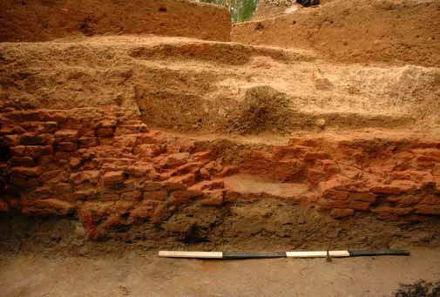
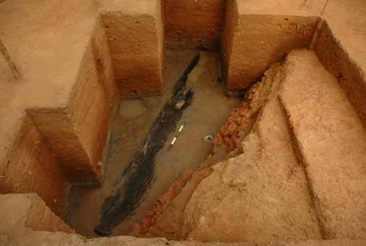
The Pattanam wharf shows evidence for a dugout canoe and wheat & grain pips, supporting the coastal depth evidence
The dugout canoe in the waterlogged wharf deposit
The brick lining of the wharf
Wheat & grape pips and imported wheat was also found at the wharf.
“grain in sufficient amount for those involved with shipping, because the merchants do not use it” (Periplus 56)
Cherian and Menon (eds), Unearthing Pattanam (National Museum, New Delhi, 2014), pp. 120–21. Periplus 56, trans. Casson (1989: 85)
29
Notes:
• At Pattanam: a dugout canoe and a wharf.
• The wharf deposit also held wheat and grape pips: imported food (PAMA: 120; Cherian 2012: 28).
• Periplus 56: grain was shipped to Muziris 'for those involved with shipping'. Text and object match: food for crews, not a colony.
• Caveat if asked: the deposit is undated.

Slide 30
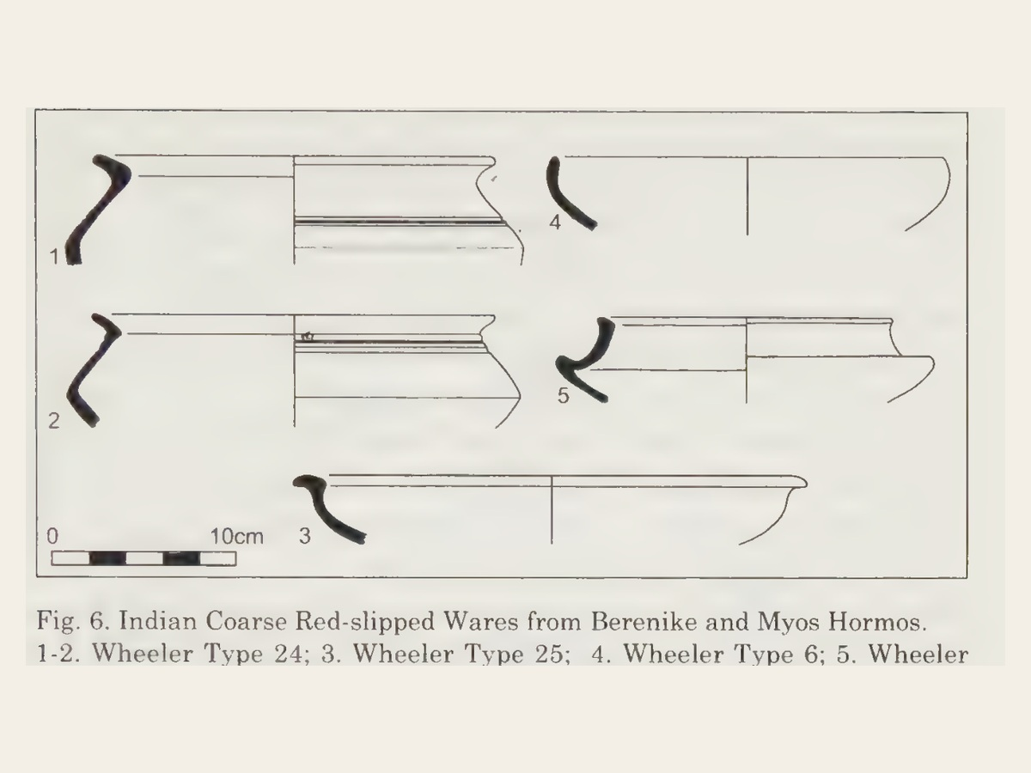
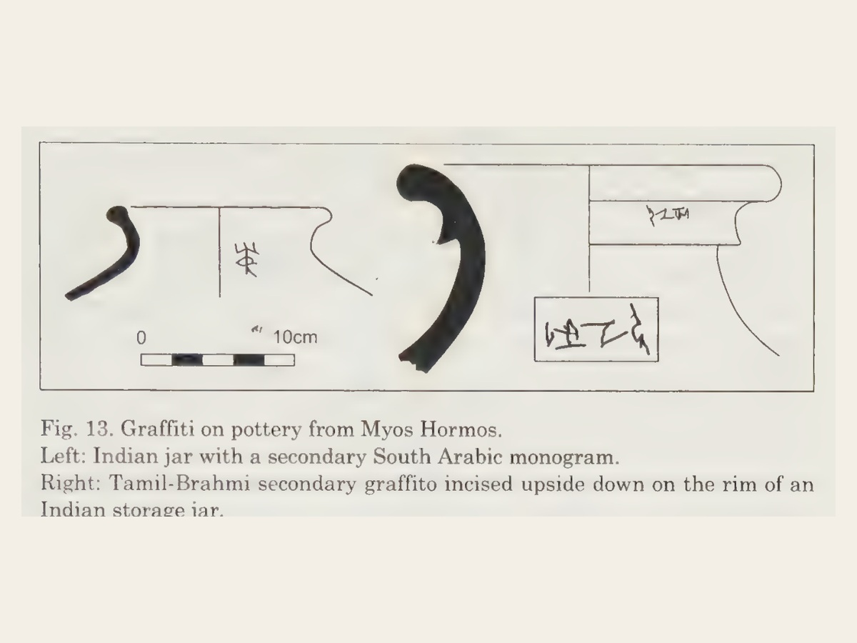
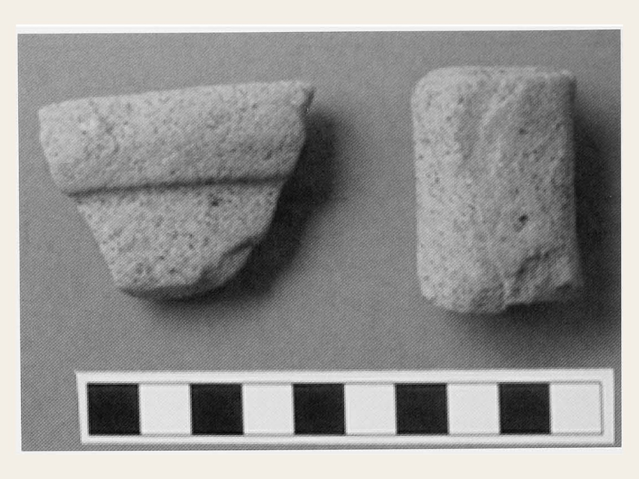
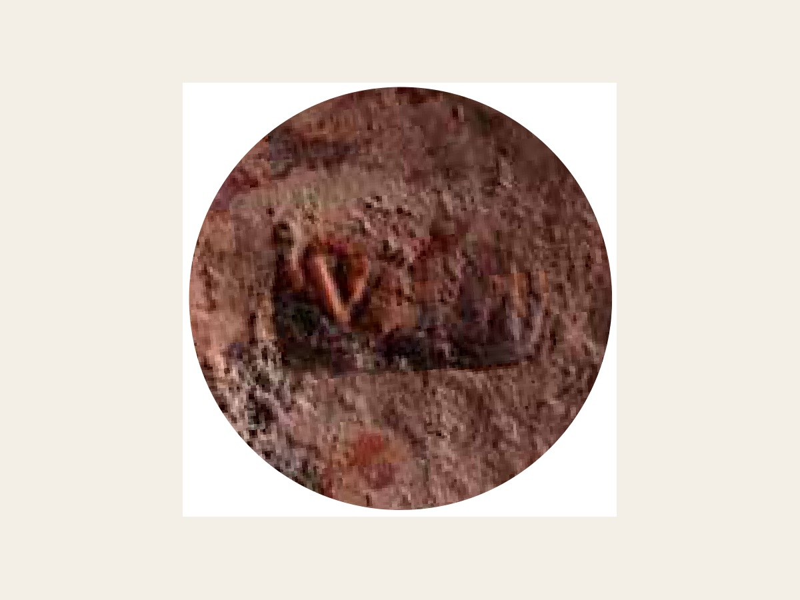
While we have evidence that Indians lived in Roman ports, there is no definitive evidence that Romans lived in the ports along the Malabar coast
Indians had household objects in Red Sea ports
The only Roman objects at Pattanam are trade goods
Indian cooking pots, Berenike and Myos Hormos
Tamil-Brahmi names scratched on jars, Myos Hormos
Dressel 2-4 wine amphora from Campania
Stamped Italian terra sigillata
Tomber, Indo-Roman Trade (2008), figs 6 and 13; Shajan, Tomber, Selvakumar and Cherian, JRA 17 (2004), fig. 5; Cherian and Menon (eds), Unearthing Pattanam (National Museum, New Delhi, 2014)
30
Notes:
• Indians in Egyptian ports left cooking pots and their names.
• Romans at Pattanam left trade goods only.

Slide 31
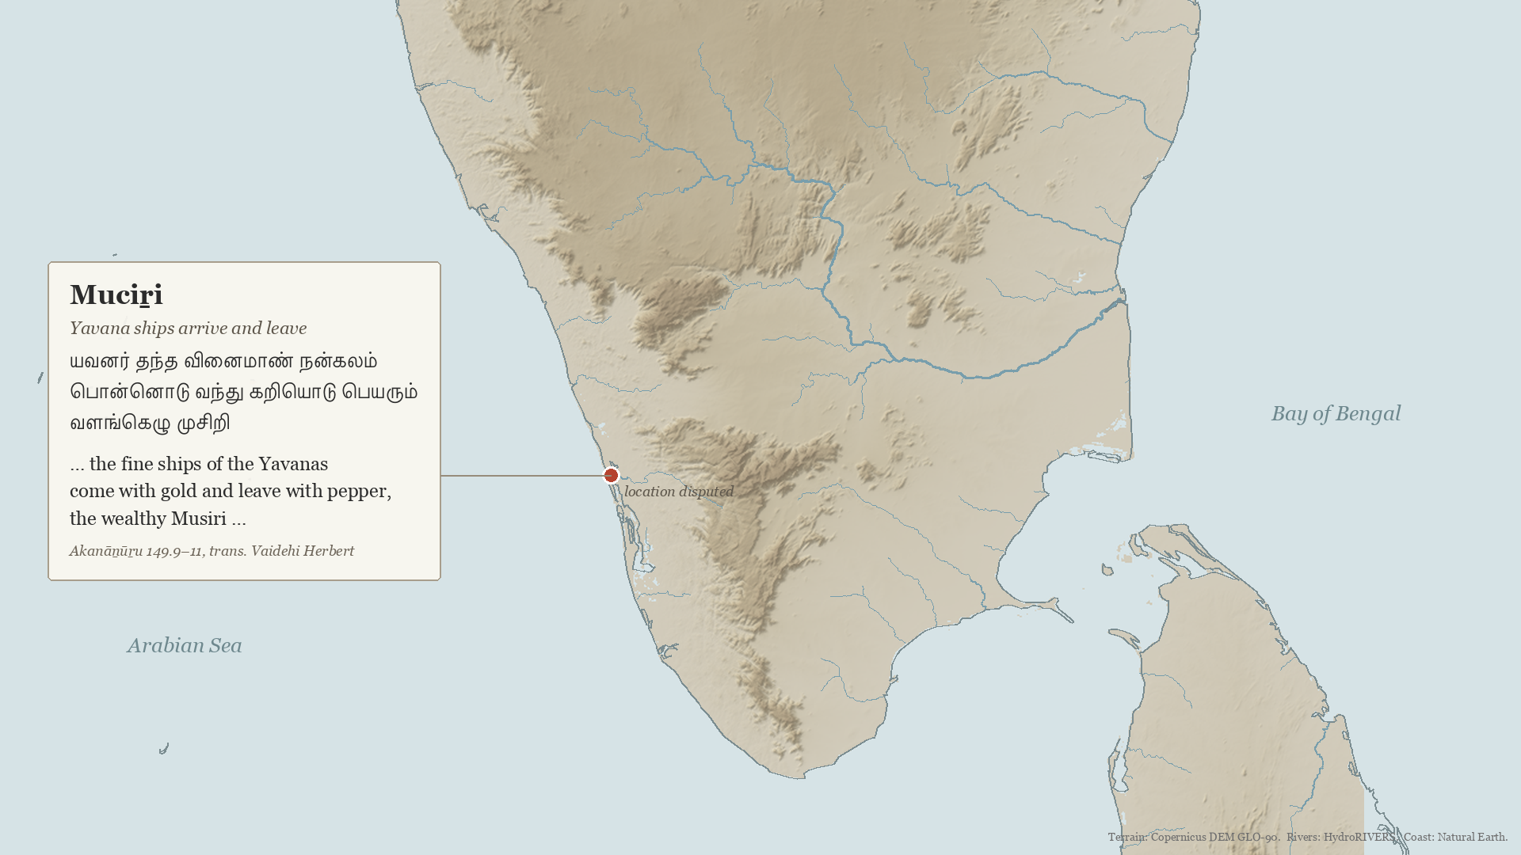
Exant tamil poetry mention foreigners living at Puhar, but none at Muziris
Translations: Vaidehi Herbert (sangamtranslationsbyvaidehi.com). Terrain: Copernicus DEM; rivers: HydroRIVERS; coast: Natural Earth
31
Notes:
• Tamil poems: at Muciṟi, Yavana ships come and go.
• At Madurai, Yavanas are guards and wine suppliers.
• Only at Puhar do foreigners 'dwell'.
• A port run by locals for seasonal crews.

Slide 32
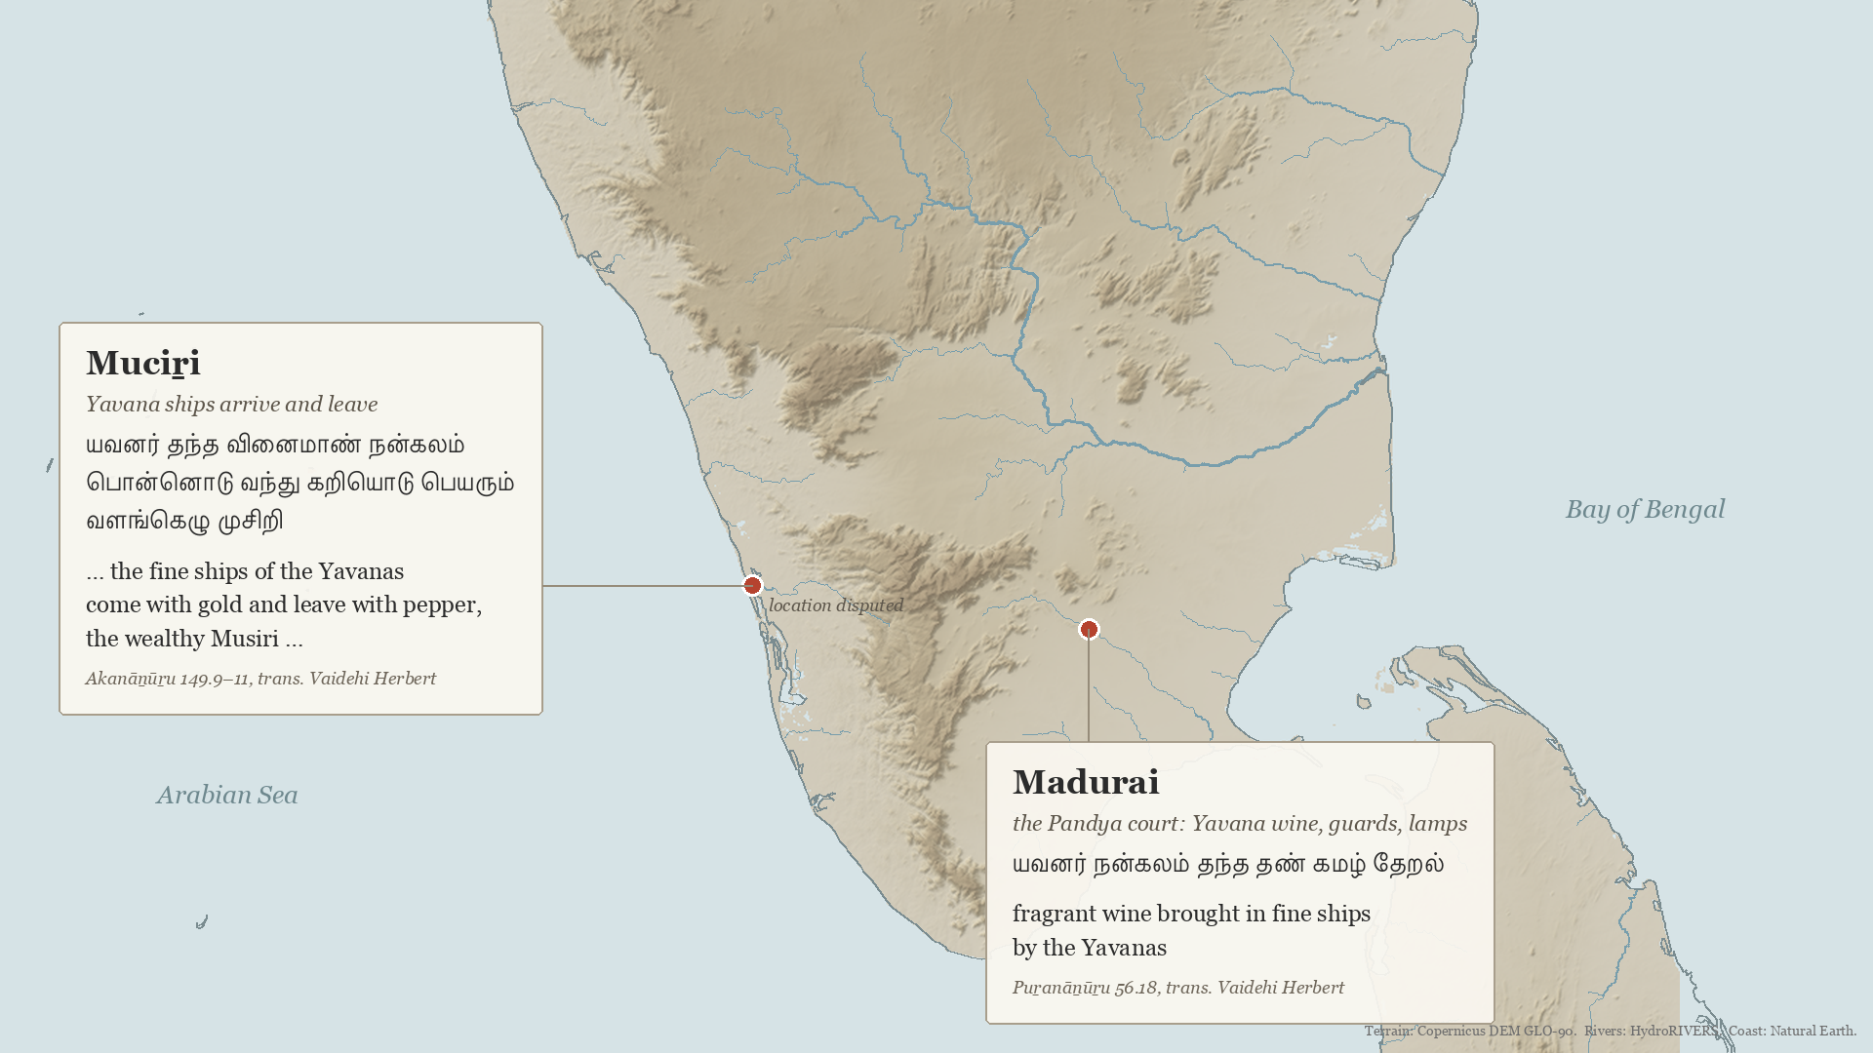
Exant tamil poetry mention foreigners living at Puhar, but none at Muziris
Translations: Vaidehi Herbert (sangamtranslationsbyvaidehi.com). Terrain: Copernicus DEM; rivers: HydroRIVERS; coast: Natural Earth
32
Notes:
• Tamil poems: at Muciṟi, Yavana ships come and go.
• At Madurai, Yavanas are guards and wine suppliers.
• Only at Puhar do foreigners 'dwell'.
• A port run by locals for seasonal crews.

Slide 33
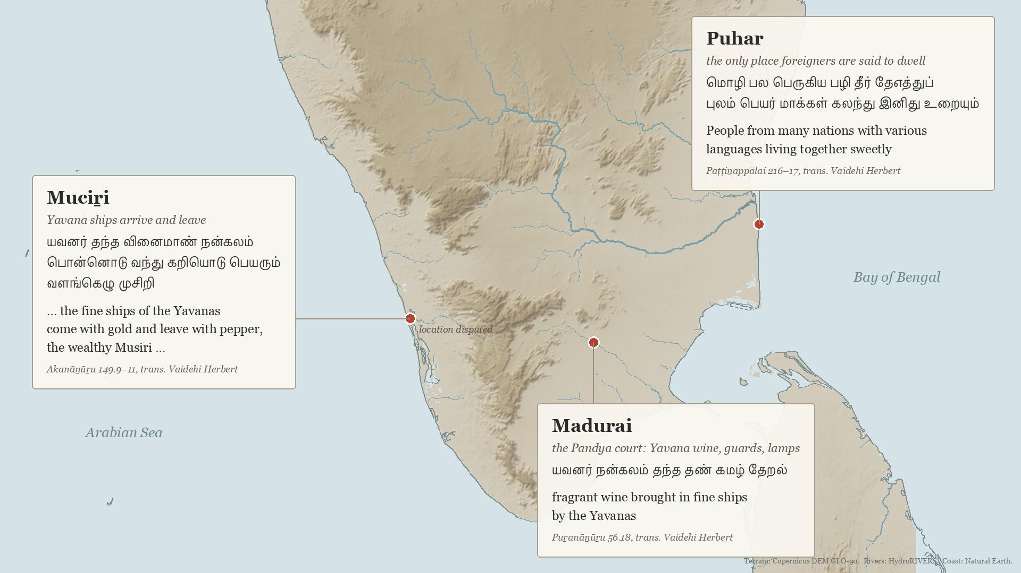
Exant tamil poetry mention foreigners living at Puhar, but none at Muziris
Translations: Vaidehi Herbert (sangamtranslationsbyvaidehi.com). Terrain: Copernicus DEM; rivers: HydroRIVERS; coast: Natural Earth
33
Notes:
• Tamil poems: at Muciṟi, Yavana ships come and go.
• At Madurai, Yavanas are guards and wine suppliers.
• Only at Puhar do foreigners 'dwell'.
• A port run by locals for seasonal crews.

Slide 34
The crossing
When south India began to cross the Arabian Sea
34
Notes:
• Next: when the crossing began.

Slide 35
Before the Periplus, Indian and Egyptian ships met at Aden, indicating that Indian goods reached Rome by relay
“vessels from India did not go on to Egypt and those from Egypt did not dare sail to the places further on but came only this far”
Periplus 26, on Eudaimon Arabia (Aden)
Periplus 26, trans. Casson (1989: 65). Map: PHGCOM, 'Map of the Periplus of the Erythraean Sea', Wikimedia Commons, CC BY-SA 4.0; arrows added by the author
35
Notes:
• Periplus 26: Eudaimon Arabia (Aden) got its name because, before the author's day, ships from India did not go on to Egypt and ships from Egypt did not sail beyond it.
• So Indian goods reached the Mediterranean, but through a meeting point in Arabia, not by Indian ships sailing all the way.
• Which Indian ships came to Aden, and from when, is the question the pottery has been used to answer.

Slide 36
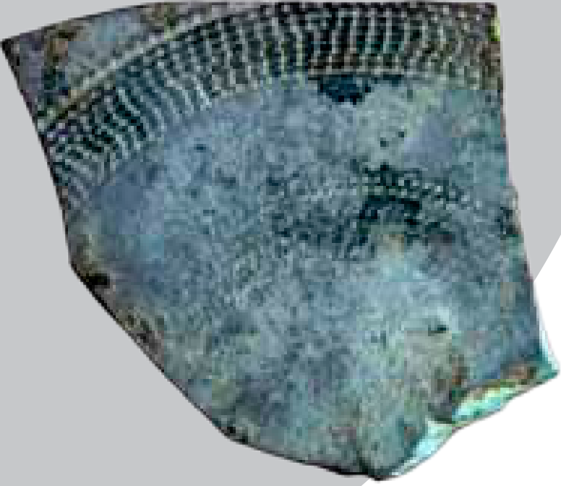
Wheeler misread Indian pottery at Arikamedu to argue for a Roman trading settlement in India
1 Misread as Roman
Initially mistaken for Roman pottery because of its fine finish and rouletted decoration, which resembled Greco-Roman ceramics.
Its shape was later argued to be Indian (Begley), which was then confirmed by X-ray analysis (Gogte).
Rouletted Ware, Pattanam
Pattanam sherd: Cherian and Menon (eds), Unearthing Pattanam (2014), p. 50. Tomber, Indo-Roman Trade (2008: 44–45); Pavan and Schenk, AAE 23 (2012)
36
Notes:
• Rouletted Ware is the fine pottery used to argue for an early crossing.
• Wheeler took it for Roman at Arikamedu (his Type 1, 1946), on its finish and rouletting.
• Begley (1988) argued it was Indian; X-ray diffraction (Gogte) traced the clay to the lower Ganges delta.

Slide 37
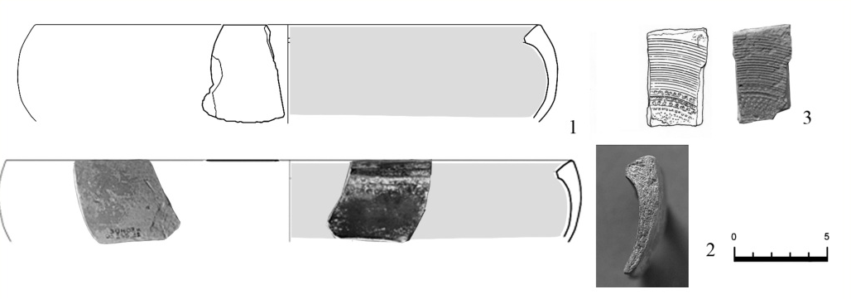
Later scholars misdated similar pottery in Arabia to argue that south Indian merchants crossed before the Romans
2 Misdated as early
Similar ware found at Sumhuram in Oman was dated to the late 2nd century BC by matching it to finds in Sri Lanka, and was taken as evidence that south India traded across the Arabian Sea before Rome.
Yet at Sumhuram itself, the sherds were found near the surface, in later layers, or alongside Roman amphorae of the late 1st century BC.
Fine pottery like this was often kept as an heirloom for generations, so these pieces could have arrived long after they were made, after Roman contact had begun.
Rouletted Ware, Sumhuram (Oman)
Sumhuram sherd: Pavan and Schenk, AAE 23 (2012), fig. 3. Tomber, Indo-Roman Trade (2008: 44–45)
37
Notes:
• Once it was known to be Indian, finds in Arabia, such as Sumhuram in Oman, were read as proof that south India crossed before Rome.
• The early date comes from Sri Lanka, where Tissamaharama dates the ware by its own layers.
• The Arabian sherds were dated by borrowing that date, not from the layers they were found in.

Slide 38
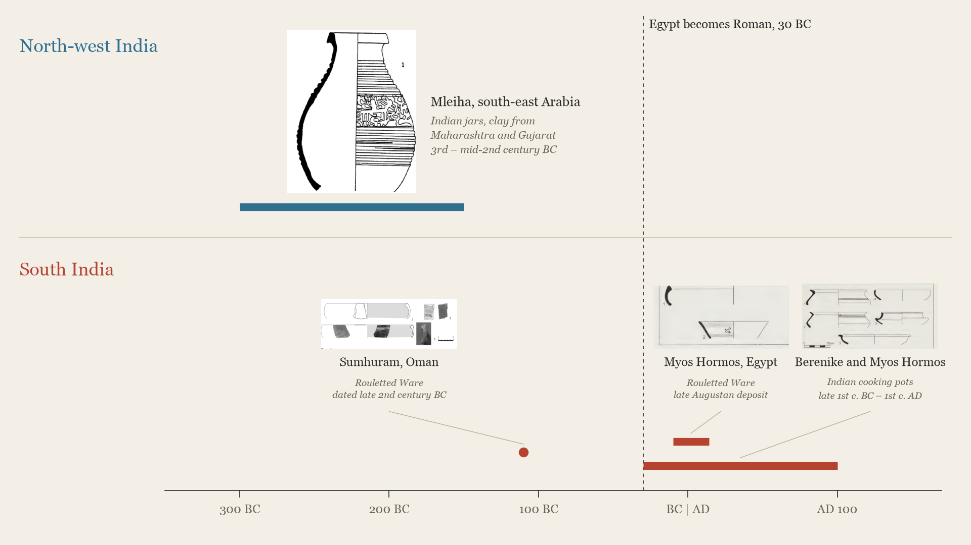
While north-west Indian pottery reached Arabia before Rome, nothing from south India is securely dated before the Roman trade
Reddy 2013: 32, fig. 213 (after Mouton 2008); Pavan and Schenk 2012, fig. 3; Tomber 2008, figs 5–6, pp. 74–75; Shoebridge 2017: 112–13
38
Notes:
• Each pot sits at the date of the layer it was found in.
• North-west: Indian jars at Mleiha, clay from Maharashtra and Gujarat, 3rd to mid-2nd century BC (Reddy 2013: 32). Before Rome.
• South: the only early piece is Sumhuram, and its date is the one borrowed from Sri Lanka (slide 37).
• Everything else is Roman-period: Rouletted Ware at Myos Hormos in one late-Augustan deposit; Indian cooking pots at Berenike and Myos Hormos, at least one from Kerala, most common in the early Roman period (Tomber 2008: 75).
• If asked: Rouletted Ware's clay is from the Ganges region; it counts here because it is the ware used to argue for an early south Indian crossing.

Slide 39
After Rome
What became of the port when Rome's trade faded
39
Notes:
• Next: after Rome.

Slide 40
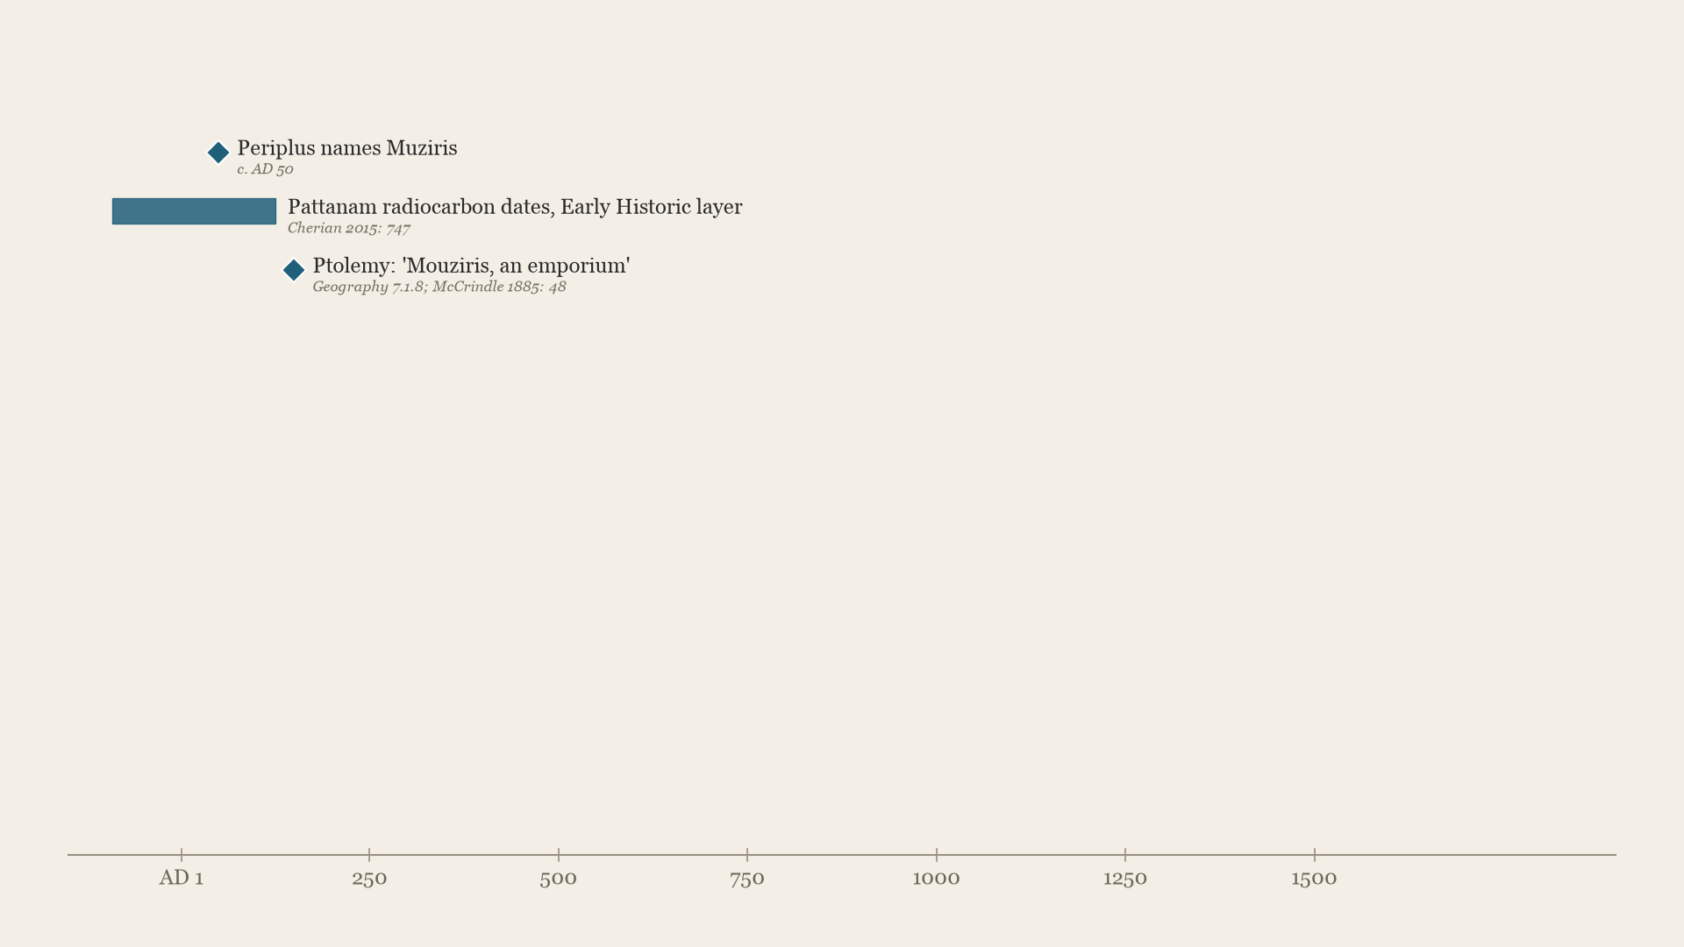
When Roman trade faded, Pattanam turned to the Gulf, and the coast's main port moved to Kollam, Kodungallur and then Kochi
Each item's source is printed beneath it; the copper plates and the Chera dates rest on secondary summaries
40
Notes:
• Roman contact peaks in the 1st century AD.
• Gulf pottery follows, 3rd to 8th centuries. By about 550, Cosmas no longer names Muziris.
• The trade moves: to Kollam (849), the Chera capital at Kodungallur, then Kochi.
• The harbour zone moved rather than died.

Slide 41
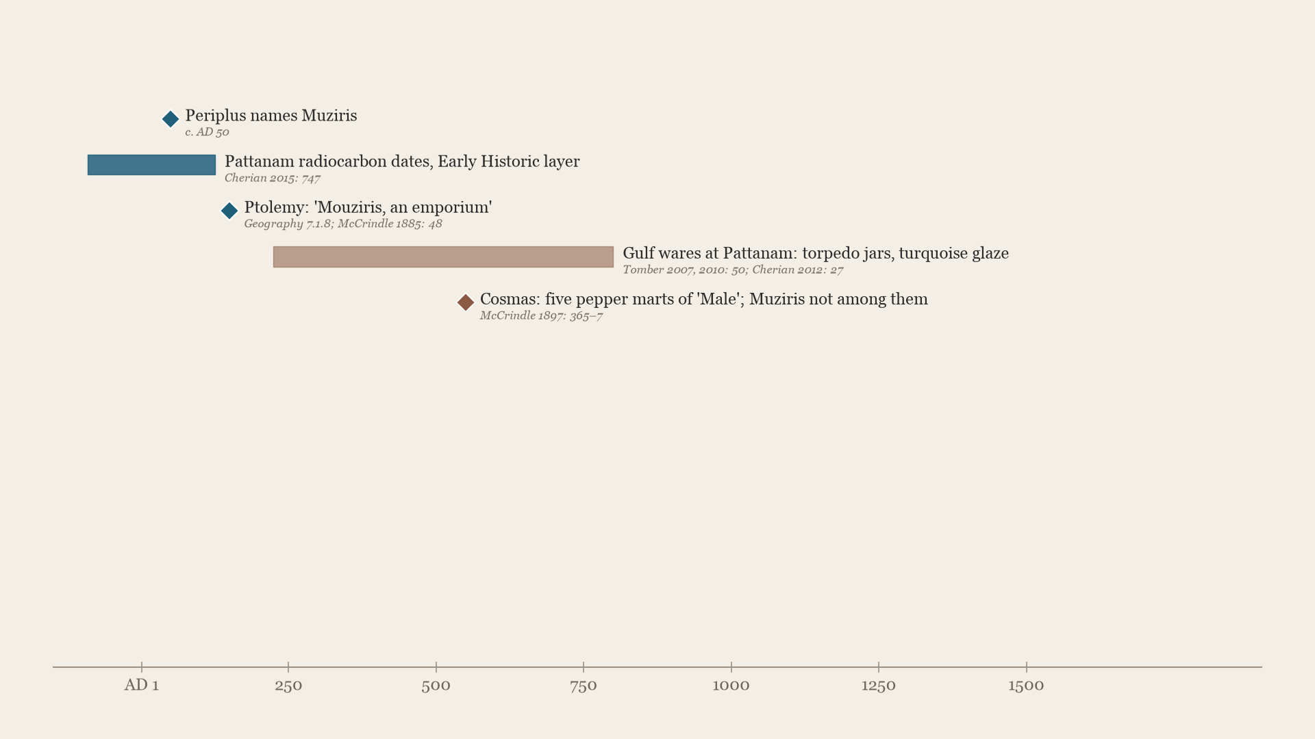
When Roman trade faded, Pattanam turned to the Gulf, and the coast's main port moved to Kollam, Kodungallur and then Kochi
Each item's source is printed beneath it; the copper plates and the Chera dates rest on secondary summaries
41
Notes:
• Roman contact peaks in the 1st century AD.
• Gulf pottery follows, 3rd to 8th centuries. By about 550, Cosmas no longer names Muziris.
• The trade moves: to Kollam (849), the Chera capital at Kodungallur, then Kochi.
• The harbour zone moved rather than died.

Slide 42
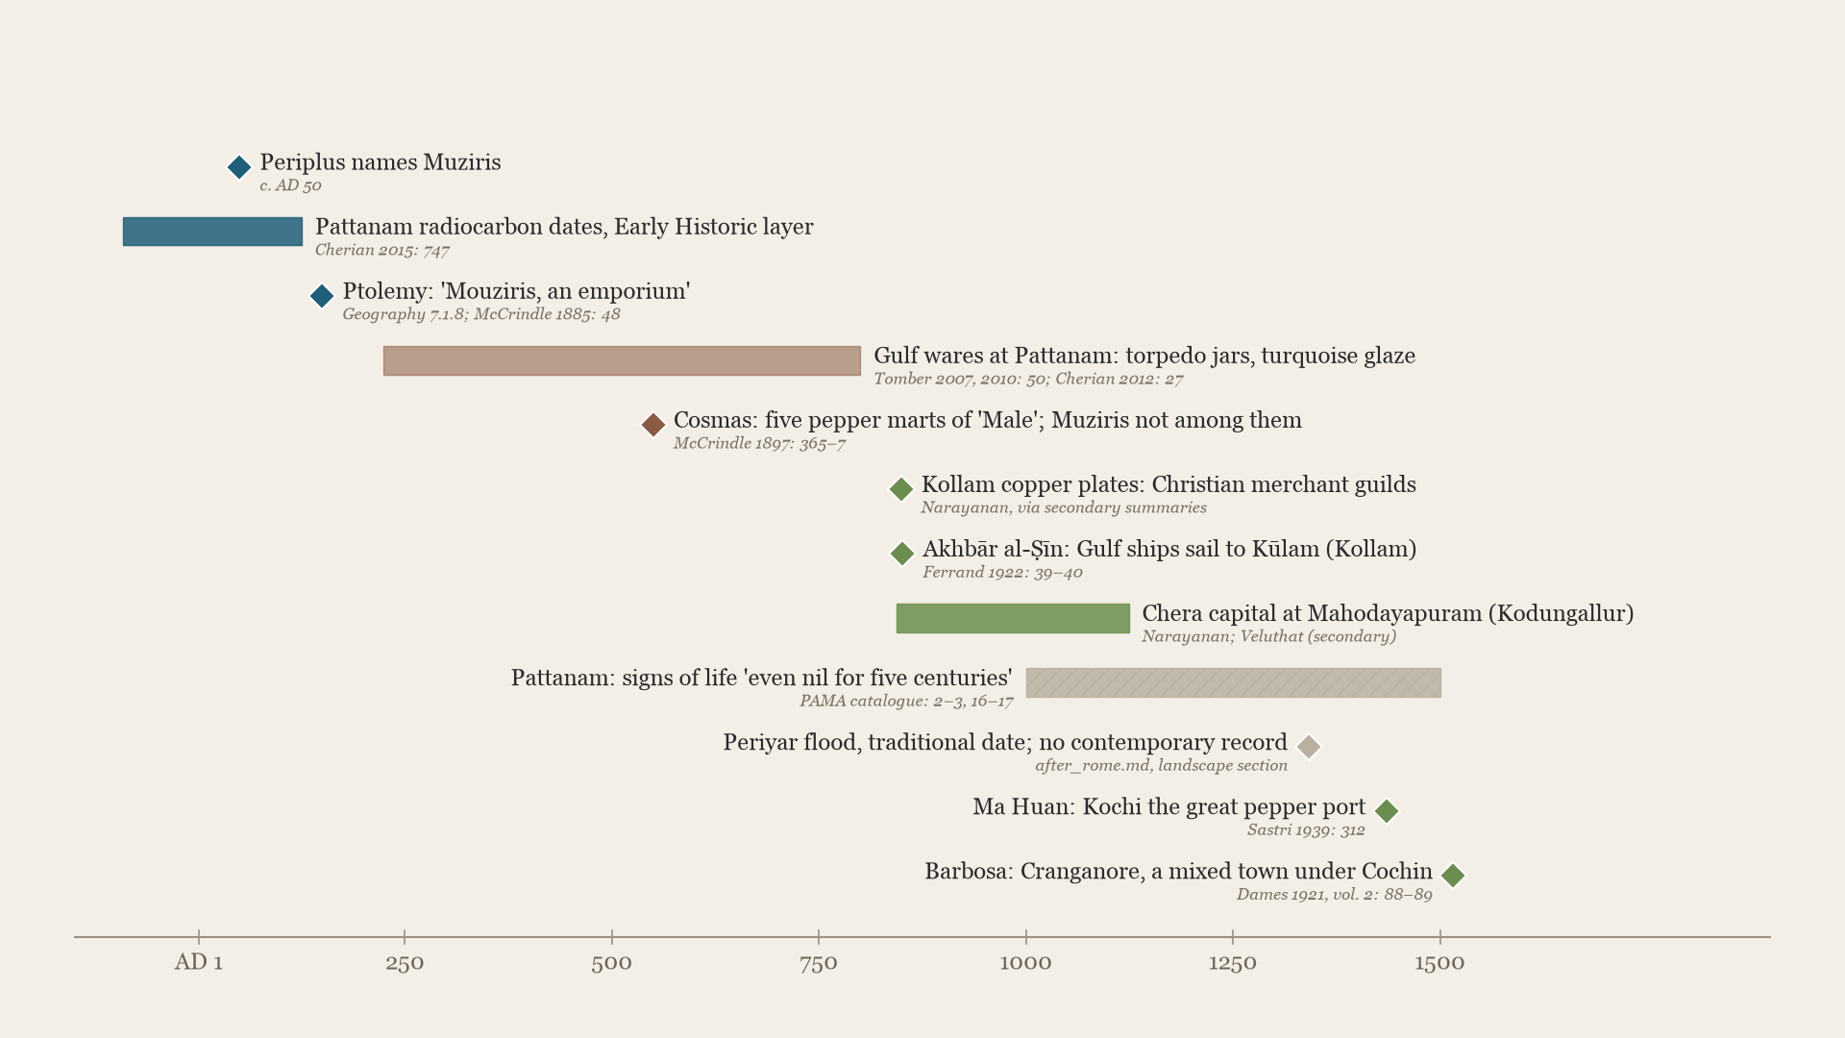
When Roman trade faded, Pattanam turned to the Gulf, and the coast's main port moved to Kollam, Kodungallur and then Kochi
Each item's source is printed beneath it; the copper plates and the Chera dates rest on secondary summaries
42
Notes:
• Roman contact peaks in the 1st century AD.
• Gulf pottery follows, 3rd to 8th centuries. By about 550, Cosmas no longer names Muziris.
• The trade moves: to Kollam (849), the Chera capital at Kodungallur, then Kochi.
• The harbour zone moved rather than died.

Slide 43
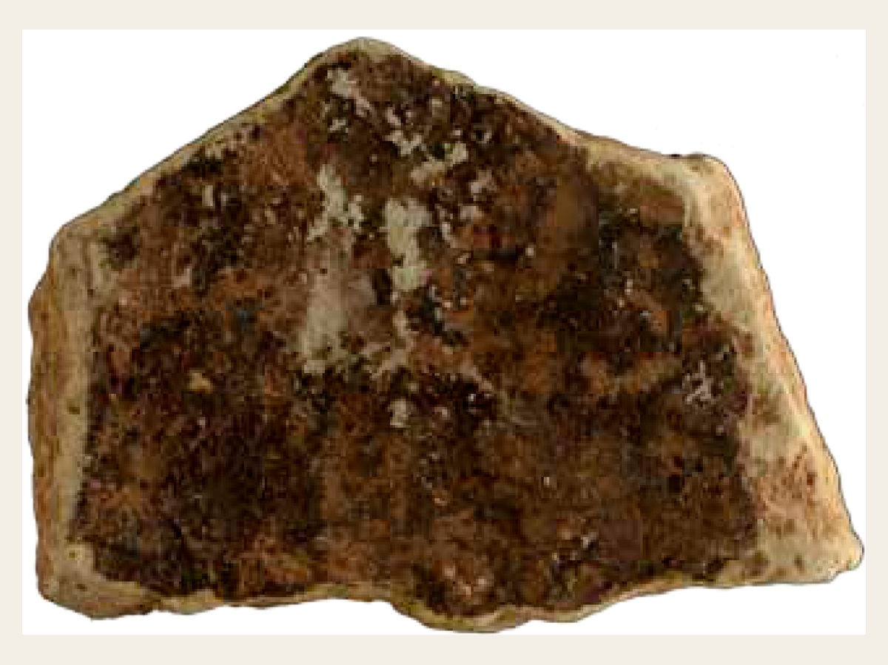
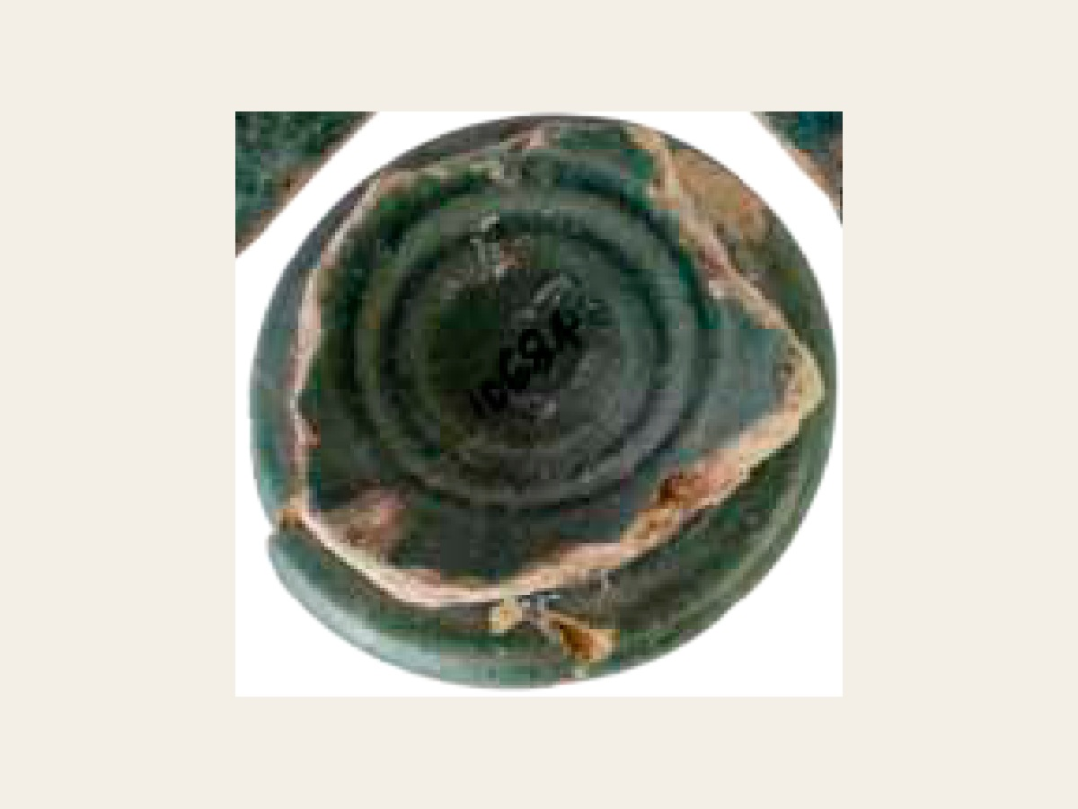
After Rome, Pattanam's foreign pottery comes mostly from the Gulf
Torpedo jar sherd with bitumen lining
Turquoise-glazed ring base
Cherian and Menon (eds), Unearthing Pattanam (National Museum, New Delhi, 2014)
43
Notes:
• Torpedo jars and turquoise-glazed ware: Gulf pottery, mostly after the Roman peak.

Slide 44
What can the landscape and the archaeology of port cities tell us about Indo-Roman trade?
There likely weren’t any natural harbors on the south Indian coast, so large cargo ships had to sit out in open water and wait for smaller ships to ferry all their cargo to shore
  De Romanis argues that hundreds of vessels were employed in unloading the cargo of large ships, which indicates significant logistical capabilities by the locals running the port
  Ships sitting out in open water would have been vulnerable to pirates, which would have made other ports more valuable
Roman traders would linger in the South Indian ports for months, but there’s no definite evidence that they lived there, as opposed to Indian traders who would live in foreign ports
While there’s evidence that South Indian ports engaged in trade both before and after the emergence of the Roman empire in Indian ocean trading networks, I argue that there’s no definitive evidence that South Indians had crossed the Arabian sea before Roman traders reached the south Indian coasts
43

Slide 45
Questions

