Slide 1
Predictive Maintenance of Industrial Machinery
Machine Learning Project
Presented By: Vivek Chauhan
World College of Technology and Management
Artificial Intelligence and Machine Learning

Slide 2
OUTLINE
Problem Statement
Proposed System/Solution
System Development Approach (Technology Used)
Algorithm & Deployment
Result (Output Image)
Conclusion
Future Scope
References

Slide 3
Problem Statement
Example:Unexpected failure of industrial machinery leads to unplanned downtime, costly repairs, and financial losses. Traditional maintenance methods are either schedule-based (which might waste resources) or reactive (after failure). The challenge is to develop a predictive maintenance model that analyzes machinery sensor data and predicts the type of failure (e.g., tool wear, heat dissipation, power failure) before it occurs, enabling proactive action.

Slide 4
Proposed Solution
Goal: Use machine learning to anticipate machinery failures using real-time sensor data.
Approach:
Collect and preprocess historical sensor data from industrial machines.
Train a classification model to identify failure patterns and predict failure types.
Deploy the model using IBM Cloud Lite services for real-time prediction and alerting.
Modules:
Data Collection: Gather sensor data (temperature, vibration, pressure, etc.).
Preprocessing: Clean, handle missing values, and feature engineer the data.
Model Building: Use Random Forest/XGBoost for multiclass classification.
Deployment: Model deployed on IBM Watson Machine Learning via Watson Studio.
Alerts: Trigger proactive maintenance notifications

Slide 5
System Approach
IBM Cloud Lite Services:
IBM Watson Studio (data analysis, model development)
IBM Cloud Object Storage (data storage)
IBM Watson Machine Learning (model deployment)
IBM Cloud services for dashboard/notification (optional)
Libraries Required:
Pandas, NumPy (data processing)
Scikit-learn, XGBoost (machine learning)
Matplotlib/Seaborn (visualizations)
IBM Watson SDKs (cloud integration)
System Requirements:
Internet, modern browser
IBM Cloud Lite account

Slide 6
Algorithm & Deployment
In the Algorithm section, describe the machine learning algorithm chosen for predicting bike counts. Here's an example structure for this section:
Algorithm Selection:
Random Forest Classifier, XGBoost, Logistic Regression.
Random Forest chosen due to its effectiveness in handling multiclass tabular data, and ability to interpret feature importance
Data Input:
Sensor readings (temperature, vibration, voltage, etc.), machine ID, age, failure labels..
Training Process:
Data split into train/test sets.
Data preprocessing: Imputation, scaling, encoding.
Model trained with cross-validation and hyperparameter tuning.
Prediction Process:
Model exported and uploaded to IBM Watson Machine Learning.
Exposed as REST API for real-time predictions on incoming sensor data.

Slide 7
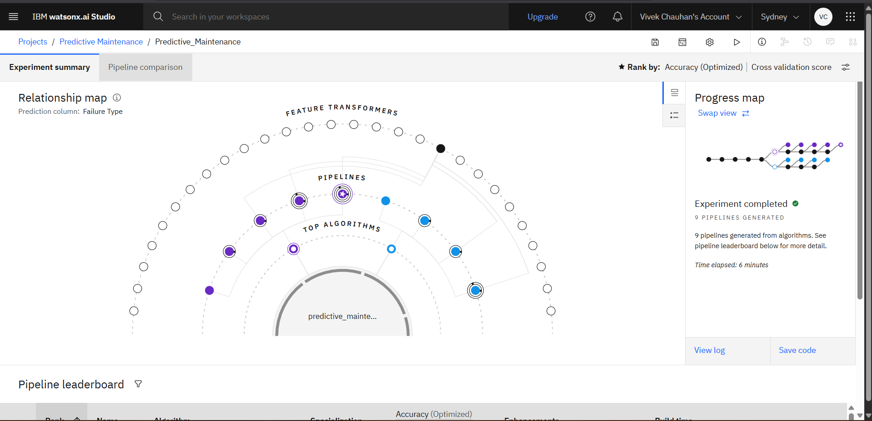
Result
Present the results of the machine learning model in terms of its accuracy and effectiveness in predicting bike counts. Include visualizations and comparisons between predicted and actual counts to highlight the model's performance.

Slide 8
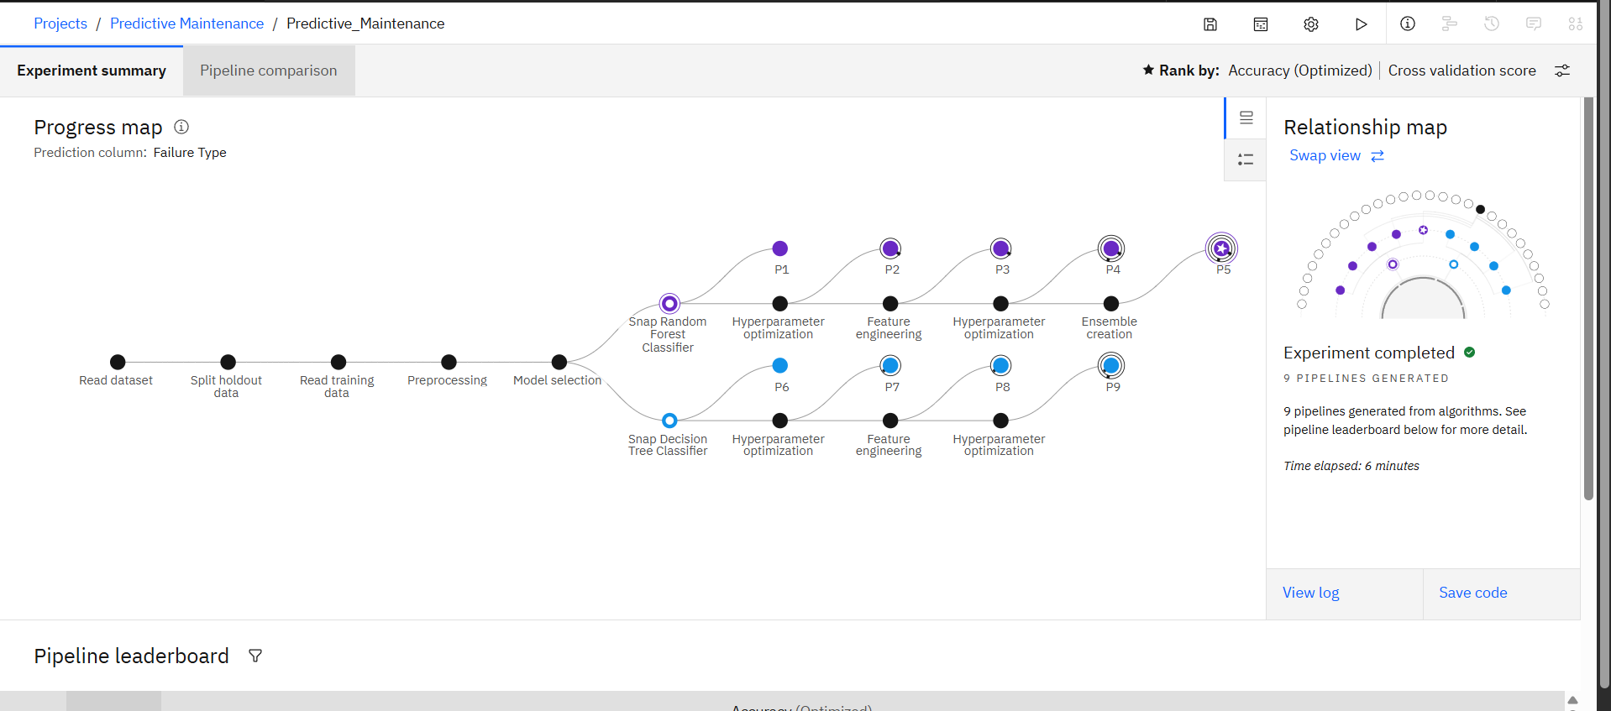
Result
Present the results of the machine learning model in terms of its accuracy and effectiveness in predicting bike counts. Include visualizations and comparisons between predicted and actual counts to highlight the model's performance.

Slide 9
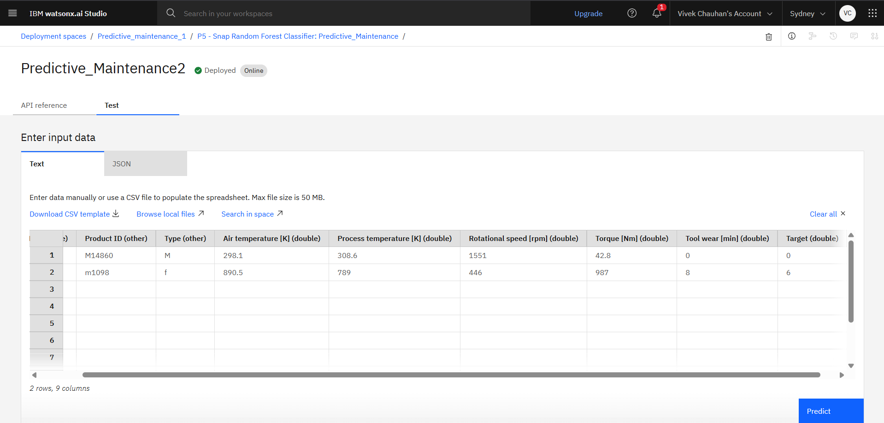
Result
Present the results of the machine learning model in terms of its accuracy and effectiveness in predicting bike counts. Include visualizations and comparisons between predicted and actual counts to highlight the model's performance.

Slide 10
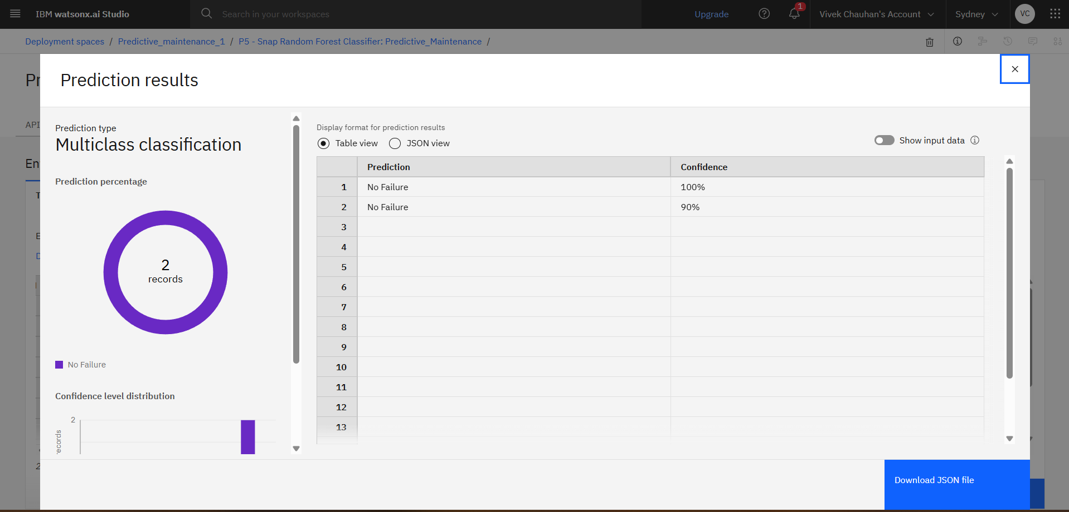
Result
Present the results of the machine learning model in terms of its accuracy and effectiveness in predicting bike counts. Include visualizations and comparisons between predicted and actual counts to highlight the model's performance.

Slide 11
Conclusion
Developed a robust predictive maintenance solution leveraging IBM Cloud and machine learning.
Achieved high accuracy in predicting and classifying failure types.
Enables maintenance teams to act proactively, thereby reducing downtime and cost.
IBM Cloud Lite proved scalable and simple for deployment.

Slide 12
Future scope
Integrate the solution with IoT platforms for seamless real-time data ingestion.
Use advanced models (e.g., LSTM for time series).
Expand to more failure types and equipment.
Add dashboard and mobile app notifications for maintenance staff.

Slide 13
References
Kaggle Predictive Maintenance Dataset
IBM Cloud Documentation
Research papers on predictive maintenance and machine learning in industry

Slide 14
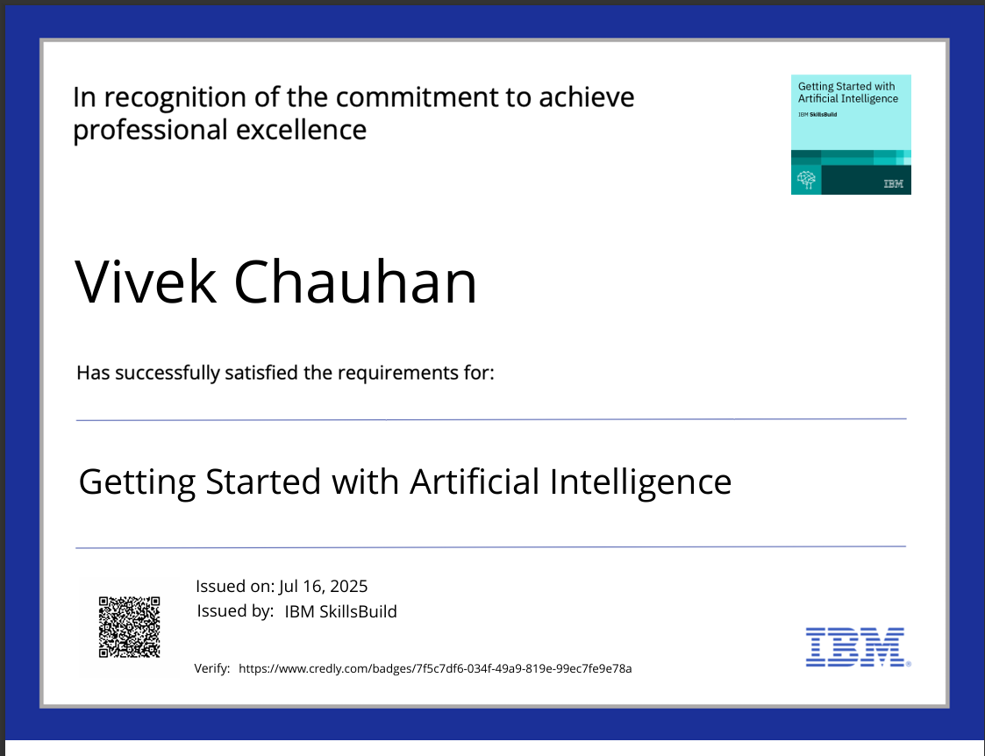
IBM Certifications
Screenshot/ credly certificate( getting started with AI)

Slide 15
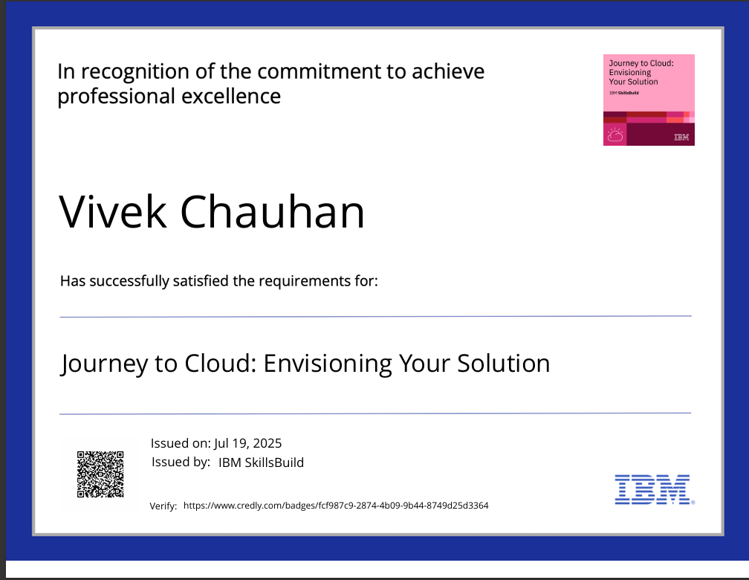
IBM Certifications
Screenshot/ credly certificate( Journey to Cloud)

Slide 16
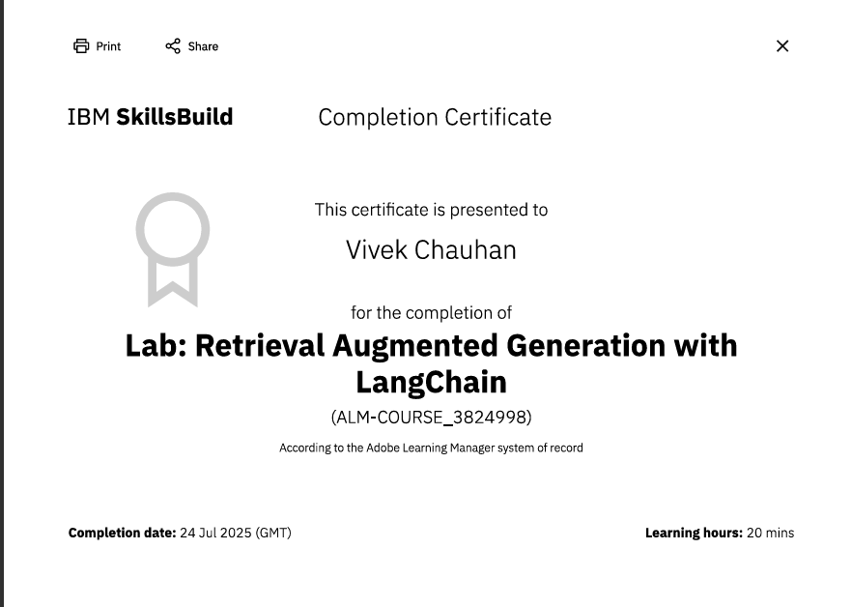
IBM Certifications
Screenshot/ credly certificate( RAG Lab)

Slide 17
THANK YOU

