Slide 1

IOT:SMART UNMANNED BORDER SECURITY SYSTEM
AND APPLICATION IN DEFENCE
UNDER GUIDANCE OF :
MR. SRINIVASULU DAKALA
SUBMITTED BY:
RAVI CHANDRA JHA (06311502815)
SHIVANG PANDEY (07311502815)
VAIBHAV GOEL (08611502815)
VIVEK CHAUHAN (09411502815)

Slide 2
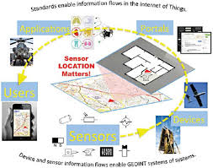
IOT:SMART UNMANNED BORDER SECURITY SYSTEM AND APPLICATION IN DEFENCE
IOT is all about integrating data and providing the controlled autonomity to the independent yet inter connected modules to make decisions based on this data.

Slide 3
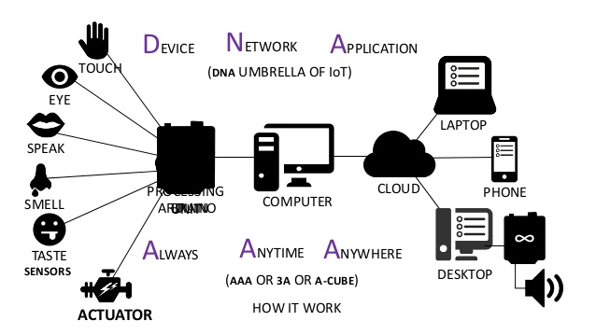
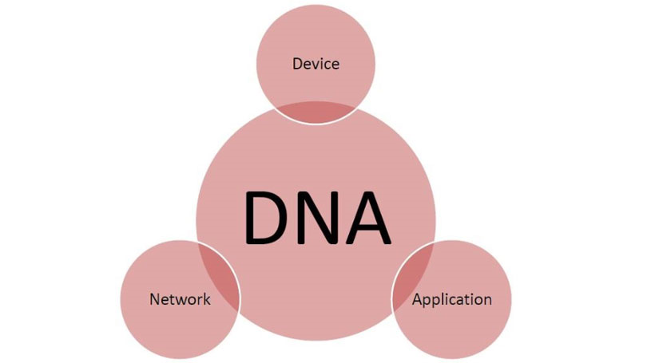
UMBRELLA OF INTERNET OF THINGS AND 3A’S OF IOT

Slide 4
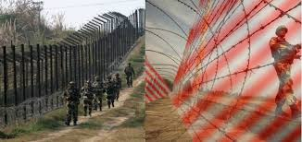
IOT:SMART UNMANNED BORDER SECURITY SYSTEM AND APPLICATION IN DEFENCE
IOT is about providing virtual signature to devices to identify them uniquely in an unstructured or structured system to communicate with each other over a shared set of protocols on an agreed platform to utilize the resources in the best possible way.

Slide 5
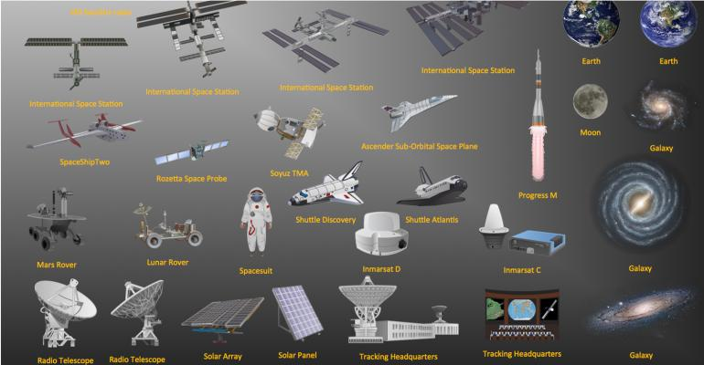
IOT:SMART UNMANNED BORDER SECURITY SYSTEM AND APPLICATION IN DEFENCE

Slide 6
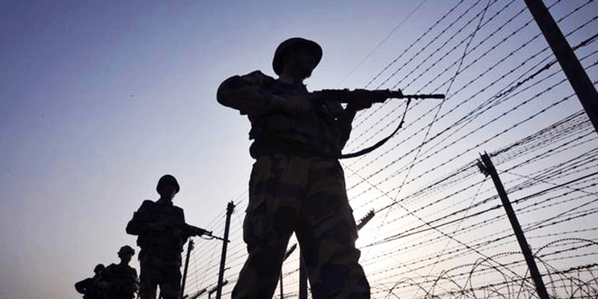
IOT:SMART UNMANNED BORDER SECURITY SYSTEM AND APPLICATION IN DEFENCE
Modern military operations are conducted in a complex, multidimensional, highly dynamic and disruptive environment – sometimes with unanticipated partners and irregular adversaries.

Slide 7
IOT:SMART UNMANNED BORDER SECURITY SYSTEM AND APPLICATION IN DEFENCE
Border Security system Market worth 52.95 Billion USD by 2022
According to the new market research report "Border Security System Market by Environment (Ground, Aerial, Naval), System (Laser, Radar, Camera, Wide Band Wireless Communication, Perimeter Intrusion, Unmanned Vehicles, C2C, Biometric Systems), and Geography - Global Forecast to 2022", the border security system market is expected to grow to USD 52.95 Billion by 2022,

Slide 8
IOT:SMART UNMANNED BORDER SECURITY SYSTEM AND APPLICATION IN DEFENCE
Ground-based systems to hold the largest market share during the forecast period
The major challenges faced by ground border security are conventional international disputes, cross-border infiltration, illegal migration, smuggling, and other forms of criminal activity.
Ground-based border security systems comprise systems such as laser, radar, cameras, perimeter intrusion, unmanned ground vehicles (UGV), communication systems among others.

Slide 9
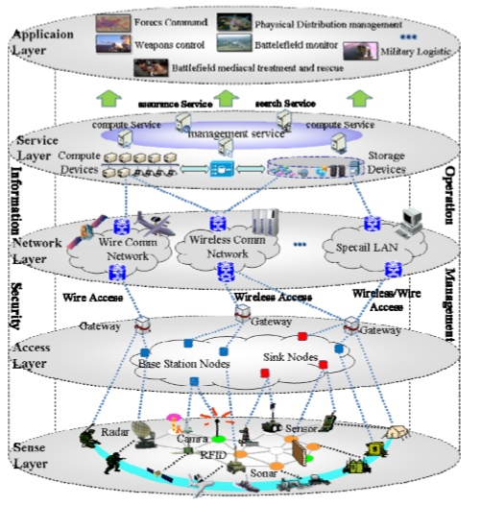
MIOT:APPLICATION MODES
Three modes of MIOT are:
Information sensing
Information transmission
Information Serving

Slide 10
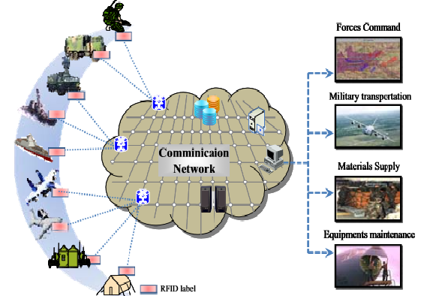
MIOT:ARCHITECTURE
Information based war and Network Centric Warfare(NCW) connect all kind of forces weapon platform.
It implements real time sharing .
It shortens the decision making and command time .

Slide 11
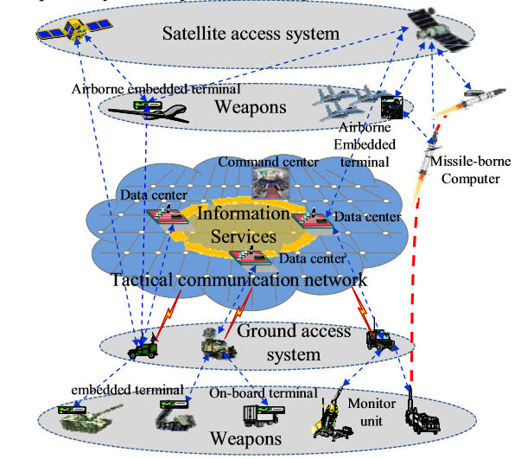
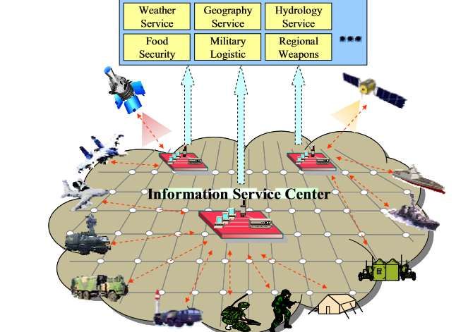
MIOT:ARCHITECTURE

Slide 12
Security and safety risk analysis of IoT ecosystem
Unmanned aerial vehicles (UAV), as well as various generations of self-diving cars are gaining popularity
The security and safety analysis are applied to all four layers of Internet of Things (IoT) architectures which include:
-Sensors and actuators
-Communication
-Data processing
-Applications layer

Slide 13
Sensors and actuators layer
Hardware elements can be accessed or replaced, sensor output biased, which can violate confidentiality, availability and integrity objectives- use tamper-resistant packaging.
Obvious possibility is to relocate the device into a similar environment to which it used to navigate in. The device would get lost an unable to navigate or return to its original position.

Slide 14
Communication layer and application layer
-Communication layer
Easier to perform attack in the communication layer than in the physical layer
Known attack against UAVs is jamming of GNSS signals thereby making navigation impossible
-Application layer
Deals with the navigation tasks and keeps track of previous input and validate new input

Slide 15
Data Processing Layer
Integrate the sensor data and calculate the location of the vehicle
Introduced error by a deceived sensor can easily corrupt the whole localization solution
Kalman filters are used which is very sensitive to the input variations from which the uncertainty is calculated

Slide 16

Integrity Attestation in Military IoT
The presence of a TTP
Community of Trust
Software integrity

Slide 17
INTEGRITY ATTESTATION :
The authorization of the subject in control of the transaction in the other end
The integrity of the equipment used in the transaction
The key management procedures used in the domainThe integrity protection of the transmiited data

Slide 18
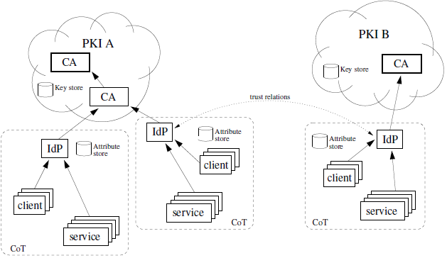
The functional components of the Gismo IdM.

Slide 19
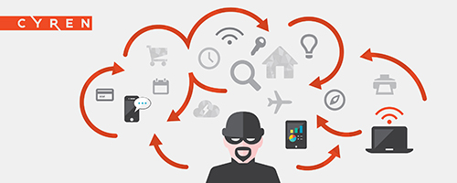
Types of attack from which there will be no
protection:
A physical attack on circuit boards
An unfaithful operator who modifies the software stacks

Slide 20
Realisation of robot for defence application through IOT
Multitasking wireless robot system is very effective in regions where the environment is not good enough for human survival.
This system uses IOT technology for communication.
The whole system can be controlled by a remote.

Slide 21
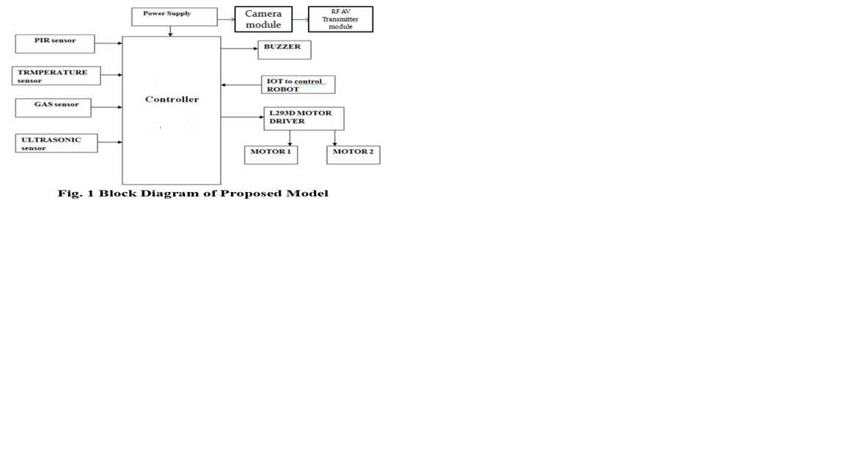
Block diagram of proposed model :

Slide 22
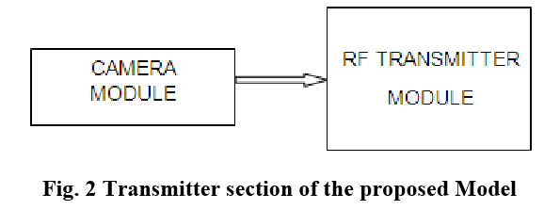
The transmitter section of proposed model having a camera module.

Slide 23
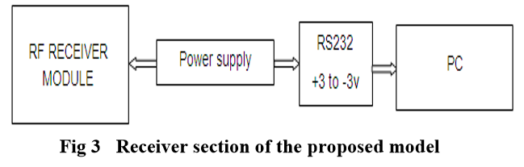
Receiver section of the proposed model

Slide 24
IOT:SMART UNMANNED BORDER SECURITY SYSTEM AND APPLICATION IN DEFENCE
INTRUSION DETECTION SYSTEM & AUTONOMOUS SURVEILLANCE
SUBS is the first line of defence made to act as a force multiplier. It is developed to help you know when someone tries to intrude your jurisdiction.
Enabled with multiple sensors, SUBS is an ideal end to end solution for securing any perimeter from borders to airports.
It allows autonomous vehicles such as drones and rovers to act upon an intrusion alert and provide first response, surveillance, and threat verification capabilities

Slide 25
IOT:SMART UNMANNED BORDER SECURITY SYSTEM AND APPLICATION IN DEFENCE
ENCRYPTED NETWORK & C&C PLATFORM
SECURE is the brain of the SUBS Integrated Security Solution.
All SUBS units at field, which protect the perimeter, are controlled and managed by SECURE.
SECURE keeps the Security Solution Grid intact and runs complex algorithms and artificial intelligence in order to make the security even stronger.

Slide 26
REFERENCES
[1] I. Paliy, V. Turchenko, V. Koval, A. Sachenko, G. Markowasky, “”, Proc. IEEE International Joint Conference Neural Network, vol. 4, pp. 2965-2970, 2016-Jul.
[2] Jaehak Byun, Sooyeop Kim, Sangphil Kim, “Smart City Implementation Models Based on IoT Technology”, IEEE Journal on Networking, Communication and Processing, pp. 2019-212, 2015.
[3] ] F. A. Ian and M. J. Josep, “The Internet of NANO-THINGS,” IEEE Wireless Communications, 2010, pp. 58-64.
[4] M. Micheal and M. Darianian, “Architectural solutions for mobile RFID services for the internet of things,” IEEE Congress on ServicesPart 1, 2008, pp. 71-74. [9] D. Wobschall D, “Networked Sensor Monitoring Using the Universal IEEE 1451 Standard,” IEEE Instrumentation & Measurement Magazine, vol. 11, no. 2, 2008, pp. 18-22.
[5] H Jiang, E Learned Miller, “Automatic Image Detection and Recognition,” (FG 2017), IEEE 12th International Conference on Image Processing, pp. 650-657, 2017.

Slide 27
IOT:SMART UNMANNED BORDER SECURITY SYSTEM AND APPLICATION IN DEFENCE
THANK YOU!!

