Slide 1


SMART INDIA HACKATHON 2026
Basic Details of the Team and
Problem Statement
Problem Statement ID – SIH26082
Problem Statement Title- Air Pollution–Weather Coupled
Forecasting System (Delhi NCR Focus)
Theme- Disaster Management
PS Category- Software
Team ID-
Team Name (Registered on portal)- atom(x)

Slide 2
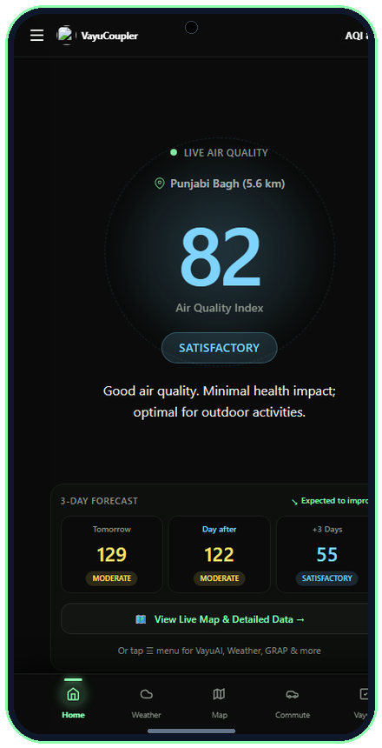
atom(x)
Real-Time Air Quality Explorer with Maps & AI
❖ Unique Idea/Solution:
Our solution leverages atmospheric physics-coupled forecasting, structured databases, and interactive dashboards to enable natural language querying, exploration, and visualization of coupled air quality and meteorology data, democratizing access for researchers, policymakers, students, and non-technical users.
Conversational Access
First-of-its-kind chatbot interface for Delhi NCR air quality, allowing users to ask questions in natural language (no coding/WRF expertise needed) on Past Data & Latest Data.
Integrated Geospatial Maps
Users can explore 16 Delhi NCR monitoring stations on an interactive map and directly query data, animated wind streamlines, and stubble fire clusters from specific regions.
Hybrid Query & Physics System
Combines structured sensor feeds with atmospheric physics equations (Ventilation Index, Inversion Factor K_trap) and Fine-Tuned LLM-driven interpretation using RAG + MCP.
Atmospheric Ambient Halo AQI
Cockpit with 3-Day Forecast Strip
Google Weather-Style Live
Microclimate Telemetry Engine
Interactive Spatial GIS Grid with
40+ CPCB CAAQMS Stations
6-Pollutant Real-Time Telemetry:
PM2.5, PM10, NO2, SO2, CO, O3
Safe Commute Clean Route Navigator
Cutting 35%–48% Inhaled PM2.5
Conversational VayuAI Assistant
for Instant Plain-Language Advice
❖ OUR PROTOTYPE UI - LINK
❖ OUR Repository - LINK
❖ Prototype Status:
100% Prototype completed; live multi-platform suite (Vercel Web App, Windows Offline App, and Android APK built).
@SIH Idea submission- Template
2

Slide 3
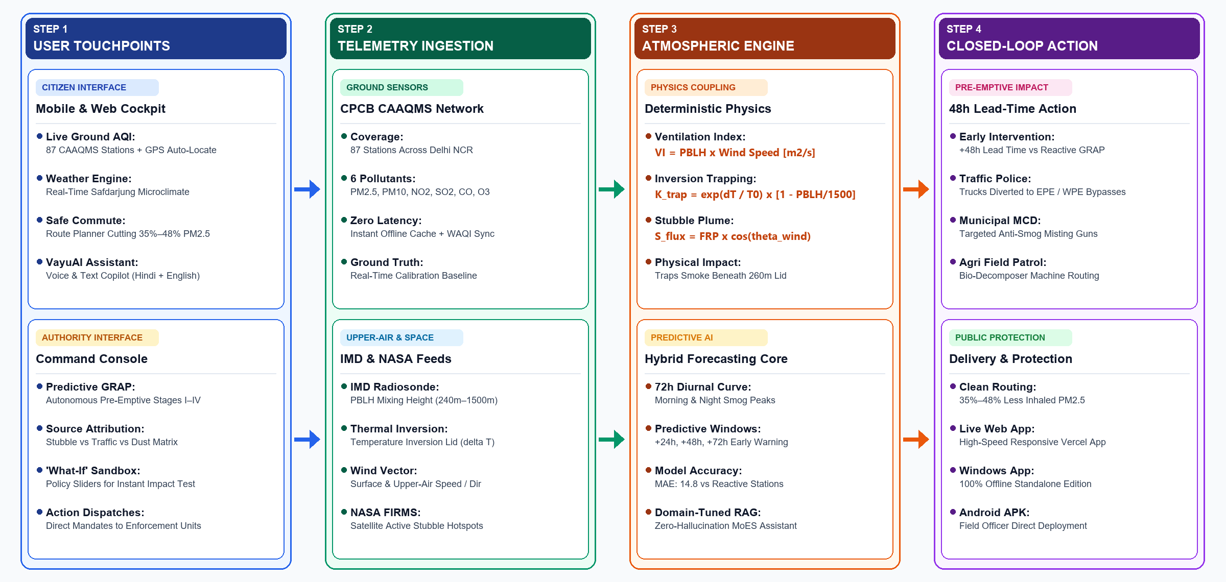
atom(x)
TECHNICAL APPROACH & APP INTERACTION MODEL
@SIH Idea submission- Template
3

Slide 4
atom(x)
FEASIBILITY AND VIABILITY
❖ Feasibility:
This project is technically feasible as it leverages existing AI/ML, atmospheric dispersion physics, and verified open geospatial datasets. CPCB ground telemetry, IMD meteorological soundings, and NASA FIRMS satellite feeds are publicly accessible, and with structured conversion plus cloud deployment, the system can scale to handle large volumes of environmental data. The integration of LLMs with geospatial dashboards and physics equations ensures both usability and accuracy, making the solution practical for researchers, policymakers, and educators.
❖ Potential challenges and risks:
➤ Query Accuracy: LLM may misinterpret complex atmospheric queries → Mitigation: Fine-tuning + RAG with domain-specific meteorological metadata.
➤ Data Quality & Coverage: Heavy cloud cover or limited sensors in certain sub-districts → Mitigation: Data augmentation + integration with satellite AOD & neighboring stations.
➤ Computational Demand: Real-time spatial-temporal dispersion maps require high resources → Mitigation: Scalable cloud deployment + vectorized NumPy/Scipy physics modules.
➤ Multi-Agency Latency: Bureaucratic delay between forecast and enforcement → Mitigation: Automated role-specific pre-drafted dispatch work orders for CAQM & MCD.
❖ Strategies for Overcoming These
Challenges:
➤ RAG + Fine-Tuning: Improve query accuracy with domain-specific atmospheric embeddings, prompt guardrails, and physics transfer learning.
➤ Data Optimization: Use Parquet, compact JSON, and compressed indexed local storage for handling large spatial-temporal datasets at sub-second speed.
➤ Efficient Visualization: Use optimized libraries (Leaflet, Canvas, SVG overlays) for smooth 60fps real-time map rendering.
➤ Multi-Source Integration: Combine CPCB ground monitors with IMD boundary layer meteorology, NASA FIRMS fire satellites, and wind streamlines to fill coverage gaps.
@SIH Idea submission- Template
4

Slide 5
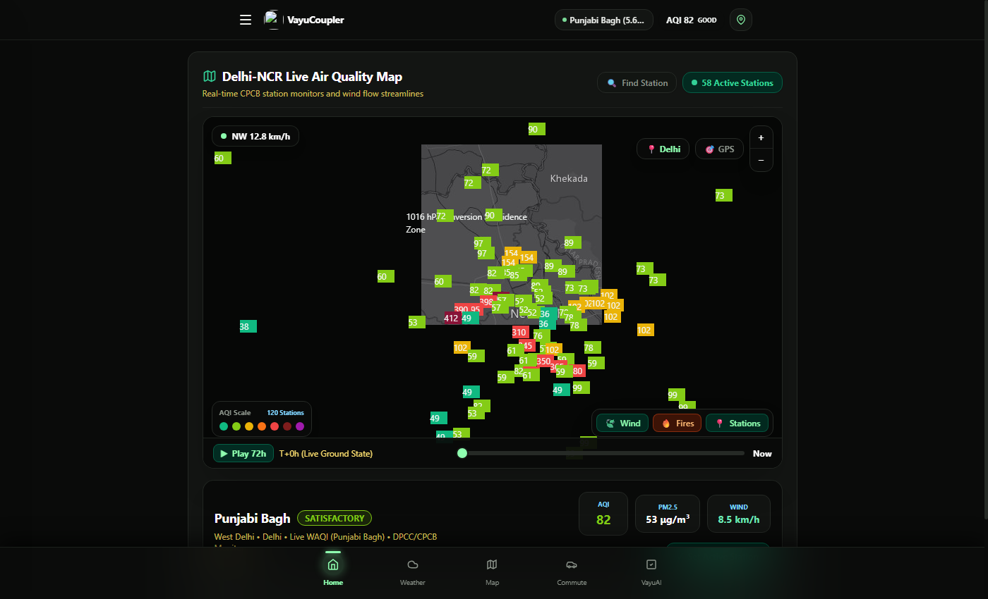
atom(x)
IMPACT AND BENEFITS
❖ Potential Impact on the Target Audience:
The solution makes air pollution data more accessible for researchers, provides policymakers with reliable predictive insights for planning, supports educators and students in learning, helps municipal & health sectors with proactive pre-emptive monitoring, and aids environmental governance groups in coordinated crisis mitigation.
❖ Benefits of the solution:
➤ Social: Democratizes access to air quality data for non-technical users, Enhances public awareness, and protects 30M+ citizens via 48h advance health advisories.
➤ Economic: Prevents chaotic sudden shutdowns of construction & freight logistics, Enables planned bypasses via EPE/WPE, and Reduces institutional costs of emergency data analysis.
➤ Environmental: Improves monitoring of atmospheric boundary layer health and smog indicators, Maximizes anti-smog gun impact before dispersion collapses, and Facilitates early detection of transboundary smoke incursions.
Air Pollution Observation Network
@SIH Idea submission- Template
5

Slide 6
atom(x)
RESEARCH AND REFERENCES
1. SAFAR: Air Quality and Weather Forecasting And Research Authors: Gufran Beig, S. Parkhi, et al. (2015) Summary: Introduces SAFAR-Delhi, the foundational operational framework for coupling meteorological boundary layer dynamics with Eulerian chemical transport models over the National Capital Region. Evaluates boundary layer ventilation coefficients and transboundary dispersion pathways.
2. NASA FIRMS: Active Fire Detection & Transboundary Smoke Attribution Authors: Wilfrid Schroeder, Louis Giglio, et al. (2014) Summary: Validates 375m VIIRS and MODIS satellite thermal anomaly detection for biomass burning, agricultural stubble fires, and real-time transboundary plume transport tracking across South Asia. Demonstrates robust spatial correlation with downwind particulate matter spikes.
3. Graded Response Action Plan (GRAP) Guidelines Authors: Commission for Air Quality Management in NCR & Adjoining Areas (CAQM, 2023) Summary: Official statutory emergency response protocol defining Stage I to Stage IV mitigation actions based on AQI thresholds and meteorological dispersion indices. Provides the baseline rulebook that VayuCoupler transforms from reactive to predictive enforcement.
4. Atmospheric Boundary Layer Dynamics & Inversion Trapping Authors: Roland B. Stull (1988/2021) Summary: Mathematical formulation of Planetary Boundary Layer Height (PBLH), nocturnal thermal inversion capping, and the Ventilation Index (VI = Wind Speed × PBLH) governing basin trapping. Provides the verified physical equations powering VayuCoupler's deterministic coupling engine.
@SIH Idea submission- Template
6

