Slide 1
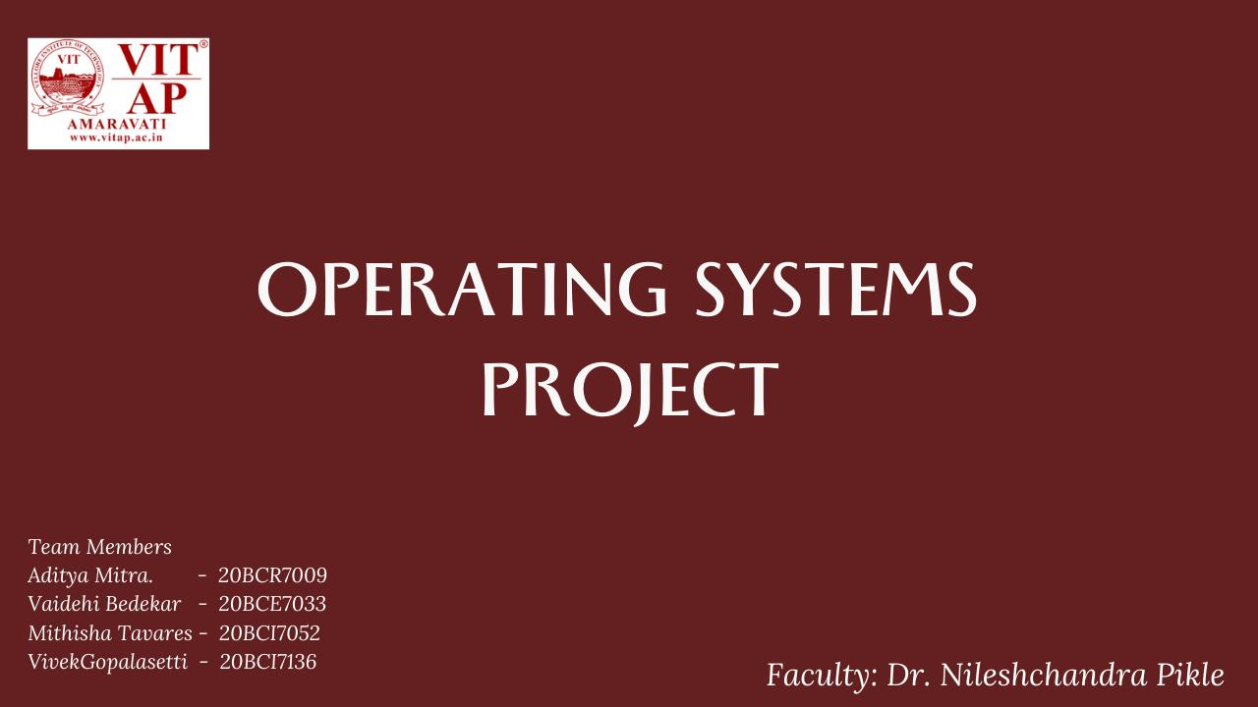

Slide 2
Project Titles
Linux Commands
Process Management
Process scheduling
Disk Scheduling

Slide 3
Project Link
http://adityamitra5102.github.io/OSLab

Slide 4
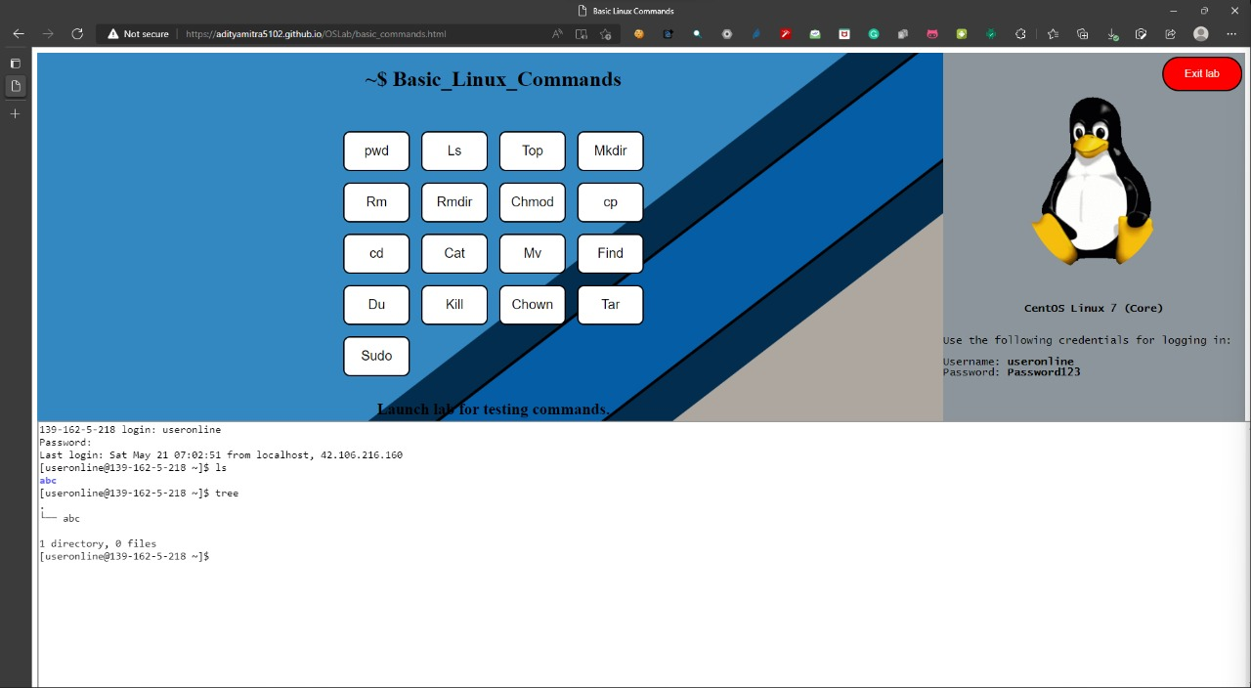
Basic Linux Commands

Slide 5
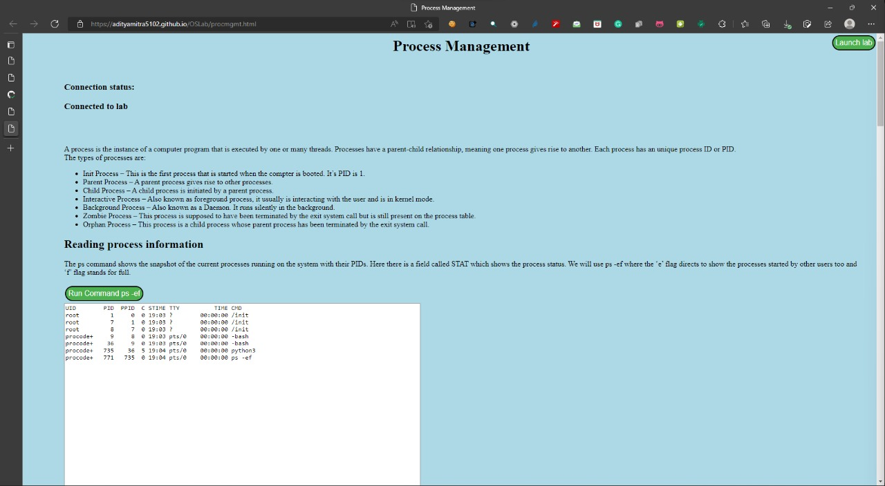
Process Management

Slide 6
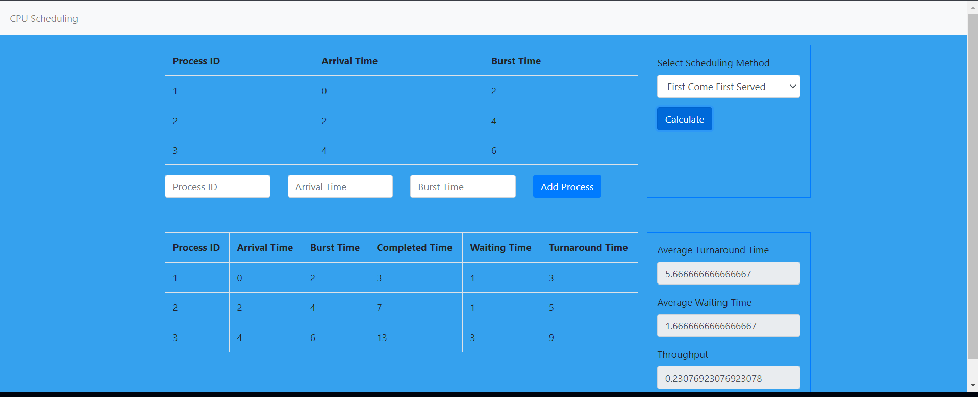
Process scheduling

Slide 7
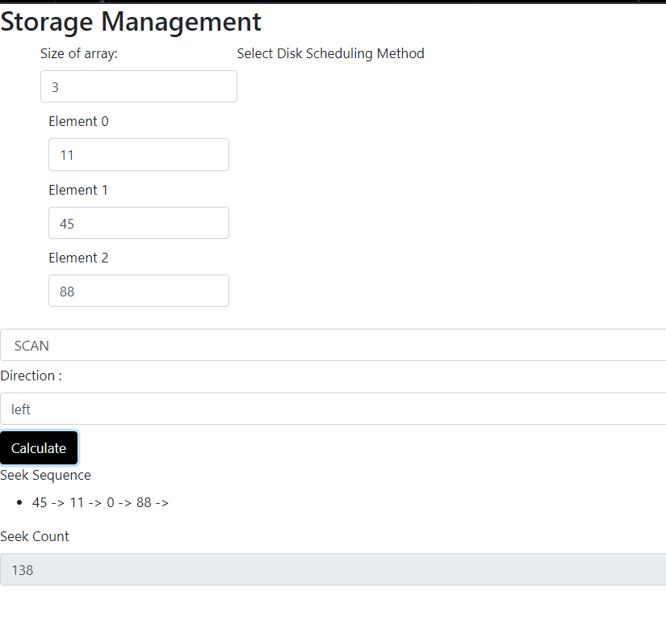
Disk Scheduling

