Slide 1

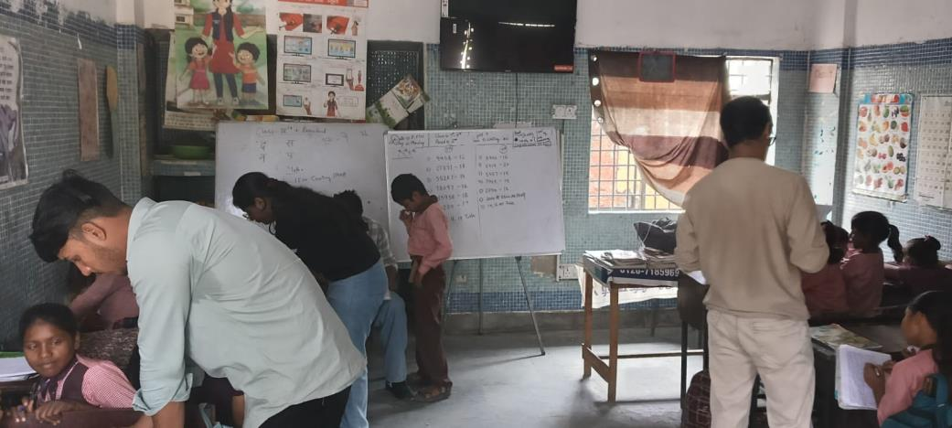
IILM UNIVERSITY, GREATER NOIDA
School of Computer Science and Engineering
AN INTERNSHIP REPORT
Community Teaching &
Social Outreach Programme
Whiteboard teaching session at the centre
STUDENT NAME
ENROLLMENT NUMBER
Vivek Kumar
25SCS1003004939
PROGRAM & SEMESTER
B.Tech CSE (AI/ML) — in collaboration with IBM
ORGANIZATION
Mahila SewaShakti Foundation

Slide 2
PROJECT DESCRIPTION · 4.1
Introduction
This report presents a detailed account of the social internship undertaken with Mahila SewaShakti Foundation, as part of the B.Tech (CSE) requirement at IILM University, Greater Noida.
Unlike a conventional technical internship, this was a group social internship in which the team taught students of Classes 1st, 3rd and 5th — strengthening their academic foundation while building communication, patience, teamwork and social responsibility.
4
2 hrs
3
Weekly sessions
Per session
Classes taught (I, III, V)
Whiteboard teaching session, Class III & V remedial batch
Community Teaching & Social Outreach Programme
2

Slide 3
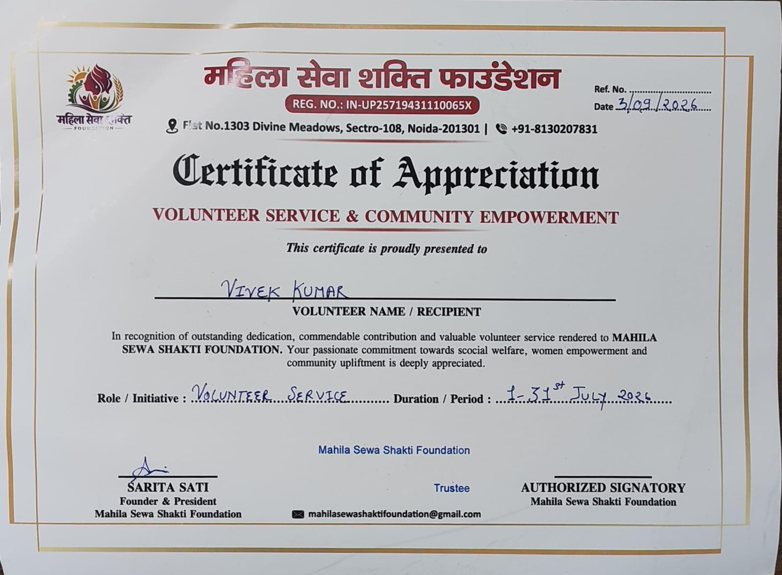
PROJECT DESCRIPTION · 4.2
Organization Profile
Mahila SewaShakti Foundation
A non-governmental organization (NGO) working towards the welfare, empowerment and education of underprivileged communities, with a special focus on women and children.
As part of its education-support initiatives, the foundation runs a learning centre for students from nearby areas who lack access to consistent quality schooling. It depends on student volunteers and interns to conduct remedial classes, mentor children, and bridge learning gaps.
Registered NGO · Noida, Uttar Pradesh · Focus: Women & Child Education
Certificate of Appreciation, awarded to Vivek Kumar for volunteer service (1–31 July 2026)
Community Teaching & Social Outreach Programme
3

Slide 4
PROJECT DESCRIPTION · 4.3
Problem Statement
A large number of children at the foundation's centre come from economically weaker backgrounds and lack consistent schooling, guidance, or academic support at home — leaving many students behind the learning level expected for their class.
The internship was designed to address this gap through:
Focused Remedial Teaching
Identifying Struggling Learners
Bridging the Learning Gap
Small-group instruction for students of Classes 1st, 3rd and 5th.
Locating and supporting the students who had fallen furthest behind.
Providing structured, consistent academic support otherwise unavailable.
Community Teaching & Social Outreach Programme
4

Slide 5
PROJECT DESCRIPTION · 4.4
Objectives of the Internship
1
Conduct engaging and effective teaching sessions for students of Classes 1st, 3rd and 5th
2
Assess the existing academic level of each student and identify learning gaps
3
Help students improve basic reading, writing, and mathematical skills
4
Build confidence among students and encourage active participation
5
Work collaboratively as a group of interns under the NGO mentor's guidance
6
Develop soft skills — patience, communication, empathy and responsibility
Community Teaching & Social Outreach Programme
5

Slide 6
PROJECT DESCRIPTION · 4.5
Scope of the Internship
The scope of this internship was limited to conducting in-person teaching sessions at the Mahila SewaShakti Foundation centre, once every week on Mondays, for two hours per session, spread across one month.
LOCATION
Mahila SewaShakti Foundation centre, in-person
FREQUENCY
Sessions covered foundational subjects including Mathematics (counting, tables, multiplication and division) and language skills — tailored to each student's individual learning level rather than a fixed curriculum.
Weekly, every Monday
DURATION
2 hours per session, 1 month
SUBJECTS
Mathematics & Language skills
Community Teaching & Social Outreach Programme
6

Slide 7
PROJECT DESCRIPTION · 4.6
Teaching Methodology & Activities
A hands-on, student-centric approach: each session began with a quick recap of the prior week, followed by focused teaching, one-on-one doubt-clearing, and group activities. Interns split up to cover smaller groups so no child was left behind.
01
02
03
04
Recap
›
Focused Teaching
›
Doubt Clearing
›
Practice on Board
Quick assessment of what students remembered from the previous week.
Whiteboard instruction split by class and learning level.
One-on-one attention for students who needed extra support.
Students solved problems themselves to build confidence.
Topics: number counting · multiplication tables · basic division & word problems · language and reading practice
Community Teaching & Social Outreach Programme
7

Slide 8
PROJECT DESCRIPTION · 4.7
Observations
A striking finding was the wide variation in academic level even within the same class — some students grasped concepts beyond their grade, while certain Class 5th students were unfamiliar with basic Class 1st-level counting and reading.
“
Patience and consistent encouragement can make a visible difference in a student's willingness to learn.
This gap highlighted real, on-ground challenges faced by underprivileged students without consistent access to quality education — reinforcing the importance of individualized attention over a one-size-fits-all method. Shy students grew steadily more participative as sessions progressed.
Community Teaching & Social Outreach Programme
8

Slide 9
PROJECT DESCRIPTION · 4.8
Session-wise Schedule
Session | Class Group | Focus Area / Activity
Session 1 (Week 1) | Class III – Remedial Introduction | Assessment of existing reading, writing and number skills; basic counting and place value (1000–1500 range).
Session 2 (Week 2) | Class III & V – Combined Remedial Teaching | Mental maths practice (multiplication and division problems); Hindi reading.
Session 3 (Week 3) | Class I, III & V – Group Teaching | Table learning (14–19); basic division and multiplication word problems; handwriting practice.
Session 4 (Week 4) | Class I, III & V – Review & Consolidation | Recap of topics; one-on-one doubt clearing; encouraging weaker students; small oral tests.
Community Teaching & Social Outreach Programme
9

Slide 10
PROJECT DESCRIPTION · 4.9
Learning Outcomes
Gained practical, hands-on experience teaching and mentoring children from underprivileged backgrounds
LASTING IMPACT
Watching the children slowly improve, gain confidence, and enjoy learning was an extremely satisfying experience — a deep sense of purpose in knowing that even a month's effort could make a small but meaningful difference.
Learned to identify and adapt to different learning levels within the same group of students
Developed patience, empathy, and effective communication through direct interaction with children
Understood the value of teamwork by coordinating with fellow interns
Experienced satisfaction, joy and personal fulfilment through teaching and contributing to students' education
Community Teaching & Social Outreach Programme
10

Slide 11
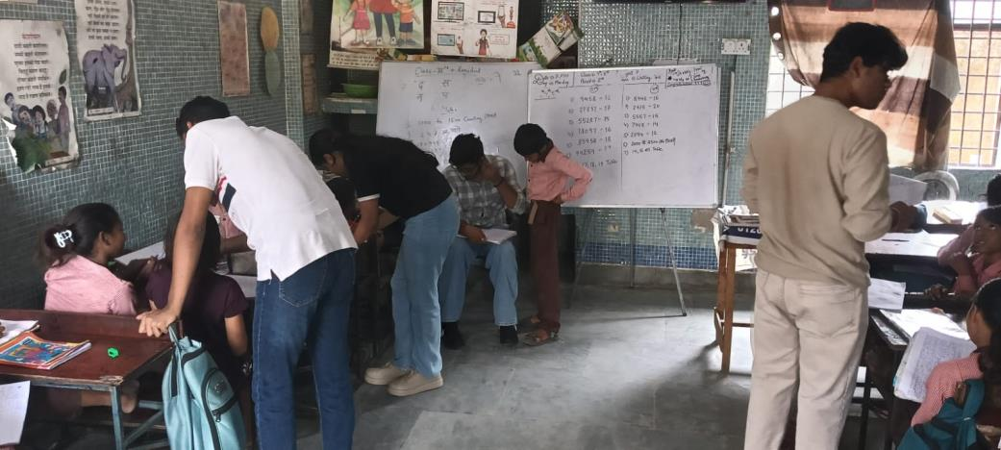
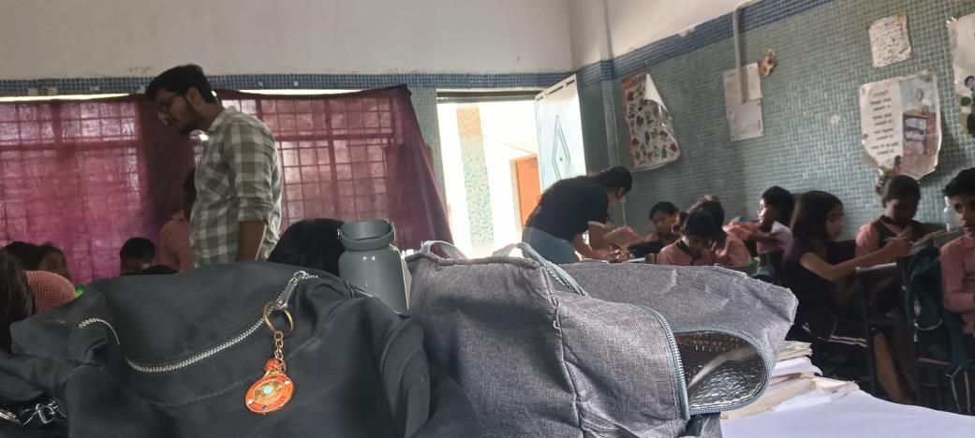
PROJECT DESCRIPTION · 4.10
Photographs of the Internship Activity
An intern helping students with their classwork
Group members teaching students at the Mahila SewaShakti Foundation centre
Community Teaching & Social Outreach Programme
Whiteboard session for Class III & V remedial batch
11

Slide 12
CONCLUSION
A truly enriching and
eye-opening experience
Working as a group to teach students of Classes 1st, 3rd and 5th allowed us to step outside the conventional technical scope of our degree and contribute meaningfully to society. It taught us that education is not just about delivering a fixed curriculum, but understanding each student's individual needs and helping them grow at their own pace.
Sincere thanks to Ms. Sarita, our NGO mentor, for her constant guidance and for the opportunity to be part of this joyful, rewarding experience — leaving a deeper sense of social responsibility and appreciation for the effort behind shaping young minds.
Community Teaching & Social Outreach Programme
12

