Slide 1
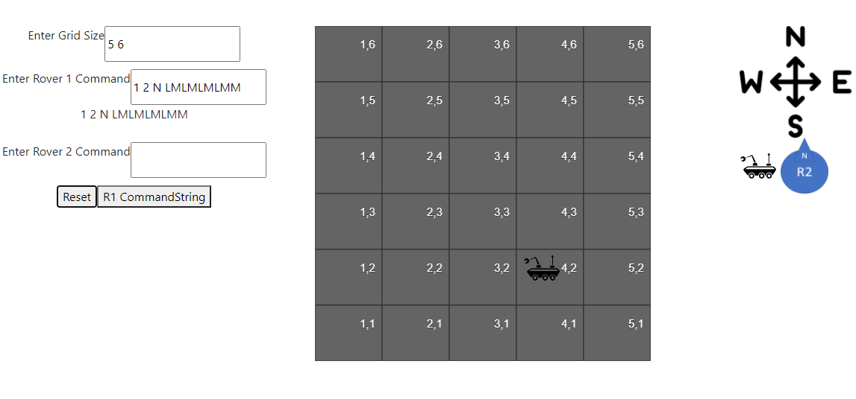
If L
Direction = N->W
If M
X = X – gw

