Slide 1

Customer shopping behavior is broad, loyal, and under-subscribed
A leadership readout from 3,900 purchases.

Slide 2
The dataset is large enough to reveal patterns, not just anecdotes
3,900
$59.76
3.75
1
2
3
purchases across 18 fields
average purchase
average review
37
4
review ratings imputed by product-category median

Slide 3
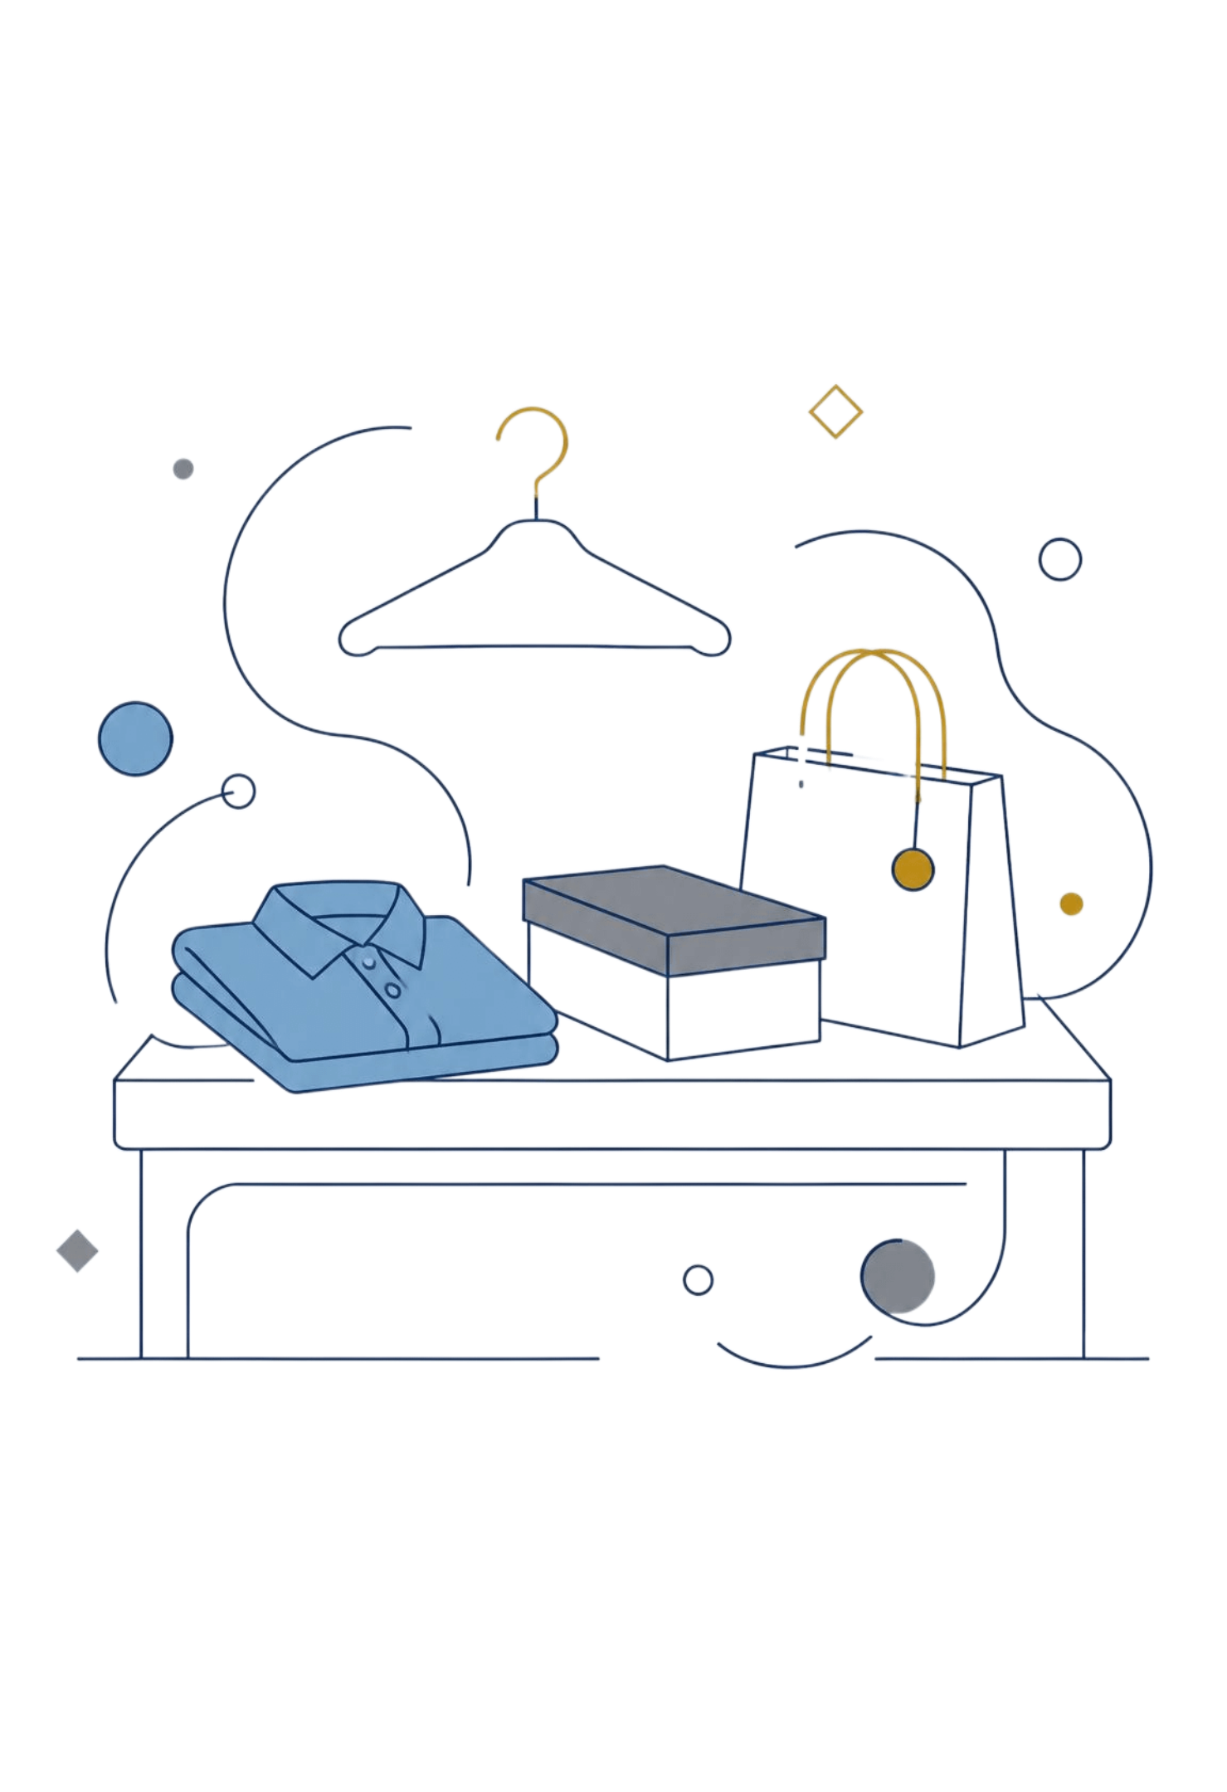
Part 1
Where the money comes from
Category mix and customer composition shape the opportunity.

Slide 4
Clothing is the commercial center of gravity
Next in the mix
Accessories
Footwear
Outerwear
#1
Clothing
Leads both revenue and sales.
Category ranking shown from the report; dashboard bar readings are approximate where exact values are not available.

Slide 5
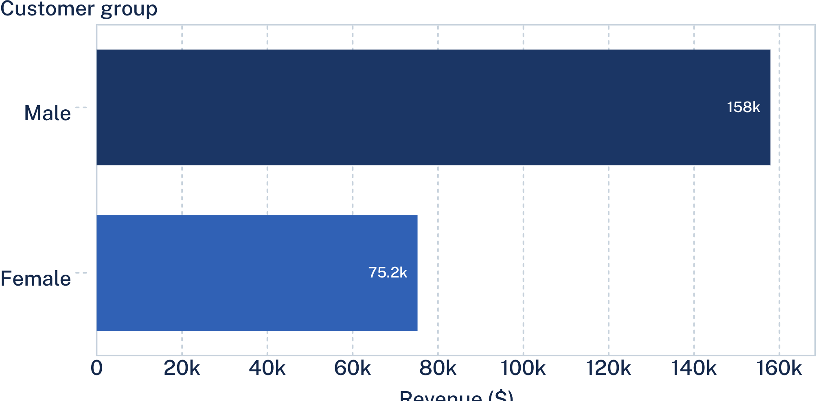
Revenue follows the customer base
$157,890 vs. $75,191
Male customers generated more revenue than female customers in this dataset.
Revenue contribution in the analyzed transactions.
Revenue contribution, not a measure of customer value or profitability.

Slide 6
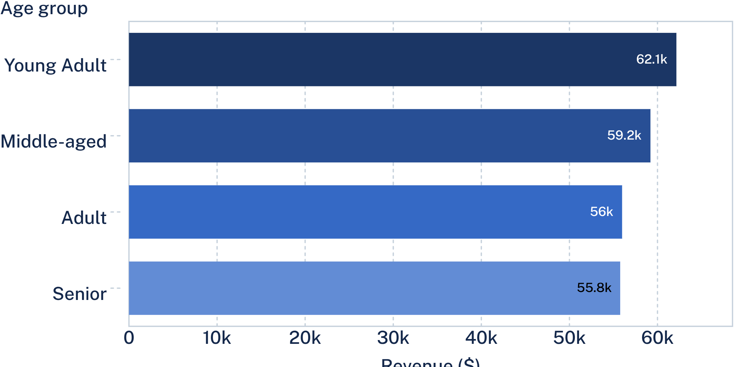
Young adults contribute the most revenue, but no age group dominates
$62,143
Young Adult revenue
Adult: $55,978
Senior: $55,763

Slide 7

Part 2
What keeps customers coming back
The strongest signal is frequency, not ticket size.

Slide 8
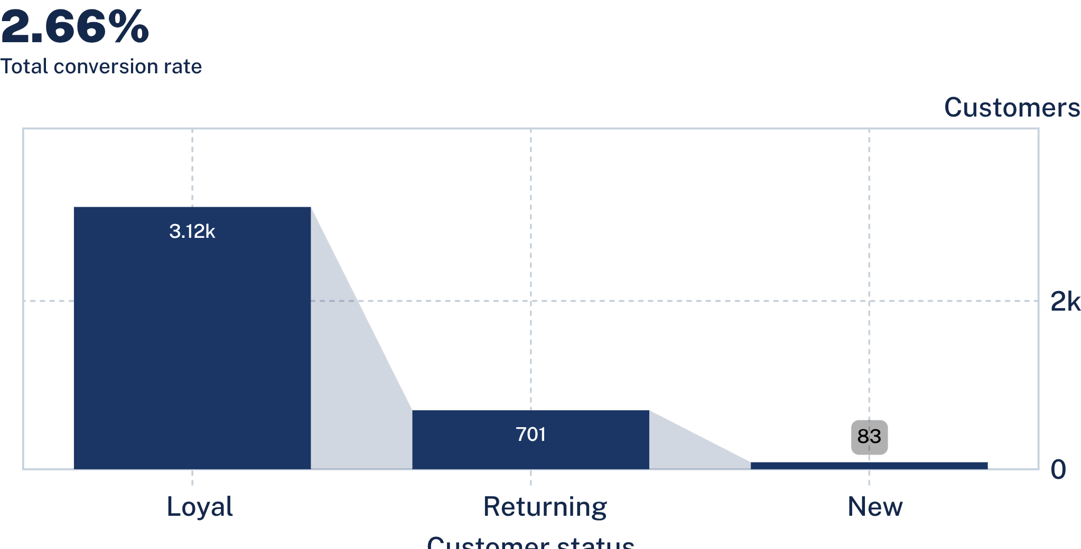
The customer base is already heavily loyal
3,116
Loyal customers
701 Returning
83 New
Retention funnel from the analyzed customer base.
The largest pool is loyal; the new-customer pool is comparatively small.

Slide 9
Subscription is a retention lever, not a higher-spend lever
$59.49
$59.87
Average subscriber purchase
Average non-subscriber purchase
73% non-subscribed
27% subscribed
Sell convenience, benefits, and continuity — not a promise of a larger basket.

Slide 10
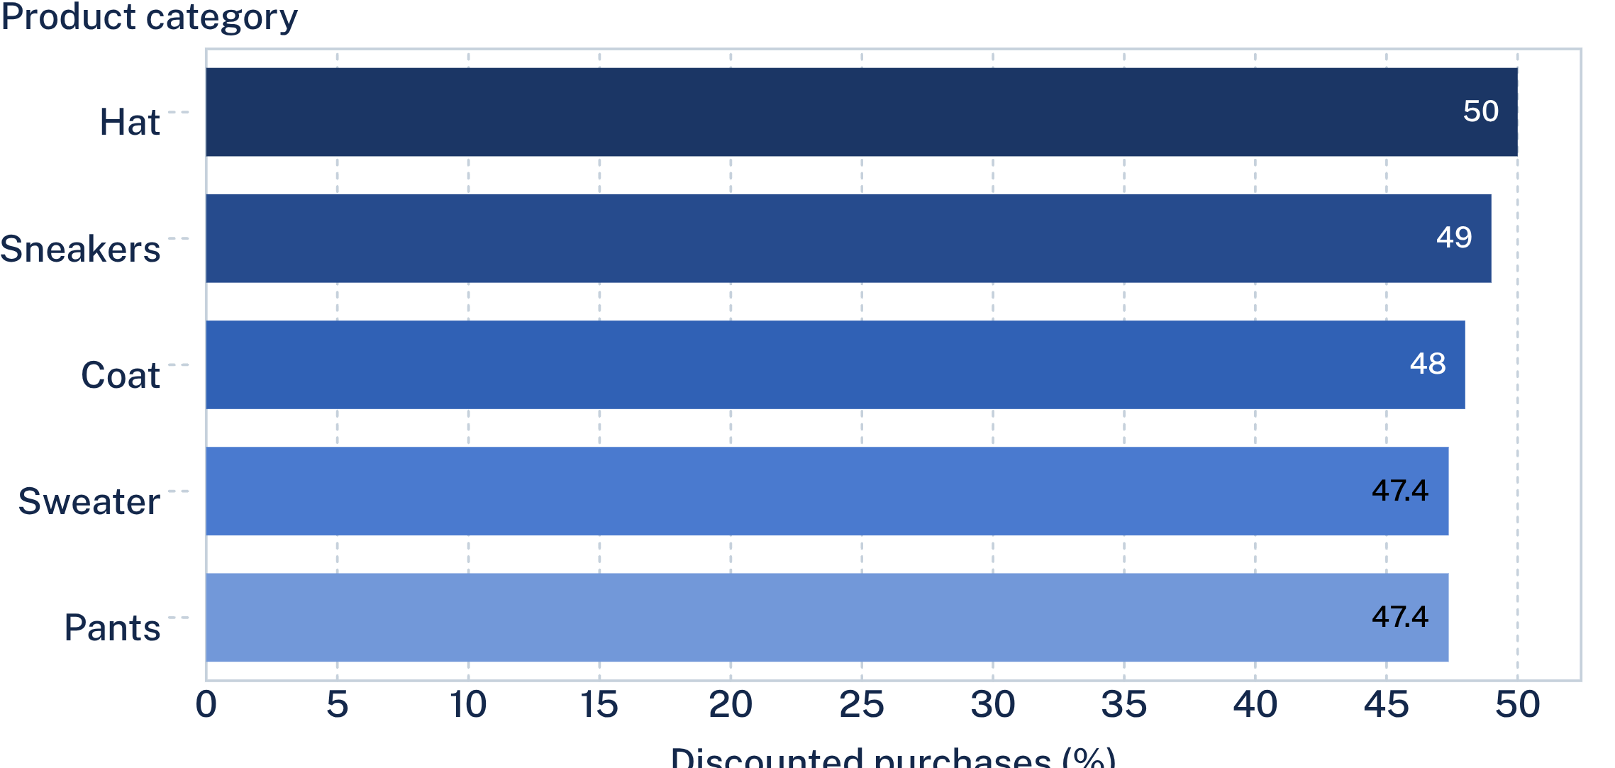
Discounts are widespread across the product mix
47.37%–50.00%
Discounted-purchase rate across the five leading categories
Ranked categories from the reported highest discounted-purchase rates; dashboard readings are approximate where exact values are unavailable.
Management question
How do we protect margin while discounts remain widespread?

