Slide 1
DAYFORCE • AI INNOVATION CHALLENGE • 01 / PROBLEM & USER VALUE
OnboardIQ
THE GAP A CHECKLIST HIDES
CLAIM
WHAT IS ACTUALLY TRUE
DayOne Proof
Laptop task ✓
Reserved, not collected
A completed task is a claim.
Evidence is the proof.
Offer letter uploaded ✓
Not yet reviewed
Profile: Hyderabad
Offer says Bengaluru
One plan, a named owner for every step, and outcomes checked independently. AI proposes fixes; people approve.
Status trackers record ticks, not outcomes.
BUILT FOR 7 ROLES IN ONE COMPANY
HR
IT
Payroll
Benefits
Training
Manager
Employee
Missing proof = UNKNOWN, never success
ONBOARDIQ | TEAM OF 8 • SYNTHETIC DEMO DATA, SIMULATED SOURCE SYSTEMS
1/5
Notes:
Open with the core idea: in onboarding, a ticked task is only a claim. A reserved laptop is not a delivered laptop, an uploaded offer is not a reviewed one, and a profile can disagree with the offer letter. Work is spread across HR, IT, Payroll, Benefits, Training and Managers, so these gaps stay hidden until day one. OnboardIQ builds one rule-based plan, names an owner for each step and checks outcomes separately: evidence is VERIFIED, BLOCKED, UNKNOWN or NOT_APPLICABLE, and missing evidence is never counted as success. Everything is synthetic: one fictional company, simulated source systems, no measured customer savings. Sources: README.md (Problem and solution, User journey and roles); frontend/PRODUCT.md.

Slide 2
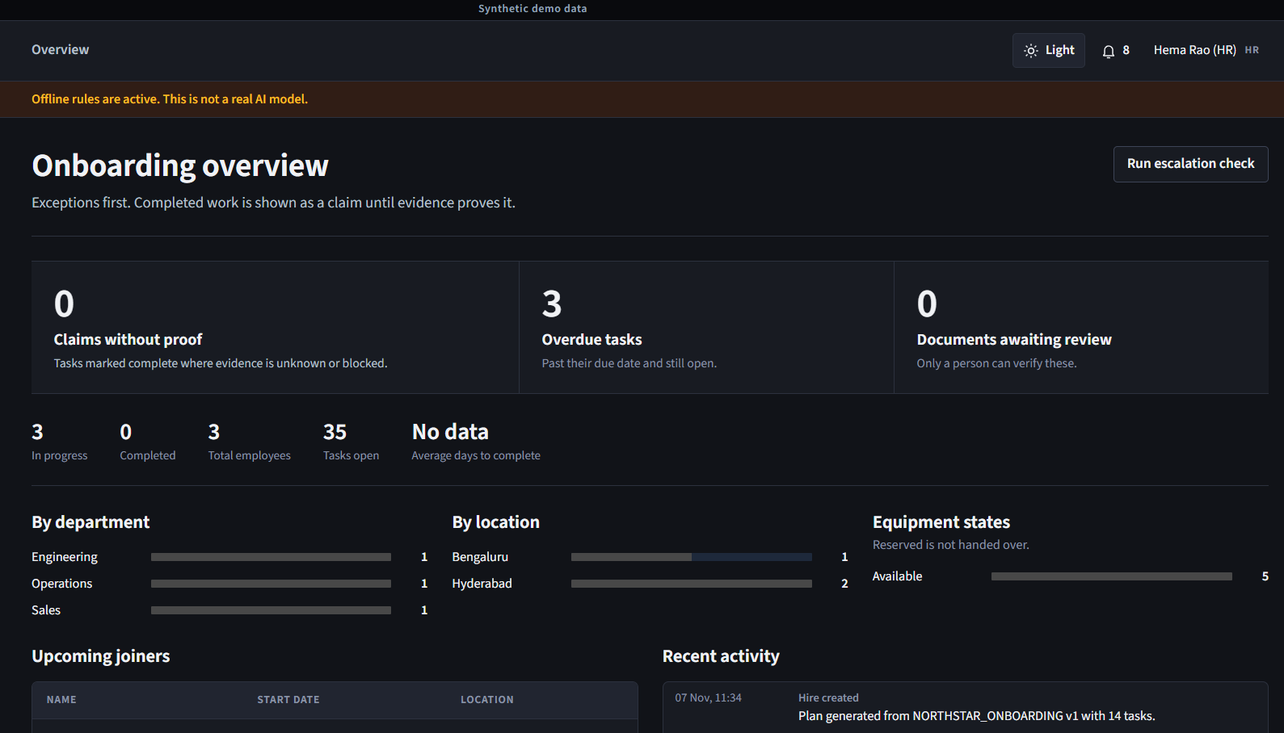
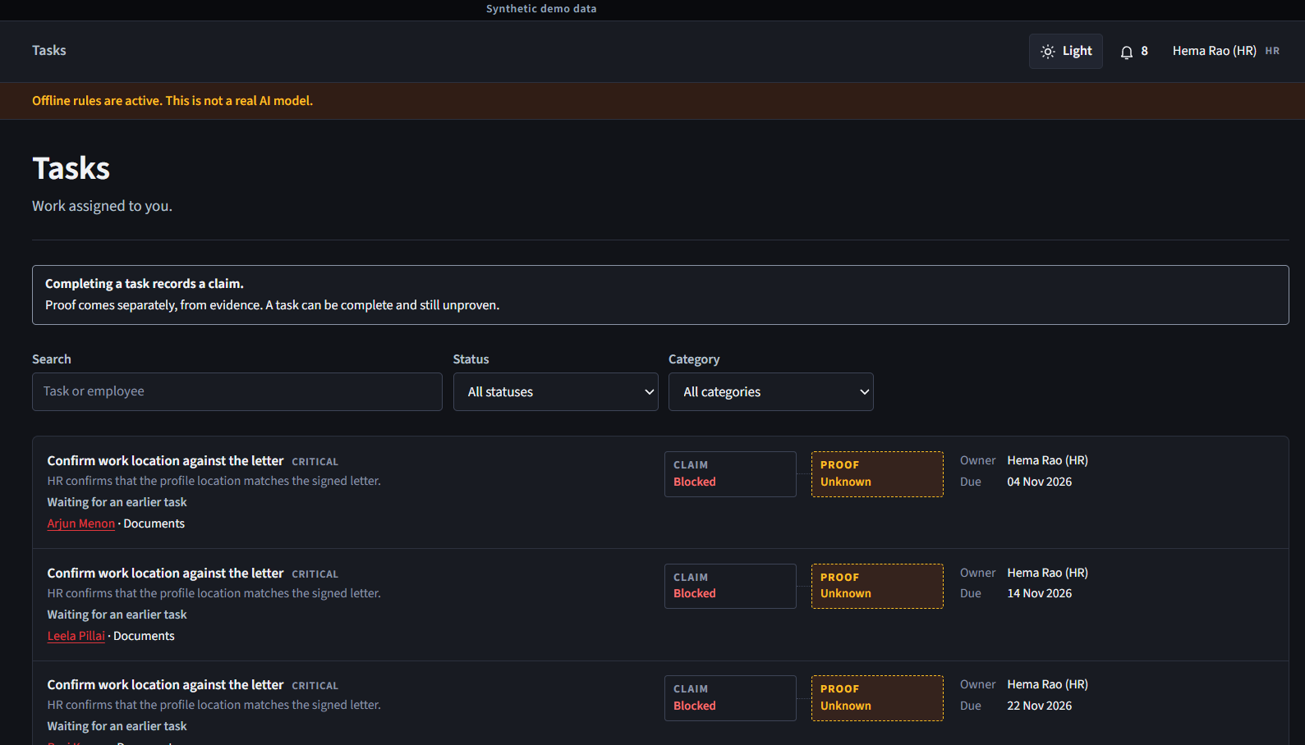
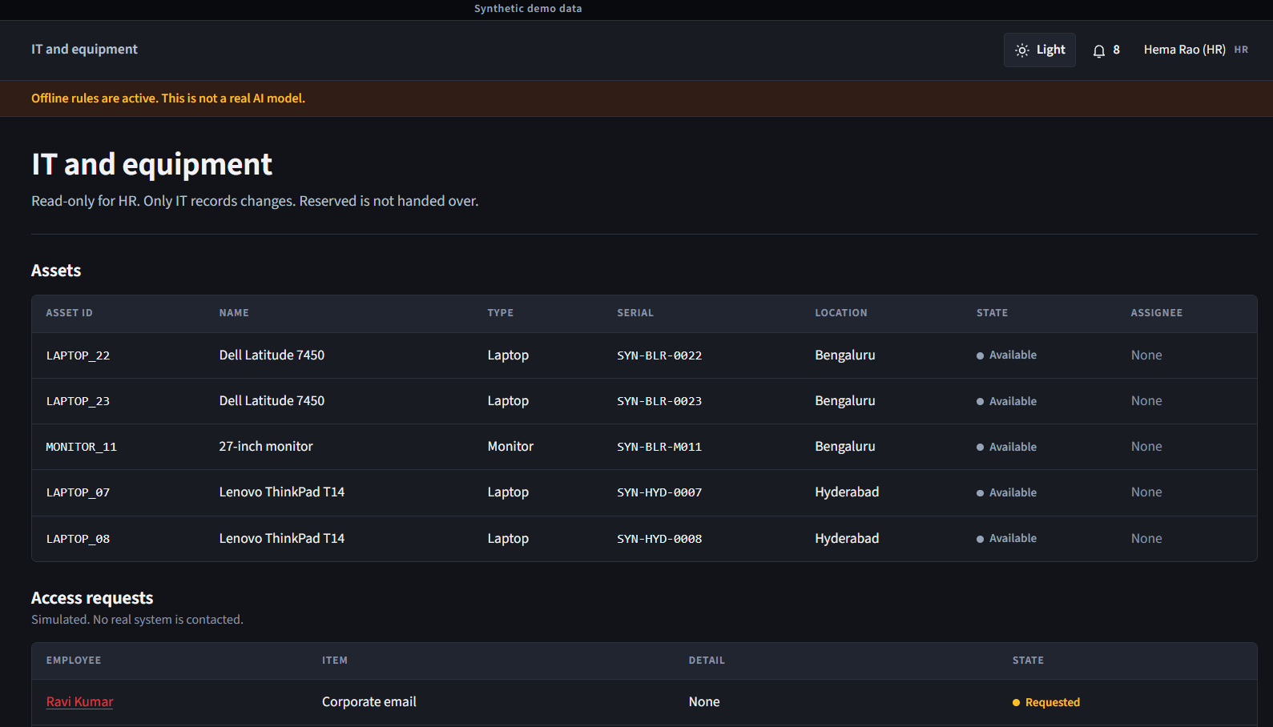
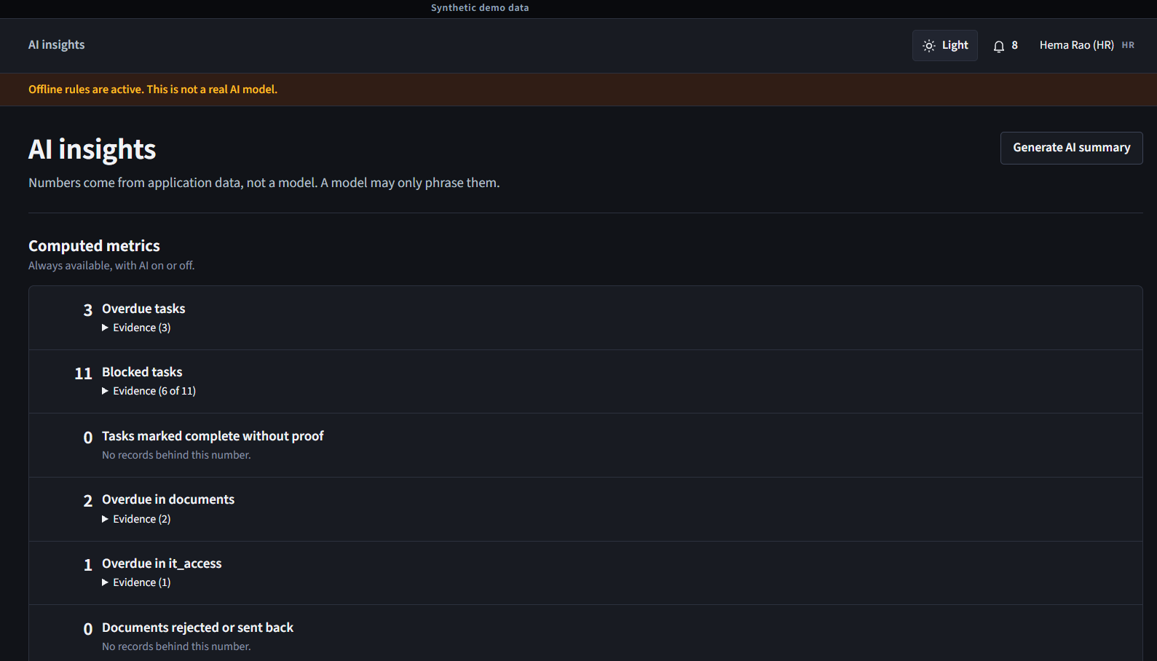
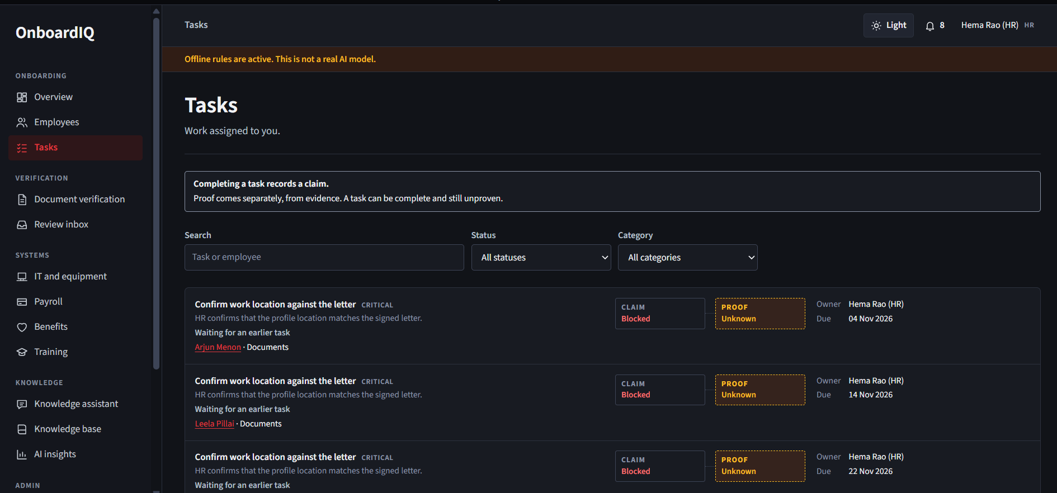
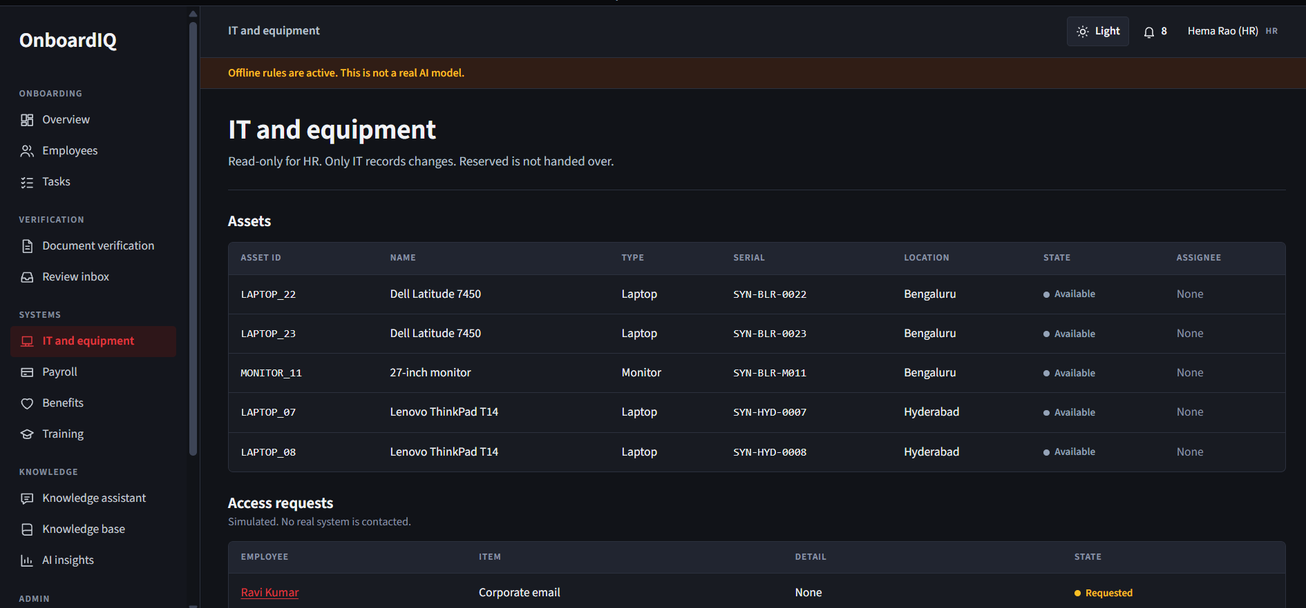
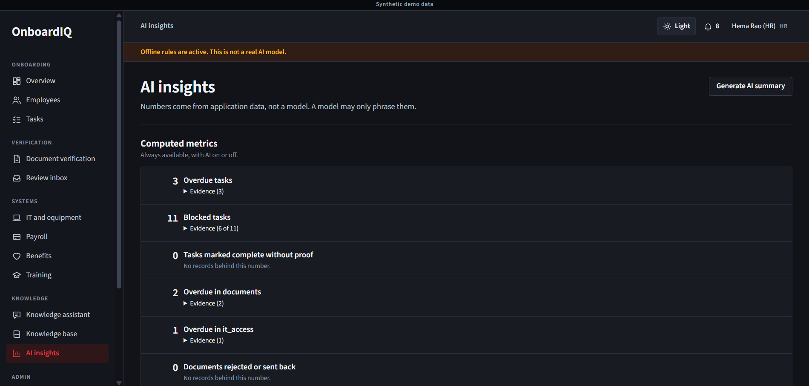
02 / PRODUCT WORKFLOW & DEMO
Follow Priya: one hire, every handoff checked
1
HR creates the hire
Engineer profile, Hyderabad
2
Rules build the plan
6 categories · owners · deadlines · dependencies
3
Priya uploads her offer
AI extraction flags Bengaluru ≠ Hyderabad
Overview: exceptions first
Tasks: claim beside its proof state
4
Agent asks HR
Scoped reads; the wait is saved, nothing guessed
5
HR, then IT, approve
Location change, then laptop reservation
6
Backend reads back
“Reserved; collection pending”
IT equipment: reserved ≠ handed over
AI insights: overdue and blocked tasks
● Red = optional AI-assisted exception path; manual works with AI off
ONBOARDIQ | DAYONE PROOF • AI INNOVATION CHALLENGE
2/5
Notes:
This is the demo storyline. HR creates Priya's engineering hire in Hyderabad; approved rules generate a plan across six categories (documents, equipment, payroll, benefits, training, manager) with owners, deadlines and dependencies. Priya uploads a synthetic offer showing Bengaluru; extraction flags the mismatch. The bounded investigation reads scoped records and asks HR which location is correct; that wait is stored in the database. HR approves the location change, IT separately approves a Bengaluru laptop reservation, and the backend reads back 'reserved; collection pending', not 'delivered'. Screenshots are synthetic data in offline-rules mode, not a live model. Sources: README.md (Priya's joining-day handoff); evals/results/hosted_*.json journey; video/script.md.

Slide 3
03 / ARCHITECTURE & HARNESS DESIGN
AI proposes. Trusted code controls.
APPLICATION
one container
React + TS + Vite
7 role screens · no keys
/api
FastAPI + Pydantic
auth · scope · input checks
Domain services
plans · evidence · docs · knowledge
SQLite + FTS5
state · audit · private uploads
case opened → queued
Worker loop
7 read tools · budgets
Versioned prompt
4 registered operations
LLM provider
Groq gpt-oss-20b (tested)
Validate
JSON + semantic · 1 repair
Typed proposal
immutable bundle
AI HARNESS
optional
outside the app (network)
invalid / outage → manual path
proposal awaits approval
HUMAN GATE
required
Right reviewer
HR or IT; never the model
Fresh checks
identity · version · expiry · dupes
Conditional write
local action + audit log
Read-back
exact outcome becomes evidence
DEPLOY
Docker on Render free tier · AI off by default · GitHub Actions CI
EVALS
evals/run.py · 82 scenarios · isolated DB · same harness
RULE
No model-to-database path: every write passes a person and code checks
ONBOARDIQ | DAYONE PROOF • AI INNOVATION CHALLENGE
3/5
Notes:
Top lane: the React app calls a relative /api on FastAPI, which authenticates, checks hire scope and validates every input with Pydantic before domain services touch SQLite. Middle lane is the AI harness: one local worker runs a bounded loop with seven allowlisted read tools and budgets of 12 model calls and 16 reads. Each of four registered operations uses a versioned prompt, one configured provider, JSON plus semantic validation and at most one repair; failures fall back to manual work. Bottom lane: a person approves, code re-checks versions and expiry, writes conditionally and reads back. Correction vs the earlier draft: no LangGraph at runtime; state lives in app tables. Sources: backend/app/ai/harness.py, agent/graph.py, agent/tools.py, actions/service.py, render.yaml, Dockerfile.

Slide 4
04 / SAFETY, TESTING & EVALUATION
Show the proof, and its limits
GUARDRAILS · BUILT
AUTOMATED TESTS · fresh run, 7 Nov 2026
Access control
scrypt hashing · lockout · scope checks
Input validation
Pydantic · 5 MB cap · type allowlist
205 / 205
58 / 58
backend tests pass
frontend tests pass
AI output checks
schema + semantic · quotes verified
Human authority
only the right HR/IT reviewer approves
LIVE MODEL EVAL · Groq gpt-oss-20b · 6 Nov · one run
0
permission leaks
0 / 10
injection attempts leaked
Stale & duplicate
version · expiry · duplicate checks
Failure path
outage or quota → manual workflow
8 / 8
advice requests refused
5 / 11
new questions: right source
Method: pytest + Vitest on isolated synthetic DBs with scripted model replies, incl. OWASP, fuzzing, race and chaos suites.
Limits: free-tier rate limits hit 7 of 39 calls; one journey ≠ success rate. Independent held-out eval: PLANNED
ONBOARDIQ | DAYONE PROOF • AI INNOVATION CHALLENGE
4/5
Notes:
Left side is what is built. Access: scrypt-hashed passwords, a five-minute lockout and server-side scope where out-of-scope records return 404. Inputs are Pydantic-validated, uploads capped at 5 MB with a type allowlist. AI output is schema- and semantically checked and citations must match real passages. Right side: I re-ran the suites on 7 Nov at commit 940cc2b: 205 backend and 58 frontend tests passed. The live eval is one Groq run on 6 Nov over 82 author-written scenarios: zero permission or injection leaks, but only 5 of 11 untuned questions retrieved the right source. Sources: backend/tests/, docs/EVALUATION.md, evals/results/hosted_openai_gpt-oss-20b_2026-11-06T165624Z.json.

Slide 5
05 / FUTURE IMPROVEMENTS & EXPECTED BUSINESS IMPACT
Less repeated entry. Same accountability.
NOW
NEXT
LATER
PLANNED · A1
PLANNED · A2
PLANNED · INFRA
Prompt-to-hire draft
HR rule editor
Production foundations
HR describes a hire once; AI fills an editable draft
preview and publish versioned rules
SSO · PostgreSQL · durable hosting · email/Slack
Expected: fewer repeated field entries
Expected: onboarding configured without code
Expected: a path to a real pilot
PLANNED · A7
PLANNED · A3
PLANNED · A5
Better grounded answers
Extract on upload
Department copilots
close the 5 / 11 new-question gap
flag conflicts automatically
narrow, approval-gated help per role
Expected: fewer HR escalations
Expected: mismatches caught before day one
Expected: less manual chasing per team
We will measure, not assume: timed same-task study · unseen-question eval · setup edits vs today’s flow
Clear work. Accountable handoffs. Checked outcomes.
ONBOARDIQ | DAYONE PROOF • AI INNOVATION CHALLENGE
5/5
Notes:
The roadmap comes straight from the active backlog, items A1 to A8. None of it is built yet. First, a prompt-to-hire draft: HR describes the hire in one sentence, AI fills an editable draft, HR confirms, and the existing rule engine builds the plan. Alongside it, better retrieval to fix the 5 of 11 weakness. Next, an HR rule editor and automatic extraction on upload. Later, production foundations such as SSO and PostgreSQL, plus narrow department copilots. Every benefit is expected, not measured; we will test it with timed same-task studies and unseen questions. Source: docs/decisions/2026-11-07-improvement-plan.md (A1–A8, Later infrastructure).

