Slide 1

SGGS-IET / NANDED
DESIGN
A SERIAL
CONVERTER
RS232 to TTL Level Translation using MAX232 IC
SUBMITTED BY
DEPARTMENT
SEMESTER / YEAR
Vivekanand Shivshankar Swami
Electronics & Telecomm. Engg.
7th Sem · 2026-27
DRAWN BY
DATE
SCALE
SHEET
V. S. Swami
2026-27
NTS
1 / 10

Slide 2
02 / 10
AB
A module that bridges the voltage gap between 5V TTL
microcontrollers and legacy RS232 serial equipment.
ABSTRACT
The MAX232 IC acts as the core transceiver, using an internal dual charge-pump to generate
±10V RS232 rails from a single 5V supply — requiring only four external 1µF capacitors.
Upstream power regulation is handled by an LM7805 linear regulator, converting a 12V DC input
to a stable 5V rail. The complete design — schematic, PCB layout, and 3D model — was produced
in KiCad EDA and verified via PSpice simulation.
NOTE:
This report documents a SETU project-based internship completed under the guidance of the
Department of Electronics & Telecommunications Engineering, SGGS-IET Nanded.
TYPE: INTERNSHIP REPORT
STANDARD: EIA-232-F
IC: MAX232CPE
VCC: 5V (REG.)
DWG: ETL-232-02

Slide 3
03 / 10 — SCOPE OF WORK
PROJECT OBJECTIVES
6 OBJECTIVES
01
03
05
Design a TTL↔RS232 level converter using
the MAX232 integrated circuit
Verify the power supply circuit
performance through PSpice simulation
Draw the complete schematic and PCB
layout in KiCad EDA
02
04
06
Design a regulated 5V power supply using
the LM7805 voltage regulator IC
Simulate and validate the TTL-to-RS232
converter in PSpice with measured outputs
Produce a compact, reliable module
suitable for serial communication
applications
DWG: ETL-232-03

Slide 4
04 / 10 — VOLTAGE LEVEL TRANSLATION
THEORY OF OPERATION
+15V
RS232 uses bipolar voltages — positive voltage for logic 0, negative for
logic 1. TTL uses 0V and 5V. These are incompatible; a direct connection
would damage microcontroller I/O pins.
5V
+3→+15V
TTL HIGH
RS232 LOGIC 0
The MAX232 contains two transmitters (TTL→RS232) and two receivers
(RS232→TTL). An internal charge pump circuit doubles and inverts the 5V
supply, creating the ±10V rails the RS232 transmitters need — with no
external power supply required.
+3V
UNDEFINED
-3V
SIGNAL PATH
-3→-15V
TTL TX → T1IN → T1OUT → RS232
RS232 LOGIC
1
RS232 → R1IN → R1OUT → TTL RX
0V
-15V
TTL LOW
RS232
TTL
DWG: ETL-232-04

Slide 5
05 / 10 — BLOCK DIAGRAM
CIRCUIT ARCHITECTURE
SYSTEM BLOCK DIAGRAM
TRANSCEIVER
INPUT
REGULATOR
RS232 PORT
DEVICE
12V DC
Vin
LM7805
+5V
MAX232
TX / RX
DB9 / Female
TTL 0–5V
MCU / PC
T1IN T1OUT · R1IN R1OUT
MAX232
LM7805
4× 1µF Caps
DB9 + Header
Dual RS232 transceiver · DIP-16 ·
single 5V supply
Linear voltage regulator · TO-220 ·
12V→5V
Charge pump network · C1+, C1−, C2+,
C2−
RS232 socket · 3-pin TTL connector
DWG: ETL-232-05

Slide 6
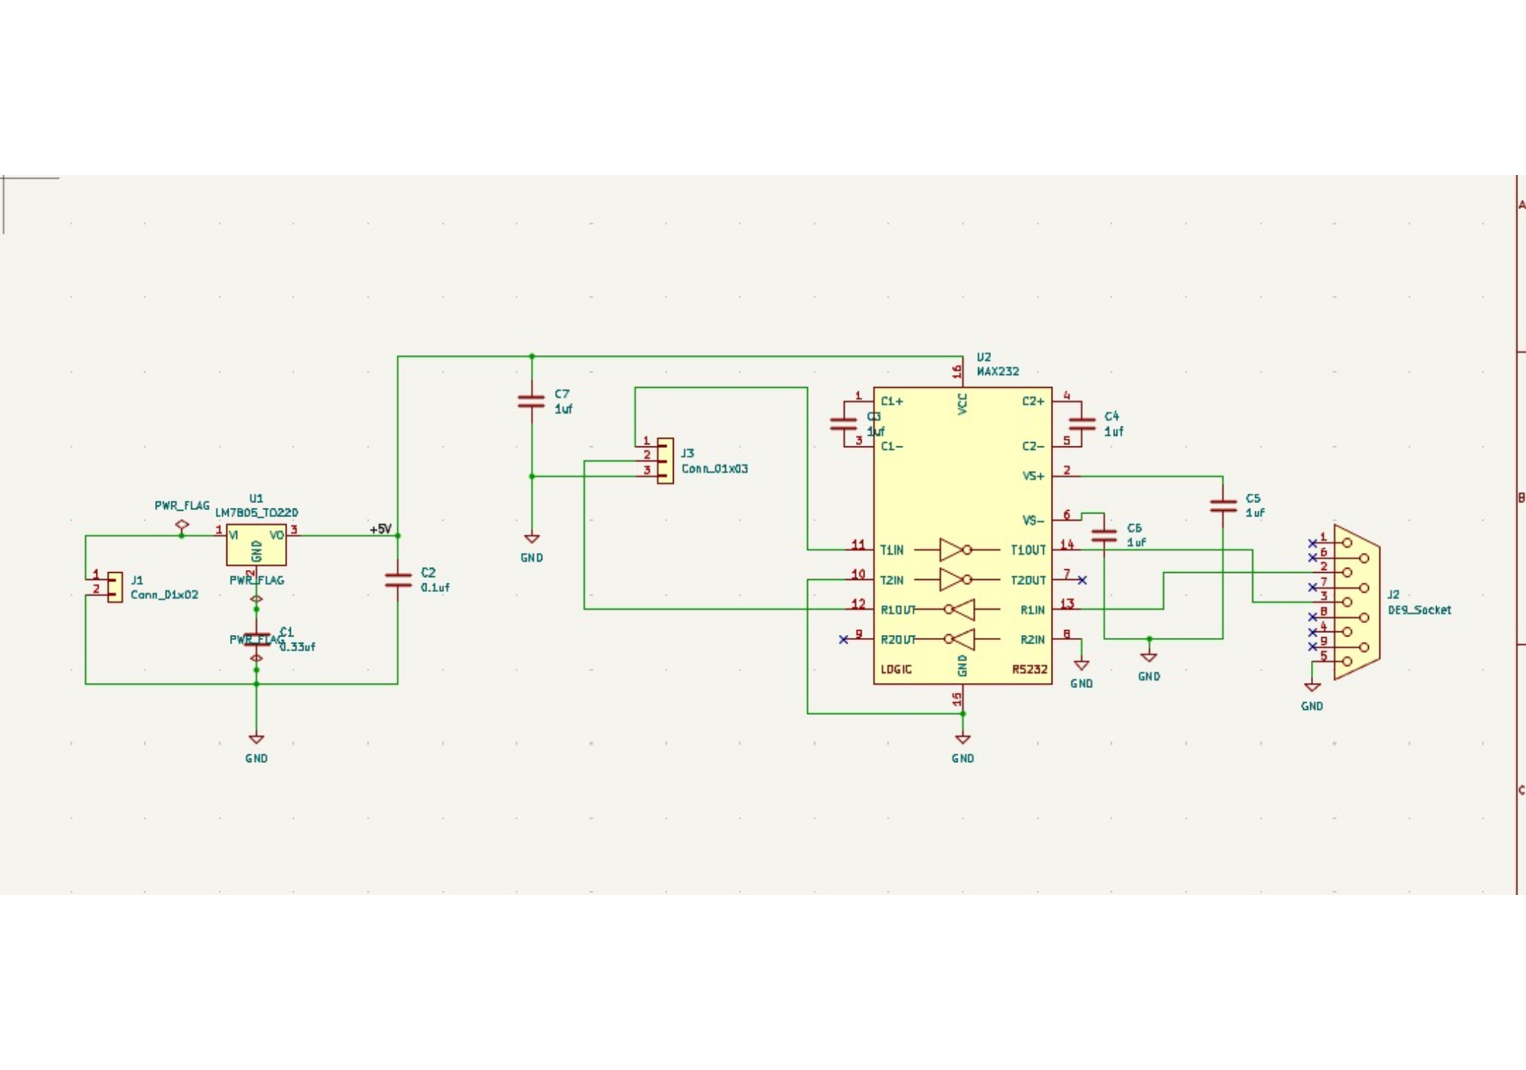
06 / 10 — KICAD SCHEMATIC
SCHEMATIC DESIGN
KiCad EDA · Verified
POWER SECTION
12V DC input → LM7805 → 5V regulated rail
powering the MAX232 and TTL side
CHARGE PUMP
C1+/C1− (doubler) and C2+/C2− (inverter)
capacitor network generates ±10V RS232
rails internally
INTERFACE
T1OUT and R1IN routed to DB9 pins 2 and 3.
TTL side via 3-pin header (TX, RX, GND)
NOTE: All cap values 1µF / 16V. C5/C6 are supply
decoupling (10µF, 100nF).
FIG. A — MAX232 SCHEMATIC (KiCad)
DWG: ETL-232-06

Slide 7
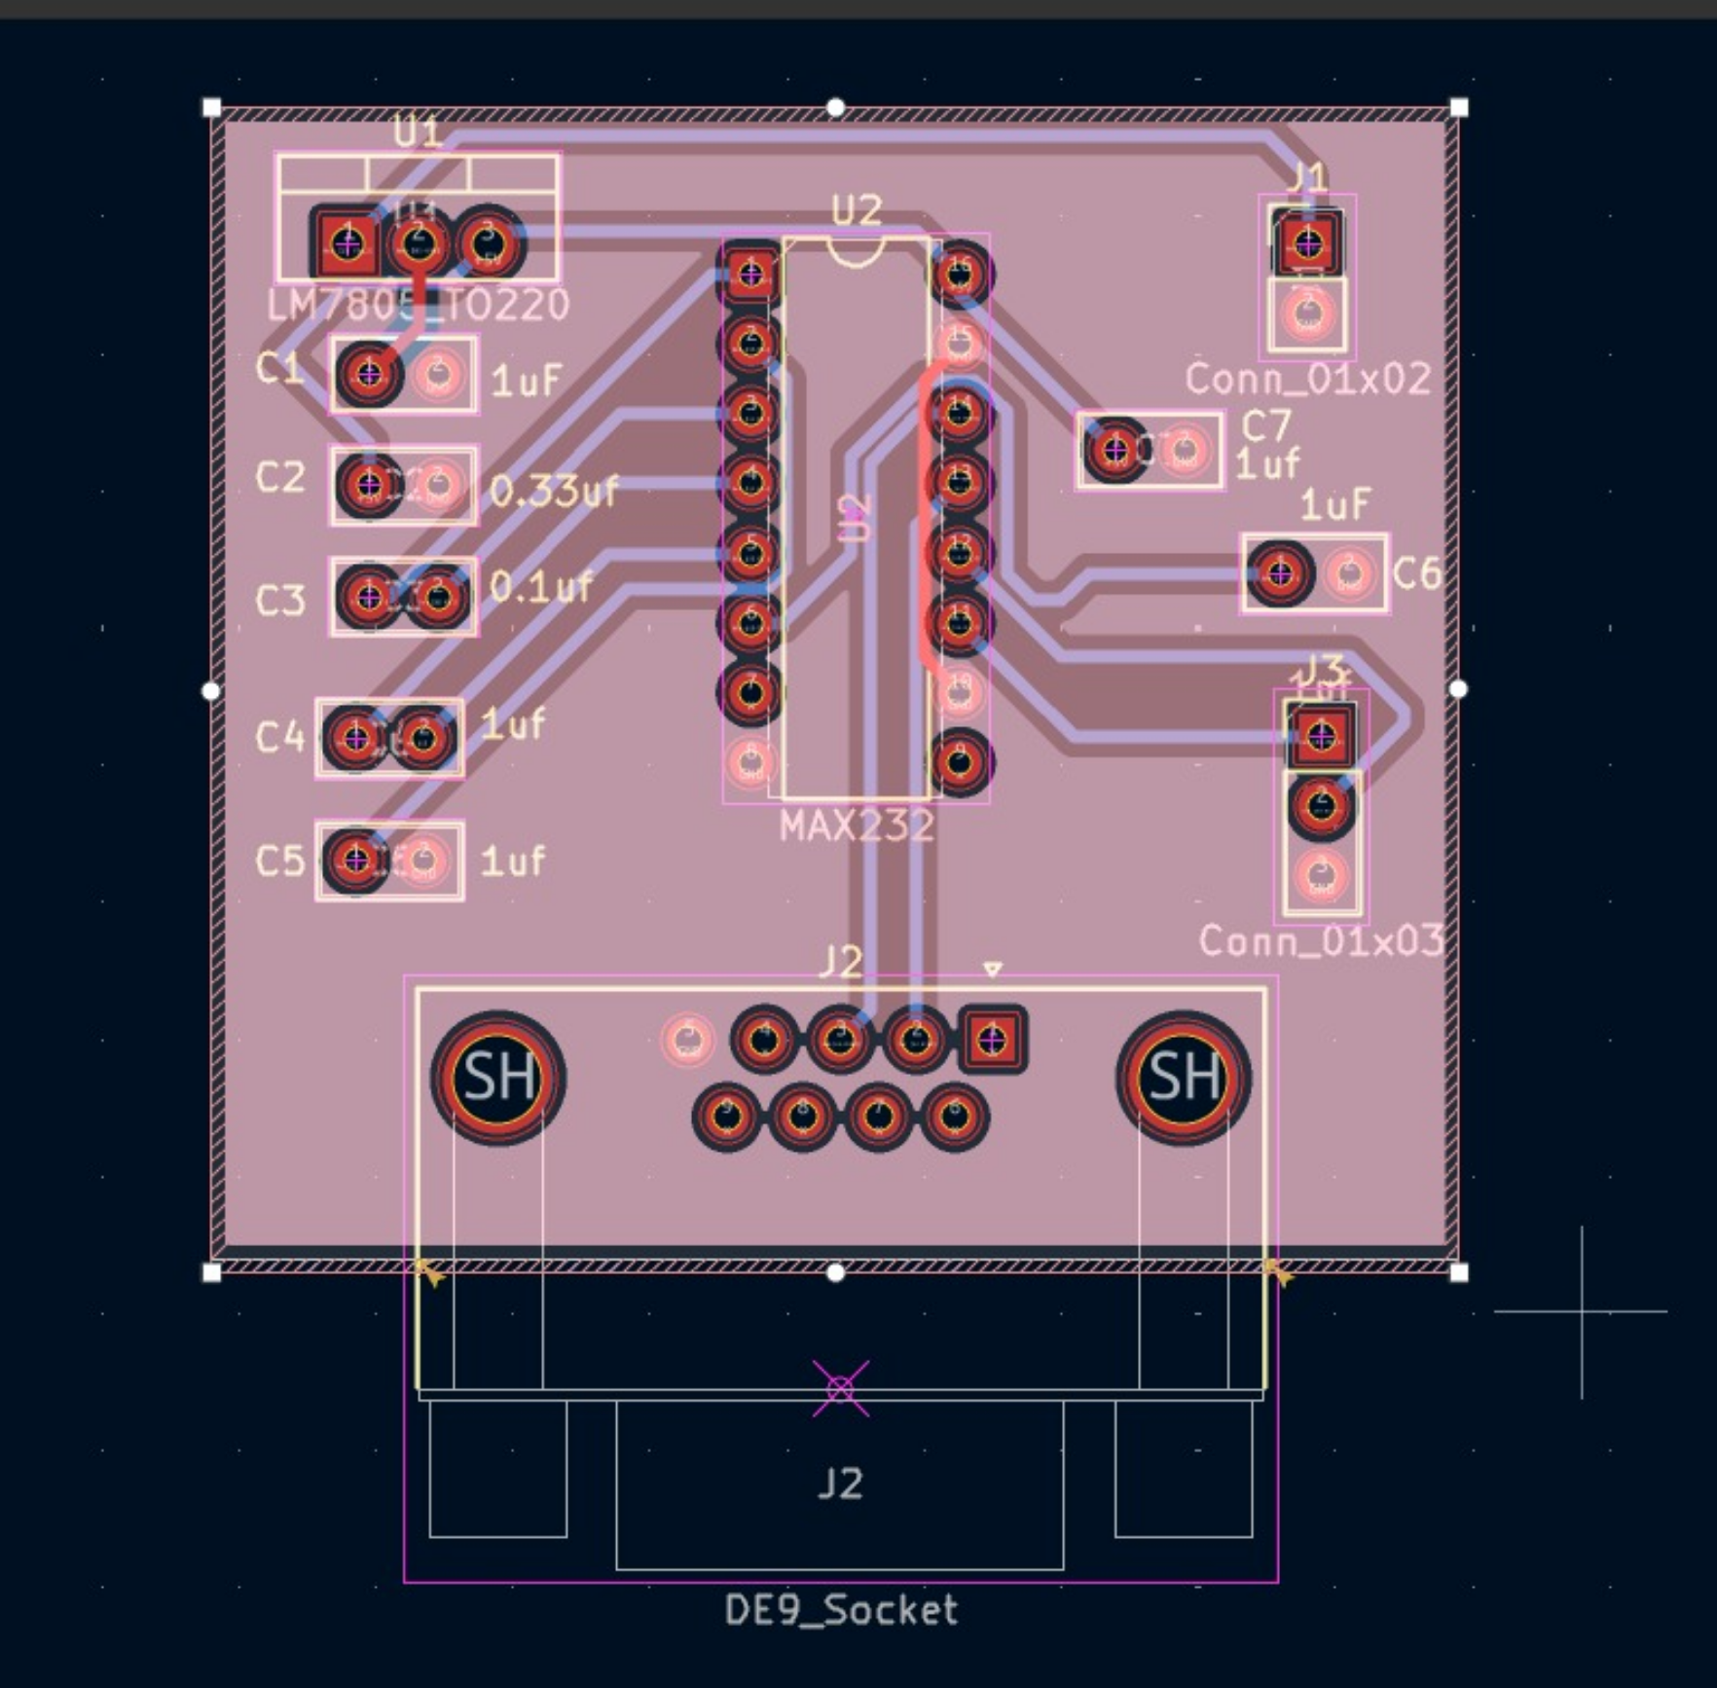
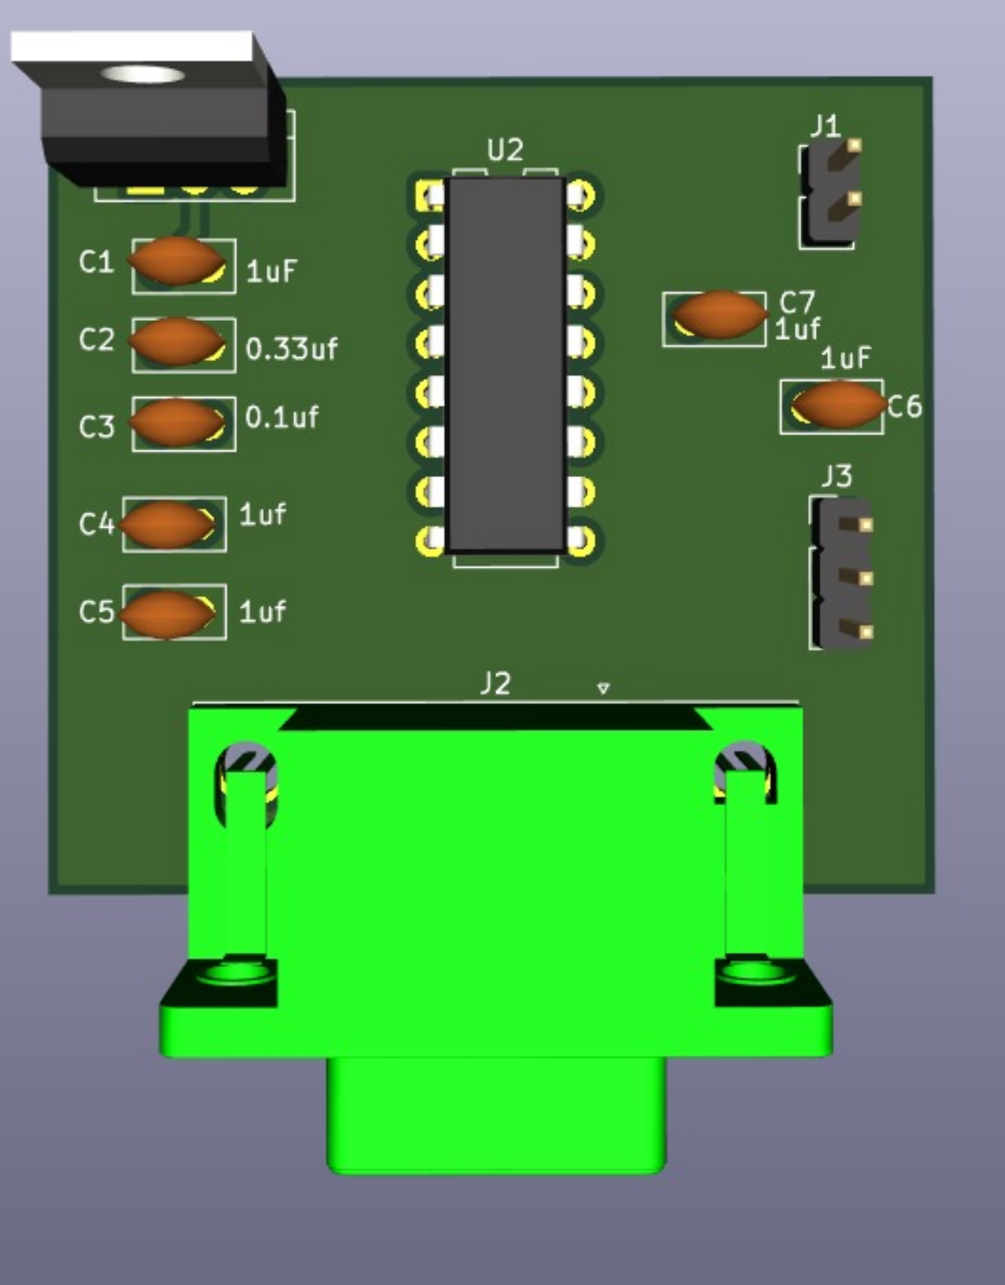
07 / 10 — PCB DESIGN
PCB LAYOUT & 3D RENDER
FIG. B — PCB LAYOUT
2-LAYER · FR4 · 1.6mm
FIG. C — 3D RENDER
KiCad 3D VIEWER
DWG: ETL-232-07
Ground plane on bottom layer for EMI suppression. All components through-hole for ease of
hand assembly.
3D view confirms component clearances and DB9 connector mechanical
fit.

Slide 8
08 / 10 — BILL OF MATERIALS
LIST OF MATERIALS
8 ITEMS · REV A
S.NO.
COMPONENT
PART / VALUE
QTY
PACKAGE
01
RS232 Transceiver IC
MAX232CPE
1
DIP-16
02
Voltage Regulator IC
LM7805CT
1
TO-220
03
Capacitor — Charge Pump
1µF / 16V Electrolytic
4
Radial
04
Capacitor — Supply Filter
10µF / 100nF
2
Radial / 0805
05
RS232 Serial Connector
DB9 Female PCB-mount
1
THT
06
TTL Interface Header
3-Pin Male · 2.54mm
1
THT
07
Power Input Connector
2-Pin Screw Terminal 5mm
1
THT
08
Printed Circuit Board
Custom · KiCad
1
2-layer FR4 · 1.6mm
NOTES:
All capacitors rated minimum 16V. LM7805 heatsink recommended for Vin above 9V. Through-hole components only — suitable for hand soldering and
prototyping.
DWG: ETL-232-08

Slide 9
09 / 10 — PSPICE RESULTS
SIMULATION & RESULTS
MEASURED OUTPUT VALUES
SIMULATION FINDINGS
5.0V
The LM7805 delivered a stable 5.0V output across all tested load
conditions. Ripple remained well within the 50mV limit specified in
the datasheet.
LM7805 output under
rated load — stable
REGULATED VCC OUTPUT
MAX232 charge pump operation confirmed: the doubler stage produced
+10V and the inverter stage -10V — sufficient margin above the RS232
minimum of ±3V.
±10V
120kbps
RS232 RAIL SWING
MAX DATA RATE
Logic inversion was verified: TTL HIGH (5V) at T1IN correctly
produced RS232 SPACE (-10V) at T1OUT. The receiver path showed the
inverse behaviour on R1OUT.
Charge pump verified
Per MAX232 datasheet
SIGNAL TRACE — SIMULATED
TTL IN
0V / 5V
RS232
±10V
Simulation tool: OrCAD PSpice · All component models sourced from manufacturer SPICE
libraries.
DWG: ETL-232-09

Slide 10
10 / 10 — FINAL SUMMARY
APPLICATIONS & CONCLUSION
APPLICATIONS
CONCLUSION
Interfacing Arduino / STM32 with PC serial ports
This internship-based project delivered a complete, verified RS232-to-TTL converter
module — from first-principles voltage analysis through PSpice
simulation to a fabrication-ready KiCad PCB.
Industrial automation — PLC and HMI communication
GPS receivers, barcode readers, legacy modems
The MAX232-based design works reliably from a single 5V
supply with no external voltage rails. The KiCad workflow
produced a schematic, 2-layer PCB, and 3D render ready for
prototype fabrication.
Medical device data logging and serial telemetry
Embedded firmware debug consoles (UART over RS232)
STATUS
INSTITUTION
STUDENT
COMPLETE
SGGS-IET, Nanded · Dept.
of E&TC
V. S. Swami · Sem
7· 2026-27
DRAWN BY
DATE
SCALE
SHEET
V. S. Swami
2025-26
NTS
10 / 10

