Slide 1
 | Controls (N=11) | FM (N=7) | FM with IENF deficiency (N=10) | Total (N=28) | p-value
IENF Deficiency |  |  |  |  | < 0.001
Absent | 11 (100.0%) | 7 (100.0%) | 0 (0.0%) | 18 (64.3%)
Present | 0 (0.0%) | 0 (0.0%) | 10 (100.0%) | 10 (35.7%)
Age |  |  |  |  | 0.577
Mean (SD) | 49.2 (15.5) | 54.2 (2.8) | 53.0 (7.3) | 51.8 (10.6)
Range | 25.0 - 75.0 | 49.6 - 57.1 | 40.0 - 63.4 | 25.0 - 75.0
Sex |  |  |  |  | 0.696
Male | 1 (9.1%) | 0 (0.0%) | 1 (10.0%) | 2 (7.1%)
Female | 10 (90.9%) | 7 (100.0%) | 9 (90.0%) | 26 (92.9%)
FSQ Score |  |  |  |  | < 0.001
Mean (SD) | 0.0 (0.0) | 41.9 (18.7) | 41.4 (7.3) | 25.3 (22.9)
Range | 0.0 - 0.0 | 9.0 - 58.0 | 28.0 - 52.0 | 0.0 - 58.0
IENF count |  |  |  |  | < 0.001
Mean (SD) | 17.3 (5.3) | 15.5 (5.4) | 7.7 (4.0) | 13.4 (6.4)
Range | 11.0 - 26.3 | 9.3 - 26.0 | 2.7 - 16.3 | 2.7 - 26.3
epidermal length (mm) |  |  |  |  | 0.124
Mean (SD) | 2.7 (0.7) | 2.1 (0.4) | 2.5 (0.6) | 2.5 (0.6)
Range | 2.0 - 4.1 | 1.5 - 2.6 | 1.6 - 3.5 | 1.5 - 4.1
IENF density (fibres/mm) |  |  |  |  | < 0.001
Mean (SD) | 6.4 (1.1) | 7.6 (2.9) | 3.0 (1.2) | 5.5 (2.6)
Range | 5.2 - 9.2 | 5.6 - 13.7 | 1.3 - 4.7 | 1.3 - 13.7
SEP (mm) |  |  |  |  | 0.364
Mean (SD) | 24.8 (8.4) | 17.9 (6.5) | 25.5 (16.1) | 23.3 (11.5)
Range | 12.0 - 37.0 | 9.0 - 30.0 | 10.0 - 65.5 | 9.0 - 65.5
ULBP+ SEP |  |  |  |  | 0.232
Mean (SD) | 10.5 (8.0) | 11.7 (6.5) | 16.4 (8.8) | 12.9 (8.2)
Range | 2.5 - 24.5 | 3.0 - 20.5 | 7.0 - 30.5 | 2.5 - 30.5
ULBP+ SEP (%) |  |  |  |  | 0.009
Mean (SD) | 39.1% (20.1%) | 62.1% (24.5%) | 66.2% (14.1%) | 54.5% (22.6%)
Range | 15.5 - 66.9% | 28.1 - 97.4% | 47.0 - 84.6% | 15.5 - 97.4%
NK+ SEP |  |  |  |  | 0.441
Mean (SD) | 4.6 (4.7) | 2.2 (2.5) | 4.2 (3.6) | 3.8 (3.8)
Range | 0.0 - 13.5 | 0.5 - 7.5 | 0.5 - 11.0 | 0.0 - 13.5
NK+ SEP (%) |  |  |  |  | 0.305
Mean (SD) | 14.6% (11.1%) | 21.0% (10.2%) | 21.1% (10.1%) | 18.5% (10.6%)
Range | 0.0 - 38.3% | 6.7 - 34.7% | 8.3 - 38.8% | 0.0 - 38.8%
NK/SEP (cells/mm) |  |  |  |  | 0.642
Mean (SD) | 1.6 (1.6) | 1.0 (0.9) | 1.6 (1.2) | 1.4 (1.3)
Range | 0.0 - 4.7 | 0.2 - 3.0 | 0.2 - 3.1 | 0.0 - 4.7
Table 1: Descriptive statistics of FM skin biopsy cohort.
FM: fibromyalgia, IENF: intra-epidermal nerve fibers, FSQ: fibromyalgia symptom questionnaire, SEP: subepidermal plexus, ULBP: UL16 binding protein (NK ligand)

Slide 2

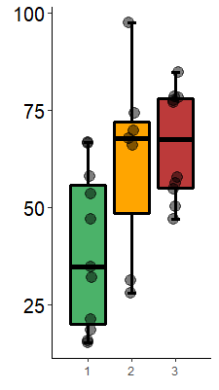
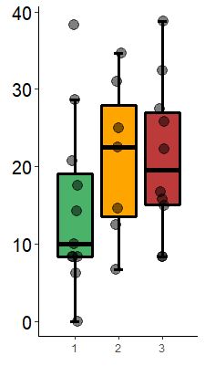
A.
B.
0.01*
0.35
0.05
0.91
0.43
0.99
ULBP+ SEP (%)
NK+ SEP (%)
Control
(n=11)
FMS
(n=7)
FMS + IENF deficiency
(n=10)
Figure 1: percent of (a) ULBP or (b) NK cells colocalized subepidermal plexus (SEP) in controls (green), fibromyalgia (FM) patients (orange), and FM patients with intraepidermal nerve fiber (IENF) deficiency (red).

Slide 3
Control
(n=11)
FMS
(n=7)
FMS + IENF deficiency
(n=10)

Slide 4
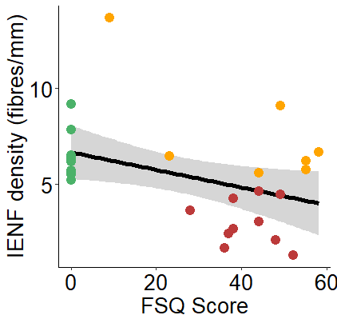
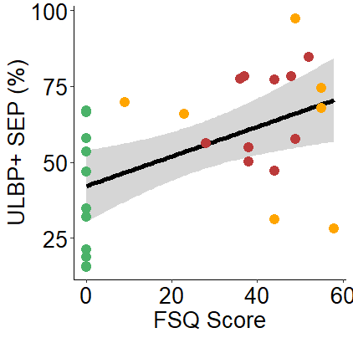
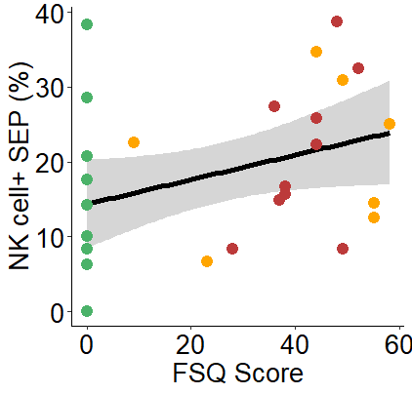
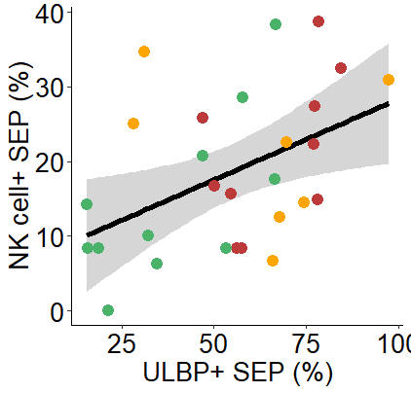
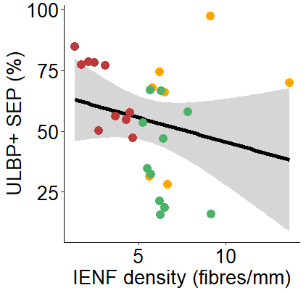
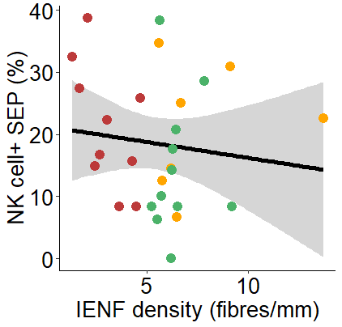
C.
D.
E.
ρ = -0.3
p = 0.1
ρ = 0.5
p = 0.01
ρ = 0.4
p = 0.04
F.
G.
H.
ρ = 0.5
p = 0.01
ρ = -0.4
p = 0.07
ρ = -0.2
p = 0.43
Control
FMS
FMS + IENF deficiency
Figure 2: Spearman’s rank correlation between intraepidermal nerve fiber (IENF) density, fibromyalgia symptom questionnaire (FSQ) score, percent of ULBP colocalized subepidermal plexus (SEP) and percent of NK cells colocalized SEP in controls (green), fibromyalgia (FM) patients (orange), and, FM patients with IENF deficiency.

