Slide 1
“Lumina” – Context Aware Code Reviewer
By Illumina
12th June 2026
TCS Confidential

Slide 2

Problem Statement
Code reviews are time-consuming and resource-intensive.
Review quality varies across developers and teams.
Static analysis tools provide generic, context-limited feedback.
Project-specific standards and architectural guidelines are often overlooked.
Developers need intelligent, repository-aware review assistance.

Slide 3

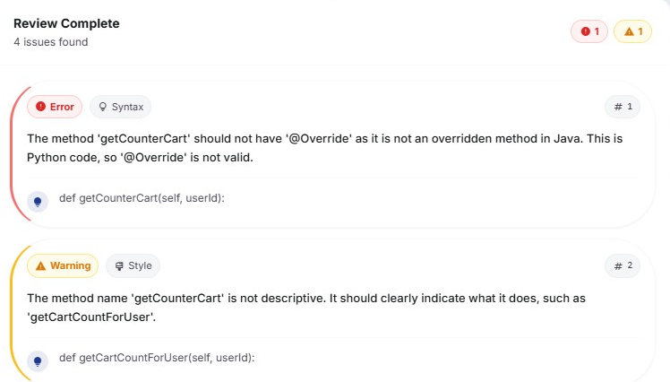
Approach
A repository-aware AI code review platform that combines knowledge ingestion, conversational code reviews, and personalized developer insights in a single solution
Context Creation – Ingests code repositories, documentation, standards, and requirements to build a searchable knowledge base.
Conversational Code Review – Enables developers to submit code snippets and receive contextual AI-generated review comments through a chat interface.
User Dashboard – Tracks review activity, preferences, conversation history, and review insights through a centralized dashboard.

Slide 4

Data Consideration
Source code repository and application codebase
Project documentation and architectural guidelines
Coding standards and best practices (Confluence)
SonarQube quality reports and findings
OWASP security guidelines and vulnerability patterns
Business requirements and user stories (JIRA)
Historical implementation patterns and design decisions

Slide 5
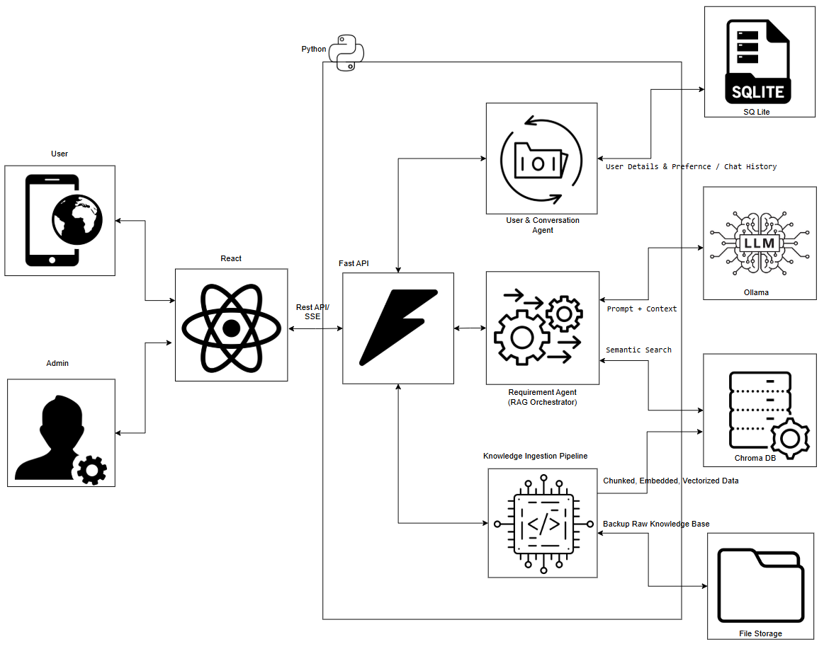
Technical Architecture

Slide 6
Context Creation Workflow
Generate Embeddings
Store in Vector DB
Chunk into Units
Parse Content
Upload Artifacts
Codebase,
Confluence Ref,
Standards,
JIRA Story
Extract Structured Content
Apply appropriate Chunking Techniques
Vectorize each Chunk
Store the Vectorized Chunk

Slide 7
Code Review Workflow
Submit Code
Embed Query
Semantic Search
Retrieve Repo Context
Generate Review Comments

Slide 8






Key AI Concepts Used
 | Retrieval-Augmented Generation (RAG) Grounds response in contextual knowledge
 | Embeddings for Semantic Representation Converts artifacts into vector representation
 | Semantic Search over Vector Database Searches by meaning rather than exact keywords. Understand intend and context
 | Natural Language Understanding Conversational Understanding and Intend recognition
 | Conversational memory / Context Retention Maintains context across interactions
 | AI guardrails for Controlled Outputs Real-time output validation and safety filters

Slide 9

Benefits
Repository-aware AI code reviews powered by RAG.
Combines source code, project documentation, coding standards, and business requirements for contextual analysis.
Augments reviews with SonarQube quality findings and OWASP security best practices.
Generates intelligent, actionable review comments instead of generic rule violations.
Promotes consistent code quality, security, and architectural compliance across teams.
Reduces dependency on reviewer expertise and accelerates the review process.
Captures and reuses organizational knowledge through a Vector Database.

Slide 10
Summary
One-stop solution for code quality review combining AI review, coding standards, security guidelines, and repository context.
Continuous learning foundation that can be enhanced with new standards, security advisories, and organizational best practices.
Comprehensive review dashboard displaying: Total code reviews performed Number of comments generated, Most common issues and trends

Slide 11
“Illumina” Arjun (1357068) Bobbin (1357066) Libin (760753) Shaneesh (1651499) Vivek (1354881) from Singapore Airlines TCS Confidential

Slide 12
Thank You ☺ TCS Confidential

Slide 13
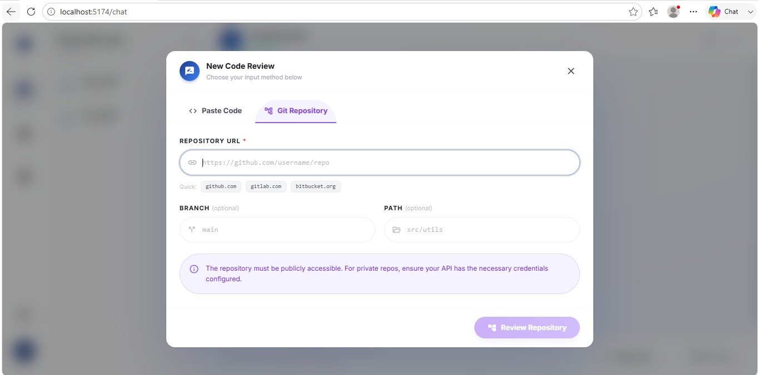
User Input Page

Slide 14
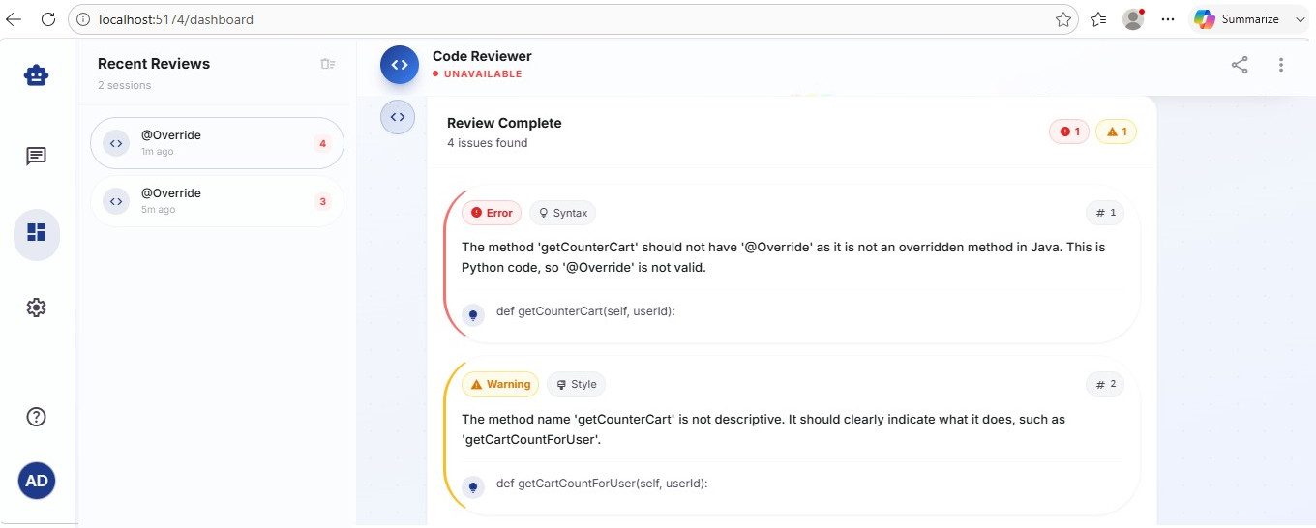
Code Review Generation

Slide 15
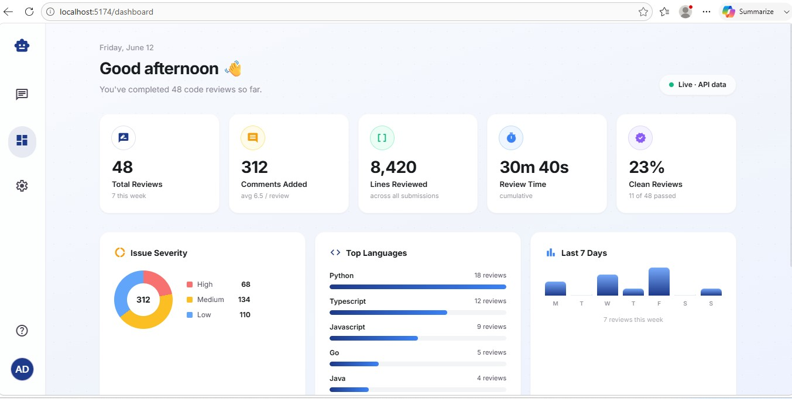
User Dashboard

Slide 16
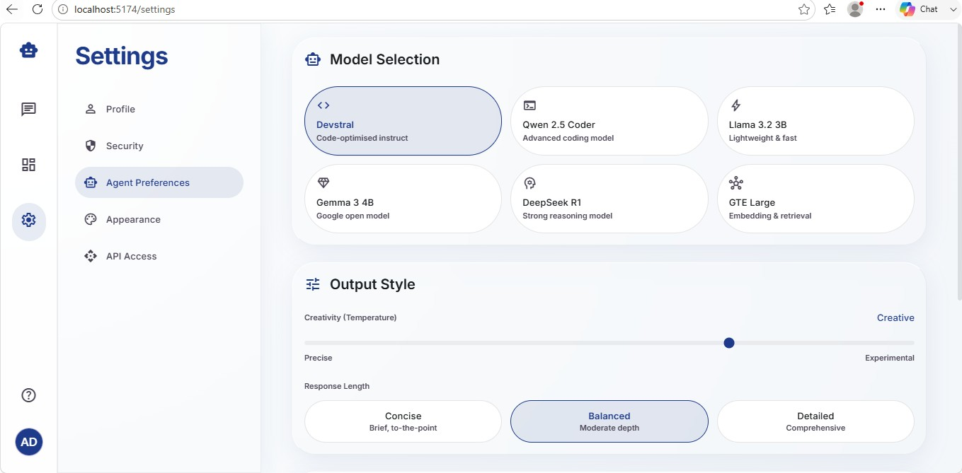
User Preference

