Slide 1

Agriculturalist_Helper using artificial intelligence
Project Report
Vivek kumar
12012031
CS 3 (A)
Mentor - Mrs. Bharati Sinha , Assistant Professor
DEPARTMENT OF COMPUTER ENGINEERING
NATIONAL INTSTITUTE OF TECHNOLOGY
KURUKSHETRA – 136119, HARYANA (INDIA)

Slide 2
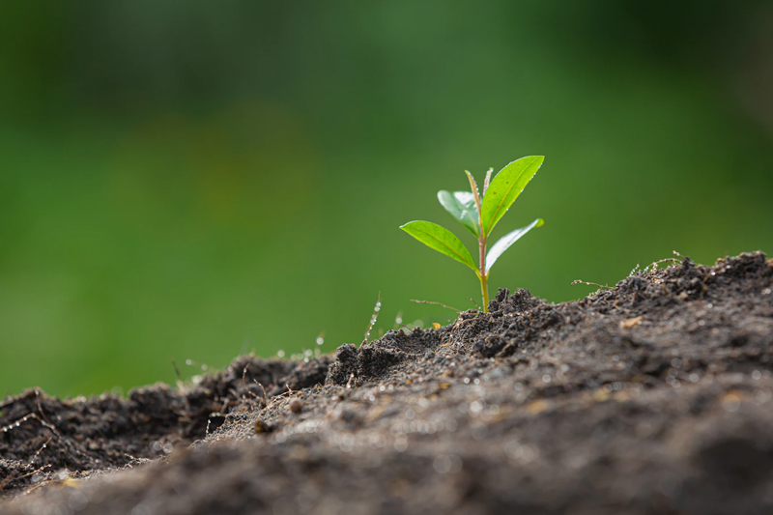
Introduction
Agriculturalist_Helper is a state-of-the-art platform that uses cutting-edge technology to revolutionize the agricultural industry. One of its key features is crop prediction, which helps farmers make informed decisions about their crops. By analyzing data from IoT sensors, weather forecasts, and historical data, Agriculturalist_Helper can accurately predict crop yield, growth rates, and potential problems.
In addition to crop prediction, Agriculturalist_Helper also offers fertilizer prediction, which helps farmers determine the right amount and type of fertilizer to use for optimal crop growth. By analyzing soil composition, weather patterns, and other data, Agriculturalist_Helper can recommend the ideal fertilizer for each crop, reducing waste and increasing efficiency.
In addition to helping farmers increase efficiency and reduce waste, Agriculturalist_Helper also aims to address some of the major challenges facing the agricultural industry, such as climate change and food security. By providing farmers with the tools they need to optimize their crops, Agriculturalist_Helper can help ensure a more sustainable and secure food supply for the future.

Slide 3
Problem Statement
The problem statement for Agriculturalist_Helper is to develop a machine learning model that can accurately predict crop yield based on various factors such as soil quality, weather patterns, and farming practices. Traditional methods of crop yield prediction rely on manual observation and estimation, which are prone to errors and may not take into account all relevant factors that affect crop yield. The model will be trained on historical data from different farms and will use predictive analytics to provide farmers with actionable insights on how to optimize their yield.
Fertilizer prediction is a process of predicting the most suitable fertilizer to be used for a particular crop or plant. The prediction is usually based on various factors such as the type of soil, climate, and plant nutrient requirements. The aim of fertilizer prediction is to help farmers increase crop yield by providing them with the appropriate fertilizer to improve soil fertility and optimize crop growth.

Slide 4
TECHNOLOGIES
Software Platform
Front-end
HTML
CSS
Javascript
Bootstrap
Software Platform
Back-end
Python
Flask
Tensorflow
Heroku
Machine learning models
Deep learning model
Weather API
Hardware Platform
RAM
Hard Disk
OS Editor
Browser etc.

Slide 5
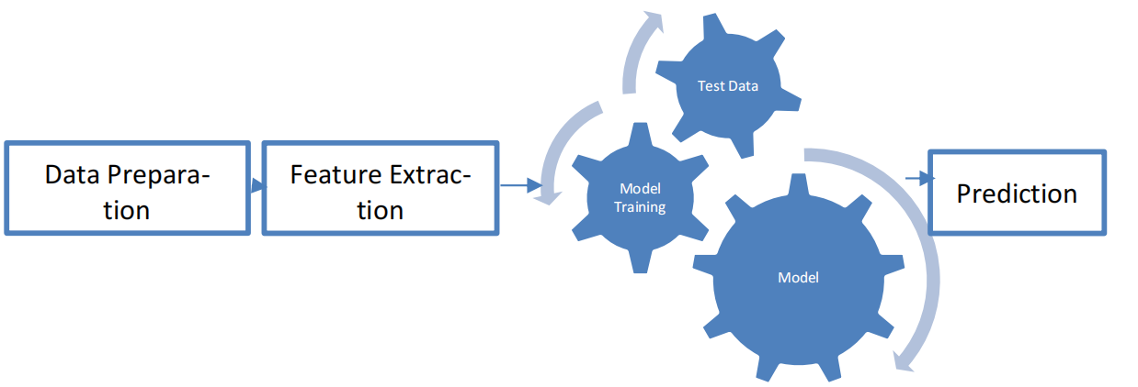
Modules
Data Module:-
It is a very most first module of this project. To train the Machine learning model it’s is important to collect the necessary dataset. In this module the data collection and data preprocessing has been done. With the help of pre-processing, it selects the features and find the correlation between the attributes of the dataset. In this firstly we download the dataset of crop prediction, fertilizer prediction and disease prediction from Kaggle. We load this the CSV file in our model and see the head to know how the data look like and group it by area type. Data cleaning process is start with handling the NA values in which we use is null function. In this we have used different function like drop NA values, unique value function so that we can differentiate between them .

Slide 6
Modules
Feature Engineering
This module is also called as dimensionality reduction. The main motive of this model is used remove the redundant features or the error from the give dataset. In feature engineering we create new feature which is helpful in future for outlier detection and removal in later stage. In our dataset label (crop type) is the categorial feature which cause problem if we have so many labels (crop type) at the same time. It creates problem in searching the best crop, fertilizer and disease analysis.
For example, some features that can be relevant for predicting crop yield include temperature, rainfall, soil pH, and soil nutrients such as nitrogen, phosphorus, and potassium. These features can be transformed using techniques such as normalization, standardization, or feature scaling to ensure that they have similar ranges and are on the same scale.
Outlier Detection
Outlier are the data points which are the data errors or sometimes they are not the errors but they represent the extreme variations in the dataset. So, it is better to remove them on time otherwise it creates problem in further processing. For removing the outlier, we can use different technique like standard deviation or we can use simple or domain knowledge. In this we set some threshold value and compare these values by using standard deviation method.

Slide 7
Modules
Model Module
In this module, firstly we train different-different machine learning algorithm model on the same data and check their accuracy and select the best fit algorithm which give high accuracy result and prediction as a crop recommendation algorithm and use for further process.
For Fertilizer Recommendation we use the same algorithm which is used by crop recommendation as they need same data as an input like Nitrogen, Potassium, Phosphorus, Ph value, rainfall in mm, location to predict the crop and fertilizer. For Disease Prediction which is a part of image classification we use the CNN and RS-Net to process the image and predict the result for this we use GPU to train our model for this GPU is not provided on every platform to train the model again and again so we train the model only once’s and save that model for the future uses.
The algorithm we check for best accuracy is: -
• Decision Tree Classifier
• Support Vector Machine Classifier
• Random Forest Classifier
• Logistic Regression
• Gaussian Naïve Bayes
• KNN

Slide 8
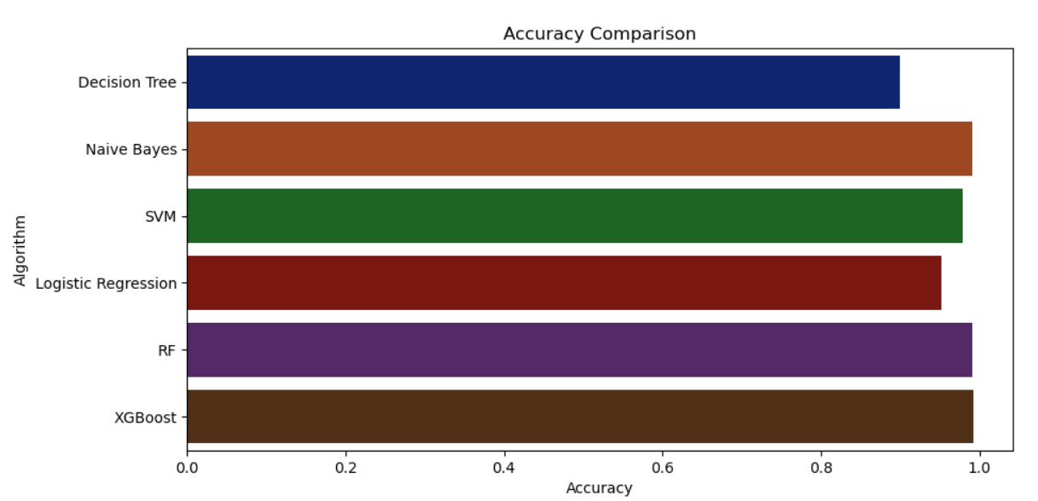

Slide 9
Modules
Application Module
The application model in the Agriculturalist_Helper model can be developed as a web or mobile application that farmers can use to access the various functionalities of the system. The application should provide a user-friendly interface that enables farmers to input the necessary information such as soil and weather data to generate recommendations for crop management.
This module is divided in three parts i.e., Crop Recommendation, Fertilizer Recommendation and Plant Diseases Prediction. For crop recommendation we take several inputs of soil testing and taking location as an input and through weather API we fetch the rainfall condition in that area and recommend the best crop based upon the input. For Fertilizer recommendation we take soil testing result values as an input and the crop that you want to grow and then recommend the fertilizer. For Diseases it will take image as an input and then classify the result and predict the diseases and crop and the prevention method and solutions.

Slide 10
Advantages
There are several advantages to using machine learning in the Agriculturalist_Helper project:
Better Yield Predictions: Machine learning algorithms can analyze data on crop yields, weather patterns, soil types, and other environmental factors to predict with high accuracy, the crop yield. This helps farmers make informed decisions regarding crop rotation, fertilization and irrigation, which ultimately leads to an increase in the overall productivity of crops.
Efficient Resource Management: Machine learning algorithms can identify factors that are critical for crop growth, such as temperature, humidity, sunlight and soil moisture, allowing farmers to optimize the resources needed for each crop. This helps to reduce waste and save resources, making farming more efficient and cost-effective.
Improved Precision Agriculture: With the help of machine learning, farmers can implement precision agriculture practices. This involves using sensors and drones to monitor the health and growth of crops in real-time. Machine learning algorithms can process this data to identify any issues with crops, allowing farmers to intervene early to protect their crops.
Better Decision-making: Machine learning algorithms can analyze large datasets on weather patterns, soil types, and crop yields, enabling farmers to make well-informed decisions. They can be used to evaluate the impact of various factors on the agricultural yield, allowing farmers to optimize their decisions.
Higher Efficiency: The use of machine learning algorithms in the Agriculturalist_Helper project helps to significantly reduce the time and effort required to monitor crops, analyze data, and make decisions. This leads to higher productivity, improved yield, and greater profitability for farmers.

Slide 11
Conclusion
The Agriculturalist_Helper project using machine learning aims to provide farmers with data-driven decision-making tools to optimize their crop yields and increase profitability. By using machine learning algorithms to analyze historical data on soil quality, weather patterns, and farming practices, the project aims to identify the most significant factors that affect crop yield and provide actionable insights to farmers.
Through the use of machine learning, the Agriculturalist_Helper project can provide accurate predictions on crop yield, which can help farmers make informed decisions on when to plant, harvest, and fertilize their crops. The project can also help farmers optimize their use of resources such as water and fertilizer, reduce waste, and improve the sustainability of their farming practices.
The success of the Agriculturalist_Helper project will depend on the quality of the historical data used for training the machine learning models and the accuracy of the predictive models. The project also requires a user-friendly web application that farmers can easily access and use to input their farm data and receive predictions on their crop yield.
Overall, the Agriculturalist_Helper project has the potential to revolutionize the agriculture industry by providing farmers with data-driven decision-making tools to optimize their crop yields and contribute to global food security.

Slide 12
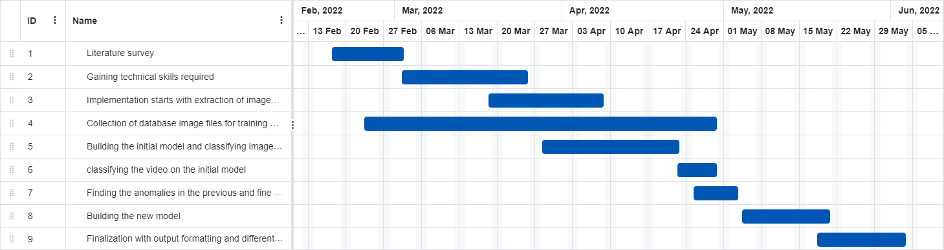
Gantt chart

Slide 13
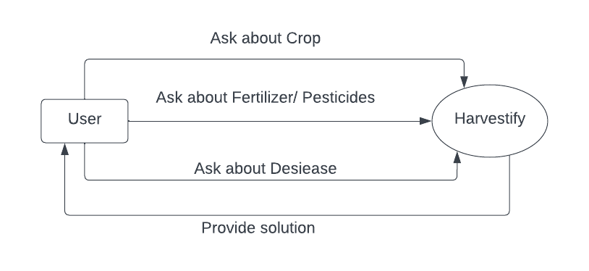
DFD (Zero Level)
T004/ Version 1.0

Slide 14
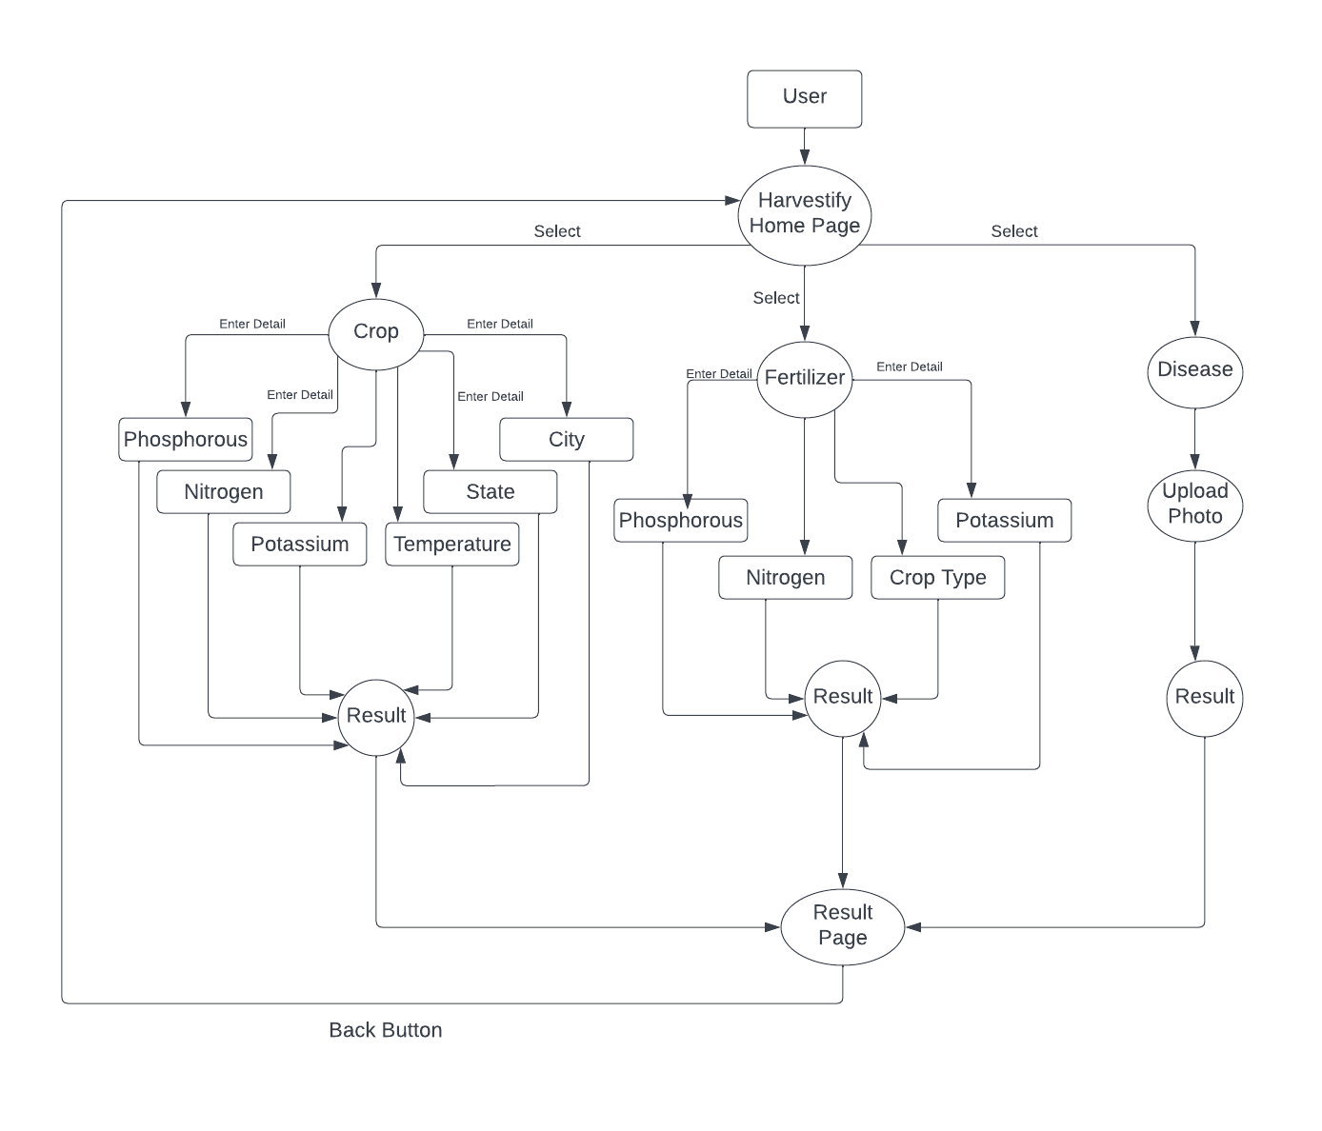
DFD (One Level)
T004/ Version 1.0

Slide 15
THANKS
T004/ Version 1.0

