Slide 1
TITLE: PCB Designing using Altium Designer
Single Layer to Multi Layer
Presenters:
Praneeth (1602-23-735-089)
Rohit (1602-23-735-095)
Vivek (1602-23-735-127)

Slide 2
Contents:
Introduction
Aim & Objectives
Literature Survey
Proposed Designs (Single and Multi-layer)
Implementation (Single and Multi-layer)
Results (Single and Multi-layer)
Conclusion & Future Scope
References

Slide 3
Introduction
PCB: Printed Circuit Boards connect electronic components using copper tracks. They form the foundation of every electronic device, providing support and connectivity.
Altium Designer:
Altium Designer is a professional PCB software that allows schematic design, layout,
simulation, and 3D visualization for manufacturing-ready designs.
Why only Home Automation? Home automation uses IoT technologies to control appliances remotely. It improves comfort, saves energy, and is becoming a major trend in smart living.

Slide 4
Aim & Objectives
Aim:
To design and develop a reliable PCB for smart home control using ESP32 Micro-controller
and Altium Designer.
Objectives:
Create a single and multilayer PCB.
Interface relay modules for appliance control.
Ensure manual switch control is available.
Build an efficient power supply circuit.

Slide 5
Literature Survey
Importance of PCB in software Design:
To design and develop a reliable PCB for smart home control using ESP32 and Altium
Designer.
Altium Designer Special Features:
Altium offers real-time error checking, large component libraries, advanced routing tools,
and full 3D previews for professional PCB creation.
Use of ESP32 Micro-controller: ESP32 microcontrollers provide Wi-Fi, Bluetooth, and GPIO capabilities, making them ideal for smart home automation projects.

Slide 6
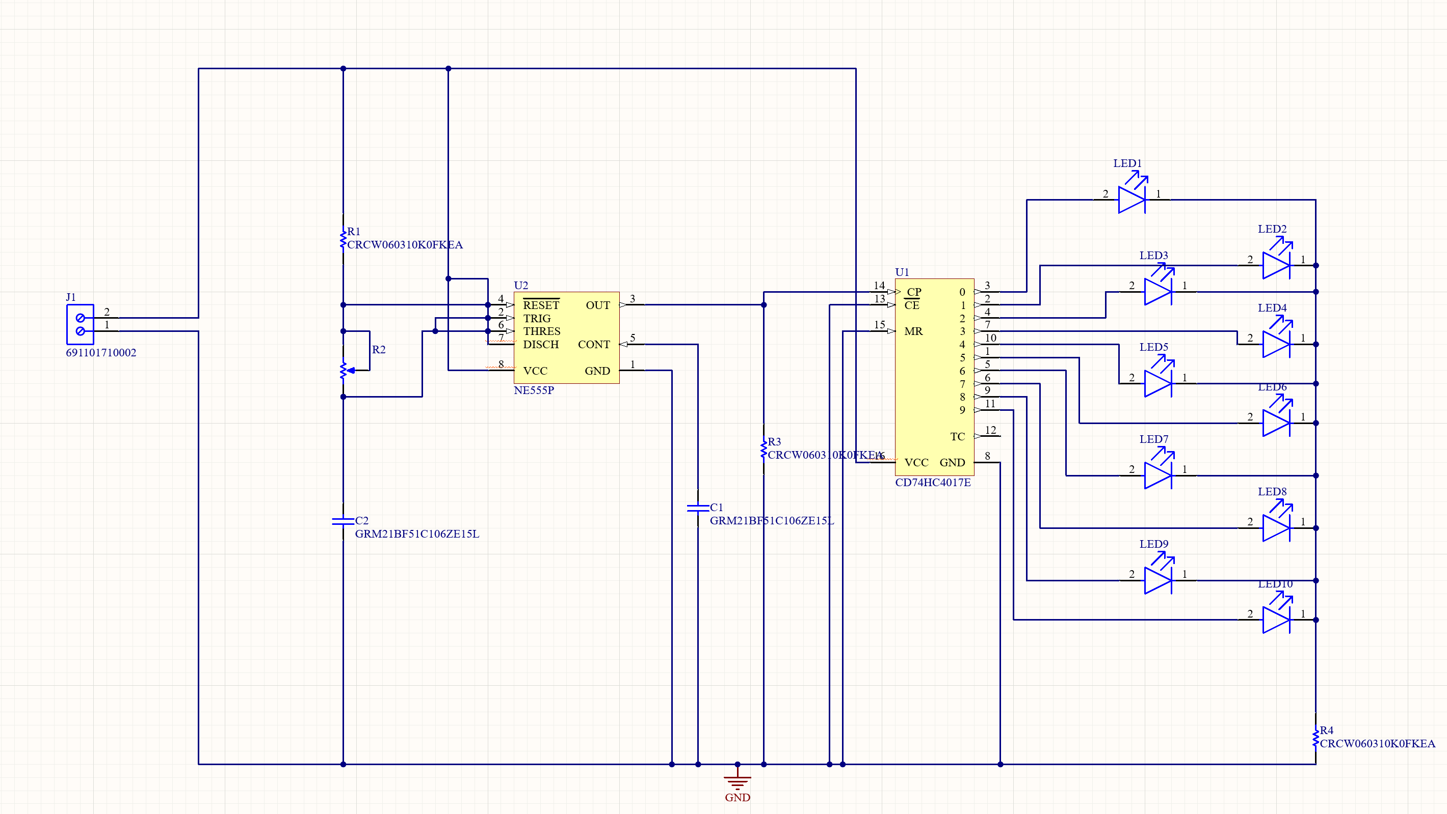
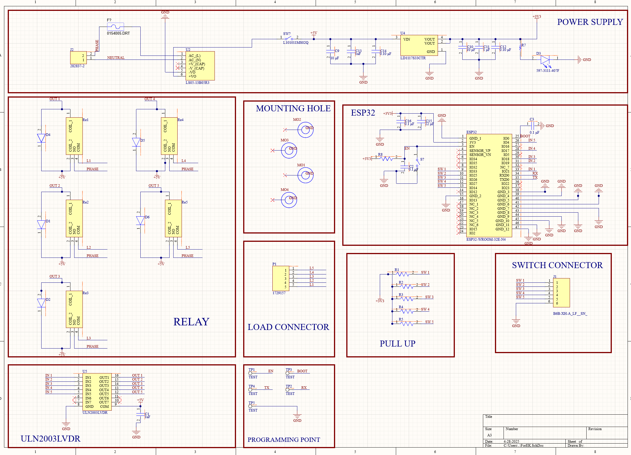
Proposed Designs
Single Layer (LED Chaser Circuit): This design uses a 555 Timer to generate pulses that drive a counter, lighting LEDs in sequence. It demonstrates simple PCB concepts.
Multi-layer (Smart Home Automation):
Uses an ESP32 controller and relays to automate appliances.
The multi-layer PCB ensures compactness, low noise, and reliable power
distribution.

Slide 7
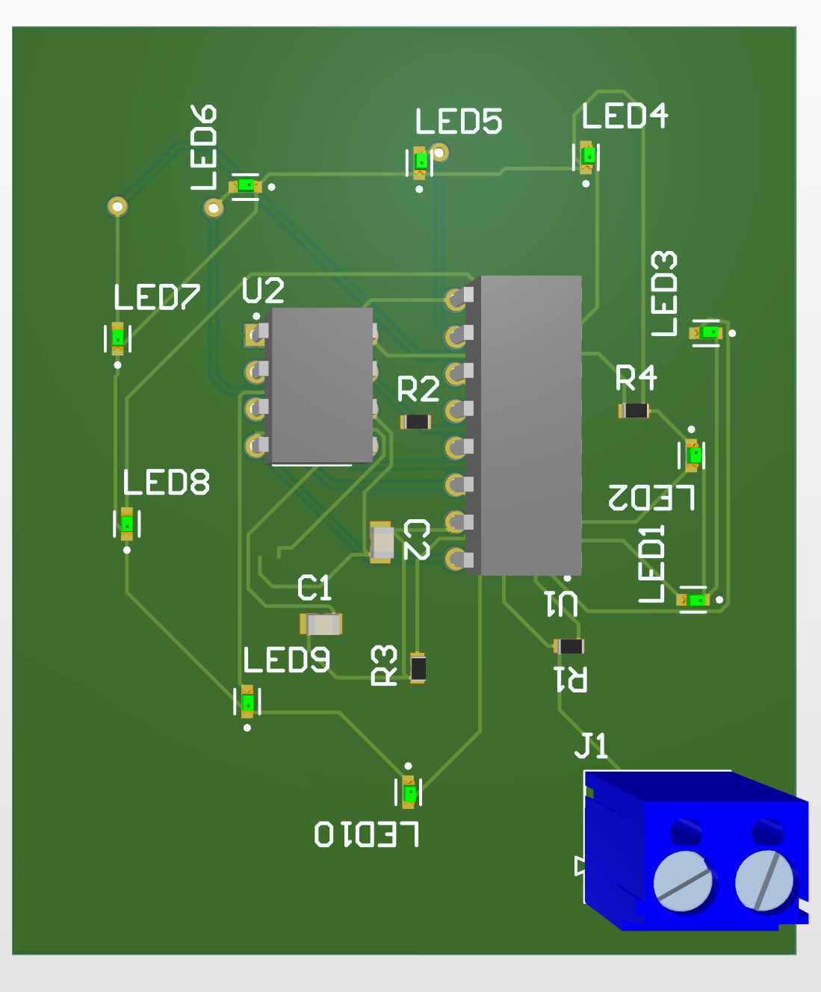
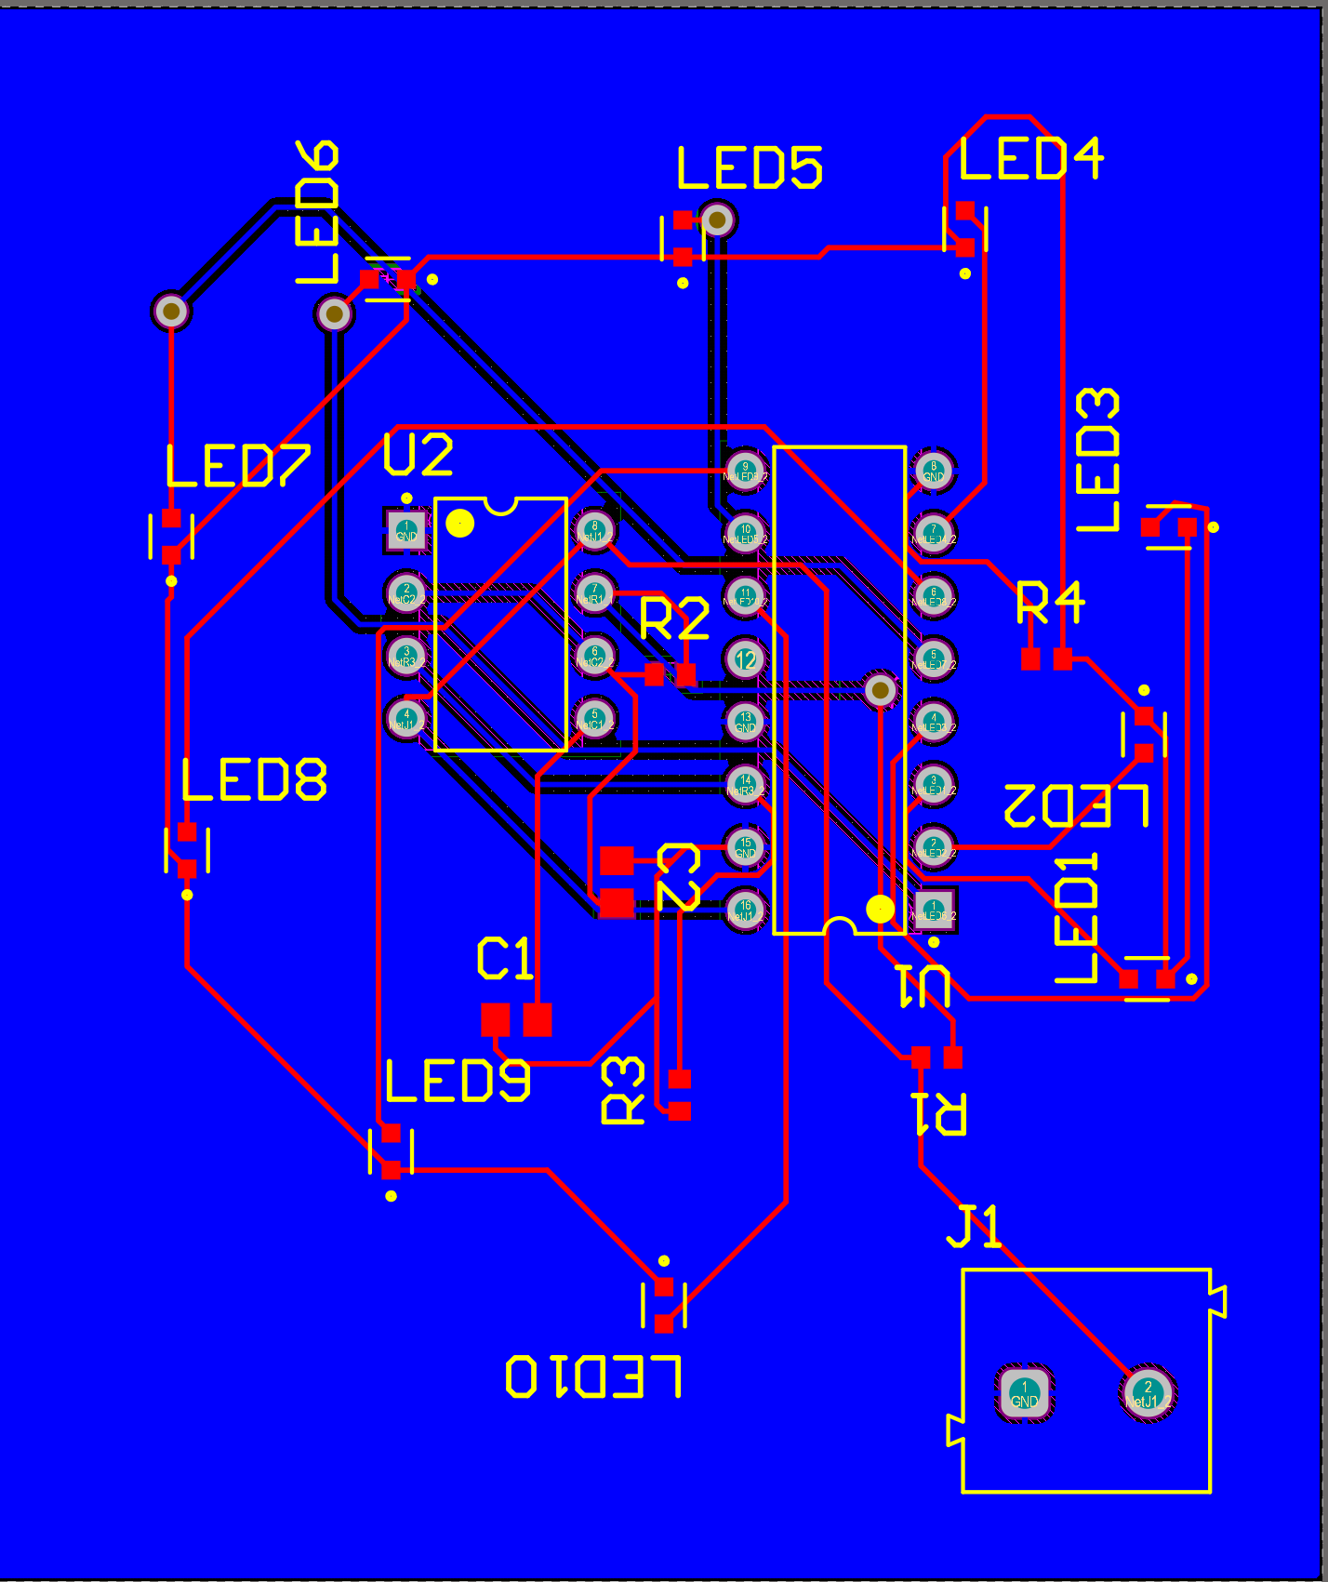
Implementation - Single Layer
The single-layer circuit uses a 555 Timer IC in astable mode to generate clock pulses. These pulses are fed into a decade counter, which sequentially lights up the LEDs. Each LED is connected through a current-limiting resistor to ensure safe current levels. This simple design helps us understand basic PCB concepts like component placement and signal routing.

Slide 8
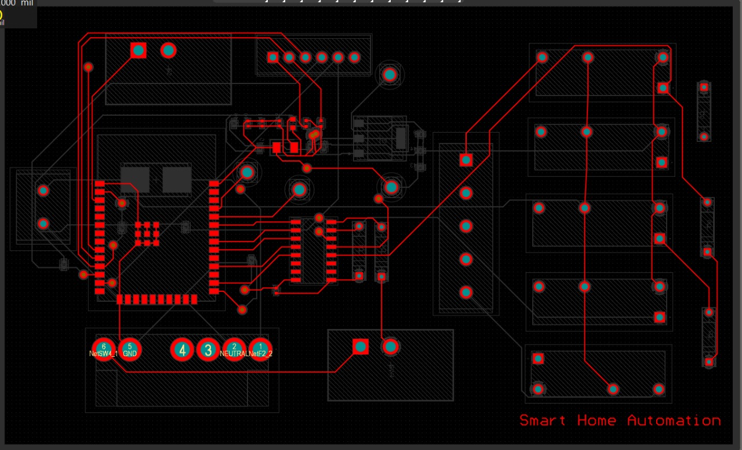
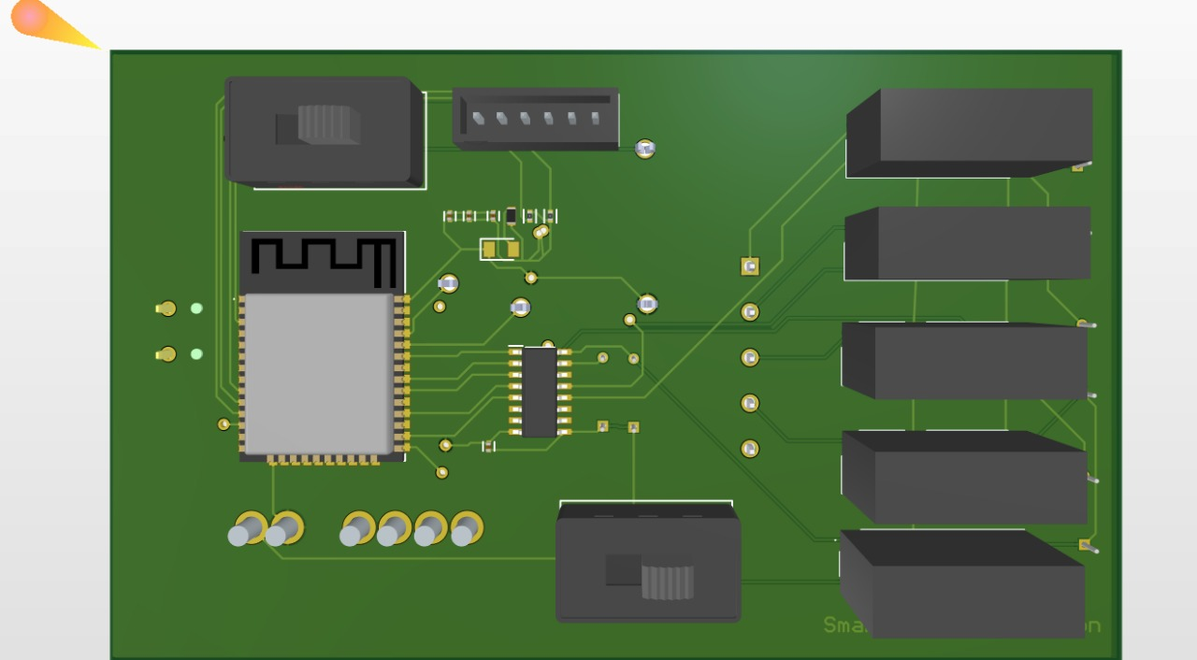
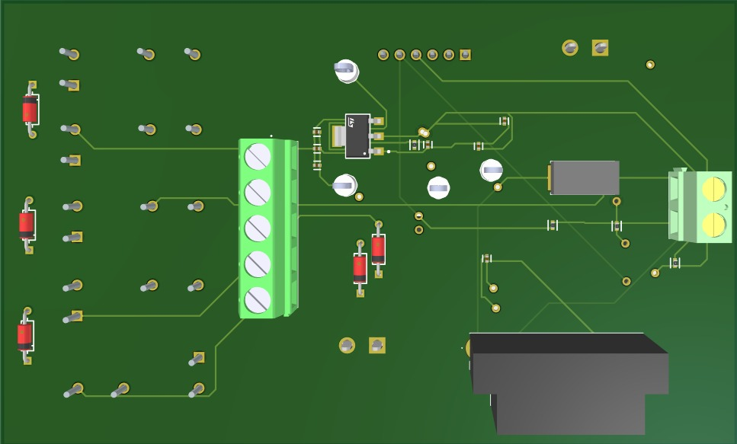
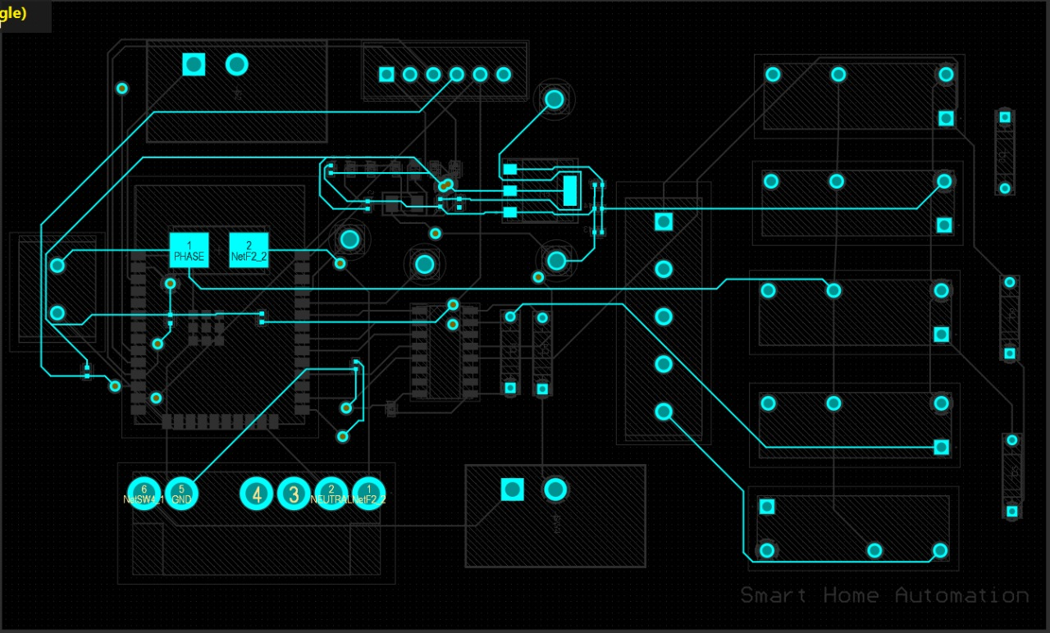
Implementation – Multi Layer
The multi-layer circuit is based on the ESP32 microcontroller, which controls multiple appliances through relay modules. The ESP32 communicates with the relays to switch appliances on and off based on user input. The six-layer PCB ensures efficient power distribution and minimizes noise for stable operation, making it suitable for complex systems like home automation.

Slide 9
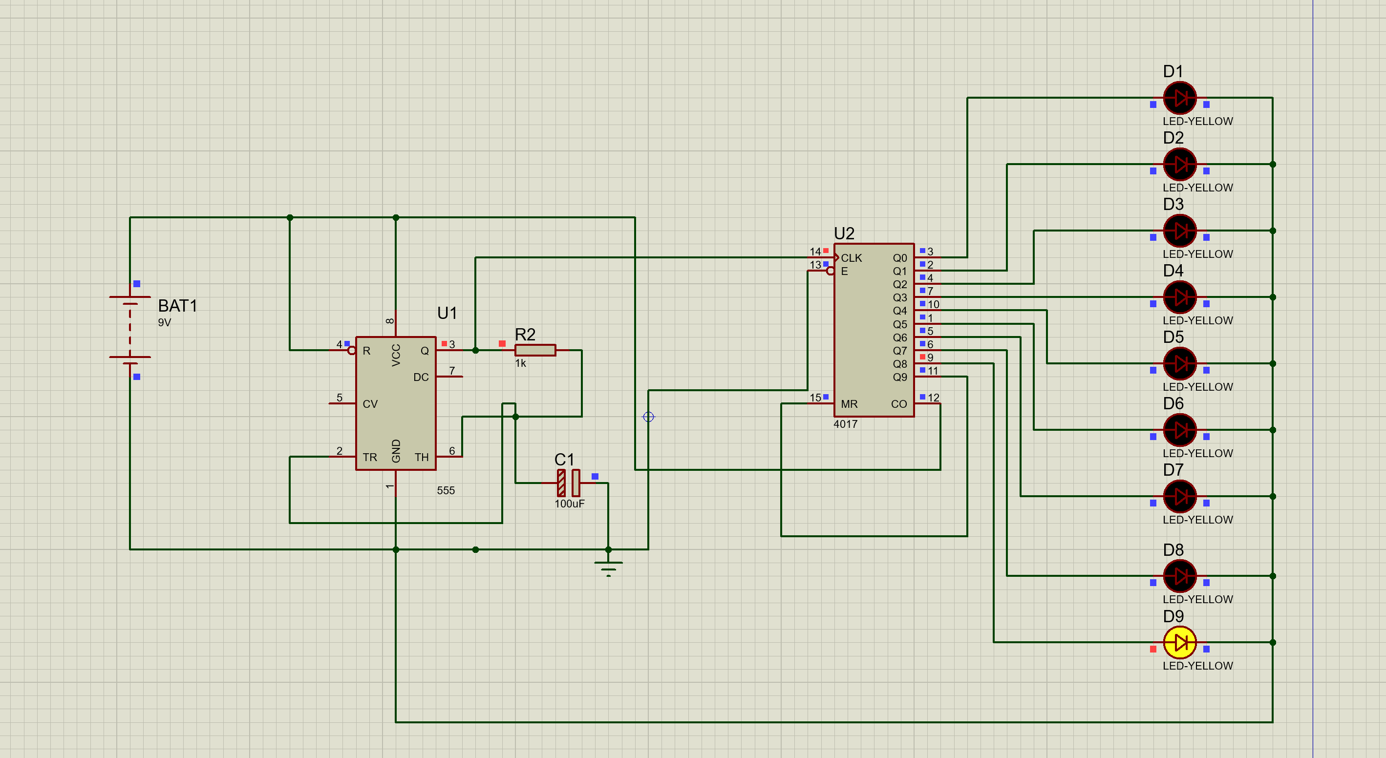
Results – Single Layer
LED Chaser Circuit:
The fabricated PCB worked as expected, sequentially lighting LEDs. 3D visualization confirmed correct placements, and Gerber outputs were ready for production.

Slide 10
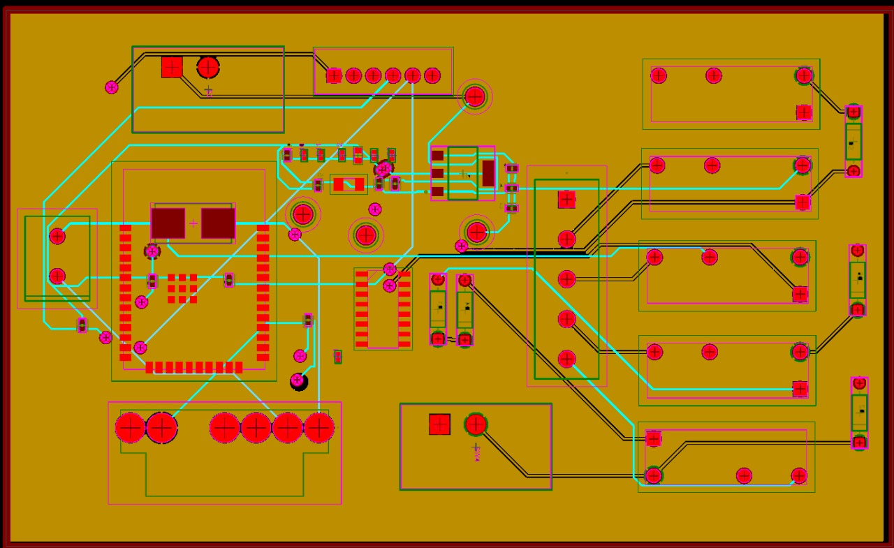
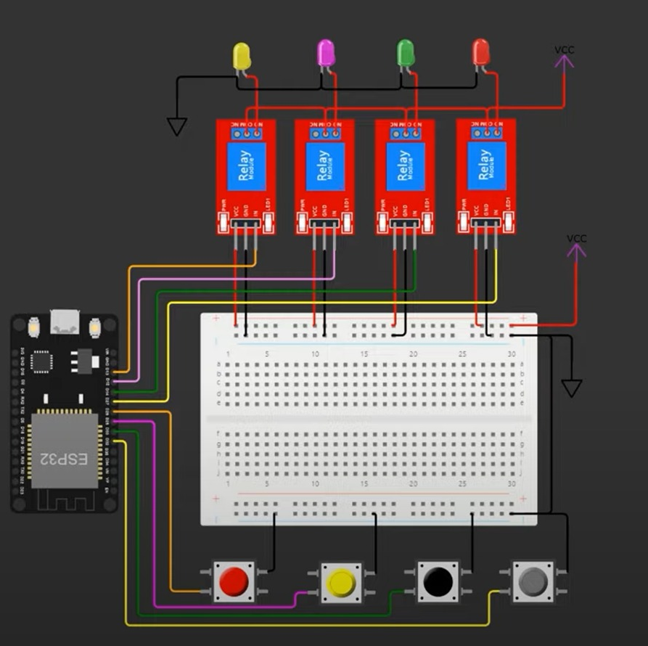
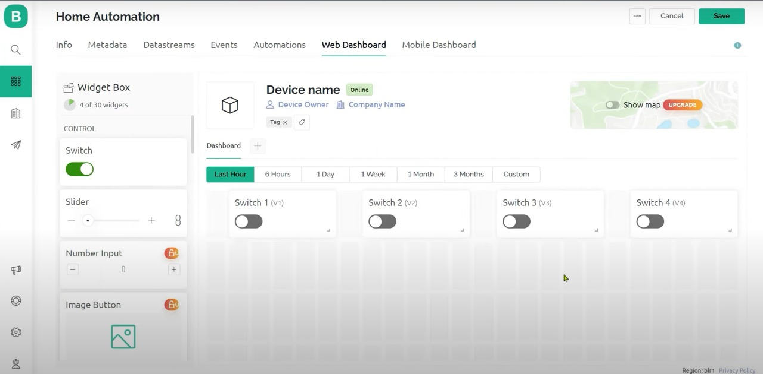
Results – Multi Layer
Smart Home Automation:
The multilayer PCB was successfully verified. All ERC and DRC checks passed, and the 3D models showed proper layer connections. Fabrication-ready files were generated.

Slide 11
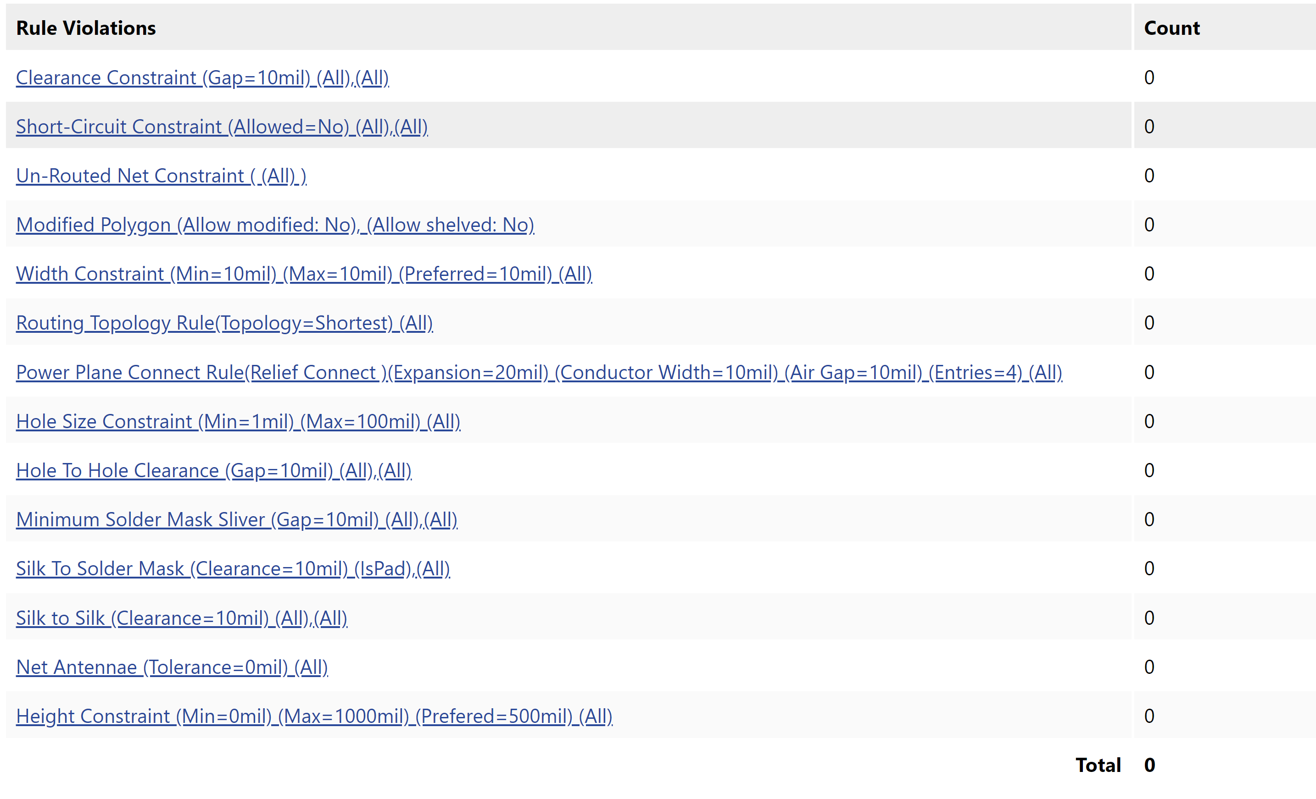
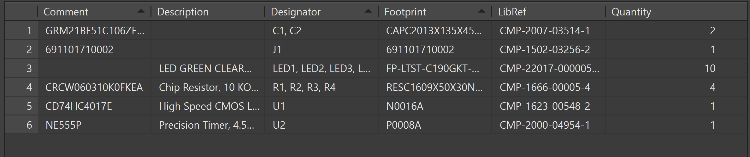
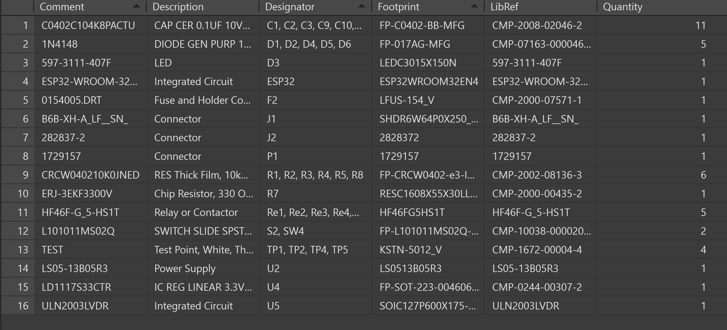
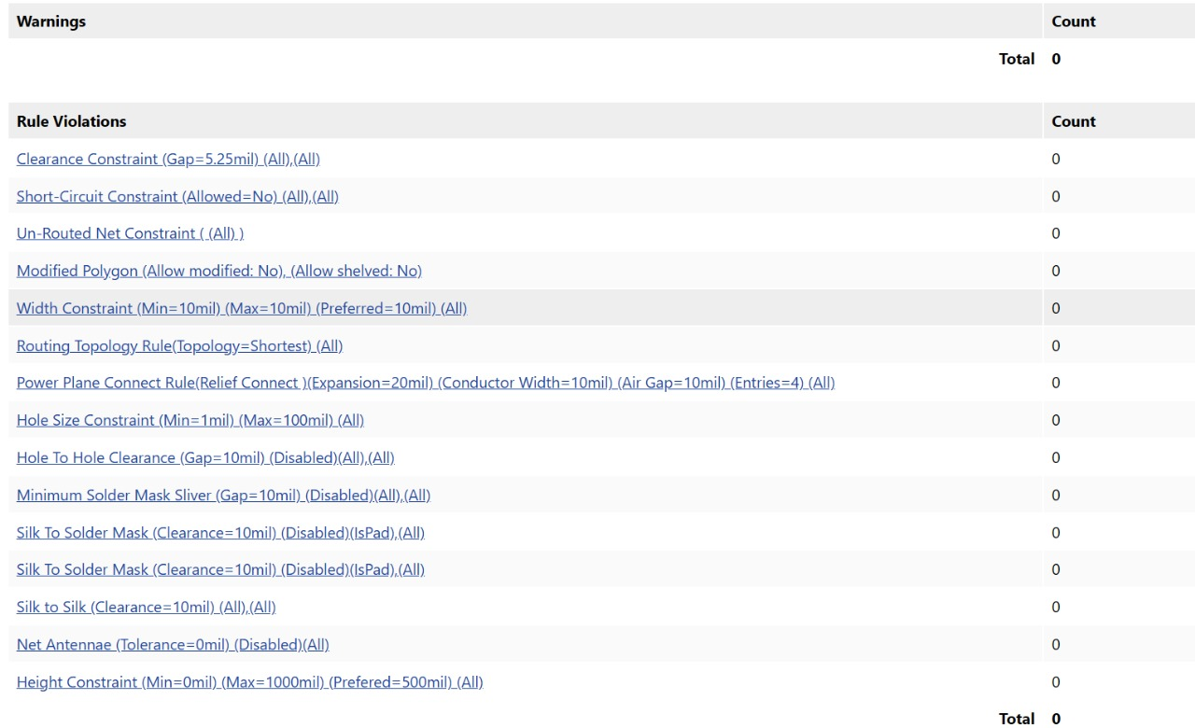
Testing and Verification
ERC and DRC checks confirmed no design errors. SPICE simulations validated circuit behavior. BOM was reviewed, and 3D clearance tests ensured no physical conflicts.

Slide 12
Conclusion
Single Layer:
We started by designing a single-layer PCB for an LED chaser circuit using Altium Designer. It
helped us learn the basics like schematic creation, component placement, routing, and
Gerber file generation. After fabrication, the circuit worked exactly as expected, with LEDs
blinking sequentially. This gave us confidence in handling simple PCB designs.
Multi Layer:
We designed a multi-layer PCB for a smart home automation system using ESP32. We
created a six-layer stack, manually routed critical signals, and focused on efficient power
distribution and noise reduction. The final PCB successfully controlled multiple appliances,
showing how multilayer PCBs are important for real-world applications.

Slide 13
Future Scope
Possible Enhancements:
Future improvements could add Bluetooth or MQTT control, integrate sensors like
temperature and humidity, and create mobile apps for easier remote management.
Additionally, there’s potential to move to the cloud, where users could control their home
appliances remotely, and even gather data for analytics. A local control system using
physical switches can also be a handy backup for scenarios where the network might be
down.

Slide 14
References 1.Espressif Systems, ESP32 Datasheet, [Online].
Available: https://www.espressif.com/en/support/download/documents
2. Altium LLC, Altium Designer Documentation, [Online].
Available: https://www.altium.com/documentation
3. IEEE, Papers on Smart Home Systems, IEEE Xplore Digital Library, [Online].
Available: https://ieeexplore.ieee.org/Xplore/home.jsp
4. Stack Overflow, Reddit Embedded Systems Community, Technical Discussions
and Troubleshooting Resources, [Online].
Available: https://stackoverflow.com/ and
https://www.reddit.com/r/embedded/
5. EEVblog Forum, Altium Designer Tips and Discussions, [Online].
Available: https://www.eevblog.com/forum/altium/

Slide 15
THANK YOU

