Slide 1

B.E – ECE, VII Semester
Project Seminar (U21PW719EC)
Abstract Level Presentation on
Integrating Language Models with Sensor Fusion for Robust Autonomous Driving
Batch Number : 6
Roll No. | Name of the Student
1602-23-735-127 | Vivek
Under the guidance of
Mr. B. Uma Mahesh Babu
Assistant Professor

Slide 2
Outline of our Presentation
Introduction
Motivation
Literature Survey
Aim & Objectives
Block Diagram
Methodology
Applications
Results & Comparison
Conclusion & Future Scope
References

Slide 3




Introduction
The Autonomous Driving Challenge
Autonomous vehicles must perceive and react to complex, constantly changing road environments in
real time.
Classical pipelines fuse camera, LiDAR/ToF, radar, IMU and GPS/GNSS data — but rule-based decision
logic struggles with novel or ambiguous scenarios.
Large Language Models (LLMs) offer contextual, human-like reasoning over rich scene descriptions,
but need to be grounded in real sensor data and constrained for safety.
This project combines multimodal LLM reasoning with multi-sensor fusion inside a deterministic,
safety-checked closed control loop.

Slide 4


Introduction
Our Proposed Approach
An LLM-assisted, closed-loop autonomous driving framework: sensor fusion builds a structured scene representation, an LLM reasons over it to propose high-level driving decisions, and a deterministic safety layer validates every decision before it reaches the vehicle's controllers.
Sensor Fusion
LLM Reasoning
Safety Layer
Embedded Control
Camera, LiDAR/ToF, radar, IMU and GPS/GNSS synchronized into one scene context.
Interprets road context and traffic to propose high-level maneuvers and goals.
Validates or corrects every LLM decision using deterministic collision & rule checks.
Jetson-class AI compute + real-time MCU drive motor and steering actuation.

Slide 5
Motivation
Contextual Reasoning: LLM-based reasoning can interpret complex, rare or ambiguous road situations better than fixed rule sets.
Safety Without Compromise: A deterministic validation layer keeps the flexibility of LLM decisions while guaranteeing safety constraints.
Robust Perception: Fusing camera, LiDAR/ToF, radar, IMU and GPS reduces failure from any single degraded sensor.
Real Hardware Relevance: Embedded AI compute and MCU integration make the framework deployable, not just simulated.
Measurable Improvement: Clear metrics — collision rate, route completion, latency — quantify gains over baseline planners.

Slide 6
Literature Survey
S.No. | Paper Title : Year | Method | Remarks
1 | DriveGPT4-V2: Harnessing LLM Capabilities for Enhanced Closed-Loop Autonomous Driving : 2025 | Multimodal LLM as high-level decision module; closed-loop CARLA evaluation | Base paper — LLM reasoning directly drives closed-loop control decisions.
2 | Domain Knowledge Distillation from LLM: An Empirical Study in the AD Domain : 2023 | Knowledge distillation from a large LLM into a compact student model | Shows domain-specific distillation retains driving-relevant reasoning at lower compute cost.
3 | Optimal Scene Graph Planning with Large Language Model Guidance : 2024 | Structured scene-graph representation + LLM-guided planning | Demonstrates LLM-guided planning over structured scene graphs for navigation.
4 | Distilling Multi-modal Large Language Models for Autonomous Driving : 2025 | Multi-modal LLM distillation for on-vehicle inference | Improves real-time feasibility of multimodal LLM inference for AD deployment.
5 | Model Optimization in Deep Learning Based Robot Control for Autonomous Driving : 2024 | Deep-learning control-model optimization | Optimizes control models for latency- and resource-constrained autonomous driving.

Slide 7
Aim & Objectives
Aim:
  To design and develop an LLM-assisted, closed-loop autonomous driving framework that fuses camera, LiDAR/ToF, radar, IMU and GPS/GNSS data with a deterministic safety layer, evaluated in the CARLA simulator and, where feasible, on embedded hardware..
Objectives:
  Synchronize and fuse multi-sensor data into a structured scene representation.
  Use a language model as a high-level reasoning module for driving-decision generation.
  Design a deterministic safety layer that validates or corrects LLM-proposed decisions.
  Convert validated decisions into waypoints and control commands via a trajectory controller.
  Integrate an embedded AI platform and microcontroller for real-time actuation.
  Evaluate the system using collision rate, route completion, trajectory error, intervention rate, control stability and inference latency.

Slide 8
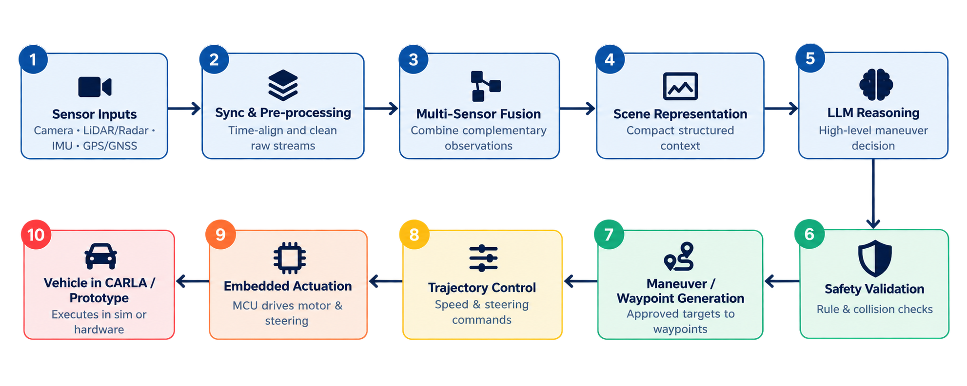
Block Diagram
System Design Methodology — Signal & Decision Flow

Slide 9

Methodology
Perception & Reasoning Stages
1. Sensor Acquisition & State Extraction
Obtain camera/object information, range/depth measurements, IMU data, GPS/GNSS position, ego speed, heading and route state.
2. Sensor Fusion & Scene Representation
Time-align and combine complementary sensor observations; encode objects, lanes, distances, traffic-light state, route goal and vehicle state into a compact structured context.
3. LLM Reasoning
Apply prompt-constrained multimodal reasoning over the scene context to select a high-level maneuver and desired driving behavior.

Slide 10


Methodology
Safety, Control & Evaluation
4. Safety Layer
Reject or modify unsafe LLM actions using collision checks, road/lane constraints, speed limits, minimum-distance rules and sensor-validity checks.
5. Closed-Loop Control & Hardware Actuation
Translate the approved maneuver into waypoints/target speed; the embedded controller drives the motor and steering actuator while vehicle state feeds back into the next cycle.
6. Evaluation
Compare the LLM-assisted sensor-fusion system against a baseline using collision rate, route completion, trajectory error, intervention rate, control stability, sensor-degradation robustness and inference latency.

Slide 11



Applications
Autonomous Passenger Vehicles
Advanced Driver Assistance (ADAS)
Self-driving cars using LLM reasoning for complex urban navigation.
LLM-augmented reasoning layered on existing driver-assist systems.
Autonomous Delivery Robots
Agricultural Autonomy
Last-mile delivery vehicles navigating mixed pedestrian-traffic zones.
Autonomous tractors and field vehicles operating in unstructured terrain.

Slide 12
Experimental Results
Closed-loop CARLA evaluation — repeated runs removed (12 logged → 4 unique results)
Test case | DS | RC (%) | IS | Latency (ms) | FPS | Primary failure mode
TC_01 Clear lane | 100.0 | 100.0 | 1.00 | 125 | 8.0 | None
TC_02 Static obstacle | 100.0 | 100.0 | 1.00 | 125 | 8.0 | Missed overtake (119)
TC_03 Rain + obstacle | 41.8 | 41.8 | 1.00 | 125 | 8.0 | Missed overtake (119)
TC_04 Urban jaywalker | 95.0 | 95.0 | 1.00 | 125 | 8.0 | None
Mean (4 scenarios) | 84.2 | 84.2 | 1.00 | 125 | 8.0 | —
0
0
0
0.0
collisions (pedestrian, vehicle, static)
red-light violations and route deviations
timeouts and agent blocks
km/h L1 speed error, 0 % DAgger takeover
Models tested: qwen2.5:0.5b, qwen2.5:1.5b, llama3.2:3b — all three gave identical values in every scenario, so repeated rows are merged. DS = RC × IS; scenarios as defined in our CARLA test suite.

Slide 13
Comparison with Base Paper
DriveGPT4-V2 (CVPR 2025, CARLA Longest6) vs. our LLM-assisted framework
Metric | DriveGPT4-V2 | Ours
DS ↑ | 70 | 84.2
RC (%) ↑ | 91 | 84.2
IS ↑ | 0.77 | 1.00
Pedestrian collisions ↓ | 0.00 | 0
Vehicle collisions ↓ | 0.80 | 0
Static collisions ↓ | 0.01 | 0
Red-light violations ↓ | 0.04 | 0
Route deviations ↓ | 0.00 | 0
Timeouts ↓ | 0.07 | 0
Agent blocks ↓ | 0.09 | 0
Safer, but less complete: IS 1.00 vs 0.77 with zero infractions, and DS 84.2 vs 70 — while RC is 84.2 % vs 91 %, pulled down mainly by the rain + obstacle scenario (41.8 %, missed overtake).
Indicative only, not like-for-like: the paper reports 36 long Longest6 routes (infraction values are event ratios); ours are 4 short CARLA scenarios (infraction values are counts). Paper values from Table 2 of Xu et al., CVPR 2025.

Slide 14
Key Observations
What the evaluation tells us
Safety first
No pedestrian, vehicle or static collisions and no red-light violations; IS stays at 1.00 in every scenario (0.77 for DriveGPT4-V2 on Longest6).
Safe but conservative
Rain + obstacle (TC_03) reaches only 41.8 % route completion. The main failure mode is a missed overtake (flagged 119 times in each of TC_02 and TC_03): the obstacle is not overtaken.
Outcome independent of model size
qwen2.5:0.5b, qwen2.5:1.5b and llama3.2:3b gave identical results, which suggests the deterministic safety and control layer dominates closed-loop behaviour in these scenarios.
Latency is the bottleneck
The control loop runs at 125 ms (8 FPS), but raw logs show roughly 2–8 s per local LLM query (0.1–0.5 FPS), so on-vehicle use needs faster or distilled models.

Slide 15
Conclusion & Future Scope
Summary of results and the road ahead
Conclusion
Future Scope
An LLM-assisted closed-loop driving framework was built and evaluated in CARLA using the same DS / RC / IS metrics as the DriveGPT4-V2 base paper.
The deterministic safety layer kept driving collision-free and rule-compliant: IS 1.00, DS 84.2 across four scenarios.
Route completion (84.2 % vs 91 %) trails the base paper, mainly due to the rain + obstacle scenario where the overtake was missed.
Results cover four short scenarios, so they are indicative; broader benchmarking is needed.
Benchmark on CARLA Longest6 / Town05 Long for a like-for-like comparison with the base paper.
Improve overtaking and gap-acceptance behaviour to raise route completion.
Reduce LLM latency with distilled, compact multimodal models.
Add LiDAR/ToF, radar, IMU and GPS/GNSS fusion, then test on a Jetson + MCU prototype.

Slide 16
References
[1] Z. Xu, Y. Bai, Y. Zhang, Z. Li, F. Xia, Kwan-Yee K. Wong, J. Wang, and H. Zhao, “DriveGPT4-V2: Harnessing Large Language Model Capabilities for
Enhanced Closed-Loop Autonomous Driving,” Proc. IEEE/CVF Conference on Computer Vision and Pattern Recognition (CVPR), 2025.
[2] Y. Tang, A. A. Bruto da Costa, X. Zhang, I. Patrick, S. Khastgir, and P. Jennings, “Domain Knowledge Distillation from Large Language Model: An
Empirical Study in the Autonomous Driving Domain,” Proc. 2023 IEEE 26th International Conference on Intelligent Transportation Systems (ITSC),
2023, doi: 10.1109/ITSC57777.2023.10422308.
[3] Z. Dai, A. Asgharivaskasi, T. Duong, S. Lin, M.-E. Tzes, G. Pappas, and N. Atanasov, “Optimal Scene Graph Planning with Large Language Model
Guidance,” Proc. 2024 IEEE International Conference on Robotics and Automation (ICRA), pp. 14062–14069, 2024,
doi: 10.1109/ICRA57147.2024.10610599.
[4] D. Hegde, R. Yasarla, H. Cai, S. Han, A. Bhattacharyya, S. Mahajan, L. Liu, R. Garrepalli, V. M. Patel, and F. Porikli, “Distilling Multi-modal Large
Language Models for Autonomous Driving,” Proc. 2025 IEEE/CVF Conference on Computer Vision and Pattern Recognition (CVPR),
pp. 27575–27585, 2025, doi: 10.1109/CVPR52734.2025.02568.
[5] S. Paniego, N. Paliwal, and J. Cañas, “Model Optimization in Deep Learning Based Robot Control for Autonomous Driving,” IEEE Robotics and
Automation Letters, vol. 9, no. 1, pp. 715–722, 2024, doi: 10.1109/LRA.2023.3336244.

