Slide 1
DEVIATHON 2.0
National Level Hackathon | GLA University, Mathura
TITLE PAGE
Problem Statement Title – ArogyaSaathi: Voice-First Triage, Chronic Care and Outbreak Early Warning
Theme / Track – Tech for Impact
Team Name – 402:SLEEP NOT FOUND
Team Member Names – Ankit Pandey, Vivek Prasad, Anshika Varshney, Unnati Khandelwal

Slide 2
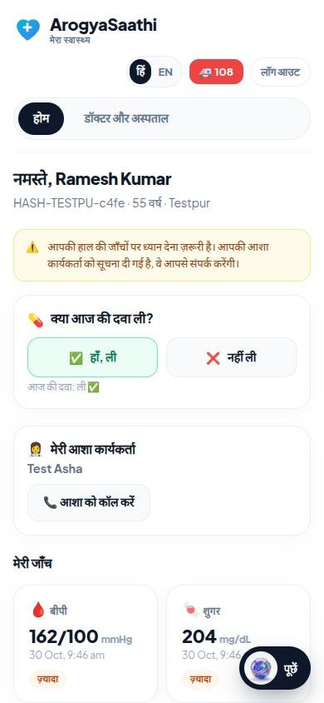
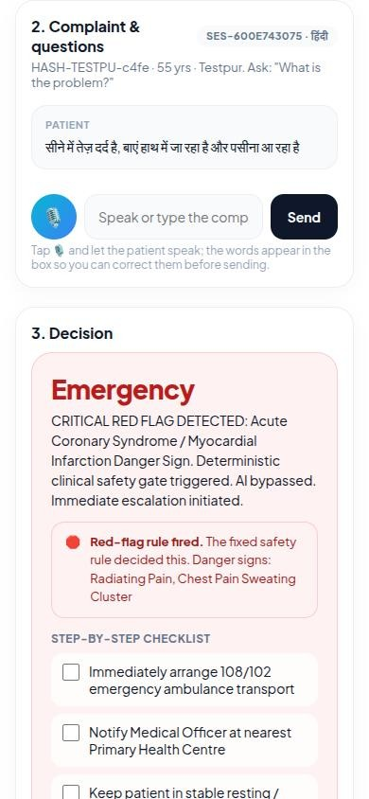
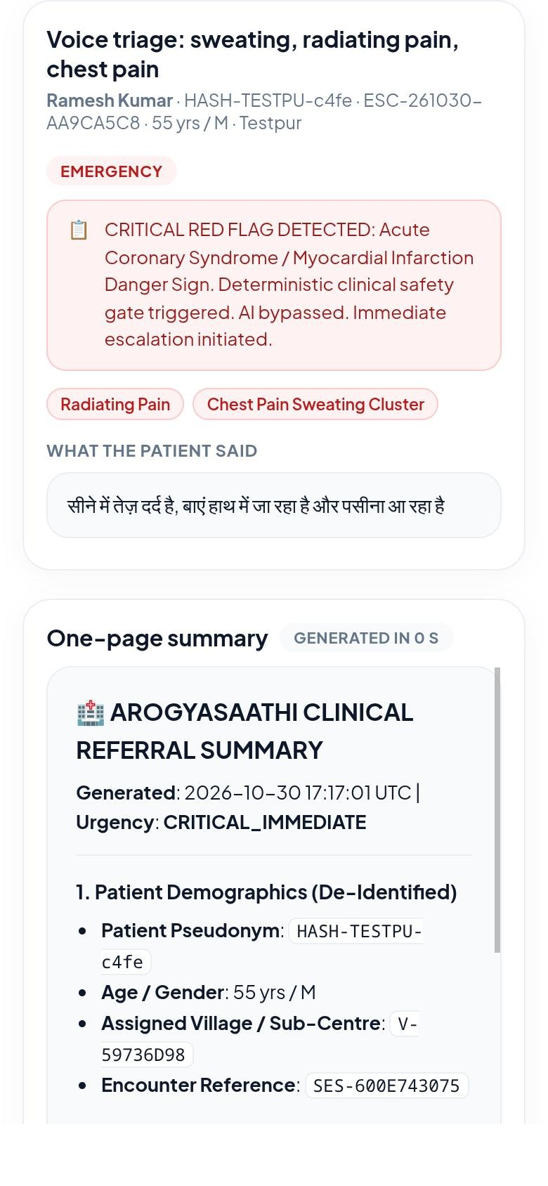
AROGYASAATHI
402:SLEEP NOT FOUND
Proposed Solution (Describe your Idea/Solution/Prototype)
Detailed explanation of the proposed solution
Voice-first health app in 5 languages (Hindi, English, Bengali, Marathi, Telugu) for patients, ASHA/ANM, PHC doctors and block officers
ASHA speaks the complaint; the app returns Emergency / Refer / Treat locally / Home care with a step-by-step checklist
How it addresses the problem
BP, sugar and missed doses tracked between visits; worsening trends go straight to the doctor
Clinic cases, chemist sales and school absence combined into village outbreak alerts
Innovation and uniqueness of the solution
Fixed red-flag rules override the AI; it never prescribes or diagnoses
One-tap 108, nearest government hospital referral, tamper-evident audit trail
Patient · Hindi
ASHA · voice triage
Doctor · escalation
Live prototype: https://16-4-93-27.sslip.io

Slide 3
TECHNICAL APPROACH
402:SLEEP NOT FOUND
Technology Stack and Methodology
Patient
ASHA / ANM
Doctor
Officer
Technologies to be used
Frontend: installable PWA (HTML/CSS/JS), Web Speech API for voice in and read-aloud, Leaflet + OpenStreetMap
Backend: Python 3.12 REST API, SQLite, encrypted names/mobiles (Fernet), scrypt passwords
AI & data: Claude API for patient chat behind the safety gate; OSM for government hospitals
Cloud: AWS Lightsail (Mumbai), Caddy HTTPS, daily database backups
Methodology and process for implementation
Triage: speech → symptom extraction (handles "no fever") → red-flag rules → triage level → doctor summary
Outbreaks: 7-day baseline z-scores per village; alert only if 2+ signals rise or the excess is large; villages within 10 km grouped
Phone app (PWA) · voice in 5 languages · works on any Android
Python API server (AWS Mumbai)
Claude API
patient chat
Voice triage
symptoms + levels
Safety gate
7 red-flag rules
OpenStreetMap
govt hospitals
Chronic care
BP / sugar trends
Outbreak engine
z-score + clusters
SQLite
encrypted PII
Hash-chained audit log: every input, rule fired, AI output and doctor override

Slide 4
FEASIBILITY AND VIABILITY
402:SLEEP NOT FOUND
Can It Be Built and Sustained?
Risk | Safeguard in the prototype
Weak internet | Offline app shell; small text requests
Noisy speech | Editable transcript, typing fallback, language chips
Unsafe AI advice | Fixed red-flag rules override AI; no prescriptions; doctor reviews escalations
False outbreak alarms | 7-day baseline; 2+ signals must rise together
Health data privacy | Encrypted PII, pseudonymous IDs, consent first, village-scoped access, audit log
Analysis of the feasibility of the idea
Working prototype already live over HTTPS on AWS with all 4 portals
Runs in any phone browser and installs like an app; only 2 server libraries
Potential challenges and risks
Weak internet, noisy speech, unsafe AI advice, false outbreak alarms and sensitive health data
Strategies for overcoming these challenges
Each risk has a built-in safeguard (see table)
Next: clinician panel review of 200+ scripted cases, Postgres + PostGIS for district scale, IVR for feature phones

Slide 5
IMPACT AND BENEFITS
402:SLEEP NOT FOUND
Value Created
5
4
Potential impact on the target audience
Patients: speak in their own language, 1-tap 108, read or hear doctor notes
ASHAs: clear treat / refer / emergency call with a checklist at the doorstep
Doctors: ranked escalation queue with a one-page summary
Officers: village-level outbreak warning on a map
Benefits of the solution
Social: earlier referrals, fewer missed deteriorations, usable by low-literacy users
Economic: catches problems before costly hospital stays; runs on phones people already own
Public health: earlier outbreak response; doctor decisions saved as labelled data to improve triage
languages by voice
connected user roles
7
0
red-flag rules that override AI
prescriptions — blocked by design
3
108
outbreak signals combined
one-tap ambulance call

Slide 6
RESEARCH AND REFERENCES
402:SLEEP NOT FOUND
Research Work and Sources
Details / Links of the reference and research work
Problem statement: DEV_107 – ArogyaSaathi: Healthcare and Public Health Access (Deviathon 2.0)
National Health Mission: ASHA programme – nhm.gov.in
Integrated Disease Surveillance Programme (IDSP), Ministry of Health & Family Welfare, Govt. of India
WHO: Integrated Management of Childhood Illness (IMCI) danger-sign guidelines
Hutwagner L. et al. (2003): Early Aberration Reporting System (EARS), Journal of Urban Health 80(Suppl 1)
Digital Personal Data Protection Act, 2023 (India) – consent and erasure rules
Web Speech API: developer.mozilla.org/en-US/docs/Web/API/Web_Speech_API
OpenStreetMap Overpass API: wiki.openstreetmap.org/wiki/Overpass_API · Leaflet: leafletjs.com
Anthropic Claude API: docs.anthropic.com
Live prototype: 16-4-93-27.sslip.io

