Slide 1


SMART INDIA HACKATHON 2026
Problem Statement ID – SIH26138
Problem Statement Title – Quantum-inspired fuel consumption prediction and green fleet optimization
Theme – Clean and Green Technology
PS Category – Software
Team ID – S16
Team Name – CloudBusters
TEAM MEMBERS
Vivek Prasad 2415001815
Ankit Pandey 2415000234
Krishna Khandelwal 2415000841
Anshika Singh 2415000265
Aniket Singh 2415000216
Devanshi Chauhan 2415000511

Slide 2
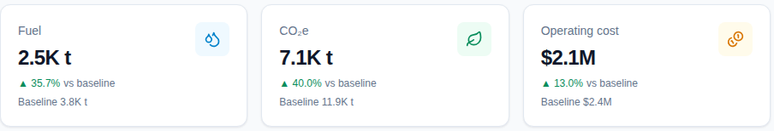
QFLEET
CloudBusters
❖ Proposed Solution (Describe your Idea/Solution/Prototype)
DETAILED EXPLANATION — ONE OPTIMIZATION LOOP
HOW IT ADDRESSES THE PROBLEM
1. ASSIGN — QIEA assigns vessels, routes and fuels — the discrete decisions.
2. TUNE — QPSO tunes sailing speed (continuous) in the same loop.
3. EVOLVE — Q-NSGA-II evolves a full Pareto front across cost, well-to-wake GHG and schedule reliability.
4. COMPLY — Every Pareto point ships with its CII rating, EEXI pass/fail and FuelEU gap computed.
Cost, GHG and schedule reliability are optimized jointly, not traded off ad hoc.
Operators pick a point on the Pareto front instead of accepting one fixed answer.
Compliance (CII / EEXI / FuelEU) is computed inside the loop, not bolted on after.
Prototype output — fuel, CO₂e and cost against the greedy baseline
INNOVATION AND UNIQUENESS
GROUNDED IN REAL PHYSICS — NOT A BLACK BOX
MILP cannot represent the non-convex V³ speed–fuel curve; QFleet can.
ML baselines only forecast — QFleet decides speed, fuel and deployment.
Single-objective GA / PSO bolt emissions on afterwards — QFleet is Pareto-native.
QUBO formulation is hardware-ready: a real annealer is a backend swap.
Admiralty V³ law and resistance modelling — hull fouling, draft and sea state.
Full tank-to-wake → well-to-wake accounting for every candidate solution.
One loop — assign, tune, evolve, comply

Slide 3
TECHNICAL APPROACH
CloudBusters
TECHNOLOGIES TO BE USED
Optimization Core
pymoo · pyqubo · dwave-neal
Hardware-ready QUBO; simulated annealing keeps demo runtime deterministic
Quantum-Inspired ML
PennyLane · Qiskit-Aer
Small statevector circuits (≤10 qubits) as feature maps — fast to simulate
Classical ML Baseline
XGBoost · LightGBM · SHAP
The benchmark QFleet must beat, with SHAP plots for interpretability
Data Pipeline
Polars · GeoPandas · Xarray
AIS + Copernicus weather at scale, stored in Parquet — not CSV
Backend
FastAPI · Celery · Redis
Optimization runs (2–5 min) go to an async job queue, never a blocking request
Reporting & Infra
WeasyPrint · Docker Compose
Auto-generated CII / EEXI / FuelEU compliance PDFs; one command boots the stack
METHODOLOGY AND PROCESS FOR IMPLEMENTATION
AIS + weather
data pipeline
Physics model
V³ · resistance
QIEA assign
vessel · route · fuel
QPSO tune
sailing speed
Q-NSGA-II
Pareto front
CII / EEXI / FuelEU
compliance report
Runs entirely on a laptop — quantum-ready, classically executed

Slide 4
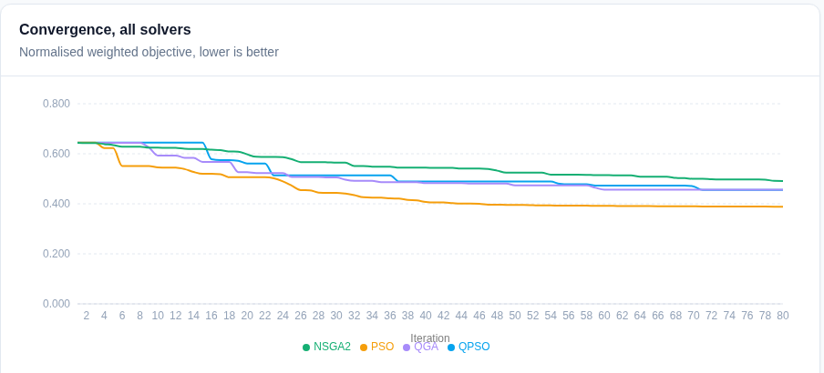
FEASIBILITY AND VIABILITY
CloudBusters
FEASIBILITY OF THE IDEA
POTENTIAL CHALLENGES AND RISKS
STRATEGIES TO OVERCOME THEM
Contract-first architecture — one shared schema
Async job queue absorbs 2–5 min runs
Runs entirely on a laptop
Deterministic, reproducible demo runs
Physics-calibrated data vs MRV aggregates
Classical annealing only — no real annealer yet
LNG + methanol prioritised over hydrogen
Fewer benchmark seeds than a full study
Synthetic data unvalidated at fleet scale
Multi-objective runtime grows with fleet size
QUBO is a backend swap — annealers plug in
Pre-compute demos; optimize small sets live
Extend fuels to hydrogen and ammonia next
Live AIS + weather for continuous re-runs
Multi-seed benchmarks with error bars
Solver convergence on one problem instance — measured in the working prototype
Start small, validate, then expand

Slide 5
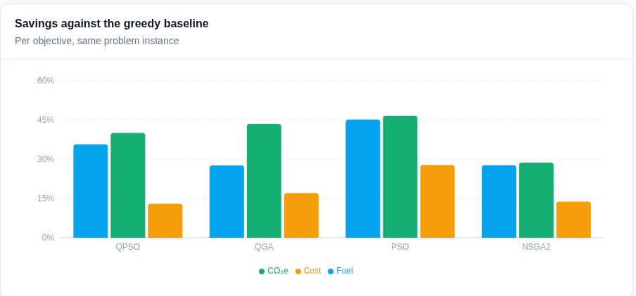
IMPACT AND BENEFITS
CloudBusters
IMPACT ON THE TARGET AUDIENCE
BENEFITS OF THE SOLUTION
HOW WE MEASURE IMPACT
Operators — lower fuel cost per voyage
Compliance teams — CII / EEXI evidence
Charterers — cleaner, priced-in voyages
Port planners — reliable, lower-emission calls
Regulators — auditable decisions
Well-to-wake accounting incl. CH₄ and N₂O
Multi-fuel: VLSFO / MGO / LNG / methanol
Avoids EU ETS and FuelEU penalty exposure
Cleaner coastal air near ECAs
Transparent, audit-ready recommendations
Fuel cost per voyage
Well-to-wake CO₂e per route
CII rating spread across the fleet
Schedule reliability (%)
EU ETS + FuelEU penalty exposure
Savings against the greedy baseline, per objective — from a prototype run
Cost, emissions and schedule reliability — optimized together, measured honestly

Slide 6
RESEARCH AND REFERENCES
CloudBusters
REGULATION AND STANDARDS
ALGORITHMS AND METHODS
DATA AND TOOLING
IMO MEPC — Carbon Intensity Indicator (CII) rating framework.
IMO — Energy Efficiency Existing Ship Index (EEXI).
EU FuelEU Maritime — GHG intensity limits for marine fuels.
EU Emissions Trading System (ETS) extension to shipping.
MARPOL Annex VI — sulphur and emission control areas.
Sun, Feng & Xu (2004) — quantum-behaved particle swarm optimization (QPSO).
Han & Kim (2002) — quantum-inspired evolutionary algorithm (QIEA).
Deb et al. (2002) — NSGA-II, IEEE Trans. Evolutionary Computation.
Admiralty coefficient / V³ speed–power law for propulsion resistance.
QUBO formulation for quantum annealing.
AIS vessel movement data for routes and speed profiles.
Copernicus Marine / ERA5 weather and sea-state reanalysis.
IMO MRV and EU THETIS-MRV aggregate emissions reporting.
pymoo, pyqubo, dwave-neal — optimization and annealing libraries.
PennyLane, Qiskit-Aer — quantum circuit simulation.
Grounded in published regulation, peer-reviewed algorithms and open data

