Slide 1

Deployment of FastAPI on Minikube
Approach,
Implementation
Results
-VIVEK HARE

Slide 2

Objective
In that assignment we have to find out the 2 end point of fast api are develop and deploy and check wheter is running or not

Slide 3

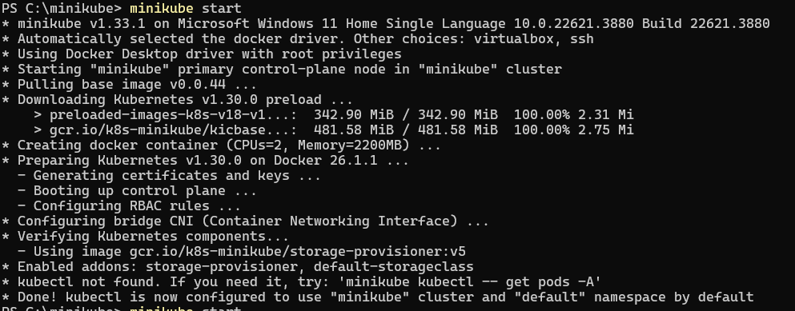
Environment Setup
Kubernetes
Docker
FastApi
Minikube
Promethus

Slide 4
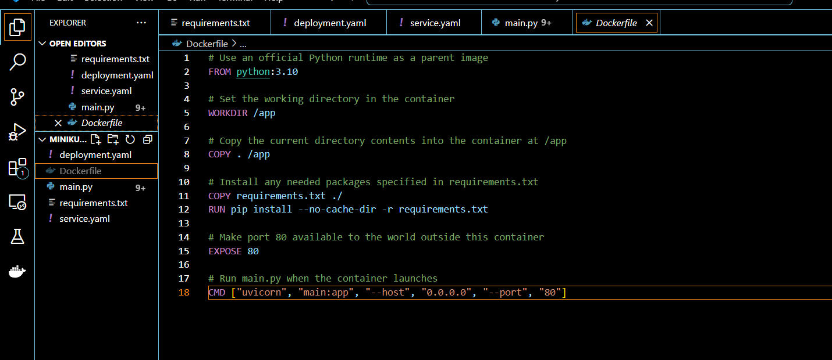

Creating FastAPI Application
Main.py (https://colab.research.google.com/drive/1cN0uvgsBUKbGHyLKgVEWBv0fwyaW4REr?usp=sharing)
Docker file

Slide 5
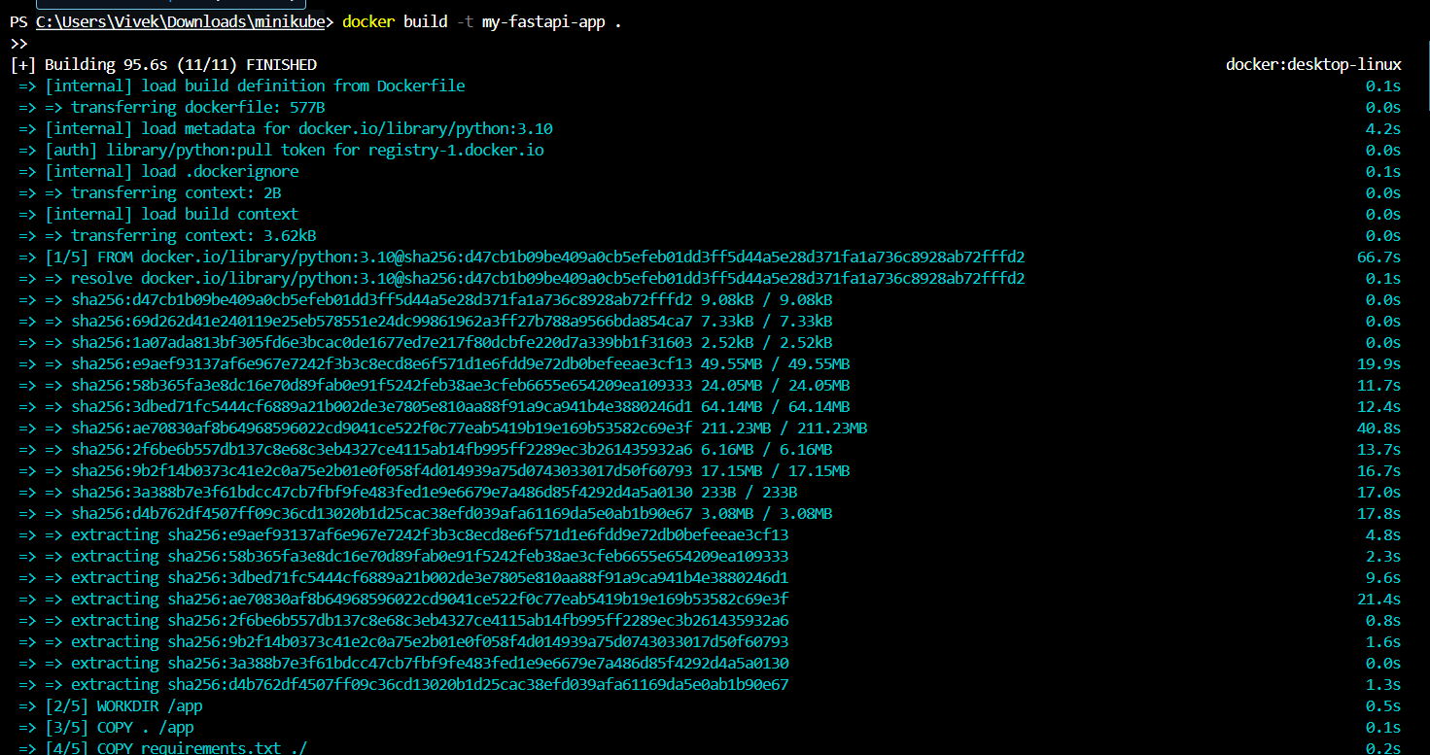

Building Docker Image
docker build -t my-fastapi-app .
output

Slide 6
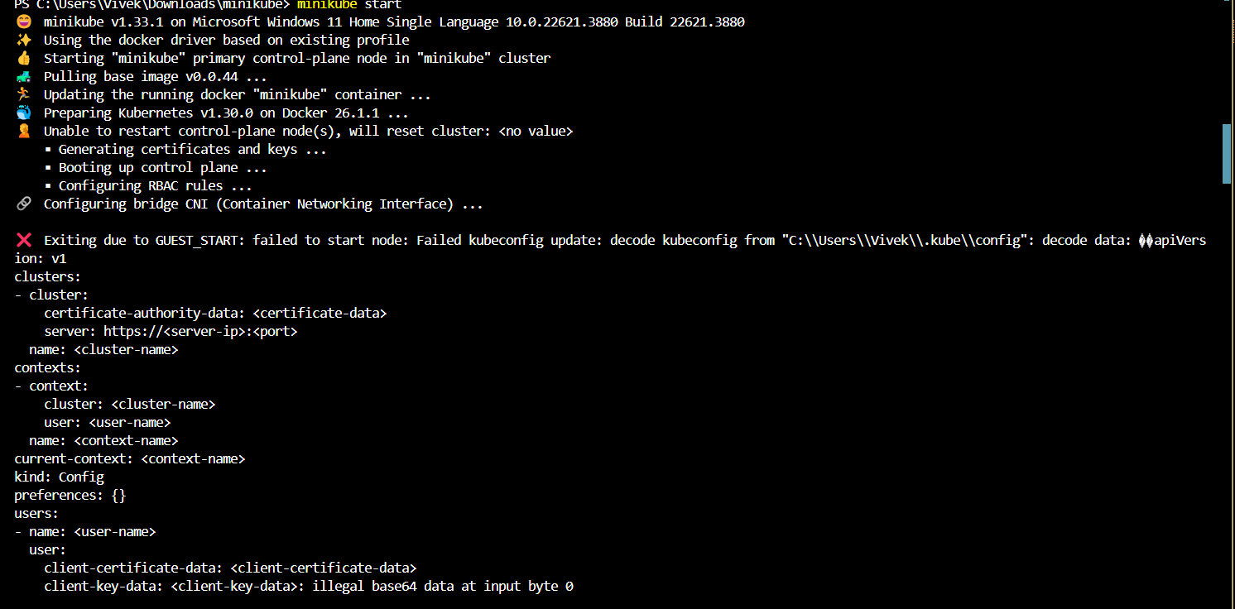
Starting Minikube

Slide 7
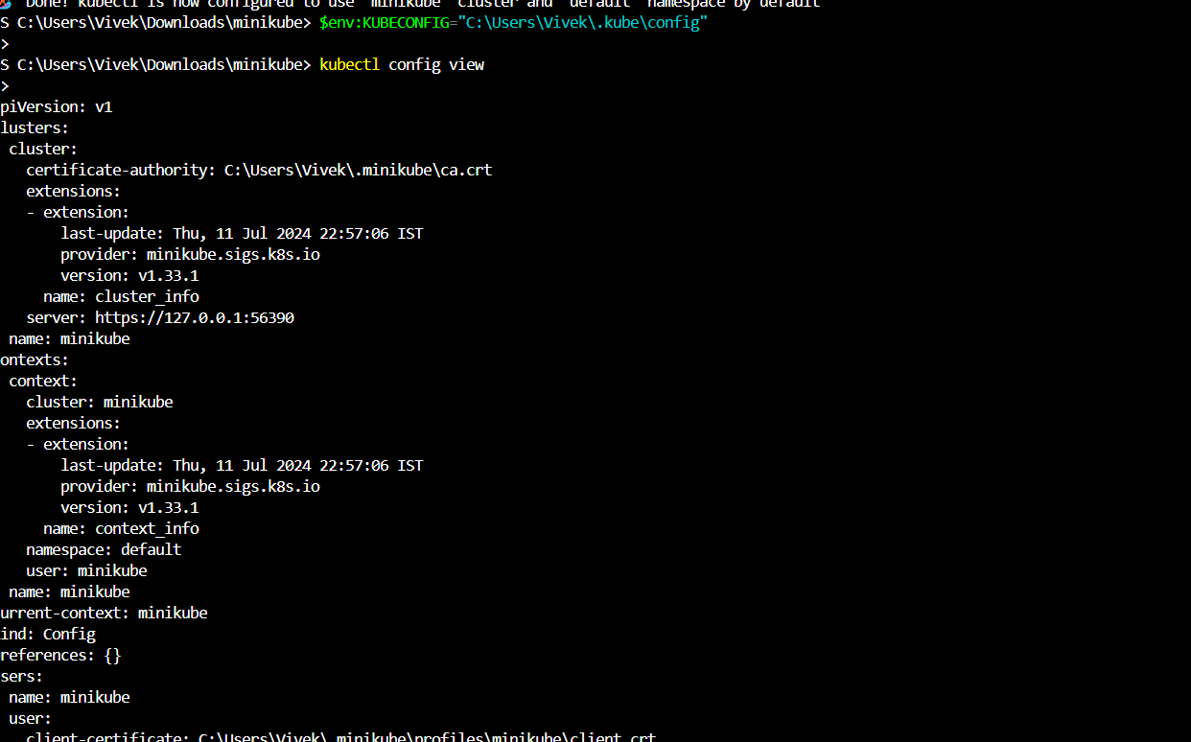
Setting Docker Environment

Slide 8
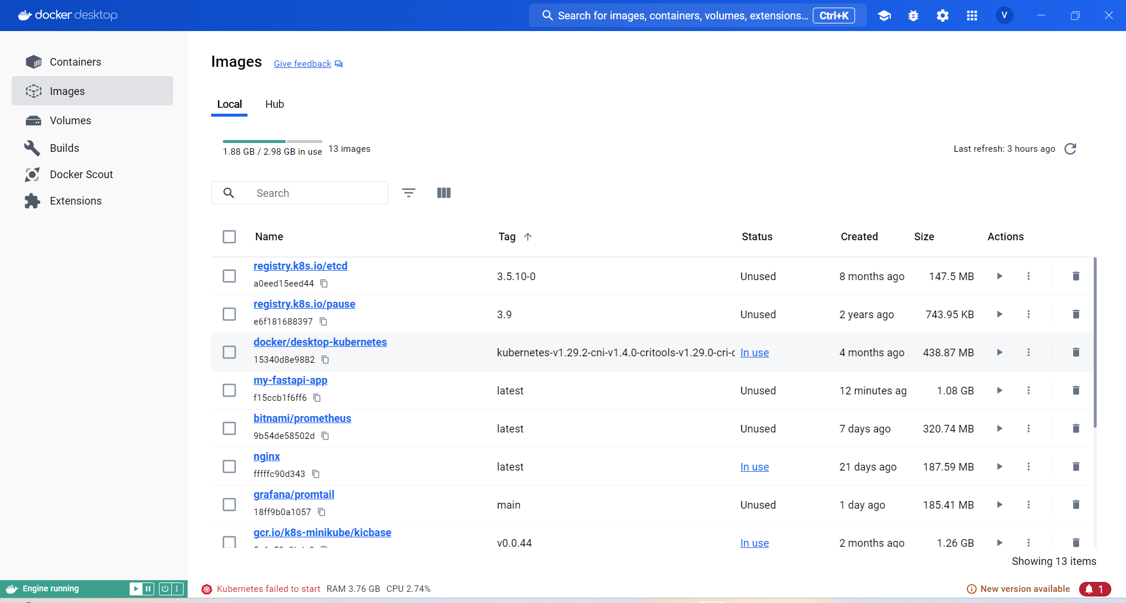

Slide 9
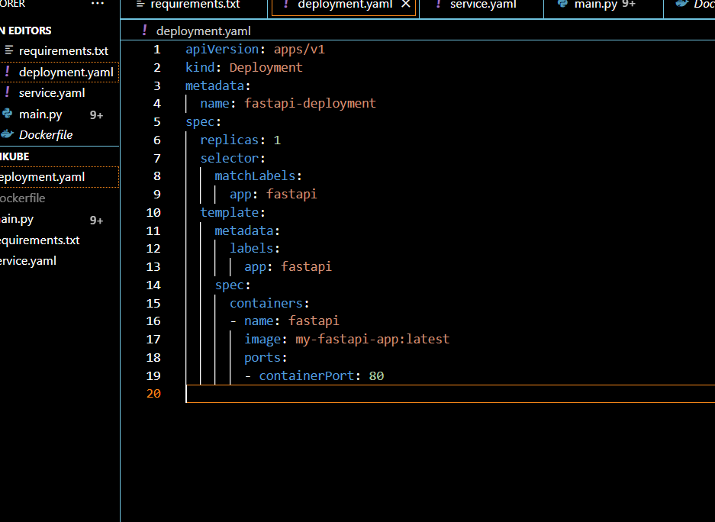
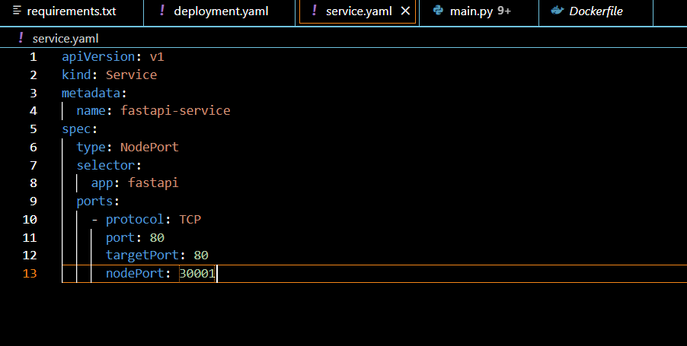
Create the Service and Deployment YAML File

Slide 10
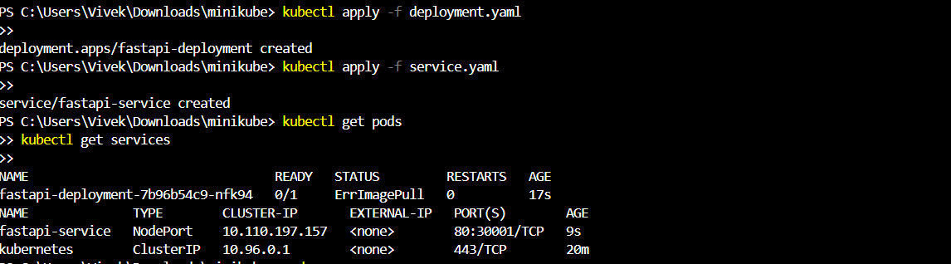
Result

Slide 11
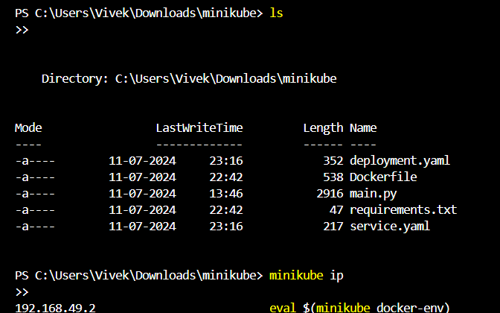
2. Result

Slide 12
I have diligently worked through the tasks and challenges presented, making significant progress. Despite encountering a few initial hurdles, I am confident in my ability to navigate and overcome these obstacles. Please let me know if there are any specific areas you would like me to focus on or any further information you need from my side. Thank you for your continued support and guidance.

Slide 13
Thanks! Git Hub:-https://github.com/vivek152oo3/FastAPI.git

