Slide 1

Capstone Project – 1
Exploratory Data Analysis
Team Champions : Play Store App Review Analysis
Team Members
Varsha Rani
Vivek Chandrakant Pawar
Rabista Parween
Tushar Gaikwad

Slide 2
POINTS FOR DISCUSSION
Problem Statement & Objective
Data Summary
Load the Data and Create Data Frame
Univariate Analysis
Skewness of Data
Bivariate Analysis
Correlation of Data
Most installed category
Content Rating vs Installs
Review vs Rating
App Size Distribution
Sentiment Subjectivity Distribution
Sentiment Distribution
Sentiment Polarity Distribution
Category vs Review vs Sentiment
Conclusion

Slide 3

Problem Statement & Objective
The Play Store apps data has enormous potential to drive app-making businesses to success. Actionable insights can be drawn for developers to work on and capture the Android market.
Each app (row) has values for category, rating, size, and more. Another dataset contains customer reviews of the android apps.
Here we are exploring and analyzing the data to discover key factors responsible for app engagement and success.
We have used the following Libraries :
Pandas - manipulation of tabular data in Dataframes
Numpy - mathematical operations on arrays
Matplotlib - visualization
Seaborn - visualization
Plotly Express - visualization
The objective of this project is to deliver insights to understand customer demands better and thus help developers to popularize the product.

Slide 4
Data Summary
df
It contains information about applications, having column like app name, size, installs,etc.
User_review_df
It contains user reviews for application containing information like Sentiment Distribution, Sentiment Polarity Distribution and Sentiment Subjectivity Distribution.
Merge_df
It contains combined information of all applications and user reviews sentiments.

Slide 5
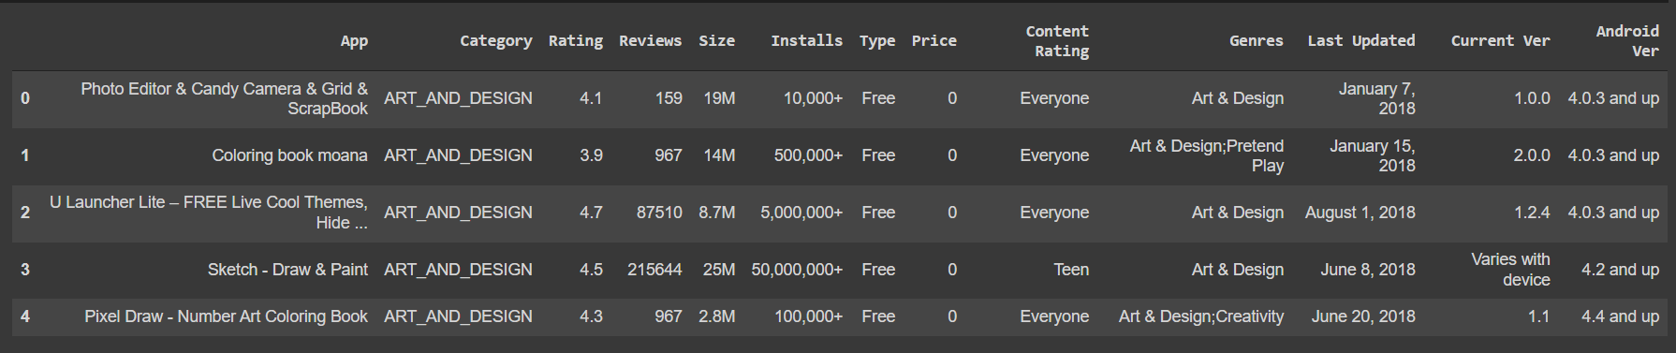
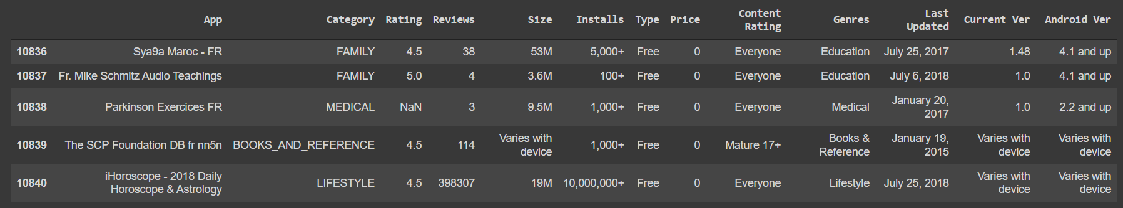
Load the Data and Create Data Frame
Data Frame creation using pandas
app_df.head()
app_df.tail()

Slide 6
Cleaning the DataFrame
Dropping Duplicates
Checking the null values
Filling the null values
Dropping improper values within columns
Converting the columns datatype

Slide 7
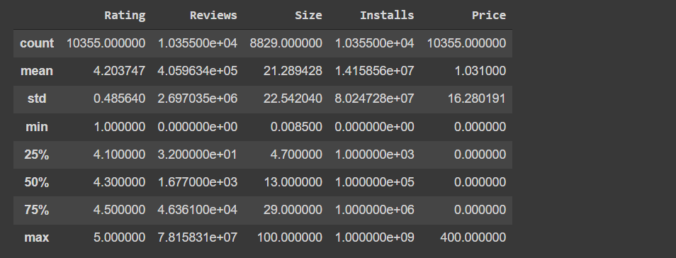
Univariate Analysis
Univariate analysis is perhaps the simplest form of statistical analysis. Like other forms of statistics, it can be inferential or descriptive. The key fact is that only one variable is involved.
Statistical Data

Slide 8
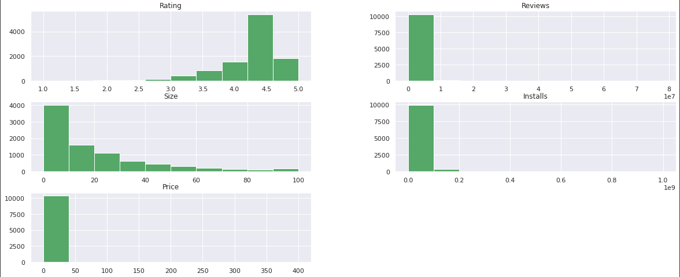
Skewness of Data
Skewness is a measure of the asymmetry of the probability distribution of a real-valued random variable about its mean. The skewness value can be positive, zero, negative, or undefined.

Slide 9
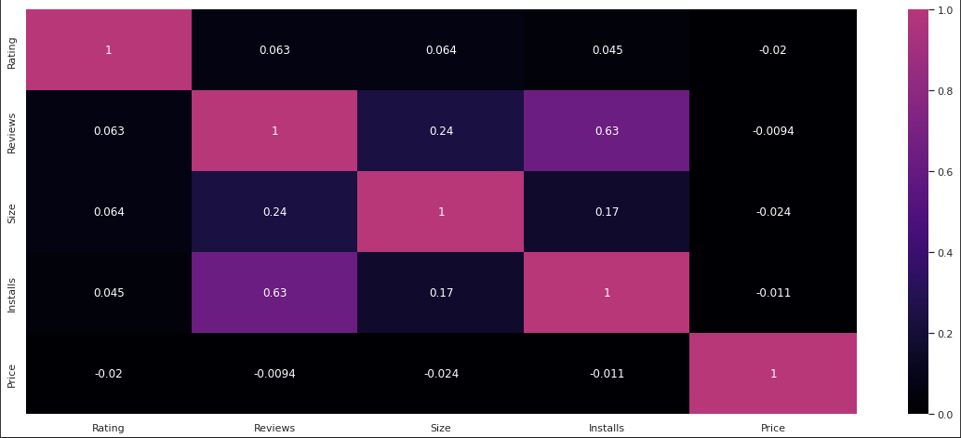
Bivariate Analysis
Bivariate analysis is one of the simplest forms of quantitative analysis. It involves the analysis of two variables, for the purpose of determining the empirical relationship between them.
Correlation of Data
Correlation is used to find the relationship between two variables which is important in real life because we can predict the value of one variable with the help of other variables, who is being correlated with it.

Slide 10
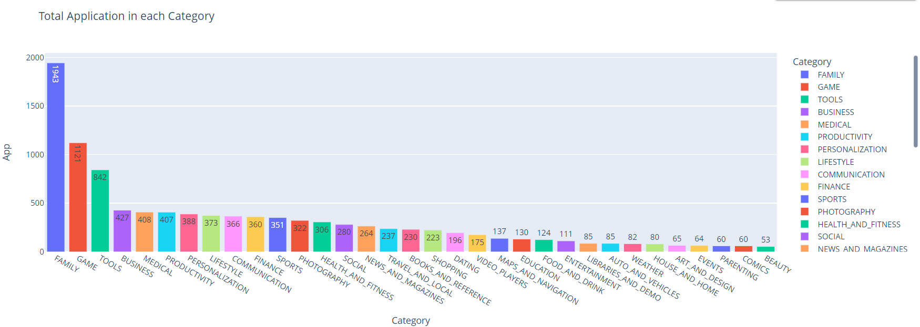
Total Number of Application in each category
From the above graph, we can see the total number of applications in each category.

Slide 11
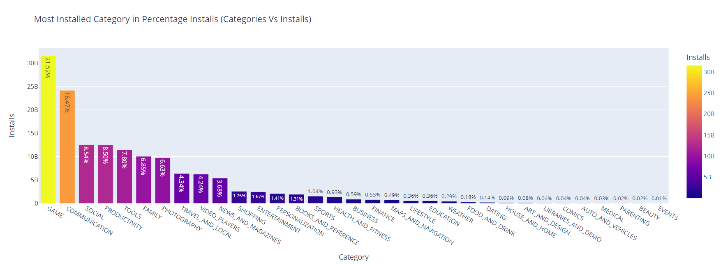
Categories Vs Installs
Maximum number of applications are being installed from the category game followed by communication category. So, this graph is the indication of interest hold by the customer, so you must bend your technologies, accordingly.
As we have seen correlation map that reviews, and installs are highly correlated with each other so here is the evidence that most positively reviewed category have the highest installation rate.

Slide 12
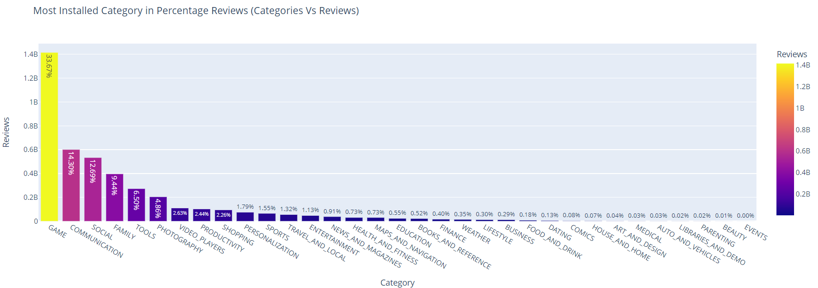
Categories Vs Reviews
Reviews have the power to gain customer trust, and they encourage people to interact with the company. Customer interaction ultimately leads to improved profits for businesses. Gaming and Communication these two categories has highest percentage of reviews 33.67% and 14.30% respectively.

Slide 13
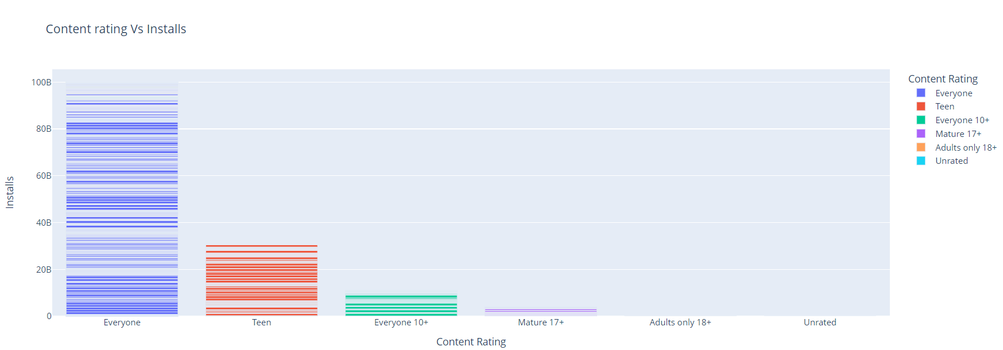
Content Rating Vs Installs
The applications which have a content rating for everyone are being installed most than other. Play Store place a greater level of importance on ratings and reviews than ever before. Apps with higher ratings and reviews rank high in search. If an app ranks high then there's a better chance of it being found and downloaded.

Slide 14
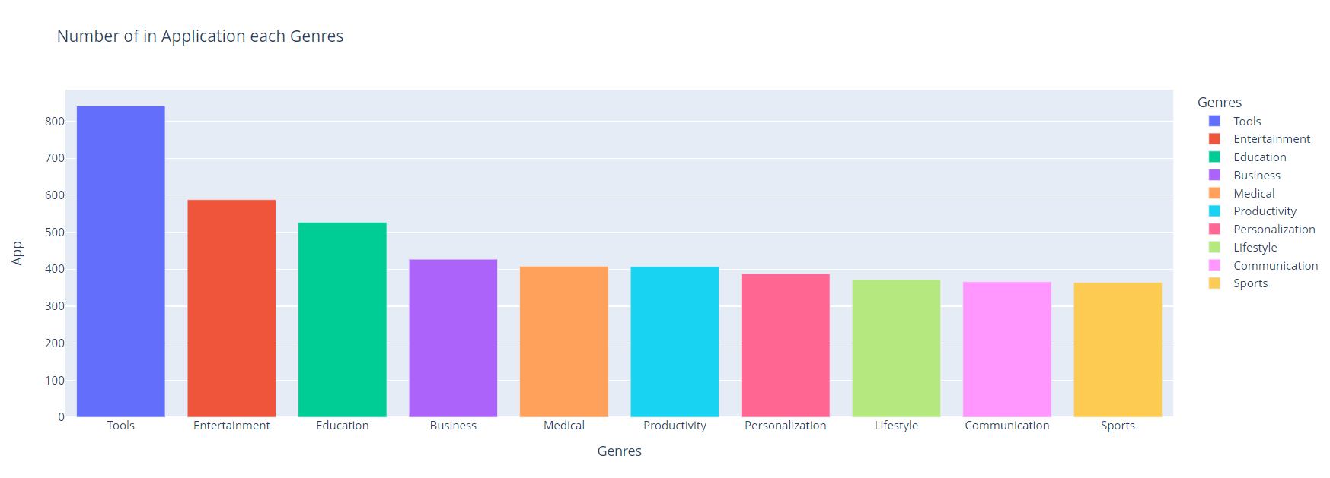
Number of Applications in each Genres
There are 10 different genres – Tools, Entertainment, Education, Business, Medical, Productivity, Personalization, Lifestyle, Communication and Sports. The above graph shows the number of applications in each genres.

Slide 15
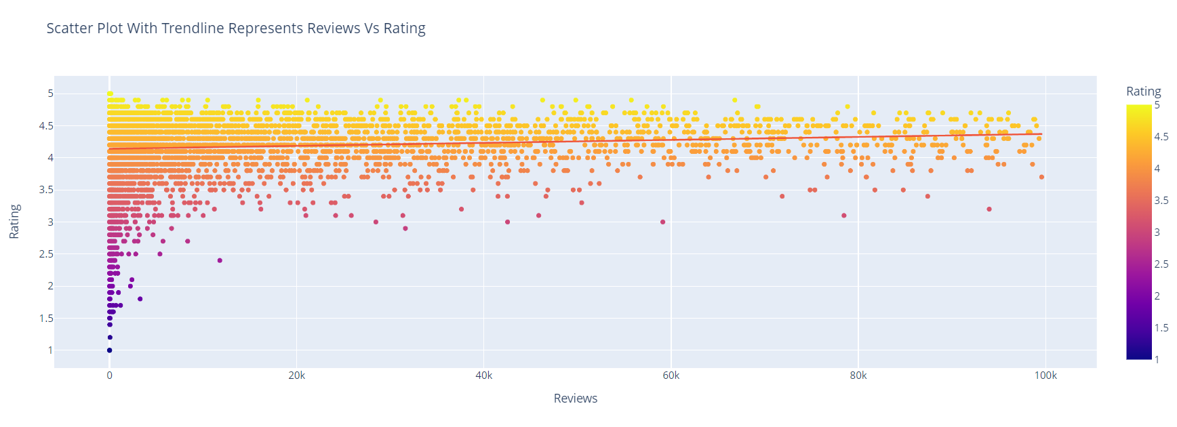
Reviews Vs Rating
By looking at above scatter plot with trendline we are able toconclude that lesser the reviews on applications lesser the rating as well.

Slide 16
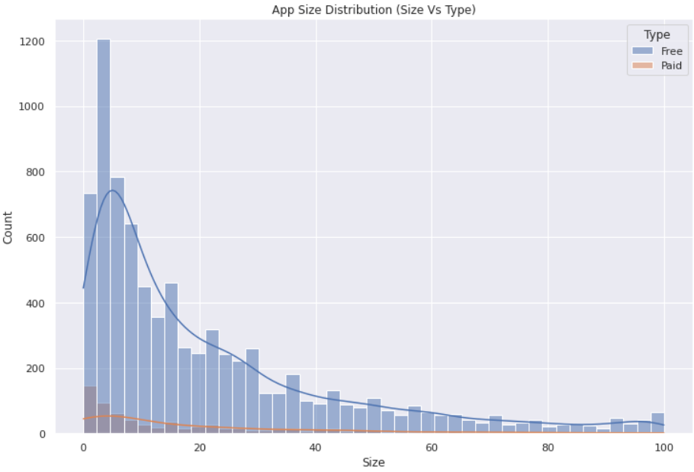
App size distribution
This histogram of apps size distribution tell us about the
optimum size range most liked by the user.
The size of your application has an impact on how fast
your app loads, how much memory it uses, and how
much power it consumes.
We can draw a conclusion that there are maximum
number of applications whose range of size is between
0 to 25 or 30 MB.

Slide 17
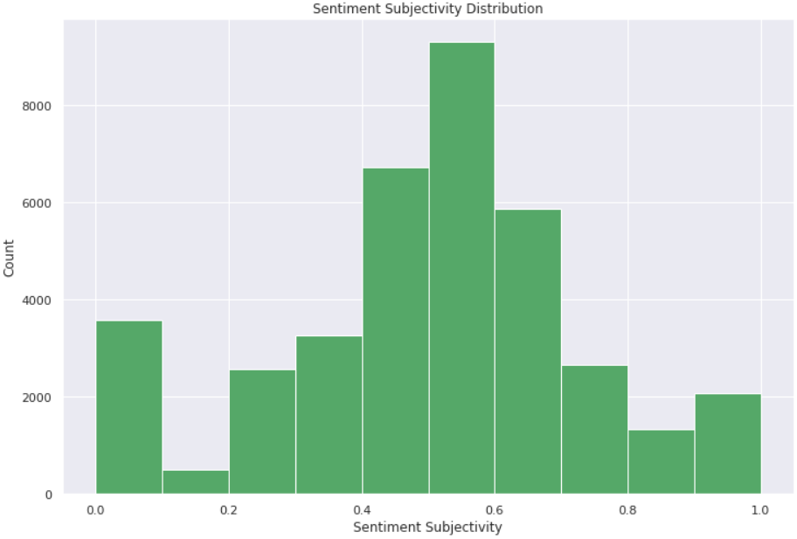
Sentiment Subjectivity Distribution
Sentiment is the emotion, feeling, opinion,
or views held or expressed by users.
Sentiment subjectivity is float number value
whose range lies in between 0 to 1, where
0 is very objective and 1 is very subjective.
Sentiment subjectivity determines the
judgement of review writer’s how happy,
disappointed, frustrated they are with the
service of the application.
For given google play store data, sentiment subjectivity range lies between 0.5 to 0.7 that’s positive one.

Slide 18
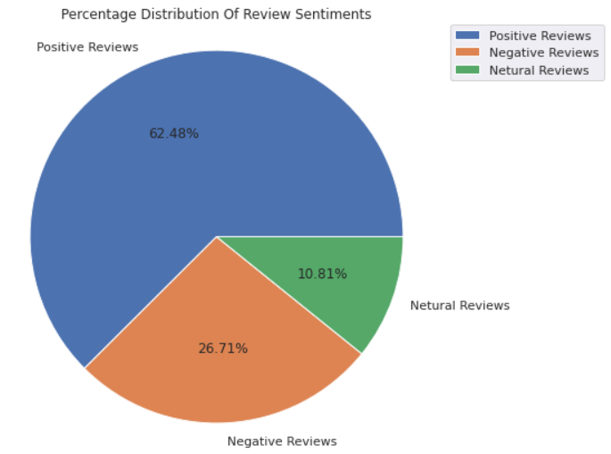
Sentiment Distribution
From the above pie chart, it can easily be understood
that there is around 62 of user reviews sentiment is
positive, around 27% of reviews sentiment is negative
and the remaining around 11% of reviews sentiment
is neutral. If some apps have a higher percentage of
positive Reviews sentiments, then it is sure that the
app is performing its intended work, and people are
enjoying it, they may share the app with somebody
thus increases the number of installations. So, need to
keep an eye-tracking on the review sentiment it is what
decides whether the app is going to feature on google
play store. By featuring I mean visibility of apps when someone searches for a category. If the app is not visible in the top 10 or 12 apps range then there are fewer chances of the app being installed.

Slide 19
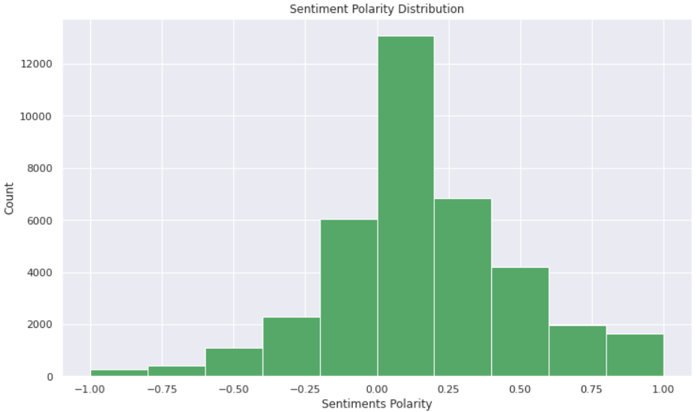
Sentiment Polarity Distribution
Sentiment polarity is a float value ranging from negative one to positive one. i.e., range (-1, 1), (dtype = float) where -1 means negative statement 1 means positive statement.

Slide 20
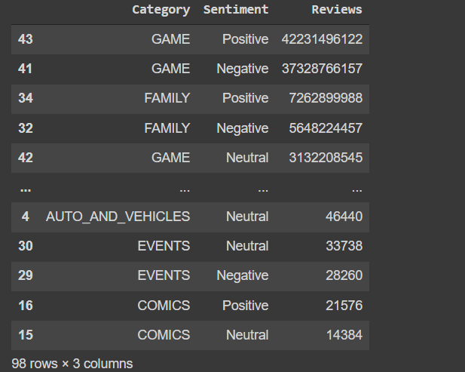
Sentiments and Count of sentiment polarity
Reviews and Sentiment of users in each category
Sentiment | Sentiment Polarity
Negative | 10108
Neutral | 4089
Positive | 23642

Slide 21
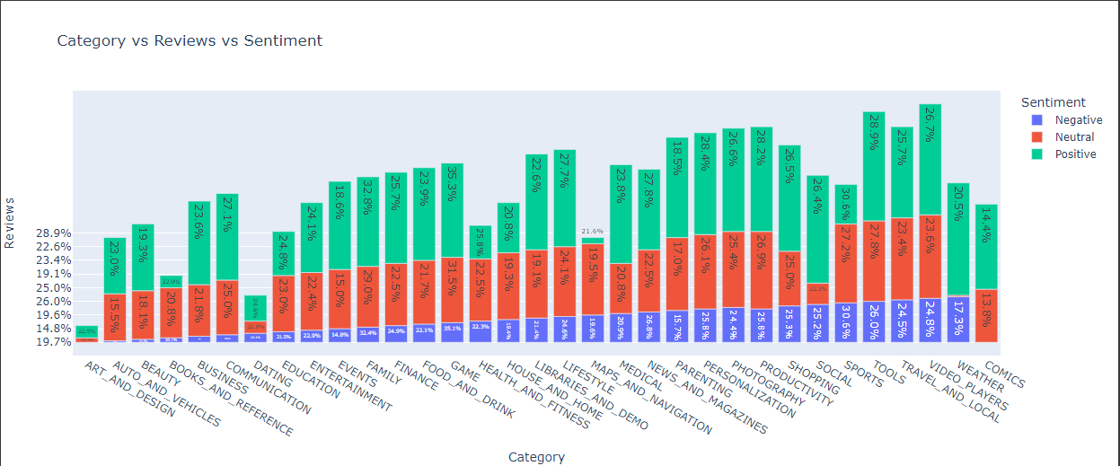
Category Vs Review Vs Sentiment
We always treat neutral reviews as insignificant, but it is not the case always, Neutral reviews are never neutral. A neutral review affects both negative and positive reviews and can also reinforce both. Statistically, neutral reviews are a good thing because without them, positive reviews will be overestimated, and negative ones will be underestimated. Neutrals give consumers a better understanding of a brand or a business.

Slide 22
Conclusion
As per our EDA, an ideal application on the google play store should obey the following properties/characteristics:
Reviews vs install: We have experienced from the seaborn heatmap that reviews on the google play store are highly correlated with the rate of installation. Reviews are given by users as per their experience with the application. So reviews on the application should be examined properly to get to know the performance of the application, whether it is catering to the need of users, From review, we will get an idea on which aspect to work on.
Family Category has the most number of applications available on the google play store, and very few apps are available for the category beauty and parenting. We can see the people does not relay on apps for parenting and beauty. And for the comics the category is very saturated.
Game category has the highest percentage of installs that is 20.93% around 21% and second highest is communication have 19.48% percentage installs. So people's are more likely to connect with the people by using apps. And for entertainment purpose they are relaying on game as well.
Most space consuming category bar plot gives us the idea that which category has the most variety of applications available, and which has low. The category which consumes high space inside the google play store, it means it has more number of applications than other categories. So we have to take a signficant decision to decide category for our future applications.

Slide 23

Thank You!!

