Slide 1

Capstone Project – 1
Exploratory Data Analysis
Team Champions : Play Store App Review Analysis
Team Members
Varsha Rani
Rabista Parween
Vivek Chandrakant Pawar
Prabhat Ranjan
Tushar Gaikwad

Slide 2
POINTS FOR DISCUSSION
Problem Statement & Objective
Data Summary
Load the Data and Create Data Frame
Clean the Data Frame
Extract Statistics from the Dataset
Exploratory Data Analysis & Visualizations
conclusion

Slide 3

Problem Statement & Objective
The Play Store apps data has enormous potential to drive app-making businesses to success. Actionable insights can be drawn for developers to work on and capture the Android market.
Each app (row) has values for catergory, rating, size, and more. Another dataset contains customer reviews of the android apps.
Here we are exploring and analyzing the data to discover key factors responsible for app engagement and success.
We have used the following Libraries :
Pandas
Numpy
Matplotlib
Seaborn
The objective of this project is to deliver insights to understand customer demands better and thus help developers to popularize the product.

Slide 4
Data Summary
app_df : It contains all the information regarding Play Store Applications, category, size, price, type, genres, version, installs, ratings and reviews of applications.
app_category : It contains number of application of each category, number of installs, percentage installs, percentage reviews, most installed category in percentage installs, most installed category in percentage reviews and content rating vs installs.
app_genres : It contains the number of applications of each genres.
reviews_ratings : It contains all the reviews and ratings given by the end users, sentiment distribution and actual number of reviews for each kind of sentiment.

Slide 5
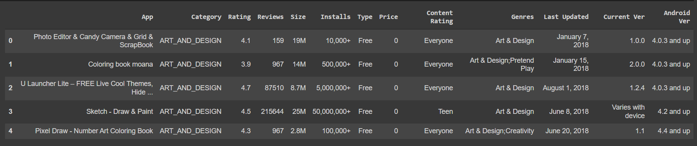
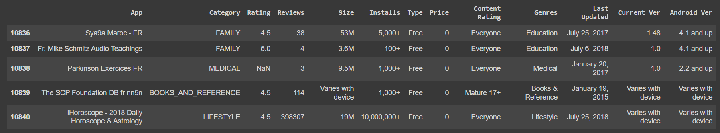
Load the Data and Create Data Frame
Data Frame
app_df.head()
app_df.tail()

Slide 6
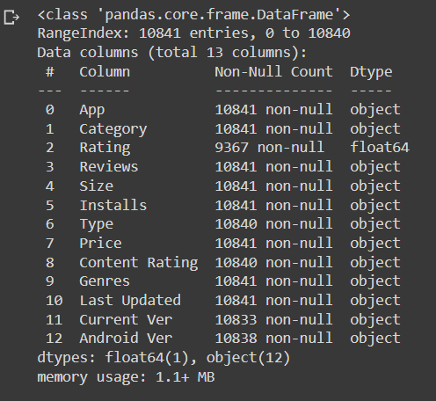
Load the Data and Create Data Frame
Shape of Data Frame is (10841,13)
Information about Data Frame

Slide 7
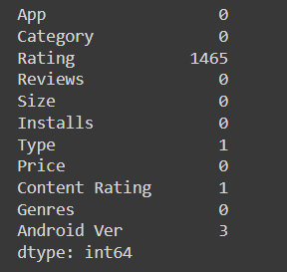
Clean the Data Frame
Check all columns
Check null value
Drop irrelevant columns
Drop ‘Last Updated’ column
Drop ‘Current Ver’ column
Drop if there are any duplicate in dataset
Shape of the data frame after dropping
is (10356,11)

Slide 8
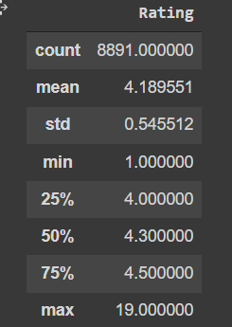
Clean the Data Frame
Zero can’t be put for replacing null so we will check its stats.
Replace null values with the median of rating.

Slide 9
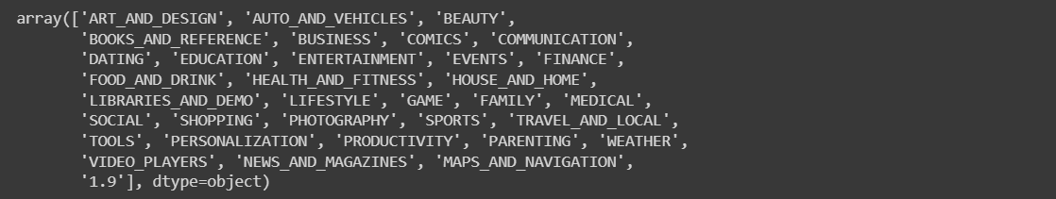
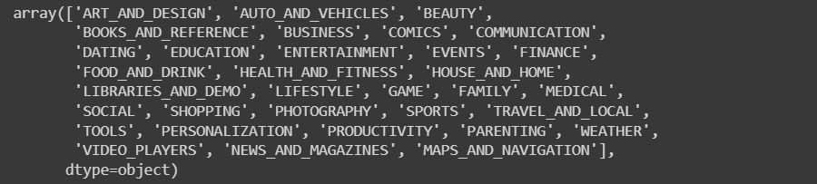
Clean the Data Frame
Check for unique values in Rating column
Drop ‘1.9’ from category

Slide 10
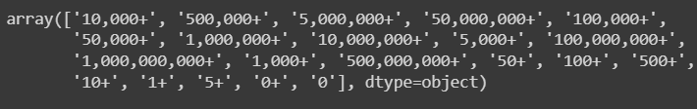
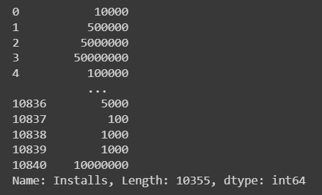
Clean the Data Frame
Check install column for any improper values
Drop + and convert values to int
Check install columns unique value

Slide 11
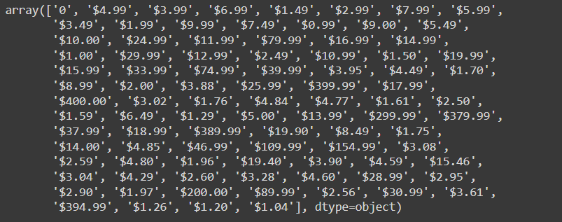
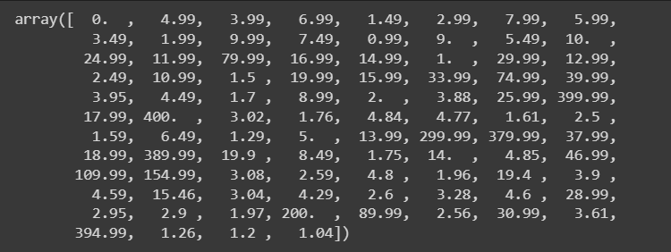
Clean the Data Frame
Check Price column
Price column after altering
Remove $ symbol and convert to numerical.
Check size column.
Convert MB and KB values to float.
Convert Reviews column to numerical.

Slide 12
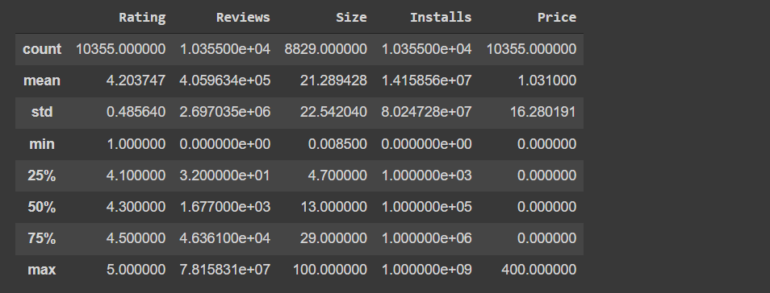
Extract Statistics from the Dataset
Univariant Analysis
Statistical Data

Slide 13
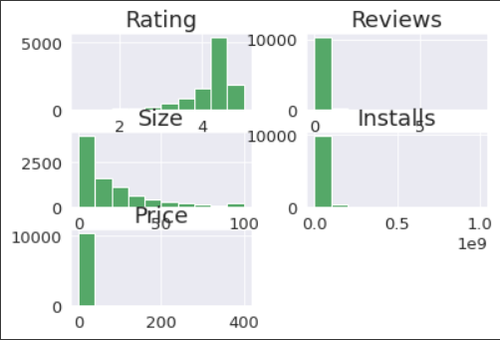
Extract Statistics from the Dataset
Skewness of Data

Slide 14
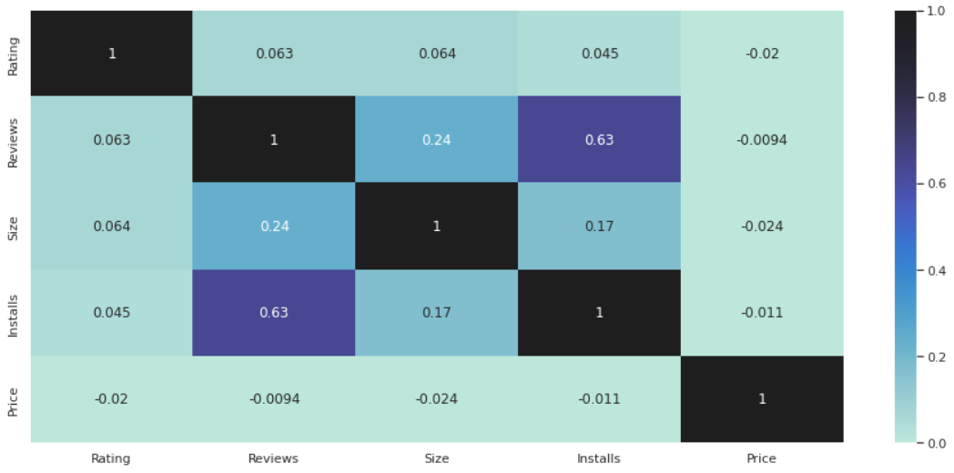
Extract Statistics from the Dataset
Corelation of Data

Slide 15
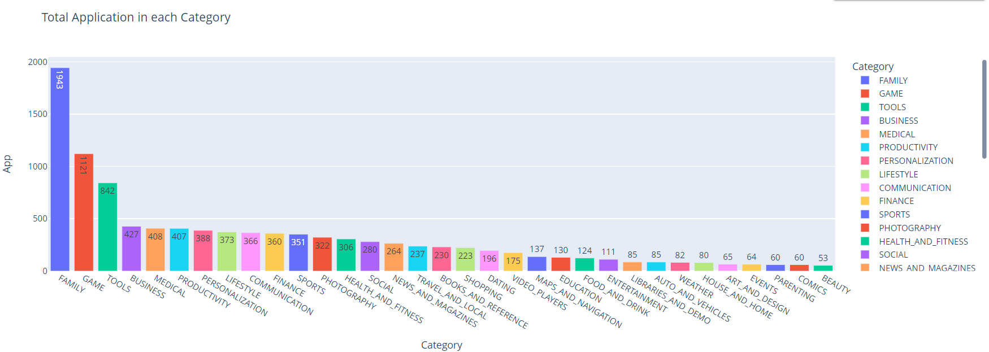
Exploratory Data Analysis
(B) Bivariate Data
Total Application in each category

Slide 16
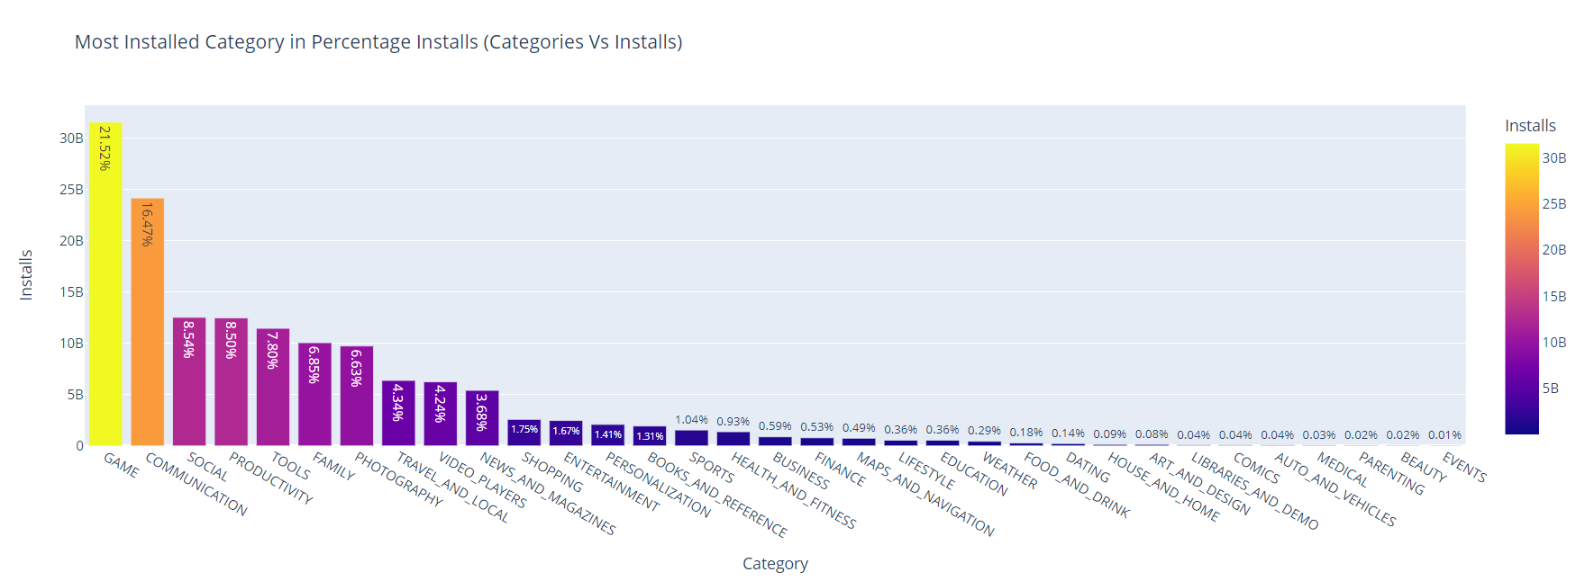
Exploratory Data Analysis
Most Installed category in Percentage Installs (Categories Vs Installs)

Slide 17
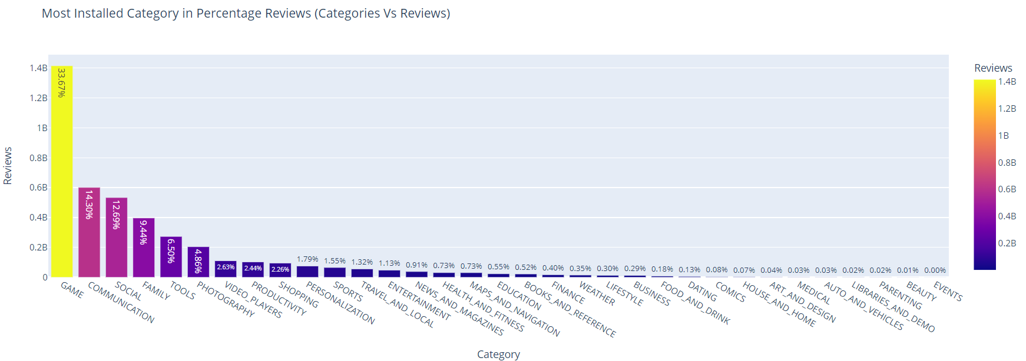
Exploratory Data Analysis
Most Installed category in Percentage Reviews (Categories Vs Reviews)

Slide 18
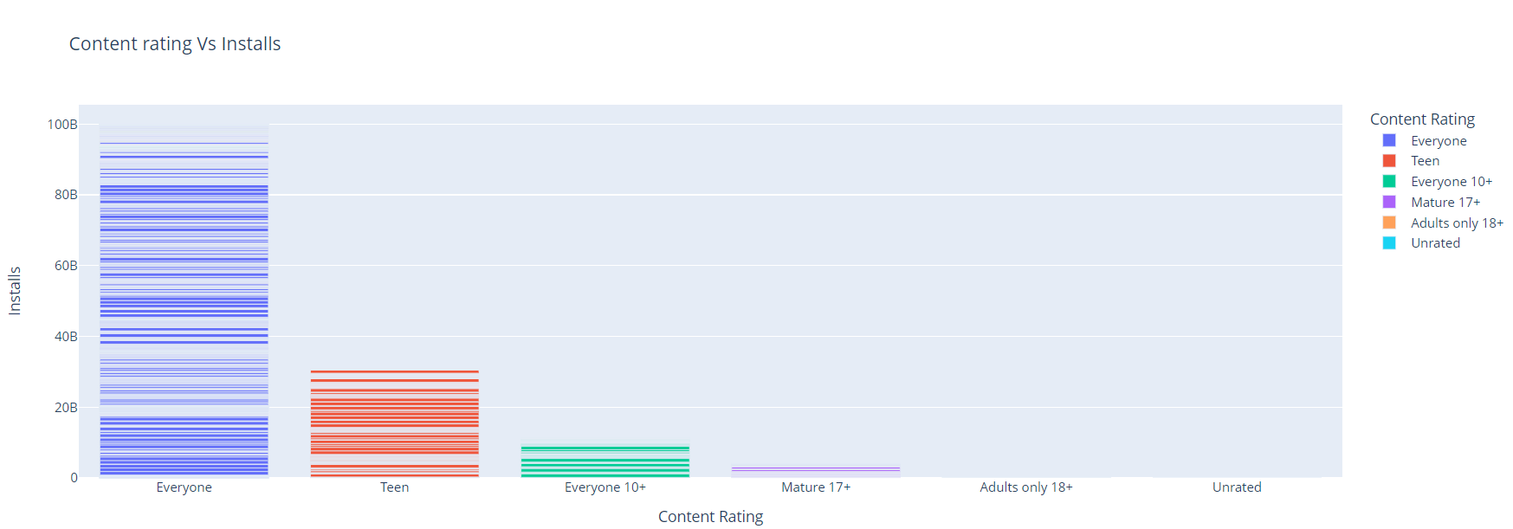
Exploratory Data Analysis
Content Rating Vs Installs

Slide 19
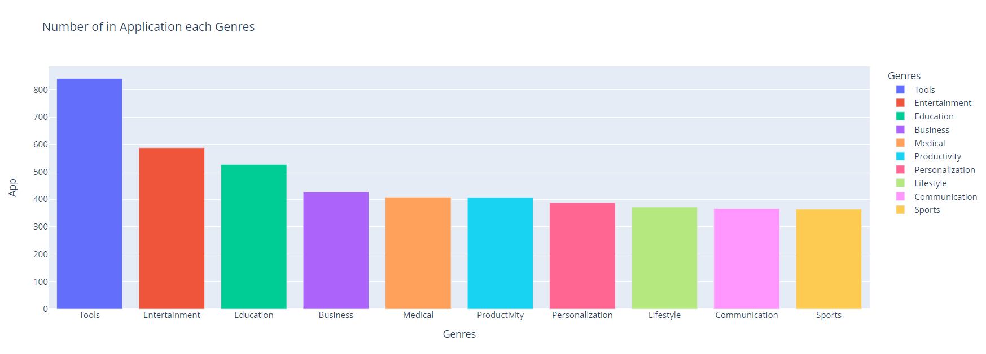
Exploratory Data Analysis
Number of Applications in each Genres

Slide 20
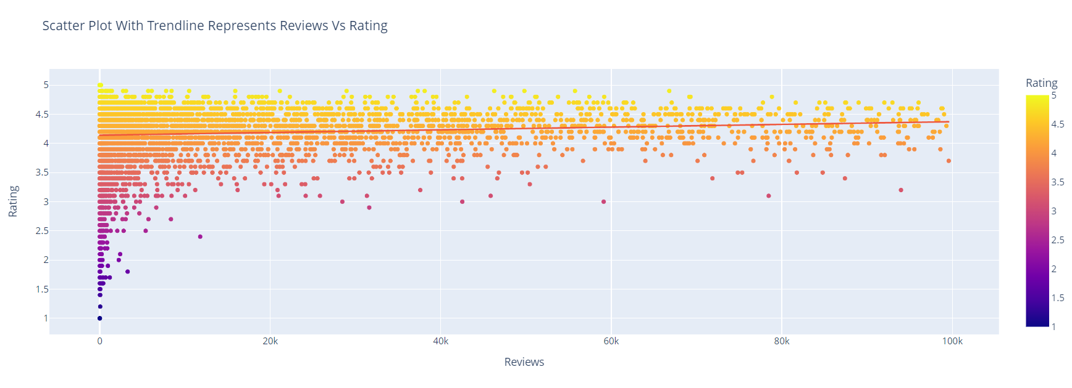
Exploratory Data Analysis
Scatter Plot with Trending represents Reviews Vs Rating

Slide 21
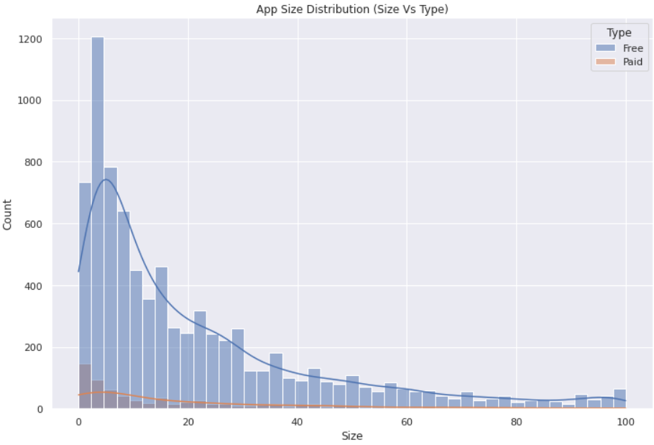
Exploratory Data Analysis
App size distribution (Size Vs Type)

Slide 22
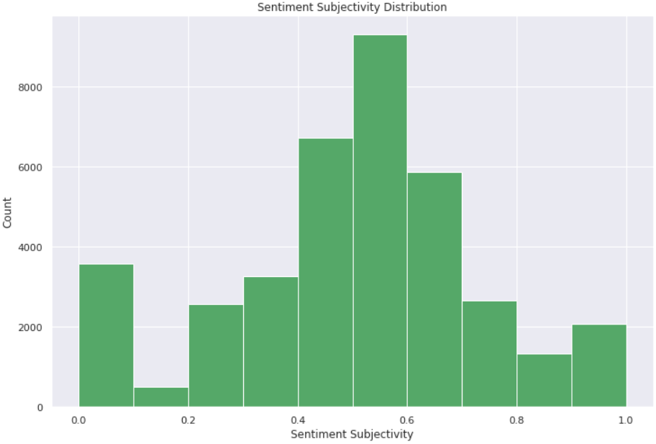
Exploratory Data Analysis
Sentiment Subjectivity Distribution

Slide 23
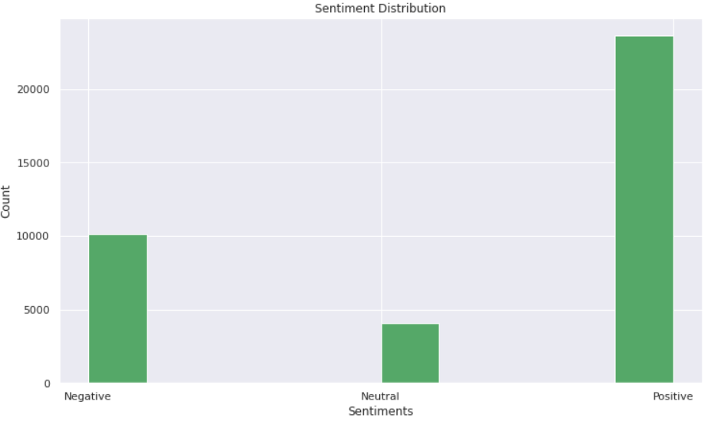
Exploratory Data Analysis
Sentiment Distribution

Slide 24
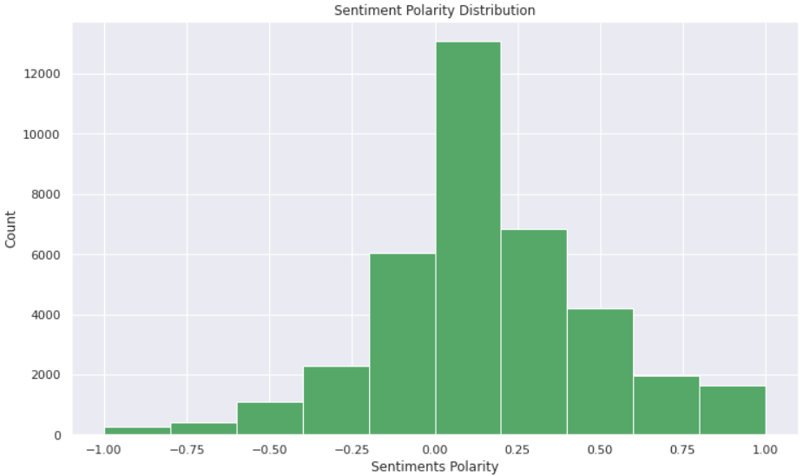
Exploratory Data Analysis
Sentiment Polarity Distribution

Slide 25
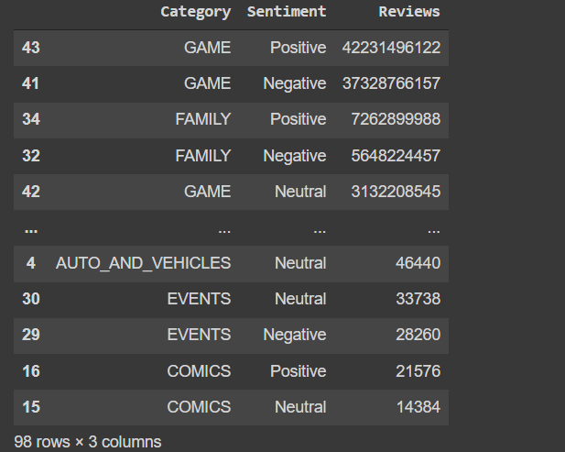
Exploratory Data Analysis
Actual number of reviews for each kind of sentiment
Reviews and Sentiment of users in each category
Sentiment | Sentiment Polarity
Negative | 10108
Neutral | 4089
Positive | 23642

Slide 26
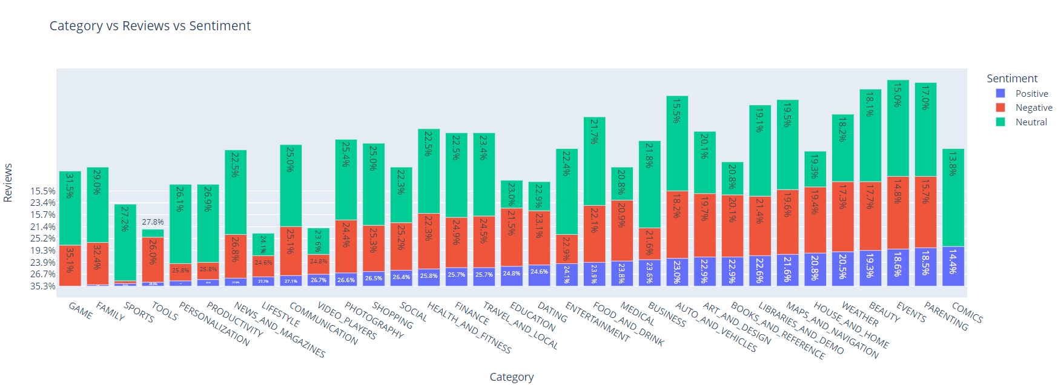
Exploratory Data Analysis
Category Vs Review Vs Sentiment

Slide 27
Conclusion

Slide 28
Thank You!!

