Slide 1

Capstone Project – 2
Machine Learning – Regression
Team Champions : Rossmann Retail Sales Prediction
Team Members
Varsha Rani
Vivek Chandrakant Pawar
Rabista Parween
Tushar Gaikwad

Slide 2
POINTS FOR DISCUSSION
Problem Statement & Objective
Data Summary
Importing Libraries & Loading Data
Exploratory Data Analysis
Pre – processing & Feature Engineering
Data Modeling
Conclusion

Slide 3
Problem Statement & Objective
Rossmann operates over 3,000 drug stores in 7 European countries. Currently, Rossmann store managers are tasked with predicting their daily sales for up to six weeks in advance. Store sales are influenced by many factors, including promotions, competition, school and state holidays, seasonality, and locality. With thousands of individual managers predicting sales based on their unique circumstances, the accuracy of results can be quite varied.
We are provided with historical sales data for 1,115 Rossmann stores. The task is to forecast the "Sales" column for the test set.
Note – some stores in the dataset were temporarily closed for refurbishment.

Slide 4
Data Summary
We are given two data sets :
Rossmann Stores Data.csv - historical data including Sales
store.csv - supplemental information about the stores
Data fields
Most of the fields are self-explanatory. The following are descriptions for those that aren't.
Id - an Id that represents a (Store, Date) duple within the test set
Store - a unique Id for each store
Sales - the turnover for any given day (this is what you are predicting)
Customers - the number of customers on a given day
Open - an indicator for whether the store was open: 0 = closed, 1 = open
StateHoliday - indicates a state holiday. Normally all stores, with few exceptions, are closed on state holidays. Note that all schools are closed on public holidays and weekends. a = public holiday, b = Easter holiday, c = Christmas, 0 = None
SchoolHoliday - indicates if the (Store, Date) was affected by the closure of public schools
StoreType - differentiates between 4 different store models: a, b, c, d
Assortment - describes an assortment level: a = basic, b = extra, c = extended
CompetitionDistance - distance in meters to the nearest competitor store
CompetitionOpenSince[Month/Year] - gives the approximate year and month of the time the nearest competitor was opened
Promo - indicates whether a store is running a promo on that day
Promo2 - Promo2 is a continuing and consecutive promotion for some stores: 0 = store is not participating, 1 = store is participating
Promo2Since[Year/Week] - describes the year and calendar week when the store started participating in Promo2
PromoInterval - describes the consecutive intervals Promo2 is started, naming the months the promotion is started anew. E.g. "Feb,May,Aug,Nov" means each round starts in February, May, August, November of any given year for that store.

Slide 5
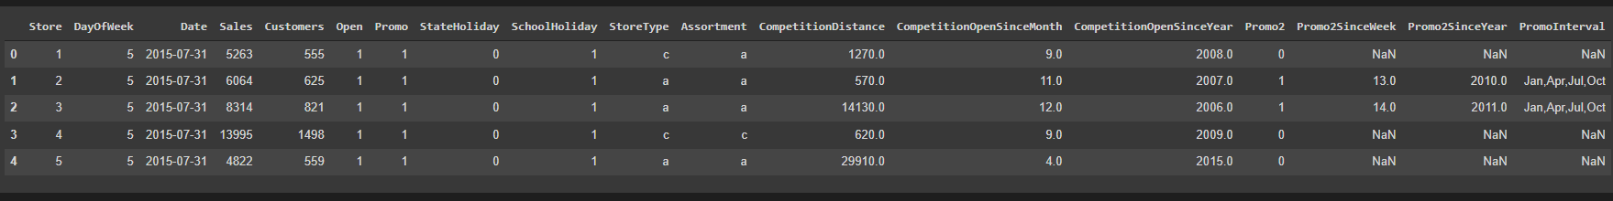
Importing Libraries & Loading Data
Pandas – Manipulation of tabular data in Dataframes
Numpy – Mathematical operations on arrays
Matplotlib – Visualization
Seaborn – Visualization
Sklearn – Data Modeling
We have merged both the dataset Rossmann Stores Data.csv and store.csv for further implementations.

Slide 6
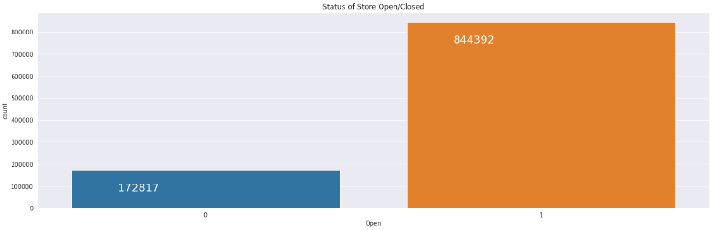
Exploratory Data Analysis
When stores are closed?
Over those two years, 172817 is the number of times that different stores were closed on given days. From those closed events, 2263 times the stores were closed because there was a school holiday. For closed event 30140 times it occurred because of either a bank holiday or easter or Christmas. Sometimes the stores were closed because they were undergoing refurbishments.

Slide 7
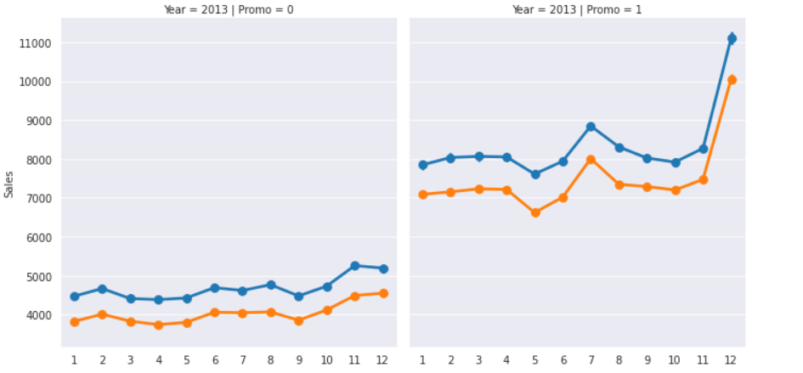
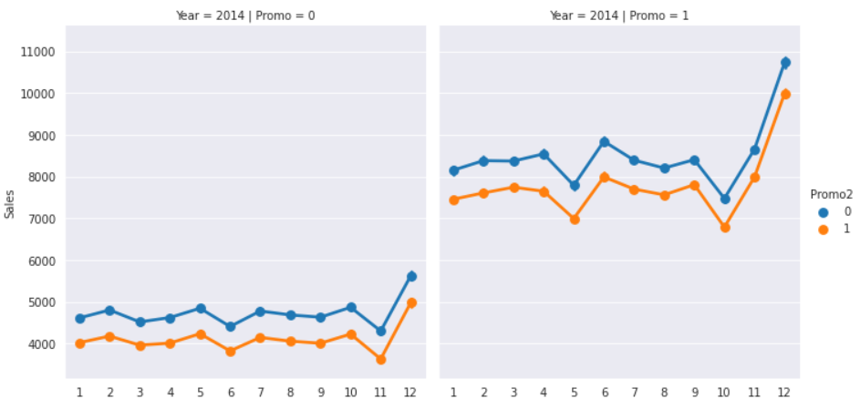
EDA Continued…
Around 62% stores were not running promotion on that day.
Sales with no promotion = 5928.965569239575
Sales with promotion = 8223.920367241544
Effect of running promotional ads on sales :

Slide 8
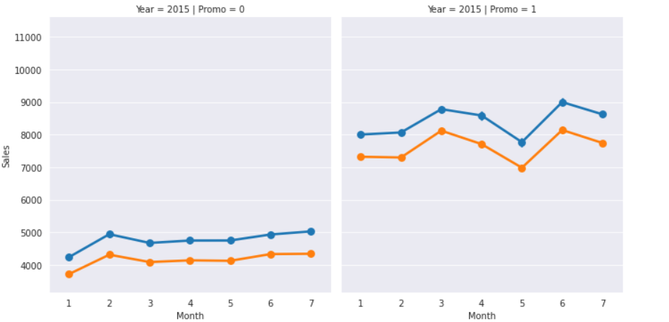
EDA Continued…
Effect of running promotional ads on sales :
Analysis clearly states that if we run promotional advertisement then there is jump in average sales, So we can say running promotion is beneficial for stores.
If we look over the years, there is a slight increase Year over Year but we don't see any major change from 2013 to 2015 and we actually see a very similar pattern in the months over the years with major spikes first around Easter period in March and April then in Summer in May, June and July and then finally around the Christmas period in November and December.

Slide 9
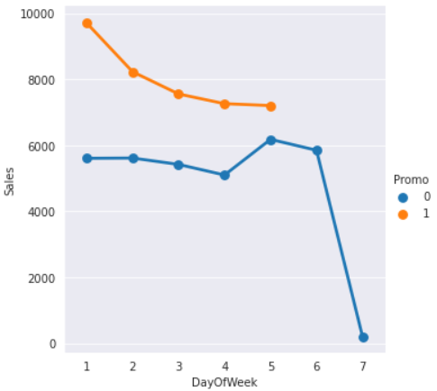
EDA Continued…
Sales according to days of week :
The above graph shows sales according to days of week.
Only 33 stores are open on Sunday.
For Sunday since a very few stores opens on Sundays (only 33); if anyone needs anything urgently and don't have the time to get it during the week, he will have to do some distance to get to the open ones even if it's not close to his house. This means that those 33 open stores on Sunday actually accounts for the potential demand if all Rossman Stores were closed on Sundays. This clearly shows us how important it is for stores to be opened on Sundays.

Slide 10
EDA Continued…
Promotional Ads and Customers count:
Percentage increase in customer when promotional ads are running = 9.665641134987318
Running promotional ads gives 9% hike in customers.
Percentage Shop Running Continuous Promotions:
The Promo2SinceWeek,Promo2SinceYear and PromoInterval variables has almost 51% fill rate since they are actually NULL values because there are no continuous promotion for those stores.

Slide 11
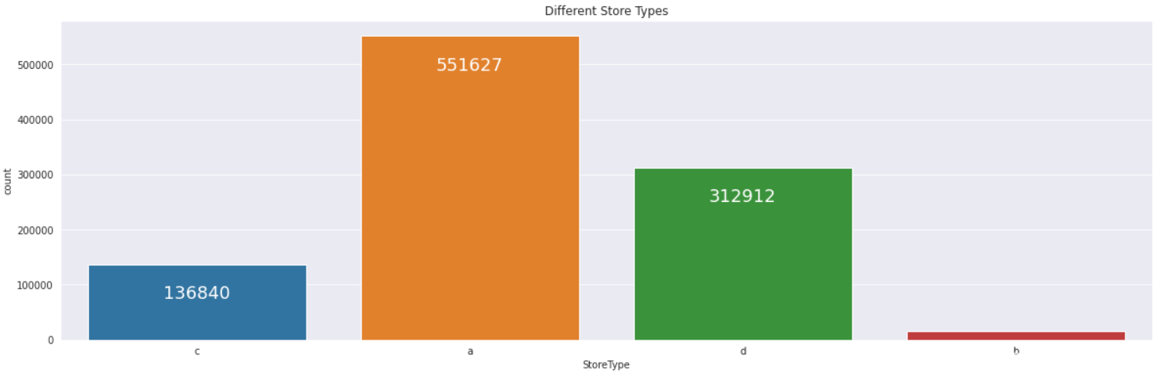
EDA Continued…
Different Store Types
There are four different types of stores – a, b, c and d.
There are 551627 stores in type a, very few number of stores in type b, 136840 stores in type c and 312912 stores in type d.

Slide 12
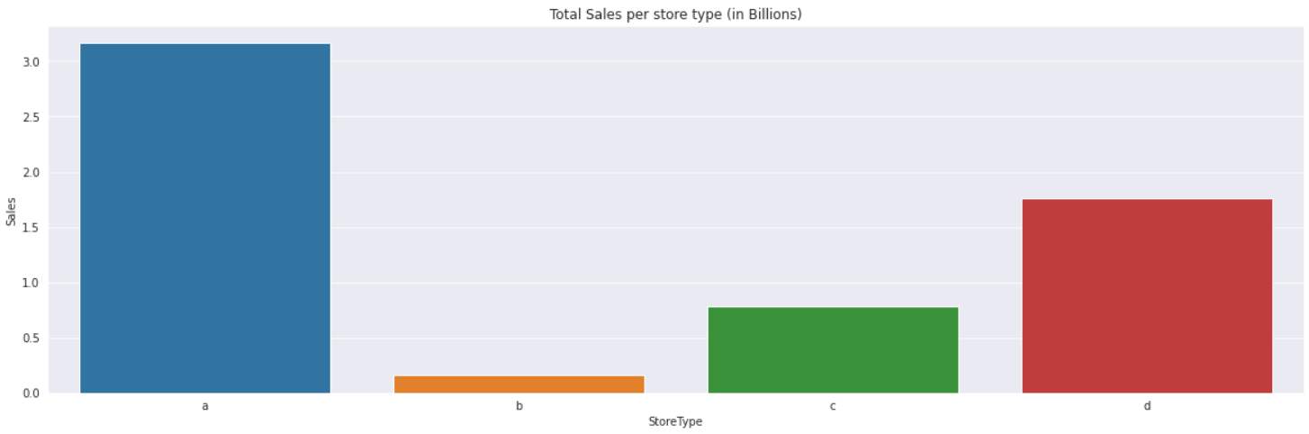
EDA Continued…
Total Sales per Store Type (in Billions)
Type a store is having more than 3 Billion sales.
Type b store is having less than 0.5 Billion sales.
Type c store is having less than 1 Billion sales.
Type d store is having less than 2 Billion sales.

Slide 13
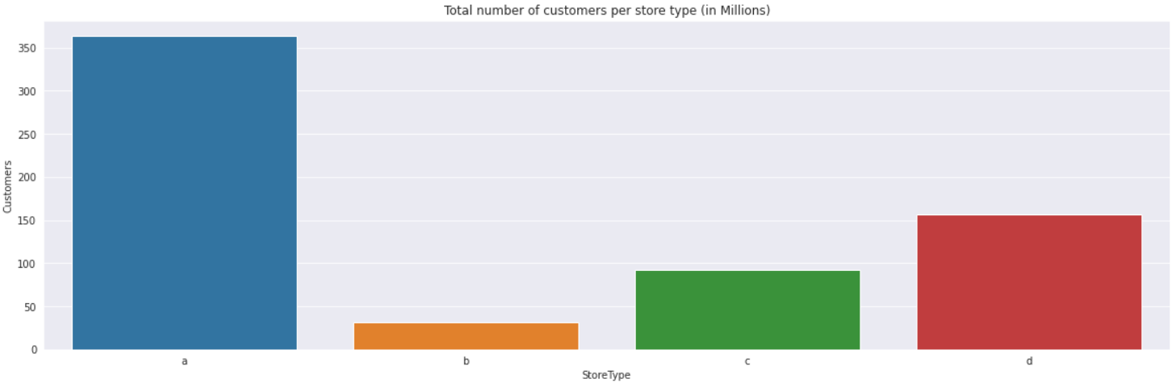
EDA Continued…
Total number of customers per Store Type (in Millions)
There are more than 350 Million customers for type a store.
There are less than 50 Million customers for type b store.
There are approximately 100 Million customers for type c store.
There are approximately 150 Million customers for type d store.

Slide 14
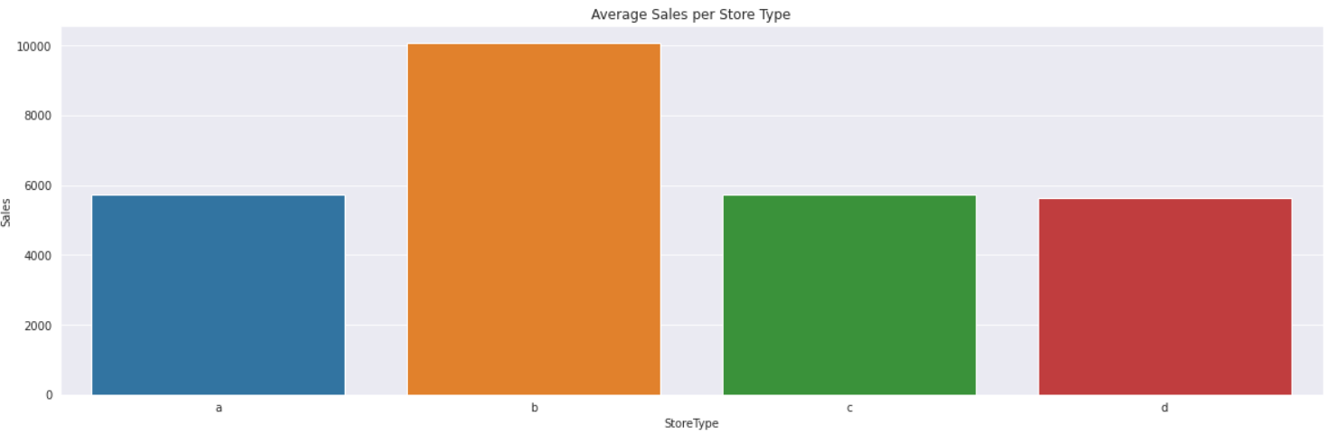
EDA Continued…
Average Sales per Store Type
The average sale of type b store is higher than all other types of stores because, according to number of stores there are more number of customers for store type b when compared with other types of stores.

Slide 15
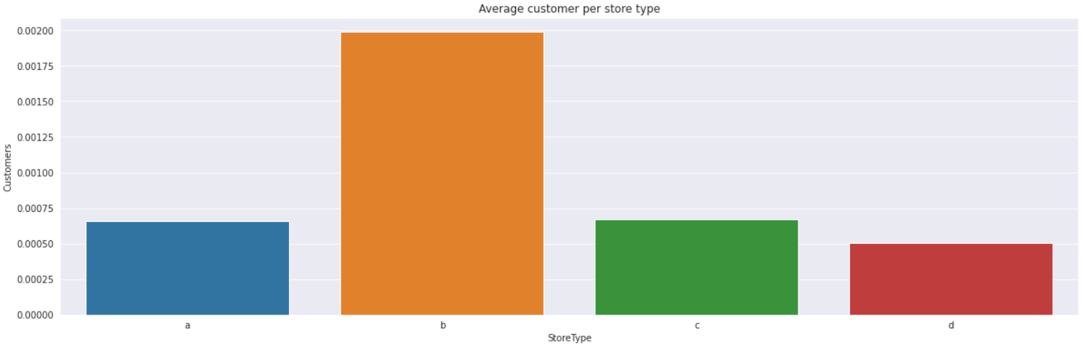
EDA Continued…
Average customer per Store Type
The average customer of type b store is higher than all other types of stores because, according to number of stores there are more number of customers for store type b when compared with other types of stores.

Slide 16
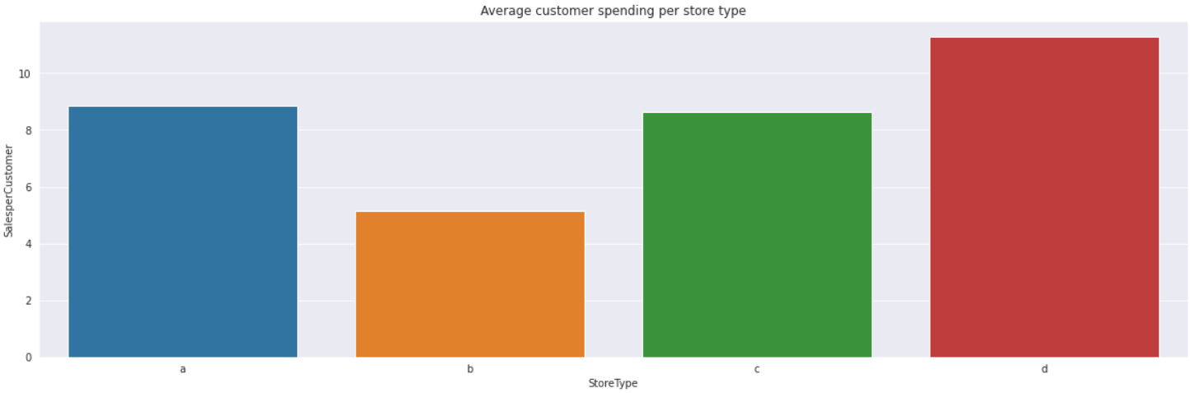
EDA Continued…
Average customer spending time per Store Type
According to above graph, the customers spend more time in store type d and less time in store type b.

Slide 17
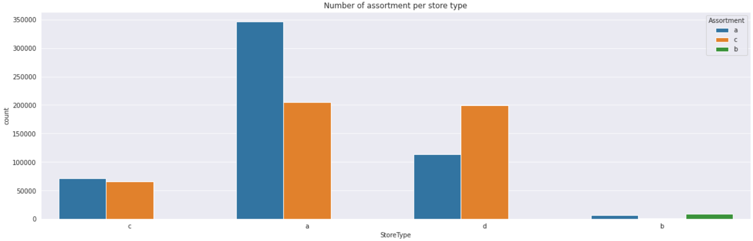
EDA Continued…
Assortments and Store Types
We can clearly see here that most of the stores have either a assortment type or c assortment type.
Interestingly enough Store Type d which has the highest Sales per customer average actually has mostly c assortment type, this is most probably the reason for having this high average in Sales per customer. Having variety in stores always increases the customers spending pattern.

Slide 18
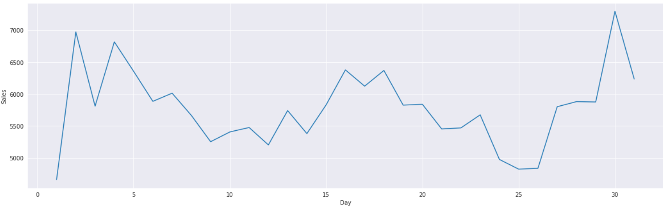
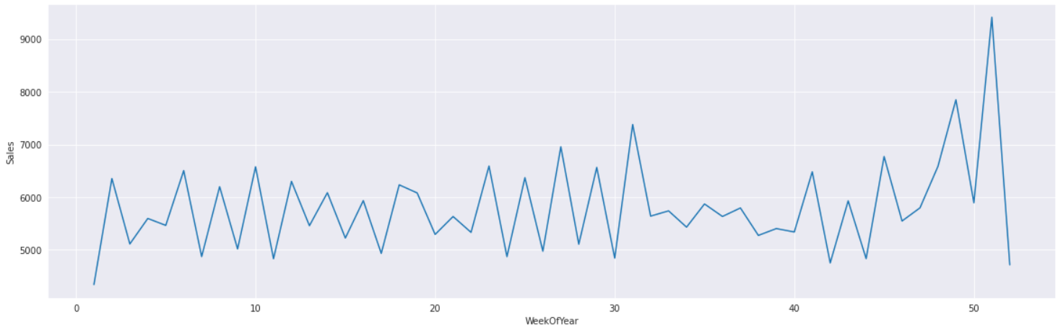
EDA Continued…
Sales Analysis
Sales per day
Sales per week

Slide 19
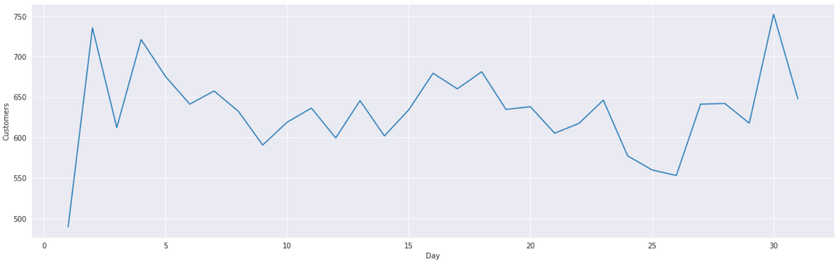
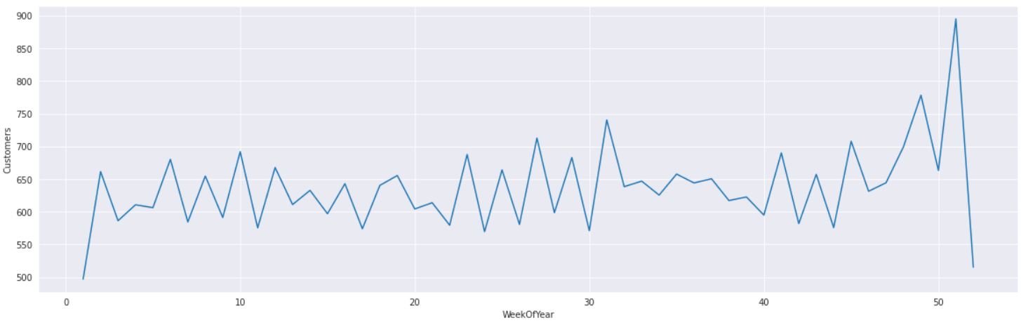
EDA Continued…
Sales Analysis
Customers per day
Customers per week

Slide 20
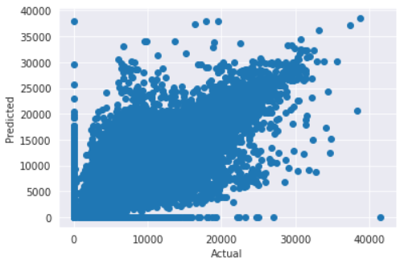
Data Modeling
Decision Tree Regression
Scatter Plot

Slide 21
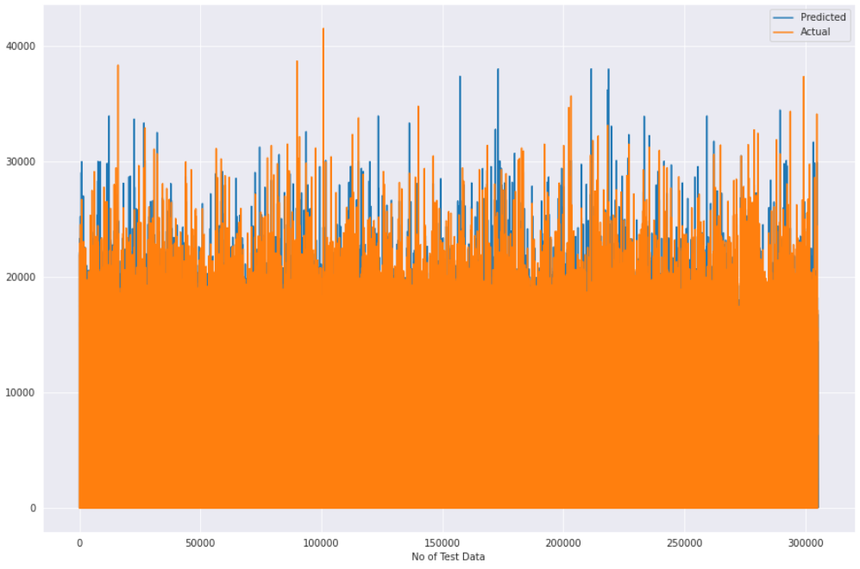
Actual vs Predicted values

Slide 22
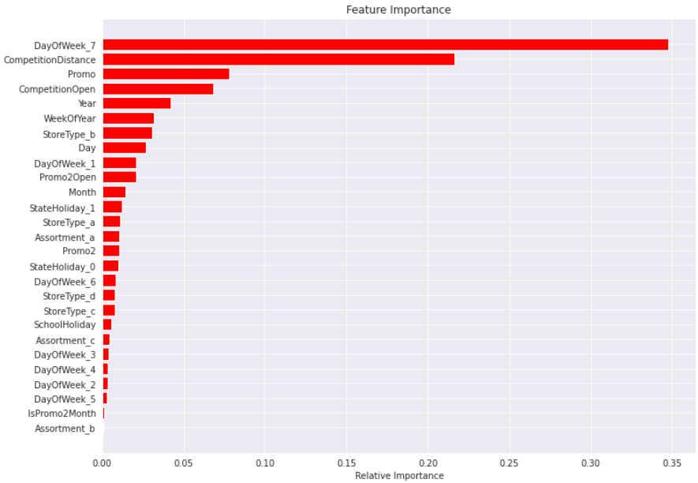
Feature Importance

Slide 23
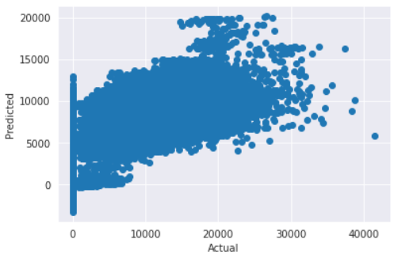
Gradient Boosting
Scatter Plot

Slide 24
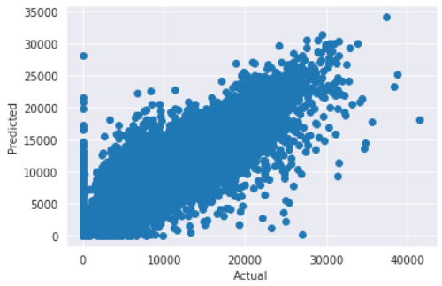
Random Forest
Scatter Plot

Slide 25
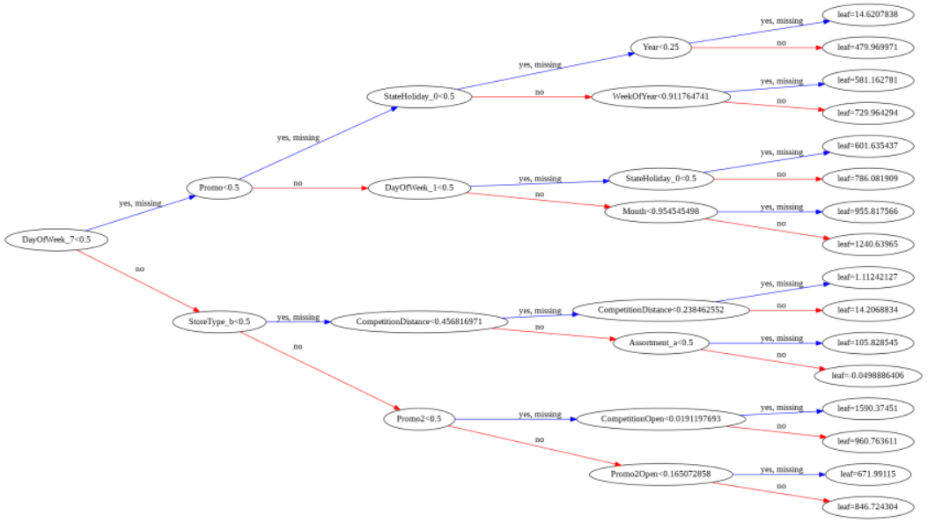
XG Boost
Tree

Slide 26
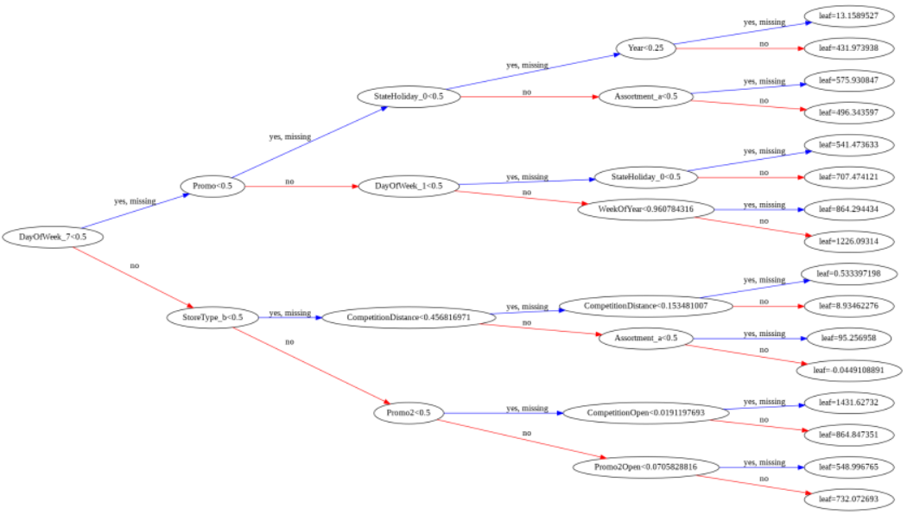
XG Boost
Tree

Slide 27
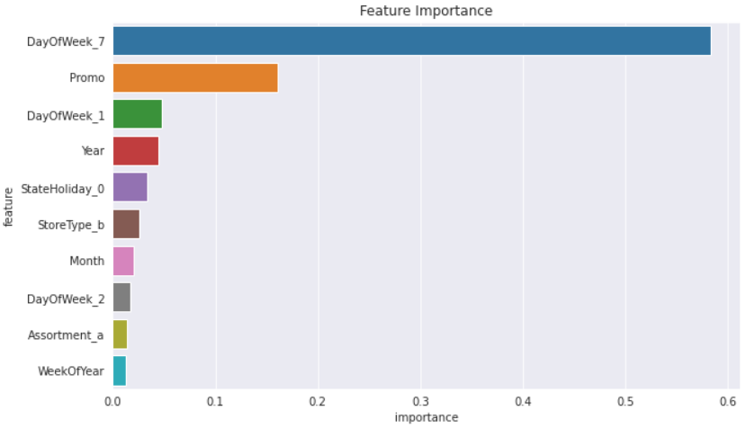
Feature Importance

Slide 28
Conclusion
Conclusion on EDA:
Over those two years, 172817 is the number of times that different stores closed on given days.
From those closed events, 2263 times occurred because there was a school holiday.
For Closed Event 30140 times it occurred because of either a bank holiday or easter or Christmas.
After reading the description of the this task, Rossman clearly stated that they were undergoing refurbishments sometimes and had to close. Most probably those were the times this event was happening.
The best solution here is to get rid of closed stores and prevent the models to train on them and get false guidance
Analysis clearly states that if we run promotional advertisement then there is jump in average sales, So we can say running promotion is beneficial for stores.
If we look over the years, there is a slight increase Year over Year but we don't see any major change from 2013 to 2015 and we actually see a very similar pattern in the months over the years with major spikes first around Easter period in March and April then in Summer in May, June and July and then finally around the Christmas period in November and December.
For Sunday since a very few stores opens on Sundays (only 33);if anyone needs anything urgently and don't have the time to get it during the week, he will have to do some distance to get to the open ones even if it's not close to his house. This means that those 33 open stores on Sunday actually accounts for the potential demand if all Rossman Stores were closed on Sundays. This clearly shows us how important it is for stores to be opened on Sundays.
Store type a has the highest number of stores, sales and customers from the 4 different store types. But this doesn't mean it's the best performing Store type.

Slide 29
When looking at the average sales and number of customers, actually it is Store type b who was the highest average Sales and highest average Number of Customers. One assumption could be that if b has only 17 stores but such a high amount of average sales and customers, whereas a would be smaller in size but much more present.
Surprisingly it is Store Type d who has the highest average spending per Customer, this is probably explained by an average competition distance higher than the rest which means each customer will buy more since he knows there isn't a lot of similar shops around.
We can clearly see here that most of the stores have either a assortment type or c assortment type.
Interestingly enough Store Type d which has the highest Sales per customer average actually has mostly c assortment type, this is most probably the reason for having this high average in Sales per customer. Having variety in stores always increases the customers spending pattern.
Conclusion on Data Modeling:

Slide 30

Thank You!!

