Slide 1
Reinforcement Learning | Q- Learning, MDPs Overview
9th Sep 25

Slide 2
Agenda | Reinforcement Learning
Reinforcement Learning Overview
Supervised Vs Unsupervised Vs RL Vs NN
RL Terminologies
RL Basic Idea
Online Vs Offline Learning
Policy & Types
Exploration & Exploitation
Monte Carlo
Temporal Difference
Q Learning
Markov Decision Property
Bellman’s Equation

Slide 3


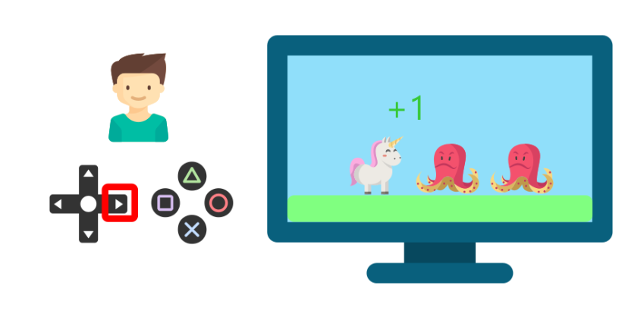
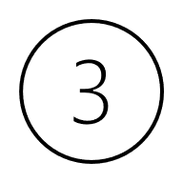
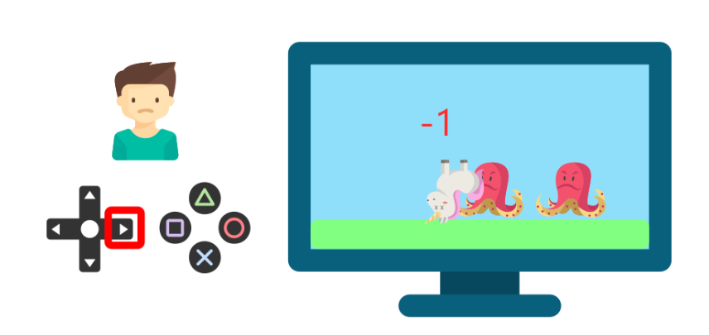
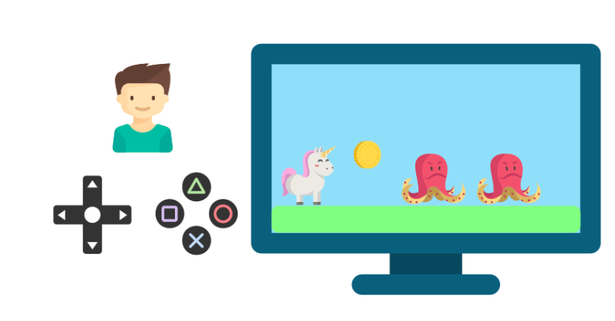
Reinforcement Learning| Overview
Reinforcement Learning is a feedback-based Machine learning technique in which an agent learns to behave in an environment by performing the actions and seeing the results of actions. For each good action, the agent gets positive feedback, and for each bad action, the agent gets negative feedback or penalty
The agent learns with the process of hit and trial, and based on the experience, it learns to perform the task in a better way. Hence, we can say that "Reinforcement learning is a type of machine learning method where an intelligent agent (computer program) interacts with the environment and learns to act within that." How a Robotic dog learns the movement of his arms is an example of Reinforcement learning.

Slide 4
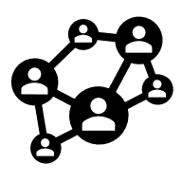


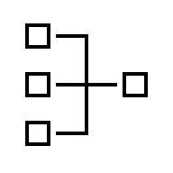













Machines solving a whole new set of problems
Comparison:
Supervised
Unsupervised
Reinforced
NNs
Labeled
Used to find complex relations between input and label
Unlabeled
Used to find patterns in the input x
States and actions
Used to find action steps
Automating deterministic problem solving
Data is unstructured in nature
Used to find patterns in data considering the spatial and temporal aspects of behavior
Best path analysis et al for Google’s self driving cars
Adobe used a Campaign Recommendation system to increase browse LTV
Walmart uses a Dynamic Pricing system to optimize store clearance

Slide 5
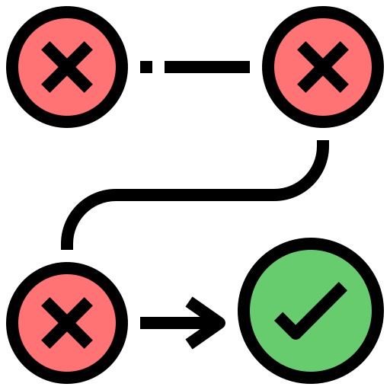





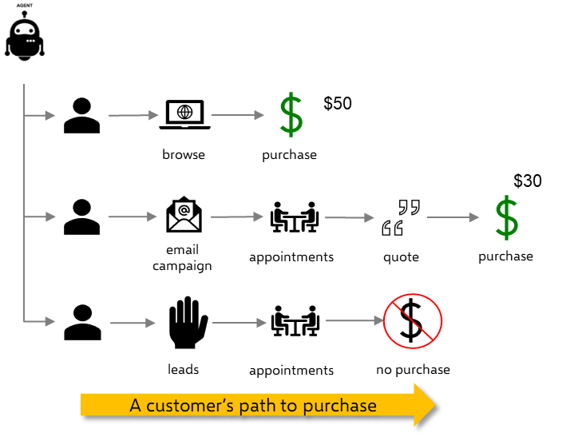
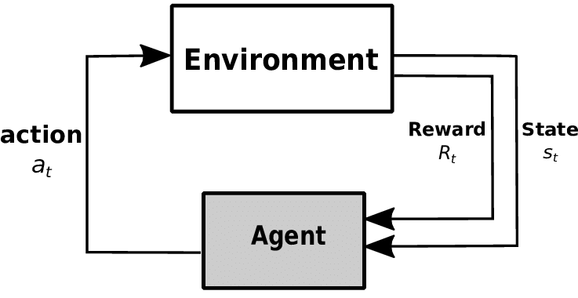
Reinforcement Learning | Key Elements of RL
Solve a whole different type of problems
A diverse set of examples
Test and learn from infinite combinations of heuristic rules
Recommend the next best action to take in each situation
Long term optimization of rewards over immediate best outcome
Finding the best path for a self-driving car in real-time
Enhancing a customer experience in an omni channel world
Designing a campaign strategy to increase Customer Lifetime Value
How a new kind of learning can help
Agent is a software application that simulates the customer behavior at each step
$15
Environment is data curated to describe or represent the real world
States are a description of the
environment at a given point in time
Actions are something an RL agent can do to change these states
Policy
Policy is a sequence of steps that should be taken from each state to maximize the reward
Learning Workflow
*Rewards are the utility the agent receives for performing the “right” actions

Slide 6
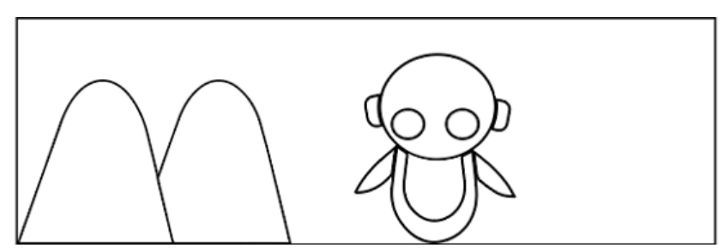
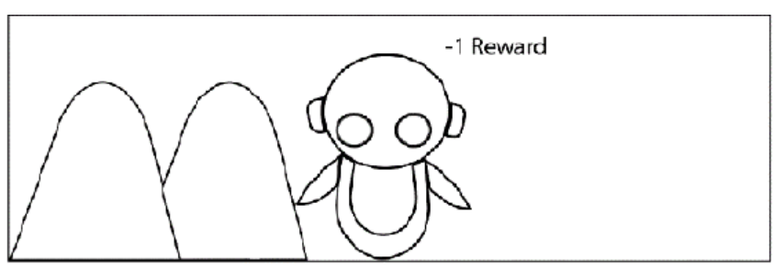
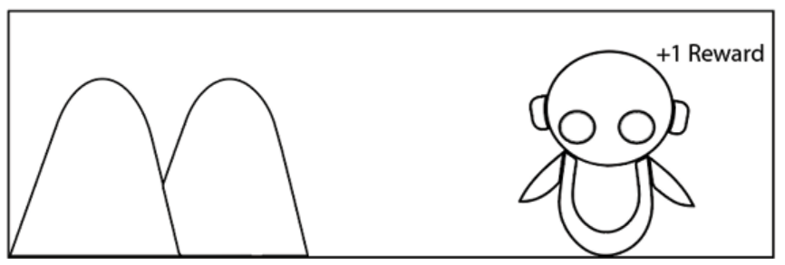
Reinforcement learning | The Basic Idea of RL
Goal: To teach a robot (agent) to walk without hitting a mountain
RL Algorithm:
First, the agent interacts with the environment by performing an action
By performing an action, the agent moves from one state to another
Then the agent will receive a reward based on the action it performed
Based on the reward, the agent will understand whether the action is good or bad
If the action was good, that is, if the agent received a positive reward, then the agent will prefer performing that action, else the agent will try performing other actions in search of a positive reward

Slide 7
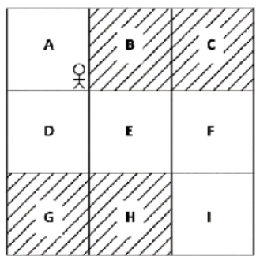
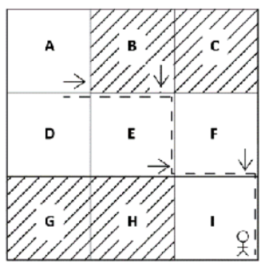
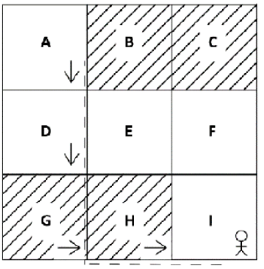
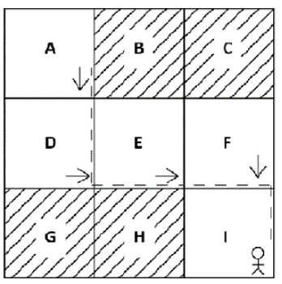
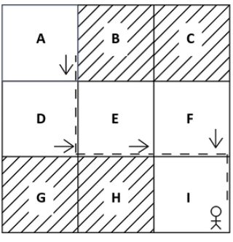
Reinforcement Learning | RL Agent in the Grid World
Episodic
Task
Continuous
Grid World Environment
Agent Actions- It.1
Agent Actions- It.2
The agent will try out different actions in each state and understand whether an action is good or bad based on the reward it obtains
The goal of the agent is to maximize rewards.
So, the agent will always try to perform good actions that give a positive reward, and when the agent performs good actions in each state, then it ultimately leads the agent to achieve the goal.
These iterations are called episodes in RL terminology
Agent Actions- It.3
Agent Succeeded

Slide 8
Reinforcement Learning | Offline Vs Online Learning
ONLINE LEARNING
OFFLINE LEARNING
Agent learns and updates its policy during interaction with the environment
Data is gathered in real-time as the agent acts
Allows continuous adaptation to changing environments
Pros: Immediate feedback, adaptive
Cons: Requires live environment access
Agent learns from a fixed dataset collected prior to training
No interaction with the environment during learning
Examples: Learning from recorded gameplay data or logs
Pros: Safe, can leverage large datasets, reproducible
Cons: Limited by dataset quality, no adaptation during deployment.

Slide 9
Reinforcement Learning | Off Policy Vs On Policy
ON POLICY
OFF POLICY
The agent learns the value of the policy it is currently following.
Explores and exploits according to the same policy.
Updates are based on actions actually taken by the agent.
Pros: Directly improves the behavior policy.
Cons: May require careful exploration strategy.
The agent learns the value of a target policy different from the policy used to generate data.
Can learn from past experiences or other agents’ data.
Examples: Q-learning, Deep Q-Network (DQN).
Pros: More flexible; can learn from offline data or demonstrations.
Cons: Can be more complex to stabilize.

Slide 10
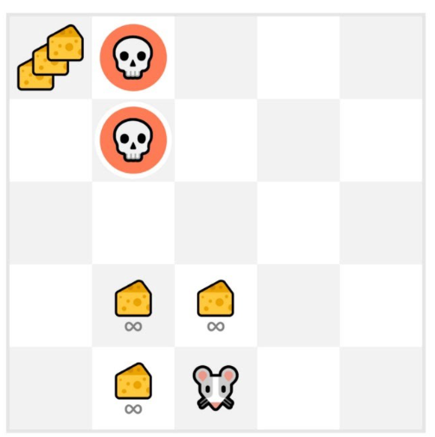
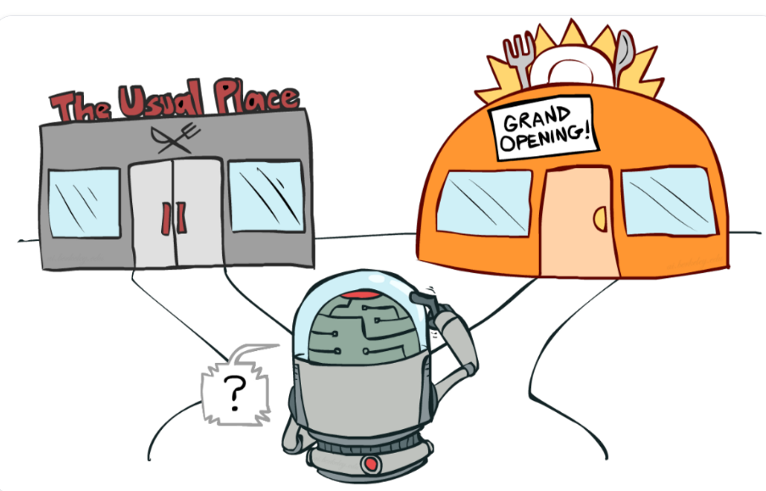
Reinforcement Learning | Exploration & Exploitation
Exploration is exploring the environment by trying random actions in order to find more information about the environment.
Exploitation is exploiting known information to maximize the reward.
In this game, the mouse can collect unlimited small cheeses (+1 each), but there's a massive cheese pile (+1000) at the top of the maze.
If the agent only exploits known rewards, it will stick to the small cheeses and never reach the big one. However, some exploration can lead to discovering the larger reward.
This illustrates the exploration–exploitation trade-off: balancing exploring the environment with exploiting known rewards. To manage this, we need a rule that effectively handles this balance

Slide 11

Reinforcement Learning | Markov Decision Property
The Markov Decision Process (MDP) provides a mathematical framework for solving the RL problem
The Markov property states that the future depends only on the present and not on the past
For example, if we want to predict the weather and we know that the current state is cloudy, we can predict that the next state could be rainy. We concluded that the next state is likely to be rainy only by considering the current state (cloudy) and not the previous states, which might have been sunny, windy, and so on
The MDP consists of states, a transition probability, a reward function, and also actions

Slide 12
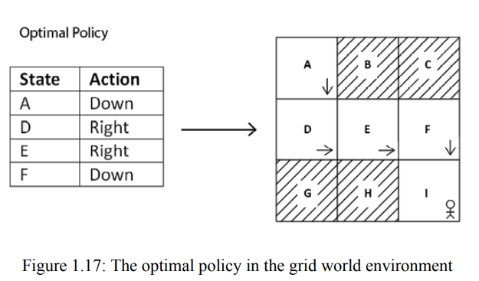
Reinforcement Learning | Action Space & Policy
The set of all possible actions in the environment is called the action space
Action Space can be Discrete (Up, left, down, right) or Continuous (E.g., Driving a car)
Policy defines the agent's behavior in an environment. The policy tells the agent what action to perform in each state. For instance, in the grid world environment, we have states A to I and four possible actions. The policy may tell the agent to move down in state A, move right in state D, and so
This good policy is called the optimal policy. The optimal policy is the policy that gets the agent a good reward and helps the agent to achieve the goal. For instance, in our grid world environment, the optimal policy tells the agent to perform an action in each state such that the agent can reach state I from state A without visiting the shaded states

Slide 13

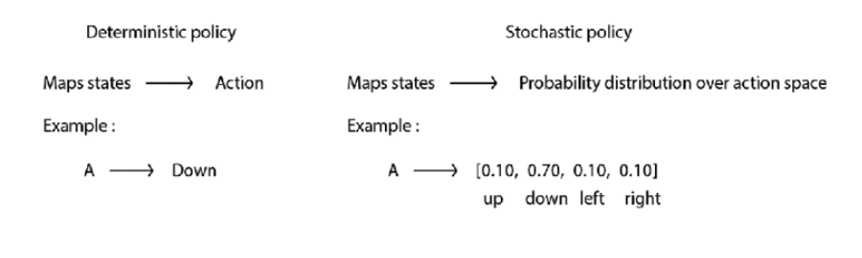


Reinforcement Learning | Types of Policy
DETERMINSITIC POLICY
A deterministic policy tells the agent to perform one particular action in a state. Thus, the deterministic policy maps the state to one particular action and is often denoted by
Consider our grid world example. Given state A, the deterministic policy tells the agent to perform the action down
2. STOCHASTIC POLICY
Stochastic policy does not map a state directly to one particular action; instead, it maps the state to a probability distribution over an action space
Stochastic policy maps the state to a probability distribution over the action space and is often denoted by

Slide 14

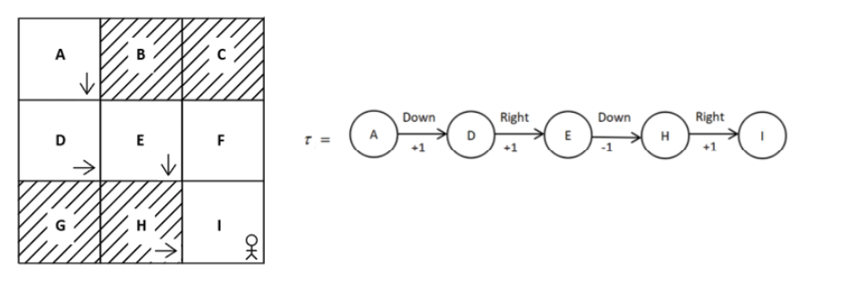
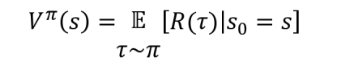
Reinforcement Learning | Value Based Method
The value function, also called the state value function, denotes the value of the state. The value of a state is the return an agent would obtain starting from that state following policy
Let’s understand the Value function with an example:
Oops! There is a small change, Instead of taking the return directly as a value of a state, we will use the expected return
V(A)=1+1-1+1=>2
V(D)=1-1+1=>1
V(E)=-1+1=>0
V(H)=1
V(I)=?

Slide 15


Reinforcement Learning | Q Function
Q function, also called the state-action value function, denotes the value of a state-action pair
The value of a state-action pair is the return the agent would obtain starting from state s and performing action a following policy ₶
Q value is the expected return the agent would obtain starting from state s and performing action a following policy
The optimal Q function is the one that has the maximum Q value over other Q functions

Slide 16
Reinforcement Learning | Types of learning
1. MODEL BASED LEARNING:
In model-based learning, an agent will have a complete description of the environment
When the agent knows the model dynamics of its environment, that is, when the agent knows the transition probability of its environment, then the learning is called model-based learning
Agent uses the model dynamics to find the optimal policy
2. MODEL FREE LEARNING
When the agent does not know the model dynamics of its environment
model-free learning, an agent tries to find the optimal policy without the model dynamics

Slide 17
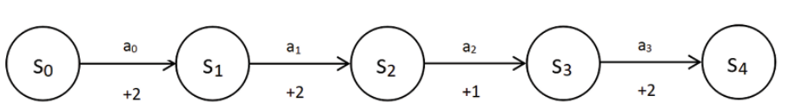
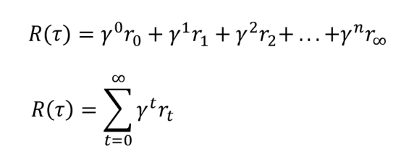
Reinforcement Learning | Return & Discount Factor
Return can be defined as the sum of the rewards obtained by the agent in an episode
Continuous Task have no terminal states so we introduce a new term called Discount Factor
The discount factor ranges from 0 to 1. A low value (near 0) prioritizes immediate rewards, while a high value (near 1) emphasizes future rewards

Slide 18

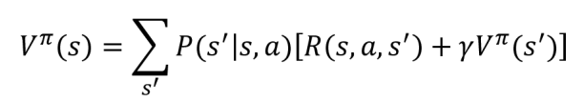
Reinforcement Learning | Bellman’s Equation
Bellman equation, named after Richard Bellman, helps us solve the Markov decision process (MDP). When we say solve the MDP, we mean finding the optimal policy
Bellman equation states that the value of a state can be obtained as a sum of the immediate reward and the discounted value of the next state
The preceding Bellman equation works only when we have a deterministic environment, If it’s a stochastic environment, the modified equation will be:

Slide 19
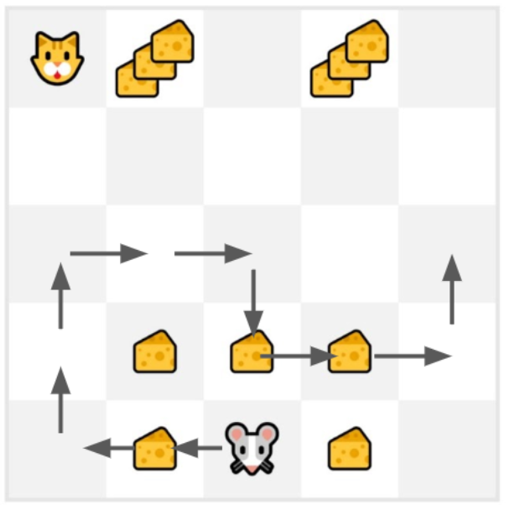
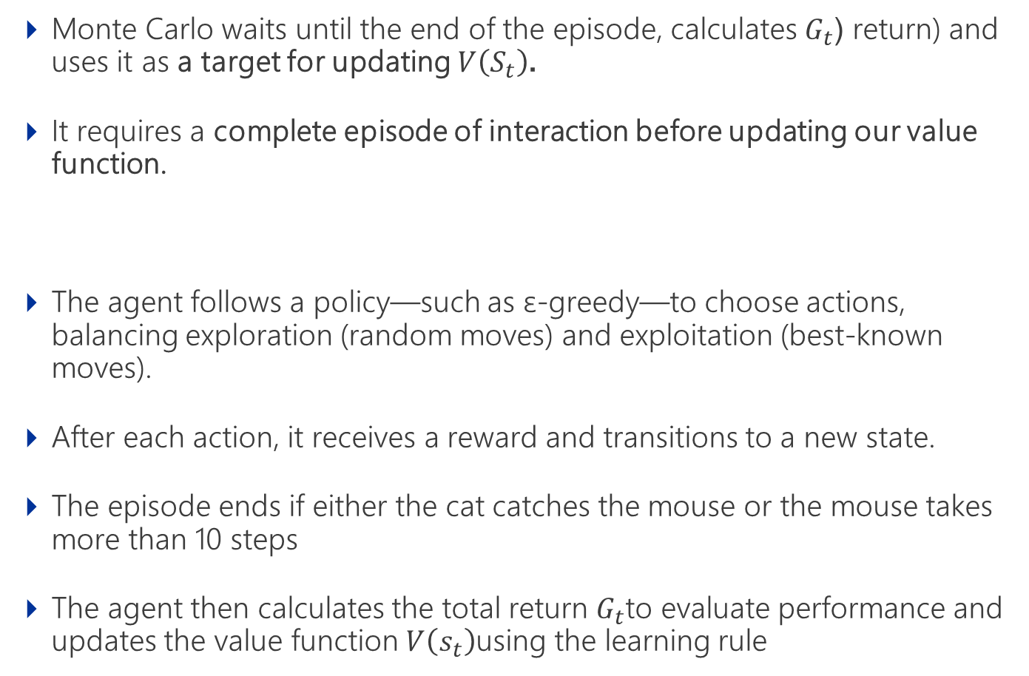
Reinforcement learning | Monte- Carlo Method
Monte Carlo waits until the end of the episode, calculates $G_{t}$ (return) and uses it as a target for updating $V\left(S_{t}\right)$.
It requires a complete episode of interaction before updating our value function.
The agent follows a policy—such as ε-greedy—to choose actions, balancing exploration (random moves) and exploitation (best-known moves).
After each action, it receives a reward and transitions to a new state.
The episode ends if either the cat catches the mouse or the mouse takes more than 10 steps
The agent then calculates the total return $G_{t}$to evaluate performance and updates the value function $V\left(s_{t}\right)$using the learning rule

Slide 20
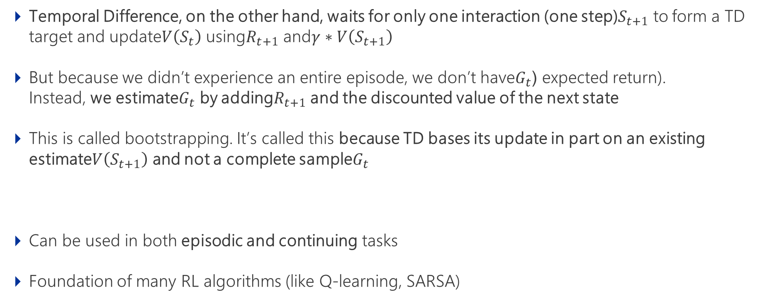
Reinforcement Learning | Temporal Difference
Temporal Difference, on the other hand, waits for only one interaction (one step)$S_{t+1}$ to form a TD target and update$V\left(S_{t}\right)$ using$R_{t+1}$ and$γ∗V\left(S_{t+1}\right)$
But because we didn’t experience an entire episode, we don’t have$G_{t}$ (expected return). Instead, we estimate$G_{t}$ by adding$R_{t+1}$ and the discounted value of the next state
This is called bootstrapping. It’s called this because TD bases its update in part on an existing estimate$V\left(S_{t+1}\right)$ and not a complete sample$G_{t}$
Can be used in both episodic and continuing tasks
Foundation of many RL algorithms (like Q-learning, SARSA)

Slide 21
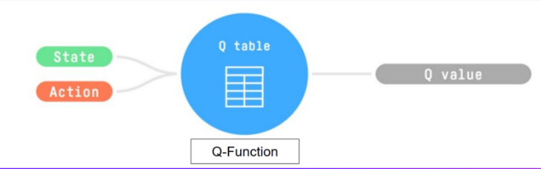
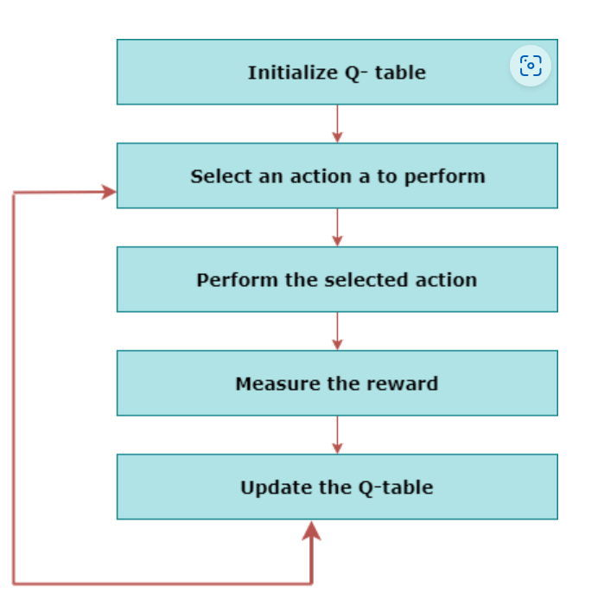
Reinforcement Learning | Q-Learning
Q-Learning is an off-policy value-based method that uses a TD approach to train its action-value function
Q-Learning is the algorithm we use to train our Q-function, an action-value function that determines the value of being at a particular state and taking a specific action at that state
It learns the value function Q (S, a), which means how good to take action "a" at a particular state "s.“
The goal of the agent in Q-learning is to maximize the value of Q.

Slide 22
Reinforcement Learning | Self - Study
DQN → Deep Q learning
DDQN → Double Deep Q Learning
CQL → Conservative Q learning
Importance Sampling
LSTM
Distributed Reinforcement Learning

Slide 23
Reference Links
On-Policy vs Off-Policy Reinforcement Learning Towards Data Science Medium Article This article provides a detailed comparison between on-policy and off-policy reinforcement learning, discussing their characteristics, advantages, and use cases.
Offline vs. Online Reinforcement Learning Hugging Face This article explains the differences between offline and online reinforcement learning, detailing how agents interact with the environment in each scenario.
Online and Offline Reinforcement Learning: What are they and how do they compare? Ericsson Blog This article contrasts online and offline RL, discussing their characteristics, advantages, and disadvantages in various contexts.
Research Papers
Bridging the Gap Between Offline and Online Reinforcement Learning Evaluation Methodologies arXiv:2212.08131 This paper proposes a sequential approach to evaluate offline RL algorithms based on training set size and data efficiency.
Understanding the performance gap between online and offline RL algorithms arXiv:2405.08448 Discusses the performance differences between online and offline RL algorithms, providing insights into their computational demands.

