Slide 1
Comprehensive SDLC Playbook for Front-end (React)
SDLC Playbook
4 June 2025

Slide 2
Objectives of Playbook

Slide 3


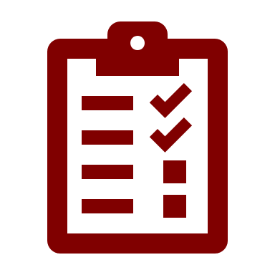

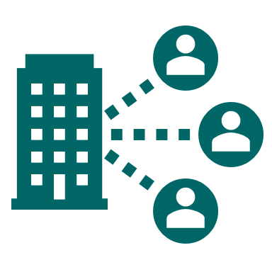
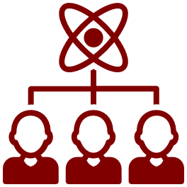

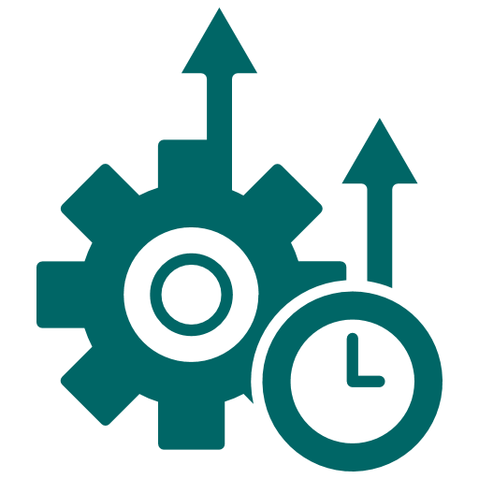
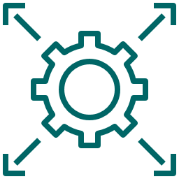

Objectives
Key objectives of Playbook
Streamline Project Execution:
Provide a structured framework for managing the SDLC of React projects, ensuring consistent and efficient workflows
Simplify Decision-Making:
Provide guidance on choosing appropriate tools, libraries, and state management techniques like Context API or Redux
Define Clear Entry and Exit Criteria:
Set unambiguous prerequisites and deliverables for each phase to avoid misalignment and reduce rework
Mitigate Risks:
Identify and address potential issues early through risk assessment, debugging, and performance monitoring strategies
Enhance Collaboration:
Foster better communication and coordination among stakeholders, developers, and QA teams through well-defined processes
Optimize Time and Resources:
Create a timeline with realistic milestones and ensure efficient use of development resources
Ensure Quality Deliverables:
Focus on meeting functional and non-functional requirements by incorporating testing and validation at every stage
Enable Continuous Improvement:
Incorporate feedback mechanisms for iterative enhancements and post-deployment updates
Support Scalability and Maintainability:
By implementing robust design principles and development strategies, ensuring the application can adapt to growing demands and remain efficient over time
Standardize Best Practices:
Serve as a reference guide for adopting industry-standard methods and practices across all React projects

Slide 4
Software Development Life Cycle (SDLC)

Slide 5
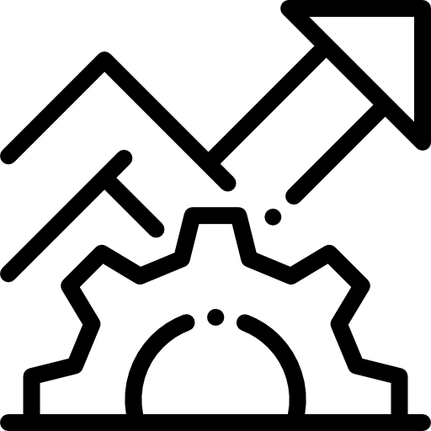
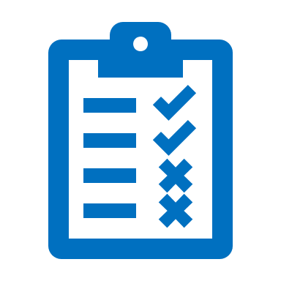



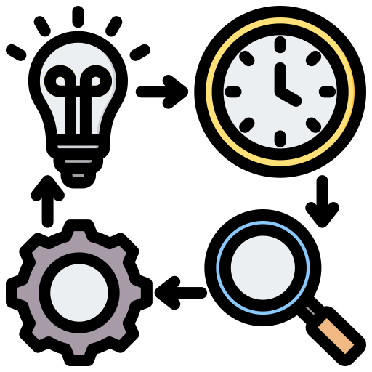


SDLC Phases
Software Development Life Cycle (SDLC)
SDLC is basically the step-by-step process teams follow to plan, build, test, and deliver software that works well, meets user needs, and gets done on time.
Build the application according to the design and as per the Business requirements
Design the architecture and visual aspects of the application
Design the architecture and visual aspects of the Application
04
Ensure the application meets the functional and non-functional requirement
Development
05
03
Design
Testing
Deploying the developed and tested software to the production environment, making it accessible to end-users
Define the project goals, tech stack, and resource requirements for efficient development.
02
06
Planning
Deployment
Gather and analyze the requirements of the application. Obtain finalized business requirements documents (BRD)
01
07
Ensure the application remains functional and updated post-deployment
Requirement
Maintenance

Slide 6
Phase 01 - Requirement Gathering / Analysis

Slide 7

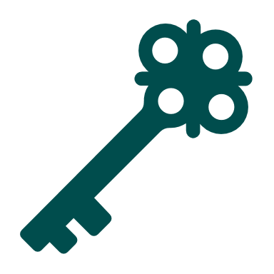

Requirement Phase
What happens in Requirement Phase?
Requirement Phase ensures alignment with strategic goals by defining clear requirements and prioritizing features to meet user needs effectively. It identifies challenges early, facilitates smooth communication among stakeholders, and establishes benchmarks for performance, compatibility, and testing to ensure long-term success.
Entry Criteria:
Stakeholder Identification: Key stakeholders, including business owners, end-users, and project sponsors, are identified.
Project Objectives: A clear understanding of the project's goals, scope, and purpose.
Technical Feasibility: Asses project constraints, dependencies, and frontend requirements like performance and compatibility.
Initial Information Availability: High-level project details, such as target audience, market needs, and existing systems, are provided
Process
Exit Criteria:
Requirement Documented: All functional, non-functional, and technical requirements are documented and reviewed.
Requirement Validation: Requirements are validated and agreed upon by all stakeholders.
Prioritized Requirements: Requirements are categorized into must-haves, nice-to-haves, and future enhancements.
Use Cases/User Stories: Detailed use cases or user stories are prepared, including acceptance criteria.
Sign-Off: Stakeholders formally approve and sign off on the requirements document.
01
Identifying Goals and Expectations *
Understand user needs by focusing on design, navigation, Gathering Insights through Research, and prioritizing features that enhance satisfaction and workflows.
Core Features and Requirements *
02
Identify functional and non-functional requirements to ensure the application delivers intended features, performance, create user Stories and prioritize the requirements.
03
Software Requirement Specification *
This is a sort of document that specifies all those things that need to be defined and created during the entire project cycle..
*Click on the headings for the detailed descriptions.

Slide 8
Phase 02 - Planning

Slide 9


Planning Phase
What activities occur during the Planning Phase?
The Planning Phase establishes a comprehensive roadmap for the project. It involves selecting appropriate tools and technologies, defining the architecture, and outlining strategies for workflows and resource management. Key activities include designing timelines and milestones, setting up CI/CD pipelines, performing risk assessments, and documenting the project plan.
Process
Entry Criteria:
Approved Required Documents: Clearly defined and approved scope, user stories, or features.
Clarity on the Technology Stack: Agreement on the core technologies To be used (frontend, backend tech, databases).
Team Availability & Roles Defined: Identified team members, their roles, and availability.
Initial Feasibility Assessment: Verification that the project is viable from technical and resource Perspectives.
Exit Criteria:
Project Plan Documented: Defined timelines, milestones, and deliverables.
Defined Architecture and design: Architecture and design of the application are clearly defined.
Defined Timelines, Milestones: Key dates and critical goals are set to track progress, with deliverables clearly defined as outcomes for each phase.
Libraries & Tools Chosen: Selection of libraries and tools justified for scalability, maintainability, and compatibility with the project’s needs.
Choosing Libraries and Tools *
Guide the team in selecting libraries and tools that align with project requirements and organizational standards.
Architecture and design*
Ensure a well-organized architecture for the project.
Timelines & Milestones *
Define clear, actionable steps with realistic deadlines to ensure steady progress.
Note : Refer Sample Timeline Estimation | Choosing Right Libraries & Tools
* Click on the headings for the detailed descriptions.

Slide 10
Phase 03 - Design

Slide 11


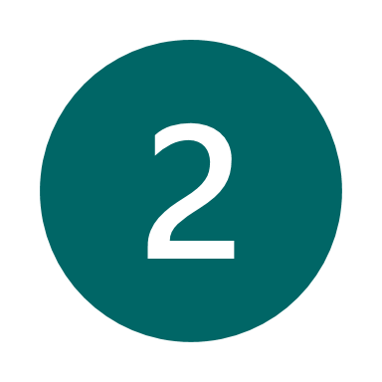
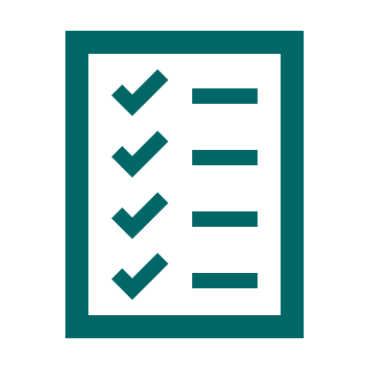

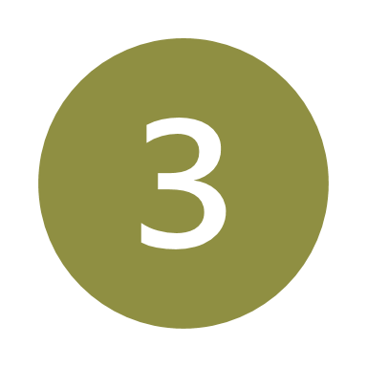
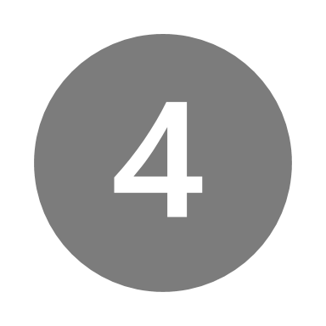

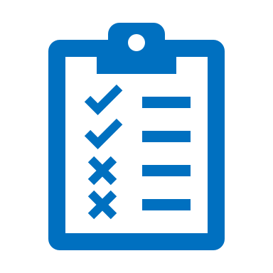
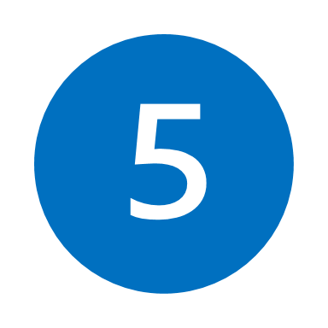


Design Phase
What takes place during the Design Phase?
Design Phase in frontend development involves creating wireframes, prototypes, and mockups to define the user interface and experience. It ensures designs
align with branding, usability, and technical feasibility before development begins.
Entry Criteria :
Requirements and Goals Finalized :All functional, non-functional, and technical requirements are documented and approved. Business goals, objectives, and constraints are clearly defined, with stakeholders aligned.
Feasibility Validated: Collaboration with developers ensures the design approach aligns with platform capabilities, addressing any major technical considerations.
Process
Discovery: Research and gather insights about user needs, business goals, and technical constraints to define the design direction.
Discovery: Research and gather insights about user needs, business goals, and technical constraints to define the design direction.
Define: Create clear design requirements, outline user personas, and establish key features to guide the design process.
Define: Create clear design requirements, outline user personas, and establish key features to guide the design process.
Ideate: Brainstorm multiple design concepts and solutions, focusing on creativity and functionality to address identified challenges.
Ideate: Brainstorm multiple design concepts and solutions, focusing on creativity and functionality to address identified challenges.
Exit Criteria:
Design Artifacts and Specifications Finalized: Wireframes, mockups, prototypes, and architecture diagrams are approved. UI/UX standards, style guides, design tokens, and technical specifications are complete and shared with the development team.
Stakeholder Approval and Handover: Final designs are signed off by stakeholders, and all necessary design assets, documentation, and tools are handed over to the development team for implementation.
CI/CD pipeline is setup: Ensure CI/CD Pipeline is aligned with the design specifications and ready for implementation.
Design: Create visual designs, including high-fidelity wireframes, mockups, ensuring that elements and interactions align with user needs and project goals.
Design: Create visual designs, including high-fidelity wireframes, mockups, ensuring that elements and interactions align with user needs and project goals.
Test: Conduct usability testing with users to validate design choices, identify issues, and make improvements based on feedback.
Test: Conduct usability testing with users to validate design choices, identify issues, and make improvements based on feedback.
CI/CD setup: Set up CI/CD pipelines integrated with a code analysis tool, such as SonarQube, for continuous code quality checks..

Slide 12
Phase 04 - Development

Slide 13





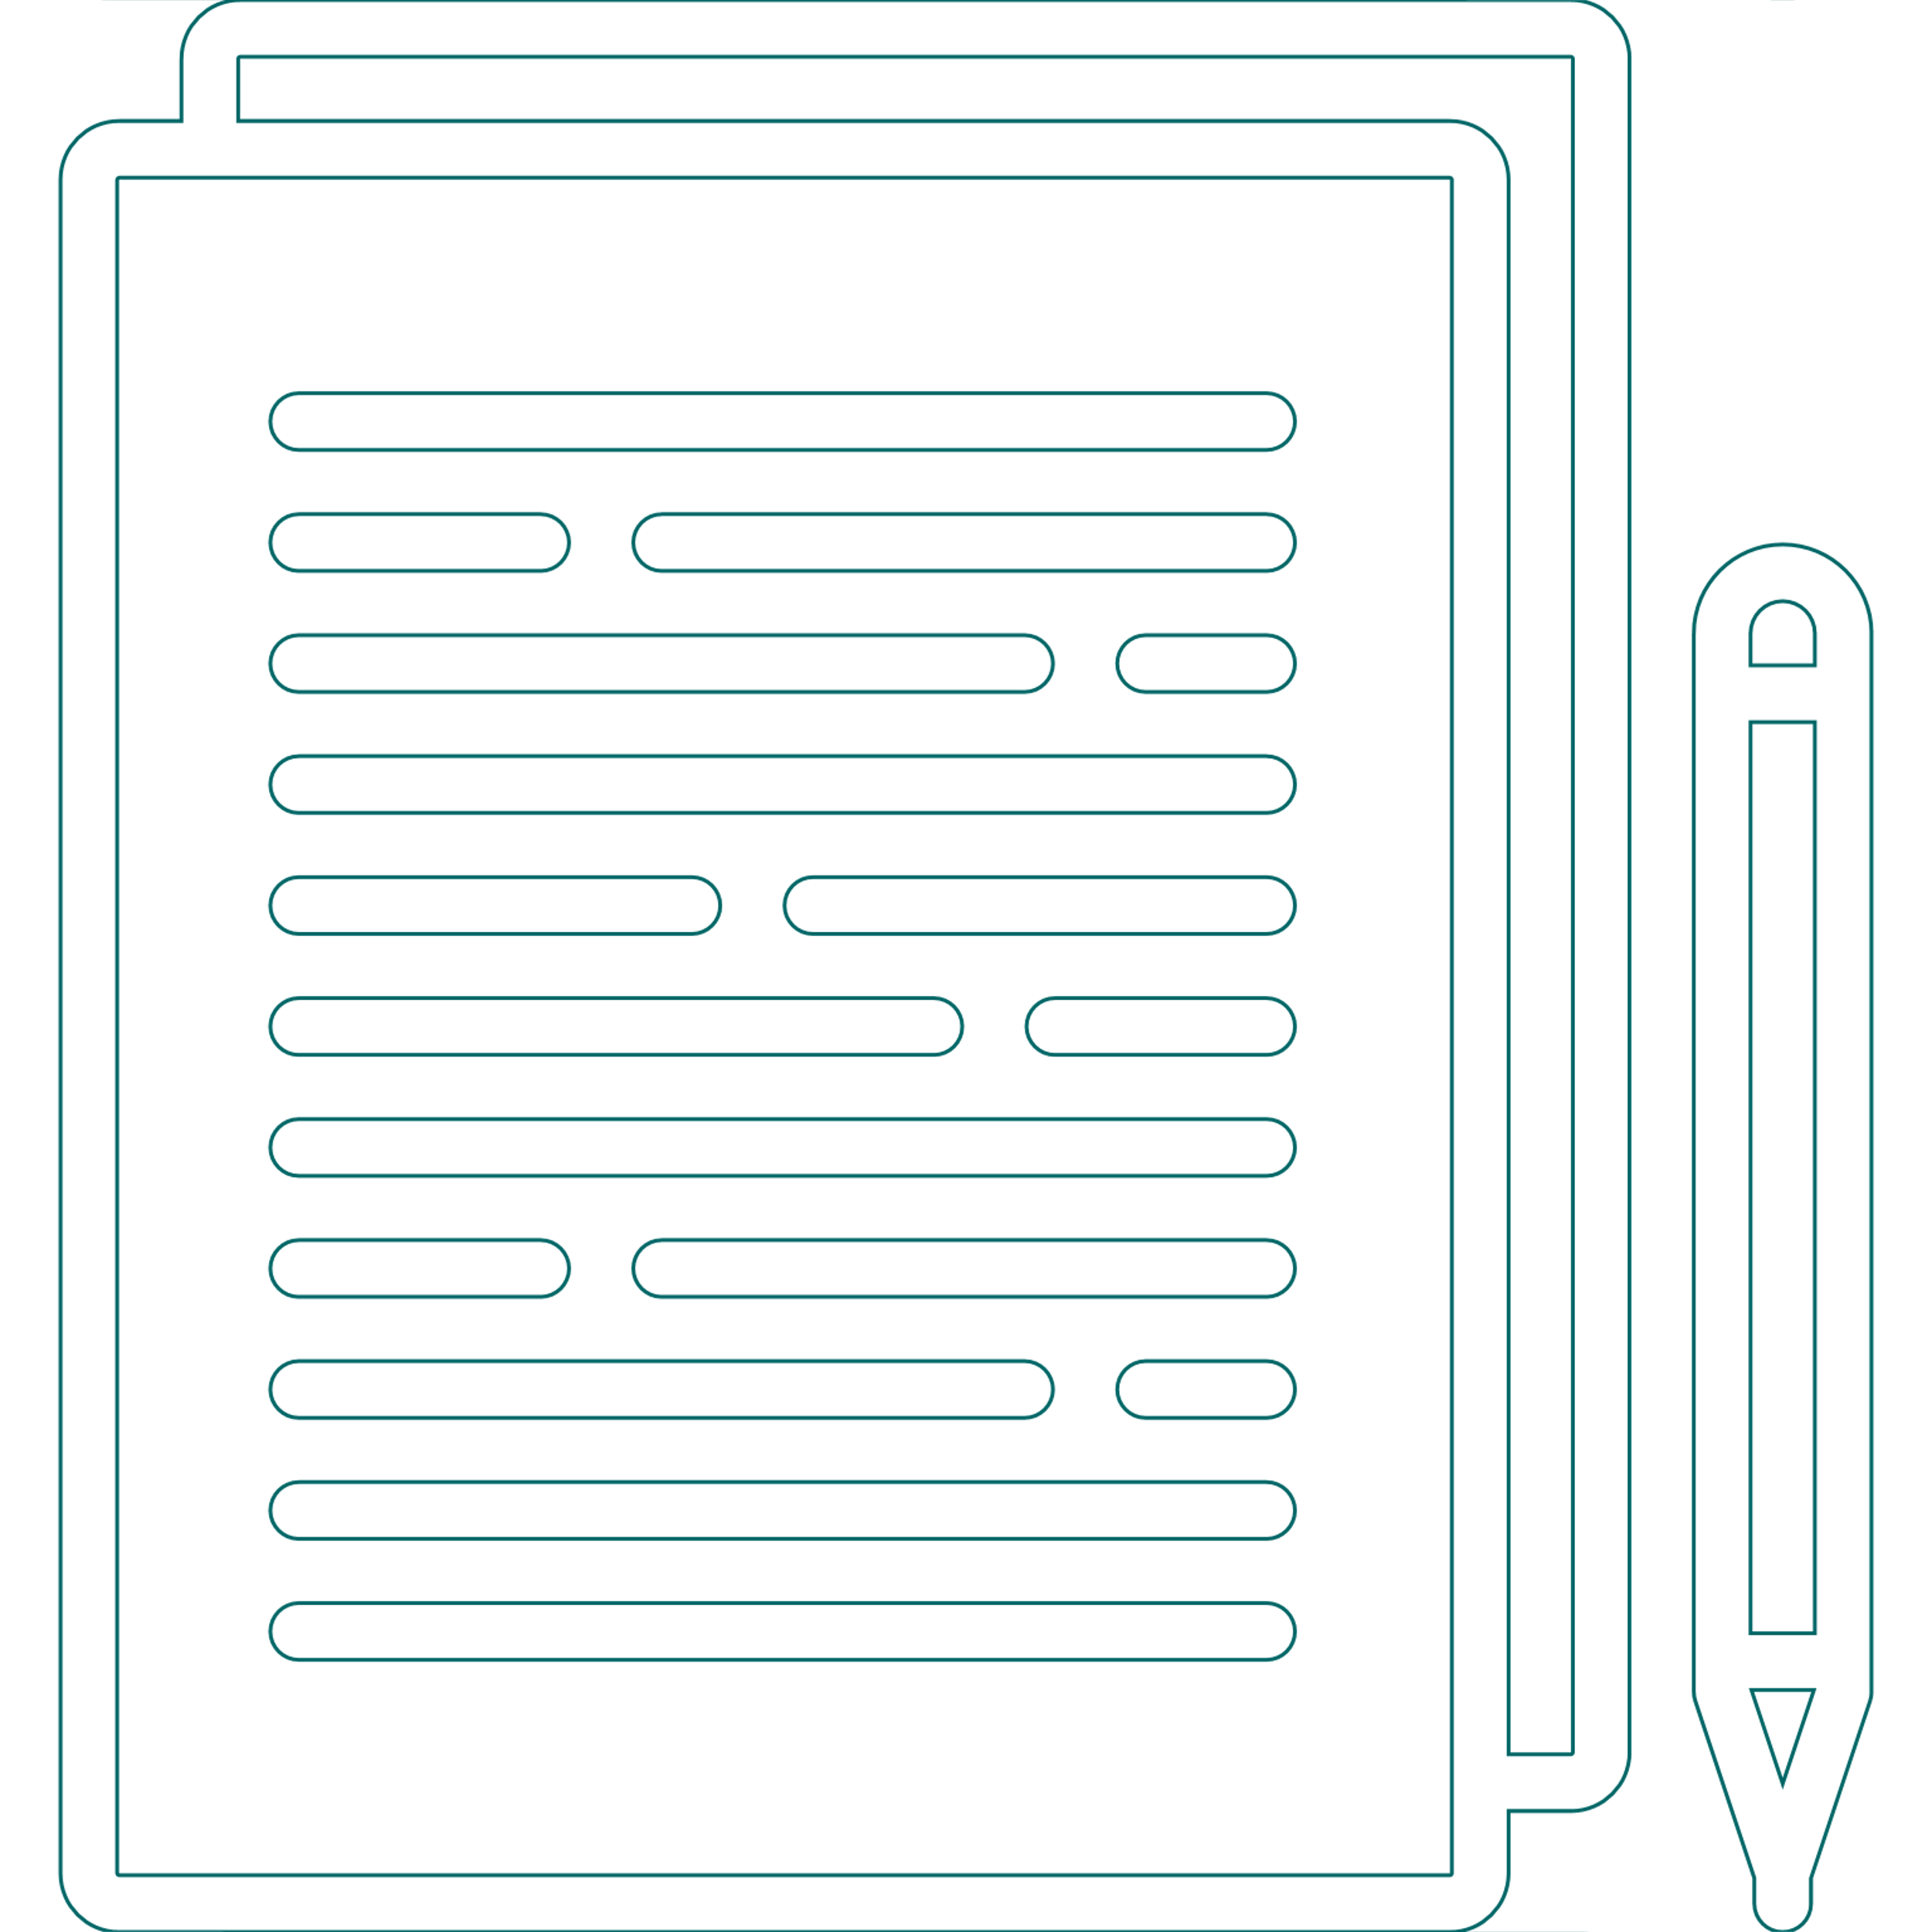
The development phase is where the actual product is built, involving coding, integrating features, testing functionality, and optimizing performance to create a secure, reliable, and efficient application.
Development Phase
What takes place during the Development Phase?
Entry Criteria:
Mockup Approval:
The client has reviewed and approved the mockup/design.
Feasibility Analysis:
Ensure the design and functionalities are feasible for implementation within technical constraints.
Environment Setup:
Tools, frameworks, and repositories are set up
Process
Task Allocation
Authentication & Authorization
Security
Documentations
Breaking down requirements, prioritizing tasks, and assigning them to team members.
Authentication verifies user identities, while authorization manages access based on roles. In frontend, it includes secure logins, session handling, and role-based accessibility.
Implement measures like Input validation, security headers, and protect API requests using https.
Documentation in the development phase involves creating detailed, structured records that describe the code, architecture, processes, and functionalities of the software being built.
Exit Criteria:
Feature Completion: All planned features are implemented and functional. Any unimplemented features are documented with reasons and timelines.
Resolved Issues: All critical bugs identified during development are fixed and low-priority issues are logged for review.
Code Review: Code has been peer reviewed and adheres to agreed-upon standards and conventions
Build Stability: The application can be built successfully in development environment without errors or warnings.
Implementation
Unit Testing
Code Quality Using SonarQube to identify bugs, vulnerabilities, and code smells and fix them to ensure clean and quality code
Develop UI components based on mockups, ensuring responsiveness and accessibility.
Apply the DRY (Don't Repeat Yourself) principle to build reusable components, enhancing code efficiency and maintainability.
Unit Testing focuses on testing individual components, functions, or modules of a frontend application to ensure they work as expected in isolation. It helps identify bugs early, improves code quality, and ensures reliable functionality.
Coding
Click here for detailed documentation.

Slide 14
Phase 05 – Testing

Slide 15




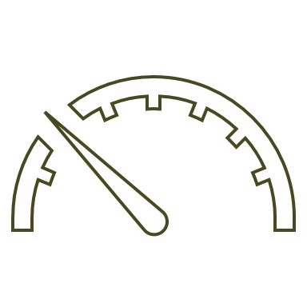


Testing Phase
What happens inside the Testing Phase?
The primary objective of React testing is to validate the functionality, usability, and rendering of React components to ensure a seamless and consistent user interface experience
.
Process:
Entry Criteria:
Completion of Development : All modules are fully developed, integrated, and unit-tested.
Test Environment Readiness: A stable, configured environment production is set up.
Approved Test Cases and Plan: All test cases and a finalized test plan are documented and approved.
2. Integration Testing Conducted to test the interactions and data flow between integrated component.
1. Component Testing Component Testing is the process of testing individual components or modules of a web application in isolation to verify their correctness, functionality, and behavior.
3.System/Regression Testing: Validates the entire system's functionality, ensuring it meets requirements and performs as expected in all scenarios..
Exit Criteria:
All Critical and High-Priority Bugs Resolved: Ensures major issues are fixed and verified
Test Case Execution Completed :. Confirms all test cases are executed, and all requirements are validated.
Security Scan Approval: Got approval from Security team that application is secure.
User Acceptance Testing (UAT) Sign-off: Ensures the system is approved by end-users and stakeholders for release.
Bug Fixes
4.Performance Testing*: Performed to assess performance, scalability, and stability using React Profiler, ensuring optimal efficiency.
6.User Acceptance Testing (UAT): Conducted at the end to ensure stability, meet business requirements, and validate functionality with real users.
5.Security Scan: Security scans identify vulnerabilities, simulate attacks, and ensure application security, data protection, and compliance.
Issues found
No Issues
*Click on the heading for the official React Profiler Documentation.

Slide 16
Phase 06 – Deployment

Slide 17




Deployment Phase
What takes place during the Deployment Phase?
Deploying the developed and tested software to the production environment, making it accessible to end-users
Entry Criteria:
Process:
Testing for Standards: Conduct thorough testing to ensure the application meets functional and performance standards.
QA and Performance Validation: The QA team performs functional testing and approves the results, while performance testing evaluates speed, stability, and scalability under expected load conditions.
UAT and Security Scan Clearance: Obtained all the approvals such as UAT and Security Scan
Pre-Deployment Check List:
Obtain necessary approvals before proceeding with deployment.
UAT testing approval confirms functionality meets user expectations.
Security Scan approval confirms the application is secure and free from vulnerabilities and potential cyber threats.
Cross Verification:
Verify that production environment matches the configuration of the staging/testing environment.
Ensure servers, databases, and networks are correctly configured.
Exit Criteria:
Deployment:
Post-Deployment Validation: Validate the production environment functionality post-deployment.
Smoke Test Core Functionality: Conduct smoke testing to confirm core functionalities operate as expected.
Ensure Production Stability: Ensure the deployed application is stable in Production
Execute the deployment process after getting all approvals and validations.
Monitor closely to ensure a seamless transition.
Deploy the application to the production environment.
Smoke Test:
Perform preliminary testing to validate the core functionalities of the application during the deployment phase.
Ensure the build's stability and readiness for further testing or production use.

Slide 18
Phase 07 – Maintenance

Slide 19



Maintenance Phase
Key Actions in Maintenance Phase
Begins after the software is deployed and operational in the production environment (post-deployment phase).
Bug Fixes & Enhancements :
Address issues identified post-deployment and implement updates or new features based on user feedback to improve functionality. Investigate underlying issues to identify and resolve the root cause of defects or user-reported problems.
Knowledge Transfer and Documentation:
Providing context to the client team about the application through comprehensive documentation and detailed explanations . Also, documenting all the bugs and their solutions for future references.
Security Updates:
Addressing Vulnerabilities to enhance system security.
Performance Optimization:
Outcome:
Improving application speed, scalability, and responsiveness.
The client has the capability to strategize and implement new features, subsequently assessing their effectiveness and impact.

Slide 20






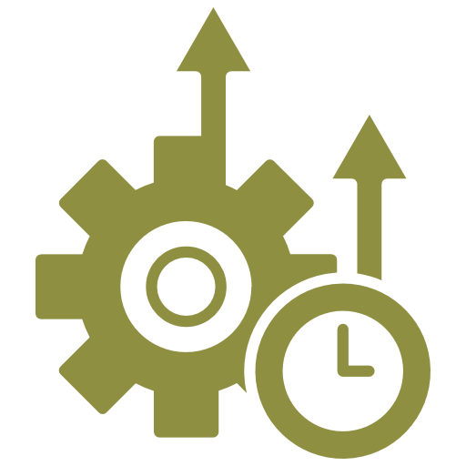
Appendix
Appendix
These documents serves as a comprehensive resource to effectively kickstart a React-based project. It covers the following key areas:
A structured roadmap tailored for beginners and experienced developers alike, focusing on React fundamentals, advanced topics, and best practices.
Learning Plan
A comprehensive overview of the unit testing process, including methodologies, best practices, and implementation steps, is available.
Unit Testing
Essential security measures and practices for the application, including common vulnerabilities and their prevention strategies.
OWASP Security Guide
Solutions to common React challenges and errors, along with debugging tips and tools for quick issue resolution
Troubleshooting Methods
Best Practices
Essential security measures and practices for the application, including common vulnerabilities and their prevention strategies.
Requirement Gathering Questions
Keyword goes here
The complete steps and processes involved in requirement gathering for a project
Performance Testing
A document outlining comprehensive details on performance testing, including key methodologies and best practices
Click on the headings or Word Icon for the detailed documentation.

Slide 21
Thank You!

Slide 22




Requirement Phase
Identifying Goals and Expectations
01
Gather User Expectations
Understand user needs by focusing on design, navigation, and accessibility, conducting user interviews, surveys, or usability testing to gather insights, and prioritizing features that enhance satisfaction and align with their workflows.
02
Define the Purpose
Define the application's purpose — web application, mobile application — and align its frontend with business goals, focusing on clarity, interactivity, and performance.
03
Ensure Compliance with Standards
21
Ensure consistent branding, scalable UI with design systems, and accessibility compliance for an inclusive user experience.

Slide 23


Requirement Phase
Core Features and Requirements
Key Features
Functional
Non-Functional
Evaluation
Define the app's core capabilities, like user management, search features, to meet user and business needs.
Outline how each feature achieves its goal, such as managing users securely, updating data in real time, or enabling filters. Ensure functionality aligns with user needs.
Specify key attributes like Performance, security, scalability, and consistent UI to ensure a reliable system. Focus on enhancing user experience while meeting accessibility and branding standards.

Slide 24



Requirement Phase
Software Requirement Specification
Selecting Core Technologies and Tools
Choose key technologies for the frontend, like React for dynamic interfaces, and CSS frameworks for efficient styling and responsiveness. Select tools that align with project needs.
Explore Libraries and Complementary Tools
Use libraries like Redux for state management, Axios for API requests, and ApexCharts or E-charts for data visualization. Include tools like React DevTools, Jest, and Cypress for debugging, testing, and performance optimization..
Identify Dependencies or Constraints
Identify dependencies like backend APIs and database compatibility for smooth integration. Consider project constraints such as team expertise, performance needs, and budget limits.

Slide 25
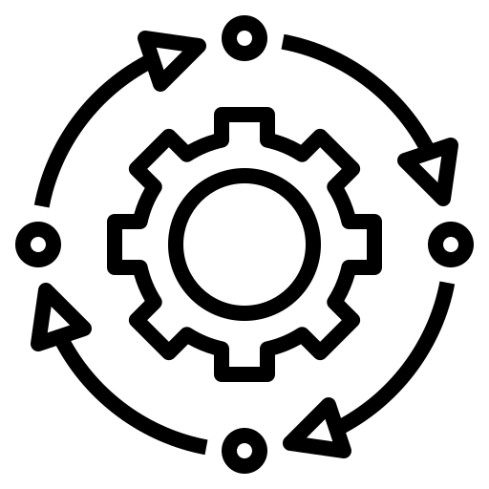
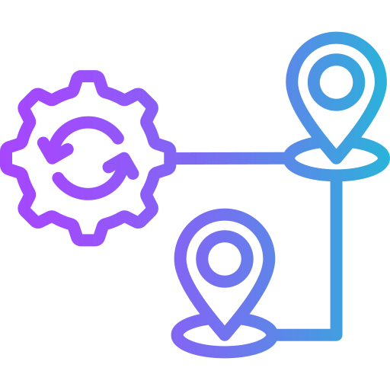
Choosing Libraries and Tools
Planning Phase
State Management
Select tools based on application complexity—Redux for robust centralized state, Context API for simpler, localized needs, or Zustand for lightweight state handling.
Routing
Use React Router for navigation to handle dynamic routing effectively in single-page applications with minimal setup.
Data Fetching
Choose for Redux Saga to manage side effects like API calls in complex applications or Axios for a versatile and feature-rich HTTP client.
CI/CD Tools
Choose scalable CI/CD platforms like Azure DevOps or GitLab for seamless integration with your workflow, supporting automated testing and deployments.

Slide 26
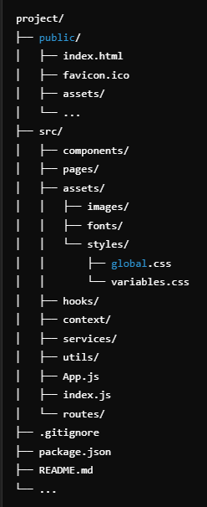


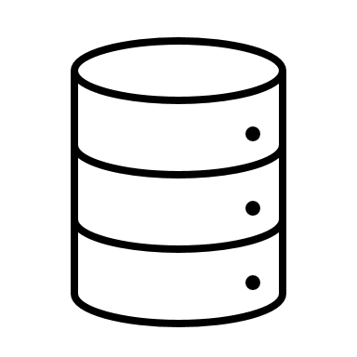

Architecture and Design
Planning Phase
Design a Modular Component Structure:
Separate UI and Logic Components
Break the application into reusable and to ensure self-contained components/Global Components scalability and maintainability. Organize components based on features or functionality to simplify development and debugging.
Separate components focused on UI (presentational) from those managing business logic and state (container), following the separation of concerns principle.
Folder Structure:
Organize your codebase for clarity and scalability.
Adopt a Clear State Management Strategy:
Choose an appropriate state management approach based on the complexity of the application. For larger apps, centralize state using tools like Redux, while smaller or feature-specific state can rely on Context API or local state within components.

Slide 27



Planning Phase
Timeline and Milestones
Project Initiation
Define the start date and initial setup tasks, such as repository creation, tool configurations, and team onboarding.
Development Phases
Break the project into distinct phases (e.g., feature development, testing, and integration) with clear deadlines for each stage.
Key Milestones / Timeline
Identify critical points like completing MVP, finalizing UI design, or passing testing benchmarks to track progress.
* MVP – Minimum Viable Product
Delivery Deadlines
Set realistic deadlines for project completion and handovers, ensuring buffer time for potential risks or delays.

Slide 28
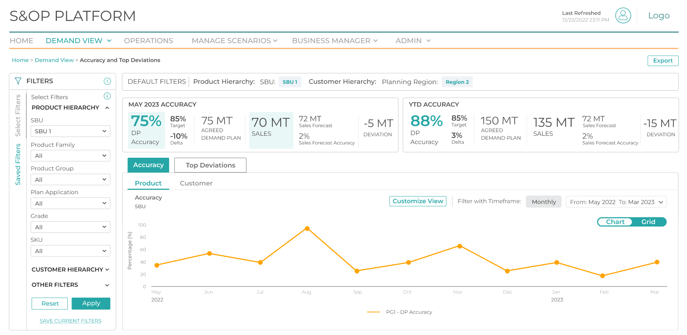
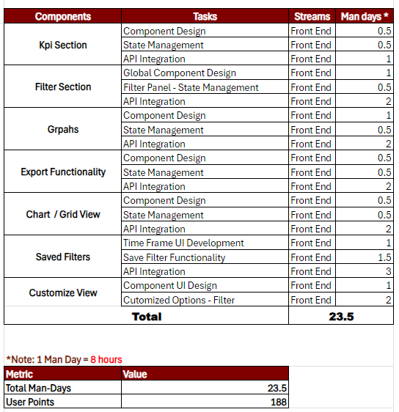
Sample Effort Estimation
Planning Phase
Design Mockup
*Tasks based on user Stories
Note:*The mentioned man-days are indicative and provided as a sample for effort estimation purposes

Slide 29
Documents
Documents
These Documents serves as a comprehensive resource to effectively kickstart a React-based project. It covers the following key areas:
A structured roadmap tailored for beginners and experienced developers alike, focusing on React fundamentals, advanced topics, and best practices.
Learning Plan
A comprehensive overview of the unit testing process, including methodologies, best practices, and implementation steps, is available.
Unit Testing
Essential security measures and practices for the application, including common vulnerabilities and their prevention strategies.
OWASP Security Guidelines
Solutions to common React challenges and errors, along with debugging tips and tools for quick issue resolution.
Troubleshooting Methods
Best Practices
Essential security measures and practices for the application, including common vulnerabilities and their prevention strategies.
Requirement Gathering Questions
Keyword goes here
The complete steps and processes involved in requirement gathering for a project
Performance Testing
A document outlining comprehensive details on performance testing, including key methodologies and best practices
Click on the headings or Word Icon for the detailed documentation.

Slide 30
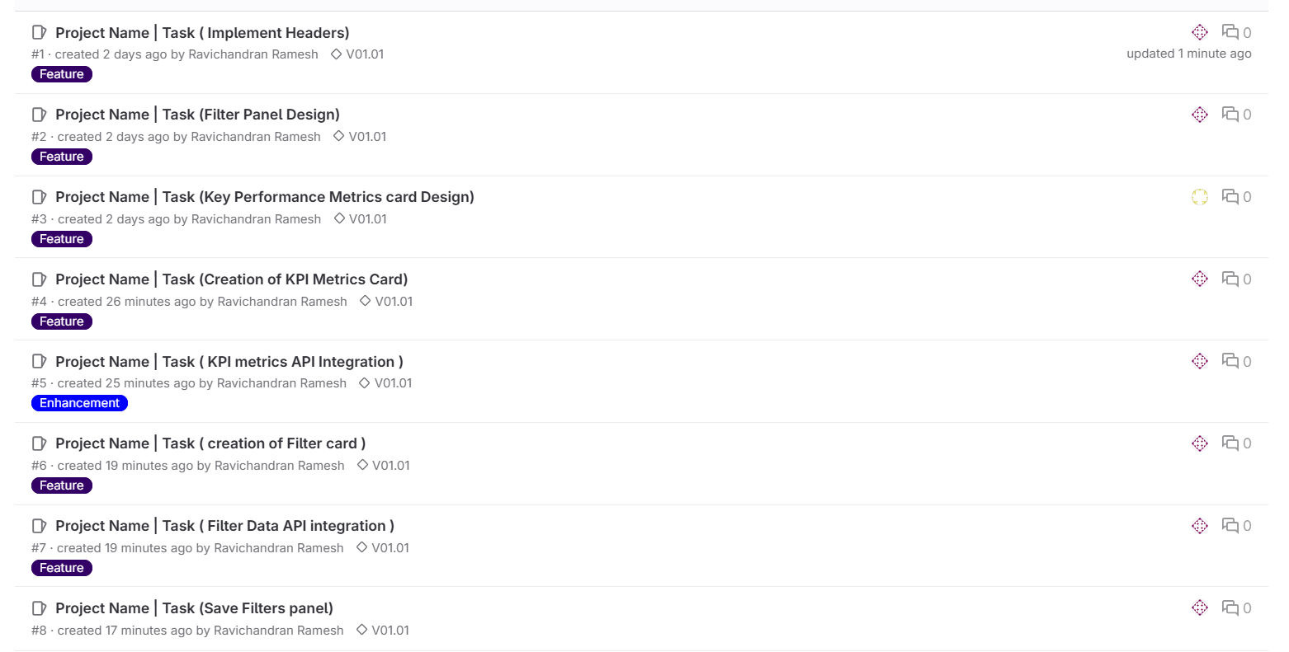
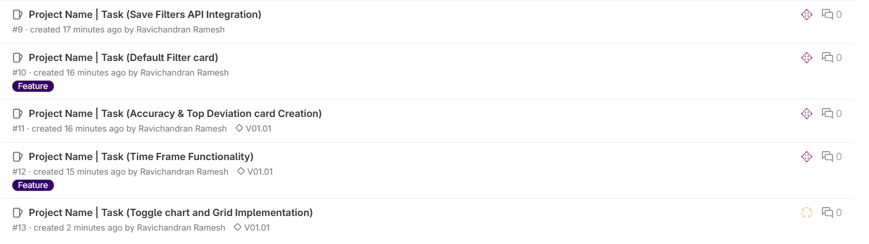
Sample Task Allocation
Development Phase
2. Assign the Issue to a Developer
In the Assignee field, assign the issue to the respective developer
Ensure the assignee has the necessary skills and bandwidth to handle the task
3.Add a Milestone and labels
Set a milestone to organize tasks by project phases (e.g., Planning Phase, Development, Testing)
In the issue, select a milestone that corresponds to the task’s timeline or phase
4.Update and Organize the Issue Board
Go to the Issue Board to visualize tasks across stages (In Progress, Review, Done)
Move issues to appropriate columns based on their status
1. Create an Issue
Go to the Issues section in the GitLab repository
Click New Issue and provide a clear title and description
Note: The listed tasks are for illustrative and based on user Stories purposes and provided as examples.

Slide 31

Testing Phase
What happens inside the Testing Phase?
The primary objective of React testing is to validate the functionality, usability, and rendering of React components to ensure a seamless and consistent user interface experience
.
Process:
Entry Criteria:
Completion of Development : All modules are fully developed, integrated, and unit-tested.
Test Environment Readiness: A stable, configured environment production is set up.
Approved Test Cases and Plan: All test cases and a finalized test plan are documented and approved.
2.System Testing: Validates the entire system's functionality, ensuring it meets requirements and performs as expected in all scenarios.
1. Integration Testing Conducted to test the interactions and data flow between integrated component.
3.Security Scan: Security scans identify vulnerabilities, simulate attacks, and ensure application security, data protection, and compliance.
Exit Criteria:
All Critical and High-Priority Bugs Resolved: Ensures major issues are fixed and verified
Test Case Execution Completed :. Confirms all test cases are executed, and all requirements are validated.
Security Scan Approval: Got approval from Security team that application is secure.
User Acceptance Testing (UAT) Sign-off: Ensures the system is approved by end-users and stakeholders for release.
Bug Fixes
4.Performance Testing*: Performed to assess performance, scalability, and stability using React Profiler, ensuring optimal efficiency.
6.User Acceptance Testing (UAT): Conducted at the end to ensure stability, meet business requirements, and validate functionality with real users.
5.Regression Testing: Conducted after bug fixes or changes, to ensure feature stability and prevent new issues.
Issues found
No Issues
*Click on the heading for the official React Profiler Documentation.

