Slide 1

CSC336
Databases
Lecture 1: Introduction
Instructor: Jianting Zhang
Department of Computer Science
City College of New York

Slide 2
Outline of this lecture
Syllabus
Introduction to Database Systems
  Evolution and trends
  Overview of DBMS
Computing environment for projects
  Unix and MySQL accounts
  PHP and HTML programming

Slide 3
Syllabus
Course Objectives:
  Introduces modern database systems
  Gain practical database programming skills and
  Become confident in seeking DB related jobs
Textbook: A First Course in Database Systems, 3rd Edition by Ullman and Widom, Prentice Hall 2008
Reference: Web Database Applications with PHP & MySQL, 2nd Edition by Williams and Lane, O'Reilly & Assoc. 2004

Slide 4
Syllabus -Topics
Concepts &
Interactive DB operations
Theory
1
2
  Relational Model
  Query Languages
  Introduction to SQL
  Entity-Relationship Model
  Database Design Theory
3
  SQL Programming @ Server Environment
  Constraints, triggers and transactions
  Indexing and views
  Authorization
Topics

Slide 5
Syllabus -Prerequisites
Mandatory
  CSc212 Data Structures
  CSc220 Algorithms
  CSc221 Software Design Laboratory
Desirable
  CS322 Software Engineering
  CSc332 Operating Systems
  CSc318 Internet Programming
  CSc473 Web site design
Notes:
http://www1.ccny.cuny.edu/prospective/gsoe/computer_sci/dso-cs.cfm
http://www.ccny.cuny.edu/compsci/upload/Csc-Fall13-Spring14.pdf

Slide 6
Syllabus -Assignments & Grading
Quizzes/Class participation – 10%
3-4 programming assignments -45%
  Every 3-4 weeks
  weights may be uneven
  Learn PHP and HTML by yourself
  25% per week deduction/maximum two weeks
Three exams (45%)
  15% each
  in-class, closed-book exams
  No final exam
  No make-ups
Academic Integrity

Slide 7
Introduction
Databases are everywhere!
  Enterprises information systems
  Online stores
  Searching engines
Database Management System (DBMS)
  Database system (for short)
  A DBMS is a powerful tool for creating and managing large amounts of data efficiently and allowing it to persist over long periods of time safely.
What are the relationships with OS files?
Notes:
ERP systems: Enterprise resource planning

Slide 8
Introduction –Evolution
Early Database Management Systems
  The first commercial DBMS: late 1960’s
  Evolved from OS file systems
  What are the problems with file systems?
    Do not support efficient access to data items
    Do not have a query language for data items
    Do not support concurrent control
    Many Others (Ch 1.1.1)
  Outdated data models: hierarchical/network

Slide 9
Introduction –Evolution
Relational Database Systems -RDBMS
  Based on a transformative paper by Edgar Frank "Ted" Codd in 1970
    Turing Award 1981
    http://en.wikipedia.org/wiki/Edgar_F._Codd
  Relations: data organized as tables
  Queries could be expressed in a very high-level language
    No need to handle complex storage structures directly
    Greatly increased the efficiency of database programmers
  RDBMS usually is the core for the first database course
The scopes of database research/applications are expanding fast – wherever there are data, there are DBMS!

Slide 10
The Constellation of Databases
Real time
Graph
Fuzzy
Probabilistic
Active
Embedded
XML
Parallel
Main-
Memory
Object-
Oriented
Relational
Moving Object
Distributed
Object-
Relational
Temporal
Image
Video
Spatial
Stream
GIS
Data
Warehouse
Web
Scientific
Data Mining
Federated

Slide 11
Introduction – Overview (p6)
User/Application
Administrator
Query Compiler
Transaction Manager
DDL Compiler
Execution Engine
Logging and Recovery
Concurrency Control
Index/File/Record Manager
Buffer Manager
Buffers
Lock Table
Storage Manager
Control/data flow
Storage
data flow only
Notes:
P-6

Slide 12
Introduction –– Overview
Two distinct types of operations (commands)
  General users and application programs
    Query/update
    Data Manipulation Language (DML)
Database Administrator
    Defining the structure (schema) of databases
    Data Definition Language (DDL)
CREATE TABLE cds (id CHAR(10), artist CHAR(10), title CHAR(20), year CHAR(4)) ;
SELECT * FROM cds WHERE title=‘zhang’;
INSERT INTO cds (title,artist,year) VALUES(‘my cd’,’zhang’,’2000’);

Slide 13
Introduction –– Overview
Query processing
  User/Application program issues DML commands
  They do not affect the schema of the database, but may (or may not) affect the content of the database
SELECT * FROM cds WHERE title=‘zhang’;
INSERT INTO cds (title,artist,year) VALUES(‘my cd’,’zhang’,’2000’);

Slide 14
Introduction –– Overview
Answering the query (p7/Ch1.2.2)
  The query is parsed and optimized by a query compiler➔ query plan
  The execution engine issues a sequence of requests for data based on the query plan
  The index/file/record manager utilize indices (if available) to locate records
  The buffer manager bring appropriate portion of data from disk to main-memory buffers (unit: disk block) by communicating with the storage manager. If requested data is already in the buffer then there is no need to load data from disk ➔ faster response times.
  The storage manager manages database files by utilizing OS commands and disk controller APIs.

Slide 15
Introduction –– Overview
Transaction Processing (p8-9/Ch1.2.4)
  A transaction is a group of database operations with certain properties.
    E.g., bank transfer ( withdraw + deposit)
  The ACID properties of transactions
    A (Atomicity): all-or-nothing execution of transaction
    C (Consistency): consistency constraints can not be violated
    I (Isolation): each transaction must appear to be executed as if no other transaction is executing at the same time
    D (Durability): the effect on the database of a transaction must not be lost once the transaction has completed

Slide 16
Introduction –– Overview
The transaction processor performs the following tasks to ensure ACID properties
  Logging: every change in the database is logged separately on disk to ensure durability. The log manager works with recovery manager to ensure the database consistency when crashes occur.
  Concurrency control: a scheduler assures that the individual actions of multiple transactions are executed in such an order that the net effect is the same when they are executed sequentially.
  Deadlock resolution: when deadlocks happen, the transaction manager needs to cancel (rollback/abort) one or more transactions to let others proceed.
    Deadlock is a situation where none can proceed because each needs something another transaction has (competition of resources)

Slide 17
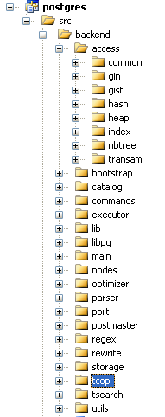
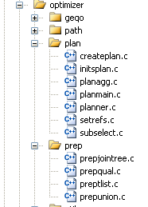
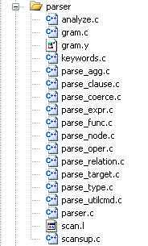
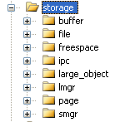
Introduction –– PostgreSQL Source Tree
Query Compiler (p10): parser/preprocessor/optimizer
Indexing
Execution Engine (p10)
Storage and Buffer (p7)

Slide 18
Accounts – Computing Environment
WAN (outside of Campus)
X
Apache Web Server (+PHP)
MySQL Server
(134.74.112.65)
CS Sub-network
(134.74.126.104)
DB
CCNY Campus Network (134.74.*.*)
Web Access
SSH Access
/../ID/public_html/xyz.php ➔
http://www-cs.ccny.cuny.edu/~ID/xyz.php

Slide 19
Accounts – Computing Environment
Procedure :
  Use your Linux account to log on to 134.74.126.104 (CSc server)
  Create the public_html directory DIRECTLY under your account
  You can create your own dynamic HTML pages in PHP
  You can connect to the MySQL database server in your PHP scripts. and query your database
You can build a Web-based database system by combining #3 and #4➔ manipulate your database over the Web!
You will need an MySQL account on a database server (already sent from Blackboard to you individually)

Slide 20
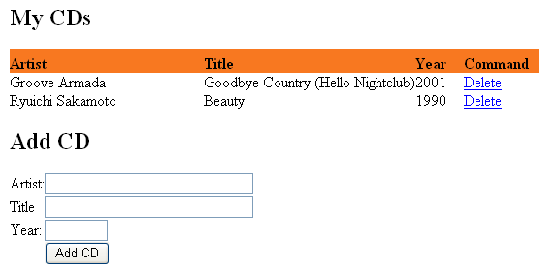
Accounts – Example GUI
http://www-cs.ccny.cuny.edu/~jzhang/dbtest/cds_demo.php

Slide 21
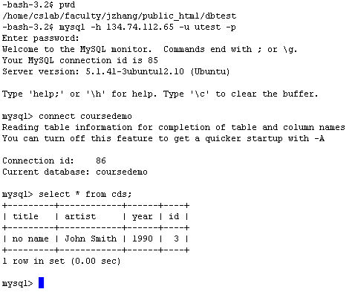
Accounts – Example Backend

Slide 22
Accounts – Example PHP Code
Code at http://geoteci.engr.ccny.cuny.edu/CSc336/cds_test.txt.gz
You will have your own user name and password later
geoteci.engr.ccny.cuny.edu
<?php
if(!@mysql_connect("134.74.112.65", "utest", "utest")) {
echo "<h2>Connection Error.</h2>";
die();
}
mysql_select_db(“coursedemo");
?>
Connect to DB Server
Select DB
Embedded HTML code

Slide 23
Accounts – Example PHP Code
<html>
<body>
<table>
  <?php
  …
  $i = 0;
  while ($row = mysql_fetch_array($result)) {
  echo "<tr valign='middle'>";
  echo "<td>".$row[artist']."</td>";
  echo "<td>".$row[title']."</td>";
  echo "<td>".$row[year']."</td>";
  echo "</td>";
  echo "</tr>";
  $i++;
  }
  ?>
</table>
</body>
</html>
$result = mysql_query("SELECT id, title, artist, year FROM cds ORDER BY artist");
You are encouraged to learn HTML/PHP features to enhance the visualization of your databases, but the primary focus of this course will be on database programming

Slide 24
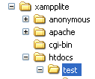
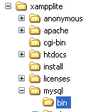
Debugging your code on your machine
XAMPP
  Easy to install and use
  Available for both Windows and Linux
  http://www.apachefriends.org/en/xampp.html
  The “lite” version also works fine
Go to here to find your MySQL executables
Put your PHP/HTML code here

Slide 25
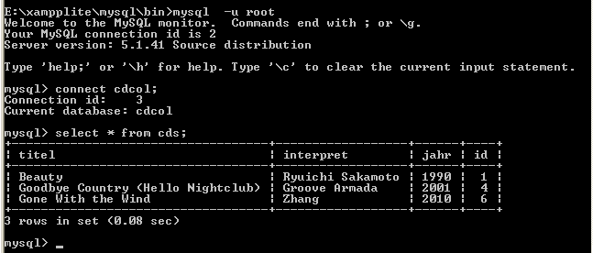
XAMPP MySQL Interface

Slide 26
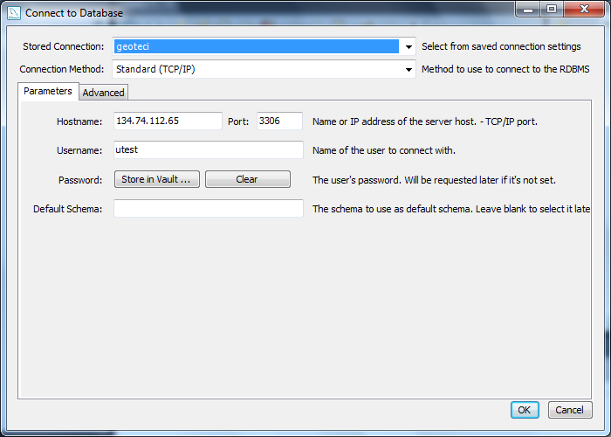
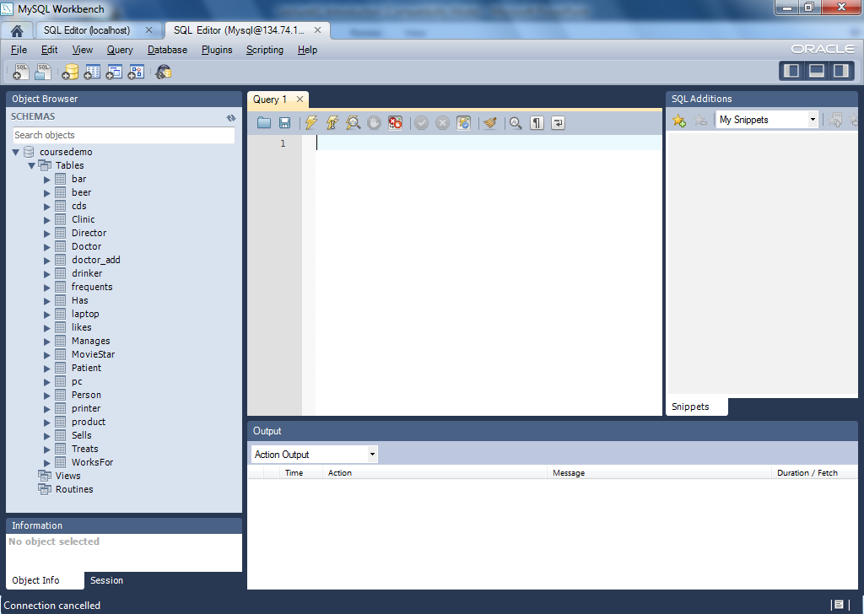
Using MySQL GUI Tools to Connect to Remote MySQL Server
http://dev.mysql.com/downloads/gui-tools/5.0.html
You can use SSH Tunneling to connect when you are off-campus

Slide 27
What’s next
Lab Session next Tuesday (by Simin You) to help you with a demo project
We will begin Ch2 on next Thursday– please read before coming to class (if you are still interested in this course)
Start learning PHP and HTML (if you are not already familiar with them) [ch9.7]
The slides and the sample PHP code will be posted on Blackboard – check your Blackboard frequently

