Slide 1

CSC336
Databases
Lecture 10: Entity-Relationship Model
Instructor: Jianting Zhang
Department of Computer Science
City College of New York
Some slides adopted from Prof. Jeffrey D. Ullman’ class at Stanford
http://infolab.stanford.edu/~ullman/fcdb/aut07/index.html#lecture

Slide 2
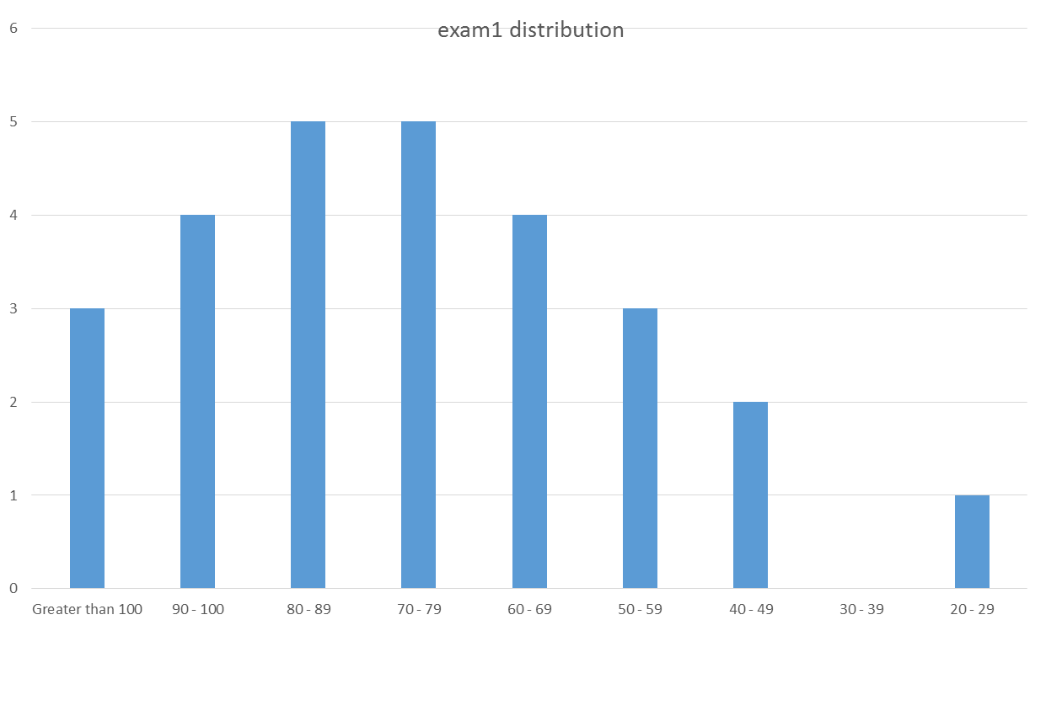

Slide 3
Where are we now?
Concepts &
Interactive DB operations
Theory
1
2
  Relational Model
  Query Languages
  Introduction to SQL
  Entity-Relationship Model
  Database Design Theory
3
  SQL Programming @ Server Environment
  Constraints, triggers, views and security
  Indexing and file organization
Programming

Slide 4
Entity-Relationship Model
E/R Diagrams
  Concepts, cardinality, representation
  Weak entity sets, roles, subclasses
Converting E/R Diagrams to Relations

Slide 5
Purpose of E/R Model
The E/R model allows us to sketch database schema designs.
  Includes some constraints, but not operations.
Designs are pictures called entity-relationship diagrams.
Later: convert E/R designs to relational DB designs.

Slide 6
Framework for E/R
Design is a serious business.
The “boss” knows they want a database, but they don’t know what they want in it.
Sketching the key components is an efficient way to develop a working database.
Architecting Apps
Cross-layer performance tuning/optimization
Database Design
Manipulate DB interactively

Slide 7
Entity Sets (4.1.1/4.1.2)
Entity = “thing” or object.
Entity set = collection of similar entities.
  Similar to a class in object-oriented languages.
Attribute = property of (the entities of) an entity set.
  Attributes are simple values, e.g. integers or character strings, not structs, sets, etc.

Slide 8
E/R Diagrams (4.1.4)
In an entity-relationship diagram:
  Entity set = rectangle.
  Attribute = oval, with a line to the rectangle representing its entity set.

Slide 9
Example:
name
manf
Entity set Beers has two attributes, name and manf (manufacturer).
Each Beers entity has values for these two attributes, e.g. (Bud, Miller)
Beers

Slide 10
Relationships (4.1.3)
A relationship connects two or more entity sets.
It is represented by a diamond, with lines to each of the entity sets involved.

Slide 11
Example: Relationships
name
addr
name
manf
Bars
Sells
Beers
Bars sell some
beers.
license
Drinkers like
some beers.
Frequents
Likes
Note:
license =
beer, full,
none
Drinkers frequent
some bars.
Drinkers
name
addr

Slide 12
Relationship Set (4.1.5)
The current “value” of an entity set is the set of entities that belong to it.
  Example: the set of all bars in our database.
The “value” of a relationship is a relationship set, a set of tuples with one component for each related entity set.

Slide 13
Example: Relationship Set
For the relationship Sells, we might have a relationship set like:
Bar Beer
Joe’s Bar Bud
Joe’s Bar Miller
Sue’s Bar Bud
Sue’s Bar Pete’s Ale
Sue’s Bar Bud Lite

Slide 14
Multiway Relationships (4.1.7)
Sometimes, we need a relationship that connects more than two entity sets.
Suppose that drinkers will only drink certain beers at certain bars.
  Our three binary relationships Likes, Sells, and Frequents do not allow us to make this distinction.
  But a 3-way relationship would.

Slide 15
Example: 3-Way Relationship
name
addr
name
manf
Bars
Beers
license
Preferences
Drinkers
name
addr

Slide 16
A Typical Relationship Set
Bar Drinker Beer
Joe’s Bar Ann Miller
Sue’s Bar Ann Bud
Sue’s Bar Ann Pete’s Ale
Joe’s Bar Bob Bud
Joe’s Bar Bob Miller
Joe’s Bar Cal Miller
Sue’s Bar Cal Bud Lite

Slide 17
Types of Relationships (4.1.6)
Focus: binary relationships
  such as Sells between Bars and Beers.
Classification based multiplicity
  Many-Many
  Many-One
  One-One

Slide 18
Many-Many Relationships
In a many-many relationship, an entity of either set can be connected to many entities of the other set.
  E.g., a bar sells many beers; a beer is sold by many bars.
many-many

Slide 19
Many-One Relationships
Some binary relationships are many -one from one entity set to another.
Each entity of the first set is connected to at most one entity of the second set.
But an entity of the second set can be connected to zero, one, or many entities of the first set.
many-one

Slide 20
Example: Many-One Relationship
Favorite, from Drinkers to Beers is many-one.
A drinker has at most one favorite beer.
But a beer can be the favorite of any number of drinkers, including zero.

Slide 21
One-One Relationships
In a one-one relationship, each entity of either entity set is related to at most one entity of the other set.
Example: Relationship Best-seller between entity sets Manfs (manufacturer) and Beers.
  A beer cannot be made by more than one manufacturer, and no manufacturer can have more than one best-seller (assume no ties).
one-one

Slide 22
Representing “Multiplicity”
Show a many-one relationship by an arrow entering the “one” side.
Show a one-one relationship by arrows entering both entity sets.
Rounded arrow = “exactly one” i.e., each entity of the first set is related to exactly one entity of the target set.

Slide 23
Example: Many-One Relationship
Likes
Drinkers
Beers
Favorite
Notice: two relationships
connect the same entity
sets, but are different.

Slide 24
Example: One-One Relationship
Consider Best-seller between Manfs and Beers.
Some beers are not the best-seller of any manufacturer, so a rounded arrow to Manfs would be inappropriate.
But a beer manufacturer has to have a best-seller.

Slide 25
In the E/R Diagram
Best-
seller
Manfs
Beers
A beer is the best-
seller for 0 or 1
manufacturer.
A manufacturer has
exactly one best
seller.

Slide 26
Attributes on Relationships (4.1.9)
Sometimes it is useful to attach an attribute to a relationship.
Think of this attribute as a property of tuples in the relationship set.

Slide 27
Example: Attribute on Relationship
Sells
Bars
Beers
price
Price is a function of both the bar and the beer,
not of one alone.

Slide 28
Equivalent Diagrams Without Attributes on Relationships
Create an entity set representing values of the attribute.
Make that entity set participate in the relationship.

Slide 29
Example: Removing an Attribute from a Relationship
Sells
Bars
Beers
Prices
Note convention: arrow
from multiway relationship
= “all other entity sets
together determine a
unique one of these.”
price

Slide 30
Roles (4.1.8)
Sometimes an entity set appears more than once in a relationship.
Label the edges between the relationship and the entity set with names called roles.

Slide 31
Example: Roles
Relationship Set
Husband Wife
Bob Ann
Joe Sue
… …
Married
husband
wife
Drinkers

Slide 32
Example: Roles
Relationship Set
Buddy1 Buddy2
Bob Ann
Joe Sue
Ann Bob
Joe Moe
… …
Buddies
1
2
Drinkers

Slide 33
Subclasses (4.1.11)
Subclass = special case
  fewer entities
  more properties.
Example: Ales are a kind of beer.
  Not every beer is an ale, but some are.
  Let us suppose that in addition to all the properties (attributes and relationships) of beers, ales also have the attribute color.

Slide 34
Subclasses in E/R Diagrams
Assume subclasses form a tree.
  I.e., no multiple inheritance.
isa triangles indicate the subclass relationship.
  Point to the superclass.
name
Beers
manf
isa
Ales
color

Slide 35
E/R Vs. Object-Oriented Subclasses
In OO, objects are in one class only.
  Subclasses inherit from superclasses.
In contrast, E/R entities have representatives in all entity sets in the ISA hierarchy
  Rule: if entity e is represented in a child entity set, then e is represented in the parent entity set (and recursively up the tree).

Slide 36
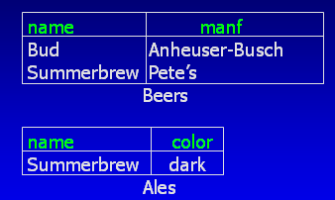
Example: Representatives of Entities
name
Beers
manf
isa
Pete’s Ale
Ales
color

Slide 37
Keys (4.3.1)
A key is a set of attributes for an entity set such that NO two entities in this set agree on ALL the attributes of the key.
  It is allowed for two entities to agree on some, but not all, of the key attributes.
We must designate a key for every entity set.

Slide 38
Keys in E/R Diagrams (4.3.2)
Underline the key attribute(s).
In an isa hierarchy, only the root entity set has a key, and it must serve as the key for all entities in the hierarchy.

Slide 39
Example: name is Key for Beers
name
Beers
manf
isa
Ales
color

Slide 40
Example: a Multi-attribute Key
dept
number
hours
room
Courses
Note that hours and room could also serve as a
key, but we must select only one key.

Slide 41
Weak Entity Sets (4.4)
Occasionally, entities of an entity set need “help” to identify them uniquely.
Entity set E is said to be weak if, in order to identify entities of E uniquely, we need to follow one or more many-one relationships from E and include the key of the related entities from the connected entity sets.

Slide 42
Example: Weak Entity Set
name is almost a key for football players, but there might be two with the same name.
number is certainly not a key, since players on two teams could have the same number.
But number, together with the team name related to the player by Plays-on should be unique.

Slide 43
In E/R Diagrams
name
number
name
Players
Plays-
on
Teams
Note: must be rounded
because each player needs
a team to help with the key.
Double diamond for supporting many-one relationship.
Double rectangle for the weak entity set.

Slide 44
Weak Entity-Set Rules
A weak entity set has one or more many-one relationships to other (supporting) entity sets.
The supporting relationships must have a rounded arrow (entity at the “one” end is guaranteed).
  E.g., a player must belong to exact one team

Slide 45
Weak Entity-Set Rules – (2)
The key for a weak entity set is its own underlined attributes and the keys for the supporting entity sets.
  E.g., (player) number and (team) name is a key for Players in the previous example.

Slide 46
Design Techniques (4.2)
Avoid redundancy.
Limit the use of weak entity sets.
Don’t use an entity set when an attribute will do.

Slide 47
Avoiding Redundancy
Redundancy = saying the same thing in two (or more) different ways.
Wastes space and (more importantly) encourages inconsistency.
  Two representations of the same fact become inconsistent if we change one and forget to change the other.

Slide 48
Example: Good
name
name
addr
ManfBy
Beers
Manfs
This design gives the address of each manufacturer exactly once.

Slide 49
Example: Bad
name
name
addr
ManfBy
Beers
Manfs
manf
This design states the manufacturer of a beer twice: as an attribute and as a related entity.

Slide 50
Example: Bad
name
manf
manfAddr
Beers
This design repeats the manufacturer’s address once for each beer and loses the address if there are temporarily no beers for a manufacturer.

Slide 51
Entity Sets Versus Attributes
An entity set should satisfy at least one of the following conditions:
  It is more than the name of something; it has at least one non-key attribute.
  or
  It is the “many” in a many-one or many-many relationship.

Slide 52
Example: Good
name
name
addr
ManfBy
Beers
Manfs
Manfs deserves to be an entity set because of the nonkey attribute addr.
Beers deserves to be an entity set because it is the “many” of the many-one relationship ManfBy.

Slide 53
Example: Bad
name
name
ManfBy
Beers
Manfs
Since the manufacturer is nothing but a name, and is not at the “many” end of any relationship, it should not be an entity set.

Slide 54
Example
name
manf
name
name
ManfBy
Beers
Beers
Manfs
There is no need to make the manufacturer an entity set, because we record nothing about manufacturers besides their names.

Slide 55
Don’t Overuse Weak Entity Sets
Beginning database designers often doubt that anything could be a key by itself.
  They make all entity sets weak, supported by all other entity sets to which they are linked.
In reality, we usually create unique ID’s for entity sets.
  Examples include social-security numbers, automobile VIN’s etc.

Slide 56
When Do We Need Weak Entity Sets?
The usual reason is that there is no global authority capable of creating unique ID’s.
Example: it is unlikely that there could be an agreement to assign unique player numbers across all football teams in the world.

Slide 57
From E/R Diagrams to Relations (4.5)
Entity set -> relation.
  Attributes -> attributes.
Relationships -> relations whose attributes are only:
  The keys of the connected entity sets.
  Attributes of the relationship itself.
Notes:
A relation is a concept relating two things.
A relationship is a conception of a relation.

Slide 58
Entity Set -> Relation
name
manf
Beers
Relation: Beers(name, manf)

Slide 59
Relationship -> Relation
name
addr
name
manf
Bars
Sells
Beers
Bar_Name Beer_Name
Joe’s Bar Bud
Joe’s Bar Miller
Sue’s Bar Bud
Sue’s Bar Pete’s Ale
Sue’s Bar Bud Lite

Slide 60
Relationship -> Relation
name
addr
name
manf
Drinkers
Likes
Beers
husband
1
2
Favorite
Buddies
Likes(drinker, beer)
wife
Favorite(drinker, beer)
Married
Buddies(name1, name2)
Married(husband, wife)

Slide 61
Combining Relations
OK to combine into one relation:
  the relation for an entity set E and
  the relations for many-one relationships of which E is the “many.”
Example: Drinkers(name, addr) and Favorite(drinker, beer) combine to make Drinker1(name, addr, favBeer).
You do NOT have to combine!

Slide 62
Risk with Many-Many Relationships
Combining Drinkers with Likes would be a mistake. It leads to redundancy, as:
name addr beer
Sally 123 Maple Bud
Sally 123 Maple Miller
Redundancy

Slide 63
Handling Weak Entity Sets
Relation for a weak entity set must include attributes for its complete key (including those belonging to its supporting entity sets), as well as its own, non-key attributes.
A supporting relationship is redundant and yields no relation (unless it has attributes).

Slide 64
Example: Weak Entity Set -> Relation
name
name
Logins
At
Hosts
location
billTo
Hosts(hostName, location)
Logins(loginName, hostName, billTo)
At(loginName, hostName, hostName2)
At becomes part of
Logins
Must be the same

Slide 65
Subclasses: Three Approaches (4.6)
Object-oriented : One relation for each subclasses, with all relevant attributes.
Use nulls : One relation; entities have NULL in attributes that don’t belong to them.
E/R style : One relation for each subclass:
  Key attribute (s) from parent class.
  Attributes of that subclass.

Slide 66
Example: Subclass -> Relations
name
Beers
manf
Do NOT create a relation for ISA
isa
Ales
color

Slide 67
E/R Style
name manf
Bud Anheuser-Busch
Summerbrew Pete’s
Beers
name color
Summerbrew dark
Ales
Good for queries involve attributes of parent classes only
“find all beers (including ales) made by Pete’s.”

Slide 68
Object-Oriented
name manf
Bud Anheuser-Busch
Beers
name manf color
Summerbrew Pete’s dark
Ales
Good for queries involve attributes of subclasses only
  find the color of ales made by Pete’s.”

Slide 69
Using Nulls
name manf color
Bud Anheuser-Busch NULL
Summerbrew Pete’s dark
Beers
Saves space unless there are lots
of attributes that are usually NULL.

