Slide 1

CSC336
Databases
Lecture 14: Views and Indexes
Instructor: Jianting Zhang
Department of Computer Science
City College of New York
Some slides adopted from Prof. Jeffrey D. Ullman’ class at Stanford
http://infolab.stanford.edu/~ullman/fcdb/aut07/index.html#lecture

Slide 2
Views
A view is a relation defined in terms of stored tables (called base tables ) and other views.
Two kinds:
  Virtual = not stored in the database; just a query for constructing the relation.
  Materialized = actually constructed and stored.

Slide 3
Defining a Relation Schema in SQL
(Slide #14, Lecture 02)
Relations in SQL: three types
  Tables:
    stored relations (most commonly used)
    exist in the database (with physical data structures)
  Views
    Relations defined by a computation.
    Constructed dynamically (ch8.1)
  Temporary tables
    Intermediate results during query processing

Slide 4
Declaring Views
Declare by:
CREATE [MATERIALIZED] VIEW <name> AS <query>;
Default is virtual.

Slide 5
Example: View Definition
CanDrink(drinker, beer) is a view “containing” the drinker-beer pairs such that the drinker frequents at least one bar that serves the beer:
CREATE VIEW CanDrink AS
SELECT drinker, beer
FROM Frequents, Sells
WHERE Frequents.bar = Sells.bar;
CanDrink
Frequents
Sells
drinker | beer
Jane | Bud
Jane | Coors
Tom | Bud
Sally | Bud
drinker | bar
Jane | Joe’s
Tom | ABC
Sally | ABC
bar | beer | price
Joe’s | Bud | 1.0
Joe’s | Coors | 1.5
ABC | Bud | 1.25
+

Slide 6
Why do we need views in databases? http://en.wikipedia.org/wiki/View_(database)
Views can provide advantages over tables
  Views can represent a subset of the data contained in a table
  Views can join and simplify multiple tables into a single virtual table
  Views can act as aggregated tables
  Views can hide the complexity of data
  (Virtual) Views take very little space to store
  Views can limit the degree of exposure of a table or tables to the outer world
  views can provide extra security

Slide 7
Example: Accessing a View
Query a view as if it were a base table.
  Also: a limited ability to modify views if it makes sense as a modification of one underlying base table.
Example query:
SELECT beer FROM CanDrink
WHERE drinker = ’Sally’;

Slide 8
Modifying Views
Remove a view
  DROP VIEW myview
Modify the tuples in a view
  Is this always possible?
  When inserting a tuple in a view, what do we do with the corresponding tuple(s) in the base table(s)?
  When deleting a tuple whose components are aggregations of a group of tuples in the base table(s), what do we do with these tuples in the base table(s)?

Slide 9
Modifying Views
Updatable Views: views that are defined by selecting (SELECT, but NOT SELECT DISTINCT) some attributes from one relation R
  The WHERE clause must not involve R in a subquery
  The FROM clause consists of one occurrence of R and no other relation
  The values of the rest attributes can be filled with NULL or proper defaults.

Slide 10
Modifying Views
Sells
CREATE VIEW JoesMenu
SELECT beer, price
FROM Sells
WHERE bar=‘Joe’’s’
bar | beer | price
Joe’s | Bud | 1.0
Joe’s | Coors | 1.5
ABC | Bud | 1.25
INSERT INTO JoesMenu
VALUES(‘Budlight’,1.15)
INSERT INTO Sells VALUES(‘Joe’’’,‘Budlight’,1.15)

Slide 11
Modifying Views
Insert Into CanDrink
values (‘Mary’,’Coors’)
CREATE VIEW CanDrink AS
SELECT drinker, beer
FROM Frequents, Sells
WHERE Frequents.bar = Sells.bar;
Frequents
Sells
drinker | beer
Jane | Bud
Jane | Coors
Tom | Bud
Sally | Bud
Mary | Coors
drinker | bar
Jane | Joe’s
Tom | ABC
Sally | ABC
Mary | ?
bar | beer | price
Joe’s | Bud | 1.0
Joe’s | Coors | 1.5
ABC | Bud | 1.25
? | Coors | ?

Slide 12
Triggers on Views
Generally, it is impossible to modify a virtual view
But an INSTEAD OF trigger lets us interpret view modifications in a way that makes sense.
Example: View Synergy has (drinker, beer, bar) triples such that the bar serves the beer, the drinker frequents the bar and likes the beer.

Slide 13
Example: The View
Pick one copy of
each attribute
CREATE VIEW Synergy AS
SELECT Likes.drinker, Likes.beer, Sells.bar
FROM Likes, Sells, Frequents
WHERE Likes.drinker = Frequents.drinker
AND Likes.beer = Sells.beer
AND Sells.bar = Frequents.bar;
Natural join of Likes,
Sells, and Frequents

Slide 14
Interpreting a View Insertion
We cannot insert into Synergy --- it is a virtual view.
But we can use an INSTEAD OF trigger to turn a (drinker, beer, bar) triple into three insertions of projected pairs, one for each of Likes, Sells, and Frequents.
  Sells.price will have to be NULL.

Slide 15
The Trigger
Create Trigger name
Before|After|Instead Of events
[ referencing-variables ]
[ For Each Row ]
When ( condition )
action
CREATE TRIGGER ViewTrig
INSTEAD OF INSERT ON Synergy
REFERENCING NEW ROW AS n
FOR EACH ROW
BEGIN
INSERT INTO LIKES VALUES(n.drinker, n.beer);
INSERT INTO SELLS(bar, beer) VALUES(n.bar, n.beer);
INSERT INTO FREQUENTS VALUES(n.drinker, n.bar);
END;

Slide 16
Materialized Views
Problem: each time a base table changes, the materialized view may change.
  Cannot afford to re-compute the view with each change.
Solution: Periodic reconstruction of the materialized view, which is otherwise “out of date.”

Slide 17
Example: A Data Warehouse
Wal-Mart stores every sale at every store in a database.
Overnight, the sales for the day are used to update a data warehouse = materialized views of the sales.
The warehouse is used by analysts to predict trends and move goods to where they are selling best.

Slide 18
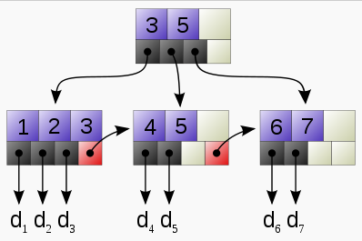
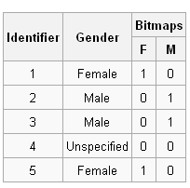
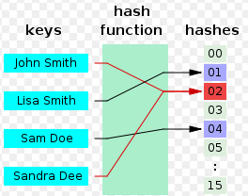
Indexes
Index = data structure used to speed access to tuples of a relation, given values of one or more attributes.
Approaches: hashing, bitmap, tree …

Slide 19
Declaring Indexes
No standard!
Typical syntax:
CREATE INDEX BeerInd ON Beers(manf);
CREATE INDEX SellInd ON Sells(bar, beer);

Slide 20
Using Indexes
Given a value v, the index takes us to only those tuples that have v in the attribute(s) of the index.
Example: use BeerInd and SellInd to find the prices of beers manufactured by Pete’s and sold by Joe. (next slide)

Slide 21
Using Indexes --- (2)
SELECT price FROM Beers, Sells
WHERE manf = ’Pete’’s’ AND
Beers.name = Sells.beer AND
bar = ’Joe’’s Bar’;
Use BeerInd to get all the beers made by Pete’s.
Then use SellInd to get prices of those beers, with bar = ’Joe’’s Bar’

Slide 22
Database Tuning
A major problem in making a database run fast is deciding which indexes to create.
Pro: An index speeds up queries that can use it.
Con: An index slows down all modifications on its relation because the index must be modified too.

Slide 23
Example: Tuning
Suppose the only things we did with our beers database was:
  Insert new facts into a relation (10%).
  Find the price of a given beer at a given bar (90%).
Then SellInd on Sells(bar, beer) would be wonderful, but BeerInd on Beers(manf) would be harmful.

Slide 24
Tuning Advisors (Optional)
A major research topic.
  Because hand tuning is so hard.
An advisor gets a query load, e.g.:
  Choose random queries from the history of queries run on the database, or
  Designer provides a sample workload
  Benchmarks, e.g., TPC-H
The advisor generates candidate indexes and evaluates each on the workload to find a suitable one.

Slide 25
Slide #11, Lecture 01
User/Application
Administrator
Query Compiler
Transaction Manager
DDL Compiler
Execution Engine
Logging and Recovery
Concurrency Control
Index/File/Record Manager
Buffer Manager
Buffers
Lock Table
Storage Manager
Control/data flow
Storage
data flow only

Slide 26
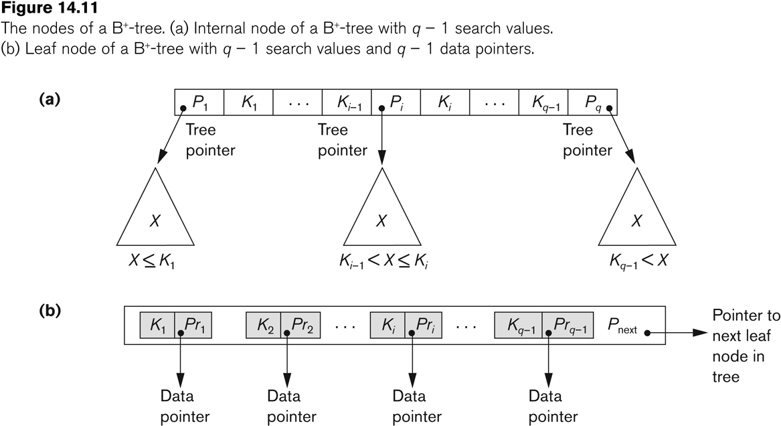
B+-Tree (Optional)

Slide 27
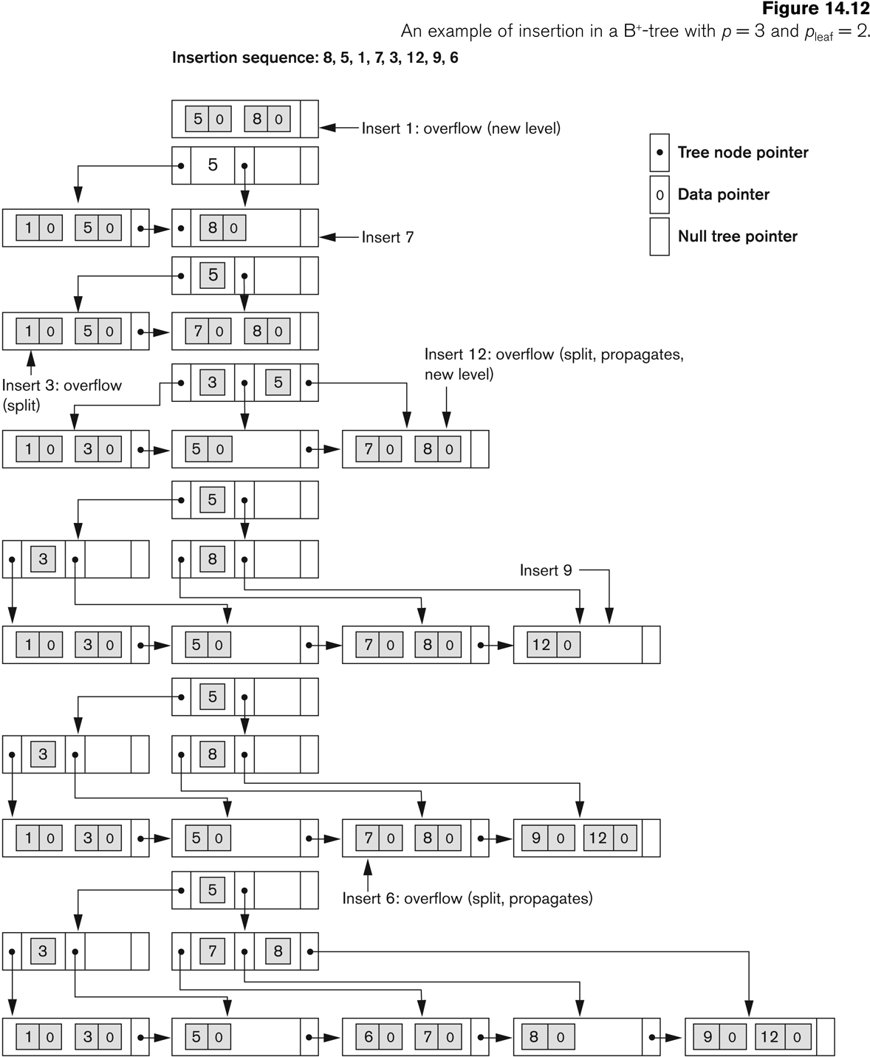
B+-Tree
Insertion
(Optional)

Slide 28
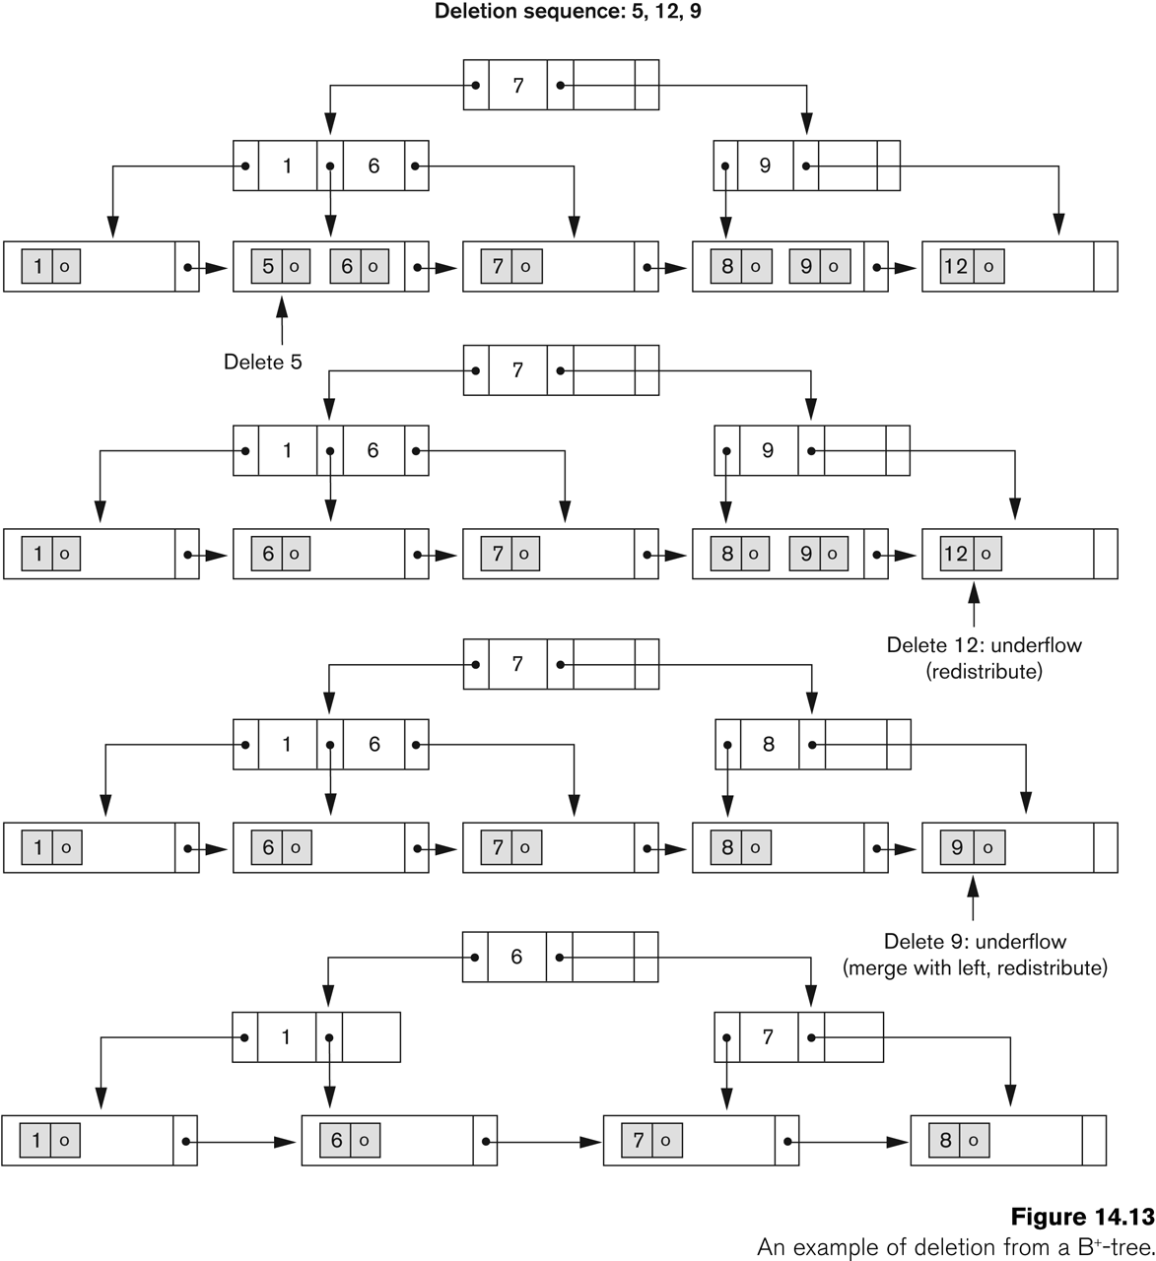
B+-Tree
Deletion
(Optional)

