Slide 1

HOMEWORK ASSISTANT USING RASA: Aryabhata (Smart Conversational Agent with the Latest Chatbot and Question Answering Technology)

Slide 2

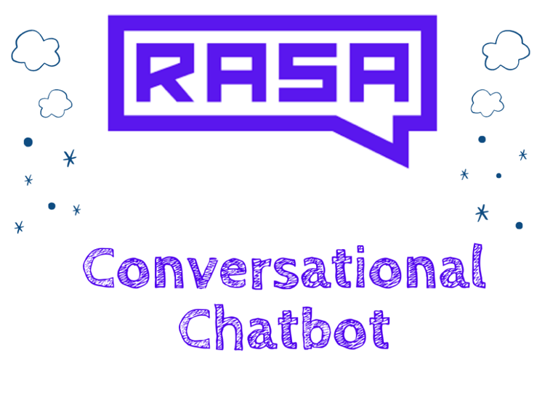
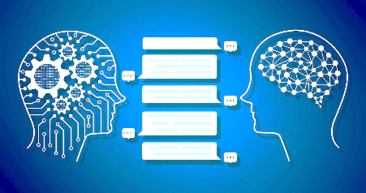
OBJECTIVES
To provide interactive medium of learning.
To provide instant help for students.
Acts as a teaching assistant.
Makes it easier for students to get information on specific subject like social science.
Improves student engagement.
To provide an exciting way of learning.
24/7 Access to learning.
Assisting students for coping stress and pressure.
Helping with holiday homework.

Slide 3
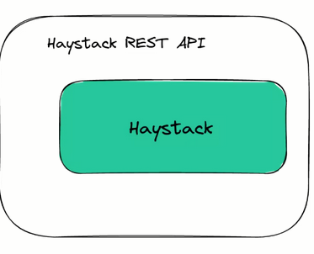

Aryabhata: Homework assistant chatbot using Rasa
user
Rasa NLU
Intent: question
entities: plant
when French revolution happened?
Rasa Stack
Haystack Api
user
Rasa Core
next_action: actions_answer
utter_ask
Answer of asked question
(5 May 1789)
Architecture of the AI ASSISTANT

Slide 4
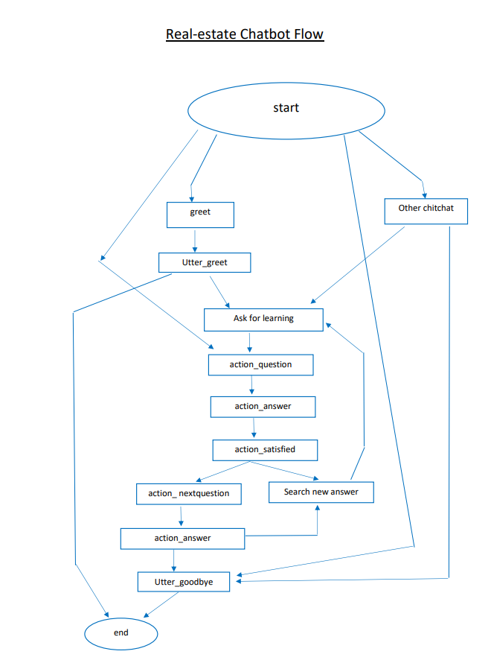

Slide 5
PROBLEM STATEMENT
The hypothesis is to build a state of the art technology that makes interactions between student and machines using natural language processing.
AI chatbot allow students to learn through online messages just like a regular chat conversation and provide exciting way of learning.
Students can learn or study anytime due to 24×7 access to AI learning. They may arrange their days without being tied to a specific location.
They may learn on the go, at any location, and at any time. Plan their days with more productive times.

Slide 6

INTRODUCTION
The Homework Assistant Application will make it easier for students to get information on specific subject like social science.
It can respond to student questions around the clock without costing extra.
The entire teaching that user get is a deep learning based AI answers in Realtime.
The proposed methodology provides an idea of using state of the art technology which is more exciting and interactive medium of learning as compared to trivial way of learning.
The use of chatbots in educational mobile apps help students in getting instant replies and help for their queries.

Slide 7
Modular description
1. Research and Information gathering.
2. Setting-up virtual environment and Rasa basic.
3. Modifying intent, rule and stories and train model.
4. Haystack Question Answering implementation.
5. Writing custom code in Chatbot for integration with Haystack API.
6. Setting up Telegram bot for UI and testing.

Slide 8
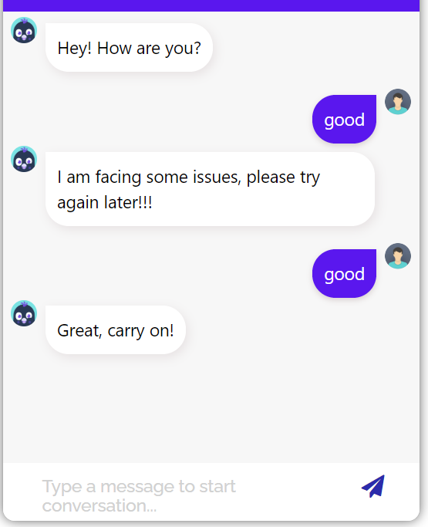
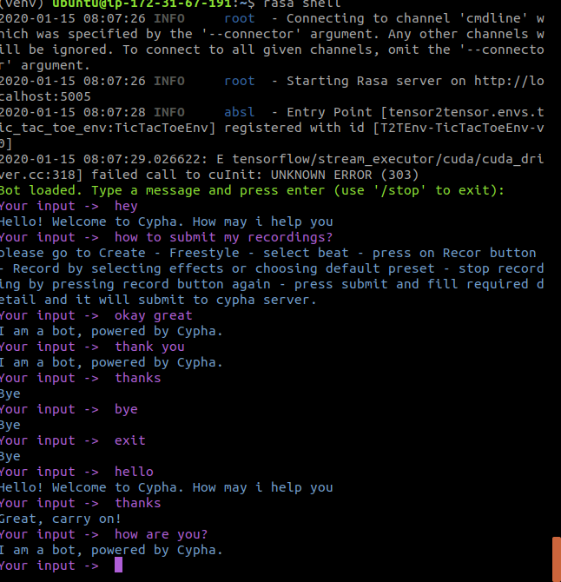
Ui layout

Slide 9
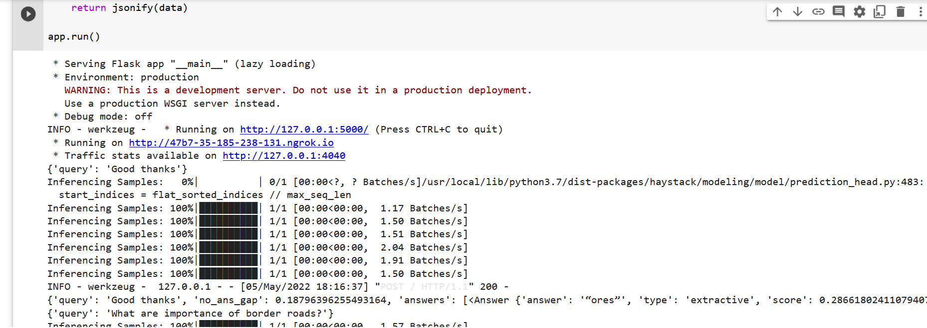
Haystack api output

Slide 10
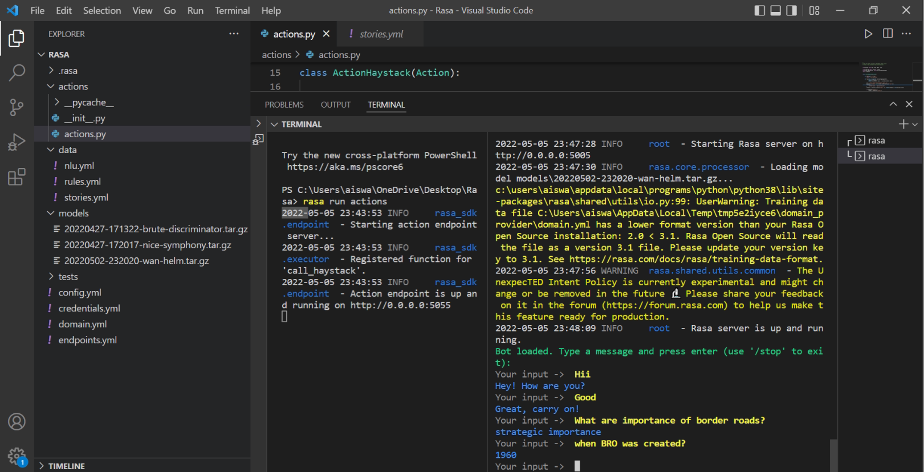
Chatbot shell output

Slide 11
CONCLUSION
Smart Conversational Agent with the Latest Chatbot and Question Answering Technology.
Through this technique user get exciting way of learning.
This helps the user to manage time.
System will be developed for simple and convenient use for all categories of people.
Reduce extra burden of cost for tuition.

Slide 12
REFERENCES
[1] A. Bordes and J. Weston. Learning end-to-end goal-oriented dialog. CoRR, abs/1605.07683, 2016.
[2] https://arxiv.org/abs/1712.05181
[3] A. Joulin, E. Grave, P. Bojanowski, and T. Mikolov. Bag of tricks for efficient text classification. arXiv preprint arXiv:1607.01759, 2016.
[4] https://www.deepset.ai/blog/build-smart-conversational-agents-with-chatbots-qa

Slide 13
REFERENCES
[5] https://github.com/deepset-ai/haystack
[6] https://arxiv.org/abs/1909.11942

Slide 14
THANK YOU

