Slide 1
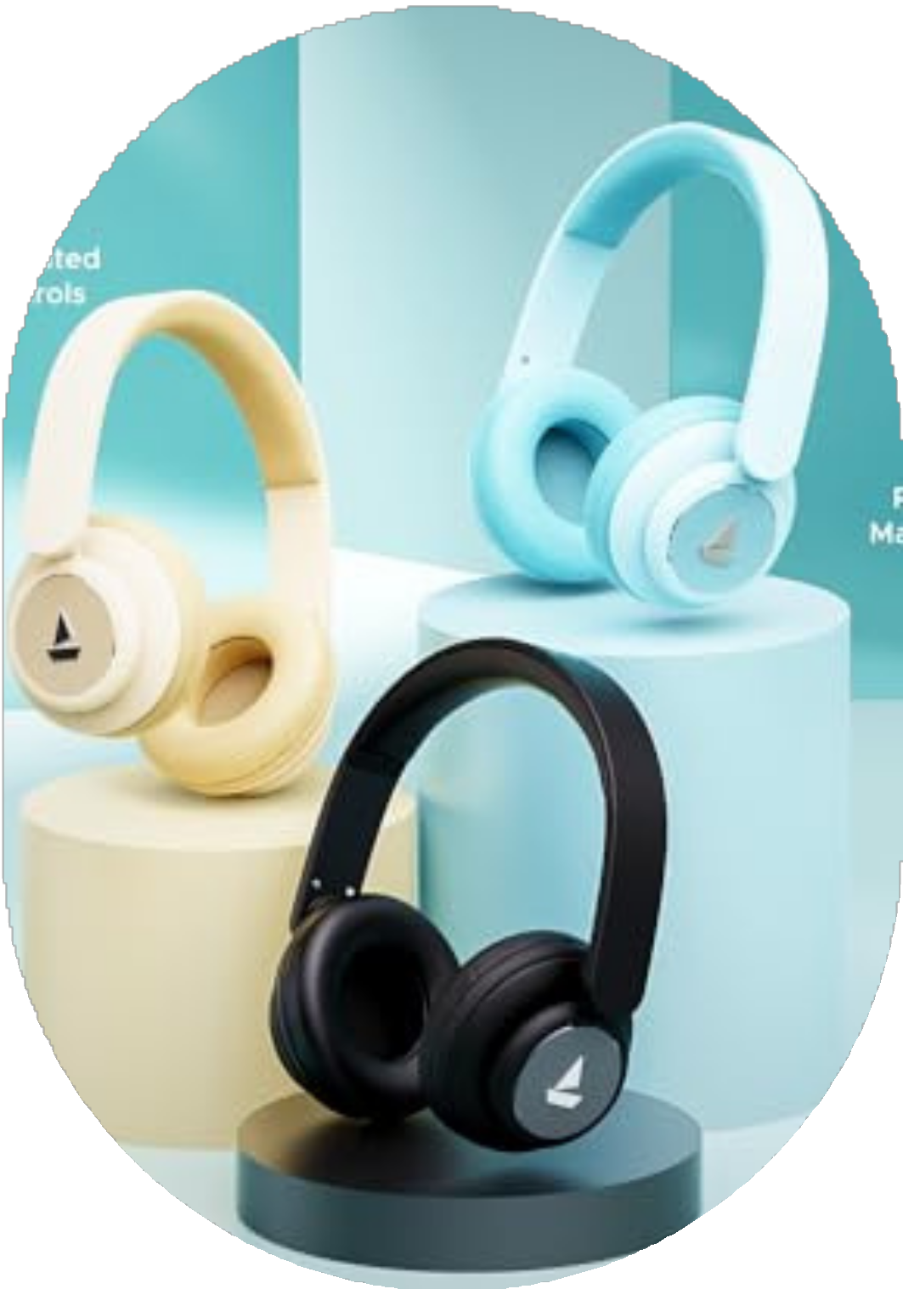


CASE STUDY ON
P r e s e n t e d b y :
Vivek kumar
Ajeet Kumar

Slide 2

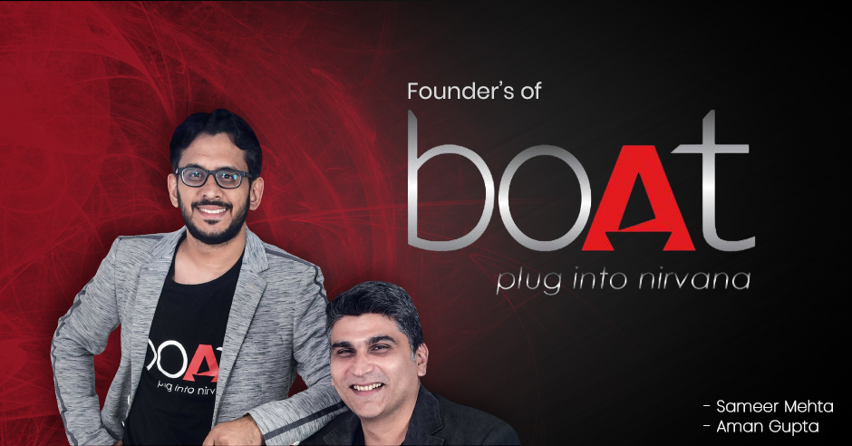

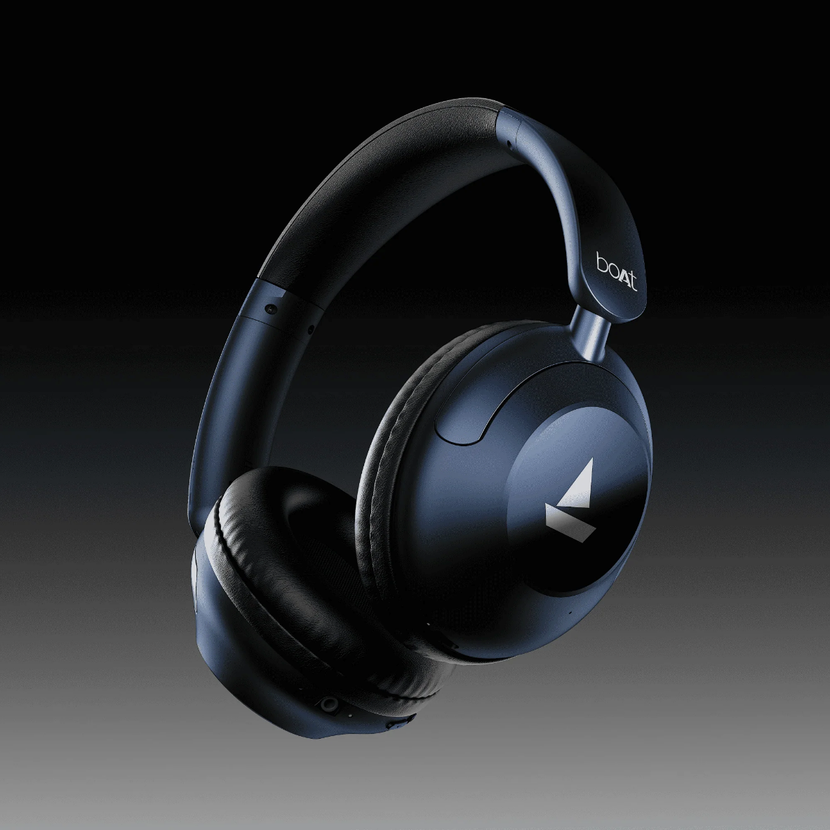
BOAT
India’s largest lifestyle tech brand
Founder - Aman Gupta, Sameer Mehta
Vision - Deliver the best tech experience and elevate lifestyle for all.
Perfect destination for lifestyle and audio gadgets Earphones
Headphones Speakers Smartwatches Soundbars
Gaming accessories

Slide 3

Journey to Glory
2022
Launches several new product lines, including boAt smartwatches, and expands internationally. boAt begins IPO
preparation, targeting an even higher valuation.
2021
boAt becomes the market leader in wireless earphones in India.
Gains a unicorn valuation of over $1 billion.
2020
boAt raises its first round of funding from Warburg Pincus and becomes a leading brand in consumer electronics in India.
2019
boAt becomes one of the top five brands in India for wearable tech and audio equipment.
2018
boAt expands into wearable devices like smartwatches
, fitness bands, and Bluetooth speakers.
2017
2016
boAt enters the Indian market with its first product, the boAt BassHeads 225 earphones.
Incorporation of boAt Lifestyle by Aman Gupta and Sameer Mehta.

Slide 4
Marketplace
Consumer Problems
Unorganized retail: Local electronic shops selling low-end audio products.
Organized retail: Big brand outlets
like JBL, Sony, Sennheiser dominating the premium audio space.
Online retail or e-commerce: Major presence on platforms like Amazon, Flipkart, and their own website.
Lack of affordable quality products: Limited options for good quality, budget- friendly audio gear.
Overpriced premium brands: Big
brands are often too expensive for young consumers.
Lack of variety: Customers face limited stylish and trendy designs in the
affordable segment.
Durability issues: Many low-end products break easily or have poor battery life.

Slide 5

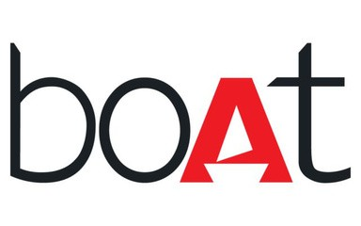




Marketplace Model
Retailers
Consumers
Provides platform and delivery services

Slide 6


Inventory Model
Boat partners with various manufacturers Also has its own plants
Boat manages its own logistics to deliver to consumers
Manufacturers
Boat Warehouse
Consumers

Slide 7


How Did Boat Rule the Audio and Wearable Market?
Boat Website
Content & Digital Marketing
Boat Mobile Application
Ominchannel Approach
YouTube
Boat Stores

Slide 8
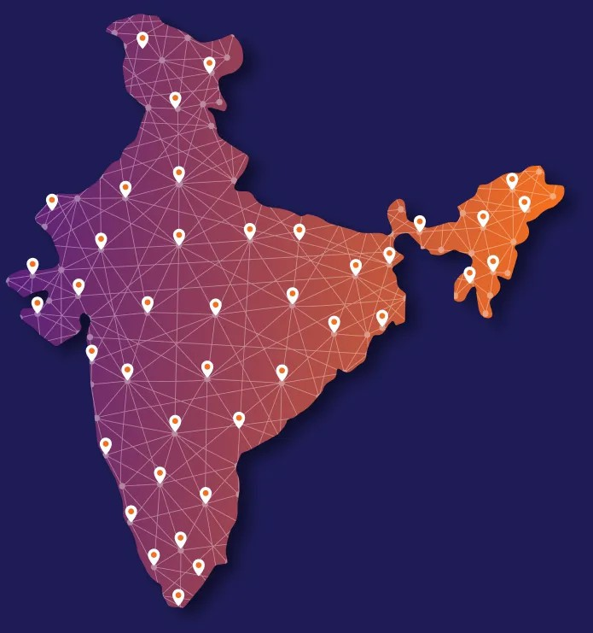
BOAT Network
Community of tech enthusiasts and audio lovers engaging with the brand.
1 million+ members as of 2021
50k weekly active users
Over 6 million followers on its Instagram page.
1.5 million subscribers of Boat’s YouTube channel.

Slide 9
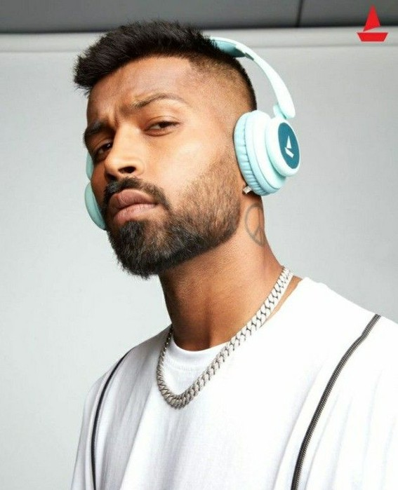
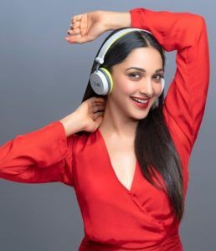

Influencer Marketing
Boat Network: Includes a team of fitness enthusiasts, lifestyle influencers, musicians, and tech bloggers who drive engagement.
Sales Drive: Through strategic collaborations, awareness, and endorsements across social media platforms.
2020: Boat collaborated with cricketer Hardik Pandya, making him the face of their "Plug into Nirvana" campaign to appeal to young consumers.
2021: Boat announced a partnership with Bollywood star Kiara Advani, amplifying their brand reach in the fashion-conscious market by launching trendy and stylish audio products.

Slide 10

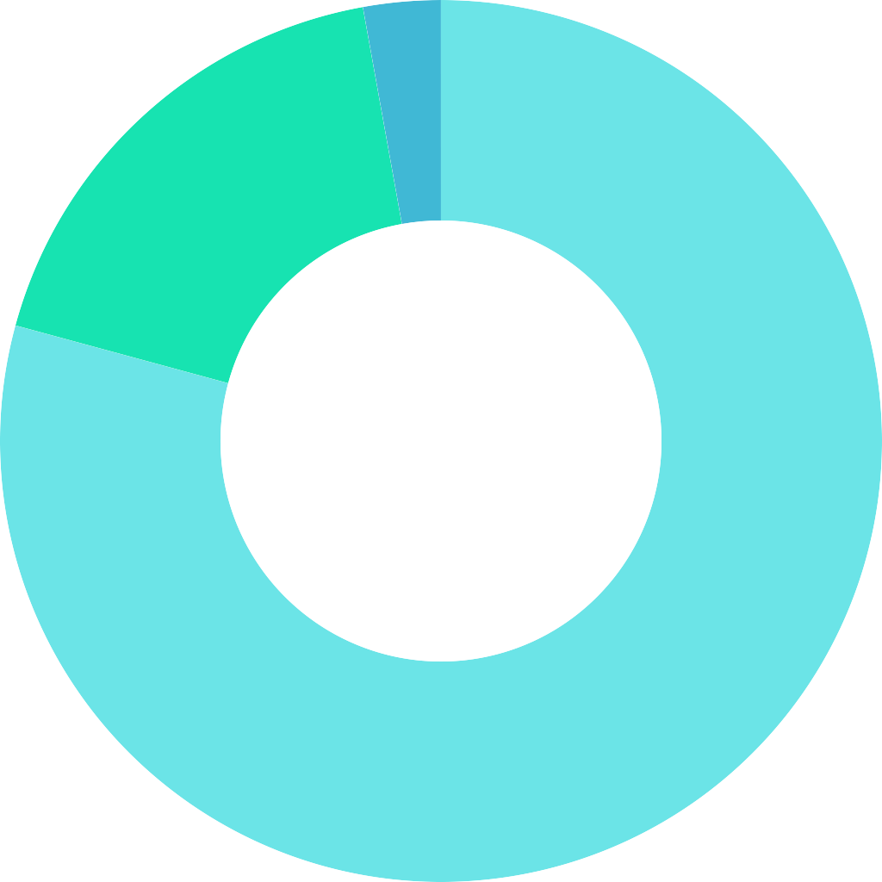

Financial Model
Net Revenue (Crores)
Audio
Wearables
Others
3500
2.8%
3000
17.9%
2500
2000
1500
1000
500
79.2%
Revenue division of different sectors
0
2020 2021 2022
Net revenue by different year
2019
2023

Slide 11

Future Outlook
Expansion into wearable and smart home devices
Collaboration with world-leading technology and lifestyle brands
Launch of a line of sustainable products
Strengthening omnichannel presence in the e- commerce sector and offline retail stores
Increased investment in R&D for the latest audio and lifestyle technologies
Expansion into international markets and building global brand recognition
Focus on customer service and post-sales support
Boat Labs to create a larger ecosystem for innovation and integrate smart devices
Boat 29.7%
Others 36.5%
Noise 10.8%
Boult Audio 5.8%
Oppo 8.5%
Fire-Boltt 8.7%
Market share as of FY23

Slide 12


