Slide 1
SEQUENCE DETECTOR
FANATICS
TEAM MEMBERS
P VIVEK VARDHAN(EE16BTECH11025)
G PREETHAM REDDY(EE16BTECH11007) P PAVAN(EE16BTECH11030)
D PRAMITH CHANDRA(EE16BTECH11005)
CONTENTS
SEQUENTIAL CIRCUITS
FINITE STATE MACHINE(FSM)
MEALY MACHINE
SEQUENCE DETECTOR EXPLANATION
VHDL SIMULATION OUTPUT

Slide 2
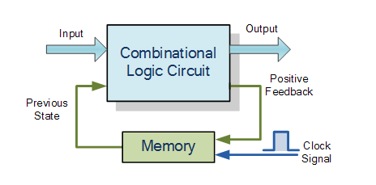
Sequence Detetector
Design a sequence detector to detect a sequence 1101.
Theory:
Sequential Circuits:
Sequential circuits works on a clock cycle which may be synchronous or asynchronous. The figure shows a basic diagram of sequential circuits. Sequential circuits use current inputs and previous inputs by storing the information and putting back into the circuit on the next clock cycle.
In other words, the output state of a ͞seƋueŶtial logic ciƌcuit͟ is a function of
the following three states, the ͞pƌeseŶt iŶput͟, the ͞past iŶput͟ and/or the
͞past output͟. Sequential Logic circuits remember these conditions and stay fixed in their current state until the next clock signal changes one of the states, giving sequential logic circuits ͞Meŵoƌy͟.
Finite State Machine (FSM):
A FSM is a model used to design sequential logic circuits. It is conceived as an abstract machine that can be in one of a finite number of states. The machine is in only one state at a time; the state it is in at any given time is called the current state. It can change from one state to another when initiated by a triggering event or condition, this is called a transition. A particular FSM is defined by a list of its states, and the triggering condition for each transition. It can be implemented using models like Mealy and Moore machine. For this expt., we will use Mealy model implementation.
Mealy Machine:
In this model of FSM, the output values are determined both by its current state and the current inputs. The state diagram of a mealy machine associates an output value with each transition edge.

Slide 3
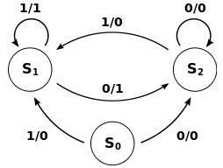
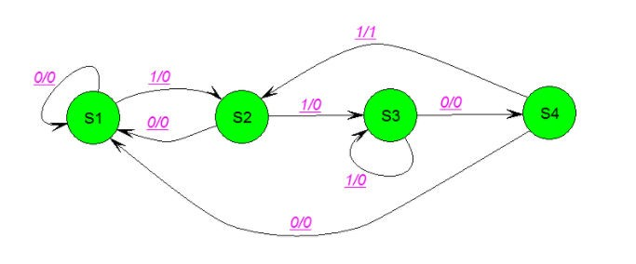
Example:
Here 1/1, 1/0, 0/1, 0/0 represent input/output and S0, S1, S2 represent the states. Consider a part of the state diagram S1 -> S2 where “0/1” is written on the arrow. This can be interpreted as, when the current state of the system is S1 and when input “0” is applied, the system goes into next state - S2 and the output of the system is “1”.
Sequence detector:
sequence detector is to be designed to detect a sequence 1101.the state diagram will be:
State S1:
Beginning at state S1 when 0 is received it stays in the same state because it has nothing to remember and the output is 0 because the sequence 1101 is not detected. Only at the instant when 1101 sequence is detected the output is high, that is, 1. Also remember that the flip flops should be used when things are to be remembered by the circuit. When 1 arrives when in state S1, then it goes to next state S2 and it remembers that 1 was received which is part of the sequence 1101 which is to be detected.

Slide 4
State S2:
When in state S2, when 1 arrives, since it is part of the sequence it goes to next state S3, meaning it remembers 1. When 0 is received it cannot go to next state S3(since 1 received has occupied the transition condition and because 0 is not part of the sequence and there is nothing to remember), and it cannot remain in the same state S2 because this would mean 010 indefinite loop while in state S2, therefore it goes back to the initial state S1. Consider 100 is received and machine remains in S2 when 0 is received, then because of 1 the state changes from S1 to S2, then 0 is received then the machine stays in S2 and when another 0 is received then it stays again in S2. But consider when 100 is received and machine goes back to S1, then when 1 is received it changes state from S1 to S2, when 0 is received then goes back to S1 and when another 0 is received it stays in S1.
State S3:
When in state S3, when 0 is received then since it is part of the sequence 1101 it goes to new state S4 because the machine has to remember the new bit 0 as part of the sequence detection algorithm. When 1 is received it stays in the same state.
State S4:
When in state S4, when 1 is received then since it is part of the sequence 1101 to be detected it goes to S2. And when 0 is received then it goes back to initial state S1. At this point the machine outputs 1.
Note that this state diagram is considering overlap i.e. if we have input 1101101 we will have output 0001001.
For same input, non-overlap case will have output 0001000. Either cases are correct but we will consider only overlap case henceforth.
VHDL SIMULATION OUTPUT:
For example :-
simulated digital waveform for the seqence 10101101010110001

Slide 5
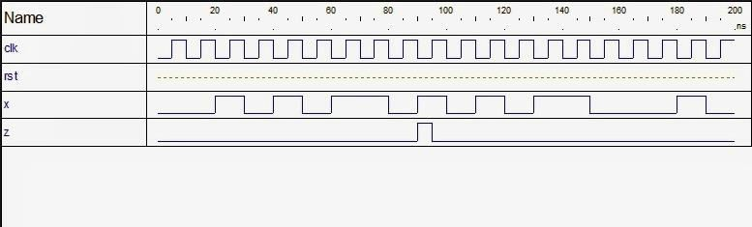
Source:google images

