Slide 1
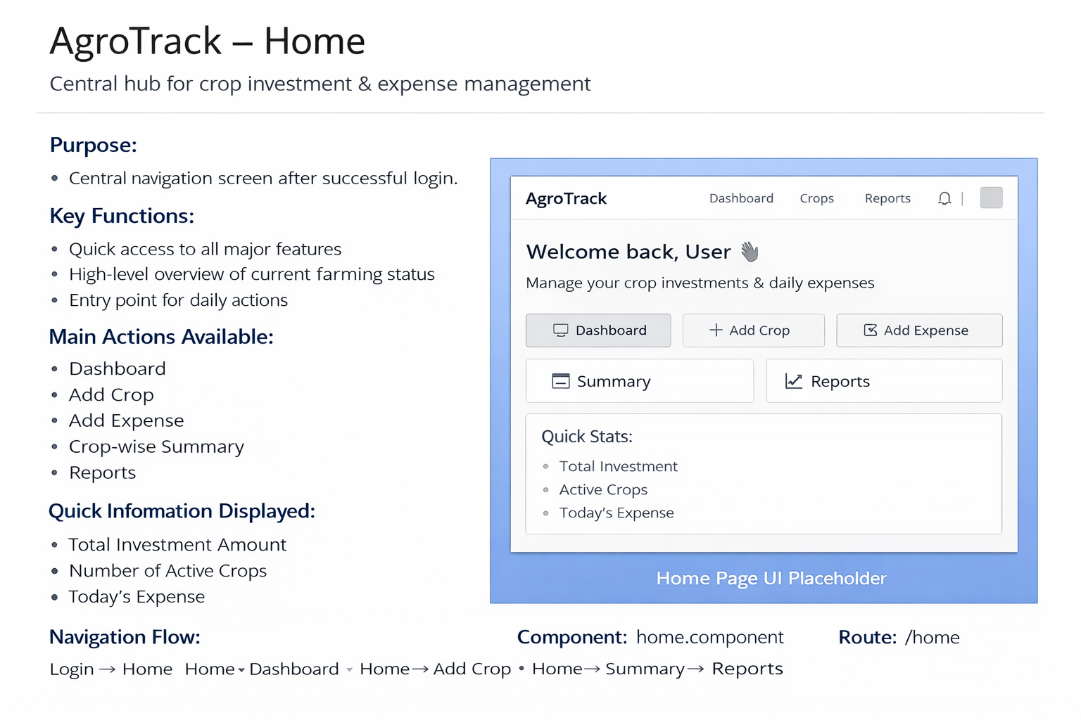

Slide 2
Login Screen
Purpose: User Authentication
  • Email / Username
  • Password
  • Login button
  • Redirect to Home/Dashboard

Slide 3
Home Screen
Purpose: Central Navigation
  • Dashboard access
  • Add Crop
  • Add Expense
  • Summary & Reports
  • Quick stats overview

Slide 4
Dashboard
Purpose: Expense & Investment Overview
  • Total Investment
  • Today's Expense
  • Monthly Expense
  • Active Crops
  • Charts & Recent Expenses

Slide 5
Add Crop
Purpose: Register Crop
  • Crop Name
  • Area (Acres)
  • Start Date
  • Expected Harvest Date
  • Status
  • Save Crop

Slide 6
Add Expense
Purpose: Daily Expense Tracking
  • Expense Date
  • Crop Selection
  • Expense Type
  • Amount
  • Notes
  • Save Expense

Slide 7
Crop Summary
Purpose: Crop-wise Analysis
  • Crop Name
  • Total Investment
  • Expense Breakdown Chart
  • Date-wise Expense Table

Slide 8
Reports
Purpose: Analytics & Reporting
  • Date Range filter
  • Crop filter
  • Expense Type filter
  • Charts
  • Tables
  • Monthly & Crop-wise reports

