Slide 1
Agile software model
Aakash Modi, Anil Kumar

Slide 2
Presentation flow
Agile.
Scrum.
Scrum Role.
Scrum Artifacts.
Scrum Events.
Scrum Metrics.

Slide 3
Agile
Agile is a word that describes an iterative and flexible approach to completing tasks and projects.
Agile refers to a set of principles and practices outlined in the Agile Manifesto. It emphasizes collaboration, adaptive planning, continuous improvement, and delivering working software in short iterations called sprints.
We want our software/application instantly, in SDLC we have one model called waterfall model.
In waterfall mode we follow the following step:-
- Requirement and analysis
- Design
- Test
- Deploy
- Maintain

Slide 4
Biggest flaw in this model is that we can’t go back.
We need all the users requirement at the start, we cannot leave any requirement for later part.
We cannot change in between.
The linear nature of the Waterfall model often results in long development cycles. Since each phase needs to be completed before moving to the next, the overall delivery time can be extended.
It is very difficult to change the process for any team, if any team is working on the waterfall model then it is very difficult for them to change it to the Agile.
Or, they follow some Manifesto and based on that manifesto what they can do is just modify it as per need. So they given the manifesto now its depend upon us how do we implement it.
There are multiple way to implement it:-
- Scrum
- Kanban
- extreme programming (XP)

Slide 5
It is a word that describes an iterative and flexible approach to completing tasks and projects, Agile refers to a set of principles and practices outlined in the Agile Manifesto.
It emphasizes collaboration, adaptive planning, continuous improvement, and delivering working software in short iterations called sprints.
So what agile have given is some set of values and principals, if you use those values and principal then you are doing an agile, there is a difference in between doing an agile and being agile, generally new teams are doing agile it takes some time to being an agile.
And, in order to build a good software we have to be a agile.
In waterfall model we focus on process, tools, on documentation, contract. In waterfall we focus on plan we cannot change in between. So these are come issues due to which there is a solve that Agile says those things are important but more then that we have to follow some VALUES.
So we have 4 values and 12 principal in Agile Manifesto .

Slide 6
Those 4 values are : -
Individuals and interactions over processes and tools.
Working software over comprehensive documentation.
Customer collaboration over contract negotiation.
Responding to change over following a plan.
During initial phase even client is confused what he/she is looking for sometime, so what we will do is that we will give MVP(minimum viable product) from which we will start building.
So these are the four values, now we also have 12 principal, and we can implement these 12 principal in our project then we are called being agile.

Slide 7
Those 12 principals are:-
Our highest priority is to satisfy the customer through early and continuous delivery of valuable software.
Welcome changing requirements, even late in development. Agile processes harness change for the customer's competitive advantage.
Deliver working software frequently, from a couple of weeks to a couple of months, with a preference to the shorter timescale.
Business people and developers must work together daily throughout the project.
Build projects around motivated individuals. Give them the environment and support they need, and trust them to get the job done.
The most efficient and effective method of conveying information to and within a development team is face-to-face conversation.
Working software is the primary measure of progress.
Agile processes promote sustainable development. The sponsors, developers, and users should be able to maintain a constant pace indefinitely.

Slide 8
Continuous attention to technical excellence and good design enhances agility.
Simplicity--the art of maximizing the amount of work not done--is essential.
The best architectures, requirements, and designs emerge from self-organizing teams.
At regular intervals, the team reflects on how to become more effective, then tunes and adjusts its behavior accordingly.
So these are the 12 principal that we are follow in our projects then we are called being agile.
Scrum is actually a framework through which we can implement an Agile.
So we follow those 12 principal and 4 values then we are being agile.
Agile is not a methodology it is a philosophy, so we follow that then we are good to go.

Slide 9
SCRUM
It is one of the most popular framework through which we can implement Agile.
We have other options as well like Kanban and XP.
Scrum is better way of building products.
Lightweight framework
Simple to understand.
framework used for managing and organizing complex projects, primarily in software development.
Scrum is based on the principles outlined in the Agile Manifesto and provides a structured approach to managing projects in an adaptive and incremental manner.

Slide 10
Key concepts and components of Scrum -
Scrum Team:- A small, self-organizing team that includes a product owner, development team, and Scrum Master. The team works collaboratively to deliver the project's goals.
Product Backlog: A prioritized list of features, requirements, and enhancements that need to be developed. It is managed by the product owner, who continuously refines and prioritizes the items.
Sprint: A time-boxed iteration usually lasting 1-4 weeks, during which a set of prioritized items from the product backlog are worked on by the development team.
Sprint Planning: A meeting at the beginning of each sprint where the product owner and development team determine which backlog items will be worked on during the sprint and create a sprint goal.
Daily Scrum: A brief daily meeting, usually lasting 15 minutes, where the development team synchronizes their work. Each team member shares what they accomplished since the last meeting, what they plan to do next, and any obstacles they are facing.

Slide 11
Sprint Review: A meeting held at the end of each sprint to present and review the work completed. The product owner and stakeholders provide feedback, and any necessary adjustments are made to the product backlog.
Sprint Retrospective: A meeting held after the sprint review to reflect on the sprint process and identify areas for improvement. The team discusses what went well, what didn't go well, and actions to enhance their effectiveness in future sprints.
Sprint Backlog: backlog for that particular sprint.
Increment: which is shipping product.

Slide 12
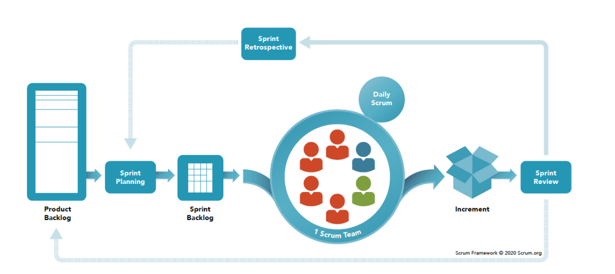

Slide 13
Scrum Roles:-
There are three key roles that collectively work together to ensure the successful implementation of the framework:
Product Owner:
The Product Owner represents the stakeholders, customers, and users and is responsible for maximizing the value delivered by the development team. Their primary responsibilities include:
-Defining and prioritizing the product backlog items.
-Collaborating with stakeholders to gather requirements and understand the product vision.
-Ensuring that the development team has a clear understanding of the product backlog items.
-Making decisions regarding the release of product increments.

Slide 14
Scrum Master:
The Scrum Master is responsible for facilitating and coaching the Scrum team and the organization on Scrum principles and practices. Their primary responsibilities include:
-Guiding the team in adopting and implementing Scrum practices.
-Facilitating Scrum ceremonies, such as sprint planning, daily scrums, sprint reviews, and retrospectives.
-Removing any obstacles or impediments that hinder the team's progress.
-Fostering a collaborative and self-organizing team environment.
-Educating the organization about Scrum and promoting its benefits.

Slide 15
Development Team:
The Development Team consists of professionals who perform the work of delivering a potentially shippable product increment in each sprint. Key characteristics of the Development Team include:
-Cross-functional: The team possesses all the skills necessary to deliver the product increment, such as analysis, design, programming, testing, etc.
-Self-organizing: The team organizes and manages its work to accomplish the sprint goals without external direction.
-Collaborative: The team works collectively to deliver high-quality increments.
-Responsible for estimating and selecting the backlog items they commit to delivering during each sprint.
-Actively engaging in the sprint ceremonies and collaborating with the Product Owner and Scrum Master.

Slide 16
Scrum artifacts
Scrum artifacts define the work that must be done, and they always add value during a sprint. In simple terms, scrum artifacts can be seen as nuggets of vital information for the scrum team. They provide structure to the scrum process because they act as guidelines for the product development plan.
artifacts are defined in Scrum Process Framework –
Product Backlog
Sprint Backlog
Increment
Burn-Down Chart

Slide 17
Product Backlog: The Product Backlog is an ordered list of features that are needed as part of the end product
Sprint Backlog: The Sprint Backlog is a forecast by the Team about what functionality will be made available in the next Increment and the work needed to deliver that functionality as a working product Increment.
Increment: The Increment is the sum of all the Product Backlog items completed during a Sprint combined with the increments of all previous Sprints.
Burn-Down Chart: At any point in time in a Sprint, the total work remaining in the Sprint Backlog can be summed.
By tracking the remaining work throughout the Sprint, the Team can manage its progress.
Conclusion: Scrum needs to be implemented in its entirety and functions well

Slide 18
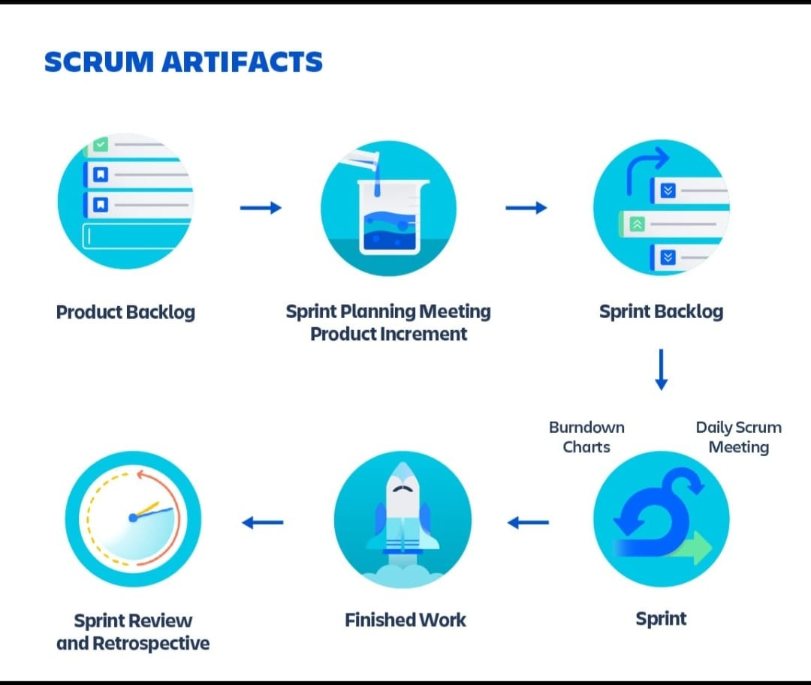

Slide 19
Scrum Events:
The Scrum events are time-boxed events.every scrum event has a predefined maximum duration
Events of scrum are:-
The Sprint
Sprint Planning
Daily Scrum Meetings
The Sprint Review
The Sprint Retrospective

Slide 20
1. The Sprint:
It is usually of duration two weeks or one month, and this duration remains constant for all the sprints in the project.
2. Sprint Planning:
Work to be performed in the Sprint is planned in the Sprint Planning.
Sprint Planning Focused on 2 major points. What needs to be and can be delivered in the Sprint Increment? How will the work needed for the execution of Sprint be achieved?
3. Daily Scrum Meetings.
Daily Scrum Meeting is a 15-minute meeting for the Team, conducted daily to quickly understand the work since the last Daily Scrum Meeting and create a plan for the next 24 hours.
In scrum meetings Teams members explanin:
1.What did he do yesterday that helped the Team meet the Sprint Goal?
2. What will he do today to help the Team meet the Sprint Goal?
3.Does he see any impediments that prevent him or the Team from meeting the Sprint Goal?

Slide 21
4. Sprint Review:
-A Sprint Review is held at the end of every Sprint.
Sprint Review includes this aspects majorly:
Attendees include the Scrum Team and key stakeholders, as invited by the Product Owner.
The Team demonstrates the work that it has completed and answers questions, if any, about the Increment.
The outcome of the Sprint Review is an updated Product Backlog, which defines the probable Product Backlog items for the next Sprint.
5.Sprint Retrospective:
This is usually a one hour meeting for two-week duration sprints and a three hour meeting for one month duration Sprints.
Purpose of the Sprint Retrospective Combine the learnings from the last Sprint Identify the major items that went well and potential improvements.
Conclusion:
Sprint Retrospective is an opportunity for the Scrum Team to introspect and improve

Slide 22
Scrum Metrics:
What are scrum metrics ?
Scrum metrics are specific data points that scrum teams track and use to improve efficiency and effectiveness. Scrum metrics can help teams establish benchmarks and guide the direction of the work
Scrum metrics is measured on the basis of this points.
1. Team Capacity
2. Workload distribution
3.Team Satisfaction

Slide 23
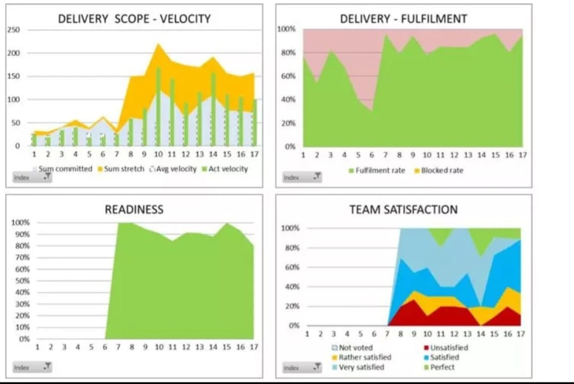

Slide 24
THANK YOU
.

