Slide 1

Machine Learning Model to Forecast Early Loan Prepayments and Customer Retention in Retail Lending
Course: Applied Research Project (B9AI107_2526_TMD1S)
Presented by: Vivek Pandey
Student ID: 20057035
Module Leader: Prof. Claudio Gonzalez

Slide 2




RESEARCH BACKGROUND:
Early loan repayment will impact the lenders’ cash flow and loan portfolio.
In traditional models, there are origination features, but these features are not dynamic; rather, they become less relevant
The borrower behavior changes, yet the overall modeling does not account for the time series nature of the data.
Sequence models model behavior but fail to consider borrower credit context
The data available for real-world lending is incomplete, making direct modeling of their behavior difficult.
PROBLEM STATEMENT:
The existing models are not capable of making a precise prepayment forecast at an early stage.
Static models neglect behavioral change; sequence models neglect the structure of borrowers.
Many “advanced” models have challenges related to interpretation and deployment.
A hybrid framework that integrates static concepts with real-world constraints into behavioral models is required.

Slide 3




AIM:
To design a hybrid machine learning model to predict prepayment for a loan and incorporate static consumer data and behavioral patterns to better manage risk and retention of customers for retailers.
RESEARCH OBJECTIVE:
To compare traditional tabular models (XGBoost and ANN) for early prepayment prediction with respect to fixed loan and borrower characteristics.
To evaluate the applicability of sequence-based Deep Learning approaches (LSTM, CNN) for describing repayment behavior in realistic data settings.
The goal here is to create a hybrid architecture for a neural network that can take inputs from both tabular data and behavior using parallel learning along with feature fusion.
For comparison between baseline models, hybrid models, or any other model based on the above performances, namely: Accuracy, Precision, Recall, F1, ROC AUC Score.

Slide 4

METHODOLOGY:
Data Description & Preprocessing
Definition of Target Variable
Feature Selection & Engineering
Loan-level structured dataset with borrower, loan, and servicing attributes
This would include key variables: credit score, DTI, LTV, loan amount, interest rate, and loan term.
Missing values are handled through median imputation for numerical data and mode imputation for categorical variables.
Features preprocessed: Numerical features standardized, categorical variables one-hot encoded.
Direct prepayment events unavailable in dataset
Early prepayment, defined using a proxy based on repayment duration
Early prepayment - loans repaid in fewer months than the median.
Proxy ensured class balance and enabled the possibility of supervised learning without any label leakage.
Selected characteristics of borrowers and loans at origination
Removed identifiers and redundant variables contributing to noisiness
Feature-set consistent across all models for fair comparison
Construction of Behavioral Sequences
Transaction level repayment histories were not available.
Fixed length, synthetic generated behavioural sequences to approximate dynamics of repayment
Sequences padded and masked to have a uniform length
Noise introduced to avoid deterministic patterns and target leakage
.

Slide 5


Modeling Framework
Model Training & Evaluation
Comparison & Decision-Oriented Analysis
XGBoost and Feed-forward Neural Network for Baseline tabular models
Sequence-based models include LSTM and 1D CNN.
Hybrid model: Parallel architecture including both tabular and sequence inputs
Feature fusion done via concatenation and dense layers
Data split using an 80/20 stratified train–test approach
Models were trained using Adam optimizer with binary cross entropy loss
Early stopping is imposed to control overfitting.
Performance measured using Accuracy, Precision, Recall, F1-score, and ROC-AUC.
All models evaluated under identical preprocessing and data splits
Emphasis on precision–recall trade-offs relevant to lending decisions
ROC-AUC used to assess ranking ability for portfolio-level risk prioritization

Slide 6


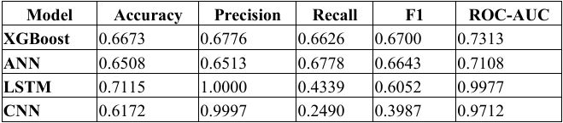
RESULTS:
1
XGBoost and Feed-forward ANN offered excellent baseline performance on tabular data
Models were successful in identifying nonlinear relationships between borrower attributes and loan attributes.
The results were not enhanced or affected owing to the lack of temporal-behavioral data
2
The models LSTM and CNN have exhibited excellent ranking capability with high ROC-AUC results
Patterns of repayment over time had pertinent information about prepayment risk
The sequence models were prone to volatile patterns of classification, especially in the recall process
Performance of Baseline Model
Performance on Sequence-Based Models

Slide 7


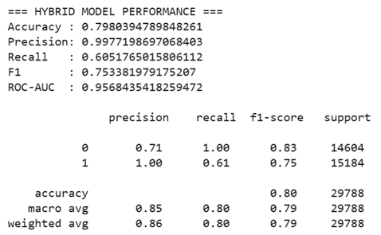
3
The hybrid model performed better than all other models
Reached approximately 80% accuracy with an ROC-AUC of 0.96
Achieved near-perfect precision with moderate recall, indicating a conserved approach
Error analysis revealed the complementing strengths of the static and behavioral inputs.
The training and validation loss curves provided evidence of stable convergence and the absence of overfitting.
Hybrid Model Performance

Slide 8



REFERENCES:
Akinjole, A., Shobayo, O., Popoola, J., Okoyeigbo, O. and Ogunleye, B., 2024. Ensemble-based
machine learning algorithm for loan default risk prediction. Mathematics, 12(21), p.3423.
Chang, V., Sivakulasingam, S., Wang, H., Wong, S.T., Ganatra, M.A. and Luo, J., 2024. Credit
risk prediction using machine learning and deep learning: A study on credit card
customers. Risks, 12(11), p.174.
Jerkerus, J., 2025. Predicting Short-Horizon Prepayment Rates using Machine Learning.
Kim, J.Y. and Cho, S.B., 2022. Ensemble of diverse deep neural networks with pseudo-labels for
repayment prediction in social lending. Science Progress, 105(3), p.00368504221124004.
11 more

Slide 9

THANK YOU!

