Slide 1
Lead Scoring Case Study
By Vivek Chauhan, Vishesh Divya and Aryan Jain

Slide 2
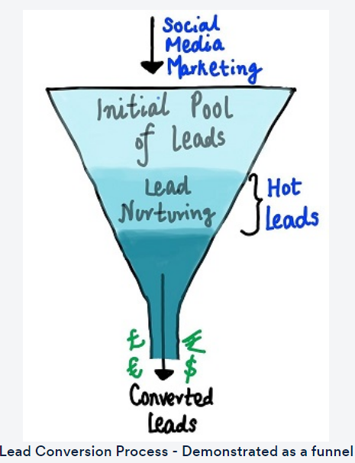
Business Objective
An education company named X Education sells online courses to industry professionals. The Company markets itself on search engines like Google, Bing and referral sites. Basis the marketing the company receives details of potential buyers (Leads) from these sites or past referrals.
Currently the company invests a lot of effort into marketing with low conversion rate (30%). To make this process more efficient, the company wishes to identify the most potential leads, also known as Hot Leads for a more focused marketing and conversion strategy. Thus, aiming for a target lead conversion rate of 80%
X Education has appointed you to help them select the most promising leads, i.e. the leads that are most likely to convert into paying customers.
Conventional Lead Conversation Process
Proposed Lead Conversion Process
Proactive Outreach to Hot Leads
Focused Marketing
Identification of Hot Leads
Higher Lead Conversion

Slide 3

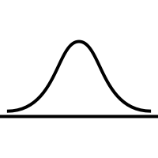
Goal of Case Study
Build a logistic regression model to assign a lead score to all leads. Customers with higher lead scores will have a higher chance of conversion.
Target Lead Conversion Rate = 80%
Input:
Data for previous Leads with important attributes
Lead Source
Time Spend on
Website
Current Occupation
Converted etc.
Probability of Lead Conversion (Lead Score) :
Apply a calculated Probability cutoff to identify hot Leads
Logistic Regression Model:
Understand pattern in past data
Identify important attributes
Predict Probability (Lead Score) of a Lead getting converted

Slide 4





Solving for Data Nuances
1. Importing Data
2. Understanding Data
Understanding Data Types, understanding data values
3. Data Cleaning
Handling Null Values, Treatment of Outliers
4. Exploratory Data Analysis
Univariate and Bivariate Analysis, Creating Visualization for Deeper understanding of data, Identifying important variables for next step
5. Data Preparation & Feature Engineering
Removing unimportant variables, Creating Dummy Variables for Categorical data, Creating Separate sets for Training and Test Data, Standardizing Numerical Variables

Slide 5
Data Understanding
The Data has 9240 records and 37 Columns
Prospect ID and Lead ID for identification purposes
Target Variables - Converted
Numerical Variables
TotalVisits, Total Time Spent on Website, Page Views Per Visit
Important Categorical Variables
Lead Origin, Lead Source, Last Activity, What is your current occupation, Last Notable Activity. There are more but limiting the list to important ones identified in the first view
Not Important Variables :
Many Variables had high percentage of null / select (to be treated as null) . Finally we dropped all those columns which had more than 30% null values. Examples - Lead Quality, Lead Profile, City, Asymmetrique Activity Index, Asymmetrique Profile Index, Asymmetrique Activity Score, Asymmetrique Profile Score
Many variables has only one value corresponding to 100% frequency. These do not add much value and can be dropped. Examples - Do Not Call, What matters most to you in choosing a course, Search, Magazine etc

Slide 6
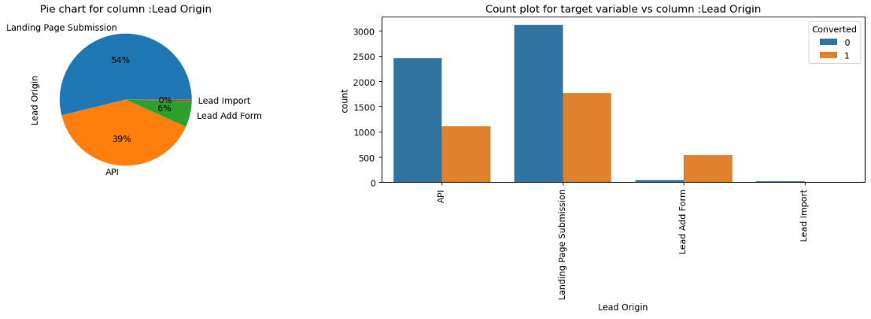
Exploratory Data Analysis : Important Categorical Variables
Understanding Variable Lead Origin
It tells about The origin identifier with which the customer was identified to be a lead. Includes API, Landing Page Submission, etc.
Lead Add Form happens to have the highest conversion rate. This can be important input to identify hot leads
These are the hottest leads which have much higher probability of conversion, this is followed by API and Landing Page Submission
Lead Import has negligible count

Slide 7
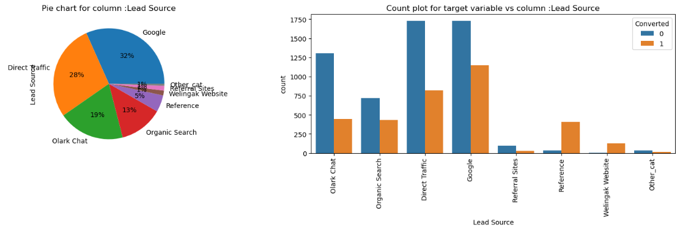
Exploratory Data Analysis : Important Categorical Variables
Understanding Variable Lead Source
It tells about the source of the lead - Includes Google, Organic Search, Olark Chat, etc.
Conversion Rate is highest for Lead Source - Welingak Websit and Reference. This could be an important input as we plan to maximize Conversion Rates
Top 3 lead generating sources are - Google, Direct Traffic and Olark Chat
Also, there were many sources with negligible frequency which we have grouped together as Other_cat

Slide 8
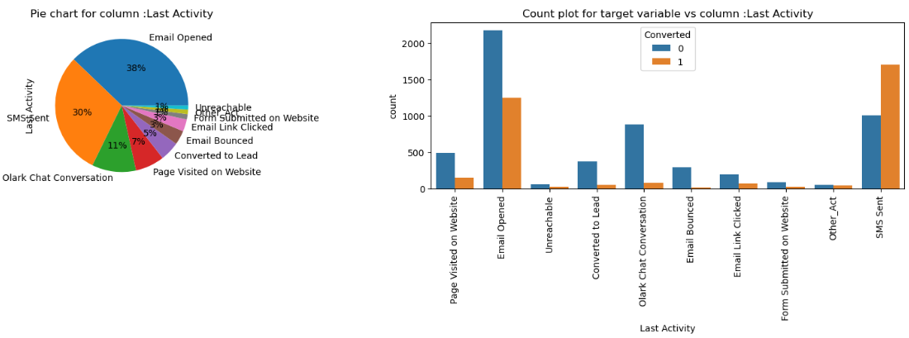
Exploratory Data Analysis : Important Categorical Variables
Understanding Variable Last Activity
SMS sent has highest conversion rate. This is an important input to identify hot leads
Olark Chat Conversation, Converted to Lead, Email Bounced have lowest conversion rates. These can be important to identify non conversions
Top 3 activities - Email Opened, SMS Sent, Olark Chat Conversation
Also, there were many activities with negligible frequency which we have grouped together as Other_Act

Slide 9
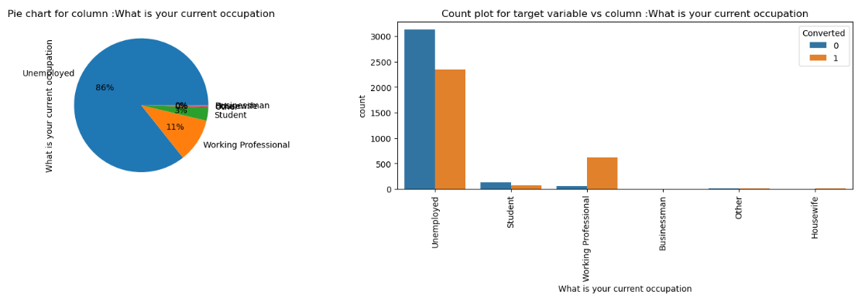
Exploratory Data Analysis : Important Categorical Variables
Understanding Variable What is your current occupation
Maximum values are Unemployed - 86%
Working Professional have very high conversion rate. This can be an important input to identify hot leads
There are many NULLs, now 86% of the Occupation is Unemployed. So Nulls can be replaced with Unemployed

Slide 10
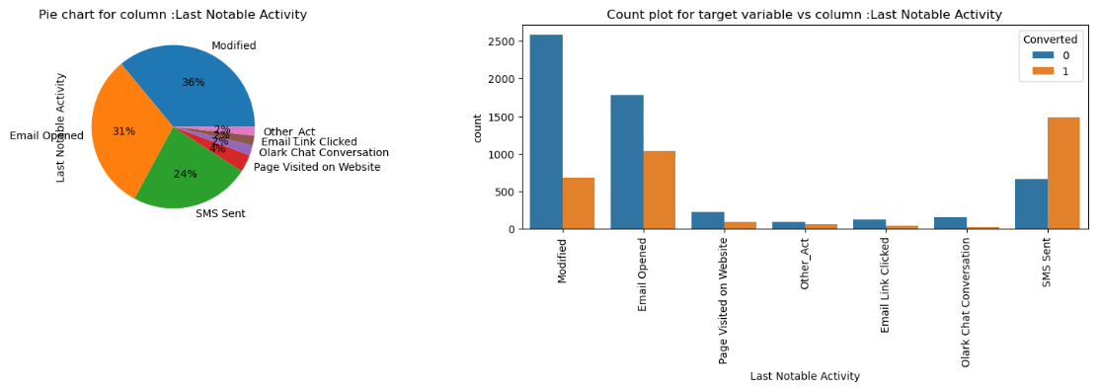
Exploratory Data Analysis : Important Categorical Variables
Understanding Variable Last Notable Activity
Top 3 Last Notable Activity are - Modified, Email Opened and SMS Sent
SMS Sent has the highest Conversion Rate and this can be an important input to identify hot leads
Also, there were many activities with negligible frequency which we have grouped together as Other_Act

Slide 11
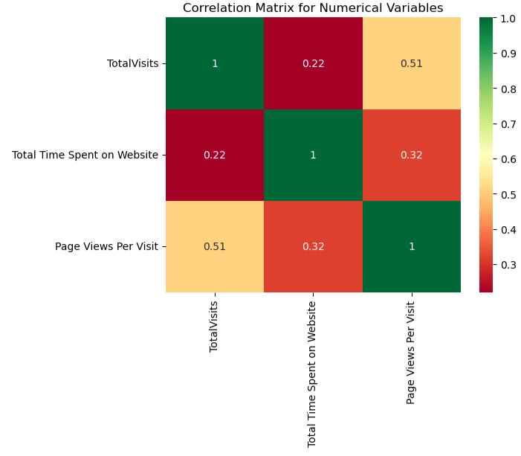
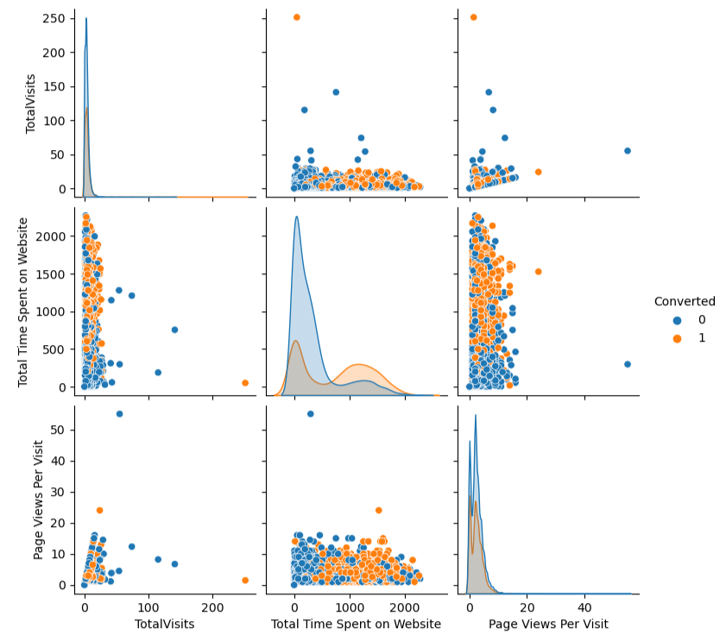
Exploratory Data Analysis : Numerical Variables
Pair Plot for Numerical Variables vs Converted Variable
Understanding Variables - 'TotalVisits', 'Total Time Spent on Website', 'Page Views Per Visit'
We see very high correlation between Total Visits and Page Views Per Visit
We will handle this in the Model Building phase via VIF

Slide 12
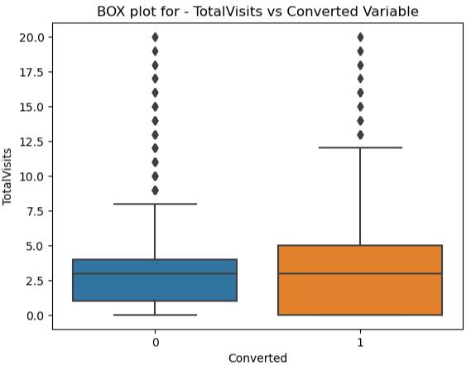
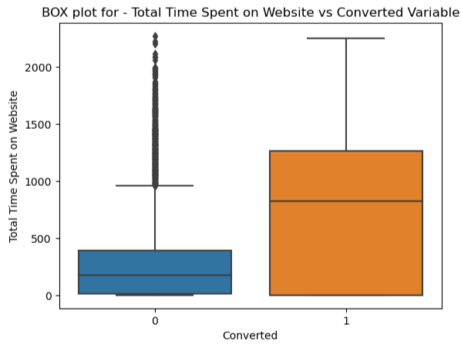
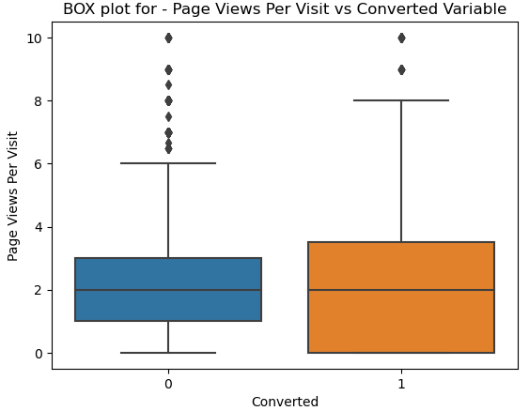
Exploratory Data Analysis : Numerical Variables
We identified outliers in the numerical values and remove them. Post outlier removal we are analyzing the numerical columns vis a vis the target variable - converted
The median of TotalVisits is similar for Non Converted and Converted Prospects
Inter Quartile Range is much higher for Converted Prospects
Also, we do not see any high outliers and the data is more of less in continuous pattern
Non Converted Prospects have much lower Median and IQR
On other hand, Converted Prospects have much high Median and IQR.
This indicates that CMs who spend higher time on website have higher changes of conversion. Which can be used to identify hot leads
There is no difference in the median for Not Converted vs Converted Prospects
Converted prospects have higher IQR

Slide 13
Feature Engineering
For Numerical Variables – we have done Standardization using StandardScaler() so that they are on similar scale and not impact model coefficients
scaler = StandardScaler()
X_train[['TotalVisits', 'Total Time Spent on Website', 'Page Views Per Visit']]= scaler.fit_transform(X_train[['TotalVisits',
'Total Time Spent on Website', 'Page Views Per Visit']])
For Categorical Variables – we have created dummy variables using pd.get_dummies()
var_dum= pd.get_dummies(leads[['Lead Origin','Lead Source', 'Last Activity',
'What is your current occupation', 'Last Notable Activity']], drop_first=True)
This will help us get the features be desired form for optimal modeling exercise

Slide 14
Building the Model
We will create two sets of Data – Training Data (70%) and Test Data (30%).
This will help us evalaute the model performance on unseen data
# We have used the option stratify = y to ensure that training and test data has proportionate values of Output variable y
X_train, X_test, y_train, y_test = train_test_split(X, y, train_size=0.7, test_size=0.3, random_state=100, stratify=y)
Since there are several variables we have used RFE to pick the top 20 significant variables.
from sklearn.feature_selection import RFE
rfe = RFE(estimator=logreg, n_features_to_select= 20)
rfe = rfe.fit(X_train, y_train)
We will then refine the model by doing multiple iterations and understanding model statistics – Pvalue and VIF to remove less significant / correlated variables.
We will be removing variables basis below criteria
Pvalue more than 5% - this means that the variable is not significant
VIF value more than 5 – This means that the variable shows multi-collinearity with other variables in the model

Slide 15
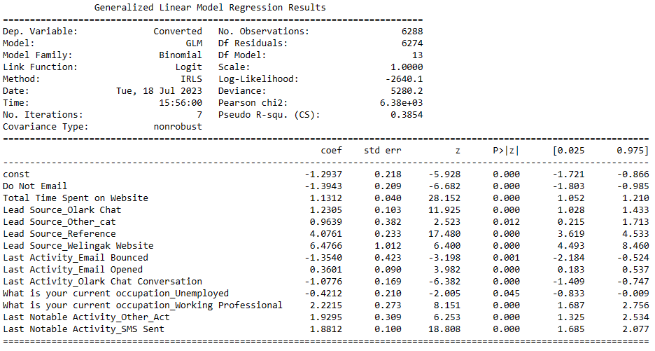
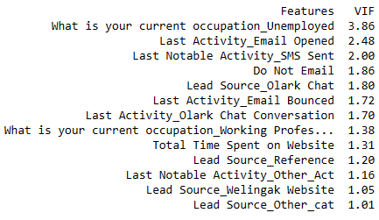
Final Model – Model Statistics and VIF Scores
Pvalue is less than 5% for all variables
VIF is less than 5 for all variables

Slide 16
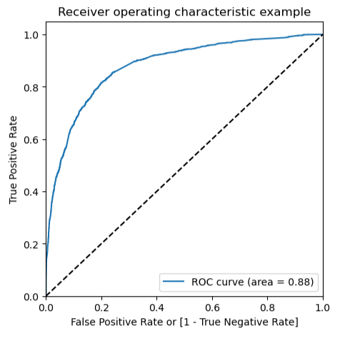
ROC Curve
Area under ROC Curve is 0.88
From the ROC curve a threshold of 0.3 appears to be good probability cutoff

Slide 17
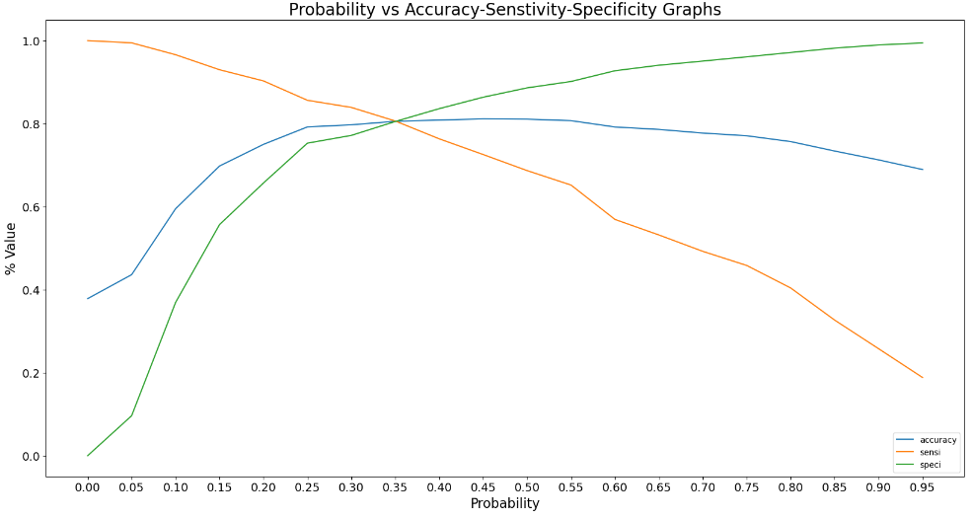
Probability Threshold vs Accuracy and Other Metrics
From the above graph, approx 0.35 is the optimum point to take it as a cutoff probability

Slide 18
Confusion Matrix and Accuracy Metrics
Confusion Matrix on Training Data
Confusion Matrix on Test Data
3147 | 762
461 | 1918
1362 | 314
208 | 811
Accuracy = 80.6%
Sensitivity = 80.6%
Specificity = 80.5%
Precision = 71.6%
Recall = 80.6%
Accuracy = 80.6%
Sensitivity = 79.6%
Specificity = 81.2%
Precision = 72.0%
Recall = 79.6%

Slide 19
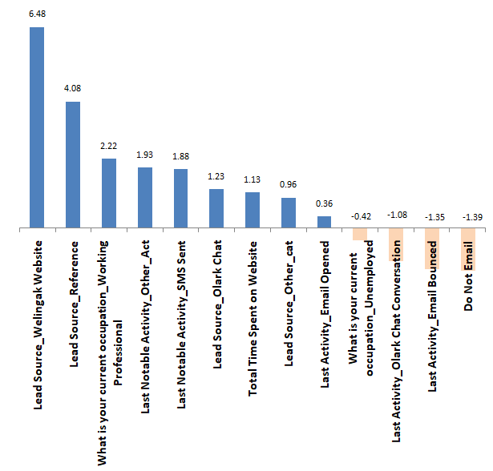
Final Model - Features
Top Three variables which lead to a higher conversion rate are
Lead Source_Welingak Website 6.48
Lead Source_Reference 4.08
What is your current occupation_Working Professional 2.22

