Slide 1
Wentainer

Slide 2
Wentainer is an inland water transportation system. The main advantage of the system is that it can transport cargo with lower cost while not being affected by the problems that the existing inland waterways has.

Slide 3
Working
The Wentainer system works as a convoy of boats in straight line(3.25m Width ) which is able to carry a container (33 TON) or equally weighing cargo. A three-rail system situated in the structure constructed above the water path helps in the movement and control of the Wentainer.
The Wentainer initiates movement by applying force onto the middle rail called puller rail , the other two rails along the sides of structure is used to guide the Wentainer along the path (guide rails) .
Wenatiner system has an engine unit situated at the front boat of the straight convoy which applies the force on the rail. The entire system works with help of electricity generated by the solar panels situated above structure.

Slide 4
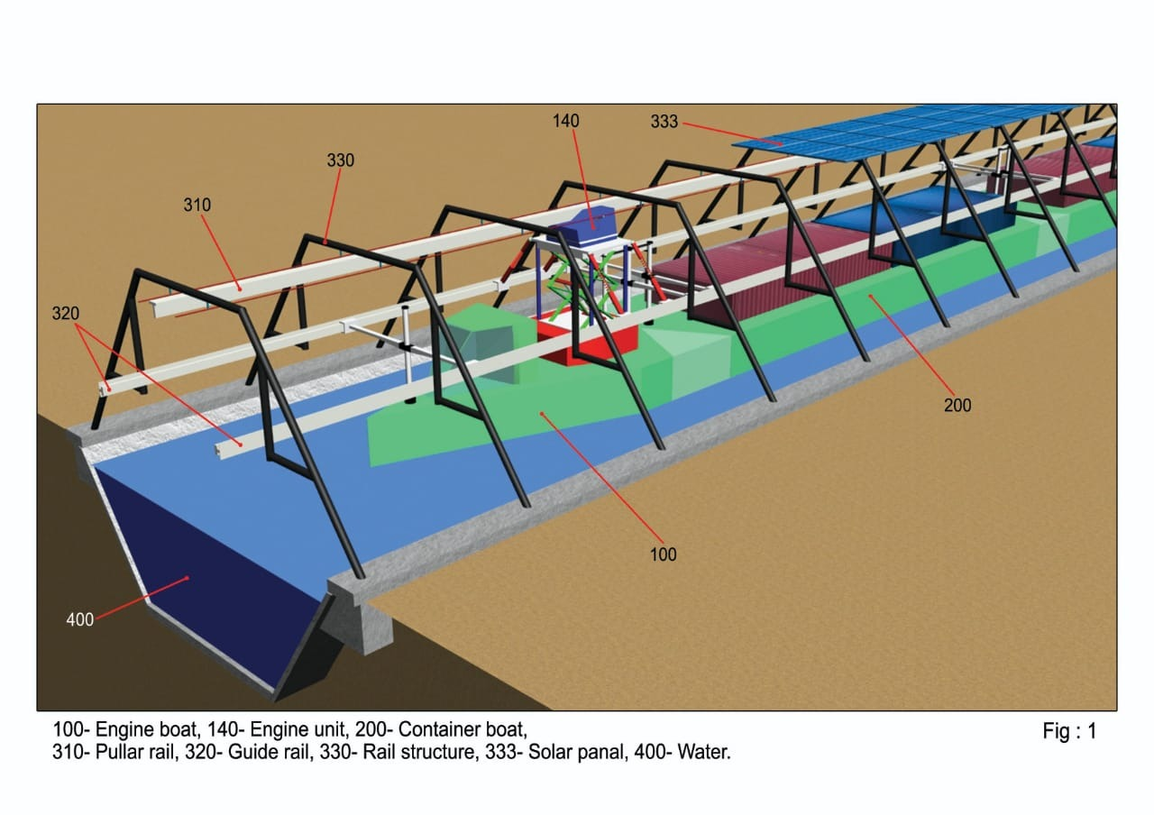

Slide 5
Problem
In the present scenario the cost effective method for cargo transportation throughout the country is waterways.
To move one-ton cargo for 1 km through highway it costs Rs. 2.28, for railways it costs Rs 1.41 and it costs Rs.1.19 for water ways.
Water transportation systems can achieve profit only if there is existing natural water canals/paths/bodies. Due to lack of this, there occurs a requirement for huge construction works which leads to huge cost in terms of money, land and water. This is often not preferred nor is it profitable.
Railways work using electricity, which decreases its working cost . But waterways works using costly fossil fuels which increases the running cost & also creates direct pollution .
Due to low speed limitation working hours of water transport also increases, moreover this leads to a requirement to provide accommodation and food storage facilities within the vessel which further increases the cost and curb weight.

Slide 6
Solution
Wentainer system works as a convoy of boats (3.25m width X 0.90m draft) in a straight line which is able to carry a container (33 Ton) or equally weighing cargo with the help of overhead rails.
Wenatiner can transport goods using a narrow pathway (6m width X 2m depth) . Large scale goods can also be transported using the very same path way.
This pathway can be constructed with comparatively lower cost, lower area of land and lower volume of water.
Solar panel can be easily integrated onto the rail structure constructed for the Wentainer system. From this, solar energy which has a lower generation cost (less than RS 2.5/KWh) can be directly utilized by the Wentainer system.
Wentainer system can be made fully automatic with help of guide rails. Thus work time can be reduced, food and accommodation facilities can be avoided. As a result overall cost can be reduced.

Slide 7
Advantages
The advantages of Wenatiner system over the conventional inland waterways systems are:
Cargo can be transported by utilizing only one third of energy used by a propeller system.
Can use solar energy directly which has lower generation cost.
Direct and indirect pollution is minimized during the cargo transport.
Large scale goods transport can be achieved using a narrow water pathway.
Can be made fully automatic.

Slide 8
Market Analysis
Current capacity of Columbo port is 6 million TEU, in China it is between 10 to 40 million TEU for 8 of its ports. However, the capacity of all ports in South-India is 3 million TEU even though they are close to international shipping route. At present works are being done to increase this capacity to 12 million TEU.
The current road/rail system is not enough to handle this huge amount of cargo, in order to overcome this Indian government is trying to implement the ‘Sagar mala’ project, aiming to link the seaports using rails, road and feeder ship systems.
If this rail, road and feeder ships are replaced by Wenatiner system it will be possible to handle cargo transport at a lower cost than that of other systems.
If the Wentainer system is used to link industrial corridors and/or between states, it will be also possible to handle cargo along with supply of water.

Slide 9
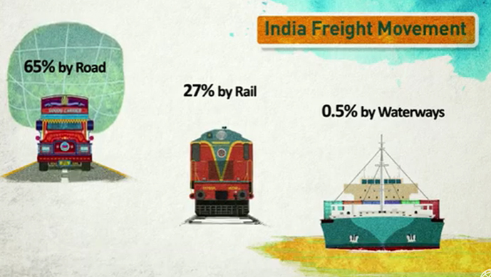
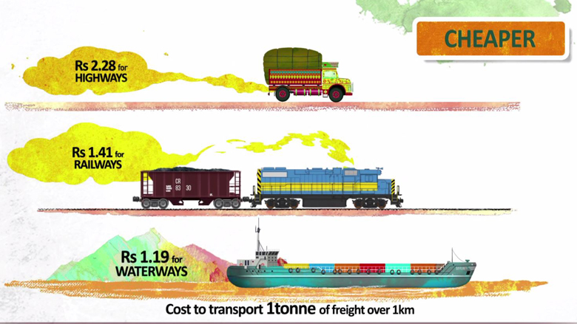
Competitors Comparison
According to study report of World Bank, to move 1 ton of cargo through a km, railway requires Rs 1.41 while waterways requires only Rs 1.19. Of the total cargo transportation throughout the country 27% of it is done by railway while only about 0.5% is done by waterways.

Slide 10
Even though the energy used for transportation of cargo is less through waterway, the cost of construction is greater due to larger area and volume of water required for the waterway. Hence it is often avoided.
Even though the energy required by the railways is very high, the cost for construction of railways is less than waterways due to lower area and money requirement. Thus a railway attains profit quickly and is rapidly taken up everywhere.
Wentainer path can be created with same cost as that of railways & can operate at a lower energy consumption than that of waterways.

Slide 11
The construction cost, running cost, fuel cost and balance amount of railways, inland waterways and Wentainer system are given below.
Transportation Mode | Construction Cost (per km) | Running Cost (TEU/km) | Fuel cost TEU/KM | Balance amount[running cost-fuel cost]
Railways | 7 to 10 crore per km | Rs.19.74 | Rs10.76 | Rs. 8.98
Inland waterways | 50-100 crore per km | Rs. 16.66 | Rs. 8.67 | Rs. 7.99
Wentainer | 7-10 crore per km | Rs. 14 | Rs.0.30 | Rs 13.70
One TEU = 14 ton

Slide 12
Product & service portfolio
Transportation of cargo at a lower cost
Wentainer can transport cargo at a lower cost when compared to Ship and railway.
Cost of transportation of cargo per Ton is Rs 1.41 for railway while it is 1.19, for a distance of 1 KM. However, for Wenatiner system it will be less than Rs 1 for the same.
Since, Wentainer can avoid lot of energy losses that occur in ship, railway s/m and by using solar energy having lower energy cost it is possible to achieve lower transportation cost.
Water supply
It is possible to supply water for agricultural and industrial needs to the areas through which Wentainer path passes through. It is possible to recover the cost of construction of the path from the profit of cargo transportation easily hence water supply can be done at a lower cost.

Slide 13
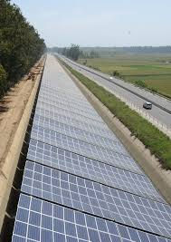
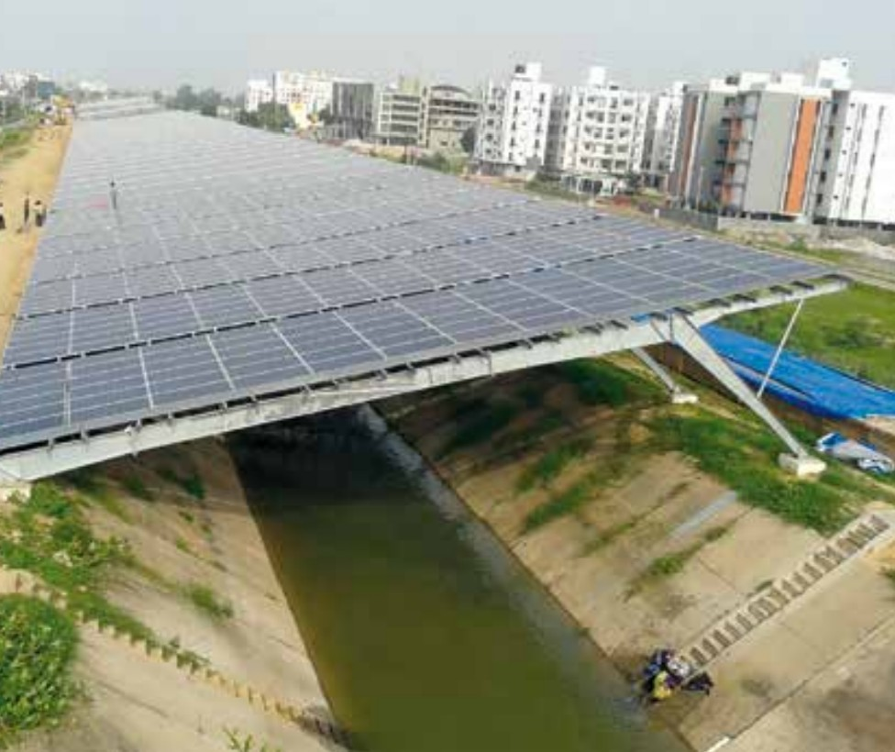
10 Mw canal top project (Punjab)
10 Mw canal top project (Gujarat)

Slide 14
Product portfolio
Generation and supply of electricity
It is possible to integrate solar panel onto the rail structure of Wentainer system without any other additional cost. On a 1 km path solar panels together having a capacity of 768kw can be placed without additional cost and an energy of 3840kwh can be generated daily. Due to this solar energy it is possible to operate Wentainer system without direct and indirect pollution.
By generation of energy for transportation it is possible to avoid service providers and their charges. The costly fossil fuels can be avoided by solar panels having a life span of 25-35 years with a very low constant generation cost.
Of the generated electricity half or less than it will be required for transportation. The surplus energy can be supplied to the grid or to nearby villages.

Slide 15
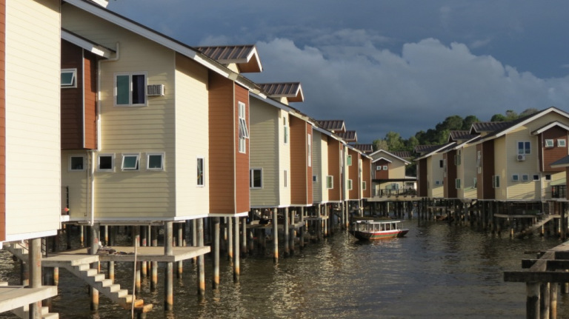
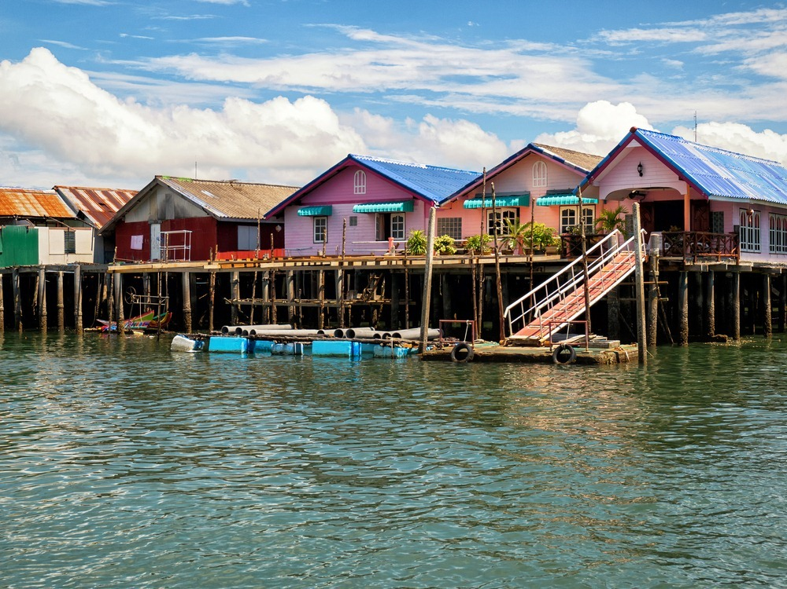
Product portfolio
Profitable accommodation facilities
It is possible to provide accommodation facilities on the Wentainer path due to its small width and height in a profitable way. This facility can be used to create commercial structures such as shops, structures for accommodation of poor can be done.
By acquisition of land and constructing Wentainer path it will be possible to achieve transportation of cargo at lower cost, supply of water, generation of electricity and provide accommodation facilities parallelly.

Slide 16
Automation of the transportation system
Since inland transportation is done at lower speed the staff work hours are very long and it is necessary to provide food and accommodation on the barge/boat. All of this increases the cost.
However, for Wentainer system since it is fully automatic all of these costs can be avoided.

Slide 17
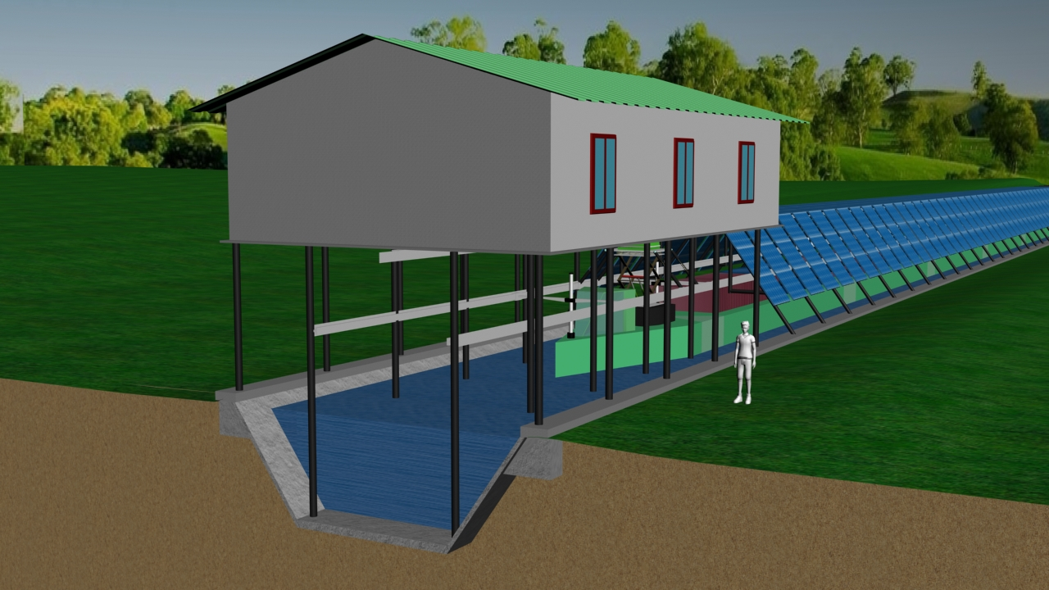
1) Water supply
2) Goods Transportation
3)Electricity Generation
4)Accommodation Facilities

Slide 18
Marketing and sales plan
The capacity of Colombo container port is 6 Million TEU , in China the capacity of it’s 8 major ports ranges between 10 to 40 million TEU for each.
Even though the ports in South India lies near to the International shipping route we only have a capacity of 3 million TEU.
Works are being carried out to achieve 12 million TEU capacity.
As the existing Road and Rail network is not capable of handling this flow of cargo, the Indian government has announced the a project called Sagarmala to improve the industrial growth of the country .
Sagarmala project aims at interconnecting ports across India using Road, Rail and feeder ship systems.

Slide 19
Marketing and sales plan
If the Road and Rail networks are replaced by a Wentainer system, cargo transportation can be achieved efficiently and cost effectively compared to the latter.
The cost of transporting 1 TON of cargo through a distance of 1 Km is Rs 1.41 for Railways whereas it only costs less than Rs 1 using Wentainer system.
Thereby Wentainer can acquire a large portion of cargo transport.

Slide 20
TamilNadu Government charges Rs 150 for 1000L .So for 1 TMC [2.83 Cr kL] of water it costs Rs425 Cr.
By constructing a Wentainer path connecting Kerala(with more than Sufficient rainfall) and TamilNadu (where there is scarcity of water), greater than 12TMC can be supplied to TamilNadu from Kerala.
12 TMC X 425 Cr= 5100 Cr
There by other than the water supply for industrial and agricultural growth, Kerala who is supplying the water and the Wentainer system passing the water can achieve profit.

Slide 21
The solar panels placed above structure has a capacity of 768kw per Km from which an energy of about 3840 Kwh can be generated per km.
The Wentainer system needs a small portion of this energy generated to run. The rest of the nergy generated can be supplied to the grid and/or nearby villages.
Hence profit can be achieved from this energy supplied.
It is possible to Provide accommodation facilities above the structure of Wentainer system which can be used for commercial and domestic purposes.

Slide 22
Product Cost
To build Wentainer pathway which can have large scale goods transportation (above 1 million TEU per year) and which is able to supply 12 TMC water (12 m³/s) per year require Rs 7 crore to 10 crore per km.
To lay solar panels together of 768kw in a km requires Rs 3.84 Cr.
After 25% Govt subsidy Rs2.88 Cr
For a Wentainer unit which carries 10 TEU requires Rs .30 crore.

Slide 23
Revenue
Income from good transportation
Wentainer system works by utilizing the solar energy generated by the solar panels laid along the path. The cost of generating 1KWh electricity using solar panel is Rs.2.5.
The life span of a solar panel is approximately 25-30 years and during these years we can generate and use electricity for the same amount.
As the Wentainer system is fully automatic expenses in terms of salary and other facilities/benefits can be reduced to the minimum.
Wentainer system can move 1 TEU of cargo for a distance of 1 Km at a fuel cost of Rs 0.3. If we charge Rs 14 for the same, it is possible to achieve a profit of Rs 13.7
A profit of Rs 1.37 Crore can be earned from a path of 1 km through which 1 million TEU passes( e.g. Sagarmala, Industrial corridors) through in a year.

Slide 24
Revenue
Income through water supply
The volume of water that can be supplied through a Wentainer path in a year = 12 TMC
Amount of 1 TMC water = Rs 425 Crore* (* Tamilnadu – Industrial water tariff per TMC)
Therefore, amount for 12 TMC water = 12 X 425 Crore = Rs 5100 Crore
Of water supply charge if 20% of amount is considered as profit,
we get 5100 X (20/100) = Rs 1020 Crore.
If the water is supplied to a distance of 500km,
The profit we obtain every year in a Km path =1020 Crore/500 Km = Rs 2.04 Crore per year for a km
Since Kerala obtain 50% of sales rate by water supply, Kerala can gain a high income
(Rs 425 Crore X 50/100 =212.5 Crore per TMC).

Slide 25
Revenue
From generation of electricity
The capacity of solar panel that can be layed above 1km=768kw
The amount required to lay 768kw solar panel=Rs. 3.5crore* [*when we consider 6crore for one MW]
After 25% government subsidy = Rs2.88 Cr
The average energy that can be generated from a 1 kw panel =1825kwh per year
Therefore for 1 Km path 768 x 1825kwh=1,401,600kwh
Electricity required for cargo transportation [1 million TEU in a year] through a one km path = 100,000kwh
Remaining electricity= 1,401,600 – 100,000 kwh
= 1,301,600kwh

Slide 26
Rate at which electricity is given to the power grid= Rs.2.5/kwh
1,301,600kwh x Rs.2.50 = Rs.0.33 crore
A[goods transportation]=Rs.1.37crore
B[water supply] = Rs. 2.04 crore
C[electricity production]=Rs. 0.33crore
Total amount= Rs. 3.74
From one kilometer path of Wentainer system we can get an approximate annual income of ₹3.74crore

