Slide 1
The Browser Object Model (BOM)

Slide 2
The Browser Object Model (BOM)
There are no official standards for the Browser Object Model (BOM).
The Browser Object Model (BOM) is used to interact with the browser.
The default object of browser is window means you can call all the functions of window by specifying window or directly.

Slide 3
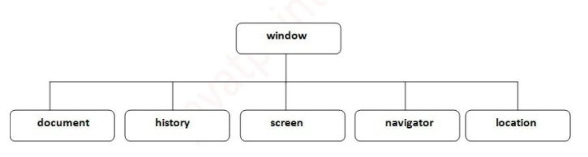
The Browser Object Model (BOM)

Slide 4
The Browser Object Model (BOM)
Global variables are properties of the window object.
Global functions are methods of the window object.
Even the document object (of the HTML DOM) is a property of the window object:
window.document.getElementById("header");

Slide 5
The Browser Object Model (BOM)
<body onmousemove="hadd();" onresize="hadd();">
<script>
const hadd=()=>
{
let w=window.innerWidth;
let h=window.innerHeight;
document.getElementById("spananswer").innerHTML="Width = " + w + " Height = " +h;
}
</script>

Slide 6
The Browser Object Model (BOM)
<div class="container w-25 p3">
<form name="frm1">
<div class="form-row">
<div class="col">
<button type="button" value="Add" class="btn btn-warning" id="btnans" onclick="hadd();">Click me </button>
</div>
</div>
<br/>

Slide 7
The Browser Object Model (BOM)
<div class="form-row">
<div class="col">
Ans <span id="spananswer"></span>
</div>
</div>
</form>
</div>

Slide 8
Methods of Window
Methods | Description
Alert () | It displays the popup messages with the ok button.
Confirm () | It displays the message on the alert box with the OK and cancel button.
Prompt () | It gets input from the user to display a text message in the dialog box.
Open () | Opens the current window.
Close () | Closes the current window.
moveTO () | Moves the current window.
resizeTo () | Resizes the current window.
setTimeout () | It performs an action after a specified time, like calling a function, evaluating expressions, etc.

Slide 9
Methods of Window Open
<body>
<script>
const hadd=()=>
{
window.open("http://www.shyamsir.com");
}
const hadd2=()=>
{
window.open("trycatch1.html");
}
</script>

Slide 10
Methods of Window
<div class="container w-25 p3">
<input type="button" value="Click_to_Next" onclick="hadd();"/>
<input type="button" value="Open" onclick="hadd2();"/>
</div>

Slide 11
Methods of Window
<style>
.hide
{
visibility: hidden;
}
</style>
<script>
let con=setInterval("hadd()",1000);
let idno=1;
const hadd=()=>
{
if(idno==1)
{
document.getElementById("main").style.visibility = "visible";
idno=0;
}
else
{
document.getElementById("main").style.visibility = "hidden";
idno=1;
}
}
</script>

Slide 12
<div class="container w-25 p3">
<div class="row">
<div class="col">
<img src="img/img1.jpg" height="200px" width="200px" name="main" id="main" class="hide"/>
</div>
</div>
</div>
</body>
</html>

Slide 13
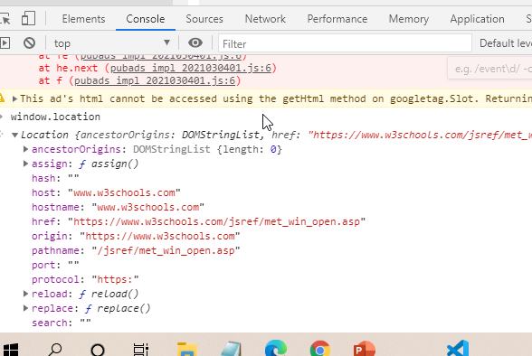

Slide 14
setTimeOut vs setTimeInterval

Slide 15
How to clear history?

Slide 16
window.print();

