Slide 1

Multiple Disease Prediction System
 | JAIN COLLEGE OF ENGINEERING(JCE), Belagavi (Approved by AICTE, New Delhi & Affiliated to VTU, Belagavi)
DEPARTMENT OF COMPUTER SCIENCE AND ENGINEERING
(Accredited by NBA)
Shrishail K Bhagoji | 2JI22CS097
Sudarshan.S.Khot | 2JI22CS104
Vinod B Sajjan | 2JI22CS121
Vivek S Lokolakar | 2JI22CS123
Guide Name:
Prof.Manjunath
2025-26

Slide 2
Abstract
The Multiple Disease Prediction System is a ML and DL-based application designed to predict diseases such as diabetes, heart disease, Parkinson’s disease , Breast cancer , Stroke prediction, Kidney disease prediction, pneumonia prediction , Eye Disease prediction ,Lung cancer prediction using patient health data..
The system takes input parameters like age, blood pressure, glucose level, and other medical attributes..
It applies machine learning algorithms such as Logistic Regression, Decision Tree, and Random Forest to analyze the data..
The model is trained using medical datasets to ensure accurate predictions.
This approach helps in early detection of diseases, reduces diagnostic time, and supports healthcare professionals in decision-making.
The system provides quick and reliable results through a user-friendly interface

Slide 3
Introduction
Background
Healthcare systems need fast and accurate disease diagnosis.
Machine learning helps analyze medical data and predict diseases efficiently.
Early detection can reduce risks and improve patient outcomes.
Problem Definition
Traditional disease diagnosis is time-consuming and depends on medical expertise, which may lead to delays and errors. Existing systems usually focus on predicting only one disease and lack an integrated approach. Therefore, there is a need for an efficient system that can accurately predict multiple diseases at an early stage using patient data.

Slide 4
Objectives
To develop a system that can predict multiple diseases using machine learning techniques.
To analyze patient health data for accurate disease prediction.
To improve prediction accuracy using efficient algorithms like Logistic Regression and Random Forest.
To provide a simple and user-friendly interface for users.
To enable early detection of diseases and support timely medical decisions.
To reduce manual effort and minimize errors in diagnosis.

Slide 5
Literature Survey
Existing systems.
Existing systems use machine learning algorithms such as Logistic Regression, Decision Trees, and SVM to predict diseases like diabetes, heart disease, and Parkinson’s disease. These systems provide good accuracy but are mostly limited to predicting a single disease.
Research gap
There is no unified system that can predict multiple diseases efficiently in one platform. Existing models lack integration, scalability, and ease of use, creating the need for a comprehensive multi-disease prediction system.
Comparision
Feature | Existing System | Proposed System
Disease Prediction | Single disease | Multiple Diseases
Accuracy | Moderate | High
Speed | Slower | Faster
Integration | Not Available | Available
User Interface | Less User Friendly | User-Friendly

Slide 6
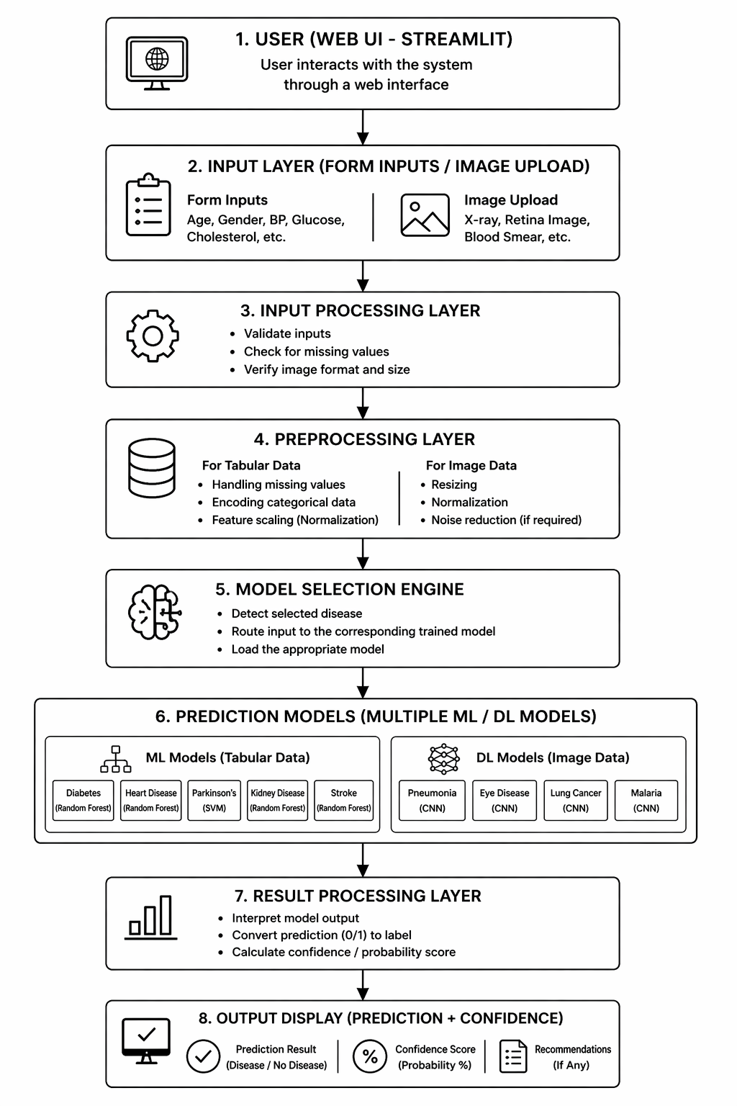
System Architecture

Slide 7
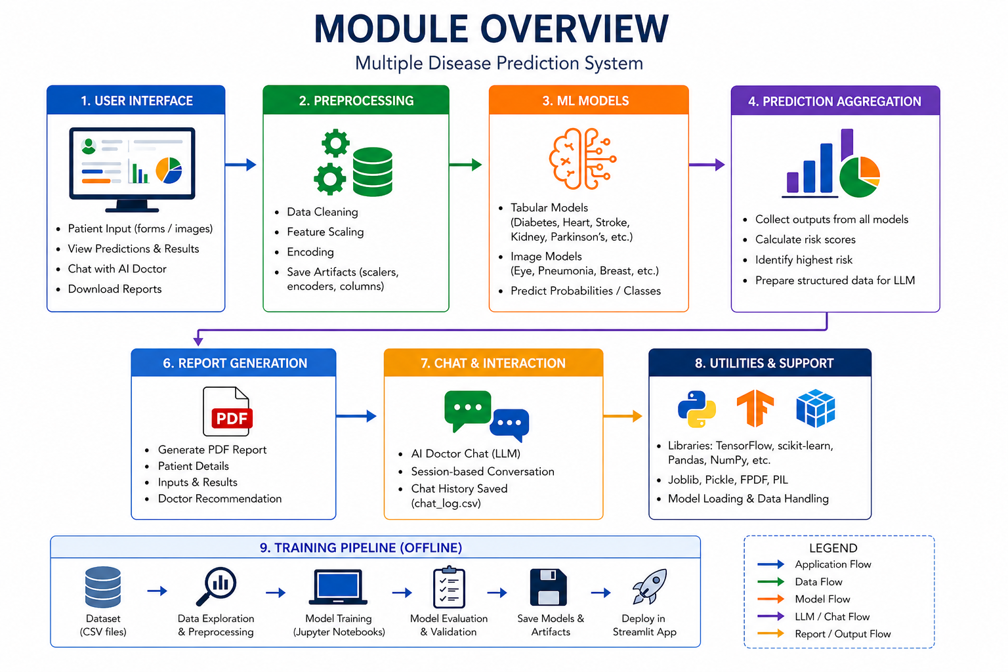

Slide 8
Methodology
Algorithms Used
Logistic Regression
Decision Tree
Random Forest
Used for classification and prediction of diseases
Random Forest improves accuracy by combining multiple trees
Design Approach
Collect medical datasets (diabetes, heart, Parkinson’s)
Perform data preprocessing (cleaning, normalization)
Select important features for better accuracy
Train machine learning models
Test and evaluate model performance
Select best-performing model for deployment

Slide 9
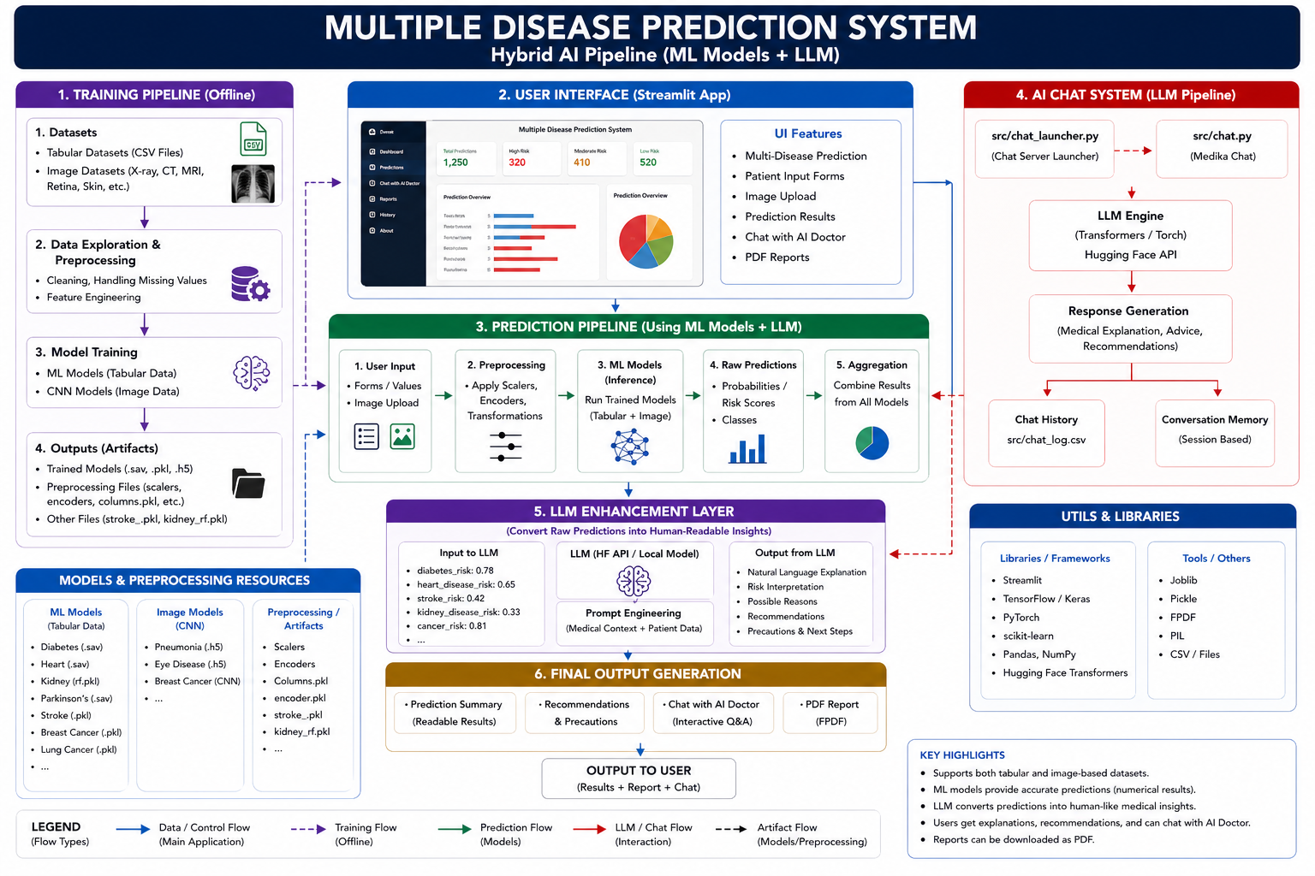
WorkFlow

Slide 10
Implementation
Tools & Technologies
Python – Programming language
Scikit-learn, TensorFlow/Keras, PyTorch – Machine learning & deep learning
NumPy, Pandas – Data processing
Matplotlib, Seaborn – Visualization
Streamlit – Web interface
OpenCV, Pillow(PIL) – Image processing
Pickle/Joblib – Model handling & explanation
Development Details
Collected and preprocessed datasets for multiple diseases
Selected features and trained ML models (Logistic Regression, Decision Tree, Random Forest and XG Boost)
Evaluated and selected the best-performing model
Saved models using Pickle/Keras
Developed user interface using Streamlit and integrated models
Tested system with real-time inputs for prediction

Slide 11
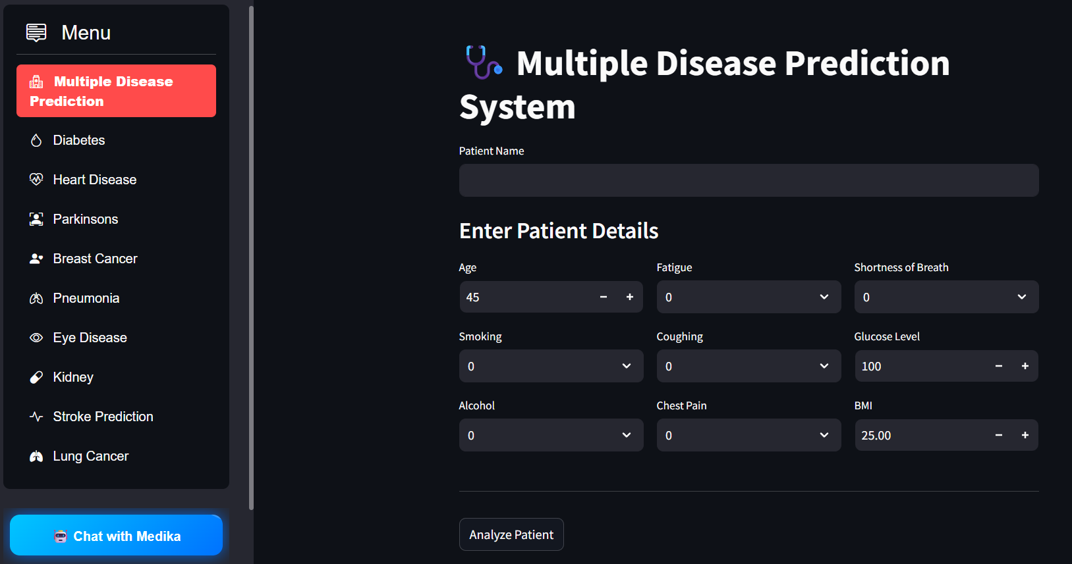
Results

Slide 12
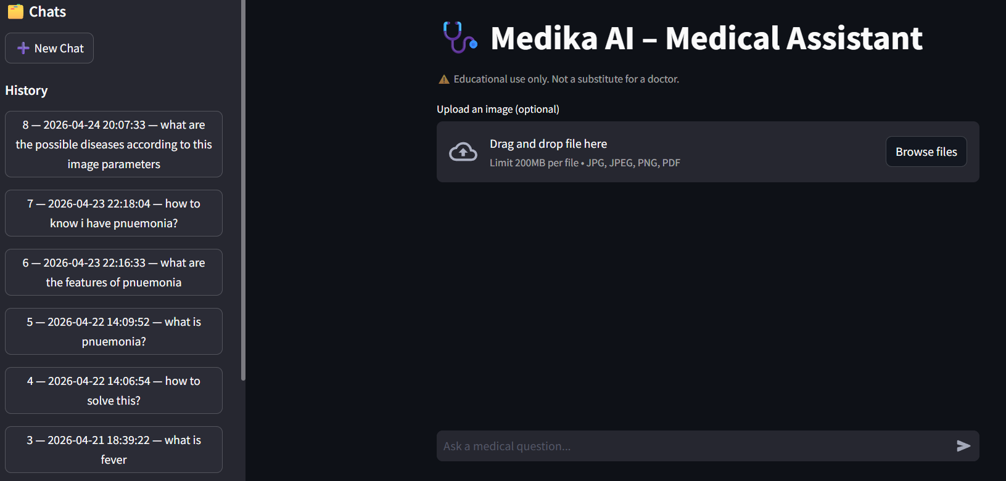

Slide 13
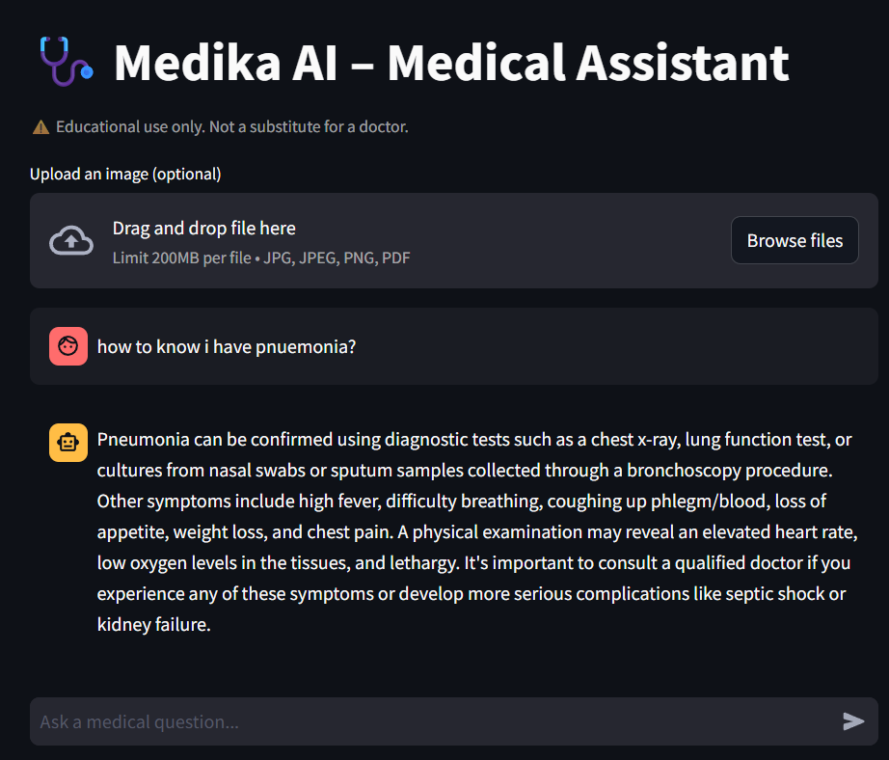
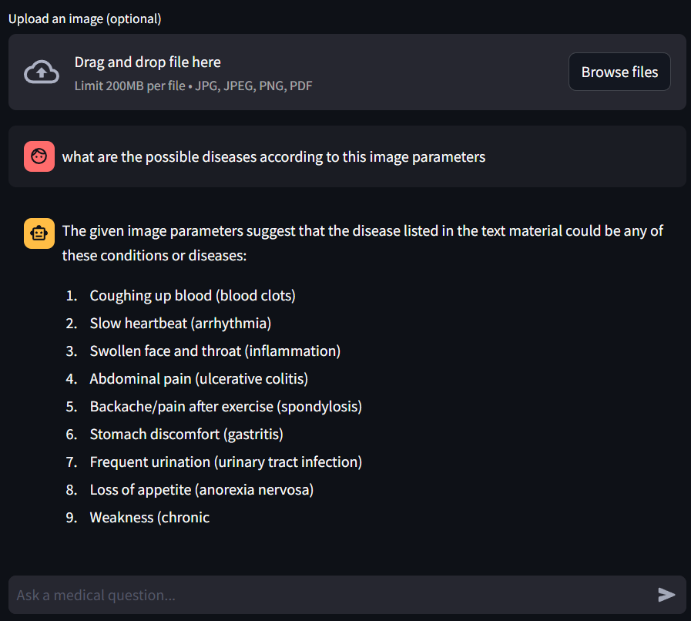

Slide 14
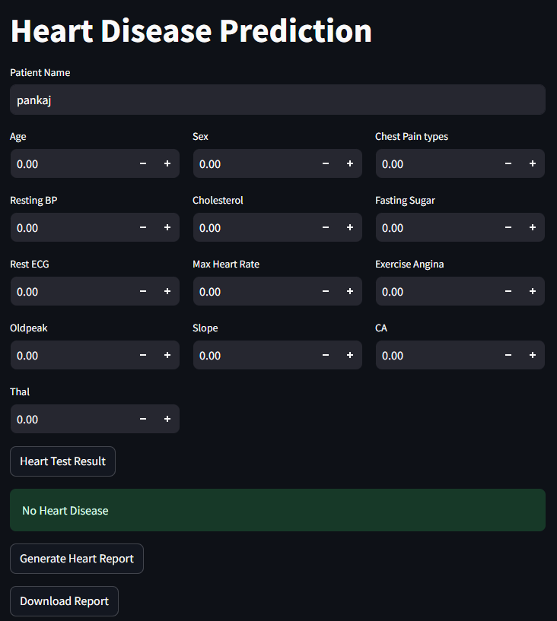
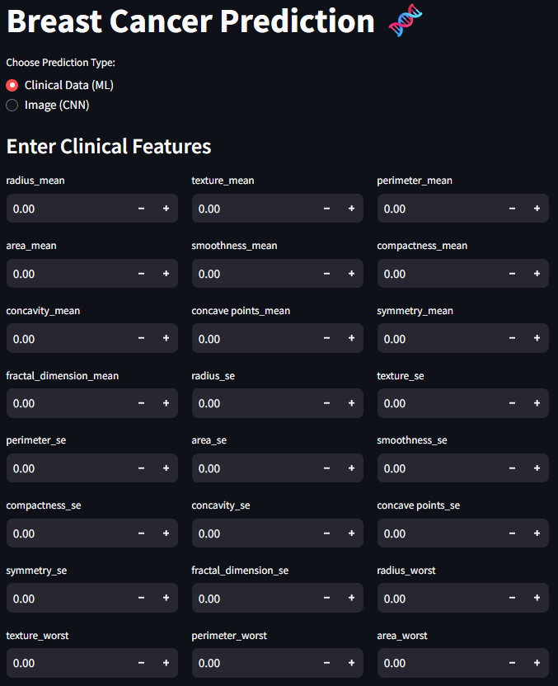
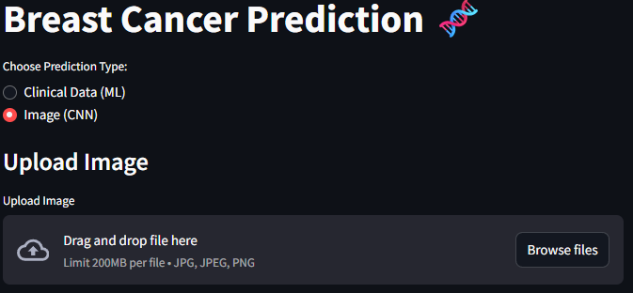

Slide 15
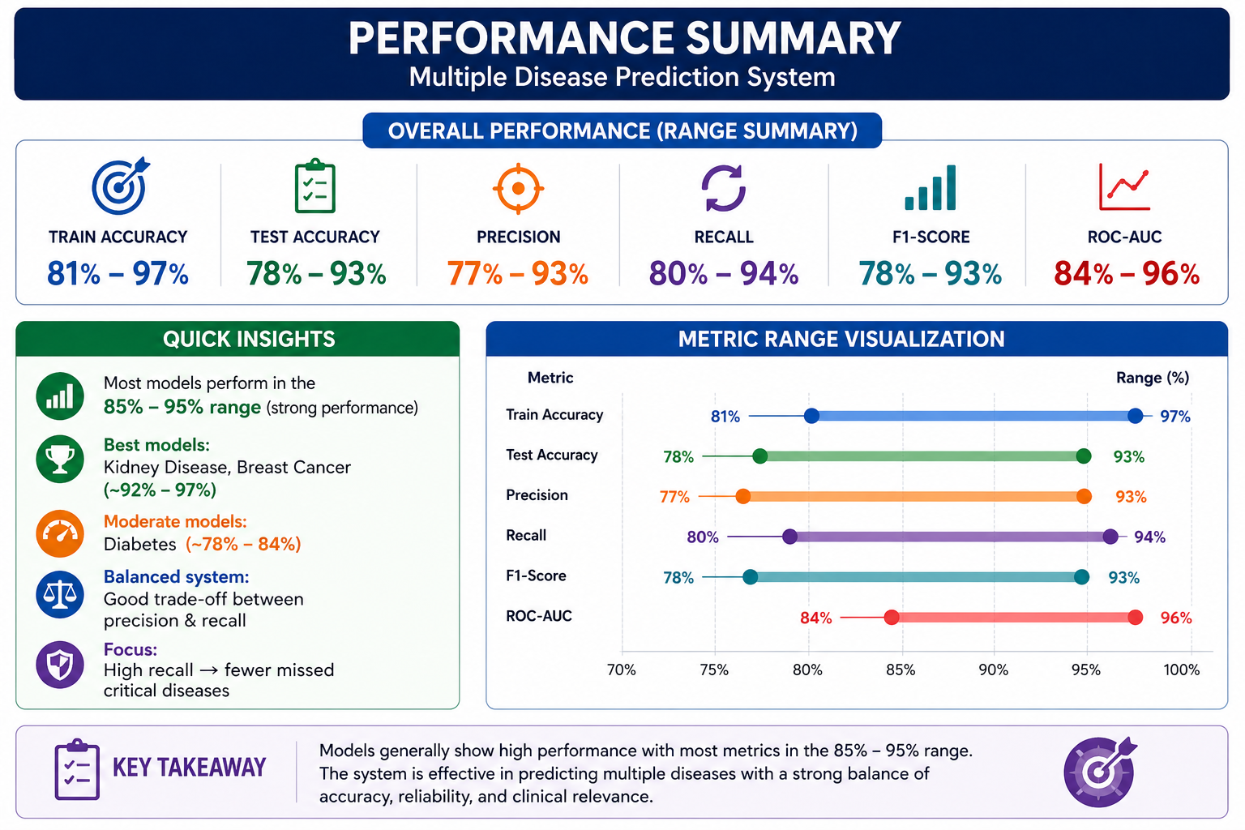

Slide 16
Conclusion & Future Work
Summary of work
Developed a multi-disease prediction system using Machine Learning and Deep Learning
Integrated prediction for 9 different diseases in a single platform
Supports both tabular data (ML models) and image data (CNN models)
Built a user-friendly web interface using Streamlit
Implemented a modular architecture with preprocessing and model selection
Displays prediction results along with confidence score
Designed a system that is scalable and easy to extend

Slide 17
Improvements
Use larger and real-world datasets for better performance
Deploy the system on cloud platforms (AWS, Render)
Convert system into API-based architecture for integration
Implement data security and user authentication
Add Explainable AI (SHAP, LIME) for better transparency

Slide 18
Future scope:
Mobile Application
Deploy as Android/iOS app for on-the-go patient self-assessment
EHR Integration
Connect with hospital systems for seamless patient data import
Multi-Language Support
Regional language interfaces for broader accessibility
Smart Hospital Management System(n8n)
Automated notifications for high-risk predictions to physicians

Slide 19
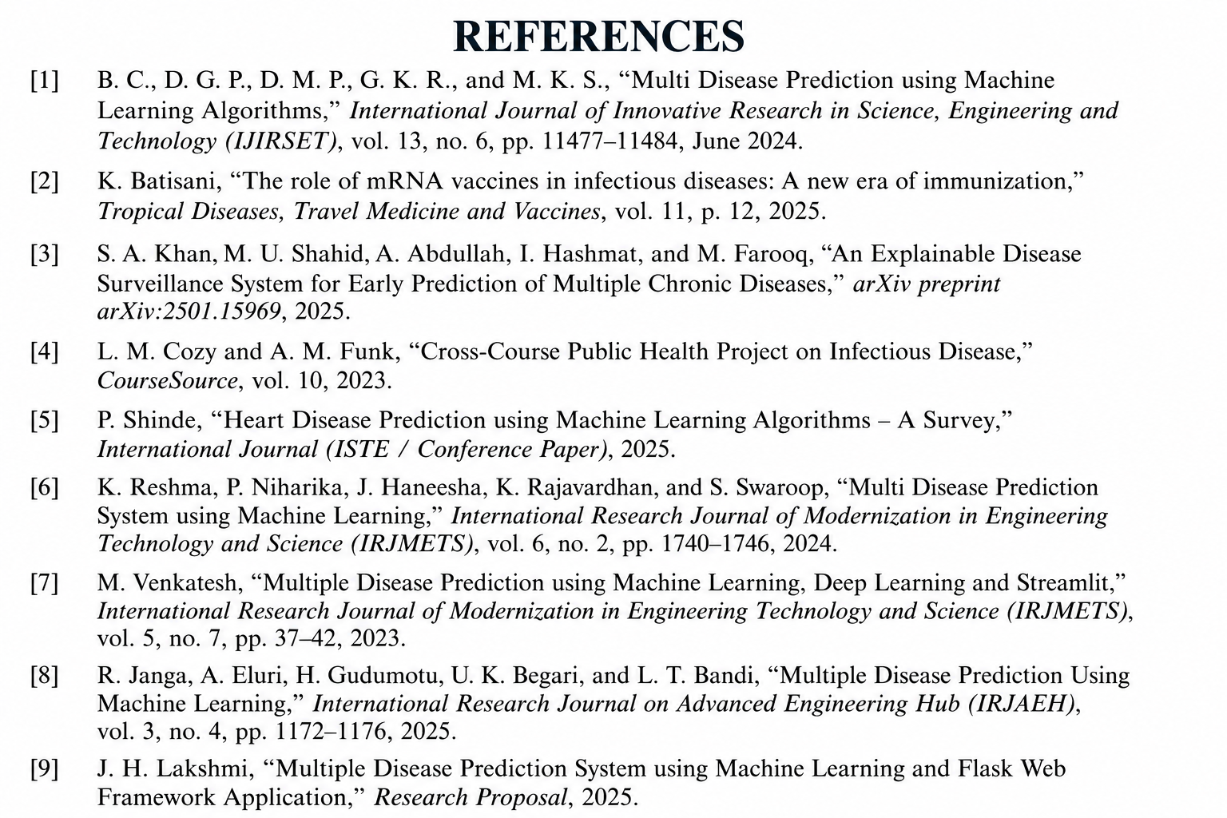

Slide 20
Thank You

