Slide 1
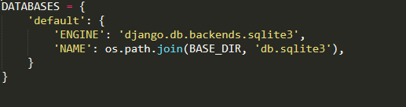
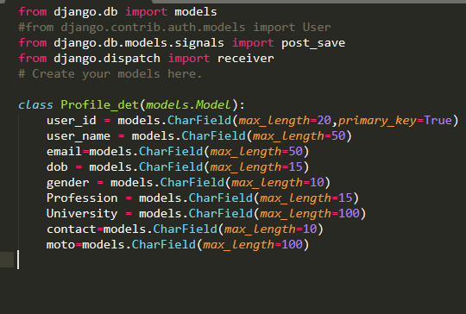
AIM: Database information of CodeHacker
1. settings.py DataBase Name = sqlite3
2. Profile.manage.py
➔ This is Profile table of Profile module which store all details of user .

Slide 2
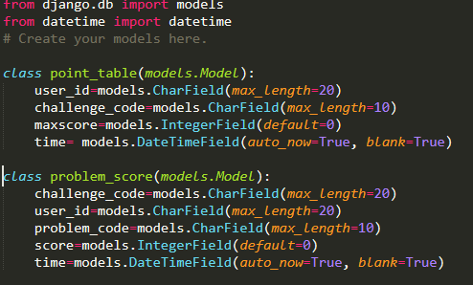
3. leaderboard.models.py
➔ point_table store total point of user of participate challenges where maxscore is sum of all problem score of any challenge solved by user
➔ problem_score store total point of particular problem where problem_score is total point gain by user of that problem and time is describe last submission time of user of that problem

Slide 3
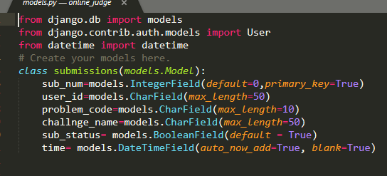
4.online_judge.models.py
➔ submission table store all details of submission
➔ sub_num id of submission, when submission happen sub_num increase by 1
➔ problem_code is, all problem have unique code
➔ same as problem_code ,all challenge have unique code that is store in challenge_code
➔ sub_status describe status of submission , means submission is accepted or not
➔ time store time of that submission ,and “auto_now_add =True” store system time automatically when details of that submission is saved.

Slide 4
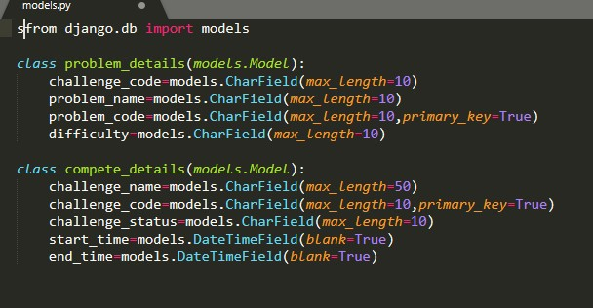
5. Login.models.py
➔ compete_details store details of challenge which is added by admin
➔ challenge_status describe challenge is present ,future or past…when challenge is added by admin that time is always future ,but after that make present and then past .
➔ start_time is time challenge stating time and ending time
➔ problem_details store details of problem which is added admin
➔ which give details of problem,e.g. problem difficulty ,problem is adden in which challenge etc..

Slide 6
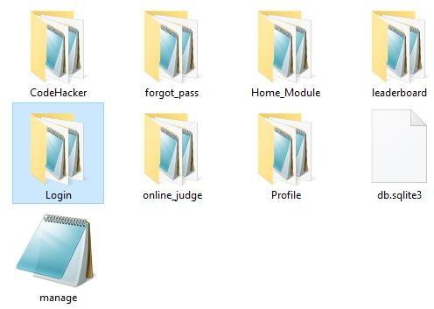
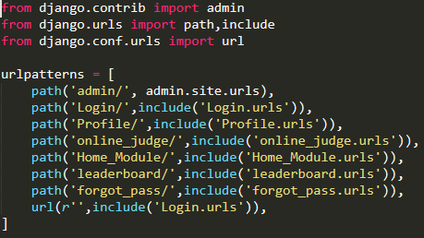
AIM: Description about CodeHacker Project.
➔ CodeHacker have 6 Application which are following:
CodeHacker:
➔ CodeHacker is our Project Name. It contains two files which are following.
1.urls.py:
➔ urls.py contains all application url of project.

Slide 7
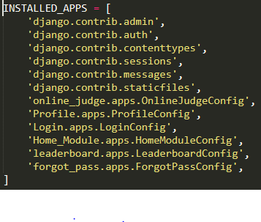
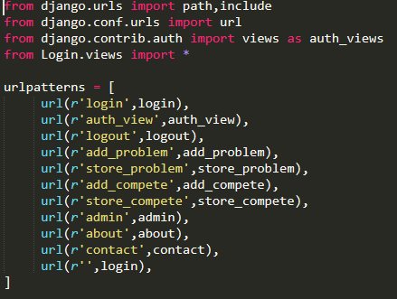
2.setting.py
➔ in setting.py we need to mention all application’s config name.
Applications:
1)Login:

Slide 8
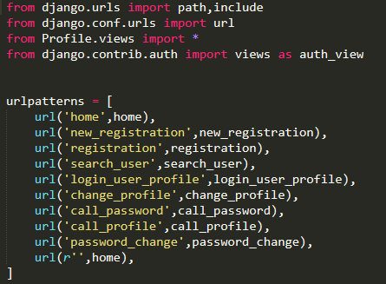
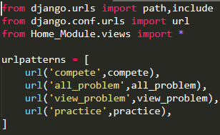
➔ Login application use for login and it gives a functionality for admin to add problems and challenges.
2)Profile:
➔ Profile application use for registration, show a user profile and gives a functionality for user to change profile details and password.
3)Home_Module:
➔ Home_Module application contains all main pages like header, compete, home, problem etc.

Slide 9
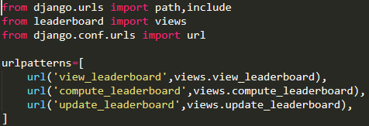
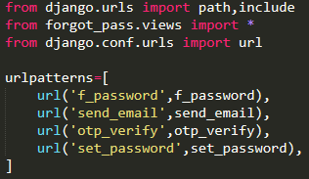
4)leaderboard:
➔ leaderboard application show the leaderboard of challenges.
5)forgot_pass:
➔ forgot_pass application useful for users who forgot their password.

Slide 10
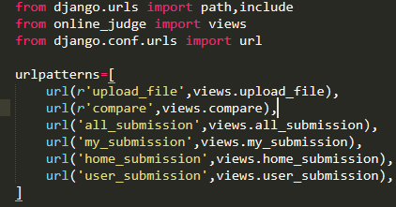
6)online_judge:
➔ online_judge application use for judging the problem and tell users that their answer is right or wrong and also show the submission of the all users.

Slide 11
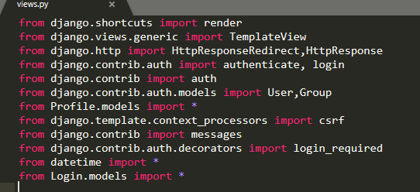
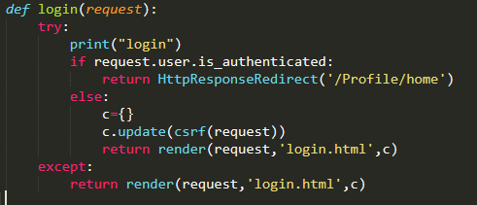
AIM : Details of views.py of all CodeHacker Module
1. Login module
➔ This picture give information of import library, packages and module
➔ login function check user already login or not, if user is login then redirect to home , else login.html for user login.

Slide 12
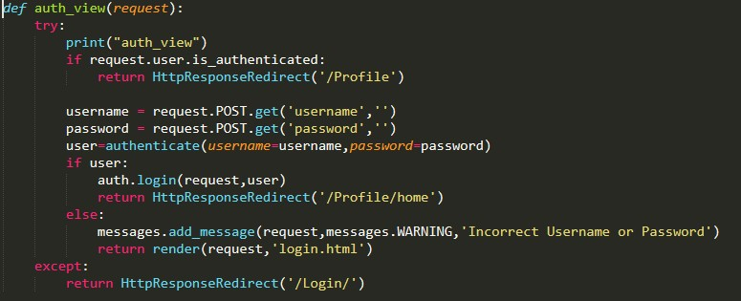
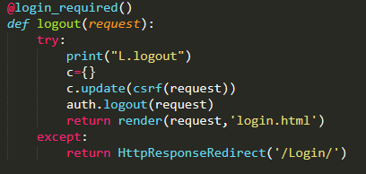
➔ auth_view take request data from login.html e.g. username and password
➔ then verify user name and password using authentication in user table
➔ if verification is success, then start session for that user and redirect to home , else return to login.html and give WARNING message
➔ logout end the login user session and redirect to login.html
➔ “@login_required()” give access of logout if and only if user is login

Slide 13
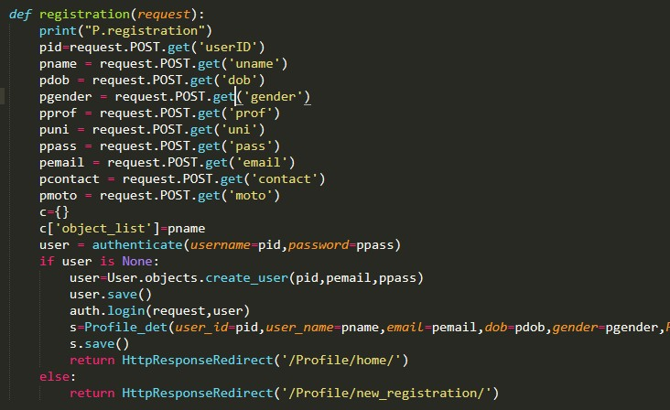
2. Profile Module
➔ Registration function foe new user registration, that take data from registration.html and store data in user table as well as Profile_det table
➔ After storing data successfully ,start session for that user

Slide 14
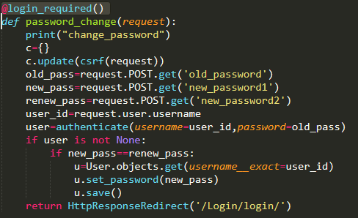
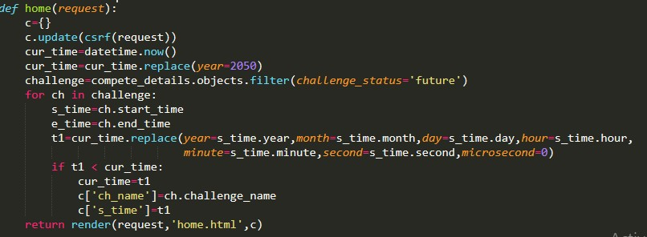
➔ password_change change password of login user, first that validate password then update password in user table
➔ home function manage home page, that send some details to home.html

Slide 15
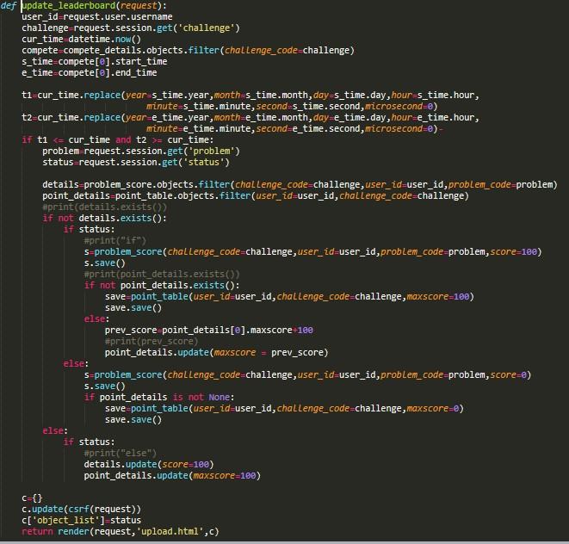
3. leaderboard
➔ update_leaderbord function called after problem submission
➔ this is update point_details table and problem_score table table , if prev= false and cur=true:
increase score in both table elif prev=false and cur =false:
nothing do
else
nothing do

Slide 16
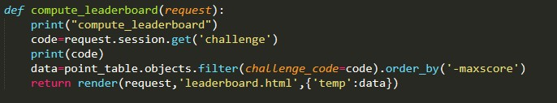
➔ “challenge=request.session.get('challenge')”- this take session attribute which is stored in session list
➔ “cur_time=datetime.now()” --- this store current system datetime in cut_time
➔ “t1=cur_time.replace(year=s_time.year,month=s_time.month,day=s_time. day,hour=s_time.hourminute=s_time.minute,second=s_time.second,micro second=0)” --- this replace datetime object (‘cur_time’) specified value
➔ “point_details.update(maxscore = prev_score)” --- this is update maxscore attribute in point_table to specified value(prev_score)
➔ this function store data of particular challenge of point_table to data for describe leaderboard
➔ “data=data.order_by('-maxscore')” - -- this is sort data to decreasing order and send data to leaderboard.html
l

Slide 17
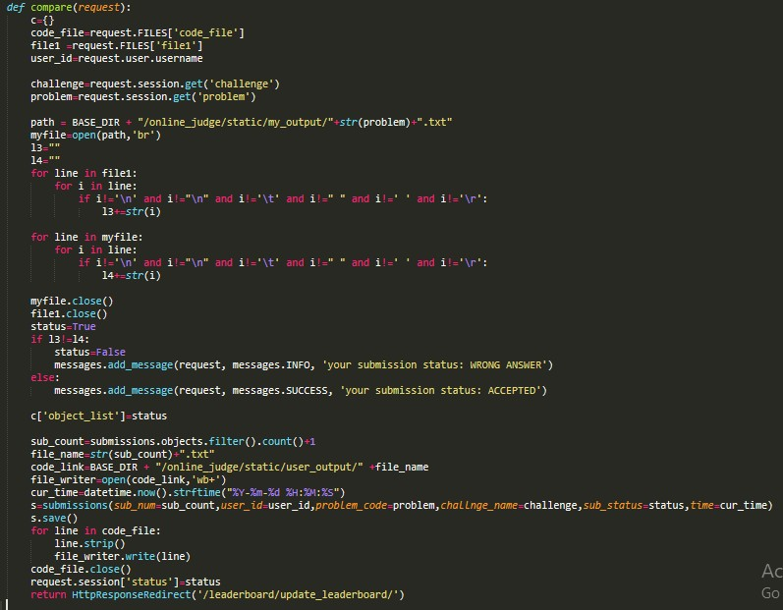
4. online_judge Module
➔ This function take output file and code file of user submission and compare user output file with my output file , if both are same then submission status is true, else false
➔ Then store submission in submission table with status ,and redirect to update_leaderboard
➔ “code_file=request.FILES['code_file']” --- store uploaded file to code_file

Slide 18
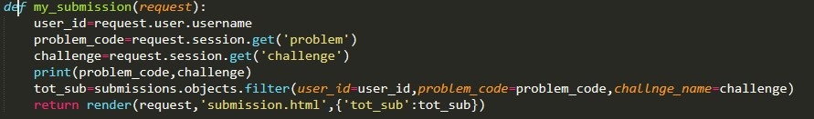
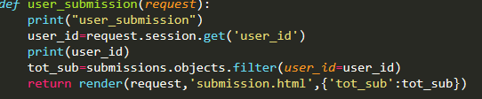
➔ “user_id=request.user.username” --- this give login user id
➔ “path = BASE_DIR + "/online_judge/static/my_output/"+str(problem)+".txt"”---set path where code file is stored for view_submission
➔ “myfile=open(path,'br')” --- open file of specified path for binary read
➔ “myfile.close()” --- close file
➔ “cur_time=datetime.now().strftime("%Y-%m-%d %H:%M:%S")” --- change current datetime to specified formate and return datetime object
➔ “request.session['status']=status” --- add kay value pair in session dictionary
➔ my_submission describe of all submission of login user and render to submission.html
➔ user_submission describe all submission user

Slide 19
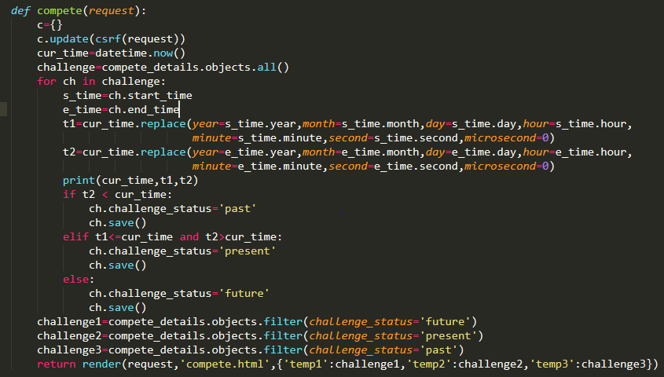
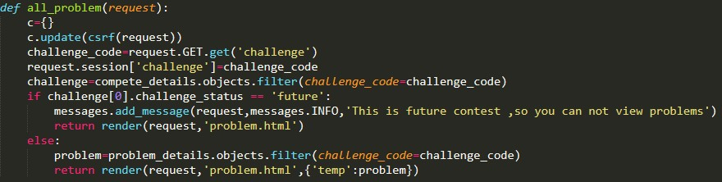
5. Home_Module
➔ Using this compete function, we can decide that problem is belong in which category past, present or future.
➔ For this decision, we compare challenge start time and end time with current time of system and comparing this we decide the category.
➔ Using this all_problem function we show all problem of challenges.
➔ In this we also check that we can’t show the problem of future challenge.

Slide 20
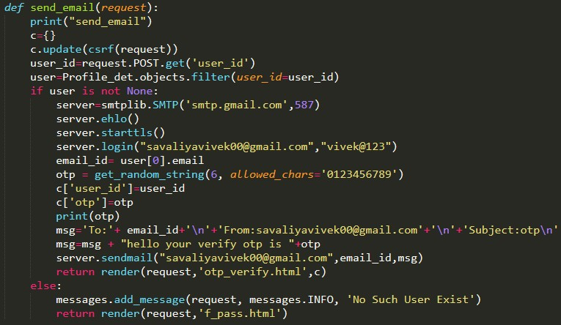
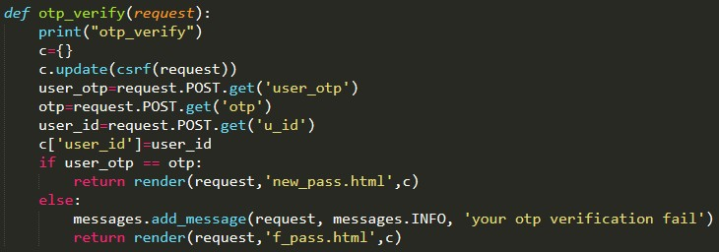
6. Forgot_pass
➔ Using this send_email function we send email to user for otp.
➔ In this email we send otp to user for forgot password and user need to this verify this otp for the new password.
➔ Using this otp_verify function we check that our generated otp and user’s enter otp is same or not.

