Slide 1
Observability & Chaos Engineering
By
Vivek Arora

Slide 2
Monitoring
Monitoring refers to the process of continuously observing, tracking, or checking something over time to ensure that it operates correctly, remains within desired parameters, or to detect changes or issues. The term can apply to various fields and contexts, each with its specific focus and methods.
Here are a few examples:
System Monitoring: In IT, this refers to the continuous observation of a computer system or network's performance, availability, and security. Tools monitor metrics like CPU usage, memory consumption, disk space, and network traffic to ensure systems run smoothly.
Health Monitoring: This involves tracking health indicators such as heart rate, blood pressure, glucose levels, or physical activity to manage a person's health. Wearable devices like fitness trackers or medical devices can be used for this purpose.
Environmental Monitoring: This involves tracking environmental factors such as air and water quality, temperature, humidity, and pollution levels. It's crucial for assessing environmental health, compliance with regulations, and responding to environmental threats.
Project Monitoring: In project management, monitoring involves tracking the progress of a project against its plan, including budget, timelines, and resource usage, to ensure it stays on track.
Surveillance Monitoring: This type of monitoring is used for security purposes, where cameras or other sensors observe a particular area to detect and prevent unauthorized activities or breaches.

Slide 3
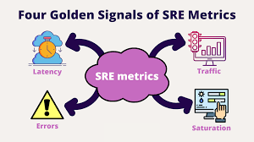

Slide 4
4 Golden Signal for monitoring
The "Four Golden Signals" are a concept from site reliability engineering (SRE) that are crucial for effective monitoring of a system's performance. These signals help in identifying issues and understanding the overall health of a system. The four golden signals are:
Latency:
Definition: Latency refers to the time it takes for a request to be processed by the system. It's essentially the delay between when a request is made and when the response is received.
Why it matters: High latency can indicate performance issues, leading to a poor user experience. Monitoring latency helps identify slowdowns in the system that could be caused by resource bottlenecks or inefficient processing.
Traffic:
Definition: Traffic measures the amount of demand being placed on your system, typically in terms of the number of requests received per second (RPS) or the amount of data being processed.
Why it matters: Monitoring traffic helps understand the load on the system and how it correlates with performance. A sudden spike in traffic could lead to increased latency or errors if the system is not scaled appropriately.

Slide 5
Errors:
Definition: Errors refer to the rate of failed requests or incorrect responses from the system. This could include HTTP 5xx status codes, timeouts, or any other indication that a request was not processed successfully.
Why it matters: Monitoring errors is critical to ensure the reliability of the system. A high error rate can indicate a serious problem that needs immediate attention, such as a misconfiguration, a bug, or an overloaded component.
Saturation:
Definition: Saturation refers to how "full" your system is, or how close it is to its maximum capacity. This could involve monitoring CPU, memory, disk I/O, or network bandwidth usage.
Why it matters: High saturation levels indicate that the system is reaching or exceeding its capacity limits, which can lead to degraded performance, increased latency, and a higher likelihood of errors. Monitoring saturation helps in capacity planning and scaling decisions.

Slide 6
Advantage of monitoring
1. Early Detection of Issues
Proactive Problem-Solving: Monitoring enables the early detection of potential issues before they escalate into significant problems. This allows for timely intervention, reducing downtime and preventing severe disruptions.
Minimizes Risk: By catching issues early, monitoring helps minimize the risk of system failures, data breaches, or other critical incidents.
2. Improved Performance
Optimization: Continuous monitoring allows for the identification of performance bottlenecks and inefficiencies. With this information, systems can be optimized for better performance, ensuring faster response times and higher user satisfaction.
Resource Management: Monitoring resource usage (e.g., CPU, memory, bandwidth) helps in better managing and allocating resources, preventing overutilization or underutilization.
3. Informed Decision-Making
Data-Driven Insights: Monitoring provides valuable data and metrics that can inform decisions regarding system upgrades, scaling, and other strategic initiatives.
Trend Analysis: Historical monitoring data can be analyzed to identify trends, helping organizations predict future needs and plan accordingly.

Slide 7
4. Enhanced Security
Threat Detection: Monitoring can detect unusual activities, such as unauthorized access attempts, DDoS attacks, or other security threats, allowing for immediate action to mitigate potential breaches.
Compliance: Continuous monitoring helps in ensuring that systems comply with security policies and regulatory requirements, which is crucial for avoiding legal issues and penalties.
5. Increased Reliability and Availability
Uptime Assurance: By tracking system performance and health in real-time, monitoring helps maintain high availability, ensuring that services remain accessible to users.
Reduces Downtime: Rapid identification and resolution of issues through monitoring lead to reduced downtime, which is critical for maintaining business continuity.
6. Better User Experience
Service Quality: Monitoring helps maintain a high level of service quality by ensuring systems operate smoothly and efficiently. This leads to a better user experience, higher customer satisfaction, and increased loyalty.
Quick Response to Issues: When issues do arise, monitoring enables quicker detection and response, minimizing the impact on users.

Slide 8
7. Cost Efficiency
Prevents Costly Failures: By preventing or mitigating system failures, monitoring can save significant costs associated with downtime, lost productivity, and recovery efforts.
Efficient Resource Use: Monitoring allows for more efficient use of resources, reducing unnecessary expenditures on over-provisioning or emergency fixes.
8. Facilitates Continuous Improvement
Feedback Loop: Monitoring provides a continuous feedback loop that helps in refining and improving systems and processes over time. This leads to ongoing enhancements in performance, reliability, and user satisfaction.

Slide 9
Monitoring Plan
A Monitoring Plan is a structured approach to systematically observe, track, and evaluate the performance, health, and security of systems or processes. It ensures that any potential issues are identified early and resolved promptly. Here's a guide on how to create an effective monitoring plan:
1. Define Objectives
Purpose: Clearly define the purpose of the monitoring plan. What do you want to achieve? Is it to ensure system uptime, improve performance, maintain security, or comply with regulations?
Key Metrics: Identify the key performance indicators (KPIs) or metrics that align with your objectives. These could include system uptime, response times, error rates, resource utilization, etc.
2. Identify What to Monitor
System Components: Determine the specific components or processes that need monitoring, such as servers, applications, databases, networks, security logs, etc.
Golden Signals: Consider the Four Golden Signals (Latency, Traffic, Errors, Saturation) if you're monitoring a service or application.

Slide 10
3. Set Monitoring Frequency
Real-Time vs. Periodic: Decide on the frequency of monitoring. Some systems may require real-time monitoring, while others might only need periodic checks (e.g., daily, weekly).
Critical vs. Non-Critical: Prioritize critical systems for more frequent monitoring and less critical ones for less frequent monitoring.
4. Choose Monitoring Tools
Tool Selection: Select appropriate monitoring tools that can track the metrics you've identified. Popular tools include Nagios, Prometheus, Grafana, Datadog, and others depending on your specific needs.
Integration: Ensure that the tools can integrate with your existing infrastructure and processes.
5. Establish Baselines and Thresholds
Baseline Metrics: Establish baseline performance metrics to understand what normal operation looks like.
Alert Thresholds: Define thresholds for each metric that, when exceeded, will trigger alerts. For example, setting a CPU utilization threshold at 80% might trigger an alert if crossed.

Slide 11
6. Define Alerting and Escalation Procedures
Alert Mechanisms: Determine how alerts will be communicated (e.g., email, SMS, dashboards) and to whom.
Escalation Path: Establish an escalation procedure for critical alerts, detailing who should be notified and what steps should be taken.
7. Documentation and Reporting
Log Management: Decide how logs and monitoring data will be stored, managed, and accessed. Consider using centralized log management solutions.
Reporting: Create regular reports to analyze trends, review incidents, and assess overall system health. Reports should be generated for stakeholders at appropriate intervals (e.g., weekly, monthly).
8. Review and Update the Plan
Continuous Improvement: Periodically review the monitoring plan to ensure it remains relevant. Update the plan based on new requirements, system changes, or lessons learned from incidents.
Feedback Loop: Incorporate feedback from the monitoring process to refine and improve the plan continuously.

Slide 12
9. Compliance and Auditing
Compliance Monitoring: Ensure the plan includes monitoring for compliance with industry standards, legal requirements, and internal policies.
Audit Trails: Maintain detailed logs of monitoring activities to support audits and ensure accountability.
10. Training and Awareness
Staff Training: Ensure that all relevant personnel are trained on the monitoring tools, procedures, and their roles in the monitoring plan.
Awareness Programs: Promote awareness of the importance of monitoring and the role it plays in maintaining system health and security.

Slide 13
What to Monitor?
1. IT Systems and Infrastructure
Servers
CPU Usage: Monitor CPU load to ensure that servers are not overburdened.
Memory Usage: Track RAM utilization to avoid memory-related issues.
Disk Usage: Monitor disk space to prevent running out of storage.
Uptime/Downtime: Ensure servers are running and available.
Network
Bandwidth Usage: Track network traffic to detect bottlenecks.
Latency: Monitor network response times.
Packet Loss: Check for lost data packets, which can indicate network issues.
Connection Errors: Identify and track failed network connections.
Applications
Response Time: Measure how long it takes for an application to respond to user requests.
Error Rates: Monitor the frequency of application errors (e.g., HTTP 5xx errors).
Throughput: Track the number of transactions or requests processed over a given time.
Logs: Monitor application logs for error messages, warnings, or unusual activities.
Databases
Query Performance: Monitor the execution time of database queries.
Connection Pooling: Track the use of database connections to prevent saturation.
Disk I/O: Monitor read/write operations to detect potential bottlenecks.
Replication Status: Ensure data replication processes are functioning correctly.
Security
Firewall Logs: Monitor incoming and outgoing traffic for suspicious activities.
Intrusion Detection: Track potential security threats or breaches.
User Access Logs: Monitor who is accessing the system and when.
Patch Compliance: Ensure that all systems are up-to-date with the latest security patches.

Slide 14
2. Cloud Services
Resource Utilization: Monitor CPU, memory, and storage usage in the cloud.
Cost Management: Track spending on cloud resources to prevent budget overruns.
Service Availability: Monitor the uptime of cloud services.
Scaling Events: Track autoscaling events to understand resource demand.
API Latency: Monitor the response times of cloud-based APIs.
3. Website Monitoring
Page Load Time: Track how quickly web pages load for users.
Downtime: Monitor the availability of your website.
Broken Links: Check for any broken links that could negatively impact the user experience.
Traffic Analytics: Analyze user traffic, including visitor count, bounce rate, and session duration.
SEO Performance: Monitor search engine rankings and keyword performance.
Security: Monitor for potential vulnerabilities, such as outdated plugins or SSL certificate issues.

Slide 15
4. DevOps and CI/CD Pipelines
Build Status: Monitor the success or failure of build processes.
Deployment Times: Track the time it takes to deploy code to production.
Code Quality: Monitor static code analysis results to detect issues.
Test Coverage: Ensure that automated tests cover a sufficient portion of the codebase.
Artifact Versioning: Track the versions of artifacts deployed across environments.
5. Security and Compliance
Access Logs: Monitor who is accessing systems and data.
Vulnerability Scans: Regularly scan for known security vulnerabilities.
Compliance Audits: Track compliance with industry regulations like GDPR, HIPAA, etc.
Incident Response: Monitor for any security incidents and the effectiveness of response measures.

Slide 16
Flow of Monitoring
The flow of monitoring is a systematic process that involves several stages, from defining what needs to be monitored to taking corrective actions based on the insights gained. Below is a step-by-step flow of the monitoring process:
1. Define Objectives and Requirements
Identify Goals: Clearly define what you want to achieve with monitoring, such as ensuring system uptime, optimizing performance, or enhancing security.
Determine Metrics: Choose the key performance indicators (KPIs) or metrics that align with your objectives (e.g., CPU usage, response times, error rates).
2. Select Tools and Set Up Monitoring
Tool Selection: Choose appropriate monitoring tools or platforms that can effectively track the selected metrics (e.g., Prometheus, Grafana, Datadog).
Configuration: Configure the monitoring tools to collect data from the relevant sources (e.g., servers, applications, network devices).
Baseline Establishment: Set baseline metrics to understand what "normal" performance looks like.

Slide 17
3. Data Collection
Continuous Monitoring: Set up continuous data collection for real-time monitoring or periodic checks based on the system’s needs.
Data Sources: Collect data from various sources, such as logs, metrics, and events, across your infrastructure or application.
Aggregation: Aggregate the collected data to provide a comprehensive view of the system’s performance.
4. Data Analysis
Thresholds and Alerts: Define thresholds for key metrics. If a metric crosses its threshold, it triggers an alert.
Trend Analysis: Analyze trends over time to identify patterns, potential issues, or areas for optimization.
Anomaly Detection: Use analytics or machine learning to detect unusual patterns that may indicate a problem.

Slide 18
5. Alerting and Notification
Real-Time Alerts: Set up real-time alerts that notify the appropriate personnel or systems when thresholds are breached.
Notification Channels: Use various notification channels (e.g., email, SMS, dashboards) to ensure timely communication.
Escalation Procedures: Define and implement escalation paths for critical issues to ensure rapid response.
6. Incident Response and Troubleshooting
Issue Identification: When an alert is triggered, quickly identify the root cause of the issue using the monitoring data.
Troubleshooting: Engage in troubleshooting to resolve the issue, whether it's a performance bottleneck, a security breach, or a system failure.
Documentation: Document the incident, including the steps taken to resolve it, for future reference and continuous improvement.

Slide 19
7. Reporting and Visualization
Dashboards: Create dashboards that visualize the key metrics and trends for easy monitoring and analysis.
Reports: Generate periodic reports (e.g., daily, weekly, monthly) summarizing system performance, incidents, and resolutions.
Stakeholder Communication: Share reports and dashboards with relevant stakeholders to keep them informed of system health and performance.
8. Review and Optimization
Performance Review: Regularly review the performance data to identify areas for improvement or optimization.
Feedback Loop: Incorporate feedback from the monitoring process to refine the metrics, thresholds, and alerts.
Plan Updates: Update the monitoring plan as the system evolves, new metrics become relevant, or monitoring tools are upgraded.

Slide 20
9. Compliance and Auditing
Compliance Monitoring: Ensure that monitoring covers compliance-related metrics and adheres to regulatory requirements.
Audit Logs: Maintain detailed logs of monitoring activities for auditing purposes.
10. Continuous Improvement
Lessons Learned: Analyze past incidents and monitoring data to identify lessons learned and areas for improvement.
Process Refinement: Continuously refine the monitoring process to improve its effectiveness and efficiency.
Example Flow Diagram
Define Objectives & Metrics → 2. Select Tools & Set Up Monitoring → 3. Data Collection → 4. Data Analysis → 5. Alerting & Notification → 6. Incident Response & Troubleshooting → 7. Reporting & Visualization → 8. Review & Optimization → 9. Compliance & Auditing → 10. Continuous Improvement

Slide 21
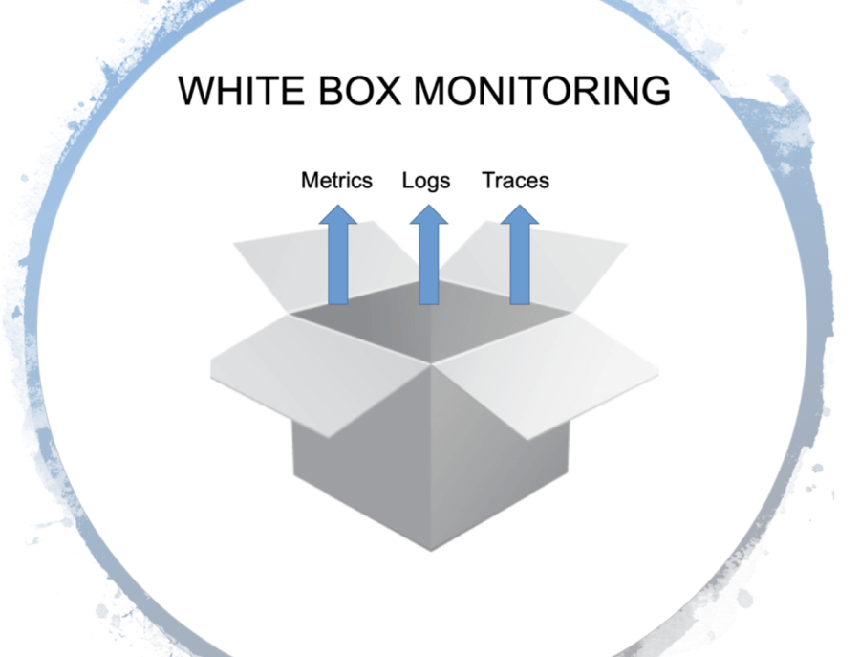

Slide 22
White Box Monitoring
White box monitoring (also known as "internal monitoring") involves observing and analyzing the internal workings of a system. It provides insights into the system's internal processes, data, and states.
Characteristics:
Internal Visibility: Access to detailed information about the system's internals, including source code, configuration files, and performance metrics.
Granularity: Provides granular data about the system's internal components, such as CPU usage, memory allocation, application-specific metrics, and code execution paths.
Instrumentation: Requires instrumenting the code or system components to collect detailed performance and diagnostic data.
Debugging: Useful for debugging and diagnosing issues because it offers a deep view into system operations.
Examples: Application performance monitoring (APM) tools like New Relic or Dynatrace, detailed logging systems, and custom metrics collected via code instrumentation.

Slide 23
Adv. & Dis.
Advantages:
Detailed Insights: Offers in-depth information about system behavior and performance.
Debugging: Facilitates troubleshooting and debugging by providing access to internal states and execution details.
Optimization: Helps in optimizing code and system performance by identifying specific bottlenecks or inefficiencies.
Disadvantages:
Complexity: Can be complex to set up and manage, requiring deep knowledge of the system's internals.
Overhead: Instrumentation and data collection might introduce additional overhead and affect system performance.

Slide 24
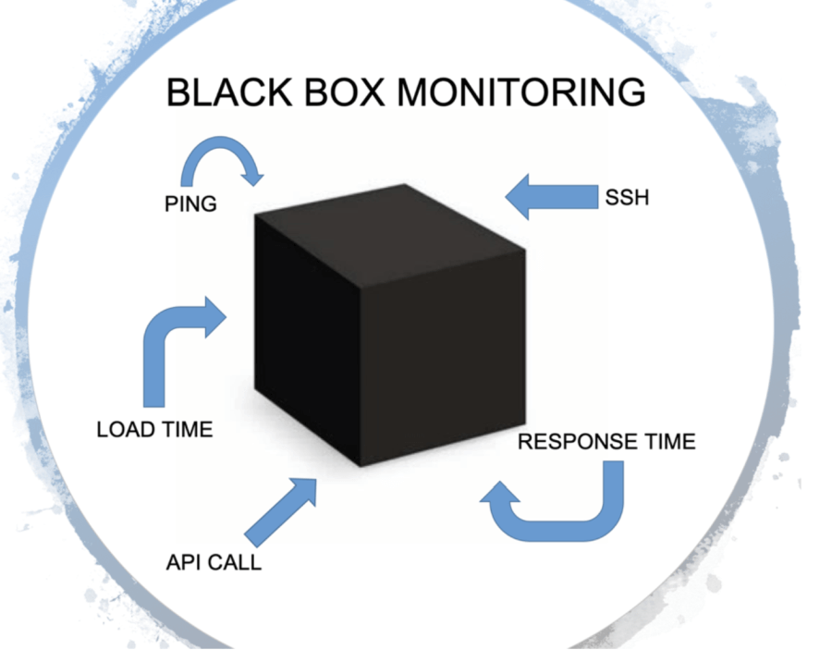

Slide 25
Black Box Monitoring
Black box monitoring (also known as "external monitoring") involves observing and analyzing the system's behavior from an external perspective without accessing its internal workings. It focuses on the system's outputs and responses to inputs.
Characteristics:
External Visibility: Monitors the system from the outside, observing how it responds to various inputs or conditions without knowledge of its internal processes.
User Experience: Emphasizes the end-user experience and system behavior from a user perspective, such as response times, availability, and error rates.
No Internal Access: Does not require access to the system's source code or internal configuration; relies on observing the system's outputs and interactions.
Examples: Website uptime monitoring, end-to-end transaction monitoring, and user experience monitoring.

Slide 26
Adv. & Dis.
Advantages:
Simplicity: Easier to implement and manage since it does not require access to the system's internals.
End-User Focus: Provides insights into the user experience and system performance as perceived by the end-users.
Less Intrusive: Typically has minimal impact on system performance as it does not require internal instrumentation.
Disadvantages:
Limited Insight: Offers less detailed information about internal processes and can be less effective for debugging and optimization.
Blind Spots: May not detect issues that do not directly impact the system’s outputs or responses.

Slide 27
Aspect |  | White Box Monitoring | Black Box Monitoring
Visibility |  | Internal details and metrics | External behavior and responses
Granularity |  | Detailed, fine-grained data | High-level, aggregate data
Setup Complexity |  | More complex, requires instrumentation | Simpler, does not require internal access
Use Cases |  | Debugging, performance optimization | User experience, availability monitoring
Impact on System |  | Potential performance impact due to instrumentation | Minimal impact, external observation

Slide 28
Choosing Between White Box and Black Box Monitoring
In practice, a combination of both approaches is often used to achieve comprehensive monitoring. White box monitoring is valuable for deep diagnostics and performance tuning, while black box monitoring provides an external view of system health and user experience. Together, they help ensure robust and effective monitoring of systems.

Slide 29
Observability
Observability is a concept in system monitoring and management that focuses on the ability to understand and diagnose the internal state and behavior of a system based on its external outputs. It involves gathering and analyzing data to gain insights into how a system operates, often in real-time, to ensure its health, performance, and reliability.

Slide 30
Key Aspects of Observability
Comprehensive Visibility
Metrics: Quantitative data about the system’s performance, such as CPU usage, memory consumption, and request rates.
Logs: Detailed, timestamped records of events, transactions, and errors within the system.
Traces: Data that tracks the flow of requests and operations through various components of the system, providing insights into request paths and latency.
Real-Time InsightsObservability allows for real-time or near-real-time monitoring and analysis of system behavior, helping to quickly identify and address issues.
Root Cause AnalysisBy correlating metrics, logs, and traces, observability enables deeper understanding and diagnosis of problems, helping to pinpoint the root cause of issues.
Dynamic ExplorationObservability supports dynamic querying and exploration of data to investigate issues, rather than relying solely on pre-configured alerts and thresholds.
Proactive ManagementIt helps in proactive system management by providing insights into system health and performance trends, enabling preemptive actions to prevent issues.

Slide 31
Components of Observability
Instrumentation
Code Instrumentation: Adding code to applications or systems to collect metrics, logs, and traces.
Agent-Based Monitoring: Using agents that run alongside applications to gather observability data.
Data Collection
Metrics Collection: Gathering quantitative performance data.
Log Collection: Aggregating and indexing logs from various sources.
Distributed Tracing: Capturing the end-to-end journey of requests across different system components.

Slide 32
Data Analysis and Visualization
Dashboards: Visual representations of metrics, logs, and traces to provide an overview of system health.
Alerts: Notifications based on predefined thresholds or anomalies.
Correlation and Context: Analyzing data in context to identify patterns and correlations that indicate issues.
Incident Management
Alerting: Setting up alerts based on metrics, logs, or traces to notify teams of potential issues.
Investigation: Using observability data to investigate and diagnose incidents.
Resolution: Addressing and resolving issues based on insights gained from the observability data.

Slide 33
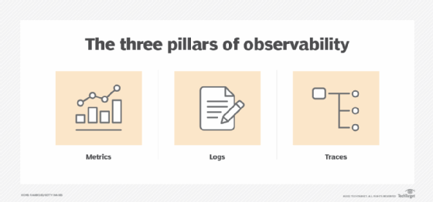

Slide 34
Pillars of Observability
1. Metrics
Definition: Metrics are quantitative measurements that provide insights into the performance and health of a system. They capture specific data points at regular intervals.
Characteristics:
Quantitative Data: Metrics are numerical and often represent values such as CPU usage, memory consumption, request rates, error rates, and latency.
Time-Series Data: Metrics are typically collected over time, allowing for trend analysis and historical comparison.
Aggregated: Metrics can be aggregated across different dimensions (e.g., average, maximum, minimum) to provide a summary view.
Use Cases:
Performance Monitoring: Track system performance and resource usage.
Capacity Planning: Analyze trends to forecast future resource needs.
Alerting: Set thresholds for metrics to trigger alerts for potential issues.

Slide 35
2. Logs
Definition: Logs are detailed, timestamped records of events, transactions, and activities within a system. They provide context and granularity that metrics alone cannot offer.
Characteristics:
Event-Based: Logs capture discrete events and actions, such as errors, warnings, and informational messages.
Detailed: Logs often contain rich context, including error messages, stack traces, and execution details.
Textual Data: Logs are typically textual and may follow specific formats or structures.
Use Cases:
Debugging: Investigate and troubleshoot specific issues by analyzing detailed log entries.
Audit Trails: Track and review system activities for security and compliance.
Correlation: Correlate logs with metrics and traces to understand the context of events.

Slide 36
3. Traces
Definition: Traces capture the end-to-end journey of requests as they flow through various components of a system. They provide a detailed view of how requests are processed and help identify performance bottlenecks and dependencies.
Characteristics:
Distributed Tracing: Traces track requests across multiple services or components, providing visibility into interactions and latencies.
Span-Based: Traces are composed of spans, which represent individual operations or steps within a request's lifecycle.
Contextual: Traces provide context on how different parts of the system interact and how long each operation takes.
Use Cases:
Performance Analysis: Identify latency issues and performance bottlenecks by examining the flow of requests.
Dependency Mapping: Visualize dependencies between different services and components.
Root Cause Analysis: Diagnose complex issues by following the path of requests through the system.

Slide 37
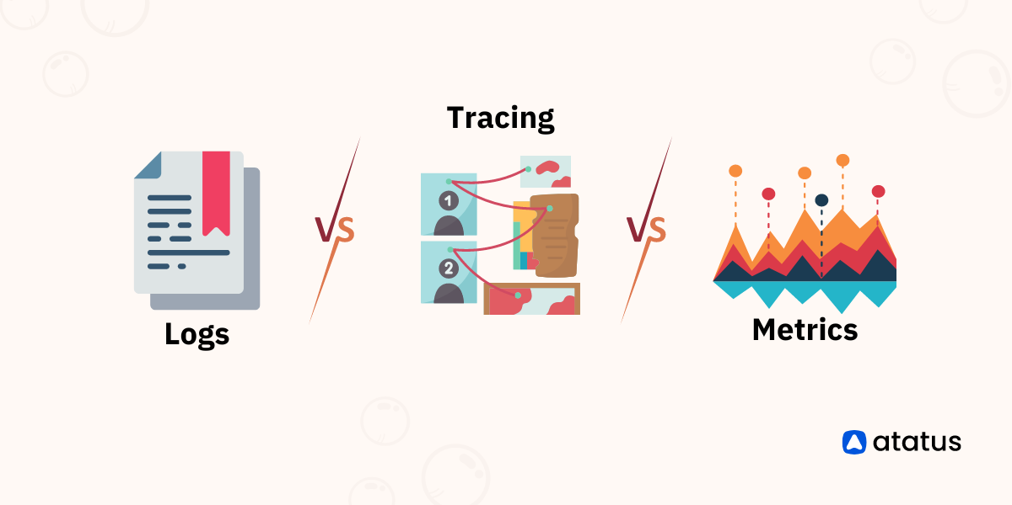

Slide 38
Summary of Pillars
Pillar | Description | Characteristics | Use Cases
Metrics | Quantitative measurements of system performance and health | Time-series data, aggregated, numerical | Performance monitoring, capacity planning, alerting
Logs | Detailed, timestamped records of system events and activities | Event-based, textual, rich context | Debugging, audit trails, correlation
Traces | End-to-end journey of requests through the system | Distributed tracing, span-based, contextual | Performance analysis, dependency mapping, root cause analysis

Slide 39
Integrating the Pillars
To achieve effective observability, it's essential to integrate these pillars, allowing for comprehensive monitoring and understanding:
Correlation: Correlate metrics, logs, and traces to gain a holistic view of system behavior.
Contextual Analysis: Use logs and traces to provide context for metrics, helping to interpret and analyze data more effectively.
Unified Dashboard: Create dashboards that visualize metrics, logs, and traces together, providing a cohesive view of system health and performance.

Slide 40
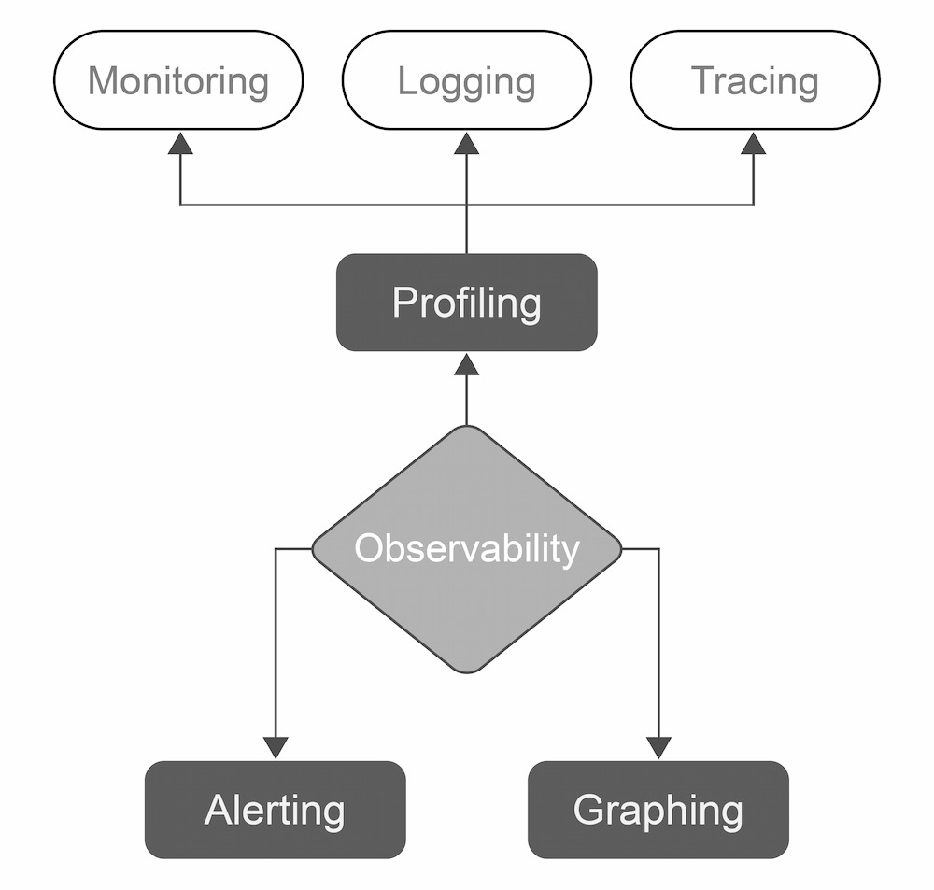

Slide 41
MELT
MELT is an acronym used in the context of observability to describe the four key types of data that contribute to a comprehensive observability strategy. MELT stands for Metrics, Events, Logs, and Traces. Each component of MELT provides different insights into system behavior and performance, and together they form a robust framework for understanding and managing complex systems.

Slide 42
Metrics
Definition: Quantitative measurements that track the performance and health of a system.
Characteristics: Time-series data, numerical values, aggregated information (e.g., averages, maximums).
Examples: CPU utilization, memory usage, request rates, error rates.
Use Cases: Monitoring system performance, capacity planning, setting up alerts based on thresholds.

Slide 43
Events
Definition: Discrete occurrences or changes in the system, often tied to specific actions or state changes.
Characteristics: Typically recorded with a timestamp, might include contextual information about the event.
Examples: Deployment events, system start/stop events, configuration changes, user actions.
Use Cases: Tracking significant changes or actions within the system, correlating with other data types to understand their impact.

Slide 44
Logs
Definition: Detailed, timestamped records of system activities and events, providing a narrative of what happened at specific times.
Characteristics: Textual data, rich in context, often includes error messages, stack traces, and operational details.
Examples: Application logs, error logs, access logs.
Use Cases: Debugging, auditing, detailed troubleshooting, correlating with metrics and traces for deeper insights.

Slide 45
Traces
Definition: End-to-end tracking of requests as they flow through different components or services within a system.
Characteristics: Provides visibility into request paths, latency, and interactions between services; often visualized as spans and traces.
Examples: Distributed traces showing the path of a request through multiple microservices, including timing and dependencies.
Use Cases: Identifying performance bottlenecks, understanding service dependencies, root cause analysis of complex issues.

Slide 46
Benefits of MELT in Observability
Holistic View: Provides a comprehensive view of system behavior by combining different types of data.
Improved Diagnostics: Enhances the ability to diagnose and troubleshoot issues by correlating diverse data sources.
Enhanced Performance Management: Facilitates better performance management and optimization through integrated insights.
Proactive Monitoring: Helps in proactive monitoring and prevention of issues by offering a broad range of data types and perspectives.

Slide 47


Slide 48
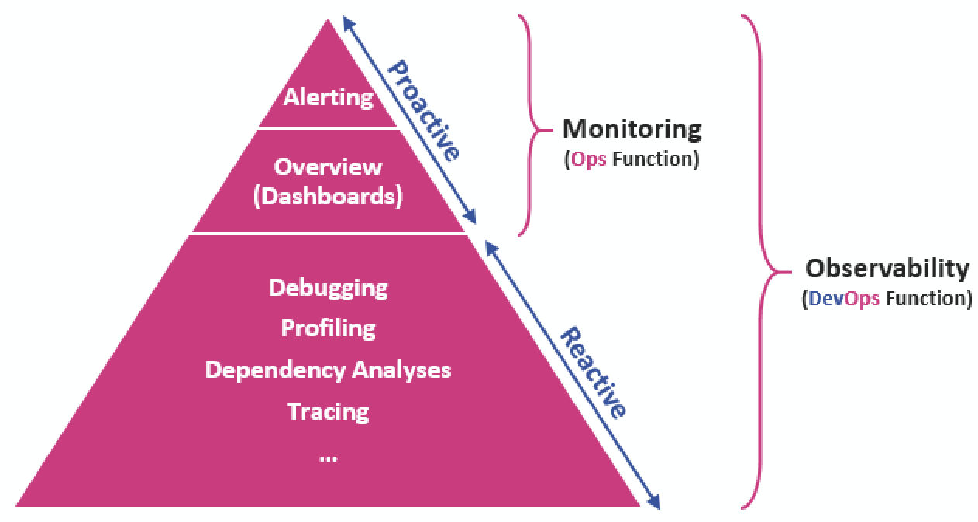

Slide 49
Key Differences
Aspect | Monitoring | Observability
Focus | Ensuring systems are running as expected | Understanding and diagnosing system behavior
Data Types | Primarily metrics; may include basic logs | Metrics, logs, traces, and events
Approach | Reactive; based on predefined thresholds | Proactive; explores and analyzes data dynamically
Depth of Insight | Surface-level; focuses on known metrics and thresholds | Deep, contextual; allows for root cause analysis
Tooling | Alerts, dashboards based on metrics | Tools for visualization, correlation, and analysis
Usage | Detecting and responding to predefined conditions | Exploring data to understand and optimize systems

Slide 50
Chaos Engineering
Chaos Engineering is a discipline that focuses on improving the resilience and reliability of systems by intentionally introducing controlled failures and disruptions to observe how systems respond. The goal is to identify weaknesses and improve the system’s ability to handle unexpected conditions and failures.

Slide 51
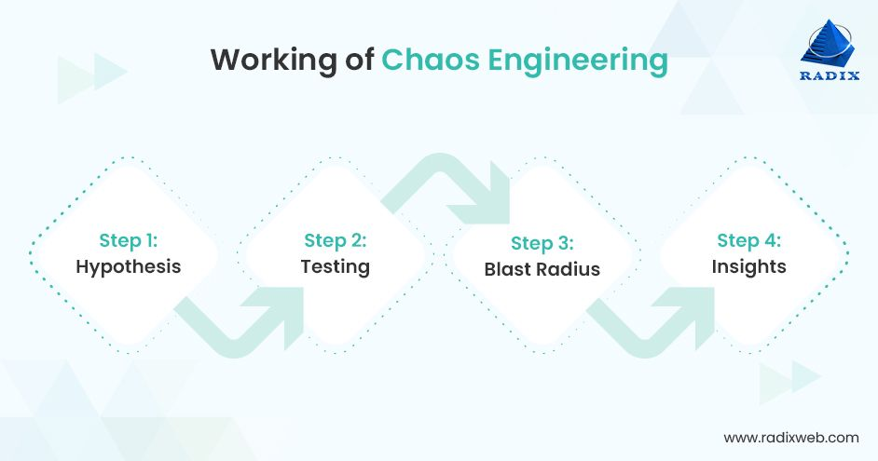

Slide 52
Key Concepts of Chaos Engineering
Hypothesis-Driven Testing
Hypothesis: Chaos engineering involves formulating hypotheses about how a system should behave under certain failure conditions.
Experiments: Conduct experiments to test these hypotheses, such as introducing failures or simulating high load conditions.
Controlled Experiments
Safety: Ensure that experiments are controlled and do not cause harm to the production environment. Often, experiments are run in a staging or test environment.
Observability: Use observability tools (metrics, logs, traces) to monitor the system's response during the experiments.

Slide 53
Failure Injection
Simulated Failures: Introduce faults such as network outages, service crashes, or resource exhaustion to test how the system handles them.
Controlled Conditions: Ensure failures are introduced in a controlled manner to observe specific aspects of system behavior.
Resilience Improvement
Identify Weaknesses: Discover weaknesses or vulnerabilities in the system’s architecture or design.
Improve Robustness: Use insights from chaos experiments to enhance the system’s resilience, such as improving error handling, redundancy, or failover mechanisms.
Continuous Testing
Regular Experiments: Conduct chaos experiments regularly to ensure ongoing resilience as systems evolve.
Adaptation: Adjust and refine experiments based on system changes and new insights.

Slide 54
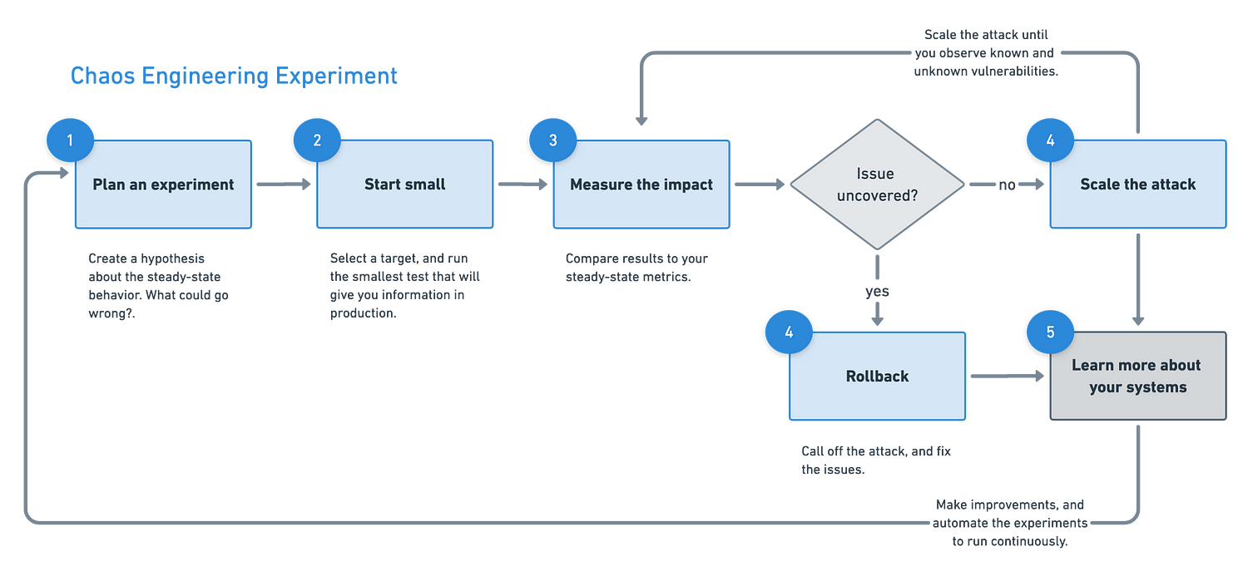

Slide 55
Steps to Implement Chaos Engineering
Define Goals and Scope
Objectives: Determine what you aim to achieve with chaos experiments, such as improving fault tolerance or validating recovery procedures.
Scope: Decide which parts of the system to test and the types of failures to introduce.
Create a Hypothesis
Hypothesis Formation: Develop hypotheses about how the system should behave under specific failure conditions. For example, “The system will continue to function normally if a database server goes down.”

Slide 56
Design and Plan Experiments
Experiment Design: Plan the chaos experiments, including the types of failures to introduce, the duration of the experiment, and the metrics to monitor.
Risk Assessment: Assess the potential risks and ensure that experiments are safe and have minimal impact on users.
Run Experiments
Controlled Execution: Execute the chaos experiments in a controlled environment, such as staging or a subset of production.
Monitoring: Monitor system behavior using observability tools to gather data on how the system responds to the introduced failures.
Analyze Results
Review Data: Analyze the data collected during the experiments to understand how the system performed and identify any issues or weaknesses.
Learnings: Document the findings and insights gained from the experiments.

Slide 57
Implement Improvements
Remediation: Make necessary changes to the system based on the experiment results, such as improving fault tolerance or enhancing recovery processes.
Iteration: Continuously iterate on chaos experiments and improvements as the system evolves.
Communicate and Document
Reporting: Share the results and improvements with relevant stakeholders and teams.
Documentation: Document the experiments, findings, and changes made to ensure knowledge is retained and accessible.

Slide 58




Tools for Chaos Engineering
Chaos Monkey: A tool from Netflix that randomly terminates instances in production to test system resilience.
Gremlin: A chaos engineering platform that allows for a wide range of failure scenarios and provides detailed reporting and analysis.
Chaos Mesh: An open-source chaos engineering platform for Kubernetes environments.
LitmusChaos: Another open-source tool for chaos engineering in Kubernetes.

Slide 59
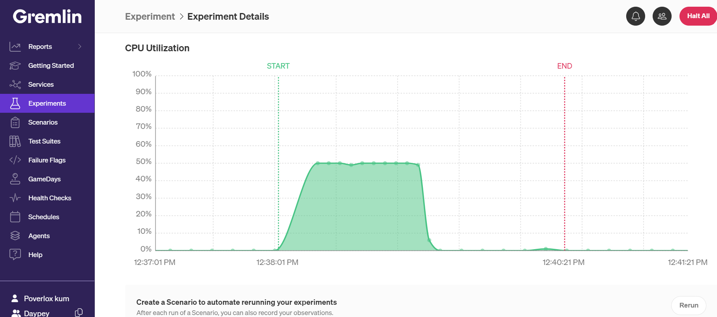

Slide 60
Benefits of Chaos Engineering
Enhanced Resilience: Improves system robustness by uncovering and addressing weaknesses.
Increased Confidence: Builds confidence in the system’s ability to handle failures and unexpected conditions.
Proactive Approach: Identifies potential issues before they impact users, allowing for proactive fixes.
Continuous Improvement: Encourages ongoing testing and improvement of system resilience.

Slide 61
Blue Green Deployment
Blue-Green Deployment is a deployment strategy designed to minimize downtime and reduce risk when releasing new versions of applications. It involves maintaining two separate environments (called "blue" and "green") to facilitate smooth transitions between versions. Here’s a detailed look at how Blue-Green Deployment works:

Slide 62
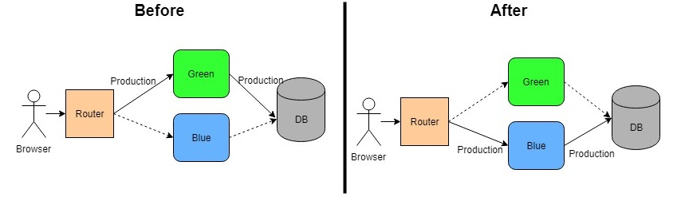

Slide 63
Key Concepts
Two Environments
Blue Environment: The current production environment that is live and serving user traffic.
Green Environment: The new environment where the updated version of the application is deployed and tested.
Deployment Process
Initial State: At the start, the blue environment is live and serving all user traffic.
Deploy to Green: Deploy the new version of the application to the green environment. This deployment is done without impacting the blue environment.
Testing: Conduct thorough testing of the new version in the green environment. This includes functional, performance, and integration testing.
Switch Traffic: Once testing is complete and the new version is confirmed to be stable, switch user traffic from the blue environment to the green environment.
Monitor: Monitor the green environment closely after the switch to ensure that everything is working as expected.
Rollback (if needed): If issues are detected, traffic can be switched back to the blue environment, effectively rolling back to the previous version.

Slide 64
Advantages of Blue-Green Deployment
Minimal Downtime
Switching traffic between environments is typically very quick, resulting in minimal or no downtime for users.
Risk ReductionThe new version is fully tested in the green environment before it goes live, reducing the risk of introducing bugs or issues to the production environment.
Easy RollbackIf issues arise with the new version, rolling back to the previous version is straightforward, as the blue environment remains unchanged and available.
Reduced Deployment RiskBy isolating the new version from the current production environment, the risk of disrupting live users is minimized.
Testing in Production-Like ConditionsThe green environment can be configured to mirror production conditions, allowing for more accurate testing and validation.

Slide 65
Disadvantages of Blue-Green Deployment
Resource Requirements
Maintaining two separate environments can be resource-intensive, requiring additional
infrastructure and management.
Cost
The need for duplicate infrastructure (blue and green environments) may increase costs, particularly for larger applications or environments.
Complexity
Managing two environments and coordinating traffic switches adds complexity to the deployment process.

Slide 66
Implementation Steps
Prepare Environments - Set up and configure the blue and green environments. Ensure that both environments are identical in terms of infrastructure and configuration.
Deploy New Version - Deploy the new version of the application to the green environment. Ensure that this deployment includes all necessary changes and updates.
Perform Testing - Conduct thorough testing in the green environment to validate the new version. Test functionality, performance, and integration.
Switch Traffic - Redirect user traffic from the blue environment to the green environment. This can be done using load balancers, DNS changes, or other routing mechanisms.
Monitor and Validate - Monitor the green environment for any issues after the switch. Ensure that the application is performing as expected and address any problems promptly.
Rollback (if necessary) - If significant issues are detected, switch traffic back to the blue environment to roll back to the previous version. Investigate and resolve the issues before attempting the deployment again.
Clean Up - Once the new version is confirmed to be stable and running smoothly, the blue environment can be decommissioned or used as the new staging environment for future deployments.

Slide 67


Slide 68
Ansible
Ansible is an open-source IT automation tool used for configuration management, application deployment, and task automation. It simplifies complex tasks by automating repetitive processes and managing infrastructure in a declarative manner.

Slide 69
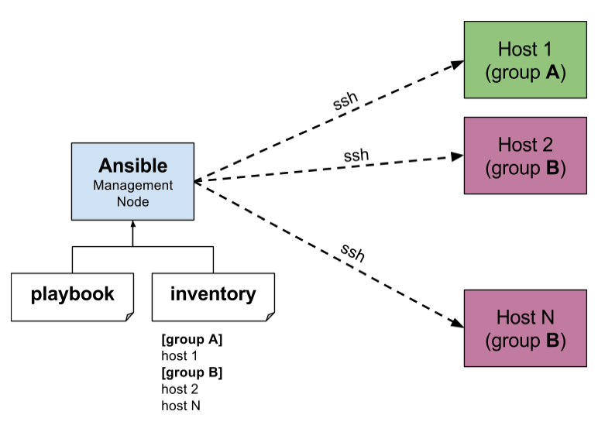

Slide 70
Core Components -
Ansible Engine
Control Node: The machine where Ansible is installed and from which commands are executed. It manages and orchestrates tasks across managed nodes.
Managed Nodes: The target systems on which Ansible executes tasks. Managed nodes can be Linux, Windows, or network devices.
Playbooks
Structure: Playbooks contain one or more plays, each specifying a set of tasks to be executed on a group of hosts.
Tasks: Individual actions performed by Ansible, such as installing packages, copying files, or starting services

Slide 71
Roles
Purpose: Roles are used to group tasks, handlers, and variables into reusable components, promoting modularity and reusability in playbooks.
Inventory
Static Inventory: A file listing the hosts and groups of hosts that Ansible will manage.
Dynamic Inventory: Scripts or plugins that dynamically generate inventory lists based on external sources.
Handlers
Purpose: Handlers are special tasks that are triggered by other tasks. They are typically used for tasks that need to be executed only when certain conditions are met (e.g., restarting a service after configuration changes).
Variables
Purpose: Variables are used to parameterize playbooks and roles, allowing for customization and flexibility. Variables can be defined in playbooks, roles, or external files.

Slide 72
Example Playbook
---
- name: Install and start Apache web server
hosts: webservers
become: yes
tasks:
- name: Install Apache
yum:
name: httpd
state: present
- name: Start Apache service
service:
name: httpd
state: started
enabled: yes

Slide 73

Terraform
Terraform is an open-source Infrastructure as Code (IaC) tool developed by HashiCorp. It allows users to define and provision infrastructure using a declarative configuration language, enabling automated and consistent management of cloud resources and other infrastructure components.

Slide 74
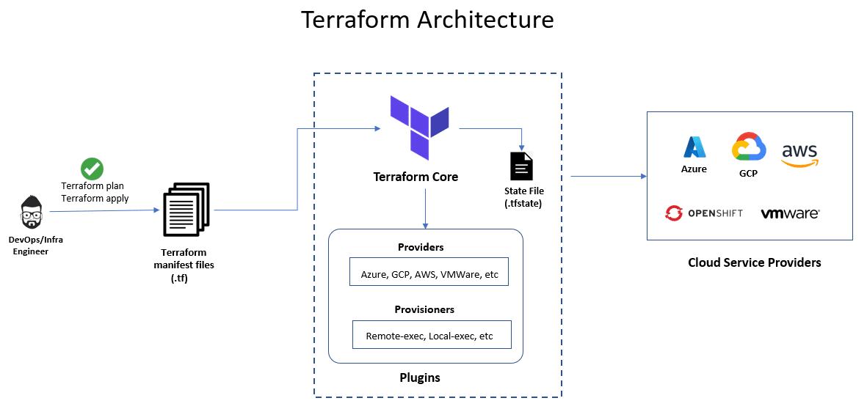

Slide 75
Core Components
Configuration Files
.tf Files: Configuration files written in HCL or JSON that define the desired state of infrastructure. These files describe resources, data sources, providers, and variables.
Providers
Purpose: Providers are plugins that allow Terraform to interact with cloud services and other APIs. Each provider manages resources and handles communication with the corresponding service.
State Files
Purpose: State files track the current state of the infrastructure and are used to determine what changes are necessary. They are essential for Terraform’ s operation and should be handled with care.

Slide 76
Modules
Purpose: Modules are reusable units of Terraform configuration that allow users to define common infrastructure patterns and share them across projects.
Variables
Purpose: Variables allow users to parameterize configurations, making them more flexible and reusable. Variables can be defined in configuration files or passed at runtime.
Outputs
Purpose: Outputs provide information about the resources created by Terraform, such as IP addresses or resource IDs. They can be used to pass data between modules or to provide information to users.

Slide 77
Example Configuration
# Specify the provider
provider "aws" {
region = "us-east-1"
}
# Define a resource
resource "aws_instance" "example" {
ami = "ami-0c55b159cbfafe1f0" # Example AMI ID
instance_type = "t2.micro"
tags = {
Name = "example-instance"
}
}
# Output the instance ID
output "instance_id" {
value = aws_instance.example.id
}

Slide 78

Kubernetes
Kubernetes (often abbreviated as K8s) is an open-source platform designed to automate the deployment, scaling, and management of containerized applications. Originally developed by Google and now maintained by the Cloud Native Computing Foundation (CNCF), Kubernetes provides a robust framework for managing complex containerized applications across clusters of machines.
Containers
Definition: Containers are lightweight, portable units that package applications and their dependencies together, ensuring consistency across different environments.
Docker: Docker is a popular containerization platform that works with Kubernetes, but Kubernetes can also manage containers from other sources.

Slide 79
Kubernetes Architecture
Control Plane
API Server: The API server handles all API requests and serves as the main entry point for interacting with the cluster.
Scheduler: Assigns workloads to worker nodes based on resource availability and constraints.
Controller Manager: Ensures that the desired state of the cluster is maintained by running controllers for different resources (e.g., ReplicaSets, Deployments).
etcd: A distributed key-value store that stores the cluster state and configuration data.

Slide 80
Worker Nodes
Kubelet: An agent that runs on each worker node, ensuring containers are running as expected and reporting the status to the control plane.
Kube-Proxy: Manages network routing and load balancing for services.
Container Runtime: The software responsible for running containers (e.g., Docker, containerd).

Slide 81
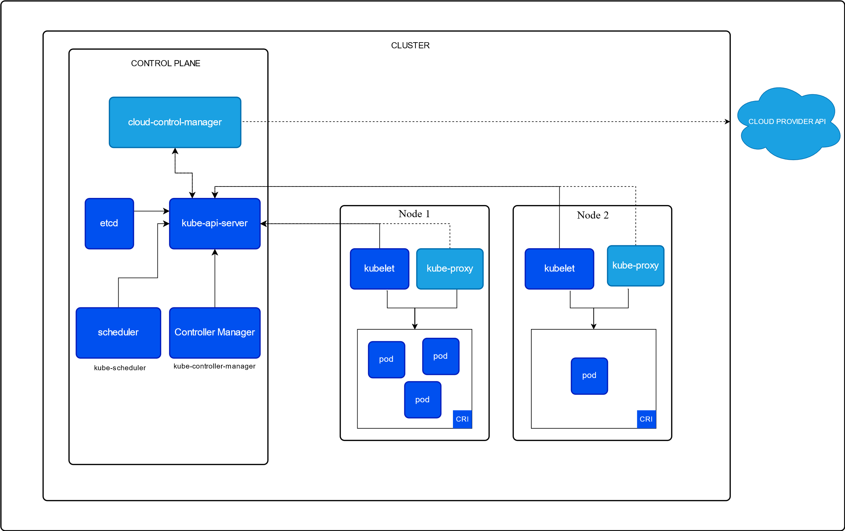

Slide 82
Example Configuration
apiVersion: apps/v1
kind: Deployment
metadata:
name: nginx-deployment
spec:
replicas: 3
selector:
matchLabels:
app: nginx
template:
metadata:
labels:
app: nginx
spec:
containers:
- name: nginx
image: nginx:latest
ports:
- containerPort: 80

Slide 83
3 Tier aws architecture

Slide 84
