Slide 1

Splunk Module - 1

Slide 2
Agenda
Splunk Overview
Types of Splunk Products
System Requirements
Installation Splunk Enterprise
Configuration Splunk Enterprise
Q & A

Slide 3
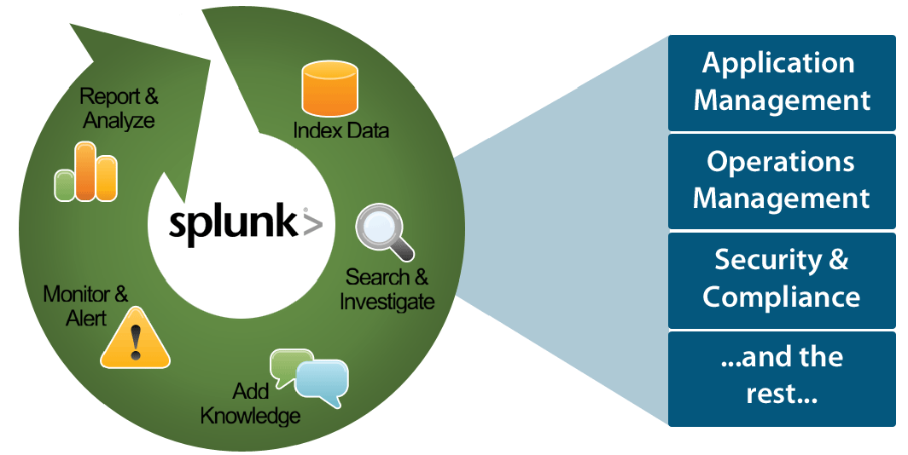
Splunk Overview
Splunk is a platform that captures, indexes and correlates real-time data in a searchable repository from which it can generate graphs, reports, alerts, dashboards and visualizations. Splunk is an excellent tool to make machine data (such as logs) accessible across an organization by identifying data patterns, providing metrics, diagnosing problems and providing intelligence for business operations. Splunk is a horizontal technology used for application management, security and compliance, as well as business and web analytics.
Each of the systems that are being monitored generates logs that are forwarded to Splunk for indexing. Once indexed these logs are centralized and can be searched through the Splunk web interface, allowing issues to be easily investigated and knowledge extracted.
Splunk dashboards will be generated by built-in Simple XML dashboards because Simple XML provides a drag-and-drop layout editor, easy panel editor, as well as PDF printing support that we would otherwise lose using Splunk's other dashboard frameworks.

Slide 4
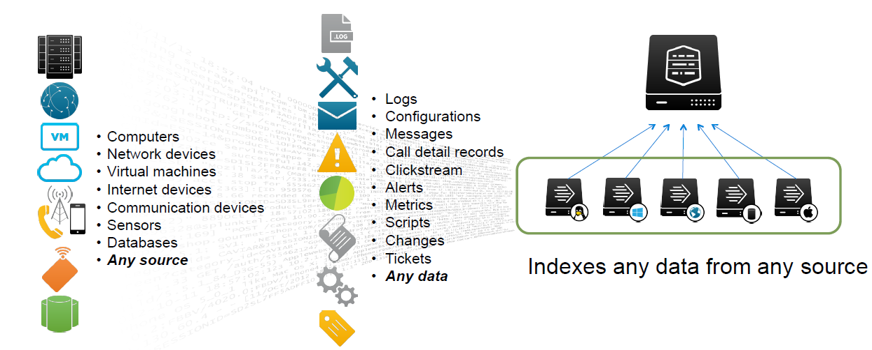
Splunk Overview

Slide 5
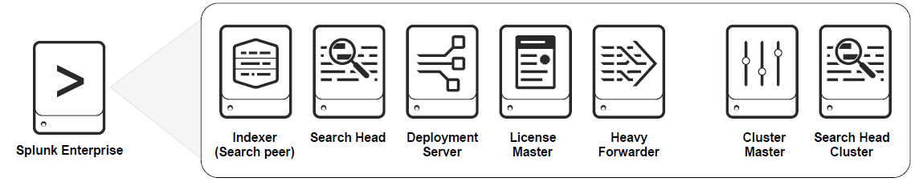
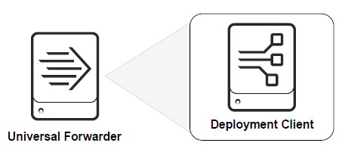
Types of Splunk Products
Splunk Enterprise
Splunk Forwarders
Splunk Cloud

Slide 6
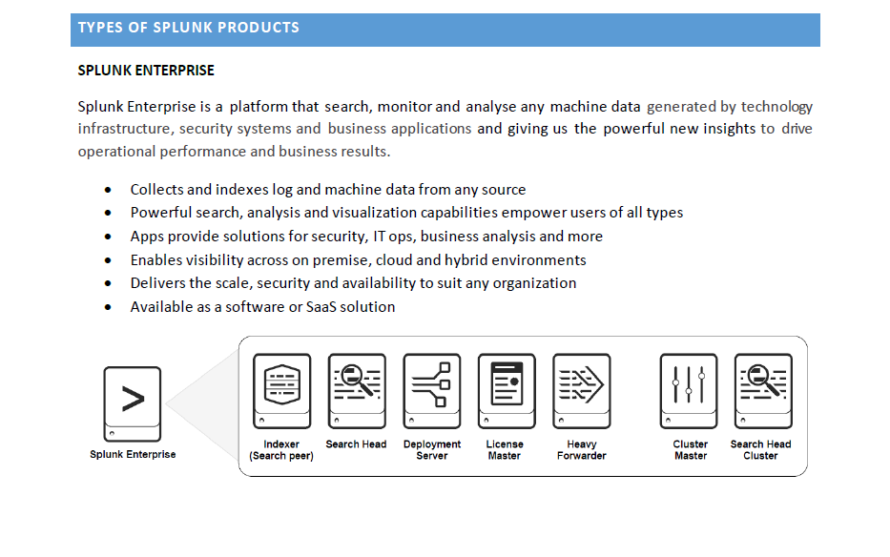

Slide 7
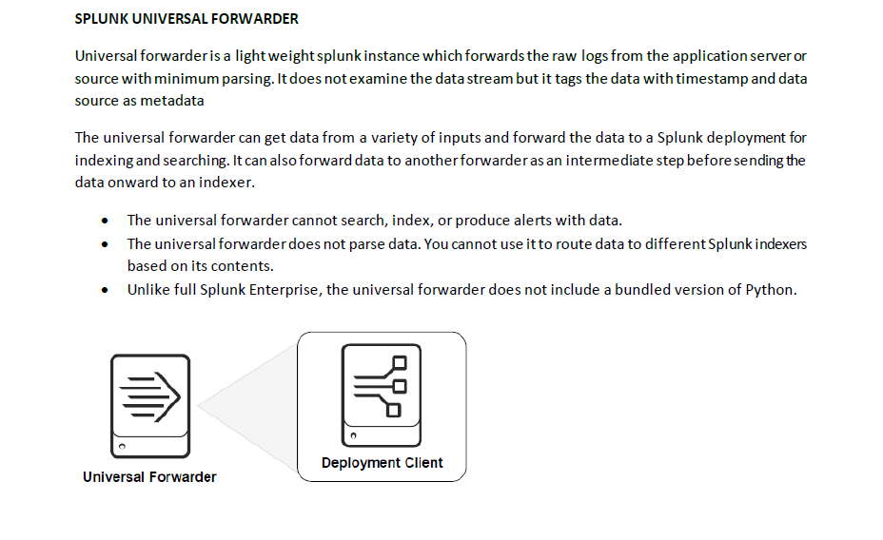

Slide 8
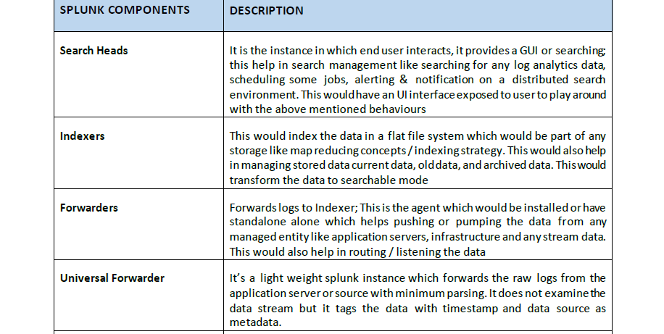


Slide 9
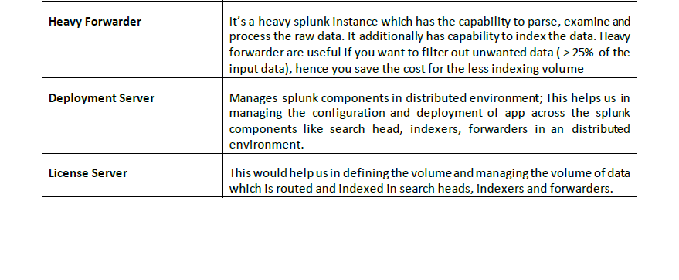

Slide 10
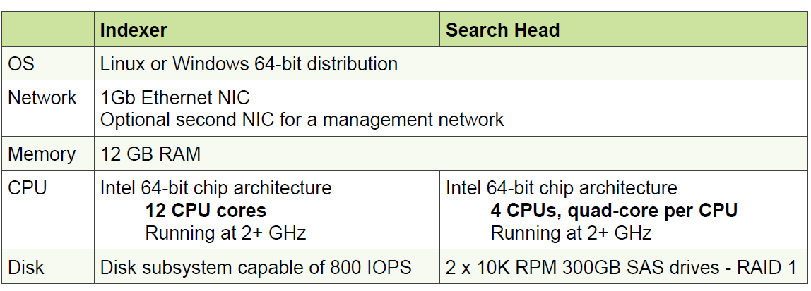

Splunk System Requirements
Forwarder
http://docs.splunk.com/Documentation/Splunk/latest/Capacity/Referencehardware

Slide 11
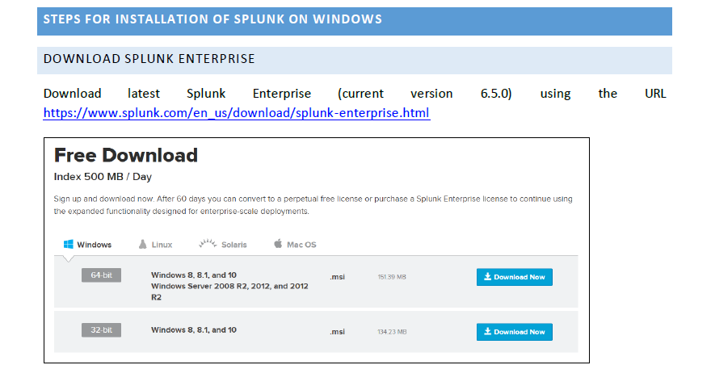

Slide 12
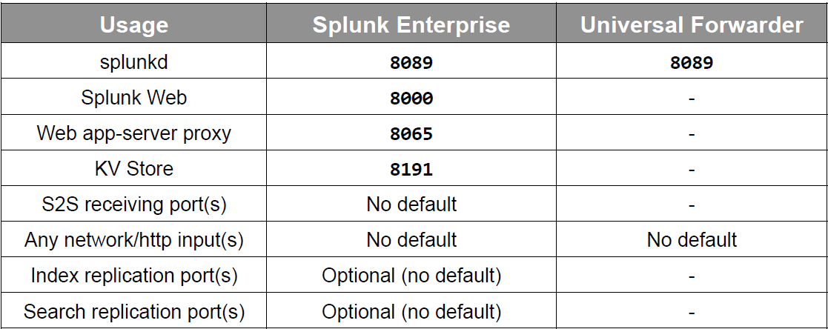
Pre-Installation Splunk Enterprise
Splunk ports

Slide 13
Installation Splunk Enterprise
Download Splunk https://www.splunk.com/en_us/download/splunk-enterprise.html
Installation Platform
Windows : Execute the .msi installer and follow the wizard steps
Splunkd runs on port 8089
Accesses, processes and indexes incoming data
Handles all search requests and returns results.
Splunk Web runs on port 8000
Provides front end for Splunkd process
Enable boot-start to run Splunk automatically upon system reboot
Enable DMC to monitor and investigate Splunk performance, resource usage etc

Slide 14
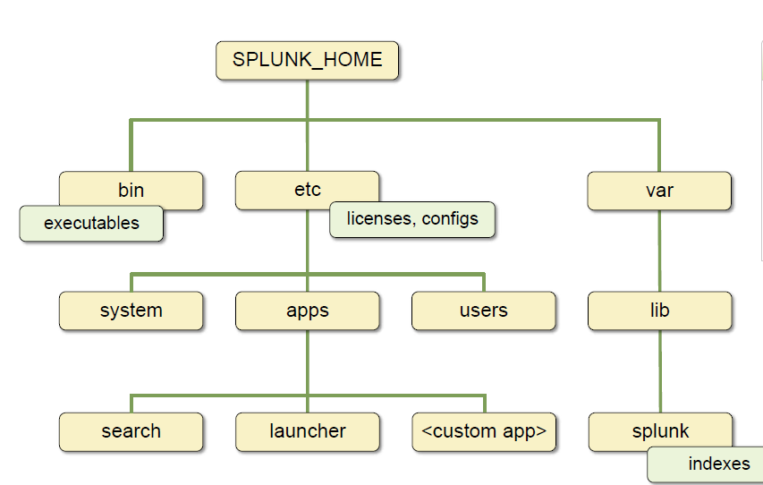
Splunk Directory Structure
Download Splunk https://www.splunk.com/en_us/download/splunk-enterprise.html

Slide 15
Configuration Splunk Enterprise
Search head
Standalone – No special configuration needed
Distributed – distsearch.conf
Indexer
Configure the receiving port (default 9997)
Indexes.conf
Deployment Server
/etc/deploymentapps
Serverclass.conf
Deploymentclient.conf
License server
Master or Slave
Enterprise trial license, Enterprise license, Free license, Forwarder license
License Pooling

Slide 16
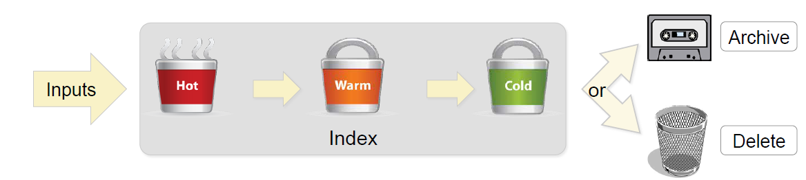
Index Management
Index
Splunk stores events in indexes under SPLUNK_HOME/var/lib/splunk
Preconfigured indexes - _internal, _audit, _introspection, _fishbucket, summary
Default index – main, used when an input does not specify any index
Retention Period
Set on per-index basis
Can be managed by data age and/or by size
Buckets
Index stores events in buckets
Directory containing set of raw data and indexing data
Hot, Warm, Cold, Frozen & Thawed

Slide 17
Estimate Index Storage
Splunk compresses raw data as it’s indexed and then added to each bucket
As Splunk indexes data it creates two main types of files
Rawdata (_raw)
Index files (*.tsidx, *.data)
Typically, Raw data compression is 15% of daily volume
And, Index file compression is 35% of daily volume
Disk storage can be estimated to meet data retention needs
Daily Rate * Compression factor (raw+index) * Retention period
Example 2GB/day of data searchable for 10 days then estimate as follows:
2GB * 0.5 (0.15+0.35) compression * 10 days = 5 GB

Slide 18
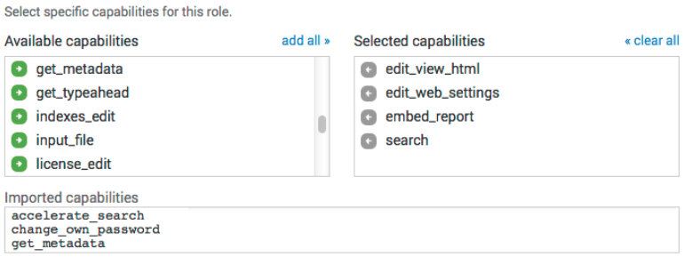
Roles/Capabilities
To have access to Splunk instance User must have
Splunk User account
Assign to one or more Splunk roles
Four built-in roles for user:
Admin, Power, User, can_delete
Adminstrators can add custom user roles by defining Capabilities to specific role.

Slide 19
Thank you
Any Q

