Slide 1
Analysis and Visualization of the E-Retail factors Affecting Customers Retention and Consumers purchasing decision in Indian E-Commerce
Submitted by: Gyan Prakash Tripathi

Slide 2
Problem Statement
Customer satisfaction has emerged as one of the most important factors that guarantee the success of online store; it has been positioned as a key stimulant of purchase, repurchase intentions and customer loyalty.
In such competitive market retaining customers and winning trust is very big challenge for e-retailers.
Understanding various factors that influence buying decision
Understanding customer’s perception regarding selected online retailers.

Slide 3
Data Visualization and analysis
In this step we will analyze and visualize our data
We will use tools available in python for data analysis and visualization.
We will use NumPy for Numerical analysis
Pandas for performing operation on data frame
Matplotlib Provide visualization capability.
We will use Seaborn for more enhanced visualization and analysis

Slide 4
EDA Steps
During EDA first I have done pre processing of column names by removing unwanted digits and \t from the column names.
Then I am checking the data shape, column types and checking the null values if any is present in any column.
The data has 269 rows and 71 columns.
All the columns are of object type except pin code detail. So we will mostly perform count plot.
Data is not having any null values and all the data is object type.
I have done the value counts for each categorical column to check values of different categories.
Then I have removed the ambiguity of different column

Slide 5
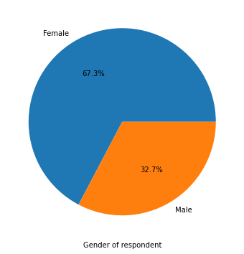
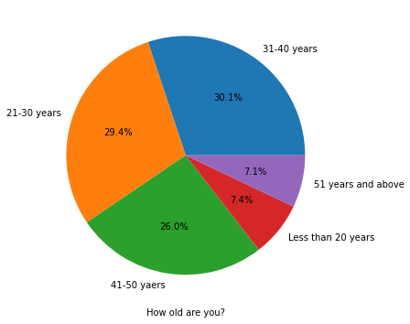
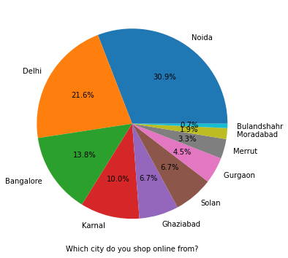
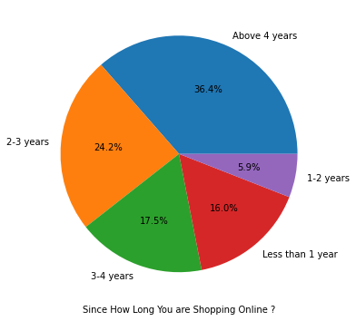
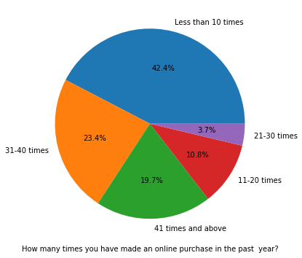
Univariate Analysis-Personal Info
CONCLUSION:
The number of women is double than men who have taken this part in the survey.
Most of the people are in their 30's followed by 20's and 30's. Teenagers and senior citizen are the least in number.
Most of the people belong to Noida, Delhi and Bangalore.
Most of the people shopping online have been shopping for more than 4 years.
Majority of people shop online less than 10 times a year

Slide 6
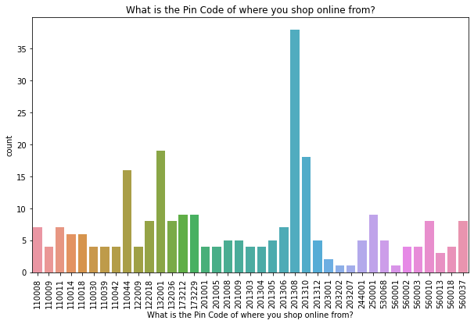
Analysis of PIN code distribution and count

Slide 7
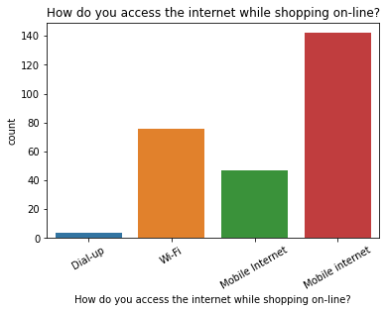
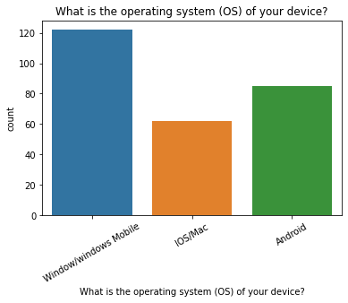
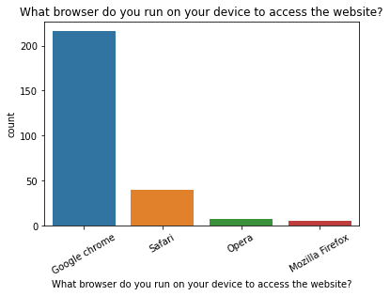
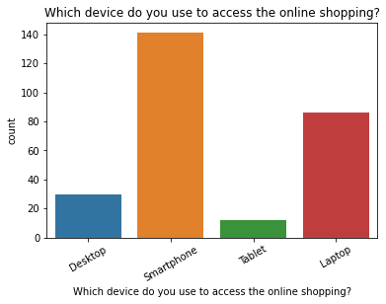
Analysis of easy access of website for customer

Slide 8
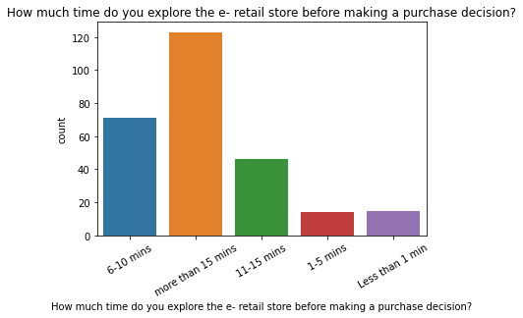
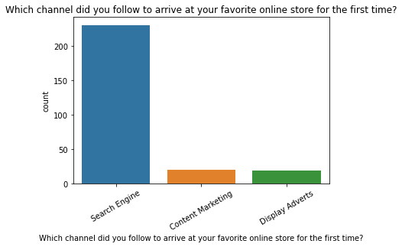
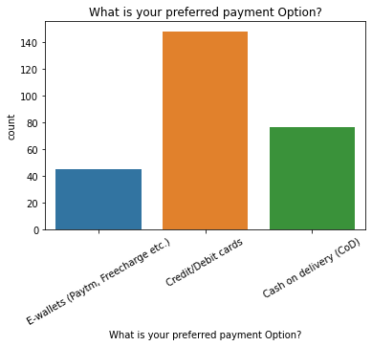
Analysis of easy access of website for customer-cont.

Slide 9
Analysis of easy access of website for customer-cont.
CONCLUSION:
Most of customer access internet for shopping online through Smartphone and Mobile internet.
Mostly used OS is windows or windows mobile.
To access the website mostly used browser is google chrome.
Most of the customer uses search engine to arrive at their favorite online store.
Customer explore more than 15 mins to make any purchase decision.
Most of the customer feels using credit/debit cards for making payment online more convenient.

Slide 10
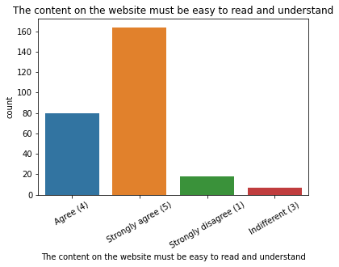
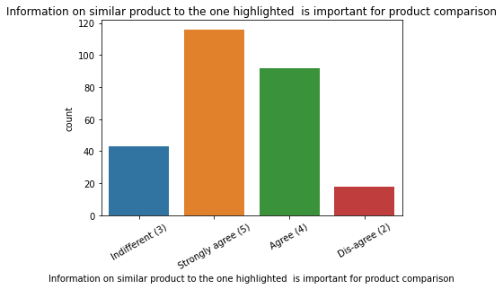
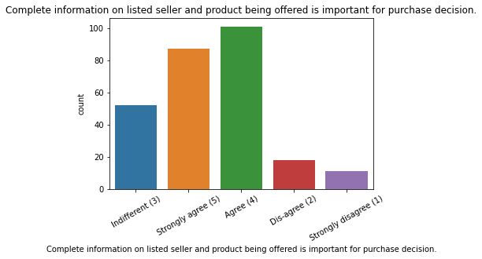
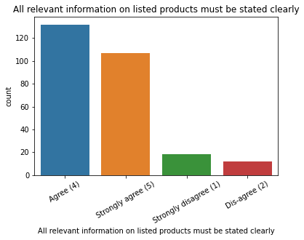
Consumer opinion on Website features

Slide 11
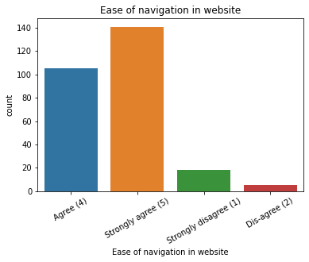
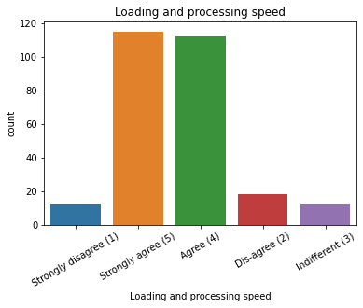
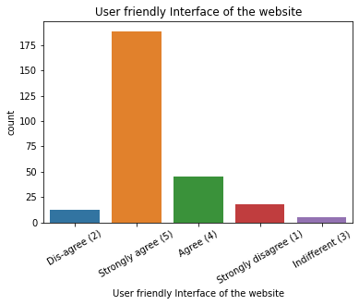
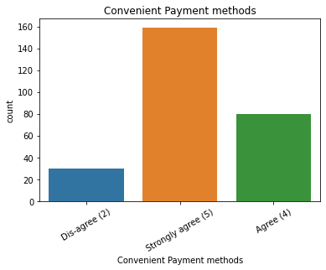
Consumer opinion on Website features-cont.

Slide 12
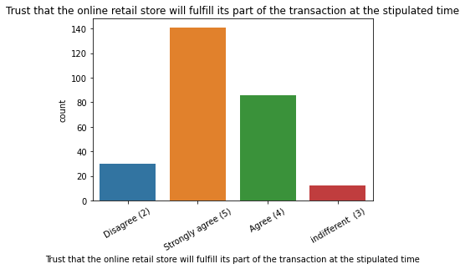
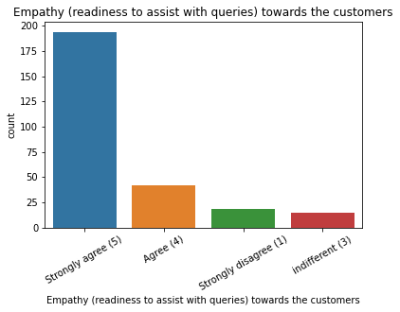
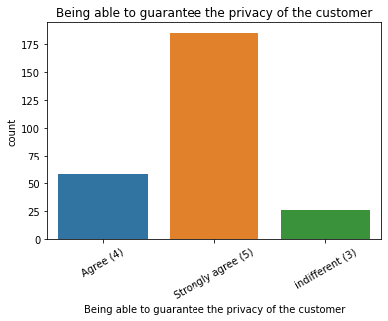
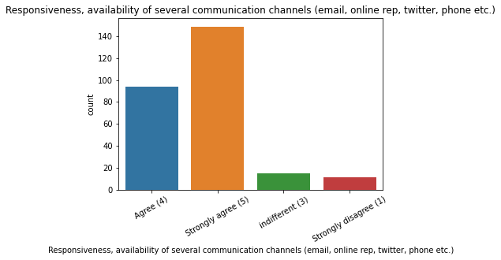
Consumer opinion on Website features-cont.

Slide 13
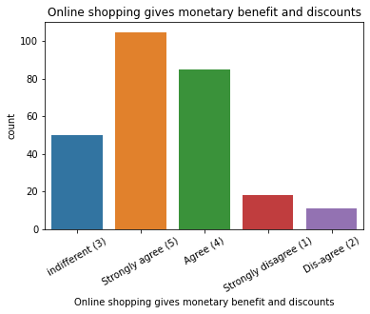
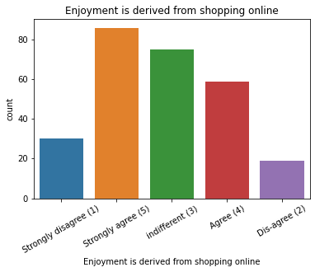
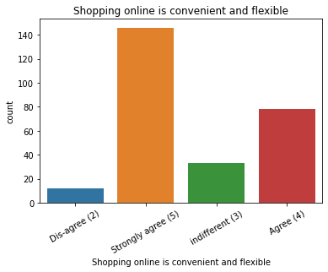
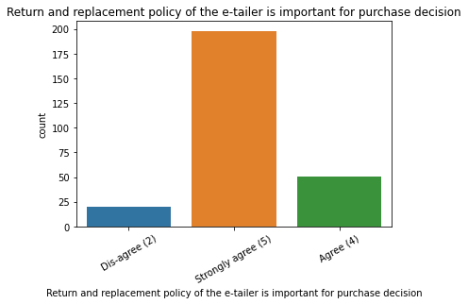
Consumer opinion on Website features-cont.

Slide 14
Consumer opinion on Website features-cont.
CONCLUSION:
The customer strongly agree that the content of website must be easy to read and understand and information on similar product to the one highlighted is important for product comparison
Most of the customer agree that Complete information on listed seller and product being offered is important for purchase decision and all relevant information on listed products must be stated clearly.
Most of the customer strongly agree that easy of navigation in website, user friendly interface of the website, loading and processing speed of website and convenient payment methods is important for selection of website for online shopping.
Customer also strongly agree that the website should be able to provide trust that the online retail store will fulfill its part of the transaction at the stipulated time, empathy (readiness to assist with queries) towards the customers, guarantee the privacy of the customer, Responsiveness and availability of several communication channels (email, online rep, twitter, phone etc.)'
They strongly agree that 'Online shopping gives monetary benefit and discounts, Enjoyment is derived from shopping online, Shopping online is convenient and flexible and Return and replacement policy of the e-tailor is important for purchase decision',

Slide 15
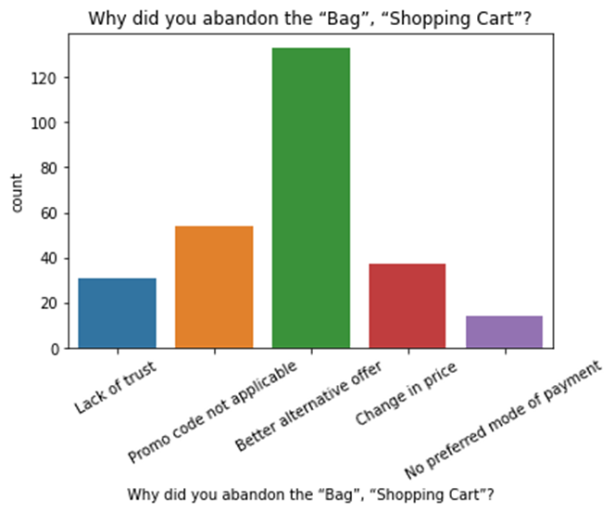
Reason Of abandon
. Majority of the shoppers having Better alternative as reason for abandon.

Slide 16
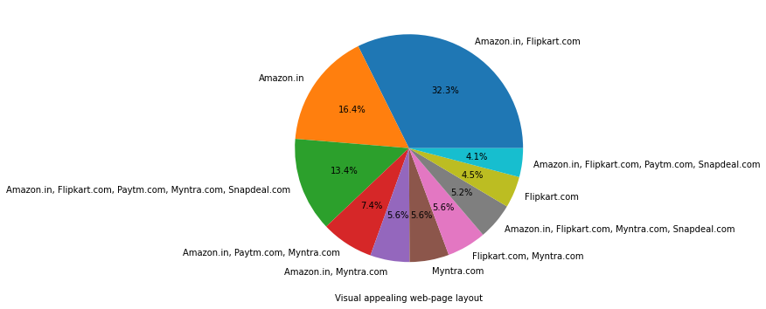
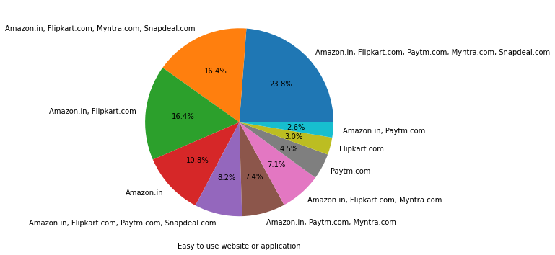
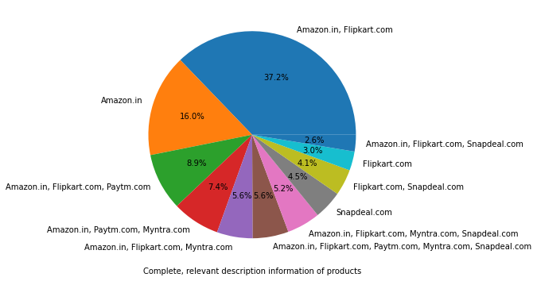
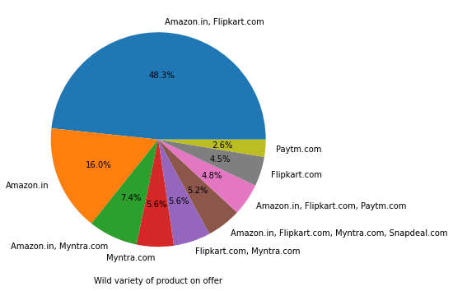
Brand Image

Slide 17
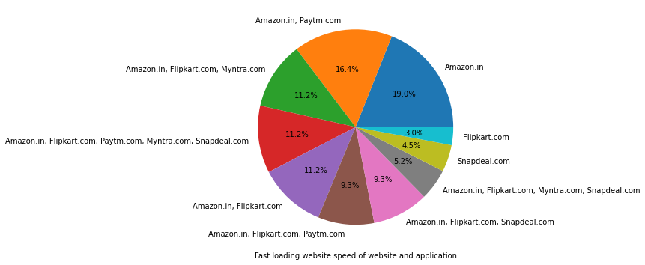
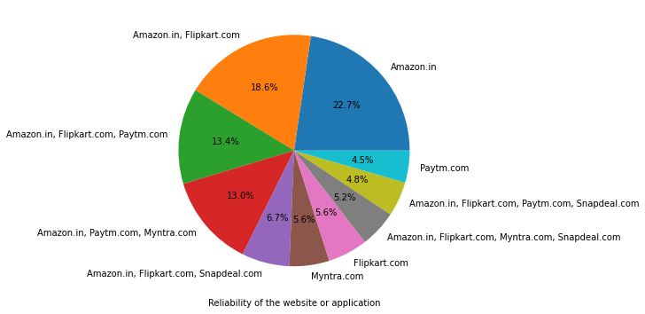
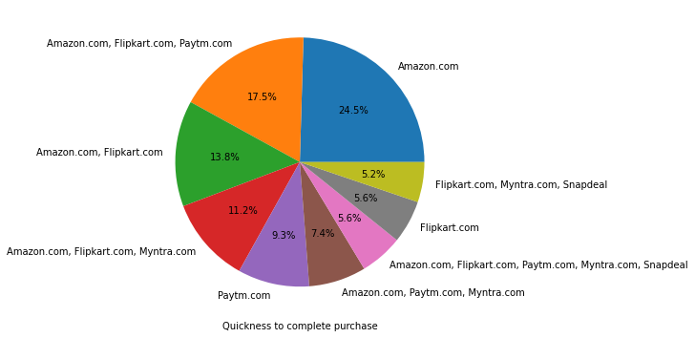
Brand Image-cont.

Slide 18
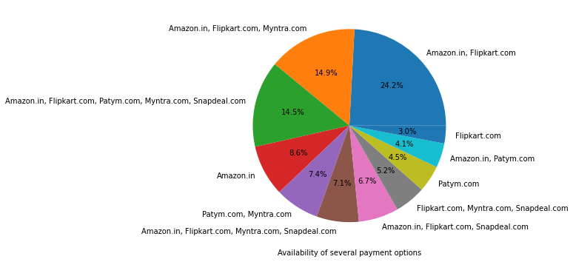
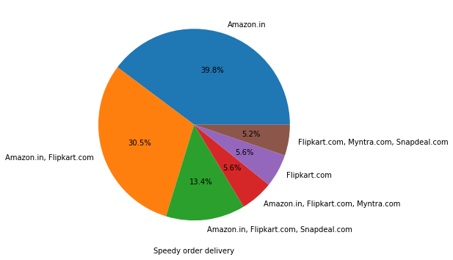
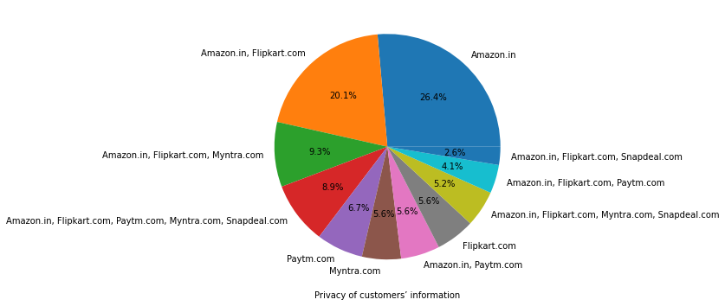
Brand Image-cont.

Slide 19
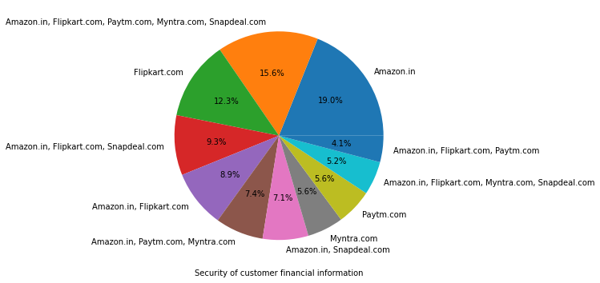
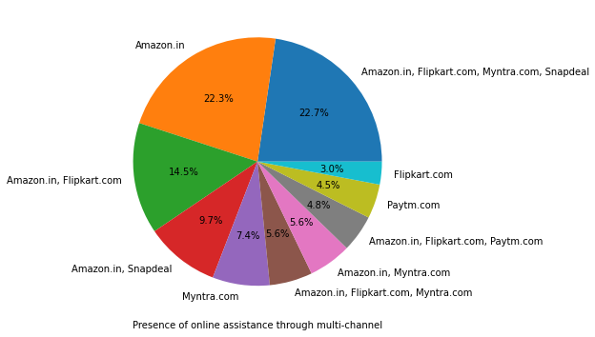
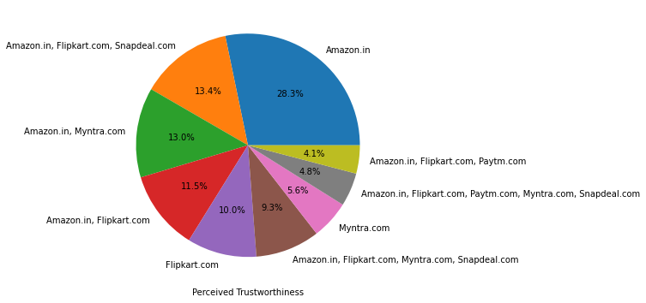
Brand Image-cont.

Slide 20
Brand Image-cont.
CONCLUSION:
Amazon and Flipkart have maintained a very good brand image as compared to Paytm and Myntra.
Amazon and Flipkart have got highest percentage for all performances points.

Slide 21
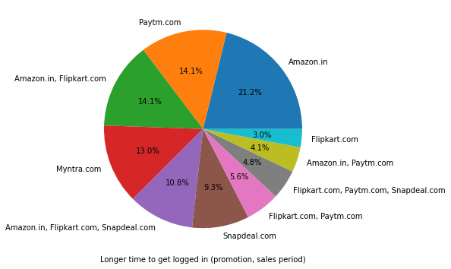
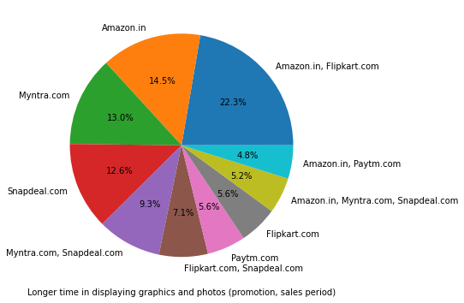
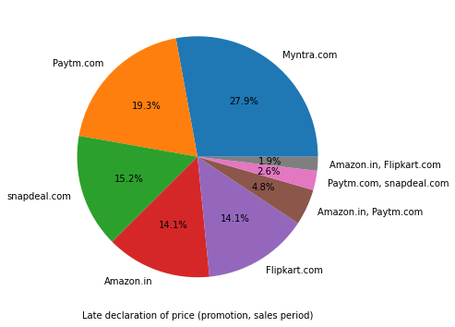
Analysis of Negative Image about the Website

Slide 22
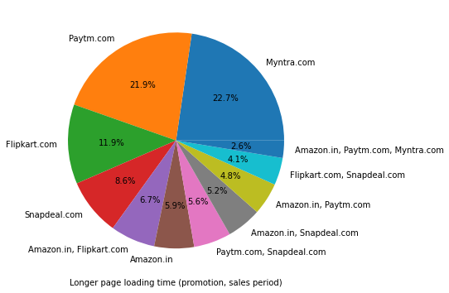
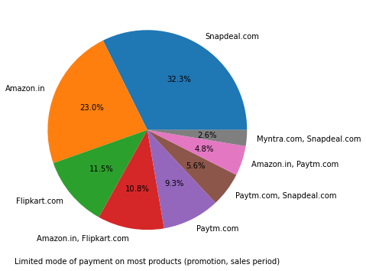
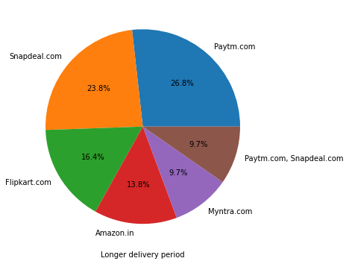
Analysis of Negative Image about the Website-cont.

Slide 23
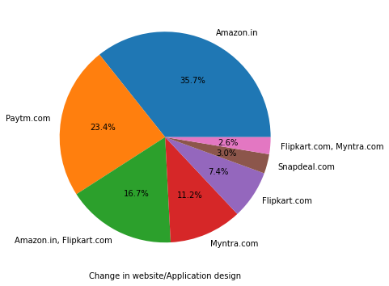

Analysis of Negative Image about the Website-cont.
CONCLUSION:
Amazon takes longer time to get logged in (promotion, sales period),longer time in displaying graphics and photos (promotion, sales period).
Myntra provides late declaration of price (promotion, sales period) and takes longer page loading time (promotion, sales period).
Snapdeal provides limited mode of payment on most products (promotion, sales period).
Paytm and Snapdeal takes longer delivery period.
Amazon and Paytm have frequent change in website/Application design.
Amazon and Myntra have frequent disruption when moving from one page to another.

Slide 24

Loyalty

Slide 25



Slide 26



Slide 27

Loyal customers are those who keep using the same brand even if it is not good as other brands. Instead of some bad experiences Amazon customers are loyal towards their shopping website and they prefer to recommend it to their friends.

Slide 28

Varieties of Product offered
Amazon and flipkart offer highest varieties of product than other websites.
Paytm provides least variety.

Slide 29

Online Retailing
This graph shows the relation between age group of customer for online shopping and Years of their online shopping.
31-40 years old customer are mostly shopping online for more than 4 years.

Slide 30

Intention of Repeat purchase:
CONCLUSION:
Heavy shoppers who shop more than 41 times a year shop from all the online brands, some of the people who shop for 32-40 and less than 10 times a year seem to exclude myntra. People shop from Amazon and flipkart whatever be the case.

Slide 31

People shopping from amazon and Paytm are getting benefits from the loyalty points, flipkart and Snapdeal also seem to give such benefits but people who shop from almost everywhere disagree with this statement too

Slide 32

we can see that density of female customers is more than male. Men living in Bangalore and Ghaziabad shop have shopped online for less than 1 year. Highest number of men shopping online belong from Delhi and Noida, while men from Moradabad have been shopping online for the longest. Women from Meerut and Noida have shopped the longest.

Slide 33

We can clearly see that most of the time people abandon the bag is because they get a better alternative offer or promo code not applicable. There is also lack of trust seen in amazon, flip kart and Paytm by some people.

Slide 34

Majority of the shoppers are using multiple retailers for shopping online.

Slide 35
Conclusion
With increase in the internet access and mobile shoppers are switching form offline mode of shopping to online mode of shopping.
Most of the online shoppers are female.
Majority of the shoppers are using multiple retailers for shopping online.
Majority of the shoppers find it adventurous, time saving and value of money.
The main factors which affect the customer’s retentions are Trust, easy accessibility to website, product price, return policy, privacy of the user payment details and Fast delivery.

Slide 36
THANK YOU

