Slide 1
INSURANCE MANAGEMENT SYSTEM

Slide 2
VEER NARMAD SOUTH GUJRAT UNIVERSITY SHRI SHAMBHUBHAI V. PATEL COLLAGE OF COMPUTER SCIENCE AND BUSSINESS MANAGEMENT
B.C.A (Bachelor of Computer Application)
Programmer
PROJECT REPORT ON
INSURANCE MANAGEMENT SYSTEM
AS A PARTIAL REQUIREMENT, FOR
B.C.A. 6th Semester
Year: 2021-22
Guided By: Submitted By:
Prof. Rekha Pichholiya Dhaduk Priyansi G
Dhaduk Vivek R
Desai Isha s

Slide 3
ACKNOWLEDGEMENT
Our self Dhaduk Priyansi, Dhaduk Vivek, Desai Isha. Have the opportunity to express our knowledge. we would like to express our gratitude to all those who gave us the possibility to complete our project.
Success is such a comprehensive project can not achieve single-handed. It is a team effort that sails the ship to the coast. so we would like to express our sincere thanks to all the dignitaries who were involved in making this project a great joy and turning it into a successful piece of work.
Prof. Rekha Pichholiya – our professor and project co-ordinates has been very prudent to us threw out college studies. They are the person who has given this direction to our work and the shape of four imagination. we express our regard to them from the core of our hearts. we also like to thank the professors who are always ready to give the best guidance they are the person who gives solutions whenever needed.
We would also like to acknowledge all the friends and colleagues, and team members for the help and encouragement by them from time to time. The constant support and encouragement of my friend are deeply appreciated. The project indeed gave challenging and exhilarating experience in designing and developing the required system.
From,
Dhaduk Priyansi G ,
Dhaduk Vivek R,
Desia Isha S.

Slide 4
Project profile
Project Title : | Auxilium Insura
Front-End : | React-JS
Back-End : | Node-JS
Browser : | All Browser Supported
Technology: | HTML, CSS, JavaScript, Bootstrap, MongoDBCompass, Express-JS
Guided By: | Prof. Rekha Pichholiya
Platform : | 16.14.0
Tools Used For: | Visual studio, MongoDBCompass, Postman
Submitted To: | Shree Shambhubhai v. Patel college of computer science
Developed By: | Isha Sanjay Bhai Desai Priyansi Gabharu Bhai Dhaduk Vivek Rajesh Bhai Dhaduk

Slide 5
Project description
Insurance Management is developed to see various kinds of insurance. This project is developed for the user to take the best insurance policy, the user to take a policy, and the admin who can manage both user and advisers.
Insurance management is an extensive and powerful script written in node js and react js. It gives the platform to manage insurance online. Users can see all policies and compare any policy to taking the best policy.

Slide 6
Hardware and software used
The efficient hardware and software configuration requires running the system is as suggested below. The configuration suggested is for better performance. The same functionality or higher configuration will always be better.
Client Side :
An Internet-enabled device with a web browser.
Server side :
Node.js - 14.16.1
MongoDB Database
Development Side :
Processor: Intel Core i5 11th generation
O.S: Windows 10
Memory: 8.00 GB
Hard disk: 1TB
Web Browser: Google Chrome (Recommended)

Slide 7

Technology used
Overview of React.js:-
React is a JavaScript library for building user interfaces.
React is a library for building compassable user interfaces. It encourages the creation of reusable UI components, which present data that change over time.
React abstracts away the DOM from you, offering a simpler programming model and better performance.
React can also render on the server using Node, and it can power native apps using React Native.
React implements one-way reactive data flow, which reduces the boilerplate and is easier to reason about than traditional data binding.
React Advantages:-
React Uses virtual DOM which is a JavaScript object. This will improve apps performance since JavaScript virtual DOM is faster than the regular DOM.
React Can be used on the client and server sides as well as with other frameworks.
React Components and data patterns improve readability, which helps to maintain larger apps.

Slide 8

Continued…..
Overview of Node.js:-
Node.js is a server-side platform built on Google Chrome's JavaScript Engine (V8 Engine).
Node.js is an open-source, cross-platform runtime environment for developing server-side and networking applications. Node.js applications are written in JavaScript and can be run within the Node.js runtime on OS X, Microsoft Windows, and Linux.
Following are some of the important features that make Node.js the first choice of software architects.
Asynchronous and Event-Driven
All APIs of Node.js libraries are asynchronous, that is, non-blocking. It essentially means a Node. The js-based server never waits for an API to return data. The server moves to the next API after calling it and a notification mechanism of Events of Node.js helps the server to get a response from the previous API call.
Very Fast :
Being built on Google Chrome's V8 JavaScript Engine, the Node.js library is very fast in code execution.

Slide 9
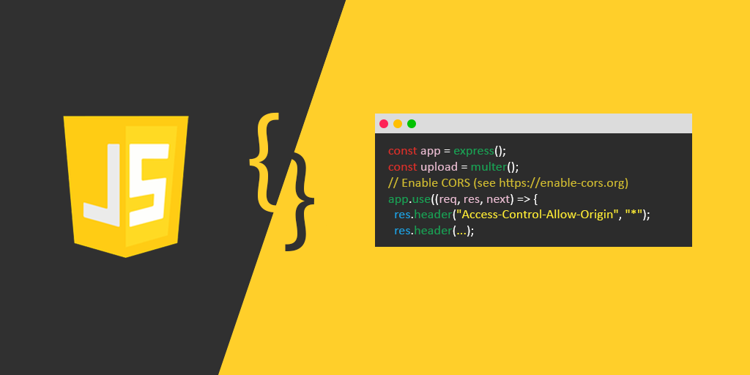
Continued…..
Overview of JAVASCRIPT
JavaScript is a programming language that can be included on web pages to make them more interactive. You can use it to check or modify the Content of forms, and change images. Open new windows and write dynamic page content.
This allows you to make parts of your web pages appear or disappear or move around on the page.
JavaScript is a client-side, interpreted, object-oriented, high-level scripting language, while Java is a client-side, compiled, object-oriented high-level language.
JavaScript Feature:-
JavaScript is a more flexible language.
JavaScript makes possible all types of validation and security.
JavaScript has a set of functions.

Slide 10
Feasibility study
The feasibility of our project has been judged on the time, technology, resources available, and project length.
Time:- This project takes at least 3 months to be completed if we take the help of reused components; otherwise it may take more than 5 months to be completed.
Technology:- This project is built on React.js & Node.js platform which is worldwide already standard. Therefore the technical risk is not so high hence feasible
Resources:- Good technology professionals are a basic requirement. Internet and favorable environment, etc. the resources were fully available.

Slide 11
Requirement analysis and data gathering
Requirement gathering
Before developing an elegant application, the best way to identify basic needs and functionality is to take an interview with the director and management who are working in that specific area addressed by the proposed application.
For gathering basic needs and functionalities, we had a meeting with people personally to understand required functionalities and also noted down some useful features to be included.
Every successful system passes through requirement gathering because without any requirement the development process is like adding bugs to an empty system.
Requirement gathering and analysis make the whole picture of the system and because of that, we can identify the features, the modules, and the functionality of the system.

Slide 12
Requirement analysis
System should be able to provide a registration facility.
System should provide a safe login facility.
System should provide forgot password facility.
System should manage email Contact, skills.
System should be able to add or remove user, policy and also manage its information.
We analyzed our gathered information and we have decided our system should have the following functionality:-
Common models
Registration
Login
Forget Password (User )
Logout

Slide 13
Continued…
Module 1 ( USER )
User Registration.
User Login / Logout.
User Change Password.
Module 2 ( ADMIN )
Admin Login
Admin Logout
Admin Insert policy
Admin Send Email To User.
Admin Add policy.
Admin Delete policy.
Admin View Top 10 User.
Admin Edit policy.
Admin Delete policy.
Admin Insert User In Some Cases.

Slide 14
scope
In the current project of WEB ANALYSIS, we have undertaken, the corresponding scope of our intranet website is as follows: For
This is a user-friendly layout & easy to understand for every user or service provider.
It will allow the user to recover the password.
It Also allows Service Providers to recover password
It is able to Give information about registered Users and also edit that information.
It allows sending mails.
This system provides the insurance policy detail of all companies.
It provides the main branch address of all insurance companies so the client can easily find the location of the company and contact it
It also provides a comparison of all insurance policies.
.pdf file download facility

Slide 15
objective
The main objective of the Insurance Agency Management system is to Provide a Service insurance Policy to the customer.
Admin
Admin can upload/delete/edit insurance policy for the insurance company
Admin can manage user
Admin can manage the insurance policy
User
Users can register Itself
Users can log in
Users can view the policy
Users get a quote
Users can change their password

Slide 16
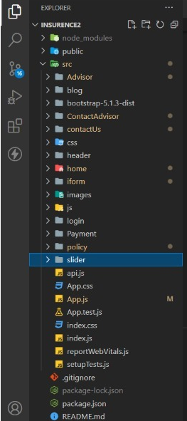
Directory Structure

Slide 17
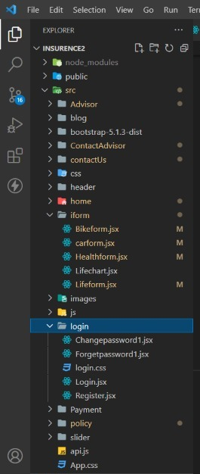
Continued…

Slide 18
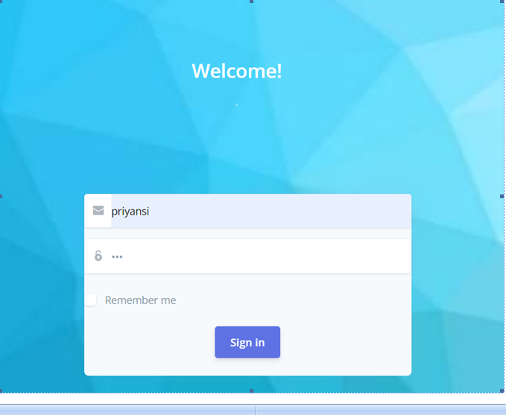
Input design
Admin login:

Slide 19
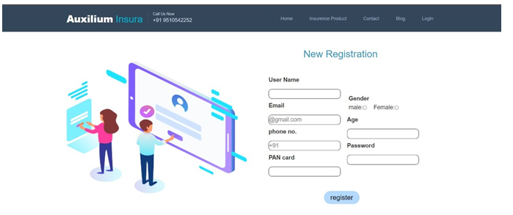
Continued…
User registration:

Slide 20
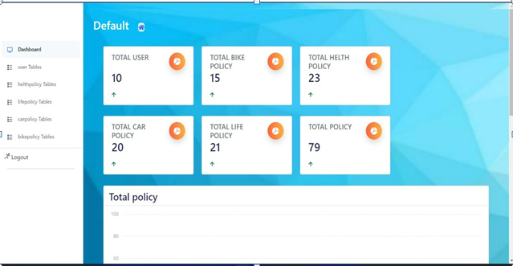
Output design
Admin panel:

Slide 21
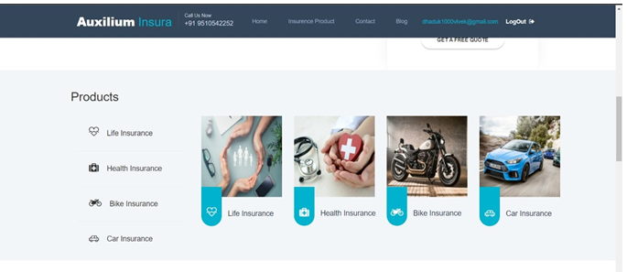
Continued…
User-side:

Slide 22
Software testing
Software testing is a critical element of software quality assurance and represents the ultimate review of specification design and coding. Testing is an exposure of a system to trial input to see whether the software meets the correct output. Testing cannot be determined whether the software meets the user’s needs, only whether it appears to conform to requirements. Testing can show that a system is free of errors, only that it contains errors. Testing finds errors, it does not correct errors. Software success is a quality product, on time and within cost. Testing can reveal critical mistakes. Testing should, therefore,
Validate Performance.
Detects errors.
Identify.
Inconsistencies

Slide 23
Continued…
Test Objective:
There Is Strong Evidence That Effective Requirement Management Leads to Overall Project Cost Savings. The Three Primary Reasons For This Are:
Errors in requirement typically cost over 10 times more to repair than other errors.
Requirement errors typically comprise over 40% of all errors in a software project.
Testing Principles
Unit Testing
Integration Testing
Top-down integration
Bottom-down integration
Validation Testing
System Testing
Recovery Testing
Security Testing
Stress Testing
Sanity Testing
White Box Testing

Slide 24
Limitations
Since every system has some limitations so our proposed system is also not untouchable in this regard.
The main limitations of our system are:
Excel export has not been developed for the policy.
admin cannot update the logo image once it is uploaded.

Slide 25
Future Scope of Enhancements
The social networking site has a wide range to change as per time requirements. That is the reason that not a particular project is ever considered complete because the demand of the user and thinking always change day by day.
Always do more than what have.
Some of the enhance which we have thought of are:
We can give more advanced software for online insurance management systems including more facilities.
We will host the platform on an online server to make it accessible worldwide.
Integrate multiple load balancers to distribute the load of the server.
Implement the backup mechanism for taking backup of codebase and database on regular basis on different servers.
Create a master and slave database structure to reduce the overload of the database queries.

Slide 26
References
https://stackoverflow.com/
https://www.w3schools.com/
https://www.youtube.com/
https://github.com

