Slide 1
Project Code. R. 0033170.001
Multicore Implementation M3 Inverter Development
Configuration Management Plan

Slide 2
Document Particular(s)
Document Control
© KPIT Technologies Ltd. All rights are reserved. This document contains proprietary information meant only for the intended recipients. No part of this document may be photocopied, reproduced or translated to another language without the prior written consent of KPIT Technologies Ltd. (Hereafter referred to as ‘KPIT’).
Document Name | Date | Authored by | Change history
Configuration Management Plan | 05-Sep-2019 | Vidyut Chokshi | Working Copy
# | Prepared for
1 | Eaton E-Mobility,Eaton Inc. Southfield, MI USA
Document Identifier | Project Name | Version | Prepared by
NPe_M3_DualCore_Configuration Management | Multicore implementation for M3 Inverter | 1.0 | PES, KPIT, Pune, India

Slide 3
Index
Introduction
Abbreviations
Folder Structure and Governance
3.1 Folder Structure-Root Folder view
3.2 Folder Structure for Eaton
3.3 Folder Structure for KPIT
3.4 Folder Structure for KPIT-Branch Folder
3.5 Folder Structure for KPIT-Program Management Folder
3.6 Folder Structure for KPIT-Release Folder
3.7 Folder Structure for KPIT-Trunk Folder
3.8 Eaton Folder Access Control
3.9 KPIT Folder Access Control
3.10 Folder Structure Governance Roles and Responsibilities
3.11 Messages
4. Configuration Management Overview
4.1 Configuration Management
4.2 Identification of Configuration Items and Tools
4.3 Example of Configuration Items
5. Configuration Management Activities
5.1 Configuration Management using Subversion
5.2 Managing Artefacts
5.3 Build Management
5.4 Access Control
5.5 Backup and Restore the SVN Repository
5.6 Perform Audits
5.7 Delivery and Release
6. Store
6.1 Planning
6.2 Systems
6.3 FUSA
6.4 Hardware
6.5 BSW
6.6 ASW
6.7 V&V

Slide 4
1. Introduction

Slide 5
1.0 Introduction
Purpose:
This document is intended for KPIT and Eaton_NPE users to understand the KPIT Configuration Management process
Scope:
The scope of this document is to give an overview of KPIT Configuration Management process and related activities
Index

Slide 6
2. Abbreviations

Slide 7
2.0 Abbreviations
Short | Long
ASW | Application Software
BSW | Basic Software
FUSA | Functional Safety
VnV | Verification and Validation
MOM | Minutes of meeting
MLR | Multi Level Review
MSR | Monthly Status Report
PDPS | Product Development Process Specification
PO | Purchase Order
SoW | Statement of work
Index

Slide 8
Version Numbering & Naming Conventions
Versioning Numbering
Following versioning guidelines shall be followed for versioning the Configuration Items. There shall be two digits version convention followed for all configuration Items as given below
X.Y
Where, X denotes a major change and Y denotes a minor change.
Draft versions (not baselined) of the product can use 0.1, 0.2, 0.3 … …
First baseline of the item shall use 1.0
Subsequent minor changes to the item shall use 1.1, 1.2, 1.3 … …
Major change to the configuration item shall use 2.0, 3.0 … …
Major Change: When there is changes with respect to Feature, function or scope , we can say that major change. (e.g 1.0, 2.0)
Minor Change: In case of hotfix and cosmetic change is called Minor change. (e.g 0.1, 0.2)

Slide 9
Naming Conventions
Every Configuration Identifier shall contain three parts as explained below
<Project Short Code>_<ITEMTYPE>
Where,
“PROJID” defines a short code of the project which shall be prefixed for all Config IDs
ITEMTYPE defines a short code for the type of the configuration item being defined.
COUNTER defines unique counters to distinguish Config IDs of same ITEMTYPE.
Example of Configuration Identifier, ABCD_SRSDC_001, ABCD_DESDC_002, Customer_OEM etc.
Release Naming Convention
Software: - HB<1, 2, ….> V&V: - V<1, 2, ….>
System: - S<1, 2, ….> Hardware: - <H1, 2, ….> FUSA: - <F1, 2, ….>

Slide 10
3. Folder Structure and Governance

Slide 11
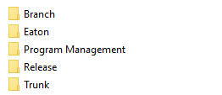
3.1 Folder Structure - Root Folder view
This Folder shall contain the Development weak store for each module such as the ASW, BSW etc.
This is the Folder shared with Eaton. It shall contain the Management data and input documents to be shared between KPIT and Eaton. All the Milestone deliverables will be shared with Eaton through this Shared Folder
This Folder shall contain all the management artefacts such as the PO, Proposal, MOM, WSR, Risk sheet etc.
This Folder shall contain all the release artefacts, release notes, and release checklist
This Folder shall contain the Development strong store for each module such as the ASW, BSW etc. This folder shall also contain a ‘Reference’ folder where any artefacts which are required purely for reference shall be maintained.
Index

Slide 12
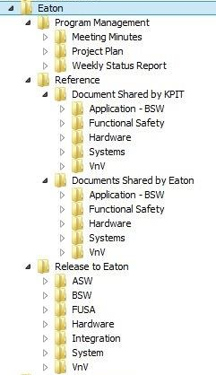
3.2 Folder Structure for Eaton
The Meeting minutes, Project plan and the Weekly Status Reports shall be shared with Eaton via the Program Management folder
All the Reference documents shared by KPIT for individual modules shall be saved in the respective Module
sub folders
All the Reference documents shared by EATON for individual modules shall be saved in the respective Module
sub folders
All the Milestone Deliverables for individual modules shall be released to EATON in the respective Module
sub folders specific to each milestone
The Integration folder shall contain the released Integrated build artefacts
Index

Slide 13
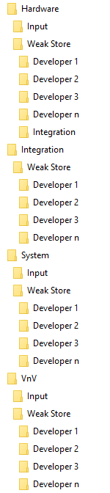
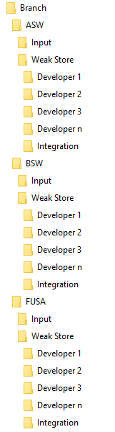
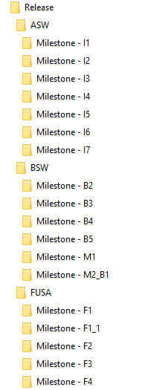
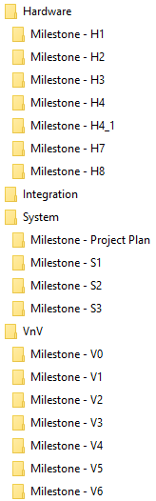
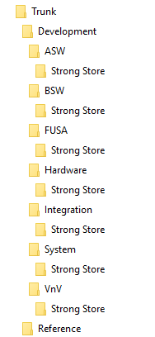
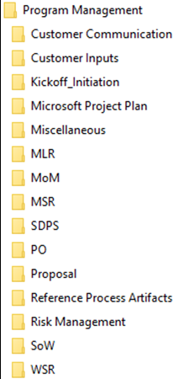
3.3 Folder Structure for KPIT
1b
1a
Root SVN Dir.
3a
3b
1
2
3
4
2a
4a
Continued
Index

Slide 14
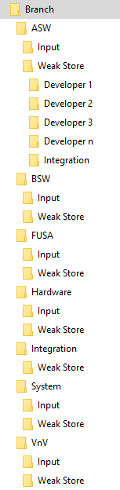
3.4 Folder Structure for KPIT- Branch Folder
Input folder shall contain all the documents, libraries, schematics etc. which can be processed to generate desired outputs for each module
All the individual modules such as the ASW, BSW, FUSA etc. shall follow the same process
Weak store shall contain the individual developers sandbox, where he/she will commit daily changes.
The weak store artefacts shall be periodically integrated to the Integration folder. The integrated code shall be built and if successful, transferred to the Strong Store
The Integration folder shall contain the Integrated build, created at regular intervals using the compatible milestone release ready module builds.
Folder Structure
Index

Slide 15
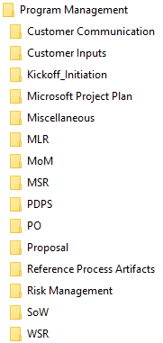
3.5 Folder Structure for KPIT- Program Management Folder
The Program Management artefacts such as the MLR, MSR, PDPS, WSR etc. shall be maintained in the Program Management folder.
Artefacts that are not covered in any of the pre-existing folders can be saved in the Miscellaneous folder
Folder Structure
Index

Slide 16
3.6 Folder Structure for KPIT-Release Folder
a
Release folder shall contain milestone folders for each module
b
Each Milestone folder shall contain module wise and milestone wise release artefacts as given below:
Release Checklist
Release Note
Release Artefact 1 (eg. Source Code)
Release Artefact 2 (eg. binaries)
.
.
.
Release Artefact n (eg. Test Reports)
Folder Structure
Index

Slide 17
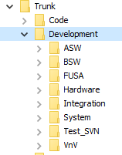
3.7 Folder Structure for KPIT-Trunk Folder
Trunk folder shall be a strong store for all the individual modules. (After review, Screen i.e Baseline the product)
Folder Structure
Index

Slide 18
3.8 Eaton Folder Access Control
Folder Name | Eaton Project Manager | Eaton User | KPIT Project Manager | Configuration Manager
<Program Management>** | Read/Write | Read | Read/Write | Read/Write
<Meeting Minutes> | Read/Write | Read | Read/Write | Read/Write
<Project Plan> | Read/Write | Read | Read/Write | Read/Write
<Weekly Status Report> | Read/Write | Read | Read/Write | Read/Write
<Reference> | Read/Write | Read | Read/Write | Read/Write
<Document Shared by KPIT>** | Read/Write | Read | Read/Write | Read/Write
<Document Shared by Eaton>** | Read/Write | Read/Write | Read/Write | Read/Write
<Release to Eaton>** | Read/Write | Read | Read/Write | Read/Write
**The access type mentioned above is applicable for all the sub-folders of the specified <folder>.
Index

Slide 19
3.9 KPIT Folder Access Control
Folder Name | Developer | Project Manager | Configuration Manager | Process Consultant | Eaton User
<Branch> | Read | Read/Write | Read/Write | Read | No Access
<Module name> | Read | Read/Write | Read/Write | Read | No Access
<Input>** | Read | Read/Write | Read/Write | Read | No Access
<Weak Store>** | Read/Write* | Read/Write | Read/Write | Read | No Access
<Program Management>** | No Access | Read/Write | Read/Write | Read | No Access
<Trunk>** | Read | Read/Write | Read/Write | Read | No Access
<Release>** | Read | Read/Write | Read/Write | Read | No Access
Module Indicates various components of the project, such as below:
ASW
BSW
FUSA
Hardware
System
VnV
*Only respective module developers will be assigned Read/Write access to the respective folder.
For eg. ASW developers will be assigned Read/Write access only to ASW weak store
**The access type mentioned above is applicable for all the sub-folders of the specified <folder>.
Index

Slide 20
3.10 Folder Structure Governance Roles and Responsibilities
Configuration Manager
Merges the development activities of various team members, ensure that the merged artefact is in a working condition (eg. Compile-ready Code) and only then move the integrated artefact to the respective strong store.
Team Members
Creates subfolders in their respective module weak store folder.
Stores Screen Report and Technical Review reports in respective Strong Store.
Ensure that the committed code is compile-ready, before the planned periodic integration to be done by the CM.
Creates separate sub-folders for each Product in ‘Release’ folder.
Creation of the SVN Folder Structure
Move all relevant artefacts to the respective Release folder during delivery.
Provide Access control to various team members as per the Access Control Strategy
Perform daily ‘Commits’ in the weak store for the changes done during the day.
Provides relevant details in the SVN Commit message panel, to indicate the operation(s) being performed.
Index

Slide 21
3.11 Messages
Following table provides guidelines for typing messages while committing changes into branches:
# | Stage | Message
1 | Creating branch for first version | Creating branch for <Config ID> to create the initial version.
2 | Creating branch for subsequent versions | Creating branch for <Config ID> to create version as per SCR_XXX
3 | Daily Changes | <Changes specific message>
4 | Products ready for Technical Review | <Config ID>, is ready for technical review
5 | Technical Review is completed | <Config ID>, is reworked for technical review comments.
6 | Products ready for Screen | <Config ID>, is ready for screen
7 | Products ready for Store | <Config ID>, is ready for store.
Note: Based on project needs, message text mentioned above can be changed.
CM Activities
Index

Slide 22
4. Configuration Management Overview

Slide 23
4.1 Configuration Management
Identification of Configuration Items and Tools
Artefact Management Strategy
Access Control Strategy
Build Management Strategy
INPUTS
Perform Configuration Management
CM ACTIVITIES
Managing Artefacts
Access Control
Perform Audits
Index
Build Management
Backup and Restore
Delivery and Release

Slide 24
4.2 Identification of Configuration Items and Tools
Various tools are available for version management activities
Subversion is one of the most widely used version control tool
The Configuration Manager shall identify the artefacts that can be considered as a ‘Configuration Item’
Identify Artefacts
Finalize Artefacts
Identify Tools
Finalize Tools
All artefacts that may undergo updates during the course of the projects shall be considered as a Configuration Item
Software artefacts such as Source code, test plans and Software requirement specification can be considered as ‘CI’ artefacts
Hardware artefacts such as Schematics, Gerber files, DAR reports and Hardware requirement specification can be considered as ‘CI’ artefacts
Some of the popular examples are Subversion, PVCS and GIT
Tortoise SVN that provides a user friendly User Interface, shall be used for version control activities
Index

Slide 25
4.3 Example of Configuration Items
Hardware
Hardware Requirement Specification
Schematics
Software
Source Code
Project Management
PAR Reports
Project Plans
Gerber files
DFMEA reports
DAR Reports
Test Plans
Software Requirement Specification
Hardware Design Document
Software Design Document
MOM
Architecture document
PSR
Risk Sheet
PO
Proposal
MLR
MSR
Index

Slide 26
5. Configuration Management Activities

Slide 27
5.0 Configuration Management Activities
Ensure Daily Check-ins with appropriate comments
SVN Hygiene
Integrate snippets from Developers Weak Store to the strong store
Continuous Integration
Provide applicable Access to Developers of respective modules
Access Control and Audits
Perform V&V, prepare Release Checklist and Deliver
Delivery and Release
All Developers must check-in their code daily with relevant messages in SVN
Code in the developers weak store must be compile-ready
For eg. ASW software components from the weak store must be regularly integrated into the ASW strong store
CM shall ensure the deliverables are committed in the correct folder
CM shall prepare the Release Notes and checklist for the delivery
Access to the ASW, BSW, FUSA and other module sub directories to be granted only to respective module developers
CM Chart
Index

Slide 28
5.1 Configuration Management using Subversion
SVN
1. Creating Working Copy
2. Adding Contents
3. Committing Changes
4. Merging changes
The User must create a working copy only for the first time
The user may later perform the SVN activities of adding contents, committing changes, merging changes as required.
CM Chart
Index

Slide 29
5.2 Managing Artefacts
Providing Co-ordination
Track the Artefact development history
Track Bugs
Developers working across projects must collaborate and coordinate to achieve complex algorithm development
For eg. BSW software is divided into sets of features to be developed by individual developers. In such a scenario,
co-ordination between all the developers is a must
1
The artefact development history can be tracked in the form of revision history
For eg. ASW source code file’s revision history can be tracked to understand the modifications done in each committed version
2
Since version control allows tracking the changes, the stage at which a bug was introduced can be easily identified
This allows performing root cause analysis as different versions can be recovered and analyzed
3
CM Chart
Index

Slide 30
5.3 Build Management
Code from the Developer’s weak store must be integrated to the integration folder in the weak store and later moved to the strong store as per pre-decided frequency
Continuous Integration
Build the code from the Integration folder in the weak store
Build the code
If the build fails, assign the issue to responsible developer
Check if the Code builds
If build succeeds, move the code to Strong store
Move the release artefacts to the KPIT Release folder.
Once delivery process is complete move the artefacts to the Eaton release folder for final delivery
Move to Strong Store
Release Process
Move to KPIT Release Folder
Move to the Release to Eaton Folder
CM Chart
Index

Slide 31
5.4 Access Control
The CM provides Access control to the respective folders in the repository to various team members as per their role
Access control enables the implementation of data security measures to manage the project development process in a defined and controlled way
For eg. Developers shall get Read/Write access only to the Weak store, while getting only Read access to the Strong store and No Access to Program Management and Eaton folders.
Access Control Strategy
Inputs to the CM
CM Chart
Index

Slide 32
5.5 Backup and Restore the SVN Repository
After restoring the SVN folder contents, the CM checks if restored data is same as the backed-up data
Backup and Restore of the project SVN repository shall be performed under the Corporate backup scheme
Required for safeguarding of the Repositories
Guards against data loss
Restore
Verify
Backup Weekly
CM Chart
Index

Slide 33
5.6 Perform Audits
Ensure all findings have been fixed and conclude the audit
Share the findings of the Audits with the team members and educate them
Log the review comments and prepare a report
Perform the audits of various Configuration Items
Plan Audit
Create Checklist
Conduct Audit
Prepare Report
Share Results with Team
Complete Action Items
Create an Audit Checklist to audit SVN hygiene
eg. daily check-ins, comments, naming conventions etc.
Inform the team members about audit schedule and frequency, typically weekly
CM Chart
Index

Slide 34
5.7 Delivery and Release
The CM shall ensure that all the pointers in the CM Checklist have been complied with
The CM shall review/check the release notes that contains relevant information such as the customer name and contact information build version, list of artefacts, configuration IDs etc.
The Configuration Manager shall integrate the individual snippets of developers into the strong store
Build Source
The CM shall release the build to the Verification and Validation team to perform the testing
Verification & Validation
CM Checklist
Release Notes
The Developers must ensure that their code from the weak store is Unit tested and Buildable
Bugs shall be assigned to respective module developers
Developers shall fix the bugs in the weak store and CM must integrate the changes into the strong store
All artefacts must be checked-in with appropriate naming conventions
CM Chart
Index

Slide 35
6. Store

Slide 36
6.1 Store: Planning
I/O/P/I | Product Name | CI Identifier | Source | Destination
I/-/-/- | Project Proposal PPT | KPIT_Proposal_Eaton_NPe_M3_Dual_core_Inverter_Program_V2.0 | KPIT | Planning Uniphase
I/-/-/- | Resource Loading sheet | Resource_Loading_sheet | KPIT | Planning Uniphase
-/O/-/- | *SDPS_NPe M3 Dual core Inverter Development | NPe_M3_Dual_core_SDPS | Planning Uniphase | All the Uniphases
-/O/-/- | *Configuration Management Plan | NPe_M3_Dual_core_Configuration Management | Planning Uniphase | All the Uniphases
-/O/-/- | *Release Management Plan | NPe_M3_Dual_core_Release Management | Planning Uniphase | All the Uniphases
-/O/-/- | *Change Management Plan | NPe_M3_Dual_core_Change Management | Planning Uniphase | All the Uniphases

Slide 37
6.1 Store: Planning
I/O/P/I | Product Name | CI Identifier | Source | Destination
-/O/-/- | *Management and Control Plan | NPe_M3_Dual_core_Management and Control Plan | Planning Uniphase | All the Uniphases
-/O/-/- | *Communication Plan | NPe_M3_Dual_core_Communication Plan | Planning Uniphase | All the Uniphases
-/O/-/- | Intragroup_Coordination | NPe_M3_Dual_core_Intragroup_Coordination | Planning Uniphase | All the Uniphases
-/O/-/- | *NPe M3 Dual core Inverter Development Project Plan – Milestone | NPe M3 Dual core Inverter Development Project Plan - Milestone.mpp | Planning Uniphase | All the Uniphases
-/O/-/- | *Milestone Plan | NPe M3 Dual core Production Milestone Plan | Planning Uniphase | All the Uniphases
-/O/-/- | * NPe_M3_Dual_core_ SDPS Development_Notes | NPe_M3_Dual_core_SDPS_Notes | Planning Uniphase | All the Uniphases
-/O/-/- | Milestone Estimations | NPe M3 Dual core Inverter Development Estimations-Uniphase-milestone | Planning Uniphase | All the Uniphases
-/O/-/- | Tools and Licenses need for NPe Program.xls | NPe_M3_Dual_Core_Tools and Licenses need for NPe Program.xls | Planning Uniphase | All the Uniphases

Slide 38
6.2 Store: Systems
I/O/P/I | Product Name | CI Identifier | Source | Destination
I/-/-/- | Project Proposal PPT | KPIT_Proposal_Eaton_NPe_M2_Inverter_Program_V1.2 | KPIT | Planning Uniphase
I/-/-/- | *SDPS_NPe M2 Inverter Development | SDPS_NPe M2 Inverter Development _001 | Planning Uniphase | All Subsequent Uniphases
I/-/-/- | Work package document | 100 Level work packages | Customer | All Subsequent Uniphases
-/O/-/- | System Requirement specification | NPe_M2_Inverter_200_Level_System_Requirement | System Uniphase | All Subsequent Uniphases
-/O/-/- | Fault reaction Plan | NPe_M2_Inverter_Fault _Reaction_Plan | System Uniphase | All Subsequent Uniphases

Slide 39
6.3 Store: FUSA
I/O/P/I | Product Name | CI Identifier | Source | Destination
I/-/-/- | Project Proposal PPT | KPIT_Proposal_Eaton_NPe_M2_Inverter_Program_V1.2 | KPIT | Planning Uniphase
I/-/-/- | *SDPS_NPe M2 Inverter Development | SDPS_NPe M2 Inverter Development_001 | Planning | All Subsequent Uniphases
I/-/-/- | Functional Safety Requirement | NPe Functional Safety Concept and Requirement | Customer | All Subsequent Uniphases
-/O/-/- | System FTA | NPe_M2_Inverter_System_FTA | FUSA Uniphase | All Subsequent Uniphases
-/O/-/- | HSR | NPe_M2_Inverter_Hardware_Safety_requirement | FUSA Uniphase | All Subsequent Uniphases
-/O/-/- | SSR | NPe_M2_Inverter_Software_Safety_requirement | FUSA Uniphase | All Subsequent Uniphases

Slide 40
Thank You
www.kpit.com

