Slide 1
Basic Software Development Process Methodology
Unit 2 – PROCESS AND EPMN
DD-MM-YY
PEG, KPIT Technologies

Slide 2
Topics
Introduction
  SDPM 2.0
  EPMN
    Objects
    Representations
    Model
    View
  Writing Vs Modelling
EPMN Visio Plug-In
  Introduction to Visio
  Introduction to EPMN Plug-In
  File Operations
  Modelling
  Exporting
EPMN Shapes & Rules
  Objects
    Uniphase
    Activity
    Artefact
    Guidance
    Role
  Relationships
    Control Flow (Uniphase Example with activities and control flow)
    Data Flow(Unihpase example appended with Artefacts & Data Flow)
    RASIC Flow ( Activity Example with RASIC/Unihpase Example with RASIC)
  Gates
    Start Gate
    End Gate
    AND Gate
    OR Gate
    XOR Gate
  Others
    Note
    Lane Of Association

Slide 3
Introduction

Slide 4
EPMN
Engineering Process Modelling Notation is composed of
Shapes
Shapes’ Representations
Model
View

Slide 5

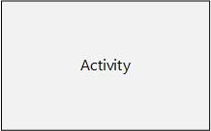
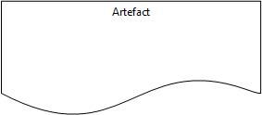
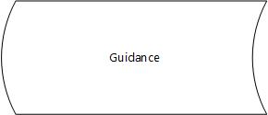



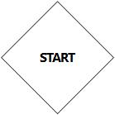
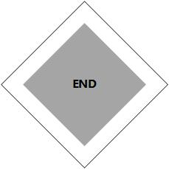
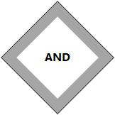
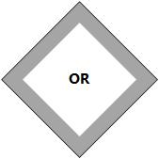
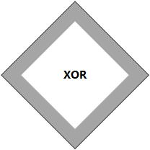
EPMN
Engineering Process Modelling Notation is composed of
Shapes
Objects (Shapes) are the building blocks of Engineering Process.
Uniphase
Activity
Artefact
Guidance
Role
Note
Lane
Start
Gate
End
Gate
AND
Gate
OR
Gate
XOR
Gate
Control Flow
Data Flow
RASIC Flow
Shapes’ Representations
Model
View

Slide 6
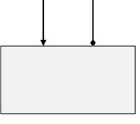
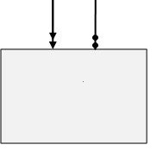


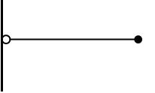
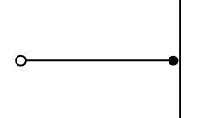
EPMN
Engineering Process Modelling Notation is composed of
Shapes
Shapes’ Representations
Some objects can be represented in different form to provide an additional meaning or constraint.
Iterative Uniphase
Iterative Activity
Output – Data Flow
Input – Data Flow
Requisite Connection
Pre-Requisite Connection
Circular
Role
Model
View

Slide 7
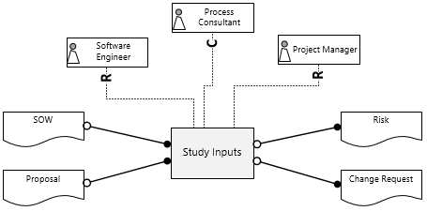
EPMN
Engineering Process Modelling Notation is composed of
Shapes
Shapes’ Representations
Model
A model is instantiation of an object or a group of objects in the process. Each instantiated object will have a some properties and relationships with each other.
Model
View

Slide 8
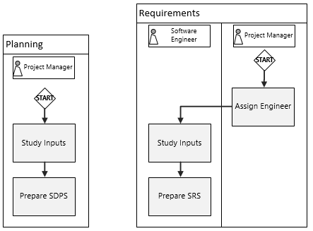
EPMN
Engineering Process Modelling Notation is composed of
Shapes
Shapes’ Representations
Model
View
View is a representation of an object, or a group of objects, where some or all of their properties and relationships may be visible. View is an avatar, of an object in the model.

Slide 9
Drawing vs Modelling
Drawing | Modelling
Creates static images | Creates abstract objects
Information is conveyed by writing/drawing on the plane | Information is conveyed using Object’s properties and relationships
 | Objects can have several avatars (views)
 | Objects can support inheritance & polymorphism (Hence supports reuse)
*abstract - existing as an idea, feeling, or quality, not as a material object.

Slide 10
EPMN Visio Plug-In

Slide 11





Introduction to Visio
Word Processor Computer application for input, editing, formatting and output of text, often plus other features.
Spreadsheet Computer application for organization, analysis and storage of data in tabular form.
Presentation Computer application used to display information in the form of a slide show.
Database A database is an organized collection of data, generally stored and accessed electronically.
Vector Graphics (Drawing) Software for creating images in a 2D surface by drawing lines and curves to make shapes
Microsoft Visio is a diagramming and vector graphics software as part of MS Office Suite of applications. It is used for all drawing applications like flow charts, building plans, electrical layouts, mind mapping, etc.
Salient features:
Easy to Use Interface
Templates & shapes (a lot of them)
Import and Export (JPG, HTML, DWG, etc.)
Customization using
  VBA Macros
  .NET VSTO (Add-Ins)
Microsoft Word®
Microsoft Excel®
Microsoft
Power Point®
Microsoft Access®
Microsoft Visio®

Slide 12
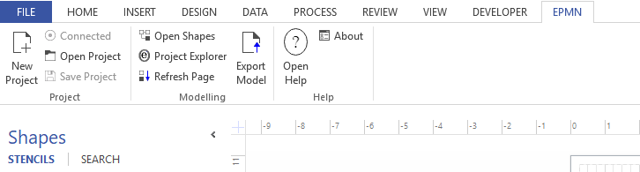
Introduction to EPMN Plug-In

Slide 13
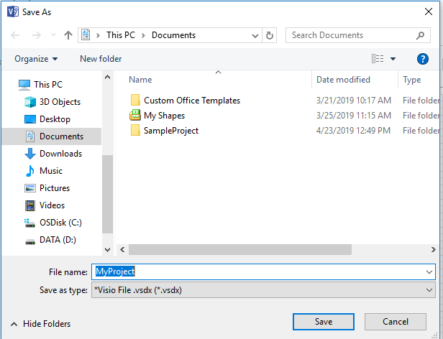
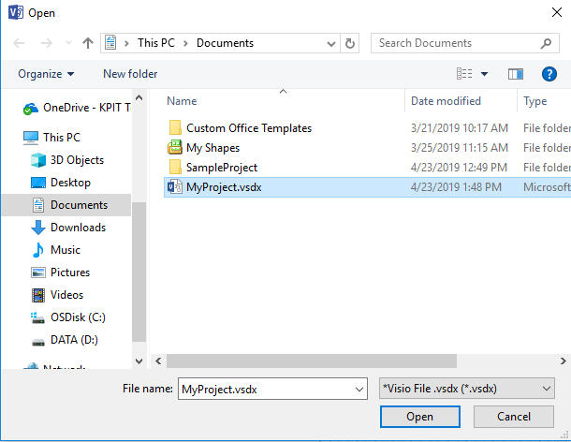
Introduction to EPMN Plug-In – File Operations
Creates new EPMN Project
One Visio Drawing (*.vsdx) is one project
Use “SaveAs” Dialog to provide the name of new project.
Opens an existing EPMN Project (*.vsdx)
It doesn’t recognize *.vsdx files which are not created using EPMN
Use “Open” Dialog to select the project.

Slide 14
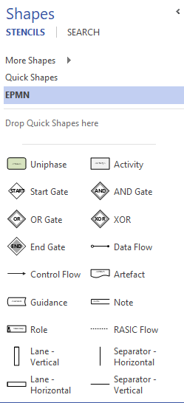
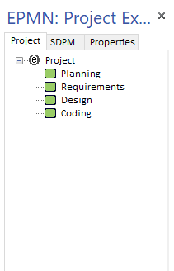
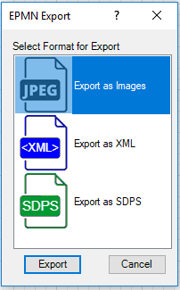
Introduction to EPMN Plug-In – Modelling Operations
Note: EPMN Shapes cannot be used in a non-EPMN drawing.

Slide 15
Introduction to EPMN Plug-In – Help Operations
Open Version Information
Open Help File

Slide 16
EPMN Shapes - Objects

Slide 17
How to Read
Object’s Representation(s) |  | Explanation
 |  | <This section provides the explanation of the objects and rules of usage> <Use of words like is, shall and will, etc., stresses the mandatory nature of the rules>
Properties
<Explicit Property> | <Property of an object which shall be provided explicitly during modelling>
<Hidden Property> | <Hidden property is described in a gray text, this property is not provided explicitly by the user>
General Guidelines
<This section provides general usage guidelines and good practices> <Use of words like can and may etc., stresses the optional nature of these guidelines>
Objects Representation
And Alternate Representations are depicted here

Slide 18
Uniphase
Object’s Representation(s) |  | Explanation
 |  | Uniphase is a small manageable phase of a process. An iterative Uniphase is executed more than once in a Process. It is a group of related activities, artefacts and guidance(s) with a common purpose. A Uniphase shall have at-least two (1 input and 1 output) artefacts A Uniphase shall have at-least three (2 Work and 1 Screen) activities. Successful completion of a Uniphase will transform input(s) into a meaningful output artefact(s) A collection Uniphase (which has children Uniphase) shall have a screen activity at the collection Uniphase level.
Properties
Name | A meaningful alpha numeric name. Don’t use special characters.
Description | A brief description, not less than two sentences.
Entry Criteria | Criteria that must be satisfied for the Uniphase to begin.
Exit Criteria | Criteria that must be satisfied for the Uniphase to conclude.
General Guidelines
Avoid activities from more than two SDLCs in a single Uniphase Process inputs and outputs shall not be associated with entry and exit criteria
Uniphase
Iterative Uniphase

Slide 19
Activity
Object’s Representation(s) |  | Explanation
 |  | A project activity which can be planned, assigned and tracked. An iterative activity is executed more than once for each iteration of the Uniphase. An activity is a next level de-composition of a Uniphase, hence an activity shall represent what to do “how to do” shall be explained using its properties, like description and/or a connected guidance; like template, standards, etc. Pseudo activities shall be depicted using “P_” prefix for the activity name Pseudo activities are performed outside the project, but are needed to complete the process’s workflow.
Properties
Name | A meaningful alpha numeric name. Don’t use special characters.
Description | An informative description, not less than two sentences.
SDLC | The Life cycle stage to which the activity belongs.
Activity Type | Work, Review, Screen, Rework
General Guidelines
Keep activity names, short, simple and meaningful. Use at-least 3 words in an activity name. Make use of iterative activities to demonstrate repetitive tasks.
Activity
Iterative Activity

Slide 20
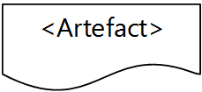
Artefact
Object’s Representation(s) |  | Explanation
 |  | Artefact is an outcome of engineering activity(ies). It can be an input or output in the engineering process. Artefact represents the data flow between Uniphase. An artefact shall be either a configuration item or a non-configuration item.
Properties
Name | A meaningful alpha numeric name. Don’t use special characters.
Description | An informative description, not less than two sentences.
Destination | Activities and/or Uniphase(s) where the artefact flows in as input.
Source | Activities and/or Uniphase(s) where the artefact flows out as output.
General Guidelines
Don’t create artefacts for intermediate outcomes. Artefacts are outcome of engineering activities, hence they are different from guidance (like templates, checklists) which are tools and methods to perform the engineering activities.
Artefact

Slide 21
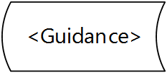
Guidance
Object’s Representation(s) |  | Explanation
 |  | Guidance is an enabler to perform the activities A Guidance can be in the form of templates, checklists, instructions manual, training material, etc.
Properties
Name | A meaningful alpha numeric name. Don’t use special characters.
Description | An informative description, not less than two sentences.
Destination | Activities and/or Uniphase(s) where the artefact flows in as input.
General Guidelines
Identify all applicable guidance from the SDPM. For project specific needs, create new guidance as needed.
Guidance

Slide 22
Role
Object’s Representation(s) |  | Explanation
 |  | A Role represents a personnel resource or department A Role can be assigned an activity with following RASIC relationship. “Responsible”/“Accountable”/“Support”/ “Informed”/“Consulted” A circular role helps in easy diagramming and simplification of views.
Properties
Name | A meaningful alpha numeric name. Don’t use special characters.
Description | An informative description, not less than two sentences.
General Guidelines
Be clear in the difference between Designation and Role. Don’t create multiple roles with similar sounding names.
Role
Circular
Role

Slide 23

EPMN Shapes - Relationships
Basic SDPM - Process & EPMN

Slide 24
Control Flow
Object’s Representation(s) |  | Explanation
 |  | Control Flow depicts the sequence of activities and/or Uniphase(s) Control Flow represents the path(s) of process execution A pre-requisite connection requires the predecessor Activity or Uniphase to be completed(100%) before starting the next Activity or Uniphase Path of execution can be split using gates.
Properties
Connection From | A source activity or Uniphase of control flow
Connection To | A destination activity or Uniphase of control flow
General Guidelines
At project level, try to keep the number of parallel paths, limited to 3
Control Flow
Pre-Requisite Control Flow

Slide 25
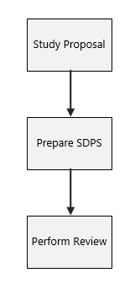
Control Flow - Example

Slide 26
Data Flow
Object’s Representation(s) |  | Explanation
 |  | Data Flow describes the data in form of artefacts to flow between Activities or Uniphase(s). A pre-requisite input connection for data flow requires the artefact coming as input be stored/checked-in.
Properties
Connection From | A source Artefact, Activity and/or Uniphase of data flow
Connection To | A destination Artefact, Activity and/or Uniphase of data flow
General Guidelines
Use data flow to achieve the desired SDP Architecture. Don’t clutter all views with data flow connection. (Model the data connections using lanes or in background models)
Data Flow
Input Connection
Output Connection
Pre-Requisite Input Connection

Slide 27
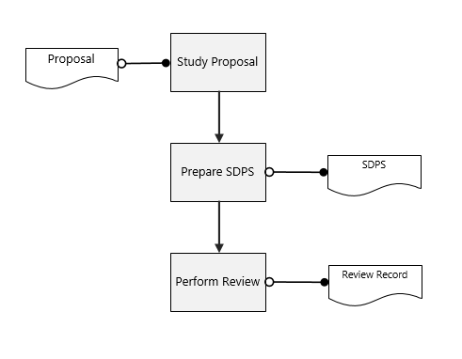
Data Flow - Example

Slide 28
RASIC Flow
Object’s Representation(s) |  | Explanation
 |  | RASIC flow establishes the relationship between a Role and an Activity. A Role can be assigned an activity with following RASIC relationship. “Responsible”/“Accountable”/“Support”/ “Informed”/“Consulted”
Properties
RASIC Type | RASIC connection can be for “Responsible”/“Accountable”/“Support”/ “Informed”/“Consulted”
Connection From | A source Role of the RASIC Flow.
Connection To | A destination Activity of the RASIC Flow.
General Guidelines
Be clear of the difference between Support and Consulted A support role will contribute in the activity by some sort of participation A consulted role only provides oral/written advice Be clear of the difference between Responsible and Accountable A responsible person executes the activity. An accountable person ensures execution of the activity
RASIC Flow

Slide 29
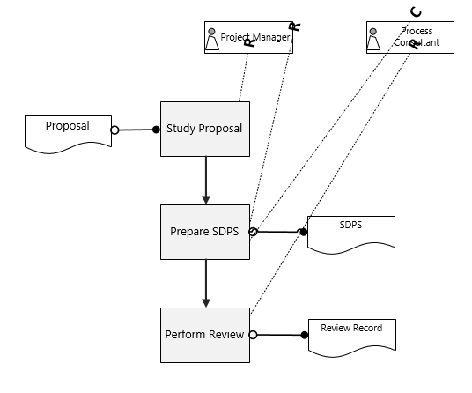
RASIC Flow - Example
Note: It looks complex in current form, it will get refined in next slides.

Slide 30
EPMN Shapes - Gates
Basic SDPM - Process & EPMN

Slide 31
Start Gate
Object’s Representation(s) |  | Explanation
 |  | Start Gate is a declaration for a sequence of engineering process which can be composed of Uniphase(s) and/or Activities. Start gates begins a single path of process execution, use intermediate gates to split the process path.
Properties
Successor | An Activity or Uniphase from which the process sequence begins.
General Guidelines
There can be more than one start gates in a single engineering process.
START
Gate

Slide 32
End Gate
Object’s Representation(s) |  | Explanation
 |  | END Gate depicts the end/finish of a sequence of activities or Uniphase. An END gate can finish only a single path of process execution.
Properties
Predecessor | An Activity or Uniphase which finishes the process sequence.
General Guidelines
There can be more than one end gates in a single engineering process.
END
Gate

Slide 33
AND Gate
Object’s Representation(s) |  | Explanation
 |  | AND Gate splits the sequence of activities into multiple paths. All split process paths shall be traversed (mandatorily). All paths split using AND Gate shall be joined with an AND Gate.
Properties
Predecessor | Activity(ies) or Uniphase(s) which are forked or joined.
Successor | Activity(ies) or Uniphase(s) which are forked or joined.
General Guidelines
All split paths need not join, some paths may have their own END. Use AND Gate to depict parallel operations Use AND Gate with data flow to depict in-coordination operations
AND
Gate

Slide 34
Gates Example

Slide 35
OR Gate
Object’s Representation(s) |  | Explanation
 |  | OR Gate splits the sequence of activities into multiple paths. One or more process paths can be traversed depending on the conditions. All paths split using OR Gate shall be joined with an OR Gate. At-least one process path shall be traversed in an OR Gate.
Properties
Predecessor | Activity(ies) or Uniphase(s) which are forked or joined.
Successor | Activity(ies) or Uniphase(s) which are forked or joined.
General Guidelines
All split paths need not join, some paths may have their own END. Use OR Gate to depict condition based parallel/in-coordination operations. Don’t use OR Gate for binary(Yes or No) decisions.
OR
Gate

Slide 36
Gates Example Cont..

Slide 37
XOR Gate
Object’s Representation(s) |  | Explanation
 |  | XOR Gate splits the sequence of activities into multiple paths. But only one path shall be traversed depending on the condition. All paths split using XOR Gate shall be joined with an XOR Gate.
Properties
Predecessor | Activity(ies) or Uniphase(s) which are forked or joined.
Successor | Activity(ies) or Uniphase(s) which are forked or joined.
General Guidelines
All split paths need not join, some process paths may have their own END. Use XOR Gate for binary (yes or no) decisions.
XOR
Gate

Slide 38
Gates Example Cont. …

Slide 39
EPMN Shapes - Others
Basic SDPM - Process & EPMN

Slide 40
Note
Object’s Representation(s) |  | Explanation
 |  | A Note provide textual explanation in an EPMN diagram. Control Flow is used to establish a connection from Note to any object.
Properties
Connection To | Any destination object which the notes is ascribed to.
General Guidelines
It is not mandatory to add a connection to note Use note only to describe explanation on the diagram, Use respective object’s description property to add any explanation regarding the objects.
Note

Slide 41
Lane (of association)
Object’s Representation(s) |  | Explanation
 |  | This is called Lane of association. All objects in a lane will have (or imply) a default relationship with each other. An explicit relationship established using Control Flow, Data Flow and/or RASIC Flow will overrule the default relationship. Objects of same type in a lane, will not have any implied relationship. For Example, If a Role and an activity is added in a lane, by default a relationship between this role and activity shall be implied as responsible, unless specified as other using a RASIC Connection.
Properties
Composed Of | All objects which the lane is composed of.
General Guidelines
Use Lanes to create complex process maps Use circular roles in Lanes to describe additional RASIC Connections.
Lane
Lane

Slide 42
Lanes Example

Slide 43
Setting Process in SDPS

Slide 44
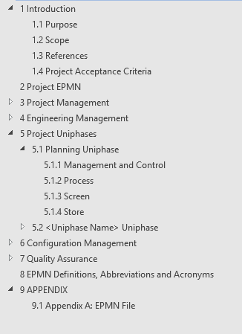

SDPS
Software Development Process Specifications is the project’s apex manual which defines the project’s process and the management plan.
Flash SDPS
A flash SDPS is an alternate version of SDPS which is created in following circumstances when a quick project planning is needed
Project duration is less than or equal to 4 Weeks, use Flash SDPS instead of regular SDPS.
project planning may take more than 3 weeks, then create Flash SDPS until regular SDPS is created.
SDPS Contents

Slide 45

Thank You

